Slide 1
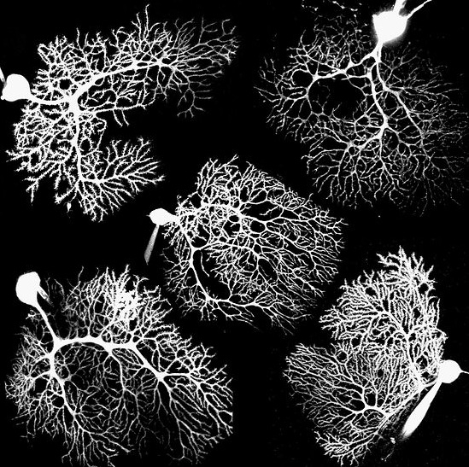
Dendritic computation

Slide 2
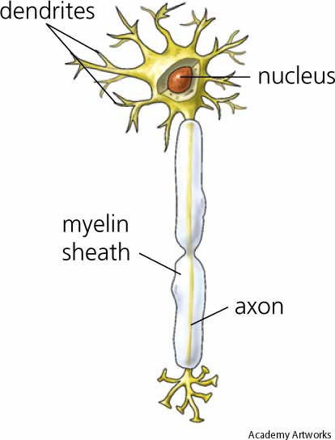
Dendritic computation
Dendrites as computational elements:
Passive contributions to computation
Active contributions to computation
Examples

Slide 3
Geometry matters: the isopotential cell
Injecting current I₀
r
V_{m} = I_{m} R_{m}
Current flows uniformly out through the cell: I_{m} = I₀/4πr²
Input resistance is defined as R_{N} = V_{m}(t→∞)/I₀
= R_{m}/4πr²

Slide 4
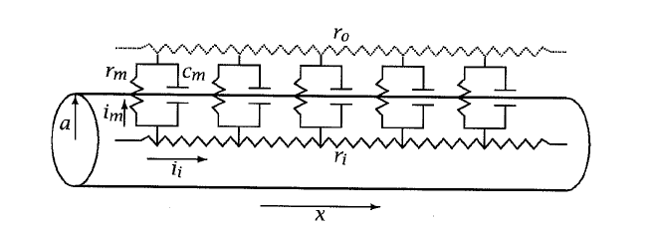
Linear cable theory
r_{m} and r_{i} are the membrane and axial resistances, i.e.
the resistances of a thin slice of the cylinder

Slide 5
Axial and membrane resistance
c_{m}
r_{m}
r_{i}
For a length L of membrane cable:
r_{i} → r_{i} L
r_{m} → r_{m} / L
c_{m} → c_{m} L

Slide 6
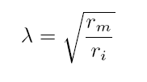
The cable equation
(1)
(2)
(1) →
or
Time constant
where
Space constant
Notes:
n

Slide 7
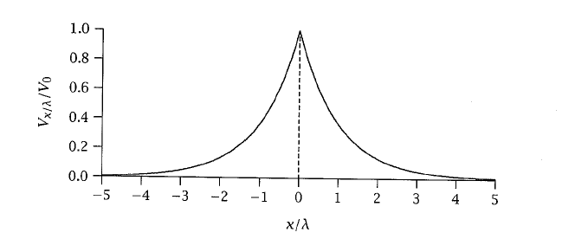
Decay of voltage in space for current injection at x=0, T → ∞
0
+ I_{ext}(x,t)

Slide 8
Properties of passive cables
→ Electrotonic length

Slide 9
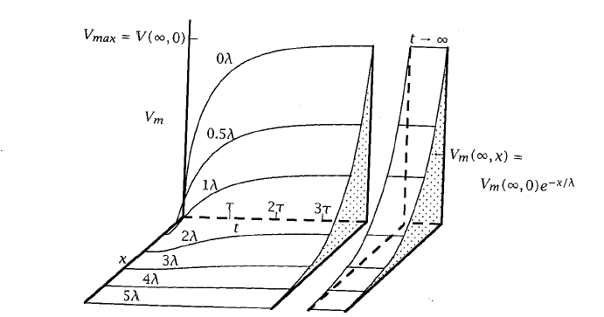
Electrotonic length
Johnson and Wu

Slide 10
Properties of passive cables
→ Electrotonic length
→ Current can escape through additional pathways: speeds up decay

Slide 11
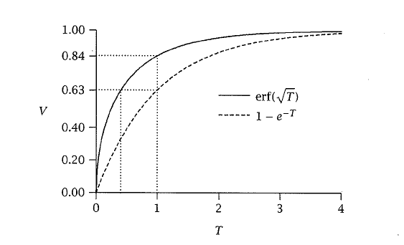
Voltage rise time
→ Current can escape through additional pathways: speeds up decay
Johnson and Wu

Slide 12
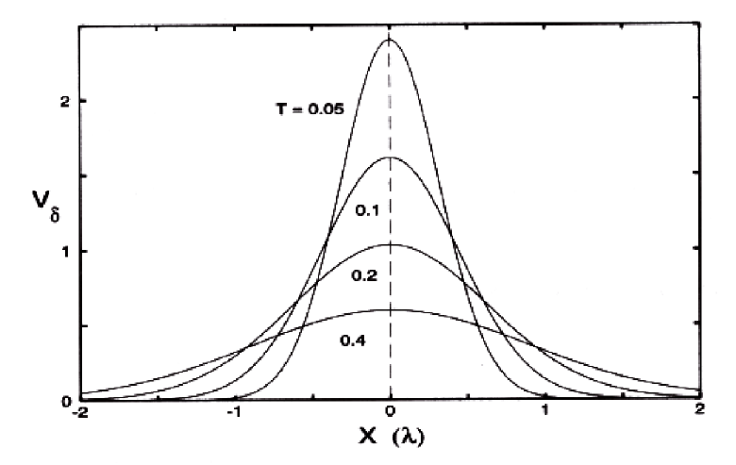
Impulse response
Koch

Slide 13
General solution as a filter

Slide 14
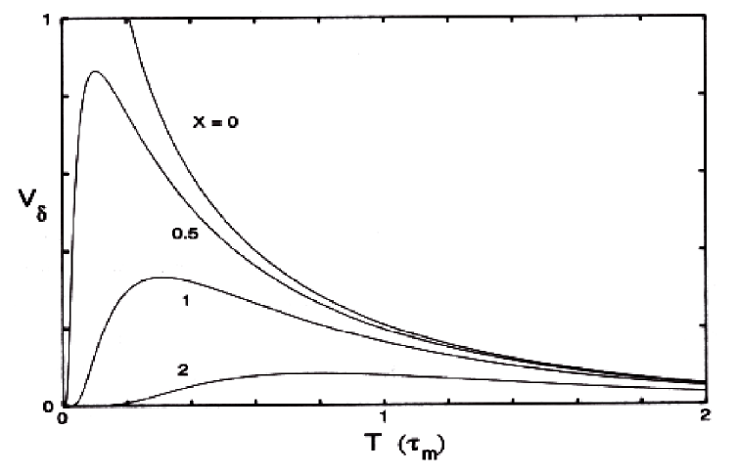
Step response

Slide 15
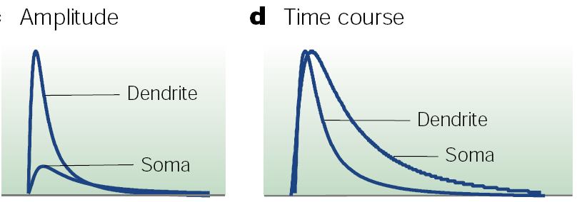
Properties of passive cables
→ Electrotonic length
→ Current can escape through additional pathways: speeds up decay
→ Cable diameter affects input resistance

Slide 16
Properties of passive cables
→ Electrotonic length
→ Current can escape through additional pathways: speeds up decay
→ Cable diameter affects input resistance
→ Cable diameter affects transmission velocity

Slide 17
Step response

Slide 18
Step response

Slide 19
Other factors
Finite cables
Active channels

Slide 20
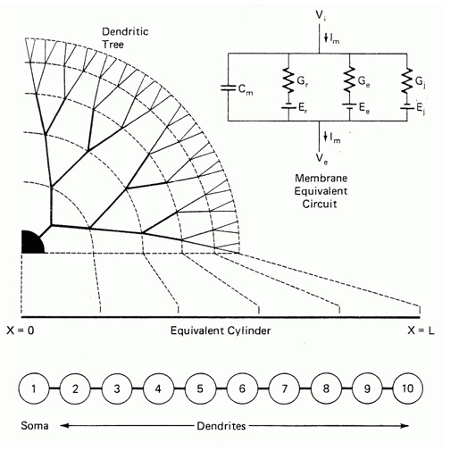
Rall model
Impedance matching:
If a^{3/2} = d₁^{3/2} + d₂^{3/2}
can collapse to an equivalent
cylinder with length given
by electrotonic length

Slide 21
Active conductances
New cable equation for each dendritic compartment

Slide 22
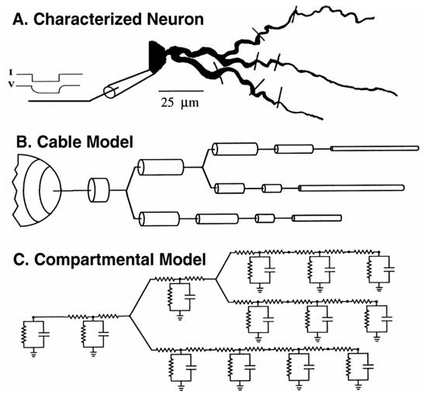
Who’ll be my Rall model, now that my Rall model is gone, gone
Genesis, NEURON

Slide 23
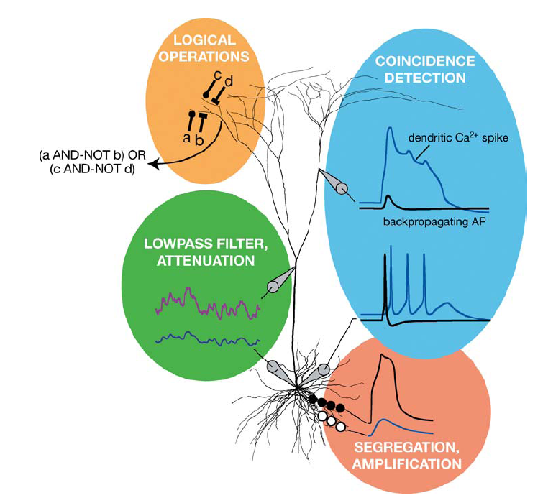
Passive computations
London and Hausser, 2005

Slide 24
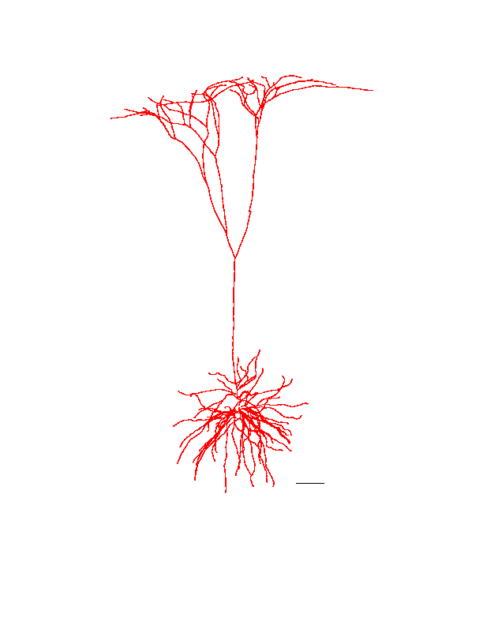
Passive computations
Linear filtering:
→ Inputs from dendrites are broadened and delayed
→ Alters summation properties..
coincidence detection to temporal integration
→ Delay lines
→ Segregation of inputs
→ Nonlinear interactions within a dendrite
-- sublinear summation
-- shunting inhibition
→ Dendritic inputs “labelled”

Slide 25
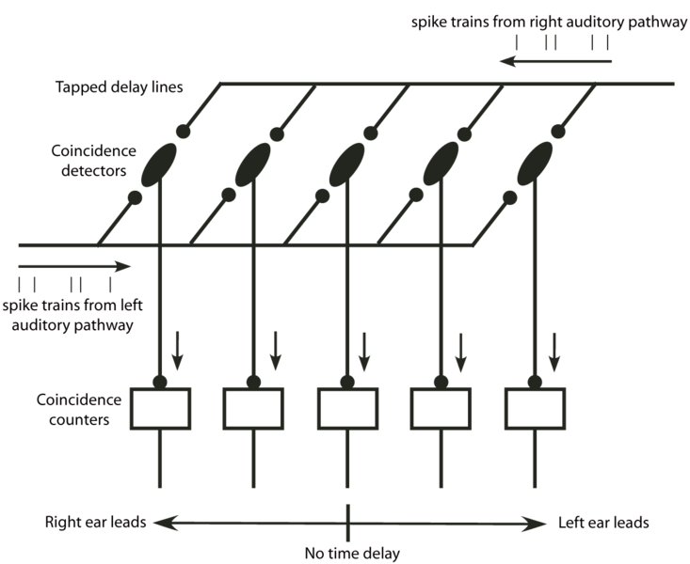
Delay lines: the sound localization circuit
Spain; Scholarpedia

Slide 26
Passive computations
London and Hausser, 2005

Slide 27
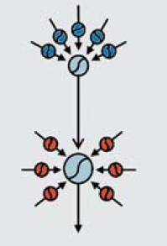
Active dendrites
Mechanisms to deal with the distance dependence of PSP size
Subthreshold boosting: inward currents with reversal near rest
Eg persistent Na⁺
Synaptic scaling
Dendritic spikes
Na⁺, Ca²⁺ and NMDA
Dendritic branches as
mini computational units
backpropagation:
feedback circuit
Hebbian learning through
supralinear interaction of backprop spikes with inputs

Slide 28
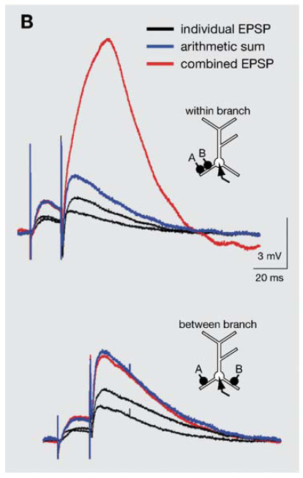
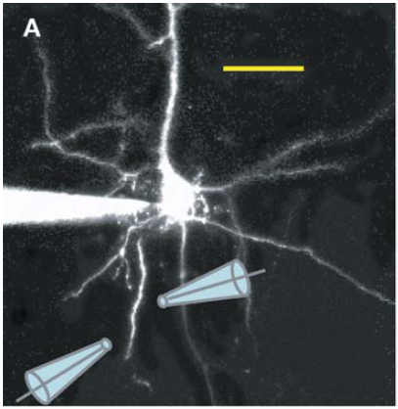
Segregation and amplification

Slide 29
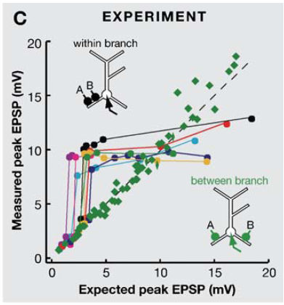
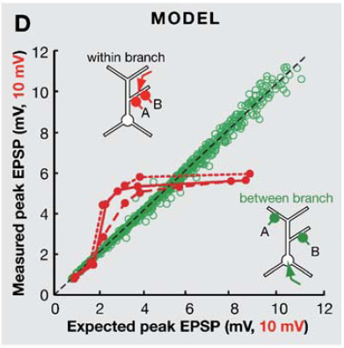
Segregation and amplification

Slide 30
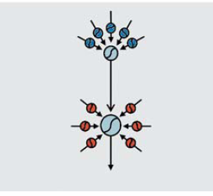
Segregation and amplification
The single neuron as a neural network

Slide 31
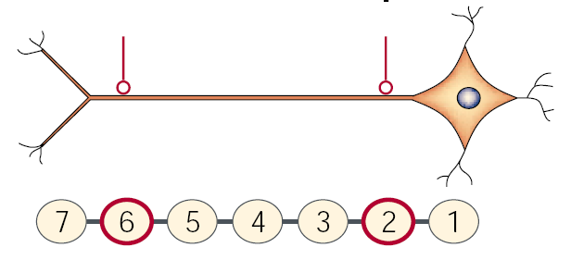
Synaptic scaling
Currents
Distal: integration
Proximal: coincidence
Potential
Magee, 2000

Slide 32
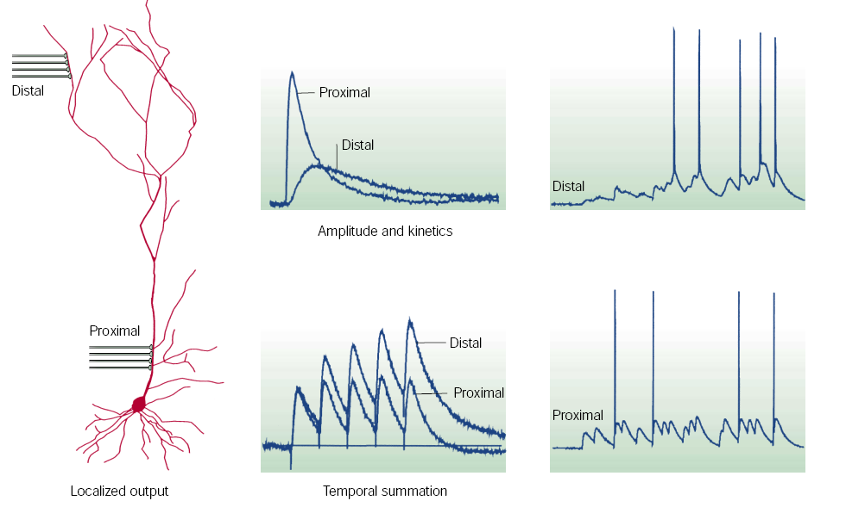
Expected distance dependence
Synaptic potentials
Somatic action potentials
Magee, 2000

Slide 33
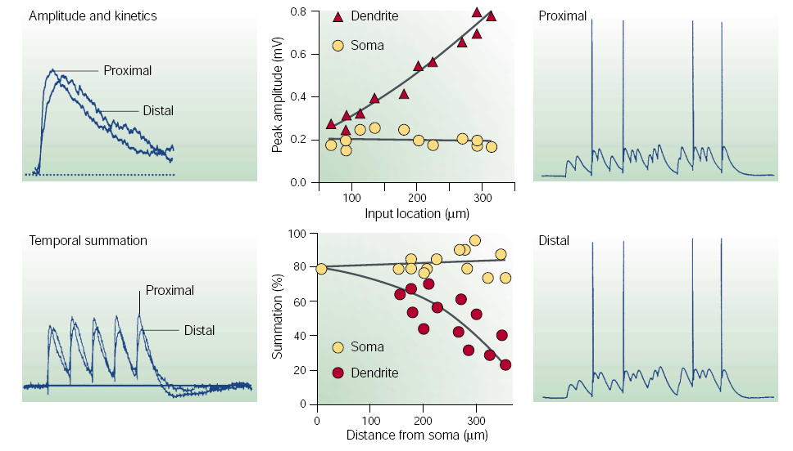
CA1 pyramidal neurons

Slide 34
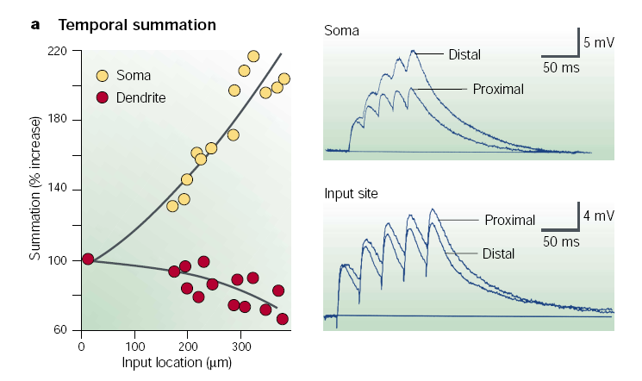
Passive properties

Slide 35
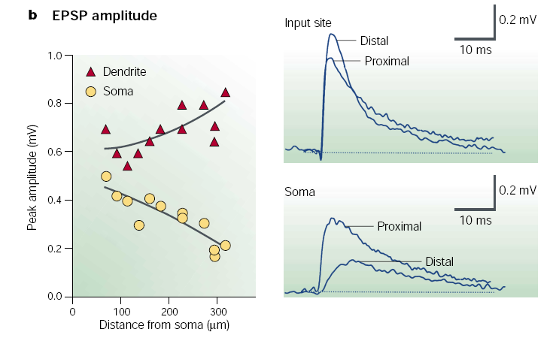
Passive properties

Slide 36
Active properties: voltage-gated channels
For short intervals (0-5ms), summation is linear or slightly supralinear
For longer intervals (5-100ms), summation is sublinear
Na ⁺, Ca ²⁺ or NDMA receptor block eliminates supralinearity
I_{h} and K⁺ block eliminates sublinear temporal summation

Slide 37
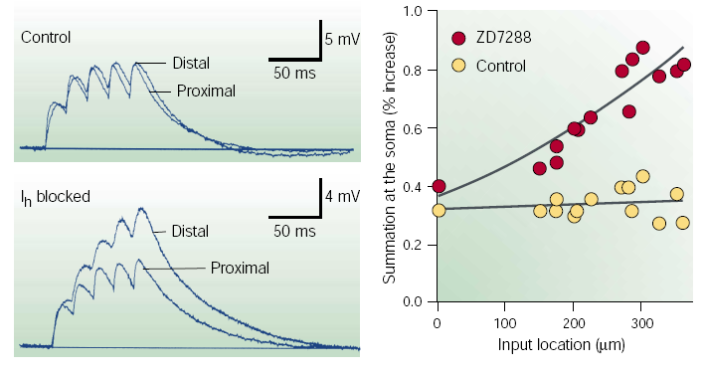
Active properties: voltage-gated channels
Major player in synaptic scaling: hyperpolarization activated K current, I_{h}
Increases in density down the dendrite
Shortens EPSP duration, reduces local summation

Slide 38
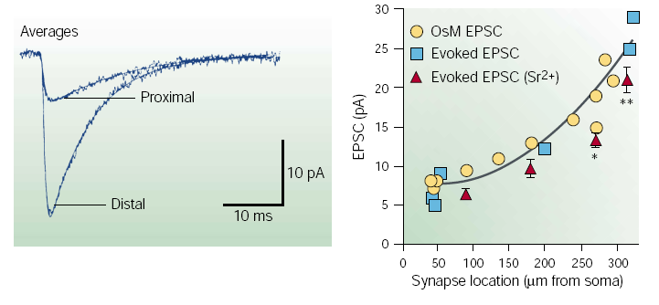
Synaptic properties
While active properties contribute to summation, don’t explain normalized amplitude
Shape of EPSC determines how it is filtered .. Adjust ratio of AMPA/NMDA receptors

Slide 39
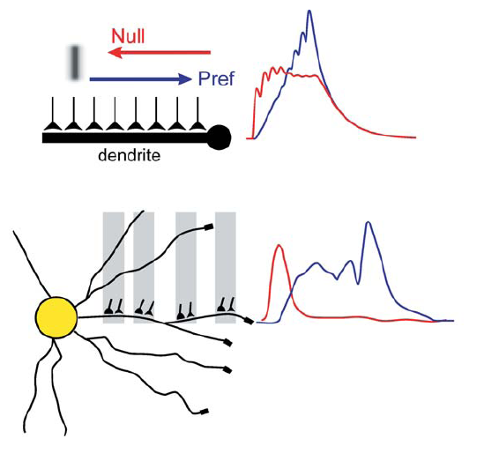
Direction selectivity
Rall; fig London and Hausser

Slide 40
Back-propagating action potentials

Slide 41
References
Johnson and Wu, Foundations of Cellular Physiology, Chap 4
Koch, Biophysics of Computation
Magee, Dendritic integration of excitatory synaptic input, Nature Reviews Neuroscience, 2000
London and Hausser, Dendritic Computation, Annual Reviews in Neuroscience, 2005

