Slide 1
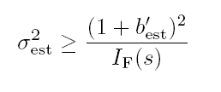
How good is our estimate?
For stimulus s, have estimated s_{est}
Bias:
Variance:
Mean square error:
Cramer-Rao bound:
Fisher information
(ML is unbiased: b = b’ = 0)

Slide 2
Fisher information
Alternatively:
Quantifies local stimulus discriminability

Slide 3
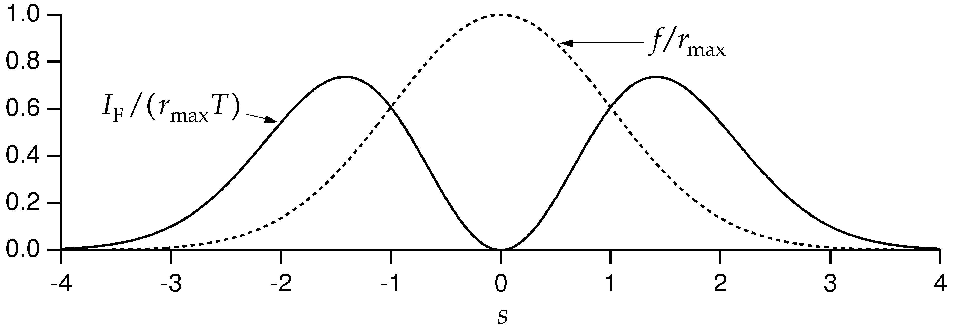
Fisher information for Gaussian tuning curves
For the Gaussian tuning curves w/Poisson statistics:

Slide 4
Fisher information and discrimination
Recall d' = mean difference/standard deviation
Can also decode and discriminate using decoded values.
Trying to discriminate s and s+Δs:
Difference in ML estimate is Δs (unbiased)
variance in estimate is 1/I_{F}(s).
→

Slide 5
Limitations of these approaches
Tuning curve/mean firing rate
Correlations in the population

Slide 6
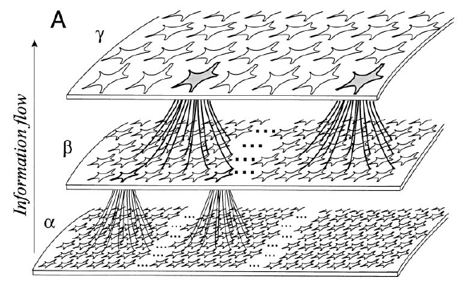
The importance of correlation

Slide 7
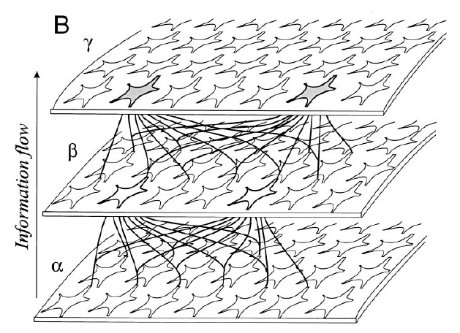
The importance of correlation

Slide 8
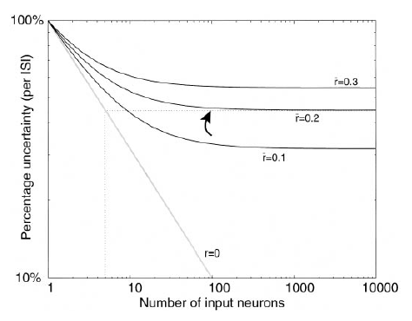
The importance of correlation

Slide 9
Entropy and information
For a random variable X with distribution p(x), entropy is given by
H[X] = - Σ_{x} p(x) log₂p(x)
Information is defined as
I[X] = - log₂p(x)

Slide 10
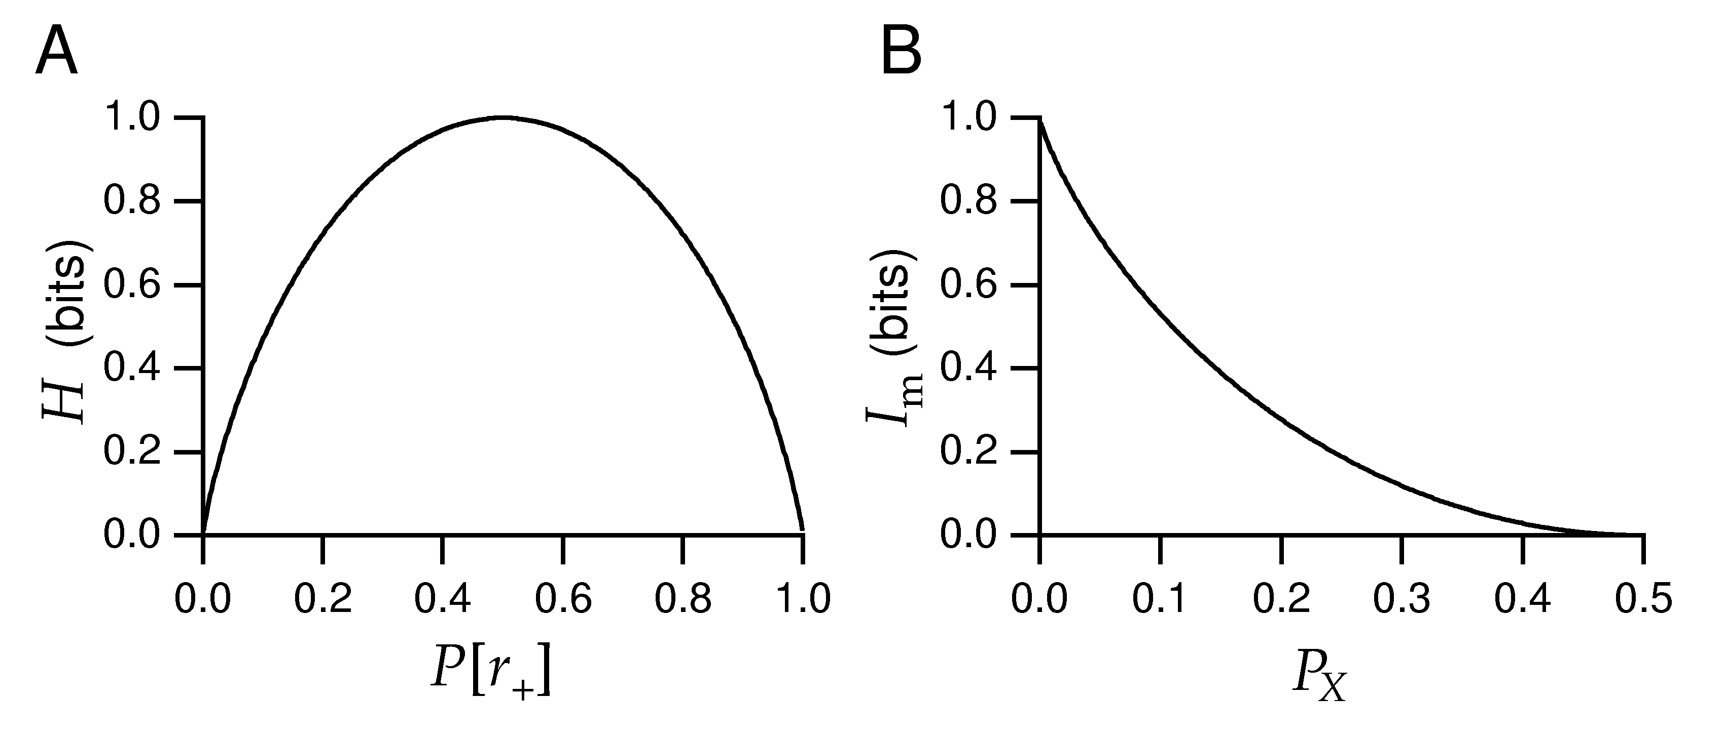
Maximising information
Binary distribution:
Entropy
Information

Slide 11
Entropy and information
Typically, “information” = mutual information:
how much knowing the value of one random variable r (the response)
reduces uncertainty about another random variable s (the stimulus).
Variability in response is due both to different stimuli and to noise.
How much response variability is “useful”, i.e. can represent different messages,
depends on the noise. Noise can be specific to a given stimulus.

Slide 12
Entropy and information
Information quantifies how independent r and s are:
I(s;r) = D_{KL} [P(r,s), P(r)P(s)]
Alternatively:
I(s;r) = H[P(r)] – Σ_{s} P(s) H[P(r|s)] .

Slide 13
Entropy and information
Information is the difference between the total response entropy and
the mean noise entropy:
I(s;r) = H[P(r)] – Σ_{s} P(s) H[P(r|s)] .
→ Need to know the conditional distribution P(s|r) or P(r|s).
Take a particular stimulus s=s₀ and repeat many times to obtain P(r|s₀).
Compute variability due to noise: noise entropy

Slide 14
Entropy and information
Information is symmetric in r and s
Examples:
response is unrelated to stimulus: p[r|s] = p[r]
response is perfectly predicted by stimulus: p[r|s] = δ(r-r_{s})

Slide 15
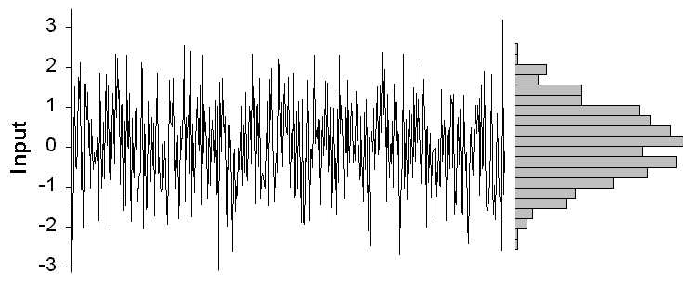
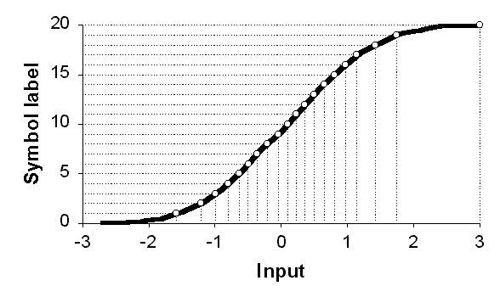
Efficient coding

Slide 16
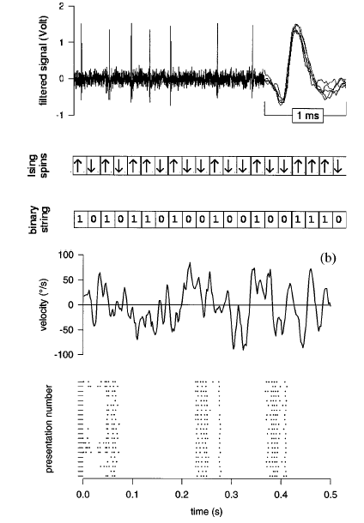
Information in single cells: the direct method
How can one compute the entropy
and information of spike trains?
Discretize the spike train into binary
words w with letter size Δτ, length T.
This takes into account correlations between
spikes on timescales TΔτ.
Compute p_{i} = p(w_{i}), then the naïve entropy is
Strong et al., 1997; Panzeri et al.

Slide 17
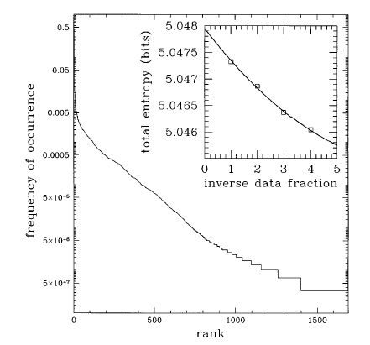
Information in single cells: the direct method
Many information calculations are limited by
sampling: hard to determine P(w) and P(w|s)
Systematic bias from undersampling.
Correction for finite size effects:
Strong et al., 1997

Slide 18
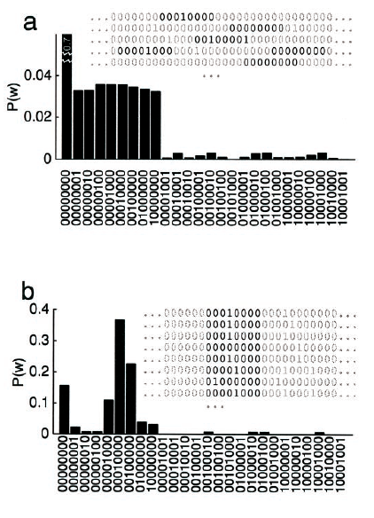
Information in single cells: the direct method
Information is the difference
between the variability driven by stimuli and
that due to noise.
Take a stimulus sequence s and repeat many
times.
For each time in the repeated stimulus, get a
set of words P(w|s(t)).
Should average over all s with weight P(s);
instead, average over time:
H_{noise} = < H[P(w|s_{i})] >_{i}.
Choose length of repeated sequence long enough
to sample the noise entropy adequately.
Finally, do as a function of word length T and
extrapolate to infinite T.
Reinagel and Reid, ‘00

Slide 19
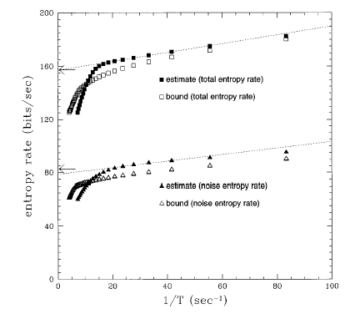
Information in single cells
Fly H1:
obtain information rate of
~80 bits/sec or 1-2 bits/spike.

Slide 20
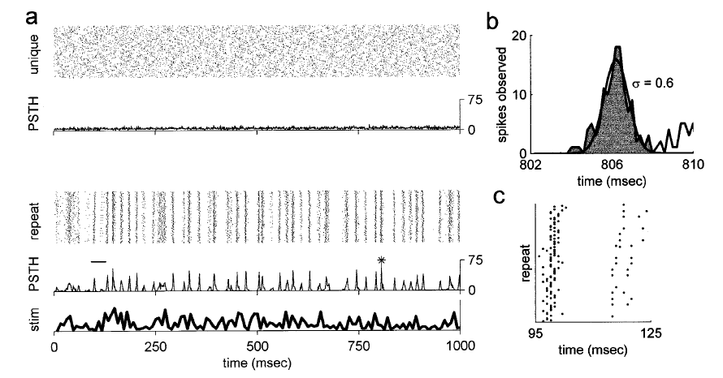
Information in single cells
Another example: temporal coding in the LGN (Reinagel and Reid ‘00)

Slide 21
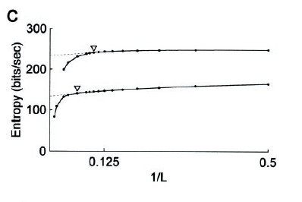
Information in single cells
Apply the same procedure:
collect word distributions
for a random, then repeated stimulus.

Slide 22
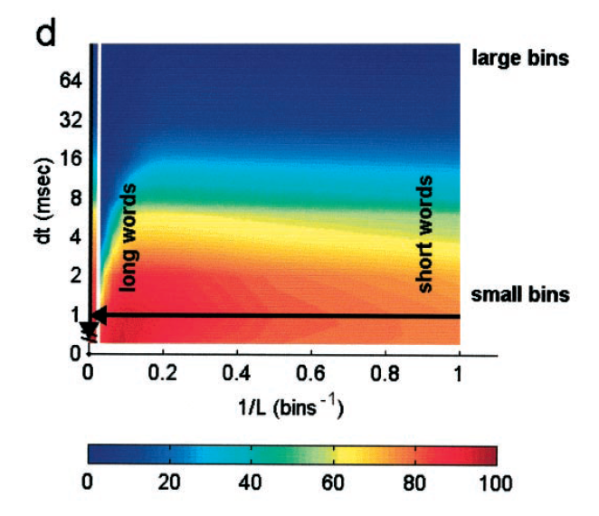
Information in single cells
Use this to quantify how
precise the code is,
and over what timescales
correlations are important.

Slide 23
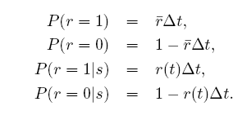
Information in single spikes
How much information does a single spike convey about the stimulus?
Key idea: the information that a spike gives about the stimulus is the reduction
in entropy between the distribution of spike times not knowing the stimulus,
and the distribution of times knowing the stimulus.
The response to an (arbitrary) stimulus sequence s is r(t).
Without knowing that the stimulus was s, the probability of observing a spike
in a given bin is proportional to , the mean rate, and the size of the bin.
Consider a bin Δt small enough that it can only contain a single spike. Then in
the bin at time t,

Slide 24
Information in single spikes
Now compute the entropy difference:
,
← prior
← conditional
Note substitution of a time average for an average over the r ensemble.
Assuming ,
and using
In terms of information per spike (divide by ):

Slide 25
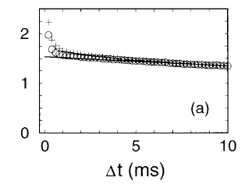
Information in single spikes
Given
note that:
It doesn’t depend explicitly on the stimulus
The rate r does not have to mean rate of spikes; rate of any event.
Information is limited by spike precision, which blurs r(t),
and the mean spike rate.
Compute as a function of Δt:
Undersampled for small bins

Slide 26
Synergy and redundancy
The information in any given event can be computed as:
Define the synergy, the information gained from the joint symbol:
or equivalently,
Negative synergy is called redundancy.

Slide 27
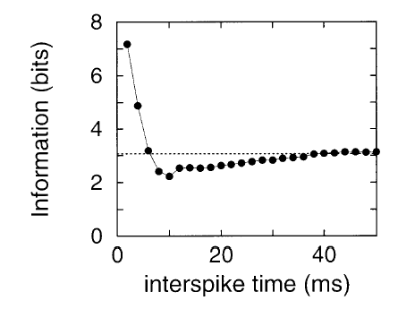
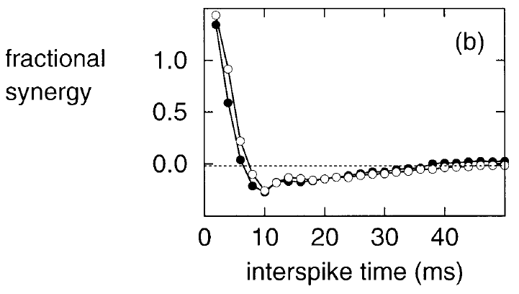
Exmple: multispike patterns
In the identified neuron H1, compute information in a spike pair, separated
by an interval dt:
Brenner et al., ’00.

Slide 28
Using information to evaluate neural models
We can use the information about the stimulus to evaluate our
reduced dimensionality models.

Slide 29
Evaluating models using information
Mutual information is a measure of the reduction of uncertainty about one quantity that is achieved by observing another.
Uncertainty is quantified by the entropy of a probability distribution,
∑ p(x) log₂ p(x).
We can compute the information in the spike train directly, without direct reference to the stimulus (Brenner et al., Neural Comp., 2000)
This sets an upper bound on the performance of the model.
Repeat a stimulus of length T many times and compute the time-varying rate r(t), which is the probability of spiking given the stimulus.

Slide 30
Evaluating models using information
Information in timing of 1 spike:
By definition

Slide 31
Evaluating models using information
Given:
By definition
Bayes’ rule

Slide 32
Evaluating models using information
Given:
By definition
Bayes’ rule
Dimensionality reduction

Slide 33
Evaluating models using information
Given:
By definition
Bayes’ rule
Dimensionality reduction
So the information in the K-dimensional model is evaluated using
the distribution of projections:

Slide 34
Experimental design
Alternate random and repeat stimulus segments:
Compute modes
and projections
A₁
B
A₂
B
A₃
B
…
Compute
mean rate

Slide 35
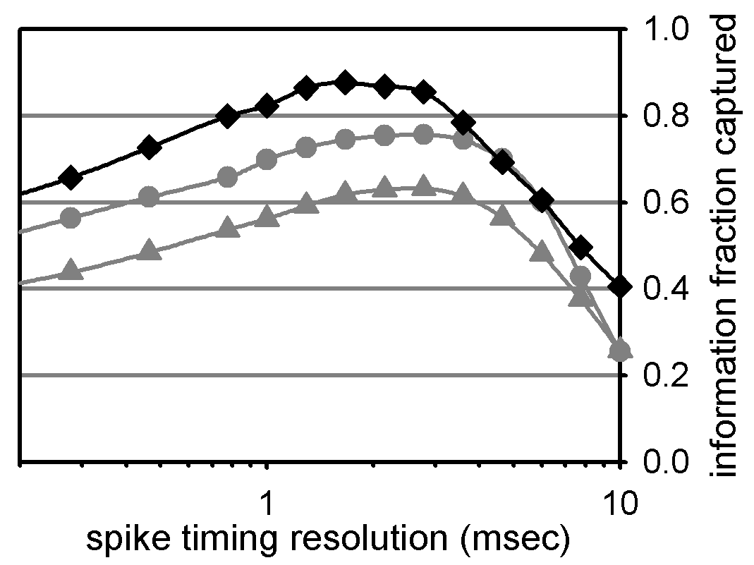
Using information to evaluate neural models
Here we used information to evaluate reduced models of the Hodgkin-Huxley
neuron.
Twist model
2D: two covariance modes
1D: STA only

Slide 36
Information in 1D
The STA is the single most informative dimension.

Slide 37
Information in 1D
The information is related to the eigenvalue of the corresponding eigenmode
Negative eigenmodes are much more informative
Information in STA and leading negative eigenmodes up to 90% of the total

Slide 38
Information in 2D
We recover significantly more information from a 2-dimensional description

Slide 39
Information in 2D
Information captured by 2D model
Information captured by STA

Slide 40
Synergy in 2 dimensions
Get synergy when the 2D distribution is not simply a product of 1D distributions
The second dimension contributes synergistically to the 2D description:
the information gain >> the information in the 2nd mode alone

Slide 41
Other fascinating subjects
Adaptive coding: matching to the stimulus distribution for efficient coding
Maximising information transmission through optimal filtering
→ predicting receptive fields
Populations: synergy and redundancy in codes involving many neurons
→ multi-information
Sparseness: the new efficient coding

