Slide 1
Decoding
How well can we learn what the stimulus is by looking
at the neural responses?
We will discuss two approaches:
devise and evaluate explicit algorithms for extracting
a stimulus estimate
directly quantify the relationship between
stimulus and response using information theory

Slide 2
Reading minds: the LGN
Yang Dan, UC Berkeley

Slide 3
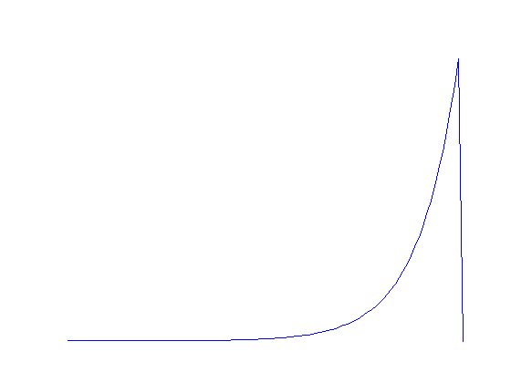
Stimulus reconstruction
K
t

Slide 4
Stimulus reconstruction

Slide 5
Stimulus reconstruction

Slide 6
Other decoding approaches

Slide 7
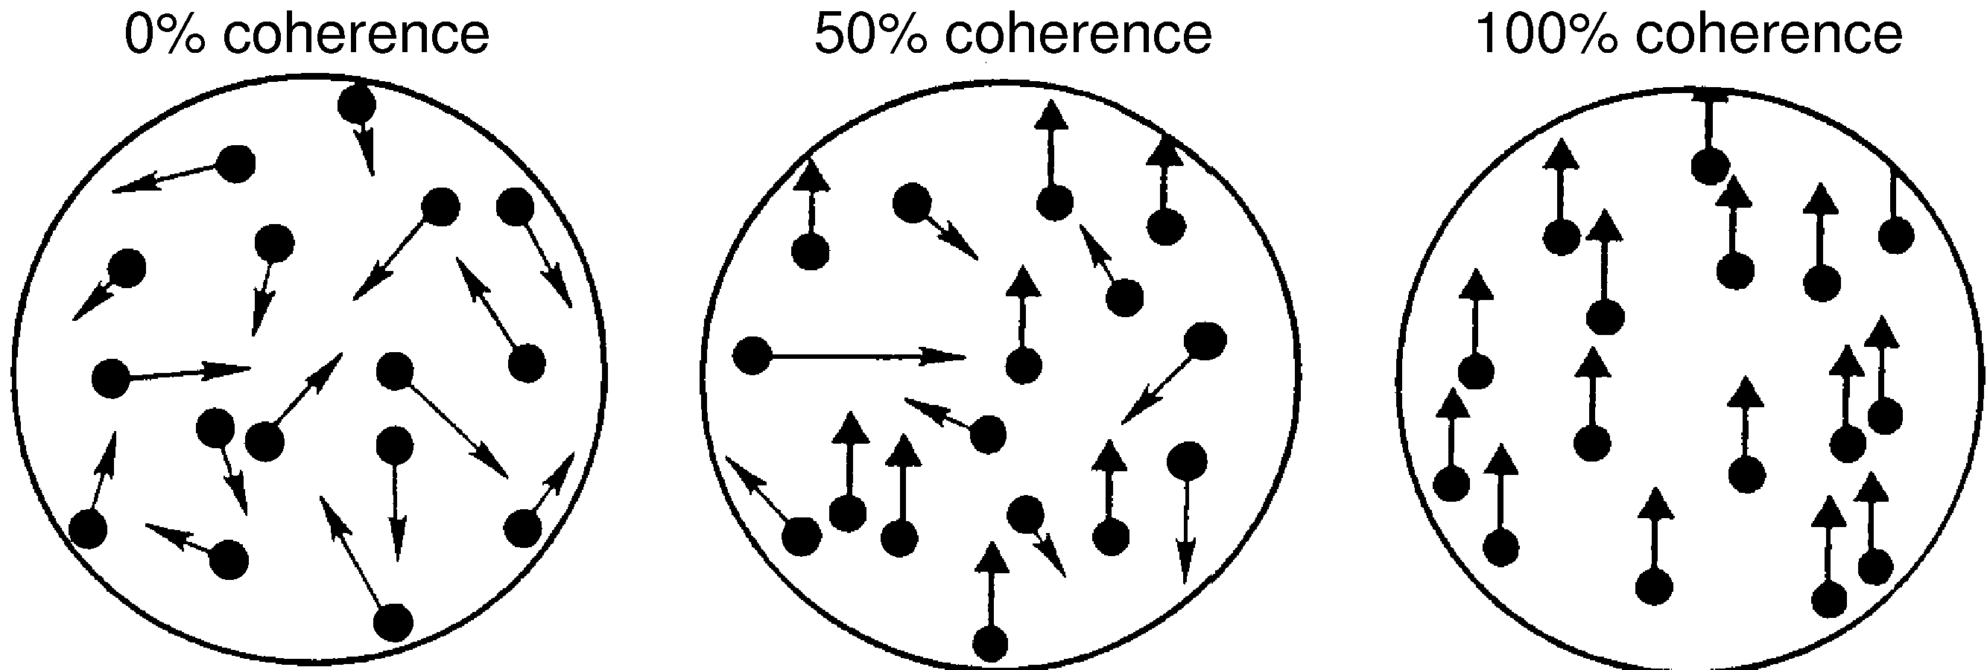
Two-alternative tasks
Britten et al. ‘92: behavioral monkey data + neural responses

Slide 8
Behavioral performance

Slide 9
Predictable from neural activity?
Discriminability: d’ = ( <r>₊ - <r>₋ )/ σ_{r}

Slide 10
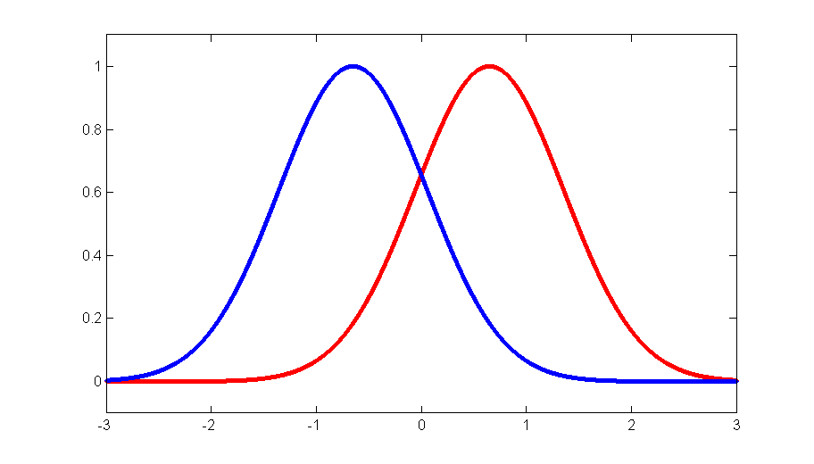
Signal detection theory
z
p(r|-)
p(r|+)
<r>₋
<r>₊
Decoding corresponds to comparing test, r, to threshold, z.
α(z) = P[ r ≥ z|-] false alarm rate, “size”
β(z) = P[ r ≥ z|+] hit rate, “power”
Find z by maximizing P[correct] = p(+) β(z) + p(-)(1 – α(z))

Slide 11
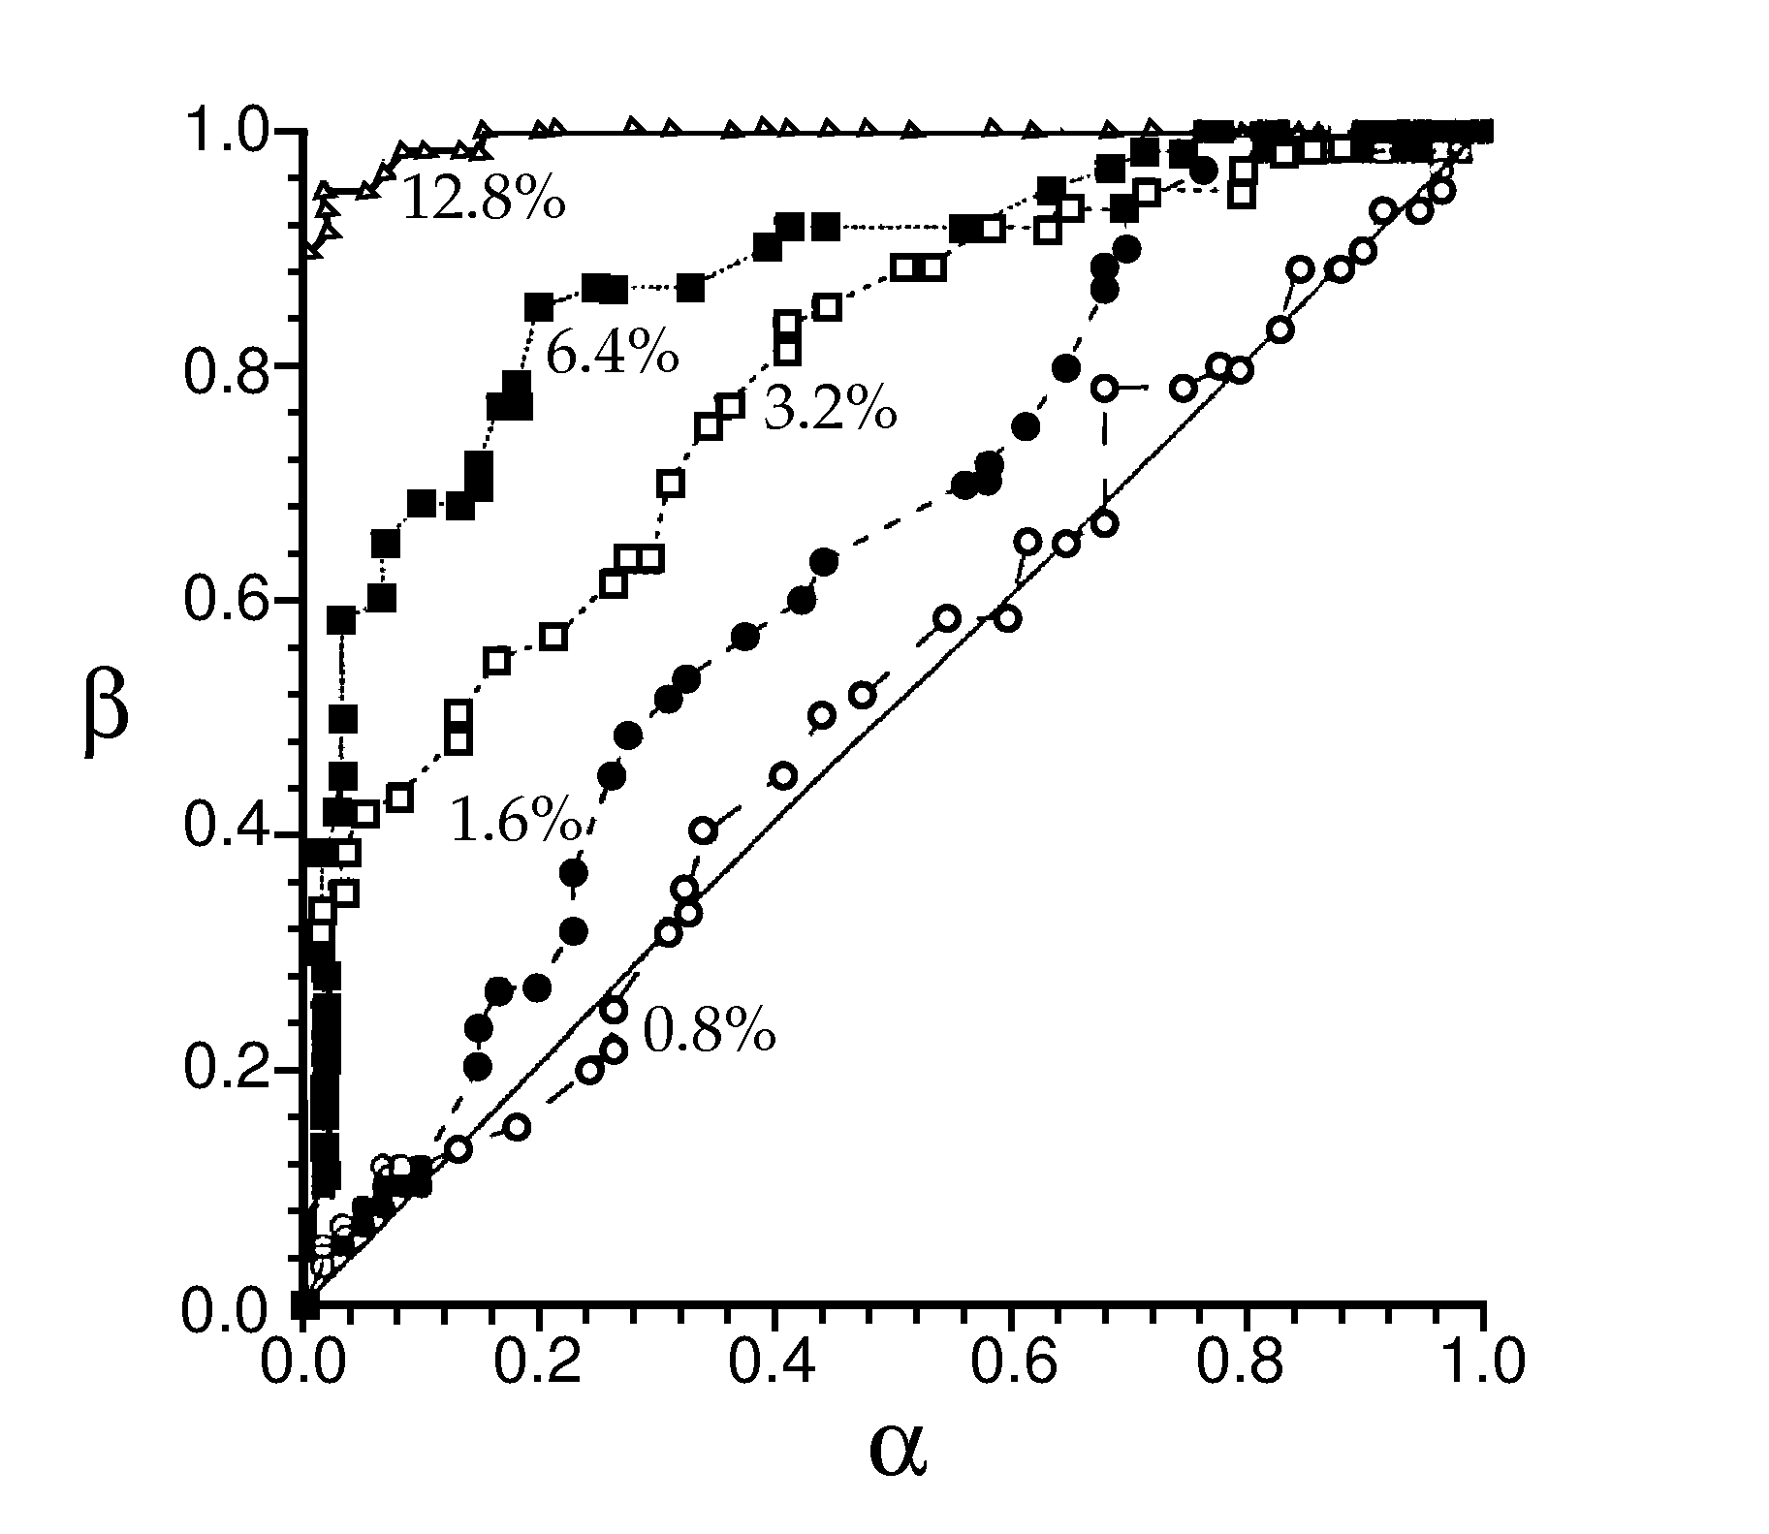
ROC curves
summarize performance of test for different thresholds z
Want β → 1, α → 0.

Slide 12
ROC curves: two-alternative forced choice
Threshold z is the result from the first presentation
The area under the ROC curve corresponds to P[correct]

Slide 13
Is there a better test to use than r?
The optimal test function is the likelihood ratio,
l(r) = p[r|+] / p[r|-].
(Neyman-Pearson lemma)
Note that
l(z) = (dβ/dz) / (dα/dz) = dβ/dα
i.e. slope of ROC curve

Slide 14
The logistic function
If p[r|+] and p[r|-] are both Gaussian,
P[correct] = ½ erfc(-d’/2).
To interpret results as two-alternative forced choice, need simultaneous responses from
“+ neuron” and from “– neuron”.
Simulate “- neuron” responses from same neuron in response to – stimulus.
Ideal observer: performs as area under ROC curve.

Slide 15
More d’
Again, if p[r|-] and p[r|+] are Gaussian,
and P[+] and P[-] are equal,
P[+|r] = 1/ [1 + exp(-d’ (r - <r>)/ σ)].
d’ is the slope of the sigmoidal fitted to P[+|r]

Slide 16
Close correspondence between neural and behaviour..
Why so many neurons? Correlations limit performance.

Slide 17
Likelihood as loss minimization
Penalty for incorrect answer: L₊, L₋
For an observation r, what is the expected loss?
Loss₋ = L₋P[+|r]
Cut your losses: answer + when Loss₊ < Loss₋
i.e. L₊P[-|r] > L₋P[+|r].
Using Bayes’, P[+|r] = p[r|+]P[+]/p(r);
P[-|r] = p[r|-]P[-]/p(r);
→ l(r) = p[r|+]/p[r|-] > L₊P[-] / L₋P[+] .
Loss₊ = L₊P[-|r]

Slide 18
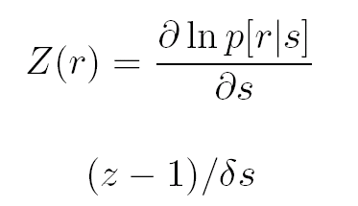
Likelihood and tuning curves
For small stimulus differences s and s + δs
comparing
to threshold

Slide 19
Population coding
Population code formulation
Methods for decoding:
population vector
Bayesian inference
maximum likelihood
maximum a posteriori
Fisher information

Slide 20
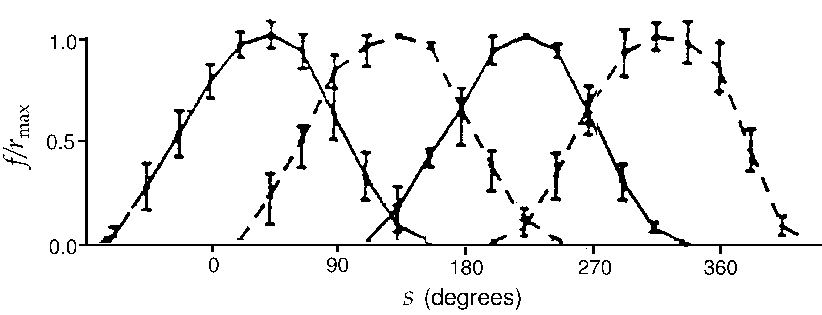
Cricket cercal cells coding wind velocity

Slide 21
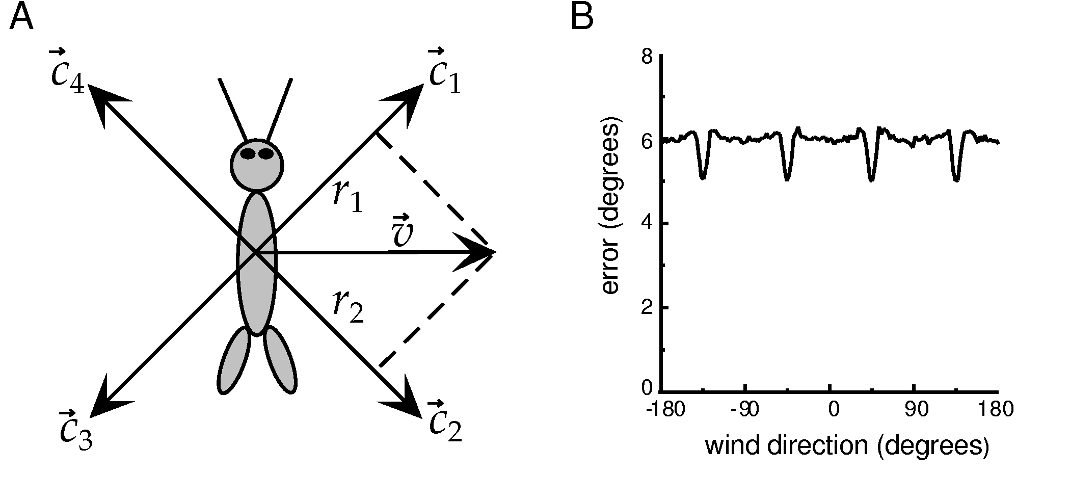
Population vector
RMS error in estimate
Theunissen & Miller, 1991

Slide 22
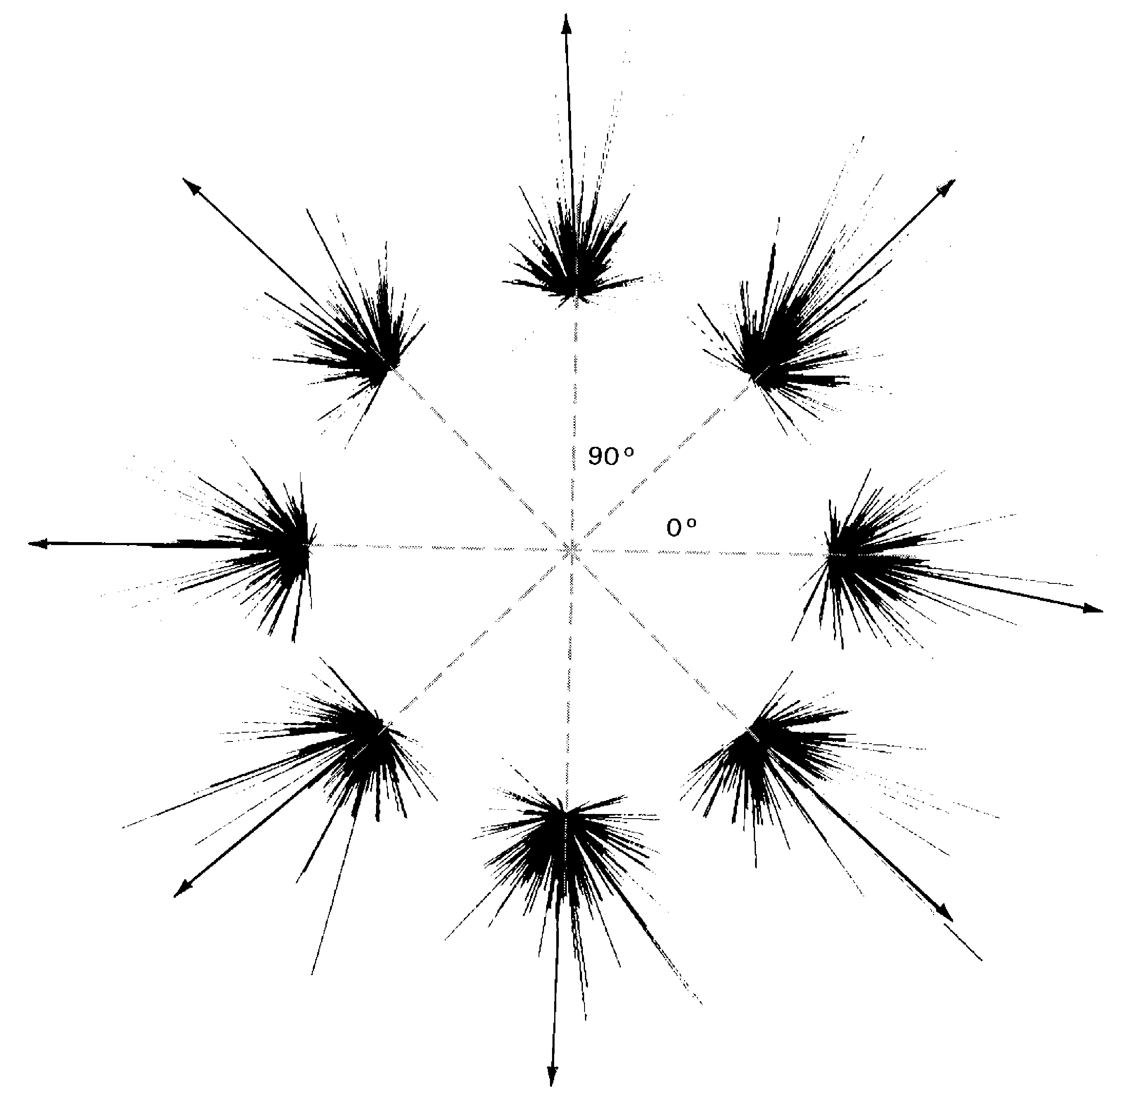
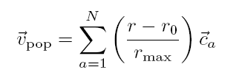
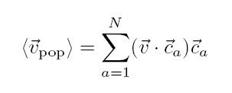
Population coding in M1
Cosine tuning:
Pop. vector:
For sufficiently large N,
is parallel to the direction of arm movement

Slide 23
The population vector is neither general nor optimal.
“Optimal”:
make use of all information in the stimulus/response distributions

Slide 24
Bayesian inference
By Bayes’ law,
likelihood function
conditional distribution
prior distribution
a posteriori distribution
marginal distribution

Slide 25
Bayesian estimation
Want an estimator s_{Bayes}
Introduce a cost function, L(s,s_{Bayes}); minimize mean cost.
For least squares cost, L(s,s_{Bayes}) = (s – s_{Bayes})² ;
solution is the conditional mean.

Slide 26
Bayesian inference
By Bayes’ law,
likelihood function
a posteriori distribution

Slide 27
Maximum likelihood
Find maximum of P[r|s] over s
More generally, probability of the data given the “model”
“Model” = stimulus
assume parametric form for tuning curve

Slide 28
Bayesian inference
By Bayes’ law,
likelihood function
conditional distribution
prior distribution
a posteriori distribution
marginal distribution

Slide 29
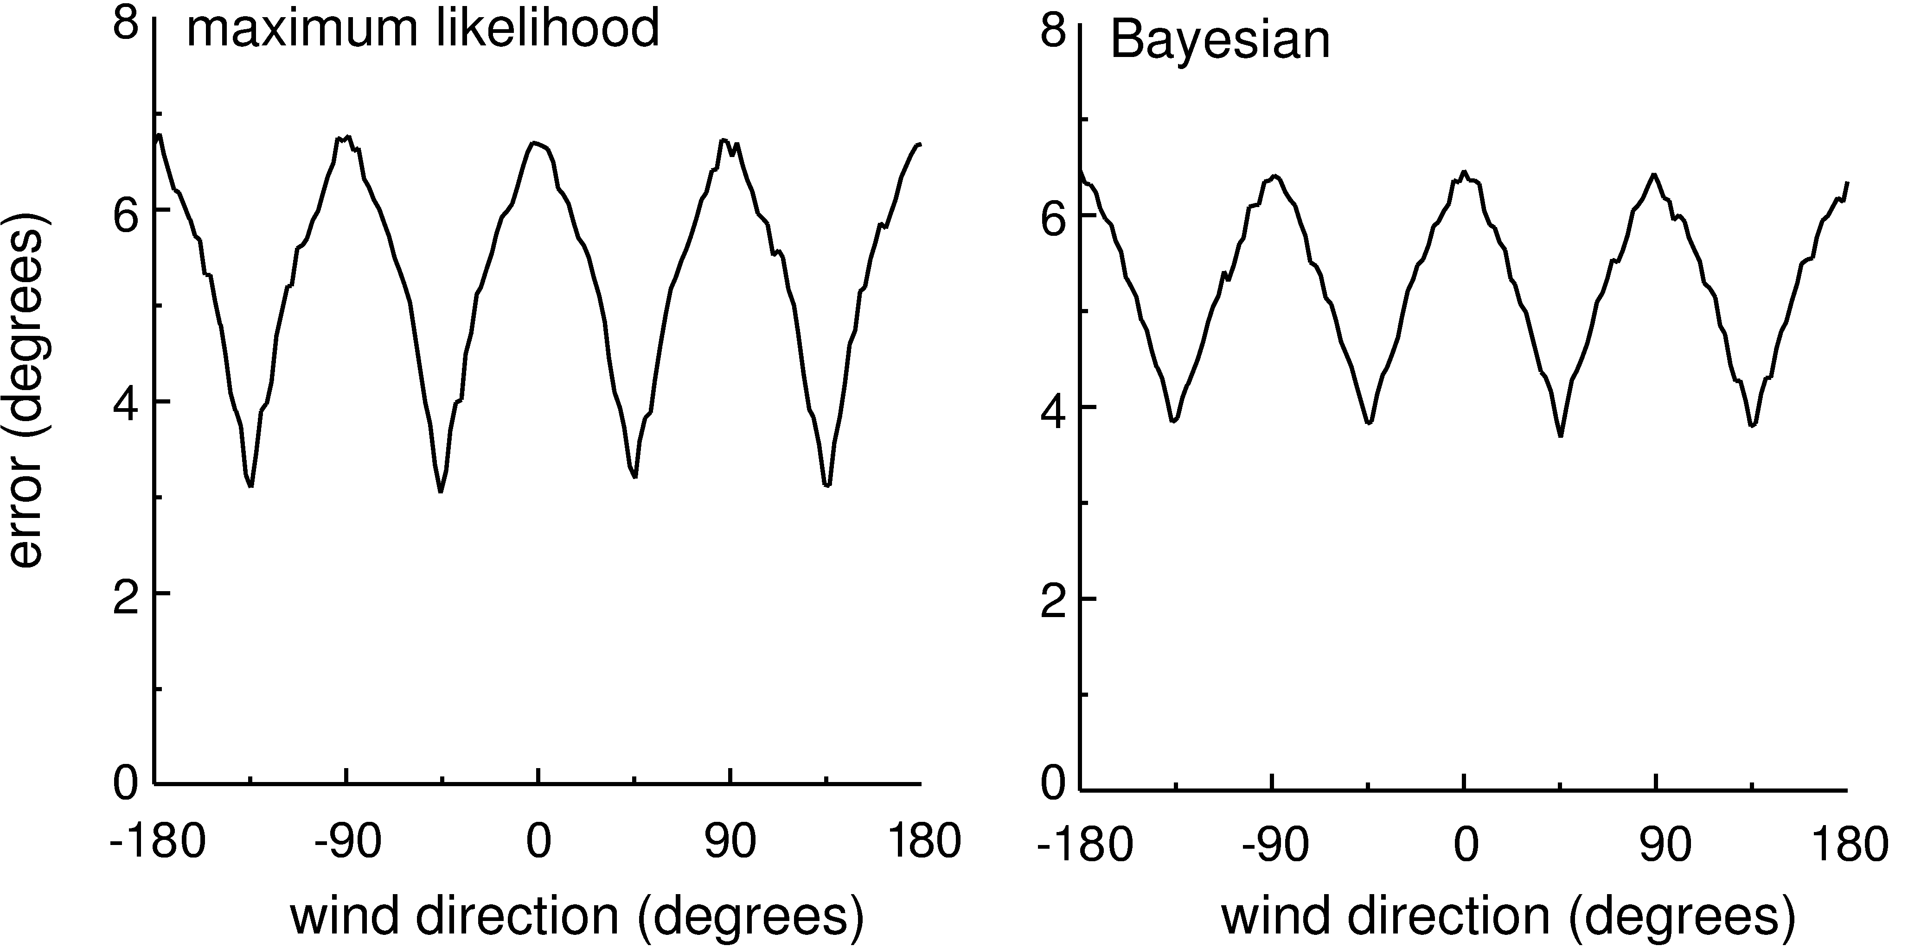
MAP and ML
ML: s* which maximizes p[r|s]
MAP: s* which maximizes p[s|r]
Difference is the role of the prior: differ by factor p[s]/p[r]
For cercal data:

Slide 30
Decoding an arbitrary continuous stimulus
Work through a specific example
assume independence
assume Poisson firing
Distribution: P_{T}[k] = (λT)^{k} exp(-λT)/k!

Slide 31
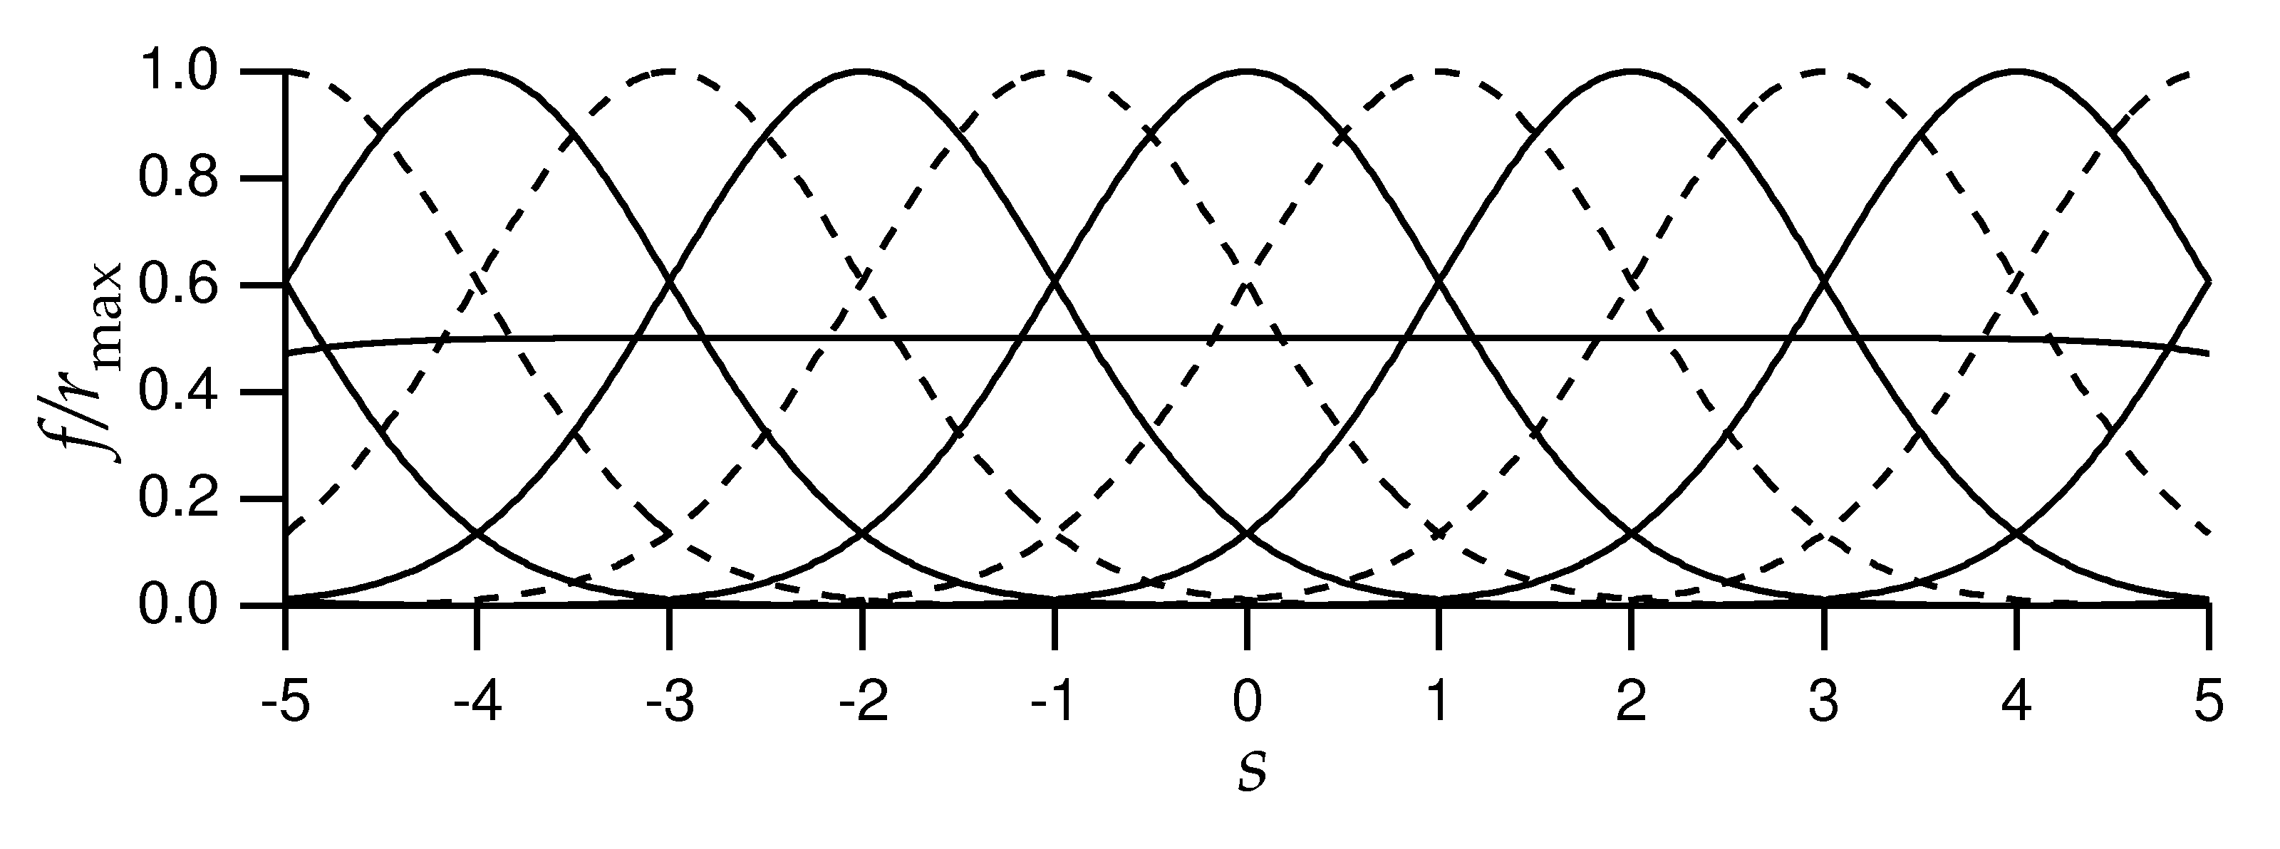
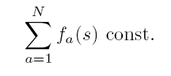
Decoding an arbitrary continuous stimulus
E.g. Gaussian tuning curves

Slide 32
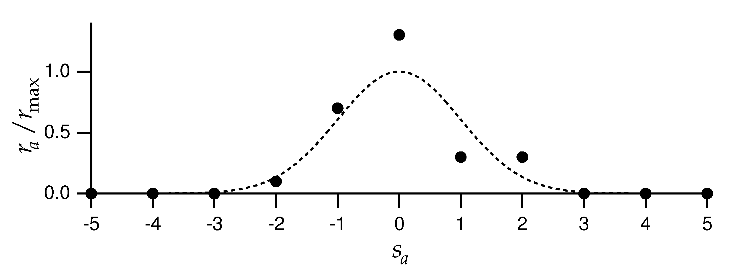
Need to know full P[r|s]
Assume Poisson:
Assume independent:
Population response of 11 cells with Gaussian tuning curves

Slide 33
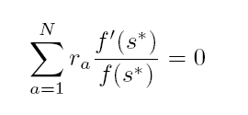
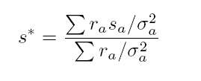
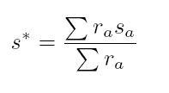
Apply ML: maximize ln P[r|s] with respect to s
Set derivative to zero, use sum = constant
From Gaussianity of tuning curves,
If all σ same

Slide 34
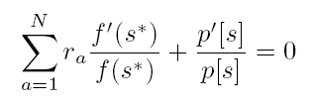
Apply MAP: maximise ln p[s|r] with respect to s
Set derivative to zero, use sum = constant
From Gaussianity of tuning curves,

Slide 35
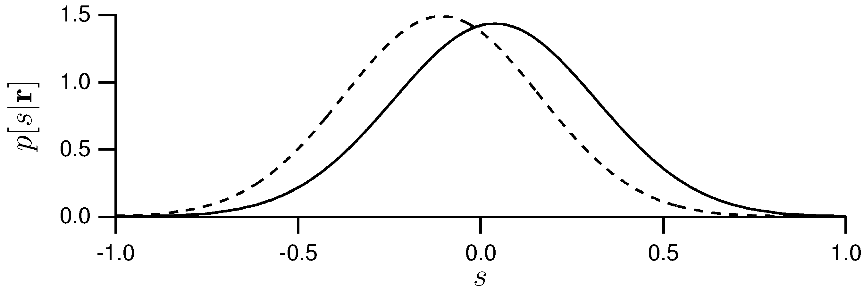
Given this data:
Prior with mean -2, variance 1
MAP:
Constant prior

Slide 36
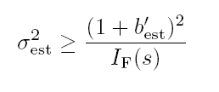
How good is our estimate?
For stimulus s, have estimated s_{est}
Bias:
Variance:
Mean square error:
Cramer-Rao bound:
Fisher information
(ML is unbiased: b = b’ = 0)

Slide 37
Fisher information
Alternatively:
Quantifies local stimulus discriminability

Slide 38
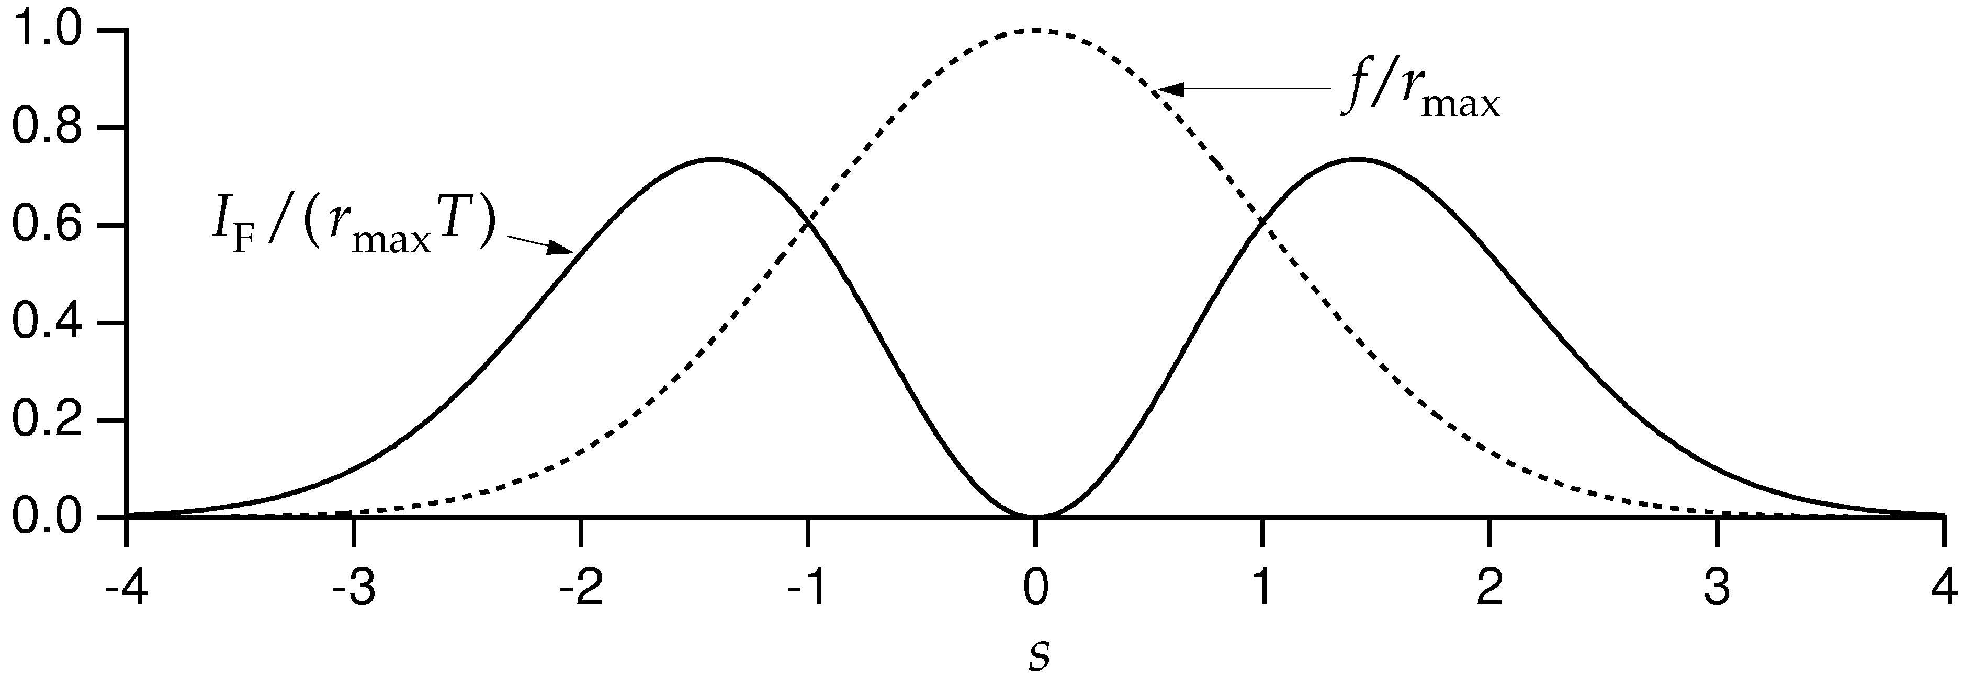
Fisher information for Gaussian tuning curves
For the Gaussian tuning curves w/Poisson statistics:

Slide 39
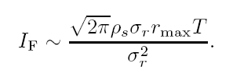
Do narrow or broad tuning curves produce better encodings?
Approximate:
Thus,
→ Narrow tuning curves are better
But not in higher dimensions!

Slide 40
Fisher information and discrimination
Recall d' = mean difference/standard deviation
Can also decode and discriminate using decoded values.
Trying to discriminate s and s+Δs:
Difference in ML estimate is Δs (unbiased)
variance in estimate is 1/I_{F}(s).
→

Slide 41
Limitations of these approaches
Tuning curve/mean firing rate
Correlations in the population

Slide 42
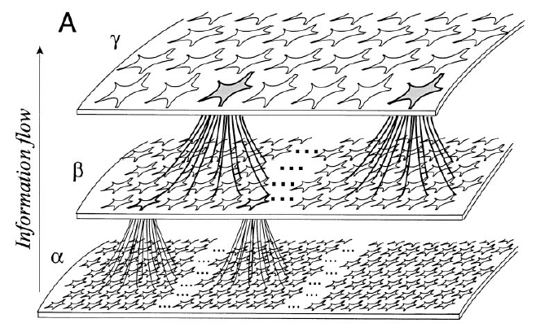
The importance of correlation

Slide 43
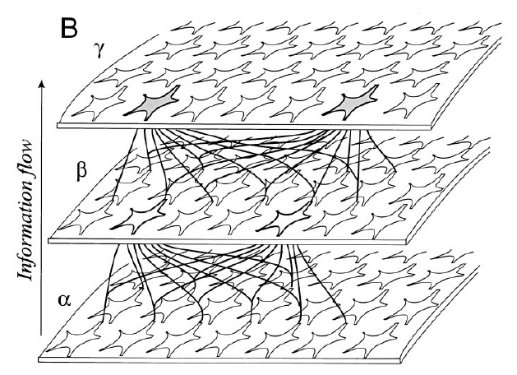
The importance of correlation

Slide 44
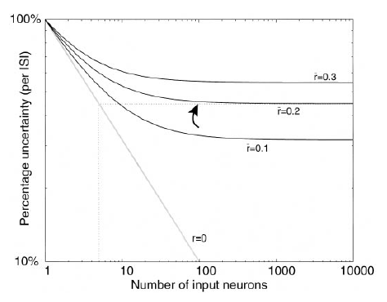
The importance of correlation

