Slide 1
Auto-active verification
K. Rustan M. Leino
Senior Principal Engineer Automated Reasoning Group (ARG), Amazon Web Services
Guest lecture in Emina Torlak’s CSE 507, Computer-Aided Reasoning for Software 21 Feb 2019, UW, Seattle, WA, USA

Slide 2
Static program verification
What is the state-of-art in program verifiers?
How to build a program verifier

Slide 3
Program verification: 1949
Source: “An Early Program Proof by Alan Turing” by F.L. Morris and C.B. Jones, Annals of the History of Computing, 1984

Slide 4
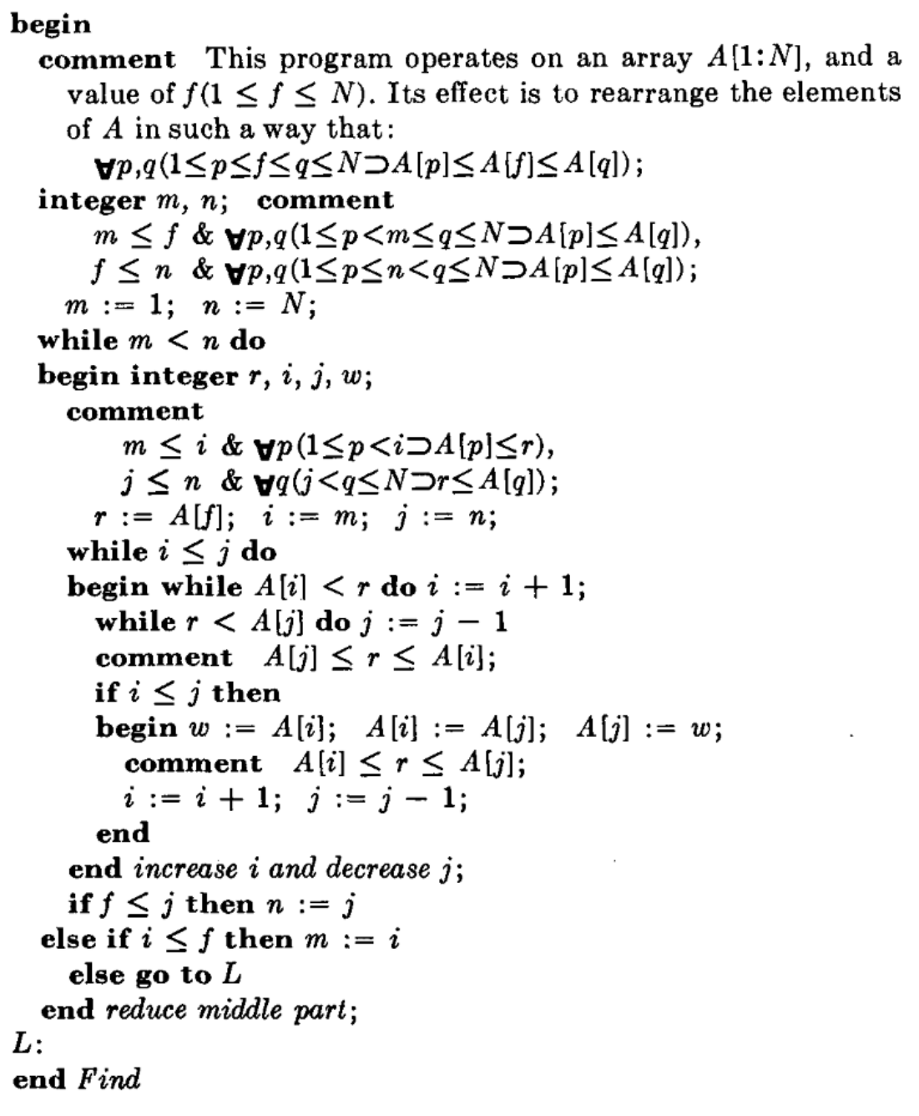
Program verification: 1971
Source: “Proof of a program: FIND” by C.A.R. Hoare, CACM, 1971

Slide 5
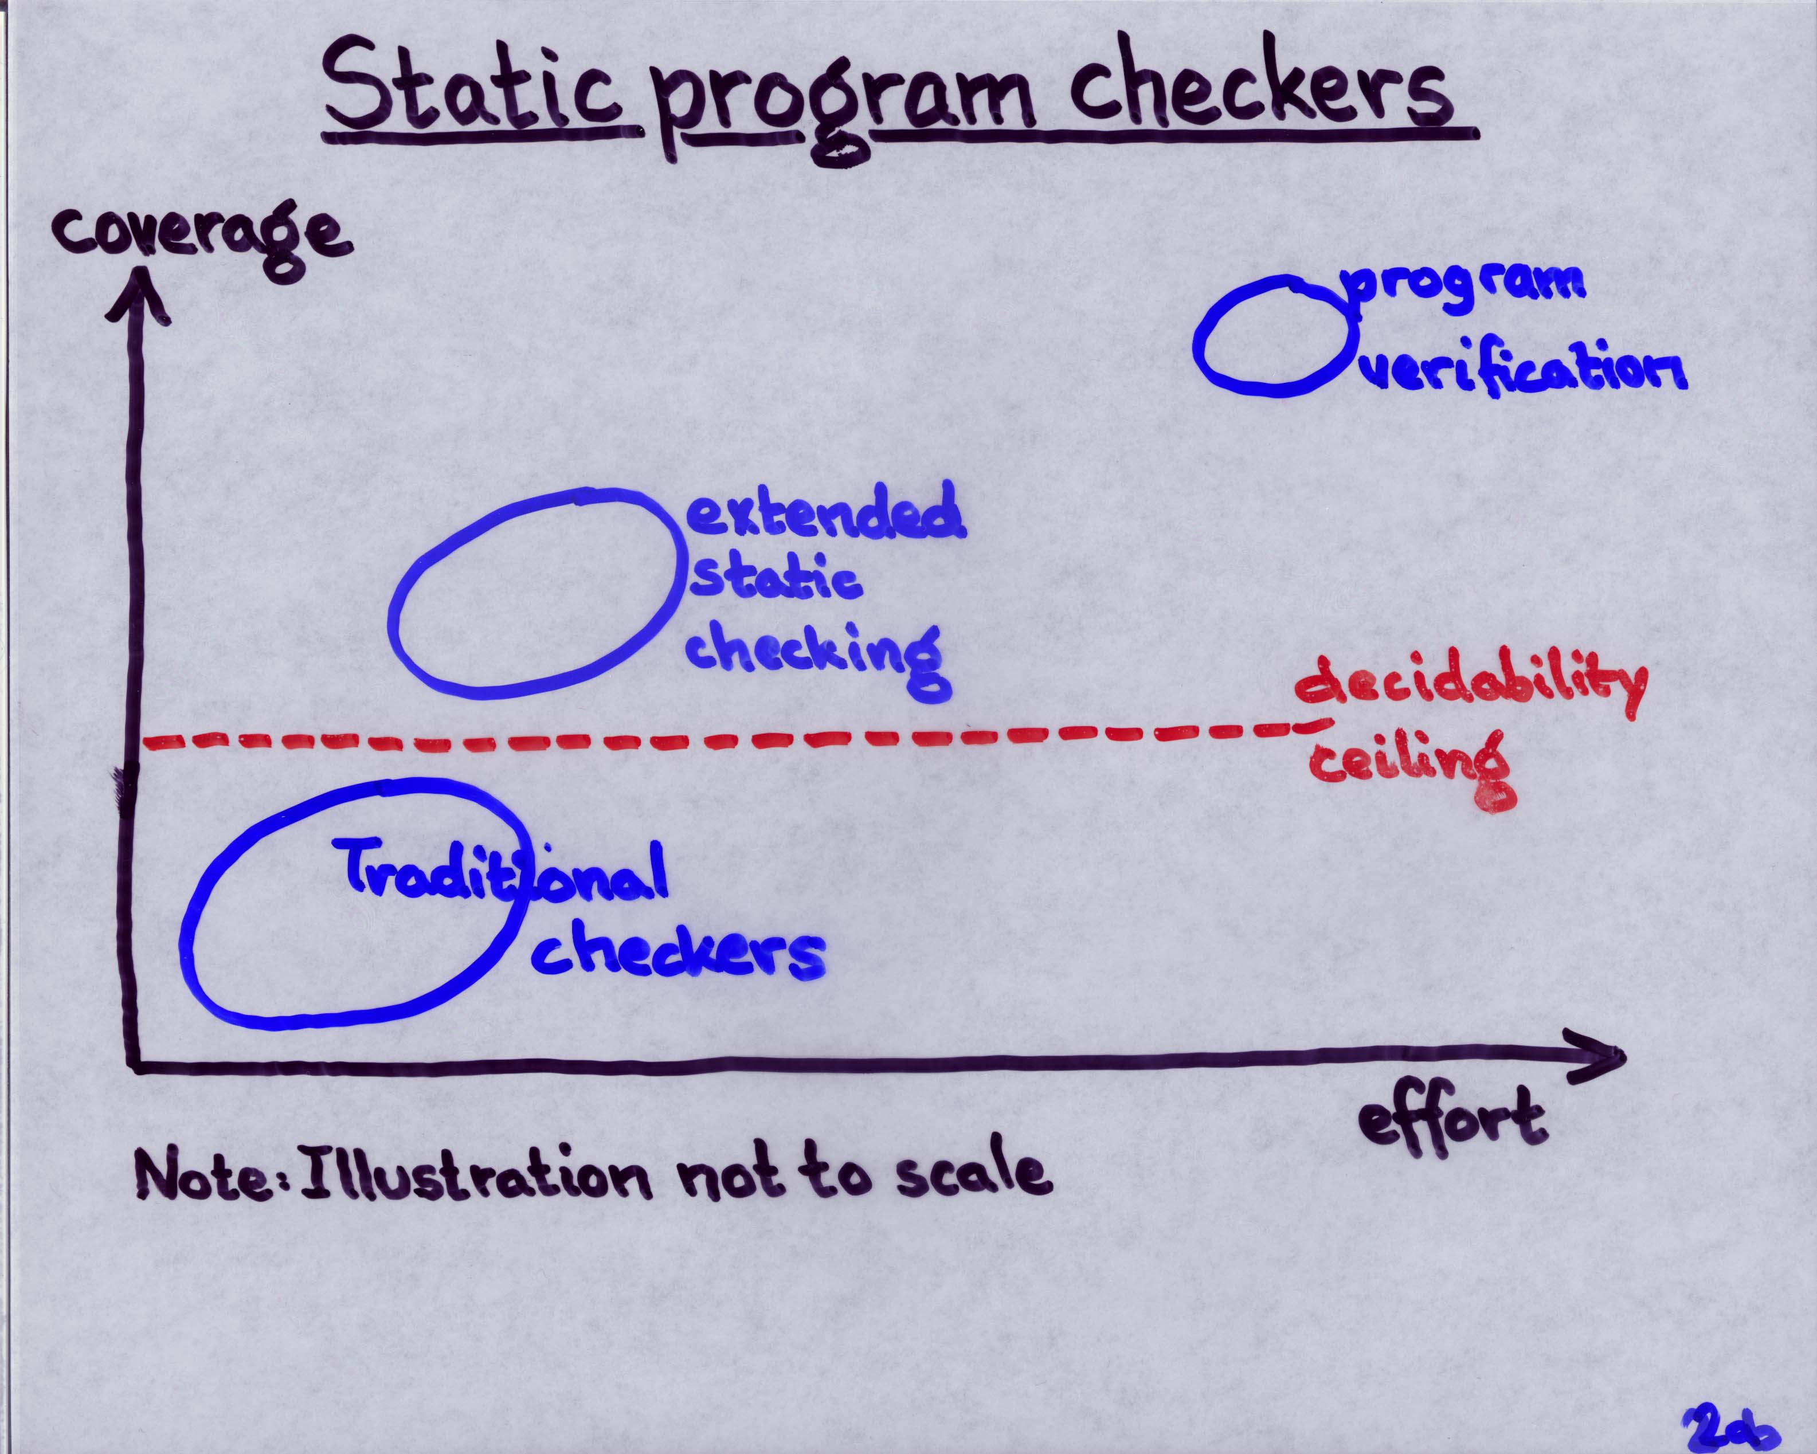
Program verification: 1998
Source: Invited talk “ESC/Java” by K.R.M. Leino at Larch User’s Group Meeting, FM’99, Toulouse, France, Sep 1999

Slide 6
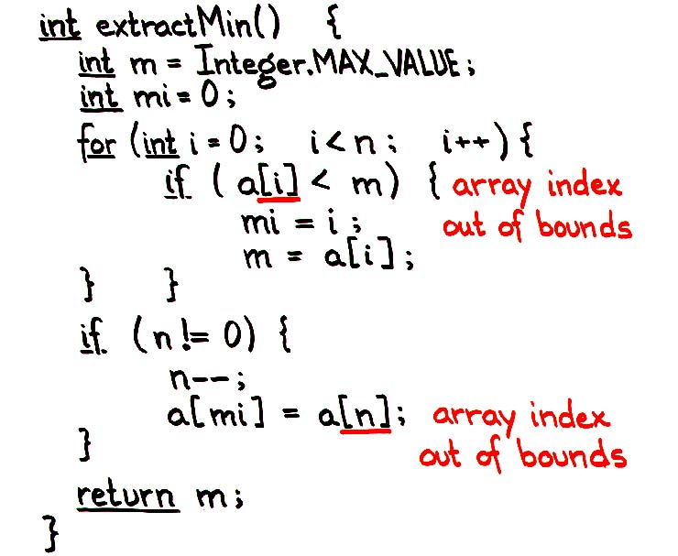
Program verification: 1998
Source: Talk and first (pre-tool) ESC/Java demo by K.R.M. Leino to Hopper et al. at DEC WRL, “Extended Static Checking for Java”, March 1998

Slide 7
Program verification: 2008
Auto-active verification
Source: Paper presentation on Dafny by K.R.M. Leino at LPAR-16, Dakar, Senegal, April 2010

Slide 8
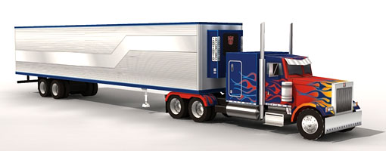
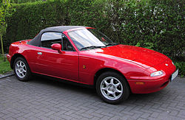
2010s
Annotated program text alone is not enough
Need ability to formalize models, state lemmas, and assist in proof authoring
This has always been possible in interactive proof assistants
Coq, Isabelle/HOL, Agda, …
Now it has come to automated program verifiers as well
Dafny, VeriFast, WhyML, F*, Liquid Haskell, …

Slide 9
Dafny
Put reasoning about programs first
Language aimed at reasoning
Constructs for recording design decisions
Tool support
Static program verifier enforces design decisions
Integrated development environment
Tools help in reasoning process
Verification is not an afterthought

Slide 10
Dafny
Imperative programming
if, while, :=, class, …
Functional programming
function, datatype, codatatype, …
Proof authoring
lemma, calc, refines, inductive predicate, …

Slide 11
Demo
(start + count) % data.Length
0
start
data:
Enqueue at (start + count) % data.Length
Dequeue at start
Imperative programs: Queue implemented by a ring buffer

Slide 12
Copying into the new array
0
start
data:
more
start
0
d:

Slide 13
Demo
Lemmas

Slide 14
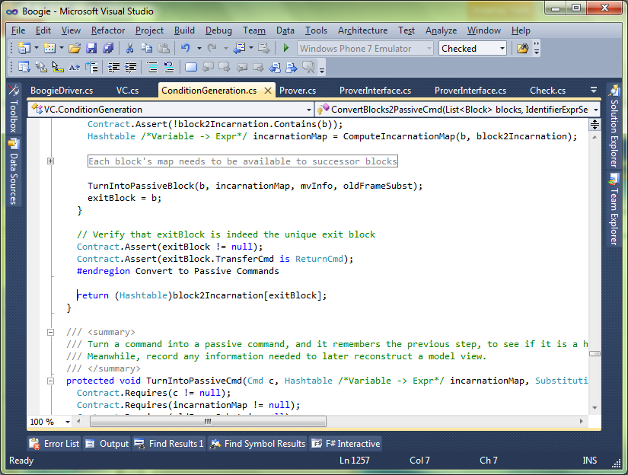
Separation of concerns
Java
Java
Intermediate representation
Intermediate verification language
Compiler
Verifier
SMT solver

Slide 15
Verification architecture
Dafny
Intermediate Verification Language
Boogie
SMT solver

Slide 16
Meet the family
GPU Verify
STORM (C)
Boogie x86
…
Corral
QED
C B Analyze
Poirot
Forró
Diego-matic
Spec#
VCC (C)
HAVOC (C)
Dafny
Chalice
Eiffel (EveProofs)
Java BML
Region Logic
Boogie
Boogie Verification Debugger
inference
SymDiff
SMTLib2
Z3
TPTP

Slide 17
Verification architecture
Frama-C
SPARK
Pangoline
Who
Jessie
Krakatoa
CAO
Why3
Alt-Ergo
…
SMTLib2
Z3
Coq
Isabelle/HOL
CVC 3

Slide 18
Boogie language overview
Mathematical features
type T
const x…
function f…
axiom E
Imperative features
var y…
procedure P… …spec…
implementation P… { …body… }

Slide 19
Boogie statements
x := E
Evaluate E and change x to that value
a[i] := E
Same as a := a[i := E]
havoc x
Change x to an arbitrary value
assert E
Check that E holds at this program point
assume E
Assume that E holds at this program point
call P()
Act according to specification of P
if
while
break
label:
goto A, B

Slide 20
Demo
RingBuffer translated

Slide 21
Translation basics
Ada
Boogie
var x: int;
procedure Update(y: int) returns (r: int)
modifies x;
{
if (x < y) {
x := y;
}
r := y;
}
procedure Main()
modifies x;
{
call x := Update(5);
}
x : Integer;
procedure Update
(y : Integer;
r : out Integer) is
begin
if x < y then
x := y;
end if;
r := y;
end Update;
procedure Main is
begin
Update(5, x);
end Main;

Slide 22
Unstructured control flow
.NET bytecode (MSIL)
Boogie
.maxstack 2
.locals init ([0] int32 i,
[1] bool CS$4$0000)
IL_0000: nop
IL_0001: ldc.i4.0
IL_0002: stloc.0
IL_0003: br.s IL_000b
IL_0005: nop
IL_0006: ldloc.0
IL_0007: ldc.i4.1
IL_0008: add
IL_0009: stloc.0
IL_000a: nop
IL_000b: ldloc.0
IL_000c: ldarg.0
IL_000d: clt
IL_000f: stloc.1
IL_0010: ldloc.1
IL_0011: brtrue.s IL_0005
IL_0013: ret
var i: int, CS$4$000: bool;
var $stack0i, $stack1i: int,
$stack0b: bool;
IL_0000:
$stack0i := 0;
i := 0;
goto IL_000b;
IL_0005:
$stack1i := i;
$stack0i := $stack0i + $stack1i;
i := $stack0i;
IL_000b:
$stack0i := i;
$stack1i := n;
$stack0b := $stack0i < $stack1i;
CS$4$000 := $stack0b;
$stack0b := CS$4$000;
if ($stack0b) { goto IL_0005; }
IL_0013:
return;

Slide 23
Reasoning about loops
Java + JML
Boogie
//@ requires 0 <= n;
void m(int n)
{
int i = 0;
//@ loop_invariant i <= n;
while (i < n) {
i++;
}
//@ assert i == n;
}
procedure m(n: int)
requires 0 <= n;
{
var i: int;
i := 0;
while (i < n)
invariant i <= n;
{
i := i + 1;
}
assert i == n;
}

Slide 24
Custom operators: underspecification
C++
Boogie
const Two^31: int;
axiom Two^31 == 2147483648;
function LeftShift(int, int): int;
axiom (forall a: int ::
LeftShift(a, 0) == a);
function Add(int, int): int;
axiom (forall a, b: int ::
-Two^31 <= a+b && a+b < Two^31
==>
Add(a,b) == a+b);
procedure P() {
var x: int;
x := LeftShift(y, z);
x := Add(y, z);
}
void P() {
int x;
x = y << z;
x = y + z;
}

Slide 25
Definedness of expressions
F#
Boogie
let x = y + z in
let w = y / z in
// ...
// check for underflow:
assert -Two^31 <= y+z;
// check for overflow:
assert y+z < Two^31;
x := y + z;
// check division by zero:
assert z != 0;
w := Div(y, z);

Slide 26
Uninitialized variables
Pascal
Boogie
var r: integer;
if B then
r := z;
(* ... *)
if C then begin
d := r end
var r: int;
var r$defined: bool;
if (B) {
r, r$defined :=
z, true;
}
// ...
if (C) {
assert r$defined;
d := r; }

Slide 27
Loop termination
Eiffel
Boogie
from
Init
until
B
invariant
Inv
variant
VF
loop
Body
end
Init;
while (!B)
invariant Inv;
// check boundedness:
invariant 0 <= VF;
{
tmp := VF;
Body;
// check decrement:
assert VF < tmp;
}

Slide 28
Modeling memory
C#
Boogie
type Ref;
const null: Ref;
type Field;
const unique C.next: Field;
var Heap: [Ref,Field]Ref;
// Ref * Field --> Ref
procedure C.M(this: Ref, c: Ref)
requires this != null;
modifies Heap;
{
var x: Ref;
assert this != null;
x := Heap[this, C.next];
assert c != null;
Heap[c, C.next] := y;
}
class C {
C next;
void M(C c)
{
C x = next;
c.next = c;
}
}

Slide 29
More about memory models
Encoding a good memory model requires more effort
Boogie provides many useful features
Polymorphic map types
Partial commands (assume statements)
Free pre- and postconditions
where clauses

Slide 30
Weakest preconditions
The weakest precondition of a statement S with respect to a predicate Q on the post-state of S, denoted wp(S,Q), is the set of pre-states from which execution:
does not go wrong, and
if it terminates, terminates in Q

Slide 31
VC generation: passive features
wp( assert E, Q ) =
E ∧ Q
wp( assume E, Q ) =
E ⇒ Q
wp( S; T, Q ) =
wp( S, wp( T, Q ))

Slide 32
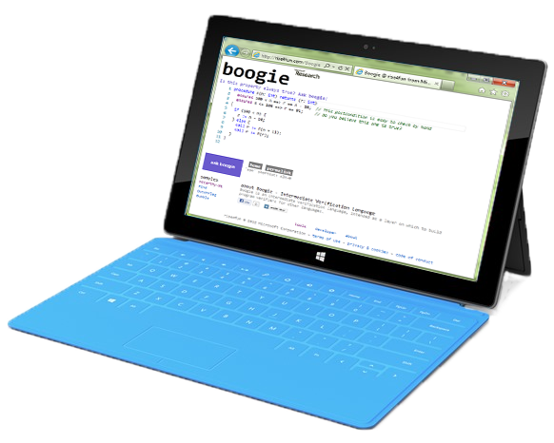
Take-home messages
Automatic + Interactive = Auto-active
An auto-active verifier focuses on the problem, not the underlying logic
To build a verifier, use an intermediate verification language (IVL)
An IVL is a thinking tool
An IVL helps you separate concerns
IVL lets you reuse and share infrastructure
Try Dafny and Boogie in your browser at rise4fun.com
Watch Verification Corner on YouTube

