Slide 1
Program Verification via an Intermediate Verification Language
K. Rustan M. Leino
Principal Researcher Research in Software Engineering (RiSE), Microsoft Research, Redmond
Visiting Professor Department of Computing, Imperial College London
Guest lecture in Emina Torlak’s CSE 507, Computer-Aided Reasoning for Software 4 May 2016, UW, Seattle, WA, USA

Slide 2
Static program verification
What is the state-of-art in program verifiers?
How to build a program verifier

Slide 3
Dafny
Put reasoning about programs first
Language aimed at reasoning
Constructs for recording design decisions
Tool support
Static program verifier enforces design decisions
Integrated development environment
Tools help in reasoning process
Verification is not an afterthought

Slide 4
Demo
(start + count) % data.Length
0
start
data:
Enqueue at (start + count) % data.Length
Dequeue at start
Imperative programs: Queue implemented by a ring buffer

Slide 5
Copying into the new array
0
start
data:
more
start
0
d:

Slide 6
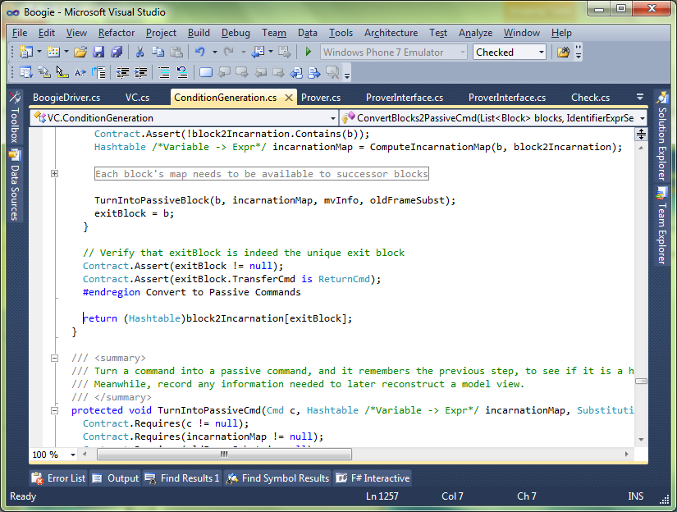
Separation of concerns
C#
C#
Intermediate representation
Intermediate verification language
Compiler
Verifier
SMT solver

Slide 7
Verification architecture
Dafny
Boogie
SMT solver

Slide 8
Meet the family
GPU Verify
STORM (C)
Boogie x86
…
Corral
QED
C B Analyze
Poirot
Forró
Diego-matic
Spec#
VCC (C)
HAVOC (C)
Dafny
Chalice
Eiffel (EveProofs)
Java BML
Region Logic
Boogie
Boogie Verification Debugger
inference
SymDiff
SMT Lib
Z3
TPTP

Slide 9
Verification architecture
Frama-C
Hi-Lite Ada
Pangoline
Who
Jessie
Krakatoa
CAO
Why3
Alt-Ergo
…
SMT Lib
Z3
Coq
Isabelle/HOL
CVC 3

Slide 10
Boogie language overview
Mathematical features
type T
const x…
function f…
axiom E
Imperative features
var y…
procedure P… …spec…
implementation P… { …body… }

Slide 11
Statement outcomes
Terminate
Go wrong
Block
Diverge

Slide 12
Boogie statements
x := E
Evaluate E and change x to that value
a[i] := E
Same as a := a[i := E]
havoc x
Change x to an arbitrary value
assert E
If E holds, terminate; otherwise, go wrong
assume E
If E holds, terminate; otherwise, block
call P()
Act according to specification of P
if
while
break
label:
goto A, B

Slide 13
Translation basics
Ada
Boogie
var x: int;
procedure Update(y: int) returns (r: int)
modifies x;
{
if (x < y) {
x := y;
}
r := y;
}
procedure Main()
modifies x;
{
call x := Update(5);
}
x : Integer;
procedure Update
(y : Integer;
r : out Integer) is
begin
if x < y then
x := y;
end if;
r := y;
end Update;
procedure Main is
begin
Update(5, x);
end Main;

Slide 14
Unstructured control flow
.NET bytecode (MSIL)
Boogie
.maxstack 2
.locals init ([0] int32 i,
[1] bool CS$4$0000)
IL_0000: nop
IL_0001: ldc.i4.0
IL_0002: stloc.0
IL_0003: br.s IL_000b
IL_0005: nop
IL_0006: ldloc.0
IL_0007: ldc.i4.1
IL_0008: add
IL_0009: stloc.0
IL_000a: nop
IL_000b: ldloc.0
IL_000c: ldarg.0
IL_000d: clt
IL_000f: stloc.1
IL_0010: ldloc.1
IL_0011: brtrue.s IL_0005
IL_0013: ret
var i: int, CS$4$000: bool;
var $stack0i, $stack1i: int,
$stack0b: bool;
IL_0000:
$stack0i := 0;
i := 0;
goto IL_000b;
IL_0005:
$stack1i := i;
$stack0i := $stack0i + $stack1i;
i := $stack0i;
IL_000b:
$stack0i := i;
$stack1i := n;
$stack0b := $stack0i < $stack1i;
CS$4$000 := $stack0b;
$stack0b := CS$4$000;
if ($stack0b) { goto IL_0005; }
IL_0013:
return;

Slide 15
Reasoning about loops
Java + JML
Boogie
//@ requires 0 <= n;
void m(int n)
{
int i = 0;
//@ loop_invariant i <= n;
while (i < n) {
i++;
}
//@ assert i == n;
}
procedure m(n: int)
requires 0 <= n;
{
var i: int;
i := 0;
while (i < n)
invariant i <= n;
{
i := i + 1;
}
assert i == n;
}

Slide 16
Custom operators: underspecification
C++
Boogie
const Two^31: int;
axiom Two^31 == 2147483648;
function LeftShift(int, int): int;
axiom (forall a: int ::
LeftShift(a, 0) == a);
function Add(int, int): int;
axiom (forall a, b: int ::
-Two^31 <= a+b && a+b < Two^31
==>
Add(a,b) == a+b);
procedure P() {
var x: int;
x := LeftShift(y, z);
x := Add(y, z);
}
void P() {
int x;
x = y << z;
x = y + z;
}

Slide 17
Definedness of expressions
F#
Boogie
let x = y + z in
let w = y / z in
// ...
// check for underflow:
assert -Two^31 <= y+z;
// check for overflow:
assert y+z < Two^31;
x := y + z;
// check division by zero:
assert z != 0;
w := Div(y, z);

Slide 18
Uninitialized variables
Pascal
Boogie
var r: integer;
if B then
r := z;
(* ... *)
if C then begin
d := r end
var r: int;
var r$defined: bool;
if (B) {
r, r$defined :=
z, true;
}
// ...
if (C) {
assert r$defined;
d := r; }

Slide 19
Loop termination
Eiffel
Boogie
from
Init
until
B
invariant
Inv
variant
VF
loop
Body
end
Init;
while (!B)
invariant Inv;
// check boundedness:
invariant 0 <= VF;
{
tmp := VF;
Body;
// check decrement:
assert VF < tmp;
}

Slide 20
Modeling memory
C#
Boogie
type Ref;
const null: Ref;
type Field;
const unique C.next: Field;
var Heap: [Ref,Field]Ref;
// Ref * Field --> Ref
procedure C.M(this: Ref, c: Ref)
requires this != null;
modifies Heap;
{
var x: Ref;
assert this != null;
x := Heap[this, C.next];
assert c != null;
Heap[c, C.next] := y;
}
class C {
C next;
void M(C c)
{
C x = next;
c.next = c;
}
}

Slide 21
More about memory models
Encoding a good memory model requires more effort
Boogie provides many useful features
Polymorphic map types
Partial commands (assume statements)
Free pre- and postconditions
where clauses

Slide 22
Demo
RingBuffer translated

Slide 23
Verification-condition generation
0. passive features: assert, assume, ;
1. control flow: goto (no loops)
2. state changes: :=, havoc
3. loops

Slide 24
Weakest preconditions
The weakest precondition of a statement S with respect to a predicate Q on the post-state of S, denoted wp(S,Q), is the set of pre-states from which execution:
does not go wrong, and
if it terminates, terminates in Q

Slide 25
VC generation: passive features
wp( assert E, Q ) =
E ∧ Q
wp( assume E, Q ) =
E ⇒ Q
wp( S; T, Q ) =
wp( S, wp( T, Q ))

Slide 26
VC generation: acyclic control flow
For each block A, introduce a variable A_{ok} with the meaning: A_{ok} is true iff every program execution starting in the current state from block A does not go wrong
The verification condition for the program:
A: S; goto B or C
…
is:
( A_{ok} ≡ wp( S, B_{ok} ∧ C_{ok} ) ) ∧
…
⇒
A_{ok}

Slide 27
VC generation: state changes
Replace definitions and uses of variables by definitions and uses of different incarnations of the variables
{x→x0, y→y0} x := E(x,y) x1 := E(x0,y0) {x→x1, y→y0}
{x→x0, y→y0} havoc x skip {x→x1, y→y0}

Slide 28
VC generation: state changes (cont.)
Given: {x→x0 ,y→y0} S S’ {x→x1, y→y0} {x→x0, y→y0} T T’ {x→x2, y→y0}
then we have:
{x→x0, y→y0} if E(x,y) then S else T end if E(x0,y0) then S’ ; x3 := x1 else T’ ; x3 := x2 end
{x→x3, y→y0}

Slide 29
VC generation: state changes (cont.)
Replace every assignment
x := E
with
assume x = E

Slide 30
VC generation: loops
loop head:
assert LoopInv( x ) ;
after loop:
loop body:
assume Guard( x ) ; x := …
assume ¬Guard( x ) ;

Slide 31
VC generation: loops
assert P = assert P ; assume P
loop head:
assert LoopInv( x ) ; assume LoopInv( x );
after loop:
loop body:
assume Guard( x ) ; x := …
assume ¬Guard( x ) ;

Slide 32
VC generation: loops
assert LoopInv( x ) ;
loop head:
assert LoopInv( x ) ; assume LoopInv( x );
after loop:
loop body:
assume Guard( x ) ; x := …
assume ¬Guard( x ) ;
assert LoopInv( x ) ;

Slide 33
VC generation: loops
assert LoopInv( x ) ;
loop head:
havoc x ;
assume LoopInv( x );
loop target
assume Guard( x ) ; x := … assert LoopInv( x );
after loop:
loop body:
assume ¬Guard( x ) ;

Slide 34
VC generation: loops
assert LoopInv( x ) ;
loop head:
havoc x ;
assume LoopInv( x );
assume Guard( x ) ; x := … assert LoopInv( x ); assume false;
after loop:
loop body:
assume ¬Guard( x ) ;

Slide 35
Demo
/traceverify

Slide 36
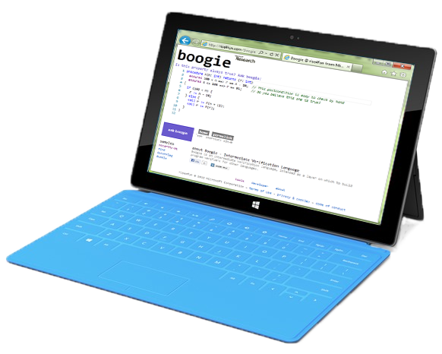
Take-home messages
To build a verifier, use an intermediate verification language (IVL)
An IVL is a thinking tool
An IVL helps you separate concerns
IVL lets you reuse and share infrastructure
Try Dafny and Boogie in your browser at rise4fun.com
Watch Verification Corner on YouTube

