Slide 1
CSE503: Software Engineering Electrifying specifications
David Notkin
Spring 2011

Slide 2
Formal methods
We’ve covered some of the basics, although there is much more out there – we’ll get to some of that
One thing is clear so far: programs execute – they are kinetic – while formalisms just sit there – they represent potential
This property makes many formalisms less attractive to many people, as the benefits are harder to see
“It is easier to change the specification to fit the program than vice versa.” –Perlis

Slide 3
Electrifying formalisms
Daniel Jackson (and others) have worked on addressing this concern by “electrifying” formalisms – that is, making them “executable” in some sense, or at least providing useful feedback to a developer quickly
Alloy is Jackson’s core approach to this, but it’s not the only one out there

Slide 4
Executable specifications
One way to electrify a formalism is to execute it – many formalisms represent high-level programs
Google Scholar found ~95K entries to “executable specifications”
Many such executable specifications look a lot like (various kinds of) logic programs or functional programs; much of this work is related to automatic programming
The execution gives insight into what the specification means
Performance of these “programs” is usually poor
And automated refinement techniques to evolve from an executable specification to an efficient program seem to be limited
This work goes back to at least 1976 with Darlington, Burstall, Manna and others

Slide 5
Type checking
Type checking is a good example of an electrified formalism – based on the type system and proof rules, the compiler reports immediately on situations where the program may be misusing typed values
This is also a good example of an alternative style of electrification
Rather than executing to “see what it does,” it rather compares two different views of the computation – what the types constrain and whether the program satisfies those constraints

Slide 6
Comparing
I believe that this comparative approach is extremely powerful – more powerful than the “let’s make higher-level specifications that we can execute” in the long-run
In some sense, that was the idea of proving desirable properties from axioms – the axioms described relationships of an ADT, and the posited properties were alternative views of what should be true for that ADT
But this wasn’t electrified in any sense

Slide 7
Model checking
Model checking is one of the bases for electrifying comparisons of program views
We’ll look at this first from the high-level notion of model checking, then look at Alloy as an instance of electrified (bounded) model checking, and then look back at more conventional model checking

Slide 8
Model checking
Finite State Machine
YES
Satisfy?
NO
Temporal Logic Formula
Counter-example
What can the finite state machines and temporal logic formulae represent?
What does “satisfy” mean? How does “satisfy” work?
Why should we care?
What is a counterexample?
What does “Yes” actually mean?

Slide 9
ACM 2007 Turing Award Citation
In 1981, Edmund M. Clarke and E. Allen Emerson, working in the USA, and Joseph Sifakis working independently in France, authored seminal papers that founded what has become the highly successful field of Model Checking. This verification technology provides an algorithmic means of determining whether an abstract model--representing, for example, a hardware or software design--satisfies a formal specification expressed as a temporal logic formula. Moreover, if the property does not hold, the method identifies a counterexample execution that shows the source of the problem. The progression of Model Checking to the point where it can be successfully used for complex systems has required the development of sophisticated means of coping with what is known as the state explosion problem. Great strides have been made on this problem over the past 27 years by what is now a very large international research community. As a result many major hardware and software companies are now using Model Checking in practice. Examples of its use include the verification of VLSI circuits, communication protocols, software device drivers, real-time embedded systems, and security algorithms. …

Slide 10
A computation tree over an FSM
S0
S1
S0
S1
S0
S0
…
…
S1
…
…
1
0
S0
S1
1
0
Represent all possible FSM paths with a computation tree – even when infinite, the structure is constrained because of finite states
The computation tree is generated from the state machine
The temporal logic formula queries the computation tree
Model checking answers questions about this tree structure – kinds of queries include
Does every accepting input include a 0? A 1?
Does any accepting input include a 0? A 1?
Does every accepting input that has a 1 have a 1 in the remaining input?
More generally, safety and liveness properties of many kinds

Slide 11
FAQ
What can the finite state machines and temporal logic formulae represent?
See the Turing Award citation (and more…)
What does “satisfy” mean? How does “satisfy” work?
Satisfy means that the temporal logic formula is guaranteed to hold over the computation tree defined by the FSM
Why should we care?
Guarantees can be a good thing
What is a counterexample?
A path through the computation tree that contradicts the temporal logic formula
There is a mismatch between the two descriptions – but one cannot tell which is “wrong” without further work
What does “Yes” actually mean?
It is a guarantee that the property holds, but it provides no guarantee that the property or the FSM are what the developers thinks they are

Slide 12
Two Approaches to Model Checking
Explicit – represent all states
Use conventional state-space search
Reduce state space by folding equivalent states together
Symbolic – represent sets of states using boolean formulae
Reduce huge state spaces by considering large sets of states simultaneously – to the first order, this is the meeting of BDDs (binary decision diagrams) and model checking (more later)
Convert state machines, logic formulae, etc. to boolean representations
Perform state space exploration using boolean operators to perform set operations
SAT solvers are often at the base of symbolic model checking

Slide 13
Bounded model checking
Restricting to finite abstractions work in many situations – protocols, etc.
But programs themselves are not generally restricted to finite abstractions – so how could model checking apply?
Simply, one can constrain the search space: exhaustively search within a finite space with the expectation (hope?) that the finite space is a good approximation to the infinite space
D. Jackson calls this the “small scope hypothesis”

Slide 14
Basic claim and idea
Most counterexamples can be identified with a failing trace that is short, by some definition
The number of operations
The complexity of the input structures (e.g., how many nodes)
Size of a device
Length of a pathname
…
If no counterexample is returned when checking the truncated space, one builds confidence in the model but cannot be certain of the properties
Eliminating counterexamples likely helps through the infinite space

Slide 15
A little pre-Alloy history
Model-based descriptions
The Z specification language

Slide 16
Model-oriented
Model a system by describing its state together with operations over that state
An operation is a function that maps a value of the state together with values of parameters to the operation onto a new state value
A model-oriented language typically describes mathematical objects (e.g. data structures or functions) that are structurally similar to the required computer software

Slide 17
Z (“zed”)
Perhaps the most widely known and used model-based specification language
Good for describing state-based abstract descriptions roughly in the abstract data type style
Based on typed set theory and predicate logic
A few commercial and honorary successes
I’ll come back to one reengineering story afterwards

Slide 18
Basics
Static schemas
States a system can occupy
Invariants that must be maintained in every system state
Dynamic schemas
Operations that are permitted
Relationship between inputs and outputs of those operations
Changes of states

Slide 19
The classic example
A “birthday book” that tracks people’s birthdays and can issue reminders of those birthdays
There are tons of web-based versions of these now
There are two basic types of atomic elements in this example
[NAME,DATE]
An inherent degree of abstraction: nothing about formats, possible values, etc.

Slide 20
Taken directly from Spivey’s ZRM
static schema
legal system state
dynamic schema
Proof of expected property

Slide 21
Some more schemas
schema w/ unchanged inputs
schema w/ unchanged inputs
initializing schema

Slide 22
What about errors?
Entering a birthday for someone already in the book?
Looking up a birthday for an unknown person?
What is the meaning of the specification in the face of errors like these – unsatisfied pre-conditions, in most situations?
Rewrite the whole specification?

Slide 23
Or use the schema calculus!
add an enumerated type
schema
conjoin the schemas
schema
schema calculus

Slide 24
Schema calculus: sweet!
The schema calculus allows us to combine specifications using logical operators (e.g., ∧, ∨, ⇒, ¬)
This allows us to define the common and error cases separately, for example, and then just ∧-ing them together
In some sense, it allows us to get a cleaner, smaller specification

Slide 25
But don’t try this on programs!
Wouldn’t it be fantastic if we had the equivalent of the schema calculus on programs?
Write your error cases separately and then just ∧ them together
Write a text editor and a spell checker and integrate them by ∧-ing them together
So you want to build a program that doesn’t blow up a nuclear power plant?
Just build one that does, and then negate it ☺!
Programs are not logic
Some classes of programming languages – largely logic and functional languages – come closer than imperative and OO languages, but they are not logic

Slide 26
Points about Z
This isn’t proving correctness between a specification and a program
There isn’t a program!
Even the specification without the implementation has (some) value
The most obvious example is when a theorem is posited and then is proven from the rest of the specification – albeit by hand
The actual notation seems more effective that some others
Z is intended to be in bite-sized chucks (schema), interspersed with natural language explanations

Slide 27
Z used to improve CICS/ESA_V3.1
A broadly used IBM transaction processing system
Integrated into IBM's existing and well-established development process
Many measurements of the process indicated that they were able to reduce their costs for the development by almost five and a half million dollars
Early results from customers also indicated significantly fewer problems, and those that have been detected are less severe than would be expected otherwise

Slide 28
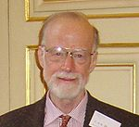
Queen’s Award for Technological Achievement
“Her Majesty the Queen has been graciously pleased to approve the Prime Minister's recommendation that The Queen's Award for Technological Achievement should be conferred this year upon Oxford University Computing Laboratory.
“Oxford University Computing Laboratory gains the Award jointly with IBM United Kingdom Laboratories Limited for the development of a programming method based on elementary set theory and logic known as the Z notation, and its application in the IBM Customer Information Control System (CICS) product. …
“The use of Z reduced development costs significantly and improved reliability and quality. Precision is achieved by basing the notation on mathematics, abstraction through data refinement, re-use through modularity and accuracy through the techniques of proof and derivation.
“CICS is used worldwide by banks, insurance companies, finance houses and airlines etc. who rely on the integrity of the system for their day-to-day business.”
Sir Charles Antony Richard Hoare

Slide 29
Z to Alloy: an electrifying path…
At some reasonable level, Alloy is Z with an analysis engine to checked bounded spaces
Up to five friends, up to five birthdays, etc.
Alloy returns either true or else a counterexample within that bounded state space
Again, recall the small scope hypothesis – in Alloy’s words, the analysis is sound and “complete up to scope”
Alloy has been designed explicitly to support automatic analysis
Alloy supports complex data structures, such as trees, and thus is a rich way to describe state

Slide 30
Underneath: SAT solving
Since Nitpick, Alloy’s predecessor, Jackson’s analysis engines have been based on broad set of SAT-solvers
They have techniques and optimizations for translating from relational to boolean logic
They are currently using their own SAT-solver, Kodkod
first order logic with relations, transitive closure, and partial models
analyses for both satisfiable and unsatisfiable problems; much of this is based on the ability to use partial models

Slide 31
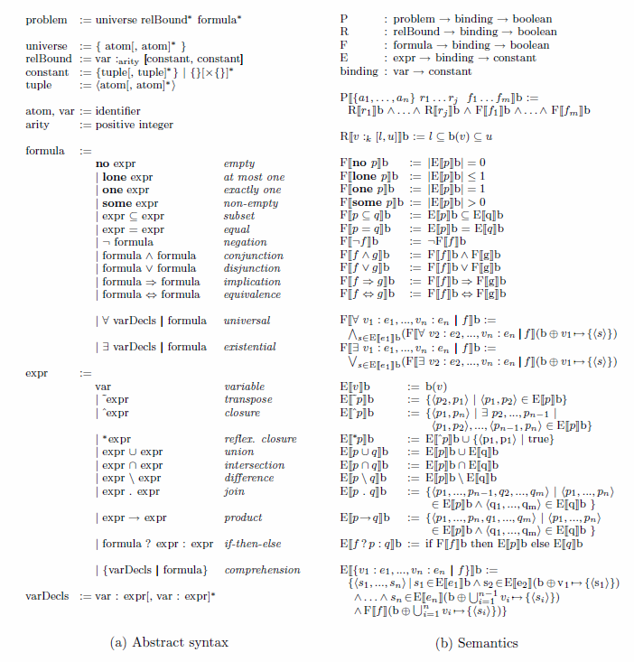
From Torlak’s kodkod dissertation – syntax and semantics of Alloy’s bounded relational logic

Slide 32
Translating to SAT
Translation to boolean logic
Break symmetries, handle sparseness, etc.
Normalize to CNF
Mapping back to original model
Basic notion: a relation over a finite university can be represented as a matrix of boolean values
Relational constraints are represented as boolean constraints over the matrices

Slide 33
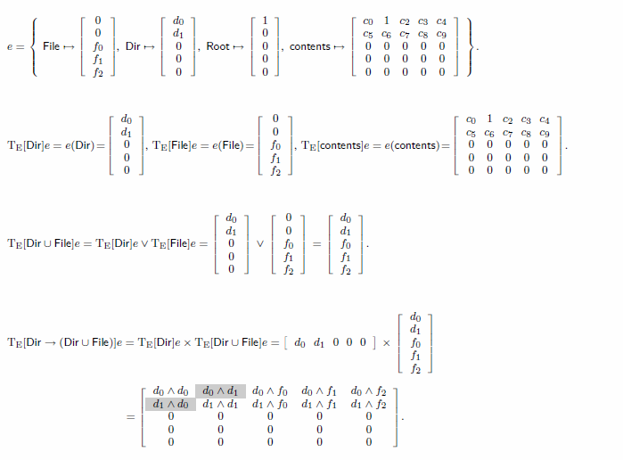
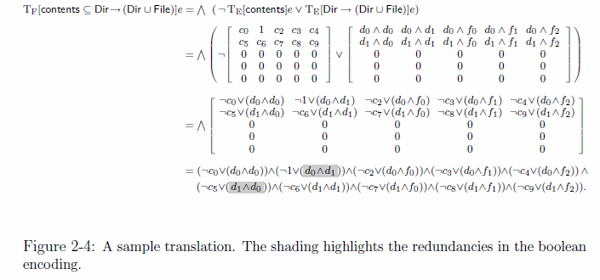

Slide 34
Facts vs. assertions
Alloy facts define truths of the model
Alloy assertions define truths you’d like check to make sure that they hold about the model
Closely related to Jackson père’s discussion of moods
Indicative mood: describes how things in the world are regardless of the behavior of the system: “Each seat is located in one and only one theater.”
Optative mood: describes what you want the system to achieve: “Better seats should be allocated before worse seats at the same price.”

Slide 35
And to designations and definitions Also Jackson père
Designations are atomic phenomena
e.g., genetic mother
Definitions define terms using designations and other definitions
e.g., genetic child of
Refutable descriptions can in principle be disproven
∀m,x•Mother(m,x)→¬Mother(x,m)
Can’t do this with definitions
The precise distinction between these is, to me, far more important than the formalization

Slide 36
Alloy … a brief demo

