Slide 1
CSE503: Software Engineering Complexity, proving adts
David Notkin
Spring 2011

Slide 2
But first… from today’s Seattle Times 2011.5.4
“Industry experts believed they knew where to look for crack-inducing metal fatigue on aging airplanes, but the in-flight rupture of a Southwest Airlines Boeing 737 on Friday has raised concerns about part of the fuselage they previously thought wasn't vulnerable.
“A similar hole opened on a Southwest 737 only 21 months ago, and then on an American Airlines 757 last year, raising awareness that metal fatigue can cause the aluminum skin to separate at the so-called lap joints, where panels are spliced together.”

Slide 3
Software complexity
From last lecture – complexity in the “why is it hard?” sense
Today: “how complex” is a piece of software?
First, some common software complexity measures
Then, why they are weak measures and (perhaps) a way forward

Slide 4
Lines of code (LOC, KLOC, MLOC)
Count the lines, often omitting comments and/or omitting blank lines
Lines vs. statements
Delivered vs. total (including tests, etc.)
Productivity: LOC/person/time
I’ve seen published numbers ranging from ~2K-8K LOC/person/year
Sensible?
"I have made this letter longer than usual, because I lack the time to make it short.” –Blaise Pascal

Slide 5
Halstead software science metrics
n1 = #distinct operators | n2 = #distinct operands | n = n1 + n2 “vocabulary”
N1 = total # of operators | N2 = total # of operands | N = N1 + N2 “length”
V = N × log₂(n) • Volume is intended to capture the size of the implementation
Making N choices from the vocabulary – assuming that humans do logarithmic search – leads to the formula
“The volume of a function should be at least 20 and at most 1000. The volume of a parameterless one-line function that is not empty; is about 20. A volume greater than 1000 tells that the function probably does too many things.” [verifysoft.com]
D = ( n1 / 2 ) × ( N2 / n2 ) • Difficulty is proportional to the unique operators and the ratio of total operands to the number of operands
The intent of the second part is based on a belief that repeated use of operands is more error-prone
E = V × D • Effort to implement or understand a program
...

Slide 6
Cyclomatic complexity (McCabe)
Take the CFG and find the number of edges (E), number of nodes (N), and the number of connected components (P)
Connected components are subgraphs for which there is a path between any two vertices
The cyclomatic complexity is M = E − N + 2P and is intended to measure the number of linearly independent paths through a program’s source code
#tests (branch coverage) ≤ M ≤ #tests (path coverage)
Question: should the complexity include method dispatch in OOP?

Slide 7
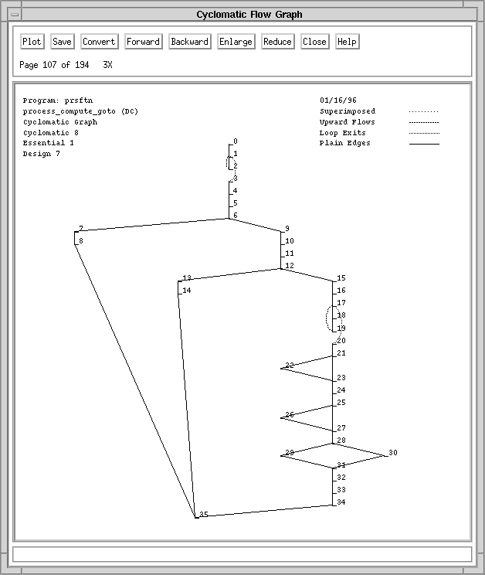
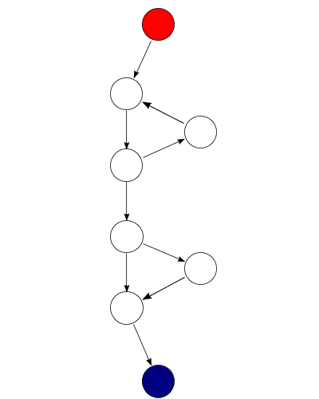
Examples
E = 9
N = 8
P = 1
M = 3
M = 8
http://en.wikipedia.org/wiki/Cyclomatic_complexity
http://hissa.nist.gov/HHRFdata/Artifacts/ITLdoc/235/chapter3.htm

Slide 8
Software structure metrics Henry and Kafura
Measures complexity in terms of fan-in and fan-out of procedures
fan-in: the number of local flows into a procedure plus the number of data structures accessed.
fan-out: the number of local flows out a procedure plus the number of data structures that the procedure modifies.
Complexity is L² × FI × FO
Where L is the length of a procedure

Slide 9
And many more
Variants of these
Some incremental improvements
Some extending to interprocedural complexity
Others that measure
Coupling and cohesion
Data complexity
Data flow complexity
…
Function points and feature points – intended to measure the function of a system as perceived by users, without reference to the implementation

Slide 10
So?
Although there is somewhat mixed data, it appears that most of these measures are proportional to LOC
“Les Hatton claimed recently (Keynote at TAIC-PART 2008, Windsor, UK, Sept 2008) that McCabe Cyclomatic Complexity has the same prediction ability as lines of code.” –Wikipedia [cyclomatic complexity]
Also, how “actionable” the information is has always confused me: if you are told your program is an “8” what are you supposed to do?

Slide 11
A hypothesis
Every complexity measure I’ve seen is based entirely on the static program (except feature/function points, which don’t consider a program directly)
If complexity measures are to have any real utility, it seems that they must also consider the relationship between the program and its behaviors
That is, the way the developer associates behaviors with a program is material to complexity, but is ignored by the literature
It is also imaginable that this measure would be “actionable” by identifying specific dependences that make this mapping complex – they could perhaps be addressed similarly to dependences that preclude parallelization

Slide 12
Project(s)?
Any attempt at trying to make this notion more precise would be terrific
Maybe a simple model and some empiric data
Showing that a reasonable model is proportional to LOC would weaken my hypothesis
Stop by and chat if you’re interested
Fits into NSF-funded work with Reid Holmes
ICSE 2011: “Identifying Program, Test, and Environmental Changes That Affect Behaviour”
Potential quals project

Slide 13
What is this?
Gray code
ASCII D
short 68
01000100
Gray scale
mask FTFFFTFF
Excess-8 60
Java byte-code fstore_1
Color scale

Slide 14
Types
Without getting precise, types are used to interpret and manipulate the bit patterns – that is, they give them (some level of) meaning
“Concrete” types manipulate the information in memory directly
Abstract types define a protocol for manipulating instances of those types, but they do not define an implementation

Slide 15
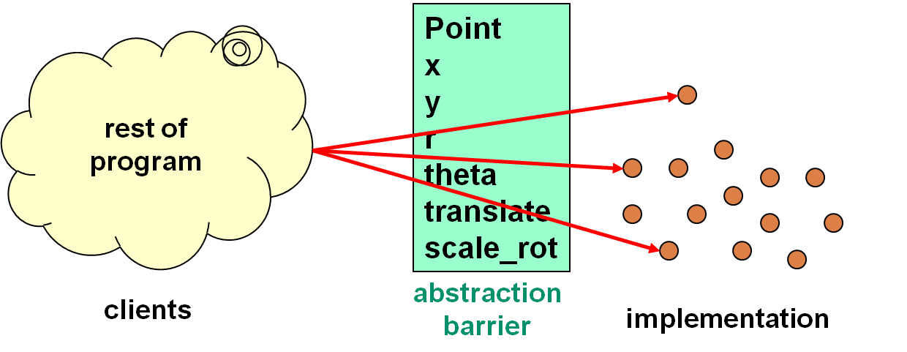
Abstract data type = objects + operations
The only operations on objects of the type are those provided by the abstraction
The implementation is hidden
We need to show that the abstraction and the implementation are each “correct” … and properly related

Slide 16
Big picture
For every
abstract operation
Element_{abstract}
Element’_{abstract}
Abstraction function (AF)
Element_{concrete}
Element’_{concrete}
For every
corresponding concrete operation
It commutes [What is purple and commutes?]
AF gives an abstract meaning to concrete representations – more soon

Slide 17
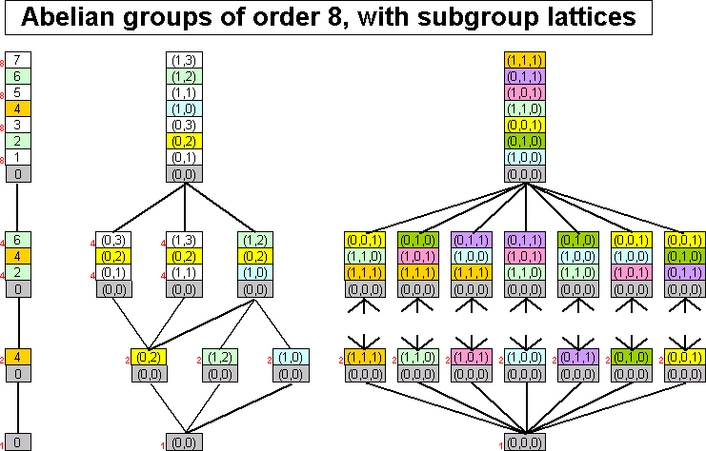
An Abelian grape (sorry)
math.asu.edu

Slide 18
Specifying ADTs
A common way is to define the abstract effect of each operation (including constructors) using formal/informal pre- and post-conditions
Might see this using an extended JavaDoc

Slide 19
Example
// Overview: An IntSet is a mutable, unbounded set of integers.
class IntSet {
// effects: makes a new IntSet = {}
public IntSet()
// returns: true if x ∈ this
// else returns false
public boolean contains(int x)
// effects: this_{post} = this_{pre} ∪ {x}
public void add(int x)
// effects: this_{post} = this_{pre} - {x}
public void remove(int x)
…

Slide 20
Algebraic specifications From Stotts (http://www.cs.unc.edu/~stotts/723/adt.html)
Define a sort – give signatures of operations (you’ve seen this kind of thing before in typed OO and functional languages) sort IntSet imports Int, Bool signatures new : -> IntSet insert : IntSet × Int -> IntSet member : IntSet × Int -> Bool remove : IntSet × Int -> IntSet

Slide 21
Define axioms
“Just” like high school algebra
variables i, j : Int; s : IntSet axioms member(new(), i) = false member(insert(s, j), i) = if i = j then true else member(s, i) remove(new(), i) = new() remove(insert(s, j), i) = if i = j then remove(s, i) else insert(remove(s, i), j)

Slide 22
Are these really sets?
Posit stuff like…
insert(insert(s, i), j) = insert(insert(s, j), i)
insert(insert(s, i), i) = insert(s, i)
Prove from axioms
Tons of issues about completeness, consistency, equality (initial vs. final algebras), etc.
But again, “just” like high school algebra

Slide 23
Proving specification properties
Regardless of the style of specification, proofs are usually done inductively
No information about the concrete representation and implementation – rather, showing the correctness of the protocol over the ADT’s operations

Slide 24
LetterSet case-insensitive character set [from Ernst]
// effects: creates an empty LetterSet
public LetterSet ( );
// effects: this_{post} = // if (∃ c₁ ∈ this_{pre} | toLowerCase(c₁) = toLowerCase(c)
// then this_{pre} else this_{pre} ∪ {c} public void insert (char c);
// effects: this_{post} = this_{pre} − {c}
public void delete (char c);
// returns: (c ∈ this)
public boolean member (char c);

Slide 25
Prove desirable property of LetterSet Large enough LetterSet contains two distinct characters
Prove: |S|>1 ⇒ (∃c₁,c₂∈S | [toLowerCase(c₁) ≠ toLowerCase(c₂)])
Base case: S = ∅, vacuously true
Inductive case: S was produced by a call of the form T.insert(c)
Assume: |T|>1 ⇒ (∃c₃,c₄∈T [toLowerCase(c₃) ≠ toLowerCase(c₄)])
Show: |S|>1 ⇒ (∃c₁,c₂∈S [toLowerCase(c₁) ≠ toLowerCase(c₂)])
where S = T.insert(c)
Remember insert’s post-condition: this_{post} = if (∃ c₁∈ this_{pre} | toLowerCase(c₁) = toLowerCase(c)
then this_{pre} else this_{pre} ∪ {c}
For inductive case, consider the two possibilities for S
If S = T, the theorem holds by induction
If S = T ∪ {c}, there are three cases
|T|=0: Vacuously true
|T|≥1: T did not contain a char of toLowerCase(c), so the theorem holds by the meaning of union
|T|>1: By inductive assumption, T contains different letters, so by the meaning of union, T ∪ {c} also contains different letters

Slide 26
Now: Assume abstraction is correct
Abstraction function (AF): E_{c}→ E_{a}
Maps a concrete object to an abstract value
Defines how the data structure is to be interpreted
Oh, that’s a “D”, that’s an fstore_1, that’s a 68, etc.
Representation invariant (RI): a boolean predicate characterizing legal concrete representations
States data structure well-formedness
In essence, defines the domain of AF
Captures information that must be shared across implementations of multiple operations

Slide 27
CharSet Abstraction A finite mutable set of Characters[From Ernst]
// Overview: A CharSet is a finite mutable set of Characters
// effects: creates a fresh, empty CharSet
public CharSet ( )
// effects: this_{post} = this_{pre} ∪ {c}
public void insert (Character c);
// effects: this_{post} = this_{pre} - {c}
public void delete (Character c);
// returns: (c ∈ this)
public boolean member (Character c);
// returns: cardinality of this
public int size ( );

Slide 28
A CharSet implementation
class CharSet {
private List<Character> elts
= new ArrayList<Character>();
public void insert(Character c) {
elts.add(c);
}
public void delete(Character c) {
elts.remove(c);
}
public boolean member(Character c) {
return elts.contains(c);
}
public int size() {
return elts.size();
}
}
CharSet s = new CharSet();
Character a
= new Character(‘a’);
s.insert(a);
s.insert(a);
s.delete(a);
if (s.member(a))
// print “wrong”;
else
// print “right”;

Slide 29
The RI can help identify an error
Perhaps delete is wrong
It should remove all occurrences
Perhaps insert is wrong
It should not insert a character that is already there class CharSet { // Rep invariant: elts has no nulls and no duplicates private List<Character> elts; …
Or…
∀ indices i of elts . elts.elementAt(i) ≠ null
∀ indices i, j of elts . i ≠ j ⇒ ¬elts.elementAt(i).equals(elts.elementAt(j))

Slide 30
Where’s the error?
// Rep invariant: elts has no nulls and no duplicates
public void insert(Character c) {
elts.add(c);
}
public void delete(Character c) {
elts.remove(c);
}

Slide 31
The RI constrains structure, not meaning
Another implementation of insert that preserves the RI
public void insert(Character c) {
Character cc = new Character(encrypt(c));
if (!elts.contains(cc))
elts.addElement(cc);
}
public boolean member(Character c) {
return elts.contains(c);
}
The program is wrong … call on the AF!

Slide 32
Abstraction function concrete to abstract value mapping
AF(CharSet this) = { c | c is contained in this.elts }
set of Characters represented by elements contained in this.elts
Typically not executable, but useful to reason about client behavior
Helps reason about the semantics of insert // effects: this_{post} = this_{pre} ∪ {c} public void insert (Character c);
Helps identify a problem
Applying the AF to the result of the call to insert yields AF(elts) ∪ {encrypt(‘a’)}
Consider the following reasonable AF
AF(this) = { c | encrypt(c) is contained in this.elts }
AF(this) = { decrypt(c) | c is contained in this.elts }

Slide 33
“Placing blame” using AF
AF(CharSet this) = { c | c is contained in this.elts }
Consider a call to insert:
On entry, the meaning is AF(this_{pre}) ≈ elts_{pre}
On exit, the meaning is AF(this_{post}) = AF(this_{pre}) ∪ {encrypt(‘a’)}
Does this AF fix things?
AF(this) = { c | encrypt(c) is contained in this.elts }
= { decrypt(c) | c is contained in this.elts }

Slide 34
Some final odds and ends
Looking at these examples using the commutative diagram may help clarify any confusions
Or ask!
AF’s can be maintained across fairly complicated implementations that (for example) reorganize dynamically for performance
Multiple concrete values still map to the same abstract value
Why map concrete to abstract?
It’s not a function in the other direction
Ex: lists [a,b] and [b,a] each represent the set {a, b}
It’s not as useful in the other direction

