Slide 1
CSE503: Software Engineering project proposals
David Notkin
Spring 2011

Slide 2
Lazy Evaluation for MapReduce Workflows
Kristi Morton, Magdalena Balazinska, Dan Grossman, and Christopher Olston

Slide 3
Motivating Scenario
Data deluge in sciences
LSST workflow process 30TB of new data every day
Only a subset of data needed
High-latency analysis tasks in workflows
On MapReduce (MR) can take hours to run
Limits scientific discovery
Goal:
Make workflows efficient by being lazy: only run on region of interest.

Slide 4
LSST Workflow
30 TB
MR Job 1
Clean data
MR Job 2
Extract/transform
features
MR Job 3
Classify particles for a region of space (x,y,z) on some property
Lazy processing: observe usage in workflow and only processes data of interest.
Any additional data is computed on demand, per user’s request.
Notes:
Maybe the scientist is only interested in a particular region of the sky, running the workflow over the entire dataset is probably a waste of resources.
Make more efficient use of compute resources

Slide 5
Lazy Evaluation for MapReduce Workflows
Context for Project # 2:
Continuation from Project 1
Workflows expressed as PigLatin scripts
Use User Defined Function (UDF) for lazy evaluation framework

Slide 6
Lazy Evaluation for MapReduce Workflows
To produce the lazy materialized view, UDF needs:
PigLatin workflow script
Fields needed by user: e.g. gas, temp
Delimiter
REGISTER udfs.jar;
gas43 = LOAD ’gas43full’ USING BinStorage() AS
(pid:long, mass:double, px:double, py:double,
pz:double,temp:double, ...);
gas = FILTER gas43 BY pid is not null AND mass is not null
AND px is not null AND py is not null
AND pz is not null AND temp is not null...;
regionA = FILTER gas BY temp > udfs.VirialTemp(Rvir,Mvir,pid)
AND px >= -0.5 AND px < -0.25
AND py >= 0 AND py < 0.5
AND pz >= -0.5 AND pz < 0;
STORE regionA INTO ’result’ USING BinStorage()
Notes:
Part 2 is simplifying assumption to avoid having to implement static analysis on user queries

Slide 7
Lazy Evaluation for MapReduce Workflows
We generate the following materialized view + metadata:
Gas | Temp
a | 200
b | 150
c | 1000
d | 999
… | …
All other fields with pointers to PigLatin scripts to generate them on the fly (i.e. the “closures” part

Slide 8
Project 2 work to do
Previous project generated simple metadata for on demand fields
Naïve approach: each field pointed to full workload script (i.e. computed all fields)
Need to have fields point to appropriate subset to compute only the data for the field not all fields
Need to generate subset scripts to compute individual fields
Involves looking at level of execution plan tree and pruning off subtrees
Will need to hack Pig query compiler, which is a nontrivial task ☺

Slide 9
Testing (and Scripting) GUIs
Daniel Leventhal – cse 503

Slide 10
We know how to test code
bool testSqrt(int input, double out)
{
return out == sqrt(input);
}
testSqrt(9, 3);
testSqrt(0, 0);
testSqrt(100, 10);

Slide 11
How do we test GUIs?

Slide 12
How do we test GUIs?
Test what the user actually sees

Slide 13
GUI testing is miserable
Support is often worse than “normal” tests
Often hard to write the test
Can’t run in parallel
They take longer to run
Harder to debug
Harder to change
Harder to figure out what to change
They are testing what the user actually sees!
(or should be)

Slide 14
Scripting Tests
How do you specify a test?
List screen coordinates
Mark the UI widget in some way
Specify what the widget look like [Sikuli]
How do you adapt to change?
UIs often undergo visual polish close to shipping
Specify widgets based on their content or their position in the tree

Slide 15
Accessibility API
Doesn’t the accessibility API provide everything you need?
Only covers 80% of the widgets out there [Hurst 2010]
If the API doesn’t work you are toast.

Slide 16
Prefab to the Rescue!
Prefab identifies occurrences of a widget from its pixels
Text is recovered
Hierarchy of widgets is identified
Use Prefab to build tools for scripting and testing GUIs
Tests/scripts can be less brittle
Specify the widget at an appropriate level of abstraction.

Slide 17
Prefab basics

Slide 18
Testing/Scripting Framework with Prefab
Develop API for testing/scripting applications
Leverage Prefab’s identification of widgets, content, and hierarchy
Author tests that are resilient to changes in the UI.

Slide 19
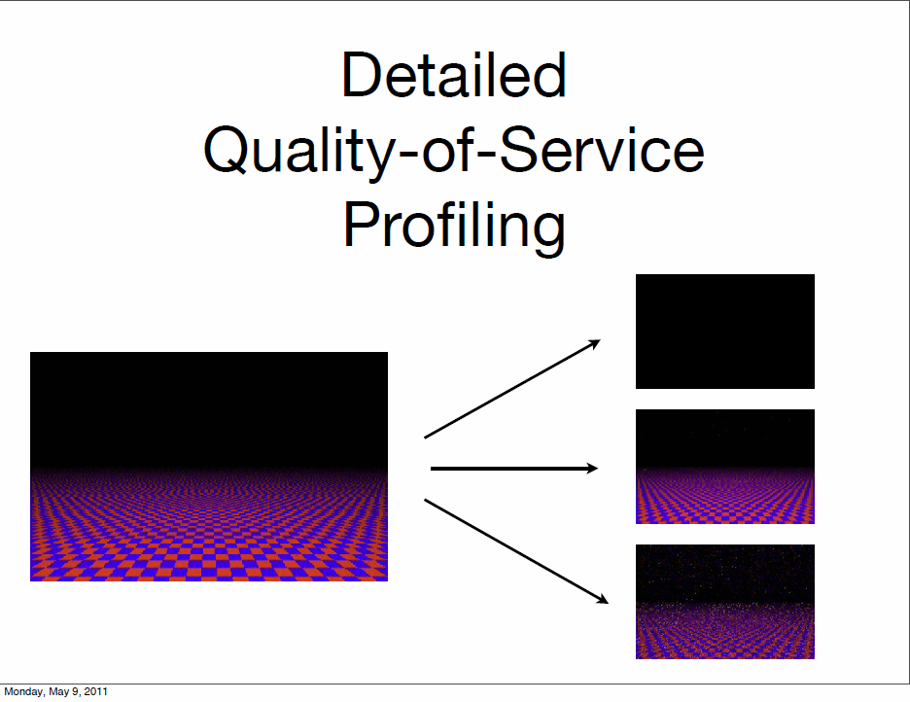
Adrian S.

Slide 22
Design Patterns for Security & Privacy
Franzi Roesner
CSE 503 Project Proposal
May 10, 2011

Slide 23
Security Design Pattern Sampler
Single Access Point: Providing a security module and a way to log into the system
Roles: Organizing users with similar security privileges
Session: Localizing global information in a multi-user environment
Limited View: Allowing users to only see what they have access to
Secure Access Layer: Integrating app security with low level security
Partitioned Application: Splits a large, complex application into simpler components; any dangerous privilege is restricted to a single, small component.
Input Validator: Validate input from the client to the server

Slide 24
Privacy Design Pattern Sampler
Informed Consent for Web-Based Transactions: Describes how websites can inform users whenever they intend to collect and use an individual’s personal information
Masking Your Online Traffic: Decreasing the flow of information from the data owner to the data collector
Minimal Information Asymmetry: Increasing the flow of information from data collectors to data owners.
Protection Against Cookies: Provides countermeasures against the misuse of cookies in the WWW.
Pseudonymous Email: Describes the mechanism of a pseudonymous email delivery system

Slide 25
Adding Security to Patterns
Secure Blackboard Pattern: Decouples interacting agents from each other with an intermediary agent.
Secure Broker Pattern: Architectural pattern can be used to structure distributing software systems with decoupled components that interact by remote service invocations.

Slide 26
Proposal: Patterns for Web Tracking
Web tracking:
Analytics on a page
Third-party tracking across sites
Tracking methods
cookies, LocalStorage, Flash LSOs, cache data, images, web history, window.name, …

Slide 27
Proposal: Patterns for Web Tracking
Properties we might want:
Trackers can’t track me across sites unless I consent.
Seamlessly associate different browsing profiles with different roles.
Retroactively remove visited sites from tracking list.
Robustness against future developments in tracking methods.
Functionality (e.g. Facebook) while opting out of tracking.
Tracking history while logged out (of e.g. Facebook) can’t be linked to my identity when I log back in.
Same guarantees on mobile browser as on desktop browser.
Today’s tools are insufficient…
Can design patterns help?

Slide 28
Incidental Research Questions
Are any of these security and privacy design patterns actually in use as such?
If not, why haven’t they been useful?
Do there need to be so many? Can they be reduced to a canonical set?

Slide 29
Answering Tomorrow’s Problems
Ben P.
Current and Coming Tech
Current and Coming Needs
Tablet PCs
Kinect, PS Move
International high-speed networks
Better domestic education system
Better trained and connected workforce
Better education and stability in developing countries

Slide 30
How will software answer these questions with these technologies?
Finding present and future solutions
Researching design and development challenges

Slide 38
GUI for Daikon
Yanping H.

Slide 39
What is Daikon
Dynamic Analysis for Inferring Likely Invariants
Guessing invariants with static analysis is hard
Solution: guessing invariants by watching actual program behavior is easy

Slide 40
Daikon in action
Generate lots and lots of potential invariants
The initial set can be infinite, provided there is a way to prune to a finite set with only a few observations
Let the tests weed out most of the candidates

Slide 41
Daikon checks invariants over variables at the entrance and exist of programs.
void sum(int *b,int n) {
pre:
n ≥ 0 i, s := 0, 0;
do i ≠ n
i, s := i+1, s+b[i]
post: s=sum(b[j], 0 ≤j<n)
}
No all detected invariants/variables are interesting.
For example 0 ≤ i≤n

Slide 42
Goals
Develop a GUI for daikon that allows users to select variants/functions/variable they are interested in
Show resulting invariant in a GUI that are easy for user to comprehend.

Slide 43
Not all interesting invariants are included
Need to modify and recompile Daikon to include new invariants.
Use Java reflection to add new-defined invariants
How to check legal invariant class?

Slide 44
If time permits
Include unities to highlight invariant changes between a pair of program versions.

Slide 45
Engineering Crowdsourcing Software
Hao Lu and Joseph Xu

Slide 46
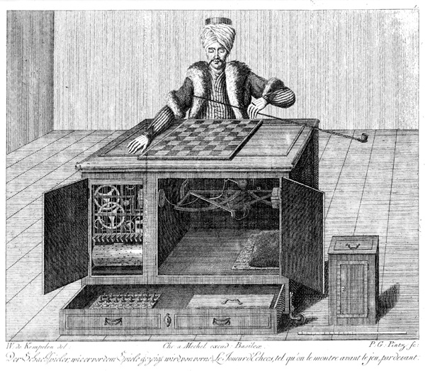
The Turk

Slide 47
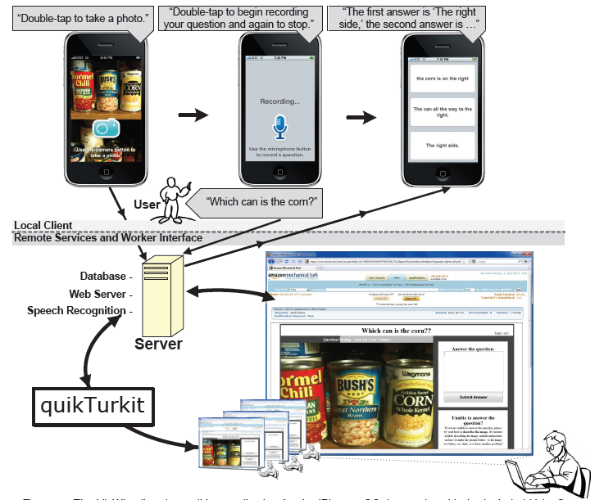
VizWiz

Slide 48
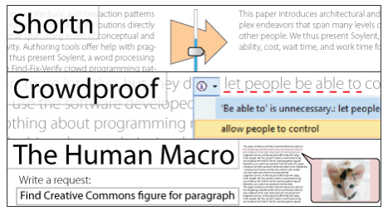
Soylent

Slide 49
Platform
Mechanic Turk
…

Slide 50
Existing Toolkit
TurKit
CrowdForge

Slide 51
Is it hard?

Slide 52
Use the crowd just as function call?

Slide 53
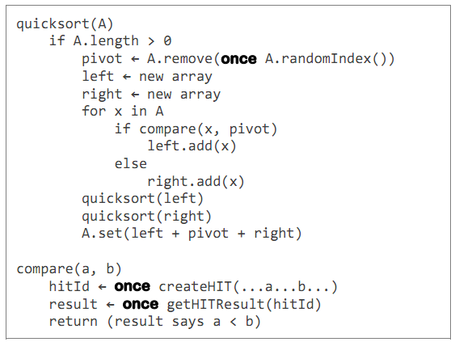
Quicksort in TurKit

Slide 54
Quicksort in TurKit

Slide 55
Quicksort in TurKit

Slide 56
Quicksort in TurKit

Slide 57
Quicksort in TurKit

Slide 58
Quicksort in TurKit

Slide 59
Crash-and-rerun programming

Slide 60
Issues
“Crash-and-rerun” is unnatural

Slide 61
Parallelism

Slide 62
Parallelism
fork
join
fork
fork
join

Slide 63
Issues
“Crash-and-rerun” is unnatural
Fork and Join adds complexity

Slide 64
Existing knowledge

Slide 65
Existing knowledge

Slide 66
Issues
“Crash-and-rerun” is unnatural
Fork and Join adds complexity
Existing knowledge adds more complexity

Slide 67
Questions to answer in our project
Are these issues general?

Slide 68
Questions to answer in our project
How can we hide these complexity?

Slide 69
Question?

