Slide 1
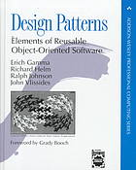
CSE503:
Software Engineering Design Patterns
David Notkin
Spring 2011

Slide 2
History
The Gang of Four (GoF)
  Erich Gamma, Richard Helm, Ralph E. Johnson, and John M. Vlissides. 1993. Design Patterns: Abstraction and Reuse of Object-Oriented Design. In Proceedings of the 7th European Conference on Object-Oriented Programming (ECOOP '93).
  Their book, Design Patterns: Elements of Reusable Object-Oriented Software, was released at OOPSLA 1994.
  The book and the authors have won several awards including the Jolt productivity award, the Software Development productivity award, and the SIGSOFT Outstanding Research award
May 1, 2011

Slide 3
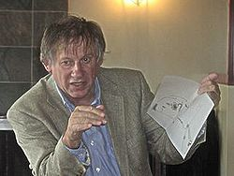

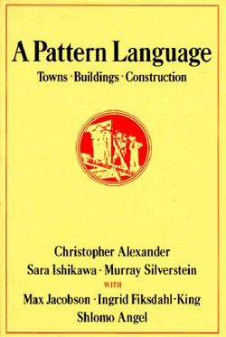

Pre-history: Christopher Alexander
“At the core... is the idea that people should design for themselves their own houses, streets and communities. This idea... comes simply from the observation that most of the wonderful places of the world were not made by architects but by the people.”
—Christopher Alexander, A Pattern Language
http://en.wikipedia.org/wiki/File:Christopher_Alexander.jpg

Slide 4
bing “design patterns” on 5/2/2011
65.5M hits including…
.NET Design Patterns in C# and VB.NET
Yahoo! Design Pattern Library
Azure Design Patterns
ASP.NET Wiki: Architecture: Design Patterns
SOA patterns
Design Patterns for Building Flexible and Maintainable J2EE Applications
Design Patterns and Refactoring
Design Patterns in Ruby
Ajax Patterns
CSS Design Patterns
PHP Design Patterns
Train the Trainer Design Pattterns Design Patterns Training
… and millions more!

Slide 5
ACM Digital Library
Hits on “design patterns” in title
2011
  Towards studying the performance effects of design patterns for service oriented architecture
  Architectural patterns to design software safety based safety-critical systems
  Evaluation of web application security risks and secure design patterns
  Type design patterns for computer mathematics
2010 & 2009
  Object oriented design pattern decay: a taxonomy
  Design patterns to guide player movement in 3D games
  Design patterns for efficient graph algorithms in MapReduce
  Towards a Comprehensive Test Suite for Detectors of Design Patterns
  Design patterns in separation logic

Slide 6
What are design patterns?
First, your view based on experience, rumor, etc.

Slide 7
What are design patterns?
Solutions to commonly arising object-oriented design problems – solutions actually used multiple times by multiple people over time
Stylized descriptions that include (in part)
  a motivation (the problem and the context),
  a design-level description (in terms of interfaces and interconnections),
  one or more example implementations in a well-known programming language
“a ‘well-proven generic scheme’ for solving a recurring design problem”
  Often overcoming limitations of OO hierarchies
Idioms intended to be “simple and elegant solutions to specific problems in object-oriented software design”
  Patterns are a collection of “mini-architectures” that combine structure and behavior
Gabriel: “Alexander could have written a 1-sentence definition of what a pattern is, or an essay, but instead he wrote a 550-page book to do it. Because the concept is hard.”

Slide 8
Similar in motivation to PL constructs

Slide 9
Simple example: singleton pattern
Only one object of the given type exists
class Bank {
private static bank theBank;
// private constructor
private Bank() { ... }
// factory method
public static getBank() {
if (theBank == null) {
theBank = new Bank();
}
return theBank;
}
...
}
Pattern isn’t explicit in code
Could be defined by a programming language
Would appear differently in different languages

Slide 10
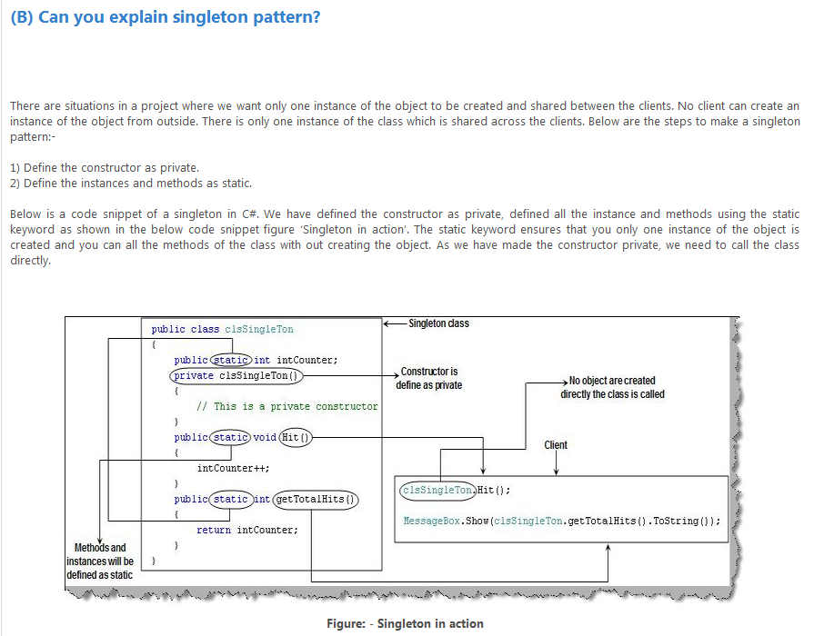
http://www.eggheadcafe.com/tutorials/aspnet/280ee727-00a7-497a-84d2-6ebb16df4140/design-pattern-interview.aspx

Slide 11
Interning pattern
Reuse existing objects instead of creating new ones
  Less space
  May compare with == instead of equals()
Permitted only for immutable objects
StreetSegment with interning
StreetSegment without interning

Slide 12
Interning mechanism
Maintain a collection of all objects
If an object already appears, return that instead
  HashMap<String, String> segnames;
  String canonicalName(String n) {
  if (segnames.containsKey(n)) {
  return segnames.get(n);
  } else {
  segnames.put(n, n);
  return n;
  }
  }
Java builds this in for strings: String.intern()
Two approaches
  create the object, but perhaps discard it and return another
  check against the arguments before creating the new object

Slide 13
java.lang.Boolean does not use the Interning pattern
public class Boolean {
private final boolean value;
// construct a new Boolean value
public Boolean(boolean value) {
this.value = value;
}
public static Boolean FALSE = new Boolean(false);
public static Boolean TRUE = new Boolean(true);
// factory method that uses interning
public static valueOf(boolean value) {
if (value) {
return TRUE;
} else {
return FALSE;
}
}
}

Slide 14
Recognition of the problem
Javadoc for Boolean constructor includes…
Allocates a Boolean object representing the value argument
  “Note: It is rarely appropriate to use this constructor. Unless a new instance is required, the static factory valueOf(boolean) is generally a better choice. It is likely to yield significantly better space and time performance.”
Josh Bloch (JavaWorld, January 4, 2004):
  “The Boolean type should not have had public constructors. There's really no great advantage to allow multiple trues or multiple falses, and I've seen programs that produce millions of trues and millions of falses, creating needless work for the garbage collector.”
  So, in the case of immutables, I think factory methods are great.”

Slide 15
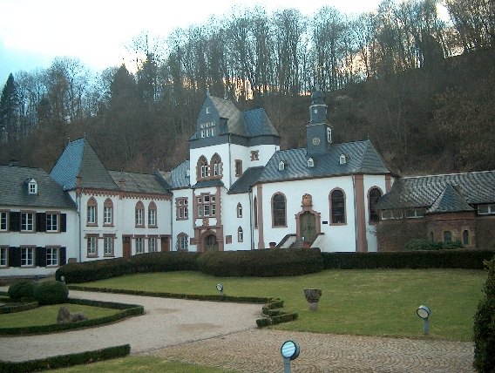
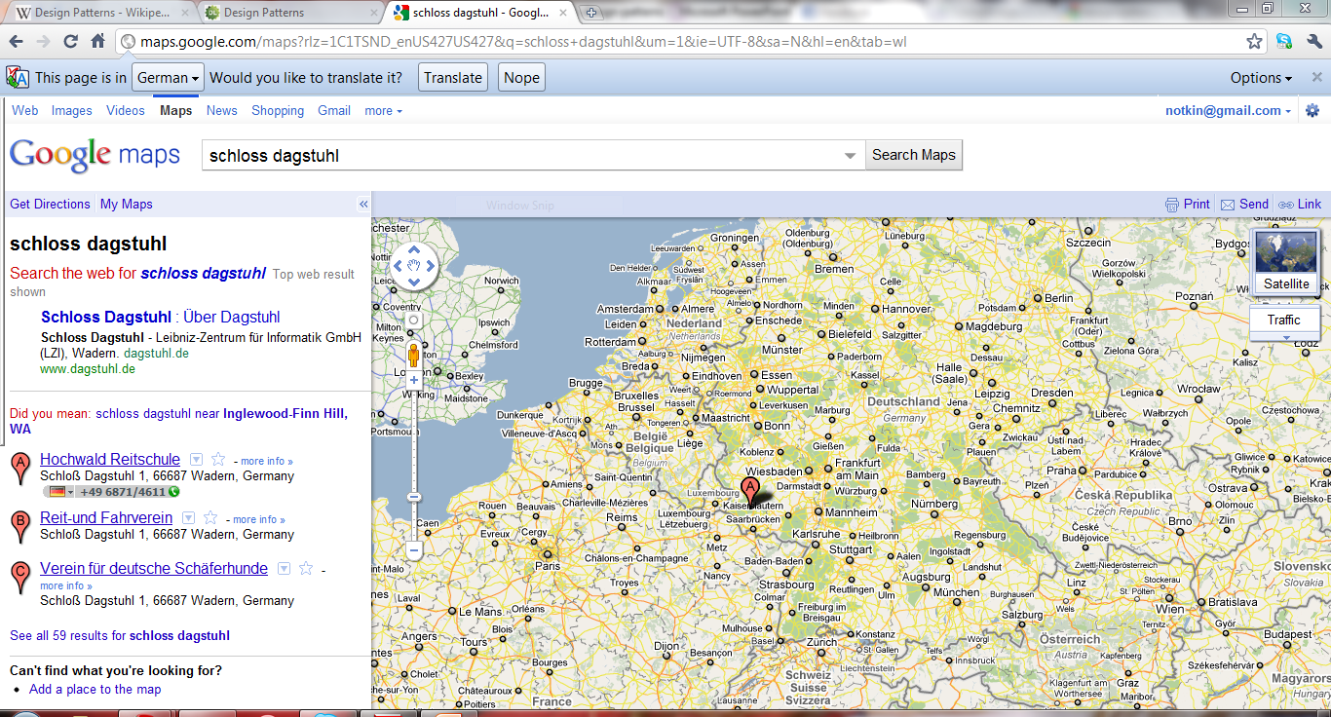
My eye-opening experience
At Dagstuhl
With Griswold
And with Helms
and Vlissides
In the bar
“How to rethink our design
for a program restructuring
system?”

Slide 16
Patterns are an example of chunking
Advanced chess players are in part superior because they don’t see each piece individually
  Instead, they chunk groups of them together
  This reduces the search space they need to assess in deciding on a move
This notion of chunking happens in almost every human endeavor
Such chunking can lead to the use of idioms
  As it has in programming languages
The following slides show some parts of a particular pattern: flyweight
  I won’t go through the slides in detail, but they give a feel for people who haven’t seen more concrete information on patterns

Slide 17
Example: flyweight pattern
What happens when you try to represent lots of small elements as full-fledged objects?
It’s often too expensive
And it’s pretty common

Slide 18
An alternative approach
Use sharing to support many fine-grained objects efficiently
  Fixed domain of objects
  Maybe other constraints
  Similar to interning

Slide 19
Flyweight structure

Slide 20
Participants
Flyweight (glyph in text example)
  Interface through which flyweights can receive and act on extrinsic state
ConcreteFlyweight (character)
  Implements flyweight interface, shareable, only intrinsic state (independent of context)
UnsharedConcreteFlyweight (row, column)
FlyweightFactory
  Creates and manages flyweight objects

Slide 21
Sample code
class Glyph {
public:
virtual ~Glyph();virtual
void Draw(…);
virtual void SetFont(…);
…
}
class Character : public Glyph {
Character(char);
virtual void Draw(…);
private:
char _charcode;
};
The code itself is in the domain (glyphs, rows, etc.)
But it’s structured based on the pattern
The client interacts with Glyph, Character

Slide 22
A little more code
Character* GlyphFactory::CreateCharacter(char c) {
if (!_character[c]) {
_character[c] = new Character();
}
return _character[c];
}
Explicit code for each of the elements in the flyweight structure

Slide 23
Classes of patterns: structural
These provide ways to compose interfaces and define ways to compose objects to obtain new functionality
Adapter allows classes with incompatible interfaces to work together by wrapping its own interface around that of an already existing class
Bridge decouples an abstraction from its implementation so that the two can vary independently
Composite composes zero-or-more similar objects so that they can be manipulated as one object
Decorator dynamically adds/overrides behavior in an existing method of an object
Facade provides a simplified interface to a large body of code
Flyweight reduces the cost of creating and manipulating a large number of similar objects
Proxy provides a placeholder for another object to control access, reduce cost, and reduce complexity

Slide 24
Classes of patterns: creational
For instantiating classes and objects
  Class-creation patterns tend to exploit inheritance
  Object-creation patterns tend to exploit delegation
Abstract Factory groups object factories that have a common theme
Builder constructs complex objects by separating construction and representation
Factory Method creates objects without specifying the exact class to create
Prototype creates objects by cloning an existing object
Singleton restricts object creation for a class to only one instance

Slide 25
Classes of patterns: behavioral
These patterns are concerned with communication between objects.
Chain of responsibility delegates commands to a chain of processing objects
Command creates objects which encapsulate actions and parameters
Interpreter implements a specialized language
Iterator accesses the elements of an object sequentially without exposing its underlying representation
Mediator allows loose coupling between classes by being the only class that has detailed knowledge of their methods
Memento provides the ability to restore an object to its previous state (undo)
Observer is a publish/subscribe pattern which allows a number of observer objects to see an event
State allows an object to alter its behavior when its internal state changes
Strategy allows one of a family of algorithms to be selected on-the-fly at runtime
Template method defines the skeleton of an algorithm as an abstract class, allowing its subclasses to provide concrete behavior
Visitor separates an algorithm from an object structure by moving the hierarchy of methods into one object

Slide 26
Patterns: ergo, anti-patterns
Rarely clear to me how they are actionable
But they have lots of cute names
God object
Object cesspool
Object orgy
Poltergeists
Yo-yo problem
Big ball of mud
Gold plating
Magic pushbutton

Slide 27
Organizational/management anti-patterns
Analysis paralysis
Cash cow
Design by committee
Escalation of commitment
Management by perkele
Moral hazard
Mushroom management
Stovepipe or Silos
Death march
Groupthink
Smoke and mirrors
Software bloat

Slide 28
Design patterns: not a silver bullet…
..but they are impressive, important and worthy of attention and study
I think that some of the patterns have and more will become part and parcel of designers’ vocabularies
This will improve communication and over time improve the designs we produce
The relatively disciplined structure of the pattern descriptions may be a plus

Slide 29
Show trial
“Indeed, this notorious cabal will soon be brought to justice at OOPSLA '99 during a panel entitled the ShowTrialOfTheGangOfFour for crimes against computer science.” [http://c2.com/cgi/wiki?GangOfFour]
“The Accused, by making it possible to design object-oriented programs in C++, have inhibited the rightful growth of competing object-oriented languages such as SmalltalkLanguage, CommonLisp, and JavaLanguage.”
“The Accused have engaged in an usurpation of perfectly good English words and well-known technical terms for the purpose of establishing an arcane argot known only to a narrow circle of GoF initiates.”
“The Accused, by cataloging mere experience, rather than conducting novel research, have displayed an utter disregard for traditional standards of academic originality.”
…

Slide 30
Discussion?
Questions might include
  What do patterns say, if anything, about the correspondence between names and invokes relations?
  Should patterns be turned into PL constructs? If so, why and when? If not, why not?
  Does AOP save the day with patterns (at least with Observer?)
  What’s on your mind about patterns?

