Slide 1
CSE 490D, Winter 2016 Readings in Digital Financial Services
Richard Anderson
Ruth Anderson

Slide 2
Topic Overview
Improved access to financial services is recognized as an important mechanism for raising people out of poverty
Financial Services for the Poor
Remittances
Savings accounts
Government payments
Digital payments

Slide 3
Computing and FSP
Mobile Computing
Smartphone applications
GSM Applications: SMS/USSD
Security
Design of secure applications
Development of robust systems
Human computer interaction
Usability

Slide 4
Why this might be interesting
New technical domain
Start of new research effort
Combination of technology and development
“Full stack” problem
From clients to telcos

Slide 5
ICTD @ UW
ictd.cs.washington.edu
Long running research effort in computing for the developing world
Open Data Kit
Projecting Health
Community Cellular
Change seminar - Tuesdays

Slide 6
490 D Administration
One credit, graded CR/NC
Weekly readings and discussion
Short answer quiz on reading due Tuesday night
Required
Lead one presentation (as part of a group)
Submit seven of nine quizzes

Slide 7
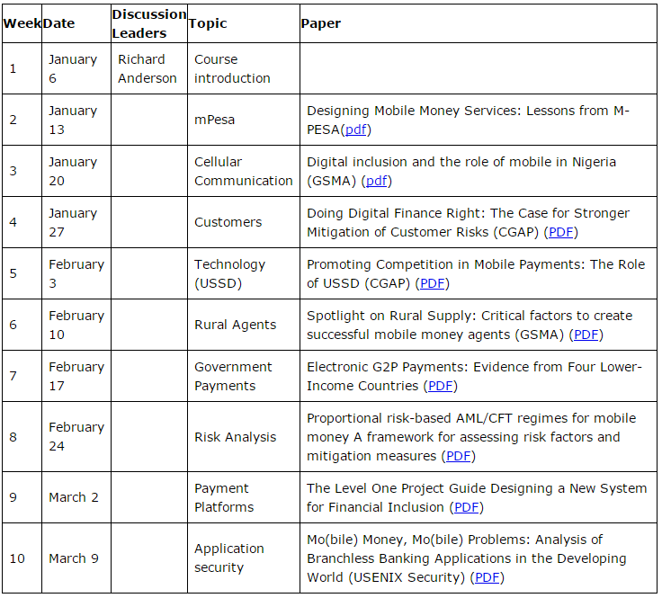
Readings

Slide 8
Leading a presentation
Presentation of about 10 minutes, and about four slides based on a template
Moderate discussion
Group of three students – all should participate in the planning, although not all need to present
Meet with instructors prior to presentation
Submit preferences for week/topic in catalyst survey
Need volunteers for January 13 now

Slide 9
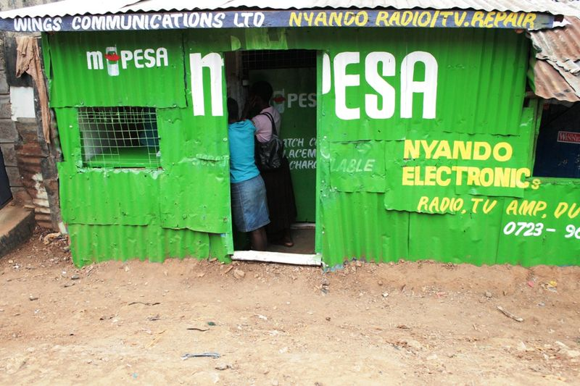
Basic Financial Services
Mobile Money
Send money to remote location
No bank accounts, but mobile phones
Rely on basic mobile phones

Slide 10
DFS Challenges
Fraud and cyberattacks
Proximity payments user experience
Mobile phone infrastructure
Extending beyond established networks
Identity and on-boarding
Analytics for product development, risk scoring, and fraud detection
Cash-in/Cash-out (CICO) agent recruitment, training, and management
Financial management for end users
Notes:
?

