Slide 1
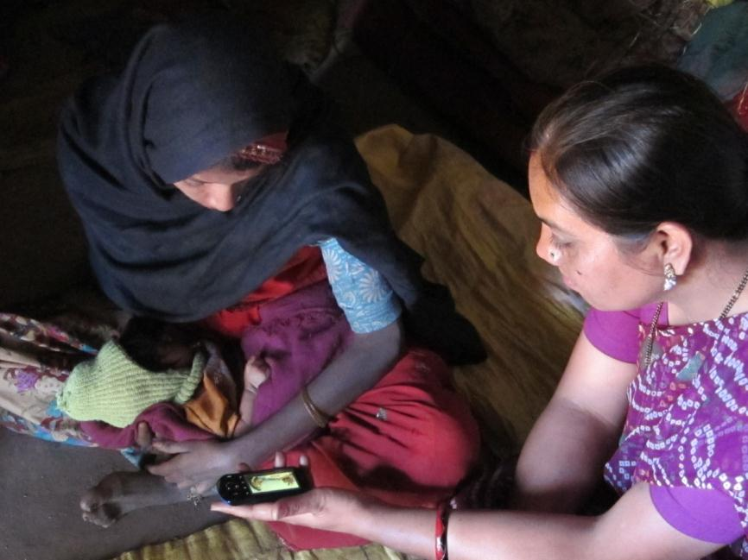
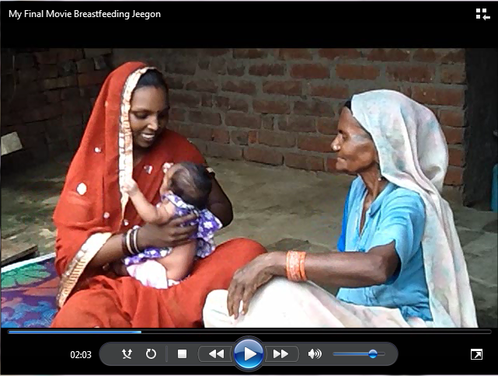
Digital Public Health: A Community Engagement Model
Richard Anderson
Kiersten Israel-Ballard
Vikrant Kumar
Michelle Desmond
Sudip Mahapatra

Slide 2
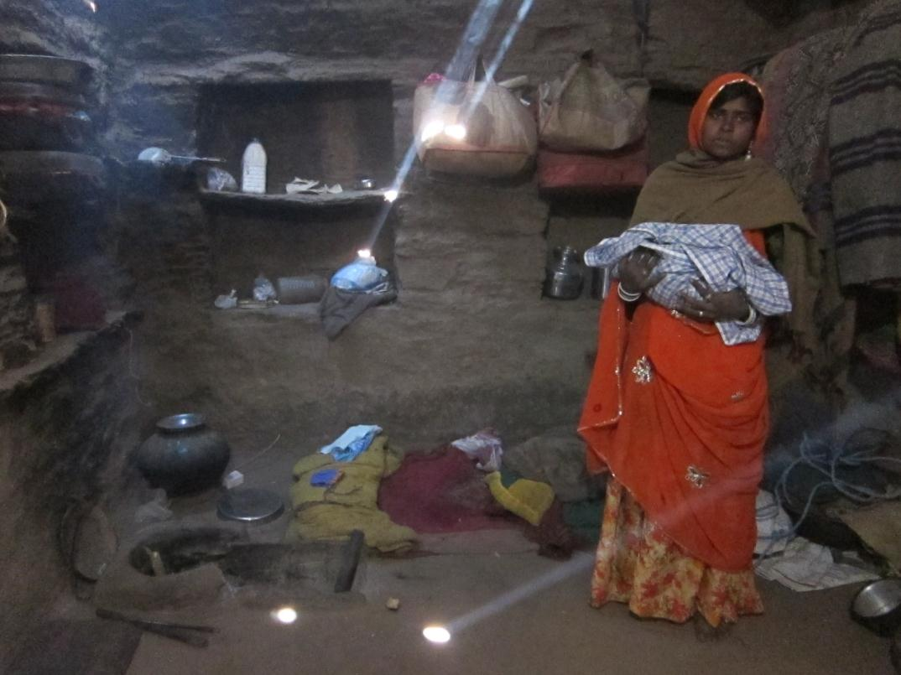
Identifying a need
Brittany Fiore-Silfvast
Notes:
The ideal model for engagement and ownership – resulting in dissemination and sustained behavior change. Gaps in this model – at every stage.
Notes from article:
It is not sufficient, however, to develop a clinically effective
health technology. It is not even sufficient to make it
available on a wide scale. A health technology must be
utilized consistently and correctly at the household level, in
order to realize its potential to significantly improve health.
Inability to effectively address household-level behavior
change has been associated with an over-emphasis on topdown,
disease-specific, vertical approaches to child survival
that over-simplify complex multifactorial welfare processes
into single-cause problems, leading to simple technological
solutions to such problems, with overestimates of their effectiveness, and often with the need for dedicated systems to
support and sustain their delivery
The BCM framework (Fig. 2) is based on the interventioncausation
pathway to improved newborn survival through
behavior change. Intervention design follows the reverse direction
from the outcome layer (ie, the goal of the behavioral
intervention) towards the agents of behavior change layer,
whereas intervention implementation follows the forward direction
along the intervention-causation pathway. Intervention
design consists of the following steps:
1. Identify epidemiologically targeted key behaviors.
2. Identify suitable target groups for a behavioral intervention.
3. Develop appropriate behavior change transaction(s) for
each target group.
4. Leverage the influence of social networks to expedite
behavior change.
5. Build mechanisms to sustain and institutionalize new
behaviors.

Slide 3
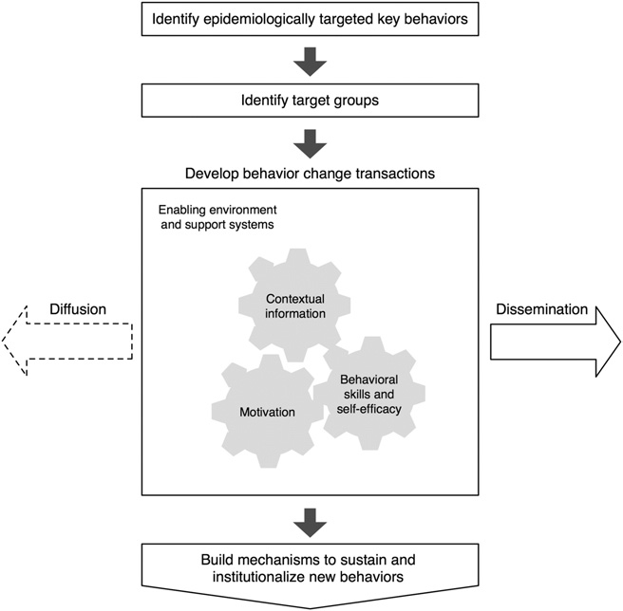
Managing behavior change: the ideal pathway
Behavior Change Management Framework from Kumar et al., 2010
Notes:
The ideal model for engagement and ownership – resulting in dissemination and sustained behavior change. Gaps in this model – at every stage.
Notes from article:
It is not sufficient, however, to develop a clinically effective
health technology. It is not even sufficient to make it
available on a wide scale. A health technology must be
utilized consistently and correctly at the household level, in
order to realize its potential to significantly improve health.
Inability to effectively address household-level behavior
change has been associated with an over-emphasis on topdown,
disease-specific, vertical approaches to child survival
that over-simplify complex multifactorial welfare processes
into single-cause problems, leading to simple technological
solutions to such problems, with overestimates of their effectiveness, and often with the need for dedicated systems to
support and sustain their delivery
The BCM framework (Fig. 2) is based on the interventioncausation
pathway to improved newborn survival through
behavior change. Intervention design follows the reverse direction
from the outcome layer (ie, the goal of the behavioral
intervention) towards the agents of behavior change layer,
whereas intervention implementation follows the forward direction
along the intervention-causation pathway. Intervention
design consists of the following steps:
1. Identify epidemiologically targeted key behaviors.
2. Identify suitable target groups for a behavioral intervention.
3. Develop appropriate behavior change transaction(s) for
each target group.
4. Leverage the influence of social networks to expedite
behavior change.
5. Build mechanisms to sustain and institutionalize new
behaviors.

Slide 4
Social and behavior change communication (SBCC)
Traditional SBCC Tools
Printed materials, media campaigns, inter-personal communication with health workers
Lack of community engagement and ownership
SBCC messages are often generic and not tailored to the local context
From Global to Local
Balance of community perspectives with scientific evidence
Community Participation
Evidence-based interventions are promoted through messages that are specific and appropriate for the community
Facilitated group meetings encourage discussion, sharing, and reflection
Group dialogue used to engage key influencers and address social norms, in addition to reaching the key audience

Slide 5
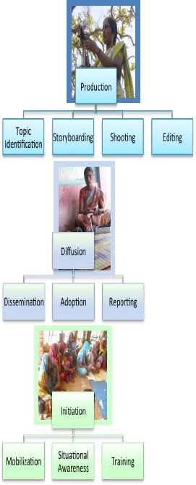
Digital Green: low-cost community video education
Video based education where content is both created and presented by the community
Localization of content and messaging
Community engagement and empowerment
Enabled by low-cost consumer digital video technology
Source: www.digitalgreen.org

Slide 6
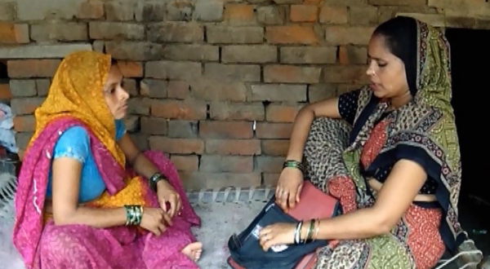
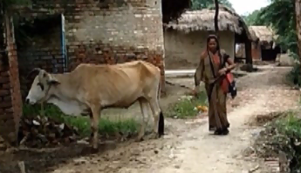
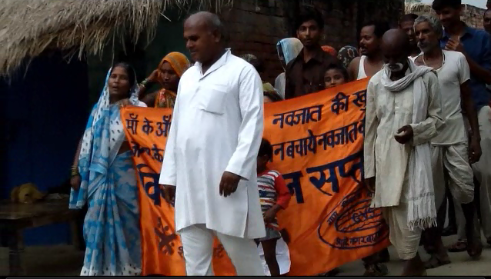
Adapting the model: Agriculture to health
Leverage similarities between agriculture and health
Importance of community based programs
Value of community created content
Many health topics relate to livelihood
Filling a gap
Focused education on more challenging practices
Notes:
Potential differences between Health and Agriculture
Different incentives for adopting agricultural and health practices
Requirements for message accuracy and review
Government oversight
Sensitivity of some topics

Slide 7
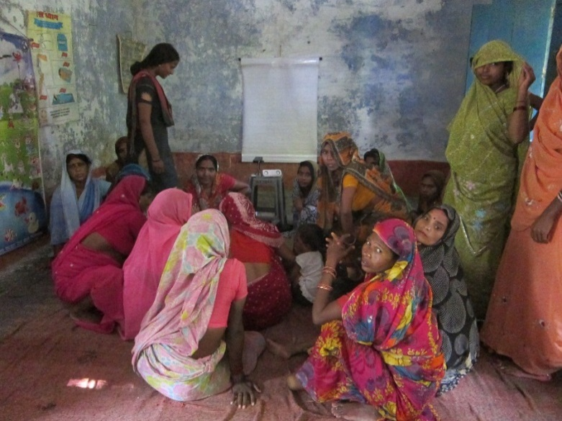
Phase 1: Determining Feasibility of the Digital Public Health model
Partnership with Digital Green and University of Washington
Project:
July 2012 – June 2013
Raebarelli District, Uttar Pradesh, India
Local partner, Gramin Vikas Sanstham (GVS)
Build on structures from PATH Sure Start project
Key components
Dissemination venues
Video topic identification
Active community advisory board
Refresher trainings for ASHAs

Slide 8
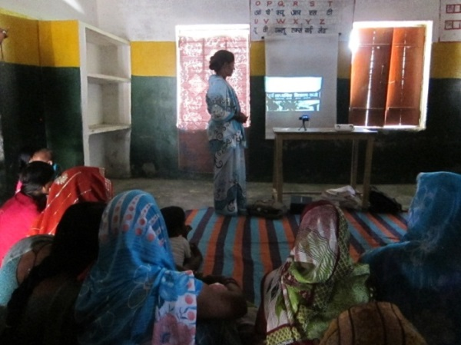
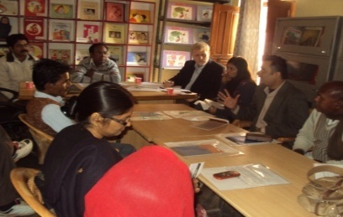
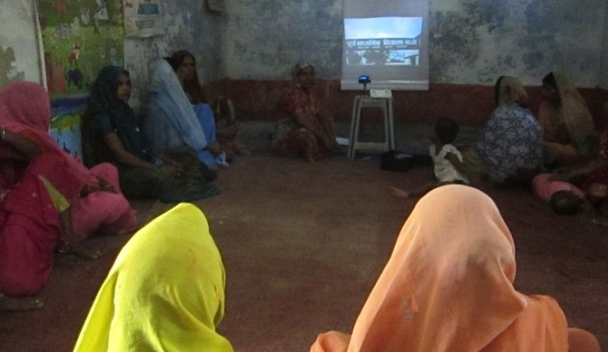
Phase 2: Measuring impact
Expanded project with additional partner
Nehru Yuva Sangathhan Tisi (NYST)
Two additional blocks in same district
July 2013 – Nov 2014
Increase from 55 to 136 mothers’ groups
Three video teams and CABs
Follow up visits by ASHAs
End line evaluation
Video intervention
Mothers’ group intervention
No intervention

Slide 9
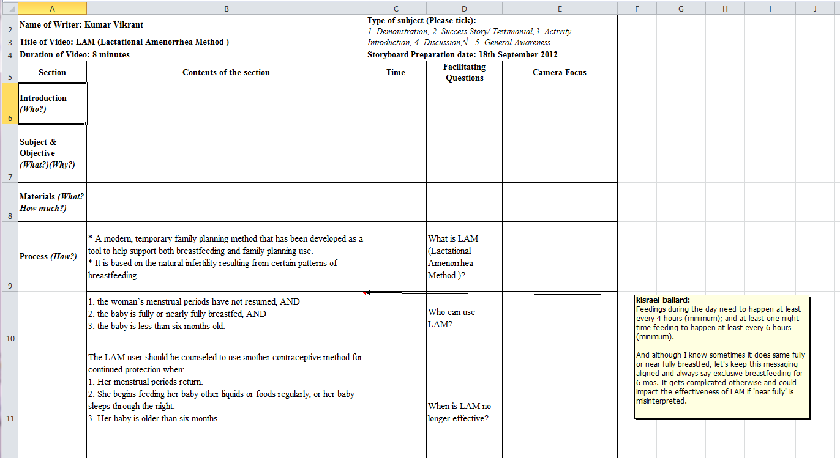
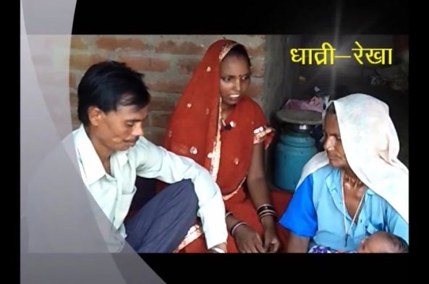
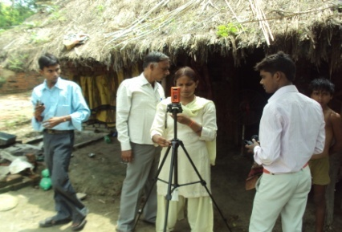
The Digital Public Health process

Slide 10
Monitoring and evaluation
Project goal: To generate evidence on Digital Public Health as a new model for community-driven behavior change communication for maternal/neonatal health issues in a targeted region in India
Impact study
Digital Public Health sites
Comparison sites
Process indicators
ASHA performance
Health outcomes and service utilization
Knowledge retention
Practices associated with key messages
Objective 1: Strengthen capacity of community based support through DPH
messaging
Objective 2: Expand the concept of
integrating DPH model into a community support program
Objective 3: Increase maternal awareness, knowledge and behaviors on key MNH practices from method of
messaging

Slide 11
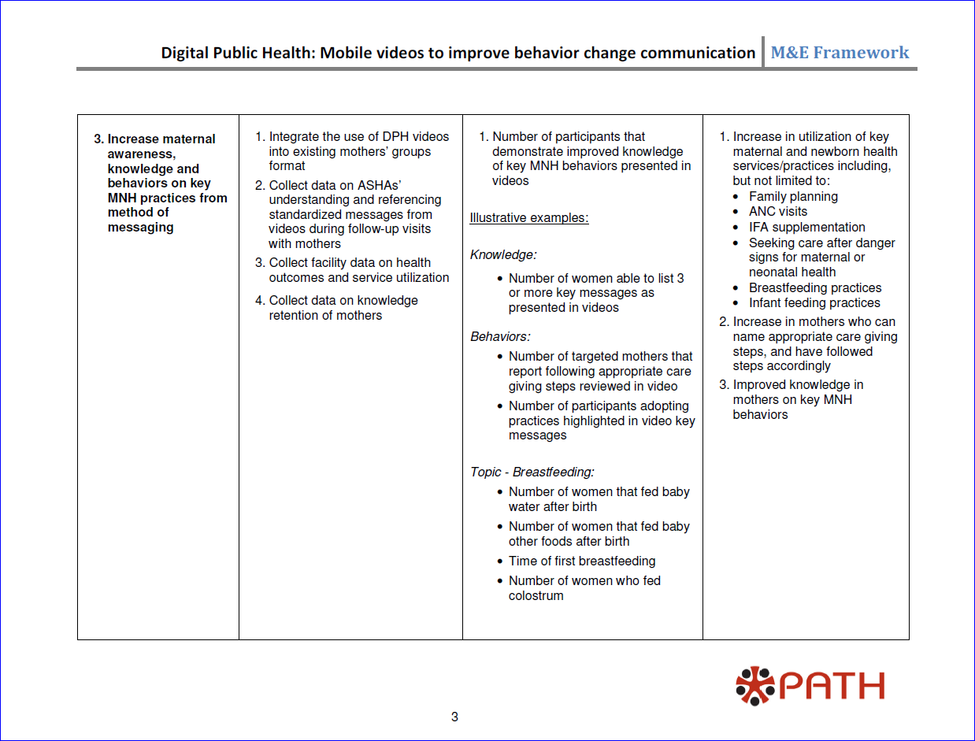
M & E Framework

Slide 12
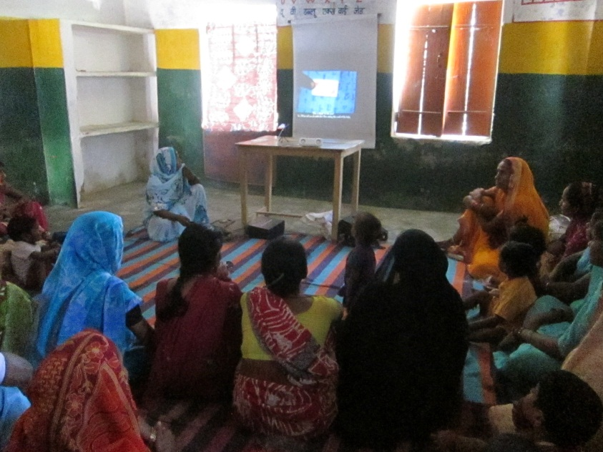
Thank you
Richard Anderson, randerson@path.org
Kiersten Israel-Ballard, kisrael-ballard@path.org
Notes:
Define metrics for evaluation.
Measure impact in a program.

Slide 13
Extra slides

Slide 14
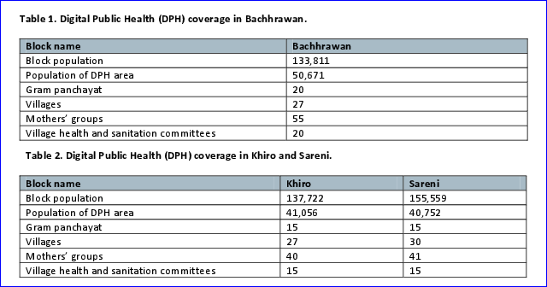
Project reach

Slide 15
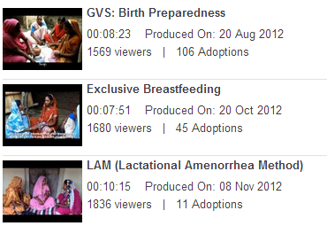
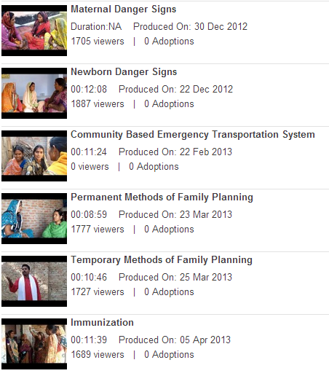
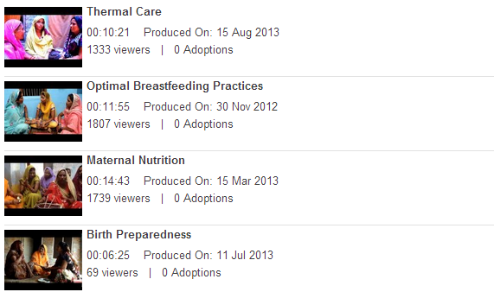
Videos

