Slide 1
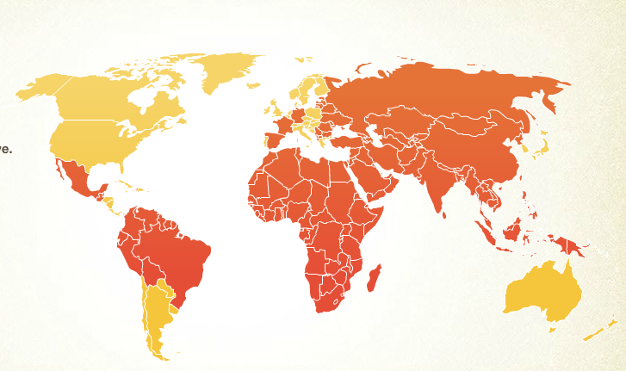
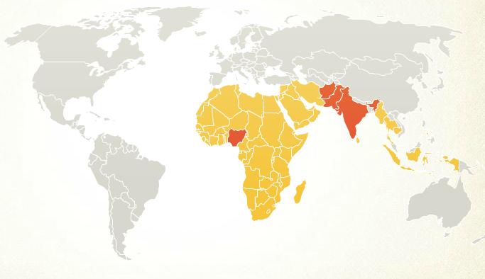
Software and Global Health: Information systems for the vaccine cold chain
Richard Anderson
Department of Computer Science and Engineering
University of Washington
Polio 1990
Polio 2008

Slide 2
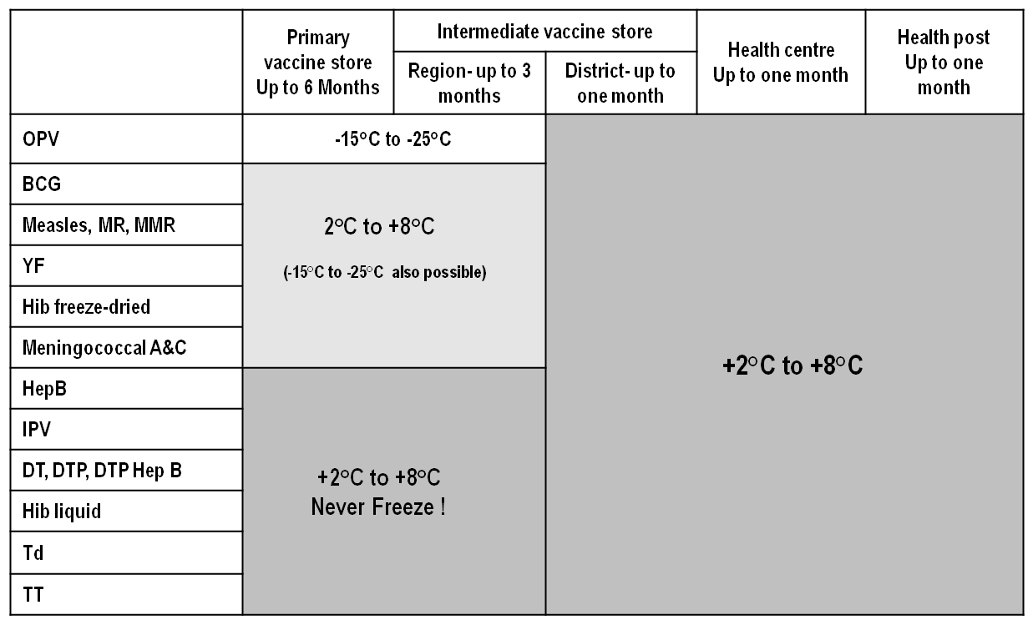
Vaccine Cold Chain Structure
Vaccine Manufacturers
National Vaccine Store
Regional Store
Regional Store
District Store
District Store
District Store
District Store
Health Center
Health Post
Health Post
Health Post

Slide 3
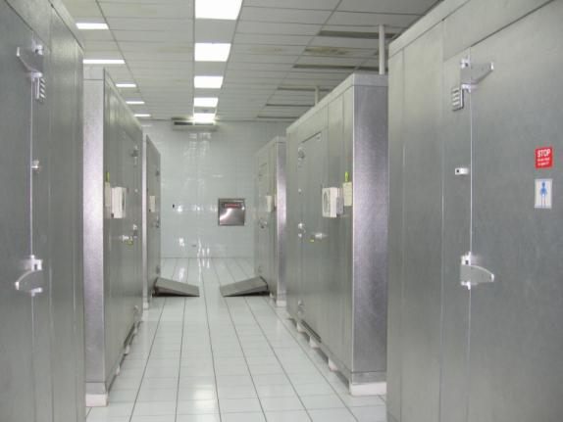
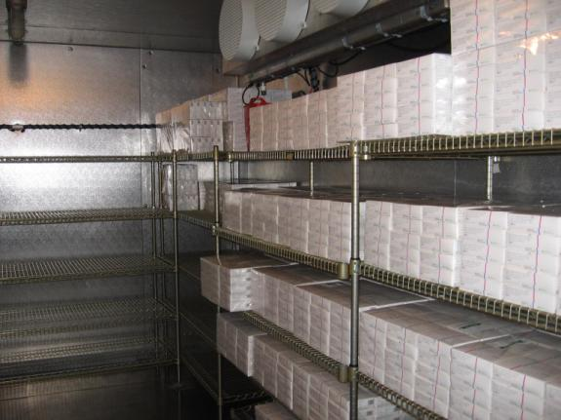
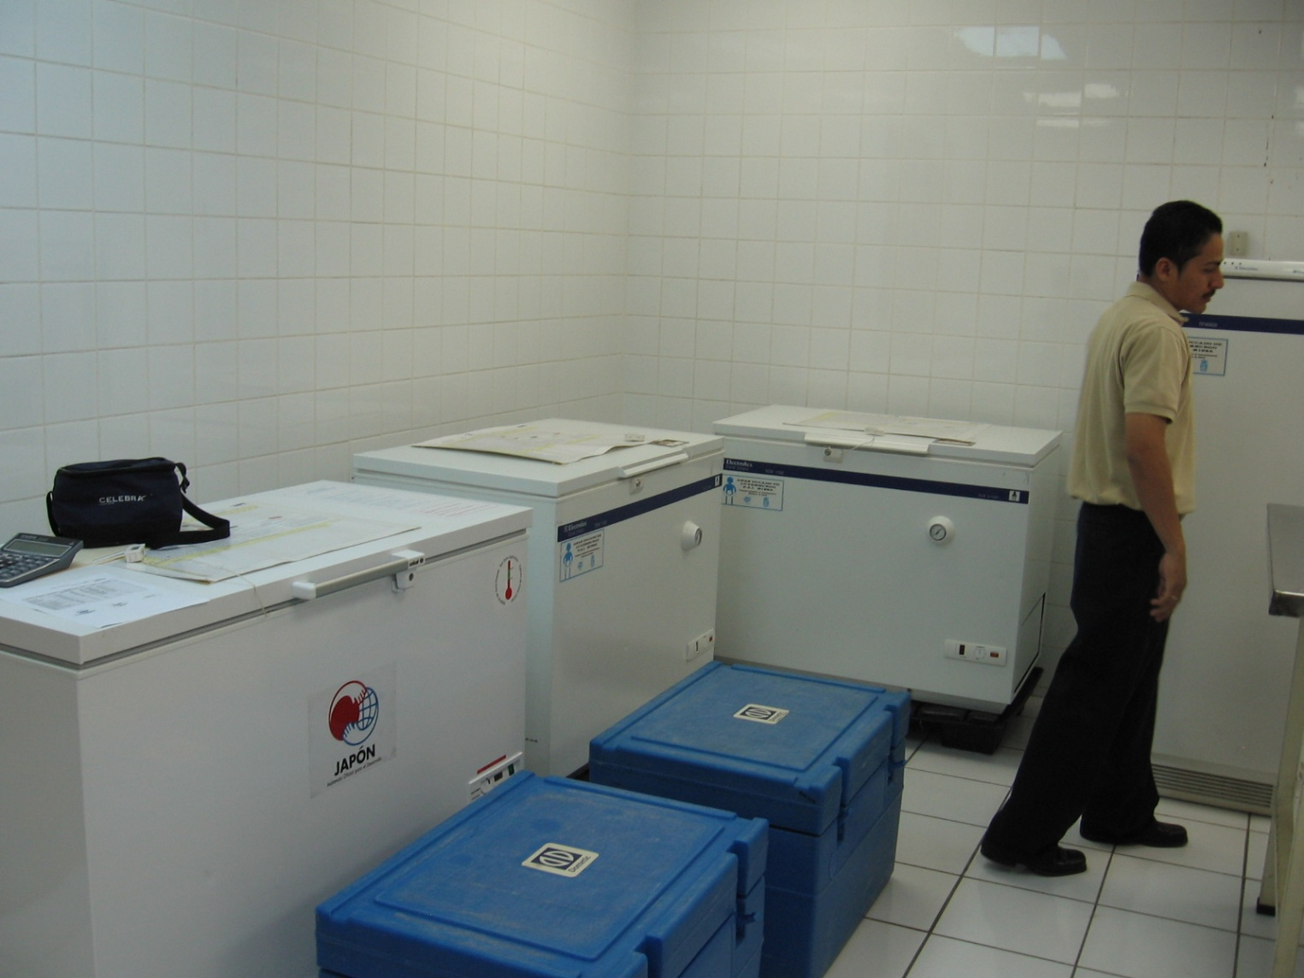
Cold Chain

Slide 4
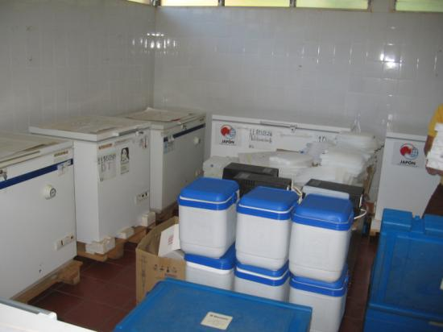
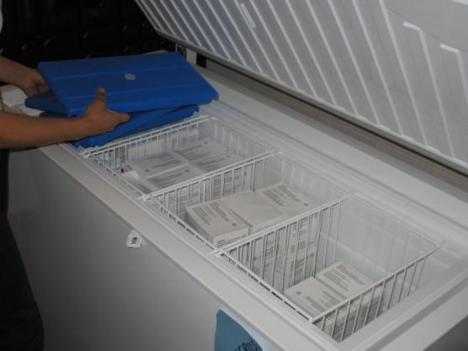
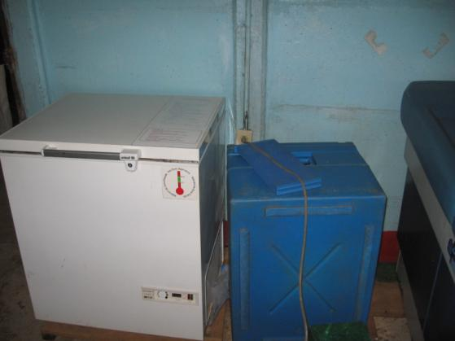
Cold Chain

Slide 5
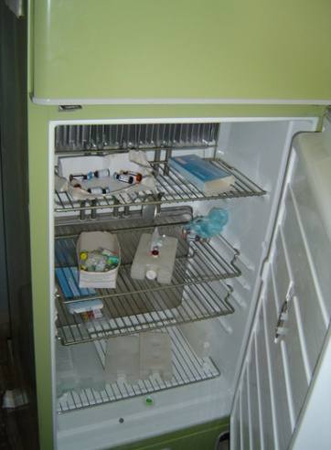
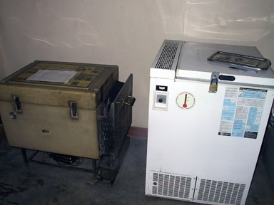
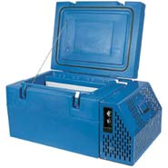
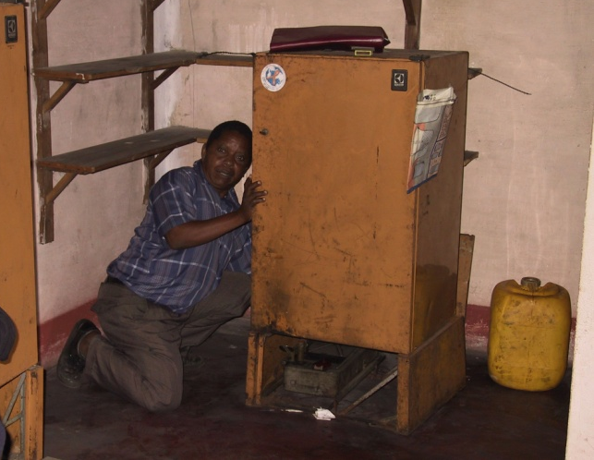
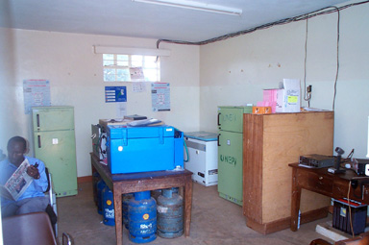
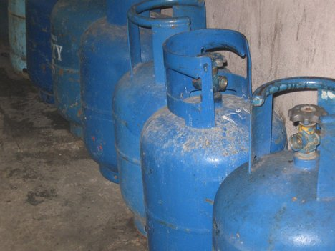
Cold chain equipment software

Slide 6
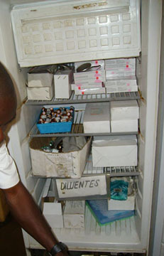
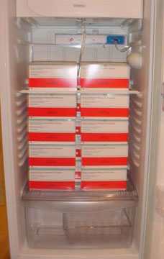
Old vs. New Vaccines
4,100 doses
Polio and Measles
$635
625 doses
Rotavirus
$4687

Slide 7
Cold chain inventory
What is the status of a country’s cold chain?
How many refrigerators?
What types are they?
How old?
Are they working?
Are they big enough for the required vaccines?
Where are they?
Country A: 5306 facilities, 4946 refrigerators
Country B: 827 facilities, 1426 refrigerators
Country C: 2846 facilities, 3153 refrigerators
Country D: 1605 facilities, 3080 refrigerators

Slide 8
Inventory Based Cold Chain Capacity Analysis
Health facility list
Capacity analysis
Cold Chain Planning Tool
(CCEM)
Demographic data
Reports
Refrigerator inventory
Equipment requirement list
Vaccine schedule

Slide 9
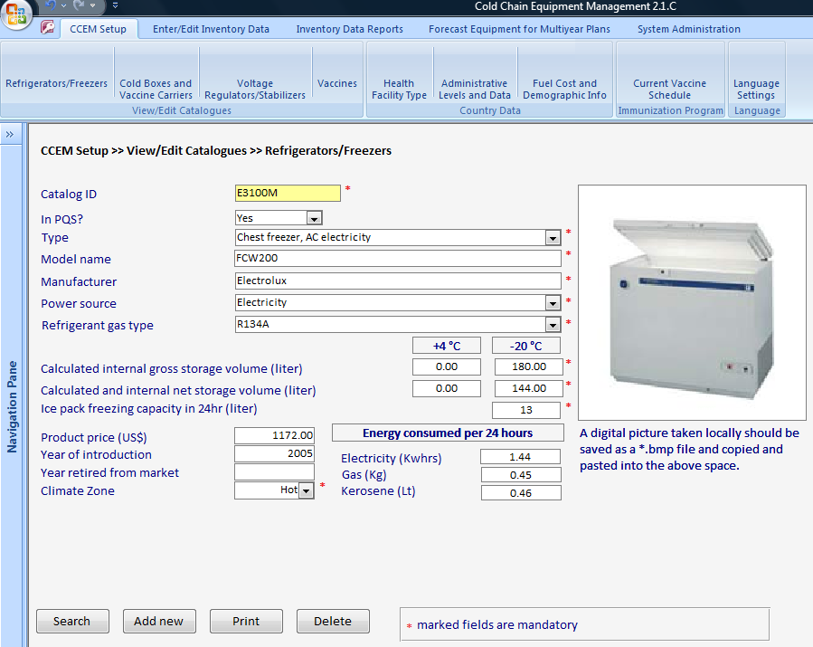
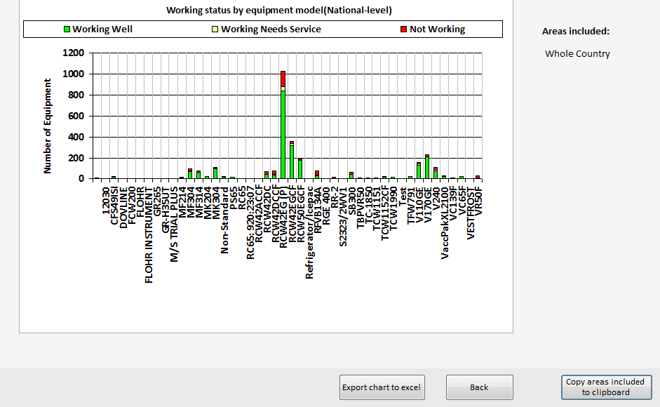
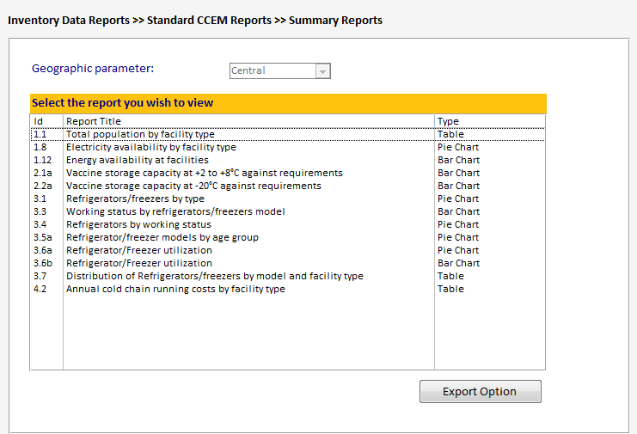
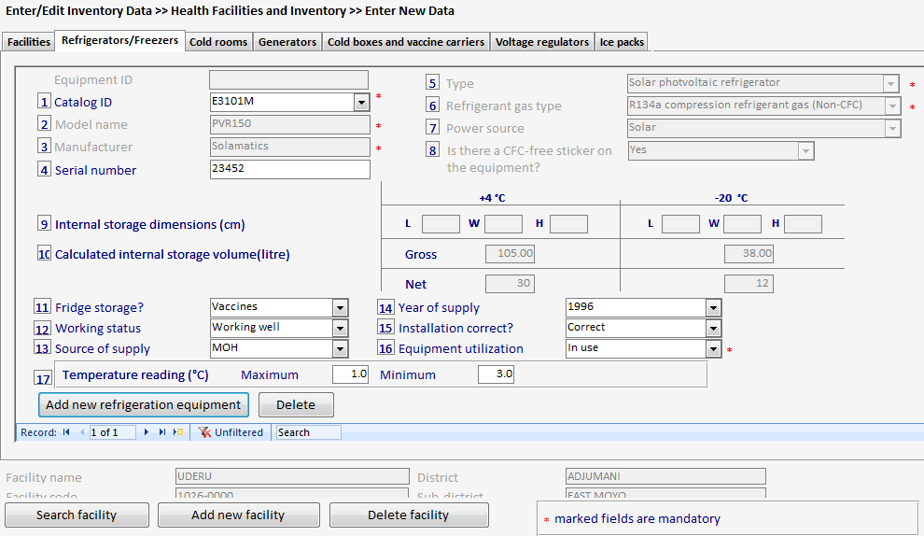
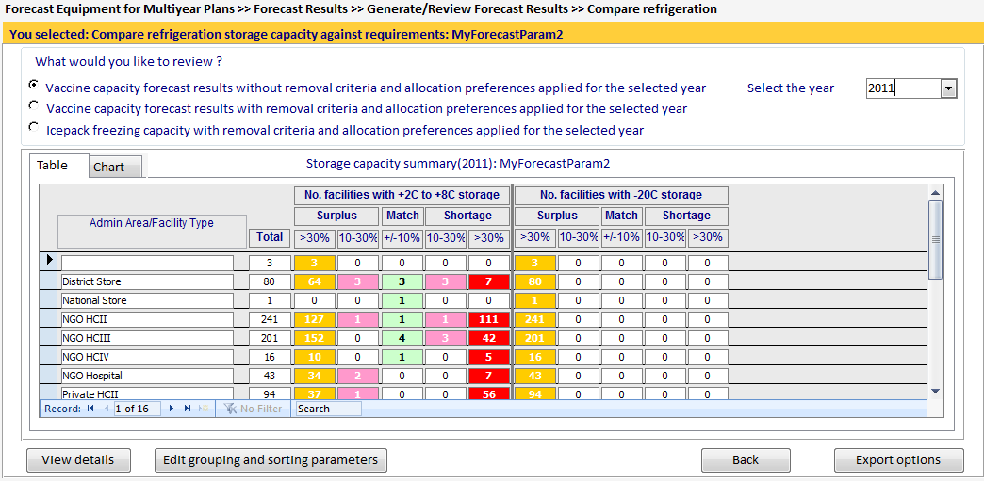
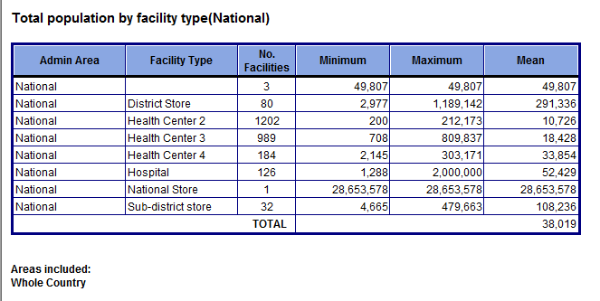
Cold Chain Equipment Manager (CCEM) Software
1/5/2012
Change Seminar
9

Slide 10
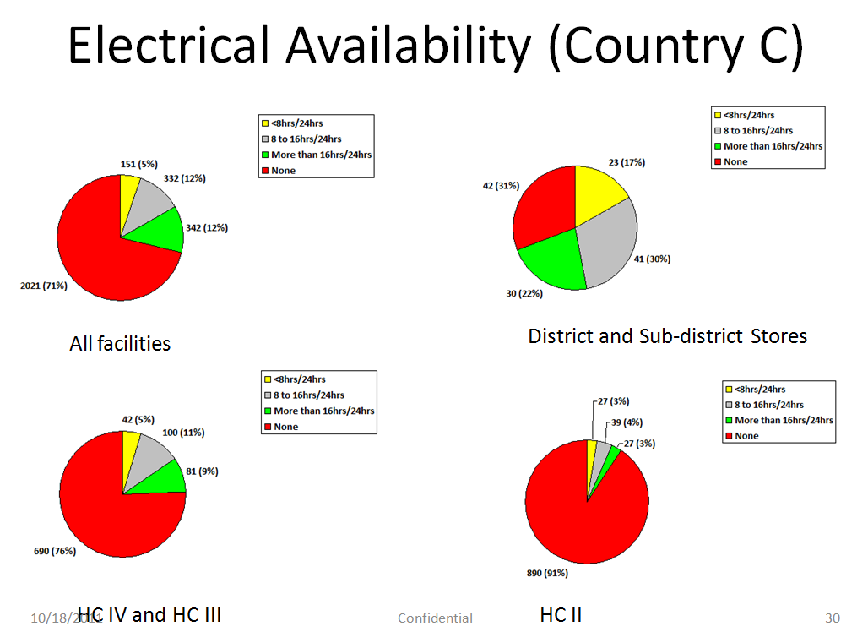
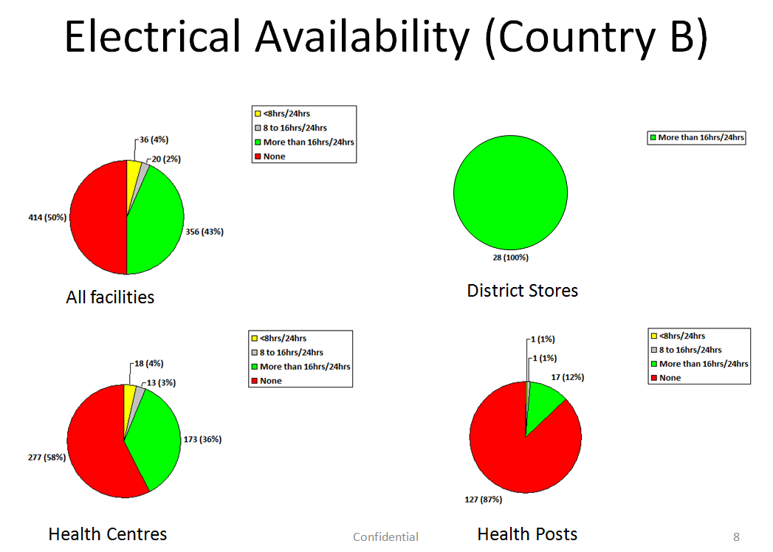
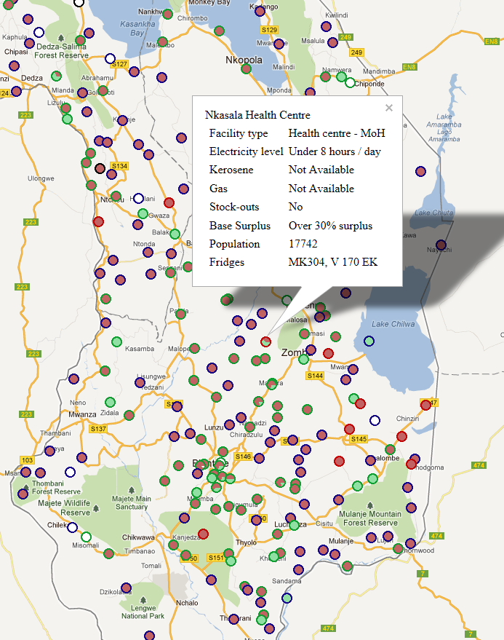
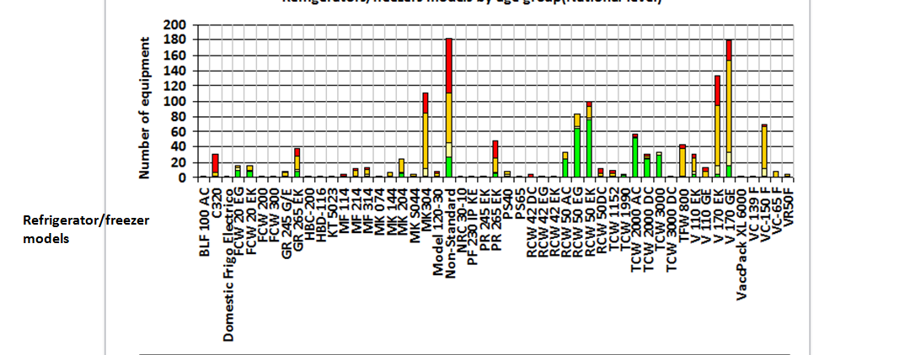
Reports

Slide 11
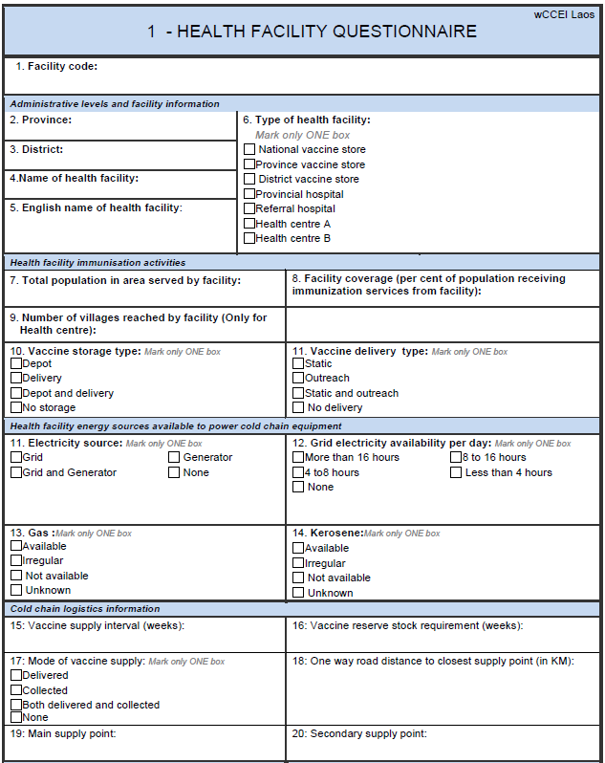
CCEI Data Standards
Goal: Agree on standards to allow tools to interoperate
Wide range of tools available
Data integration problem is central
Need for multiple software tools

Slide 12
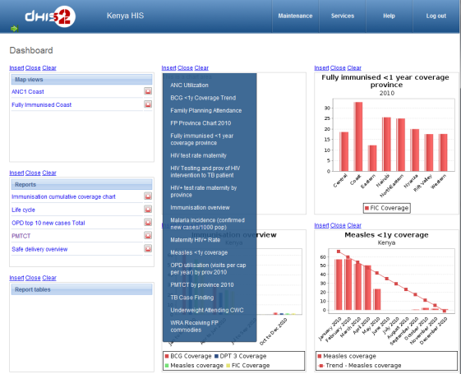
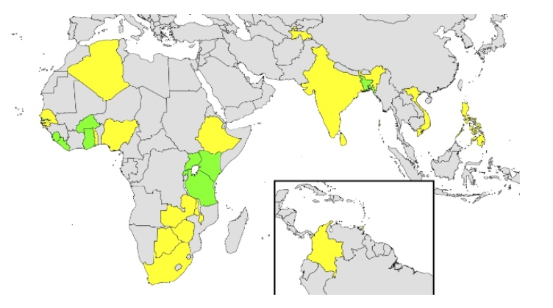
HISP / DHIS2
HISP: International effort with hubs in Norway, India, Vietnam, South Africa
DHIS2: Health indicator reporting software
Web based, to data base back end
Wide scale deployment
Roughly thirty countries, including nationwide use in some countries
State reporting in roughly half the states of India
http://www.hispindia.org/
http://dhis2.org/

Slide 13
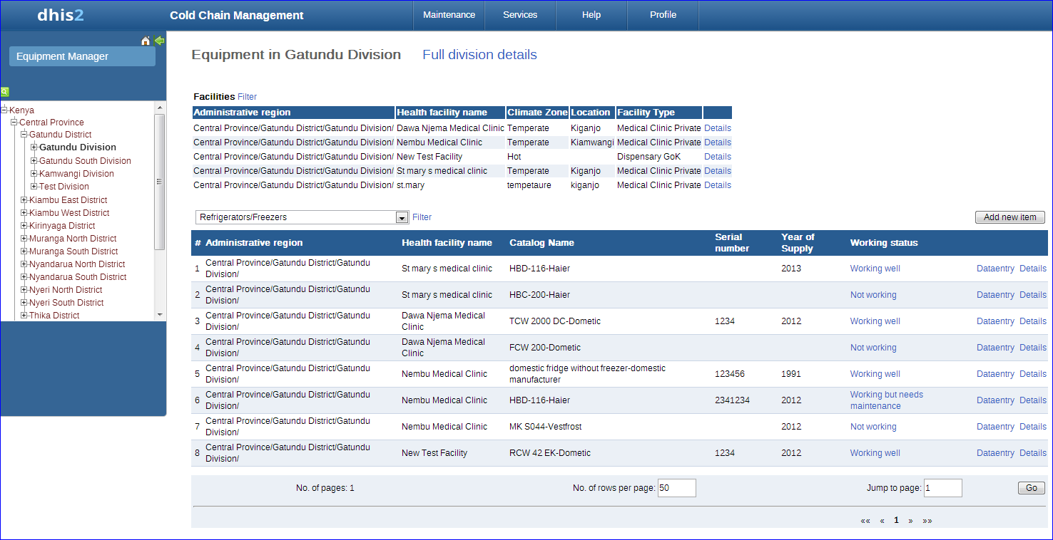
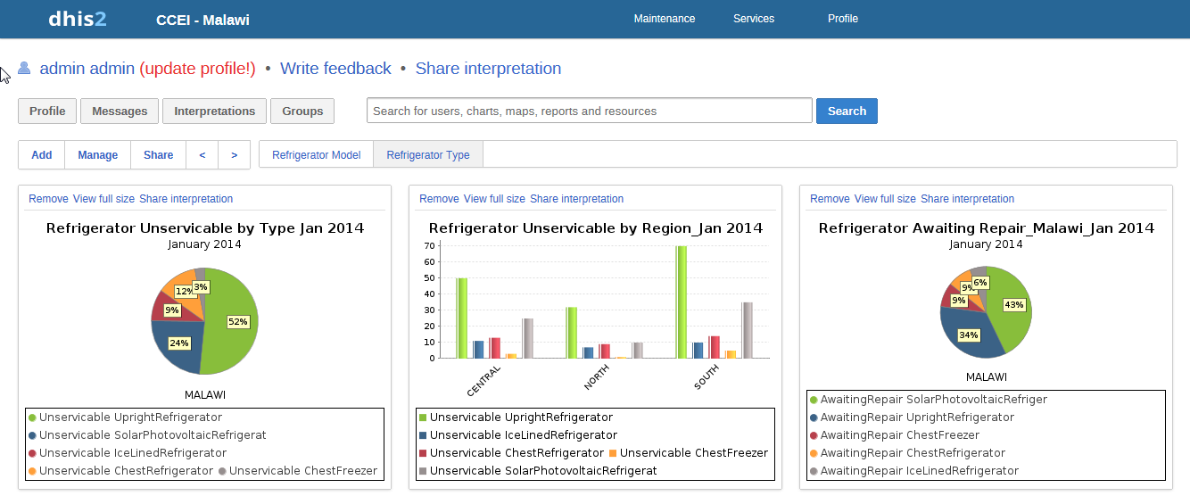
Incorporating CCEM into DHIS2
Much better architecture
Add to existing system, as opposed to introducing a new system
Implementation of inventory component and reports by HISP India
Working prototypes available

Slide 14
Unifying cold chain inventory tools
Wide range of cold chain inventory tools are used
Is it possible to bridge between the tools
Deal with the reality of Health Information System software
Support migration to contemporary software tools
General approach
Cold chain inventory model with conversion/visualization tool
One button import/export

Slide 15
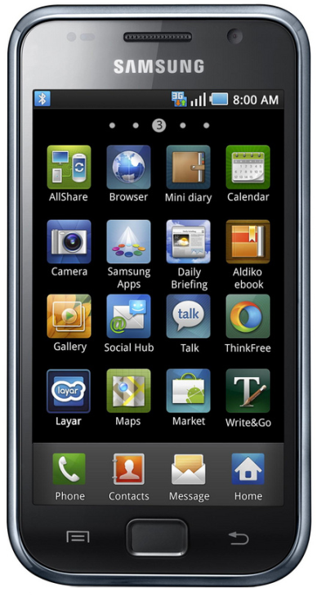
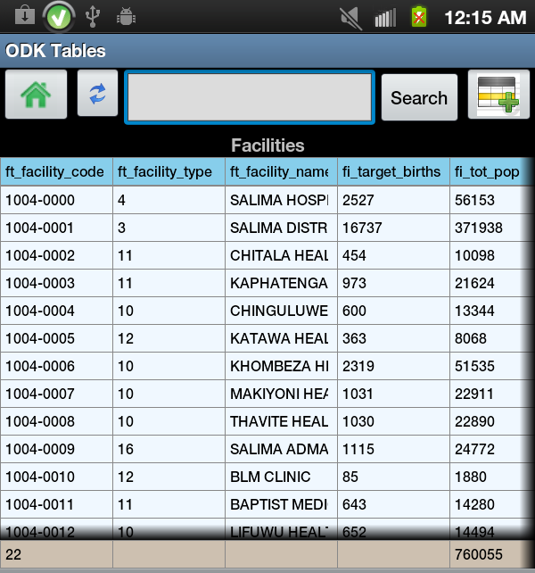
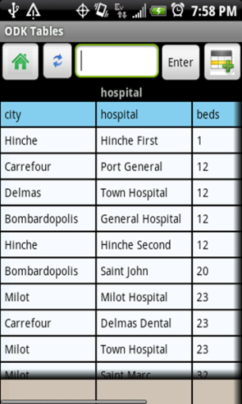
ODK Tables
Cold chain data sets natural match for tables
Use cases for ODK Tables
Inventory construction
Facility visits
Benin data set implemented in Tables

Slide 16
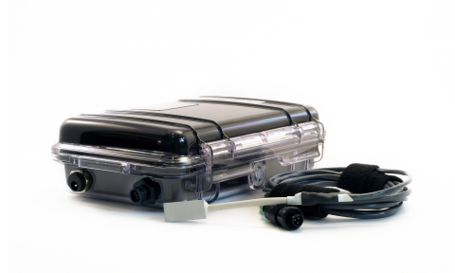
Temperature monitoring
Real time reporting of vaccine refrigerator temperatures
Key for sustainable use of temperature monitoring system is a back end that is linked to a national system

Slide 17
(Simple) Health System Modeling
CCEM relies on very simple models
Storage requirement = doses X volume per dose
The challenge for application like CCEM is to make the modeling easy to use.
Simulation based games solve the same interface problems that come up in CCEM.
Assignment of assets to locations on a map
Setting conditions over regions
Ease of use / learnability essential

Slide 18
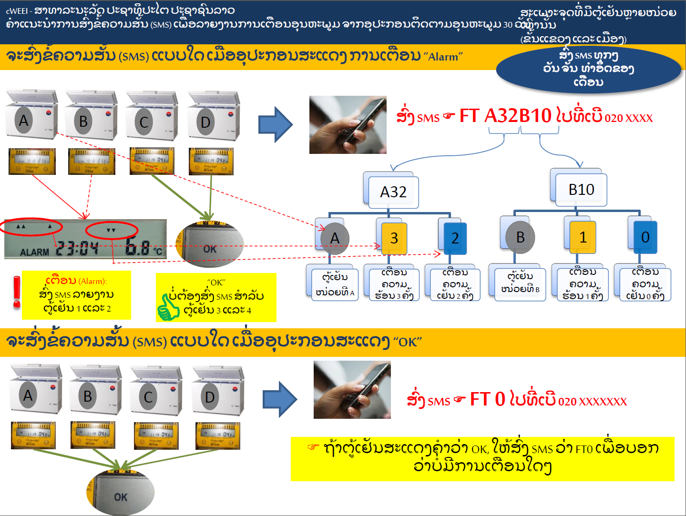
Reminders and Alerts

Slide 19
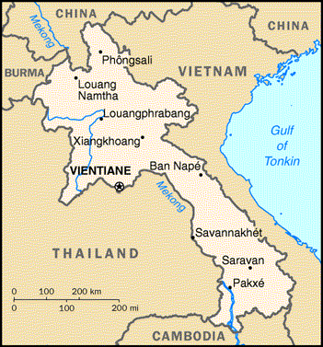
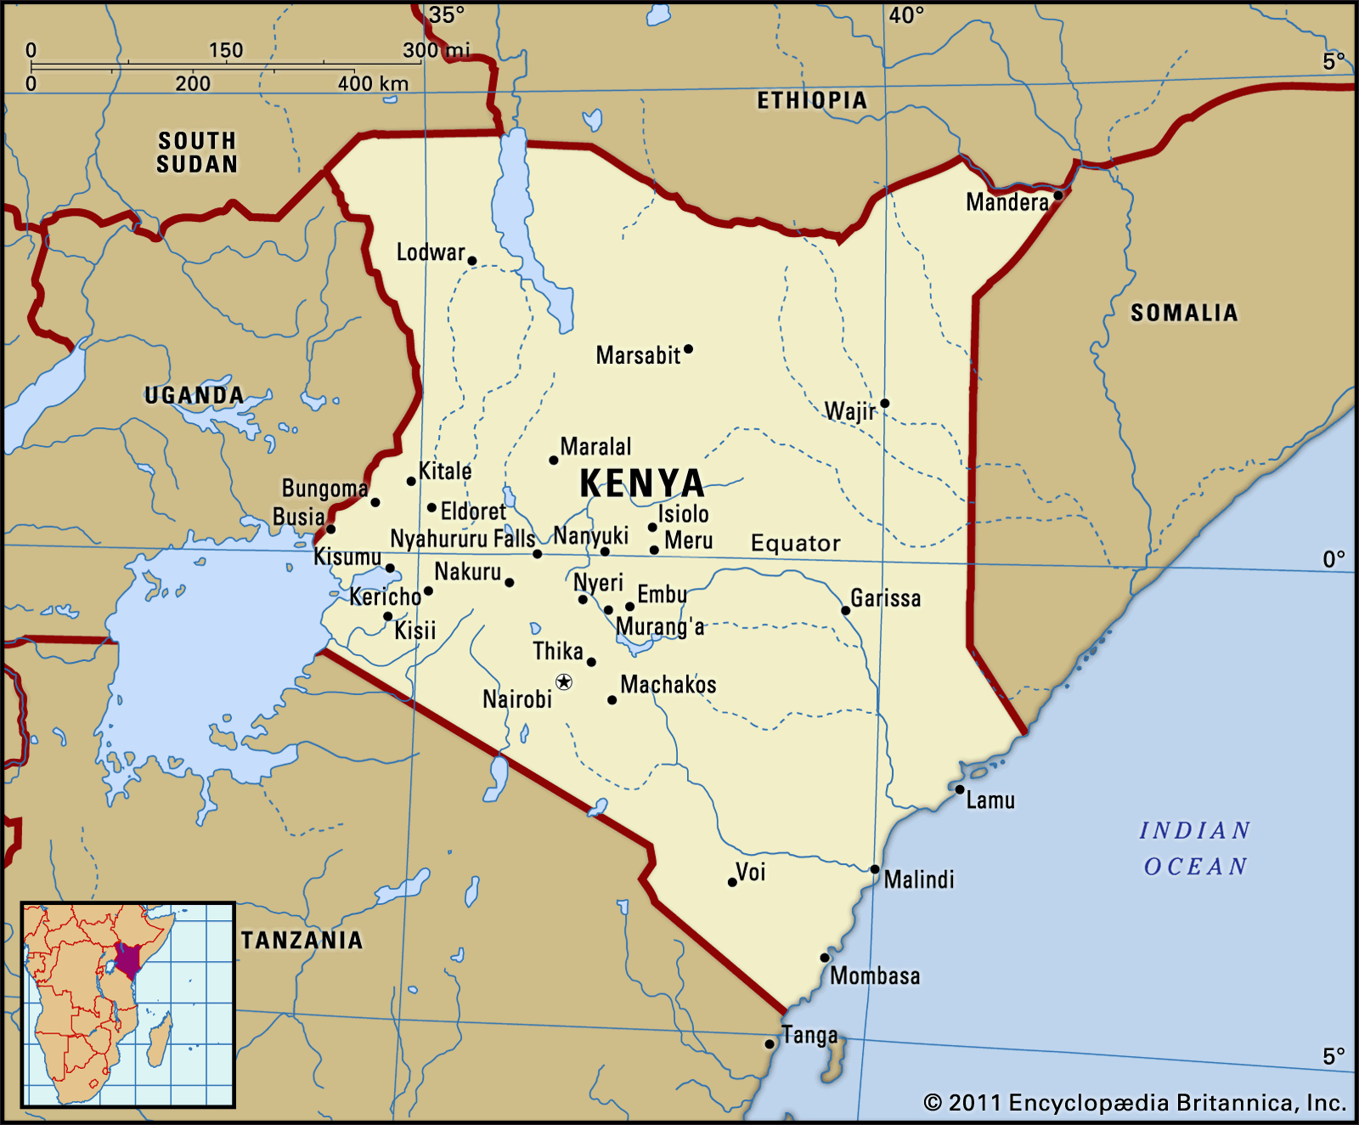
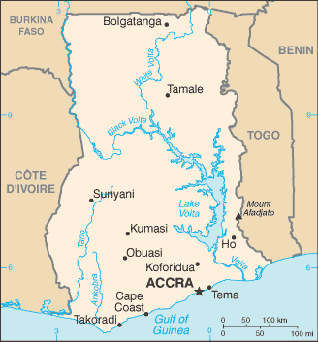
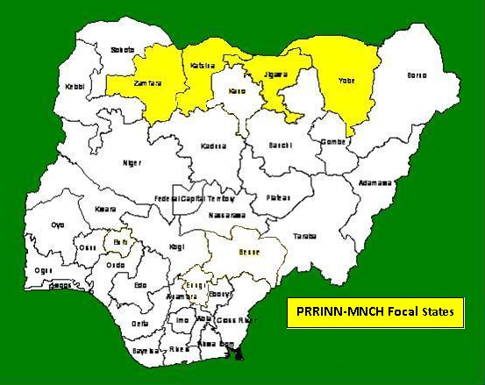
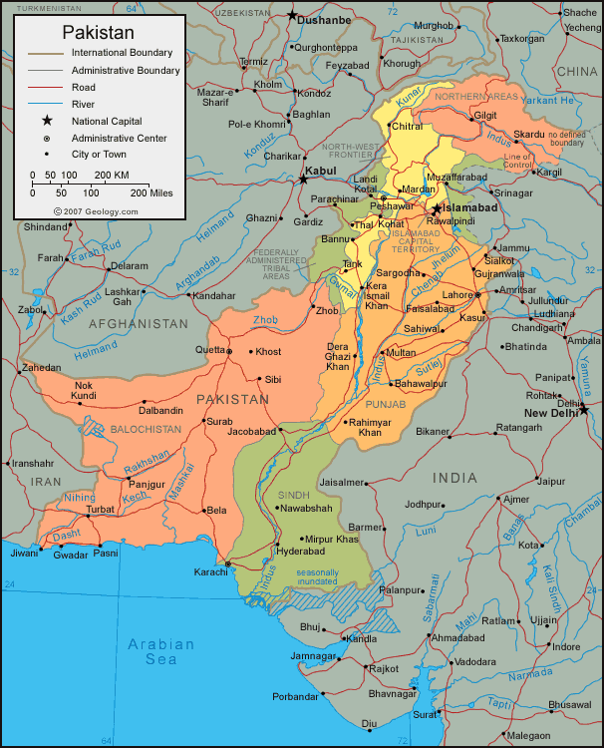
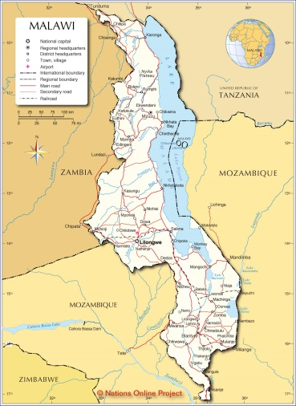
Countries

