Slide 1
The state of home networks
CSE481M: Home Networking Capstone
March 30th, 2011

Slide 2
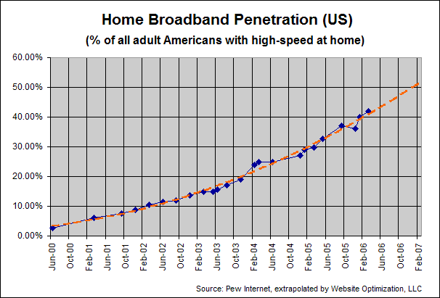
Home networks are a success
Broadband penetration (US)
Revenue for networked devices (worldwide)
Source: Home Networking Market Data, ABI Research, Nov 2010

Slide 3
Home networks are a failure
High return rates despite no technical issues
25% of routers are returned
Poor uptake for new technologies
Only 159K home automation controllers shipped worldwide in 2009
Ample evidence of user frustration

Slide 4
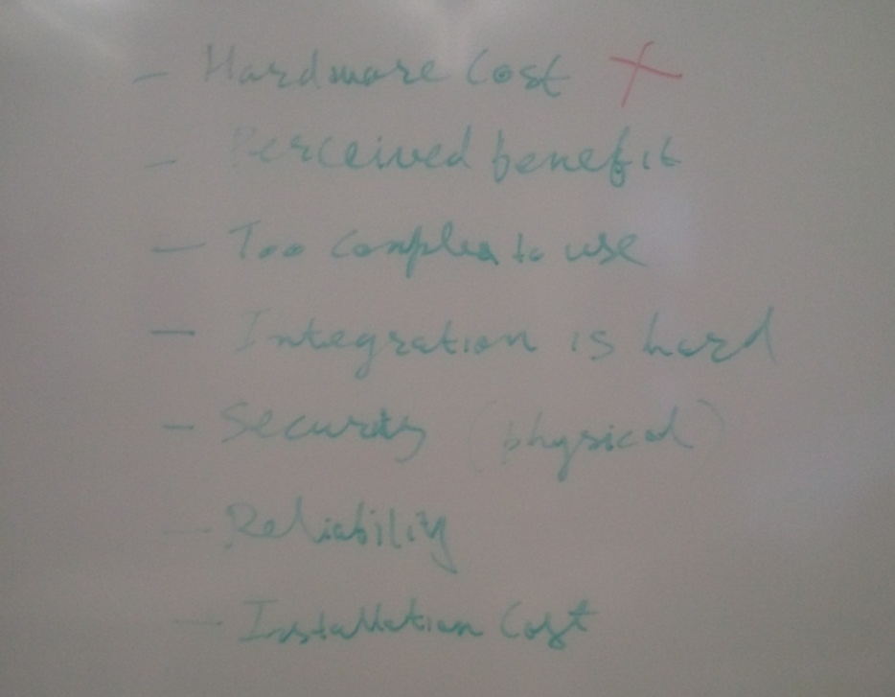
Home networks are a failure (indeed)

Slide 5
Where did home networks come from?
Short answer: The Internet and the enterprise
Long answer:
Computer networks developed to support research
Came home using dial-up; went mainstream with WWW
Intra-home connectivity became widespread with wireless
Applications developed for the home and convergence with consumer electronics
Richer mechanisms (e.g., access control) developed for the enterprise environments

Slide 6
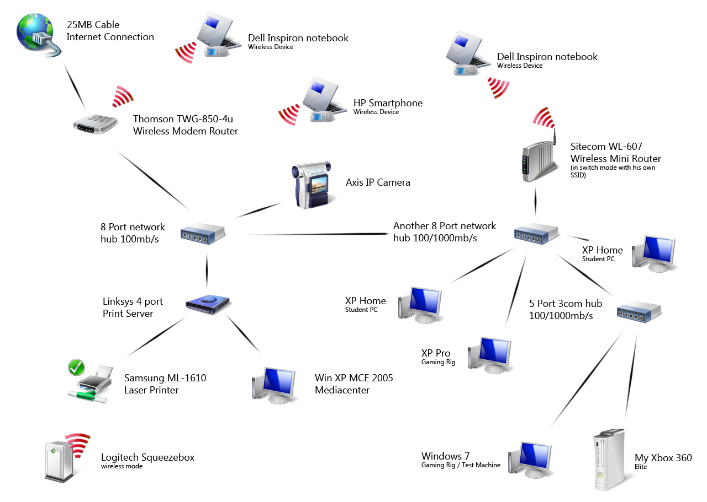
An example home network

Slide 7
But the home is different
No trained administrator
Heterogeneity
Applications
Devices
User preferences
Expectation of privacy

Slide 8
Resulting friction: Technical
Need for config and possibility of misconfig
Mismatch between real and expected network
Policy vs. mechanism

Slide 9
Resulting friction: Human factors
Poor conceptual models
Need and poor support for personalization
Hurts debugging as well
Expectation of privacy

Slide 10
Resulting friction: Economic
Multiple, competing stakeholders
Partitioned visibility and insight
Whose problem is it anyway?
Heterogeneity leads to high cost

Slide 11
Implications for the future
Develop solutions customized for the home environment
No trained admin
Heterogeneity
Privacy
Work across areas of computer science

