Slide 1
HomeOS
CSE 481m
April 4, 2011

Slide 2
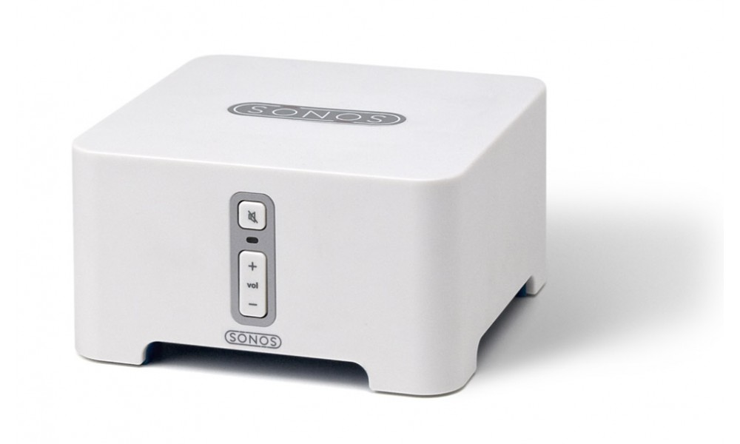

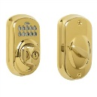
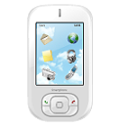



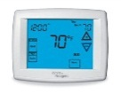
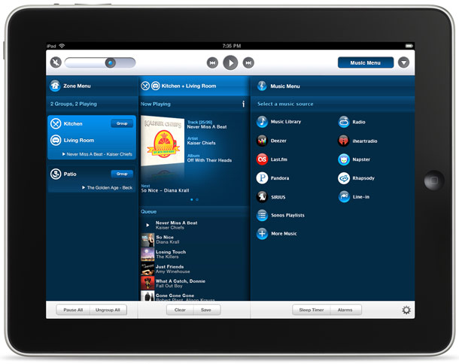
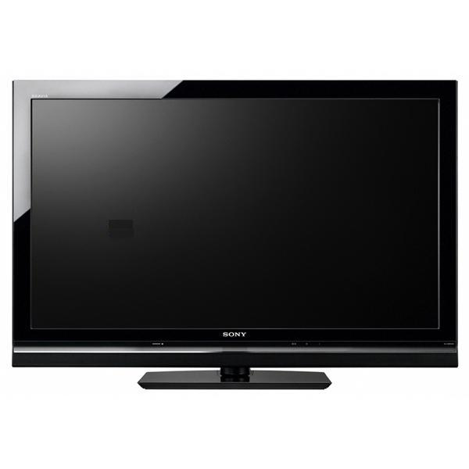

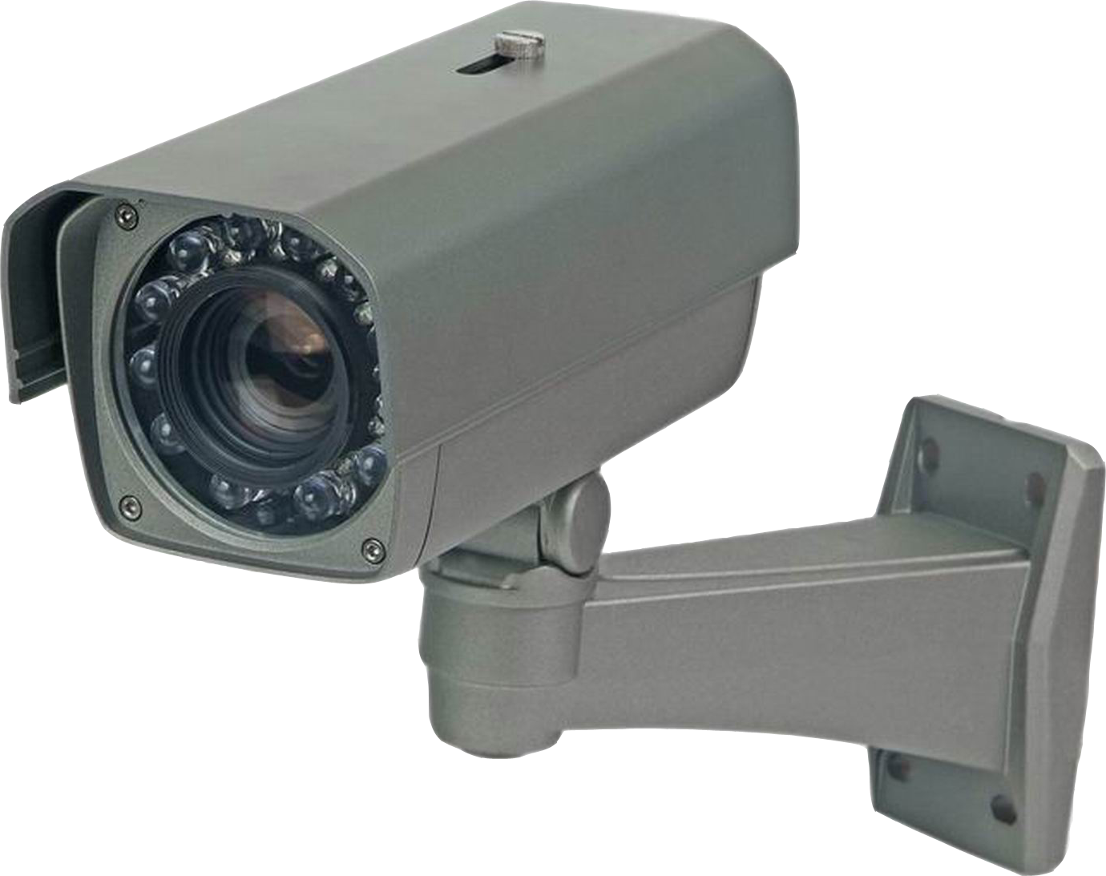
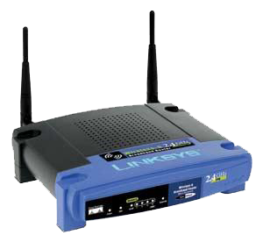
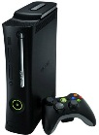
Lots of tech in homes

Slide 3
Problems with tech in homes
You easily can’t program it
Why not?
  Lack of standards
  Diverse devices (most don’t run code)
  Different connectivity (ZigBee, Zwave, 802.11)
  Sharing devices is hard
  Users want different things

Slide 4
What HomeOS does
Makes it easier to write apps for the home
  Uses drivers to hide connectivity differences
  Standardizes device interfaces
  Standardizes user control of applications
  Allows for constrained ‘sharing’ of devices

Slide 5






How it works
HomeStore
Video Rec.
Remote Unlock
Climate
Operating System

Slide 6
How it works
Application Logic
User Preference What is automated? When? How?
Coordination When apps disagree, who wins?
Device Handle different brands/models
Topology Handle WiFi vs. 3G vs. Eth, Subnets
Hardware The actual devices in the house
Application Logic
User Preference What is automated? When? How?
Coordination When apps disagree, who wins?
Device Handle different brands/models
Topology Logically centralize devices
Hardware The actual devices in the house
Application Logic
User Preference What is automated? When? How?
Coordination When apps disagree, who wins?
Device Standardize at functional layer
Topology Logically centralize devices
Hardware The actual devices in the house
Application Logic
User Preference What is automated? When? How?
Coordination Access control mediates conflicts
Device Standardize at functional layer
Topology Logically centralize devices
Hardware The actual devices in the house
Application Logic
User Preference Users’ manage access control rules
Coordination Access control mediates conflicts
Device Standardize at functional layer
Topology Logically centralize devices
Hardware The actual devices in the house
App A
App B
…
Mgmt
UI
Access Control
Port
Port
Driver
Driver
…
…
…

Slide 7
What we gave you
HomeOS
  .NET project/library to make writing apps easy
  Silverlight/WP7 SDK for GUI and phone development
Includes
  Drivers for: webcams, IP cameras, media server/player, z-wave devices, SMS notifications, face recognition, etc.
  Sample applications

Slide 8
Applications
Hopefully small pieces of code which orchestrate a series of devices
Basic App Architecture
  Boot, set up any state (windows, connections, etc.)
  Look for required devices
  Once having found all devices, enter a loop
    See if relevant devices have showed up or left
    Do whatever useful thing it is supposed to do
  On quit, clean up state

Slide 9
Drivers
Deal with connectivity and device specifics
  Find the device and establish communication
  Translate high level commands to low-level
Export functionality as Roles & Ports
  Advertise ports with relevant roles when devices are available
  Remove ports when devices are no longer available

Slide 10

Finding Devices
PortRegistered() and GetAllPortsFromPlatform()
  Cycle through all ports on boot
  Listen for new devices over time
  Might hear about a new device more than once
  Pick the ones you want
Analogous PortDeregistered()
  Listen for devices being removed

Slide 11
Ports & Roles
Port
  A handle to a device
Role
  Each port has one or more roles
  Things like lightswitch, dimmerswitch, TV, media server, media player, etc.
  What applications are actually written against

Slide 12
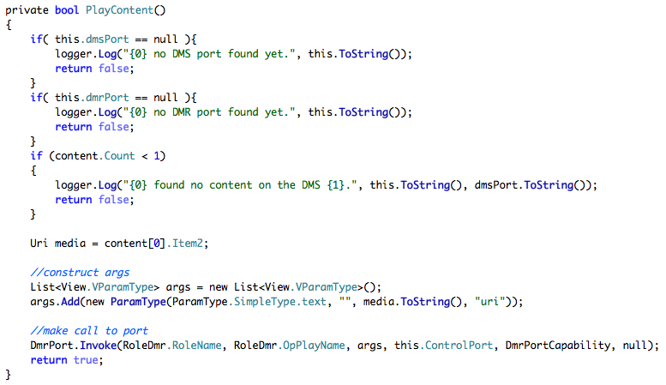
Invoking an Operation

