Slide 1
Midterm Review 2023

Slide 2
Search
• Be able to give a formal state-space model for a problem expressed in English.
Formal means to specify S, s, A, f, g and c as sets or functions as appropriate.
• Be able to specify what would be the dead states for a given problem.
• Be able to generate part of a search tree for a given model, either depth-first or breadth-first.
• Be able to answer questions about the completeness and complexity of the various search variants given in Chapter 3-4.
• Be able to explain the use of a heuristic function in a search or to give an example of one for a stated problem.
• Be able to motivate the use of heuristic-search vs. blind search.

Slide 3
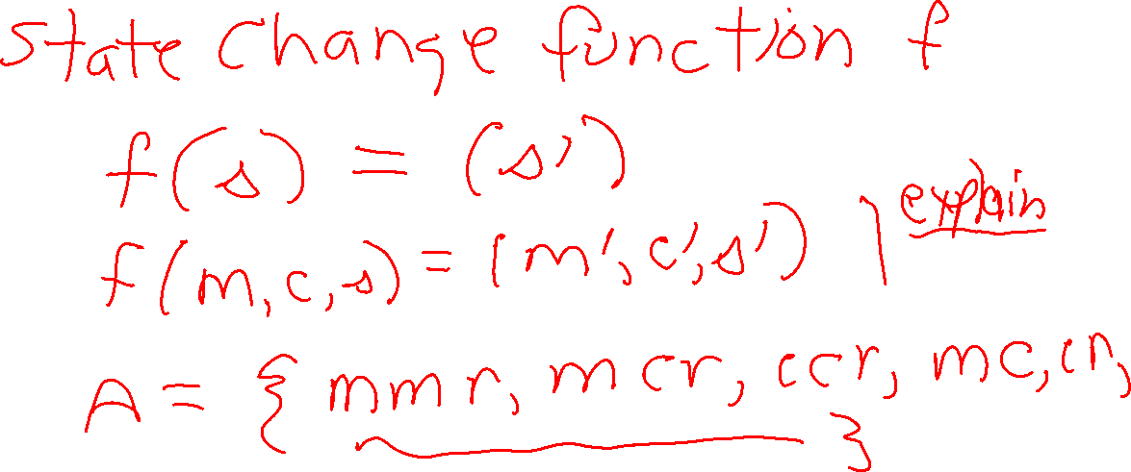

Slide 4
Be able to apply any of the following search methods to a well-stated problem
and show a portion of the search.
– best-first search/A* algorithm
– basic hill climbing
– steepest-ascent hill climbing
• Be able to answer questions about admissibility and consistency with respect to
heuristic functions for A*.
• Be able to describe or analyze the simulated annealing approach and its advantages/
disadvantages and variants.
• Be able to answer questions about complexity, completeness, and optimality for
the above algorithms.

Slide 5
2. Game Playing
• Be able to develop a utility function for a given game or show how a given one works.
• Be able to show how a basic minimax search works for some given example.
• Be able to show how the alpha-beta procedure works for some given example.
• Be able to show how shallow search might be used to improve the alpha-beta procedure.
• Be able to answer questions about how Samuel’s checker player works.
• Be able to answer questions on how minimax generalizes to games of chance.

Slide 6
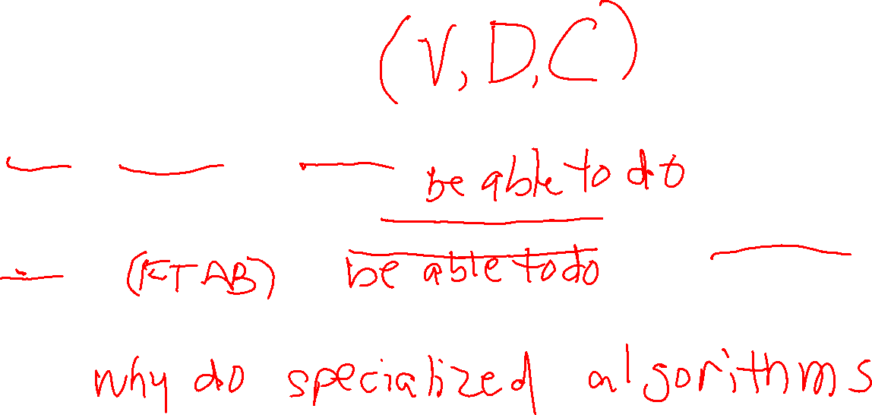
3. Constraint Satisfaction Problems
• Be able to formalize a constraint satisfaction problem by specifying the sets of
variables, possible values, and constraints.
• Be able to explain or illustrate how a backtracking tree search for a constraint
satisfaction problem would work: alone, with forward checking, or with arc consistency
checks.
• Be able to compare how a general heuristic search would compare with a constraint
satisfaction search when both are applicable to a given problem.

Slide 7
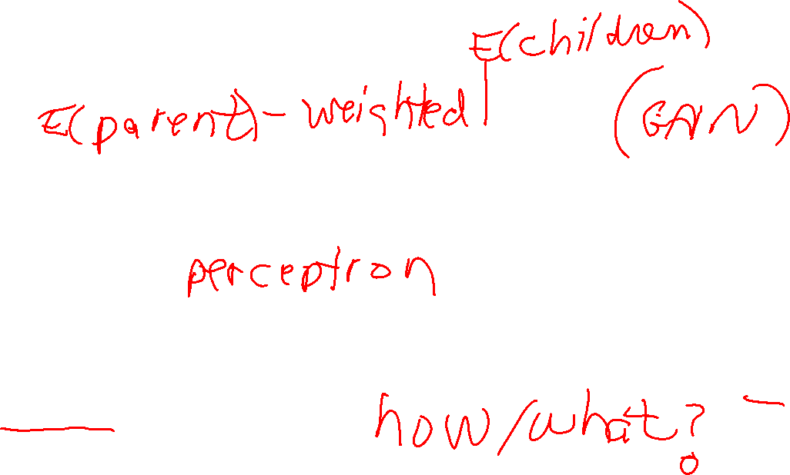
4. Machine Learning
• Be able to show how a decision tree is constructed using entropy on a simple example.
• Be able to show how Adaboost would work on a simple example or answer questions about how it works.
• Be able to show how a neural net computes its result (ie. just going forward from
input to output) for a simple example.
• Be able to answer questions on neural net learning with just one layer and back
propagation with multiple layers.

