Slide 1
Homework: CNN

Slide 2
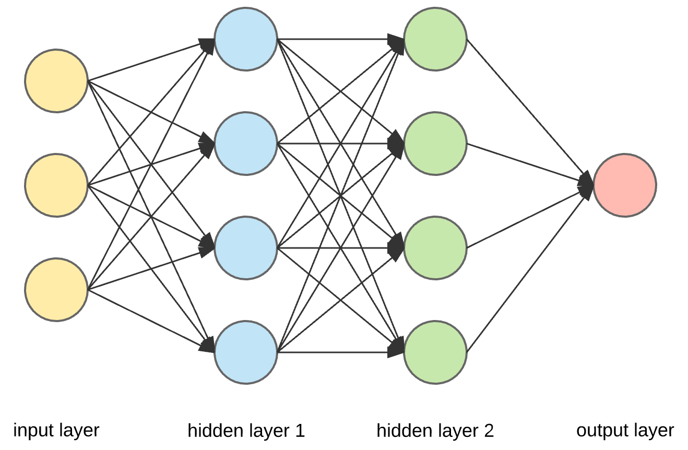
Neural Network (Q1)

Slide 3
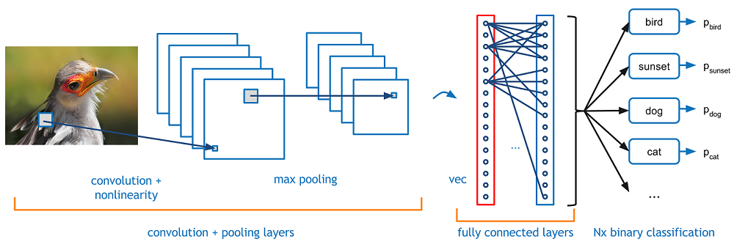
Convolutional Neural Network (Q2)
Conv
Pool
FC
Cross Entropy

Slide 4
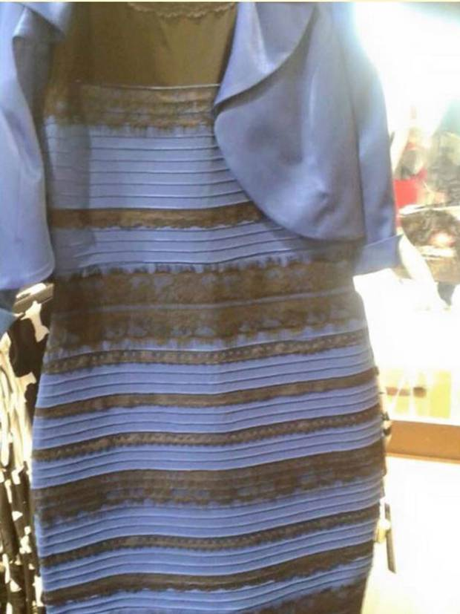
Yellow or Blue?

Slide 5
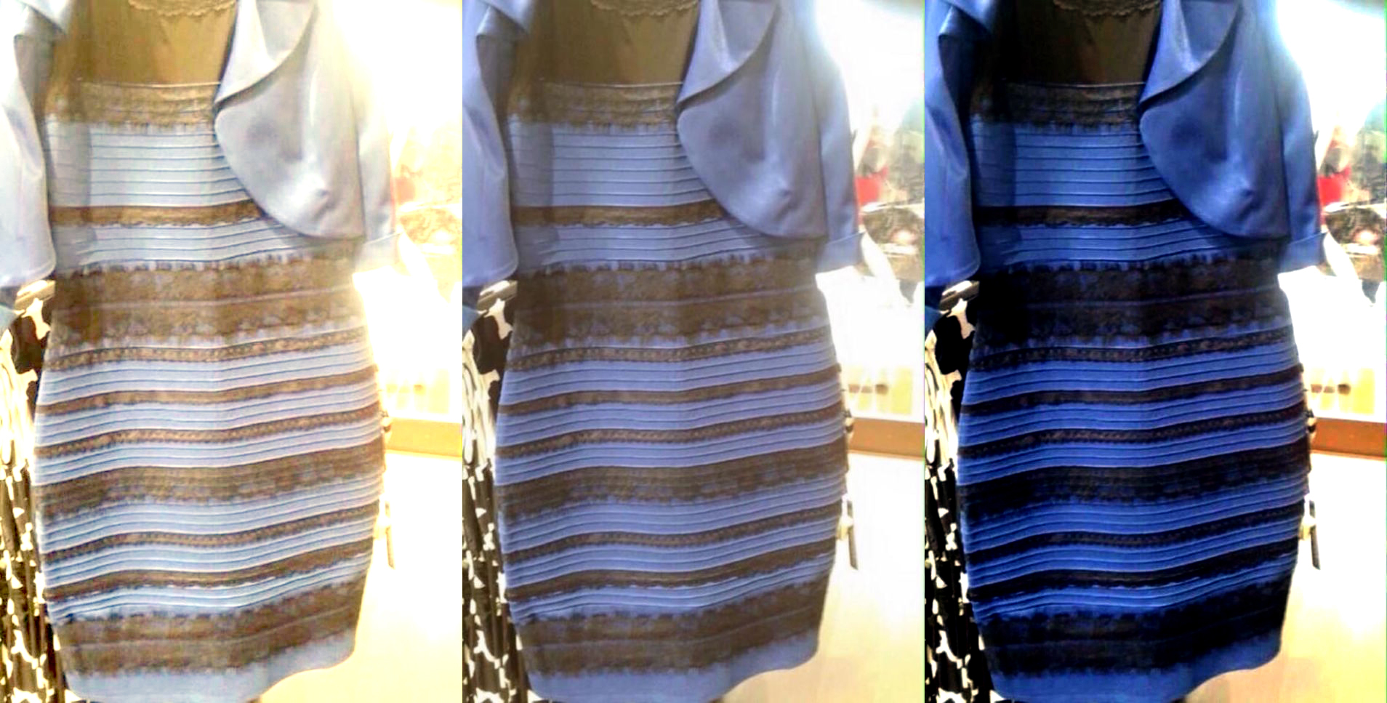
Color Normalization (Q3)

Slide 6
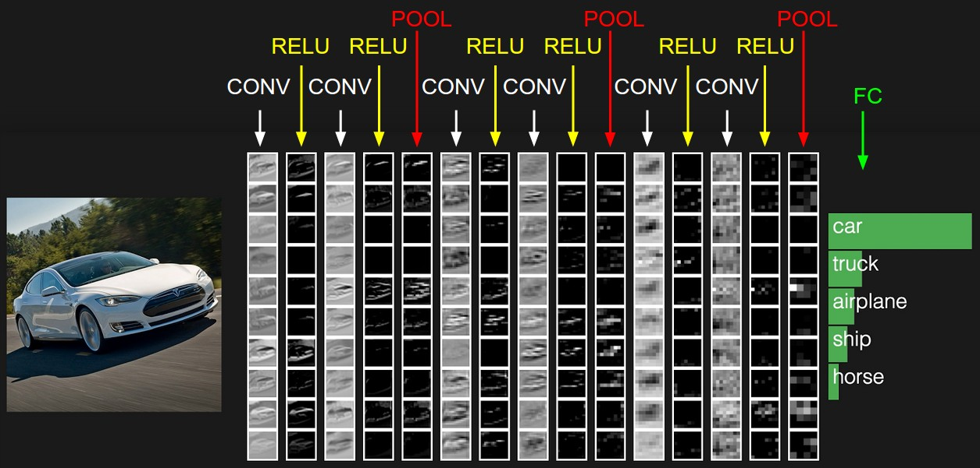
Deep Convolutional Neural Network (Q4)

Slide 7
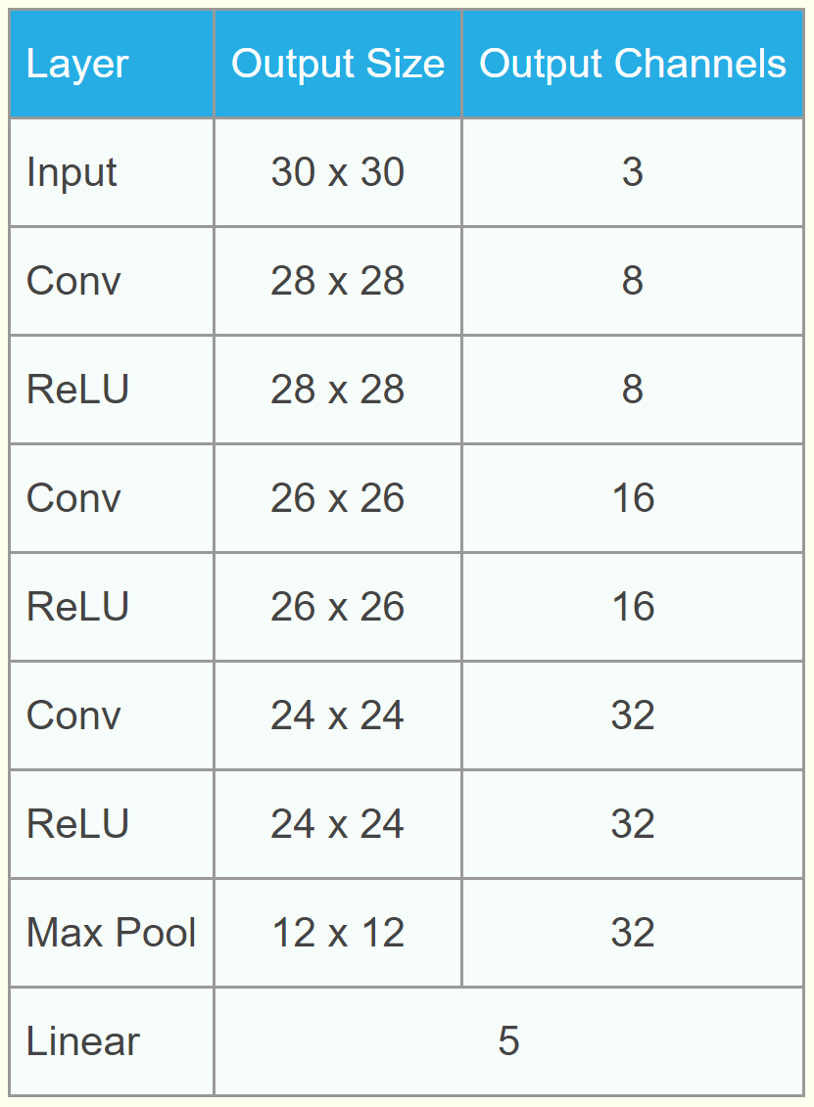
Make the Design More Flexible
Input:
[8, 16, 32, "pool"]

Slide 8
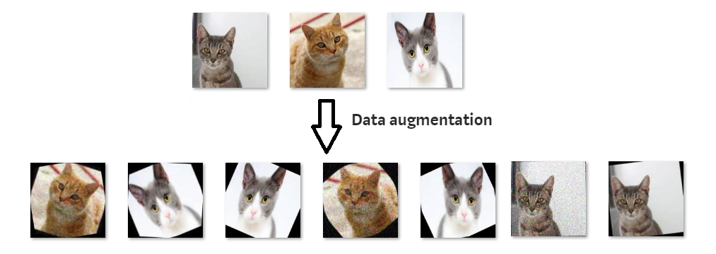
Data Augmentation (Q5)
Random Affine Transformation

Slide 9
VSGD-Net:
Virtual Staining Guided Melanocyte Detection on Histopathological Images
Kechun Liu
Contact: kechun@cs.washington.edu
2/27/2023

Slide 10
Outline
Introduction
Dataset
Methodology
  Intro to GAN
  VSGD-Net
Results and Discussions
  Main Results
  Ablation Study

Slide 11
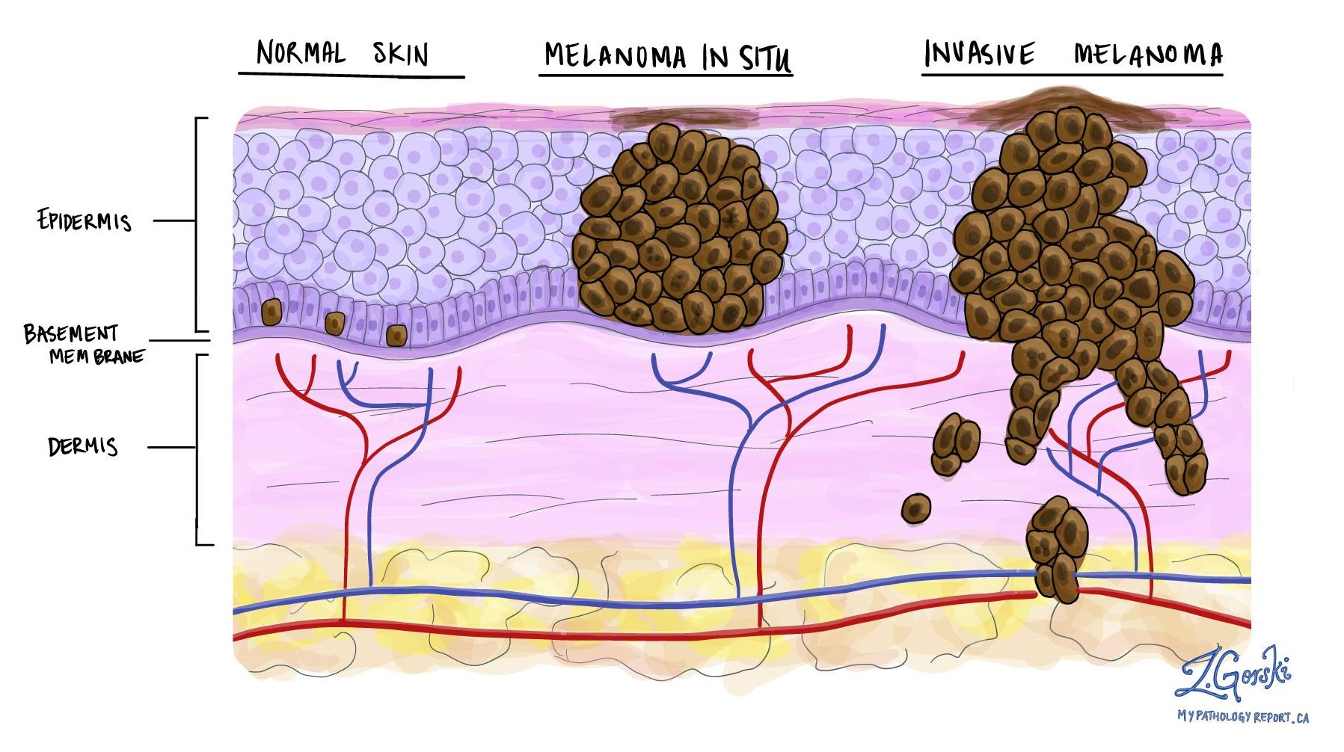
What is melanoma?
Melanoma is the most serious type of skin cancer and is potentially fatal.
Melanoma develops when melanocytes start to grow out of control.
Melanocyte:
melanin-producing cell

Slide 12
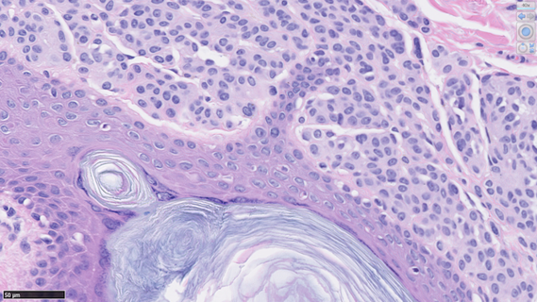
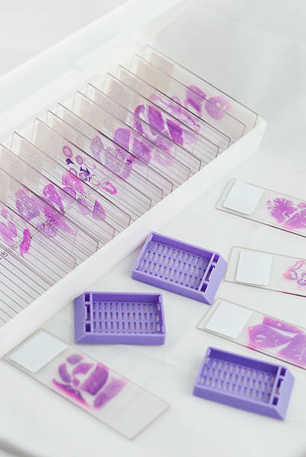

How do pathologists diagnose melanoma?
Architectural growth patterns of melanocytes?
Hematoxylin and Eosin (H&E) stained skin biopsies

Slide 13
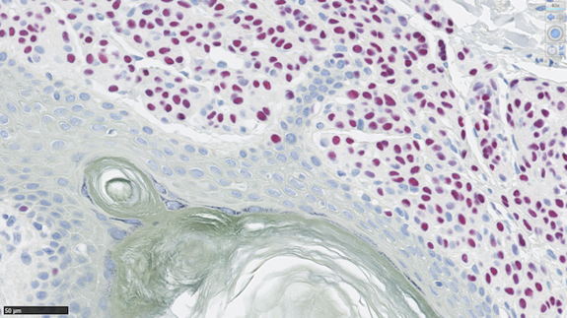
Supplemental Immunostaining
Sox10 staining can highlight melanocytes in red while keeping others in blue. But it’s not a routine procedure due to its high cost.
(a) H&E Staining
(b) Sox10 Staining – melanocytes are red
(c) Crop from Sox10

Slide 14

Study Goal
Can we automatically detect melanocytes on H&E images?
Tackle the visual similarity between melanocytes and other cells in routine H&E images
Avoid the high cost of Sox10 staining
Reduce the burden on pathologists
Aid in melanoma diagnosis in the future

Slide 15
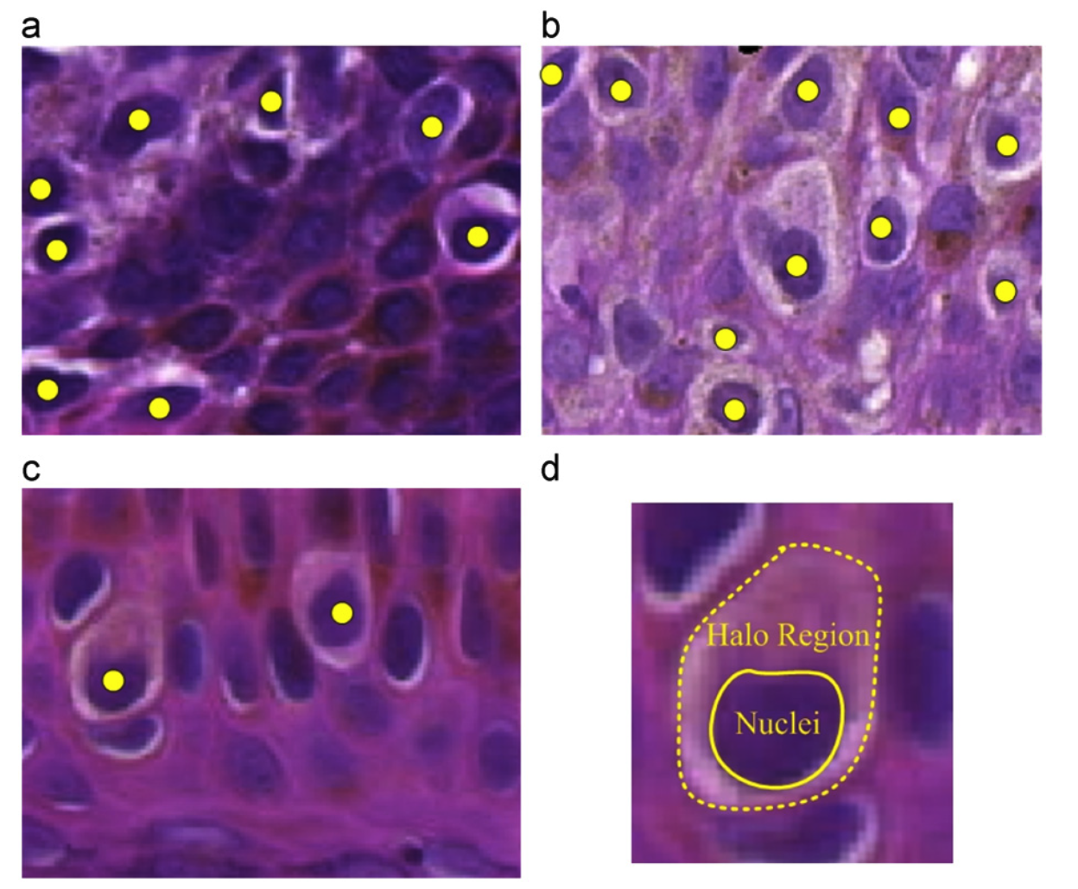
Related Work
Melanocyte detection
  Radial Line Scanning [1] based on the “halo region” assumption.

Slide 16
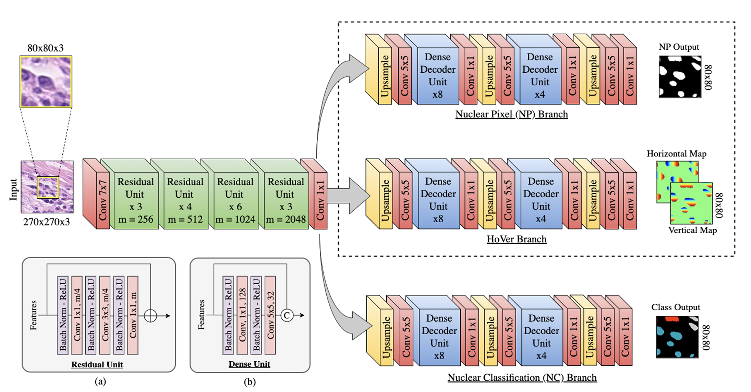
Related Work
Nuclei detection with CNN
  U-Net [2], Mask R-CNN [3], Hover-Net (deep CNN) [4], StarDist (a shape-guided CNN) [5], CHR-Net (a high resolution network) [6], etc.

Slide 17
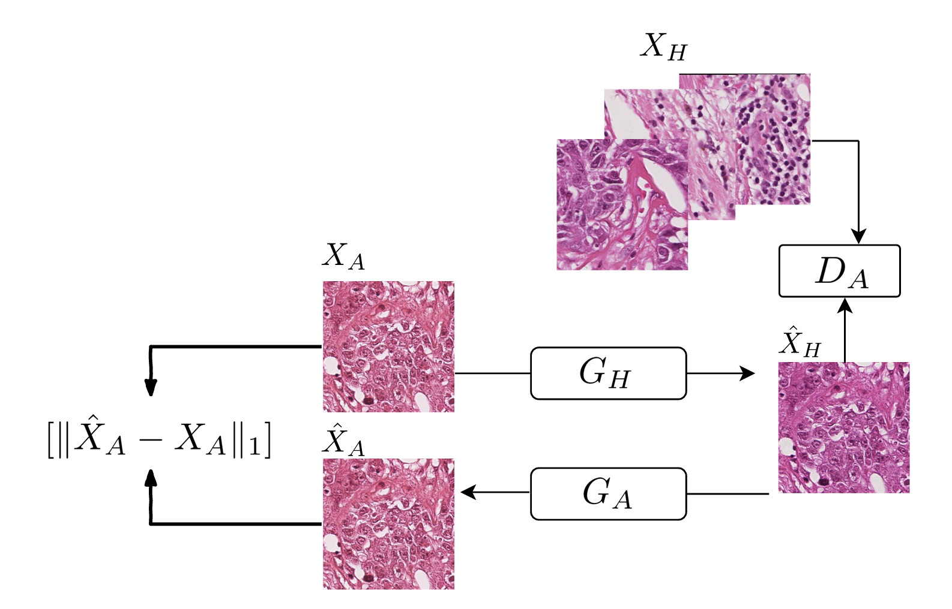
Related Work
Image-to-Image translation
  Tissues detection on images synthesized by GAN [7]

Slide 18
Related Work
Melanocyte detection
  Radial Line Scanning [1] based on the “halo region” assumption.
  Halo-regions are not the gold standard of melanocyte detection.
Nuclei detection with CNN
  U-Net [2], Mask R-CNN [3], Hover-Net (deep CNN) [4], StarDist (a shape-guided CNN) [5], CHR-Net (a high resolution network) [6], etc.
  Fail to differentiate various classes of cells due to the inter-class visual similarity.
Image-to-Image translation
  Tissues detection on images synthesized by GAN [7]
  Fail to exploit the intermediate features from the image synthesis process.

Slide 19
Study Goal
To automatically detect melanocytes on H&E stained images and leverage the information from the two stainings (H&E and Sox10), we propose VSGD-Net (Virtual Staining Guided Detection Network).
Tackle the visual similarity between melanocytes and other cells in routine H&E images
Avoid the high cost of Sox10 staining
Reduce the burden on pathologists
Aid in melanoma diagnosis in the future

Slide 20
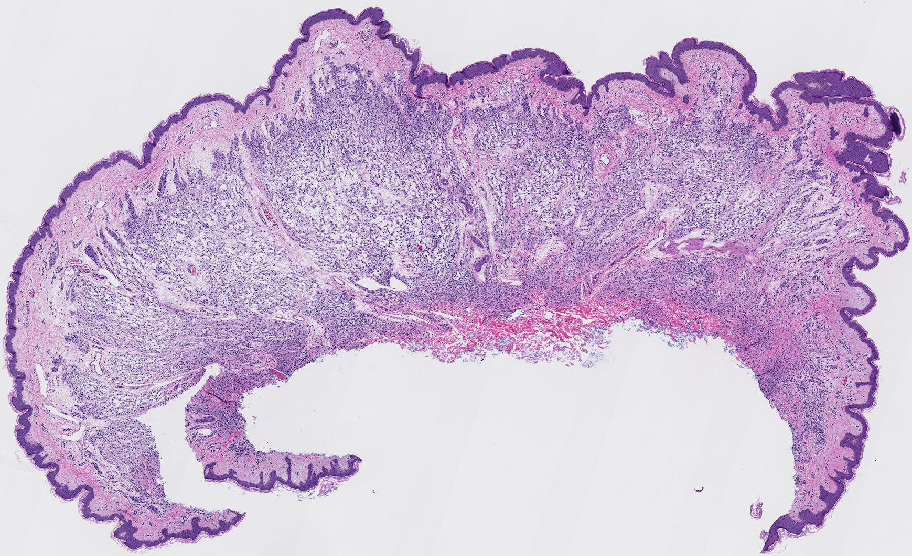
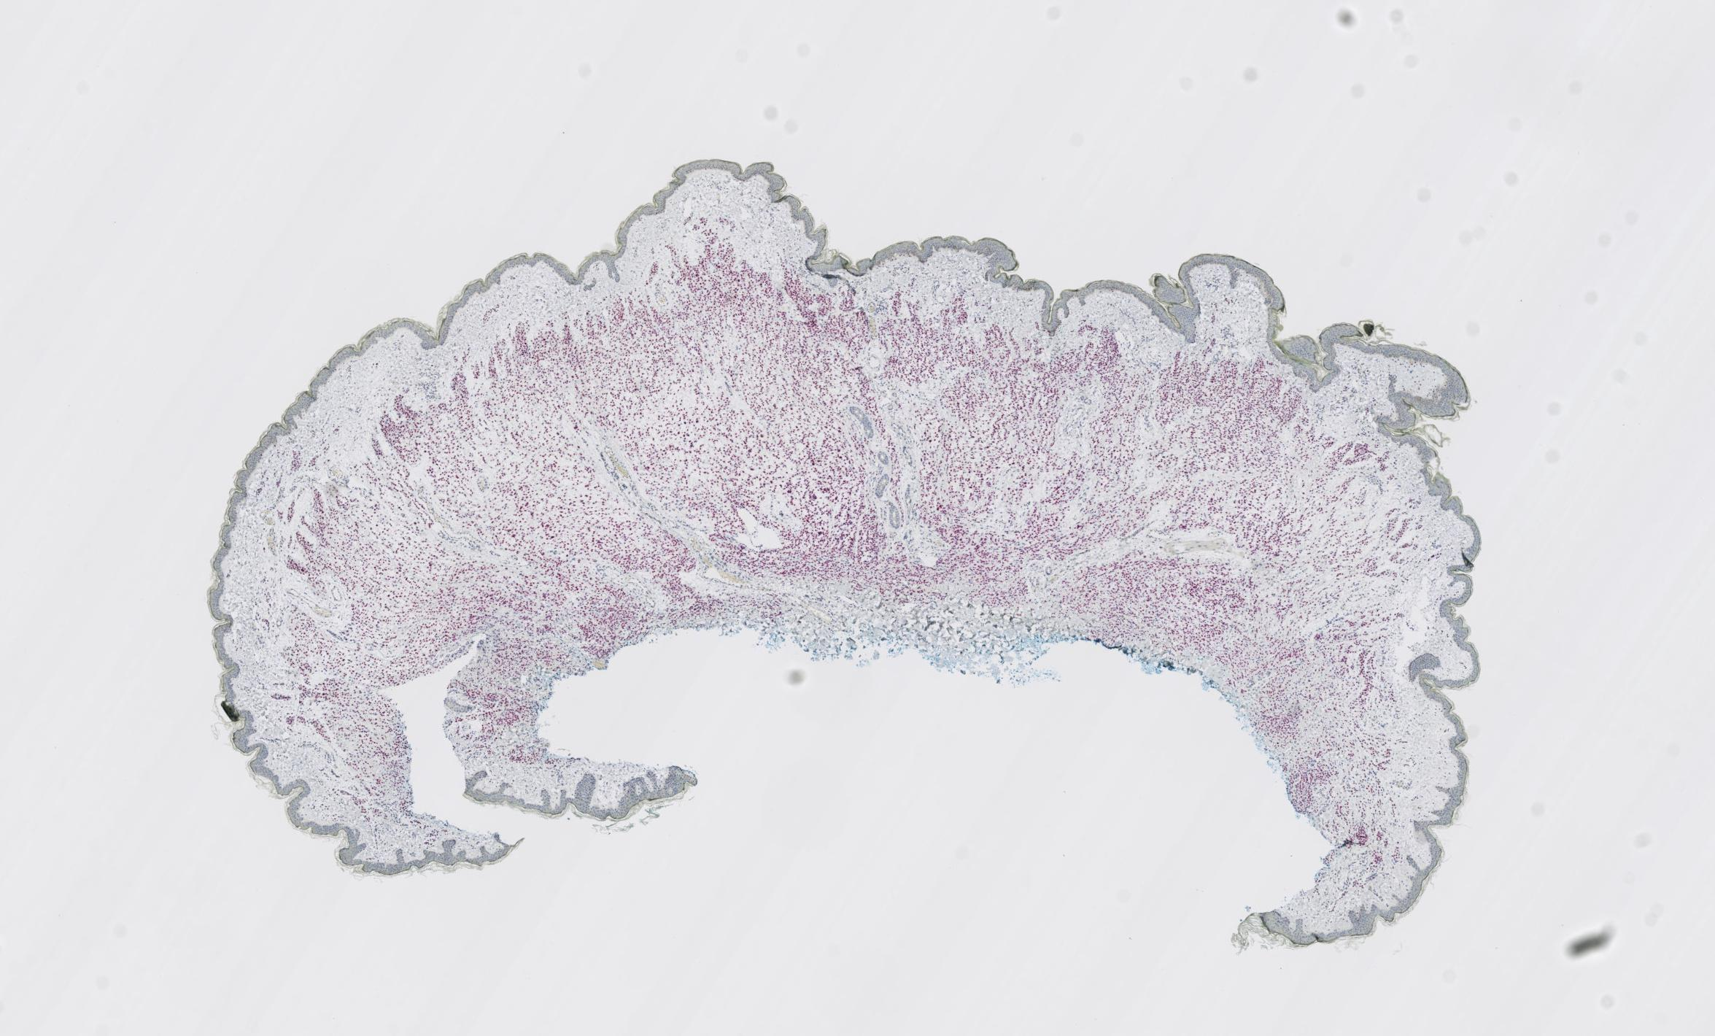
Dataset
Our dataset consists of skin tissues of 15 cases from a private dermatopathology lab, including 3 cases for each MPATH diagnostic category¹ [8].
We stain each glass slide with H&E first, then de-stain and re-stain the same glass slide in Sox10.
Each skin tissue is cut into multiple (4-6) thin slices for microscopic examination, resulting in 75 slices at 20x magnification.
¹ Class 1-5: Benign mildly atypical nevi, Moderate dysplastic nevi, Melanoma in situ, Invasive melanoma T1a, and Invasive melanoma T1b.

Slide 21
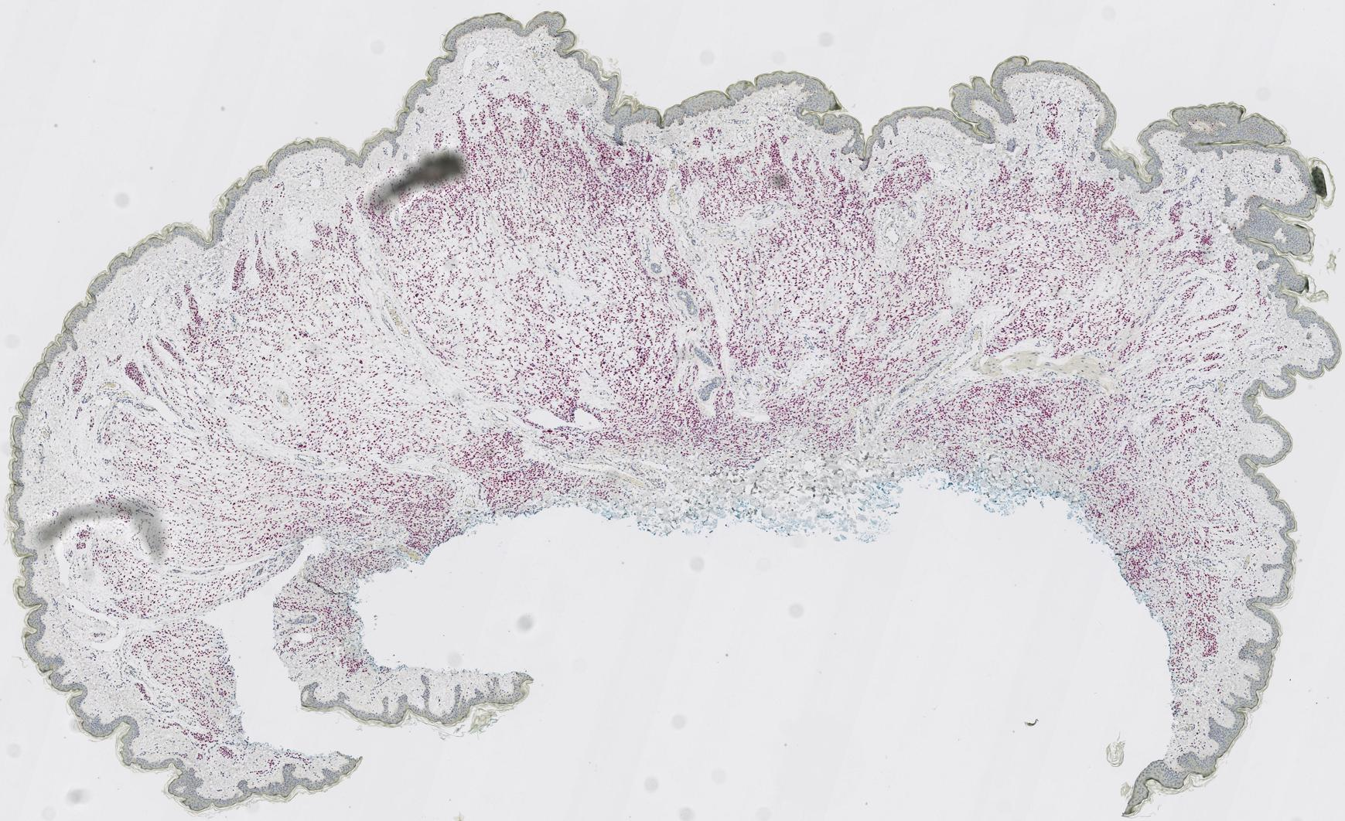
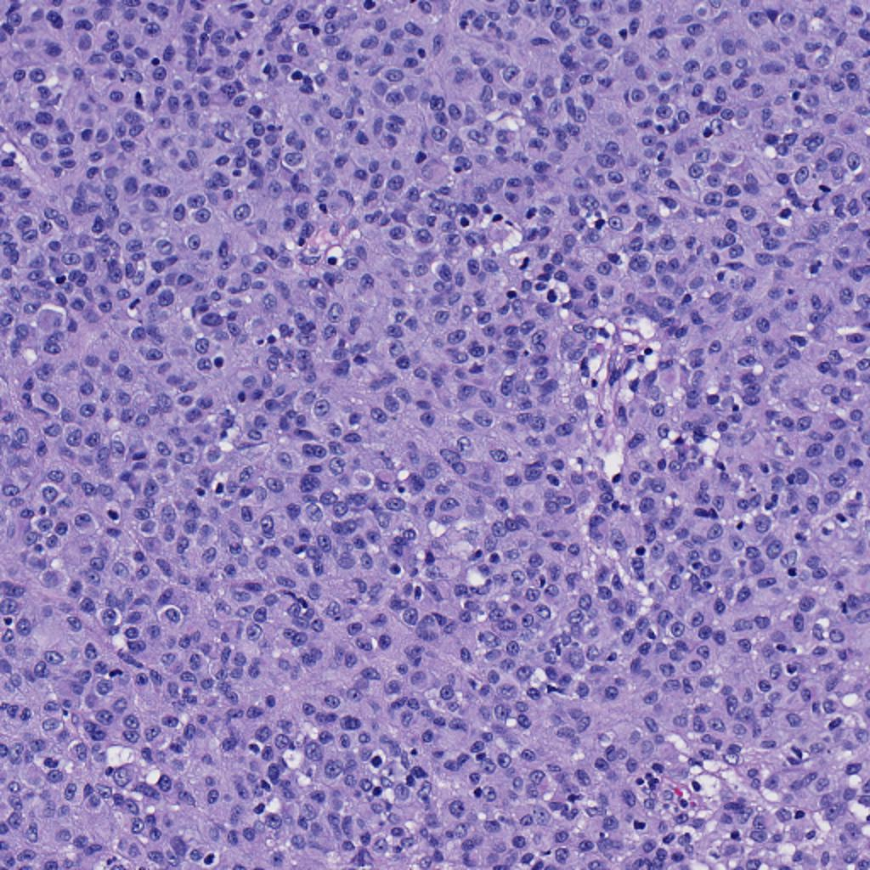
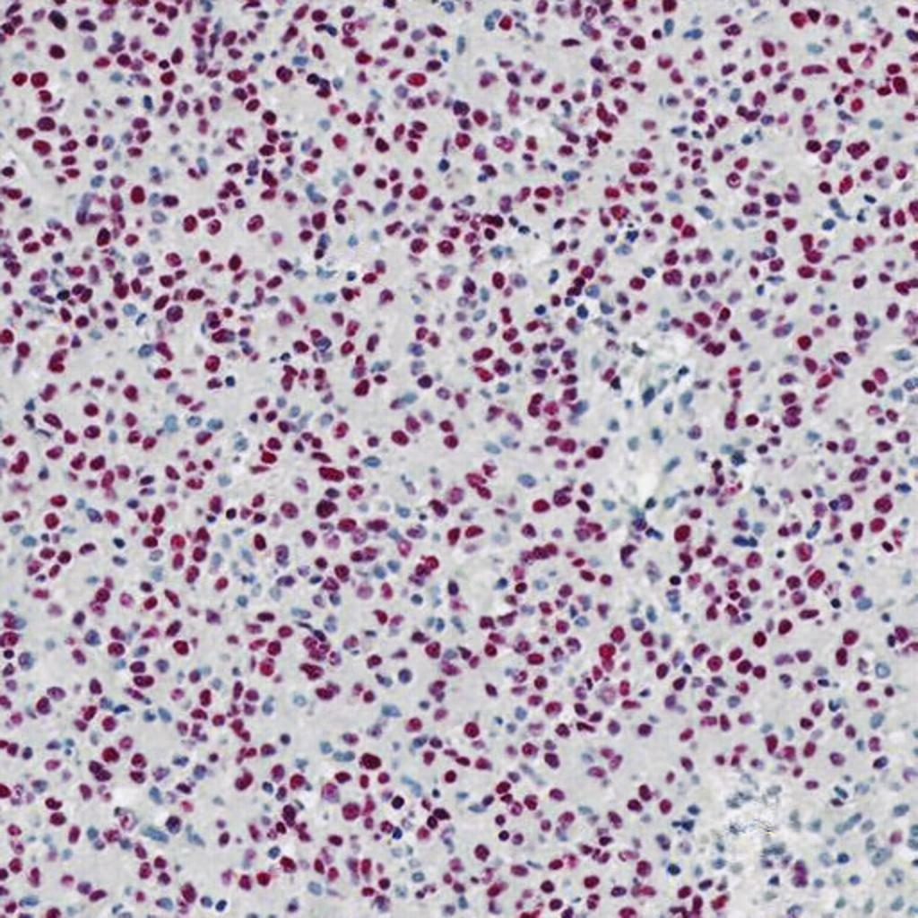
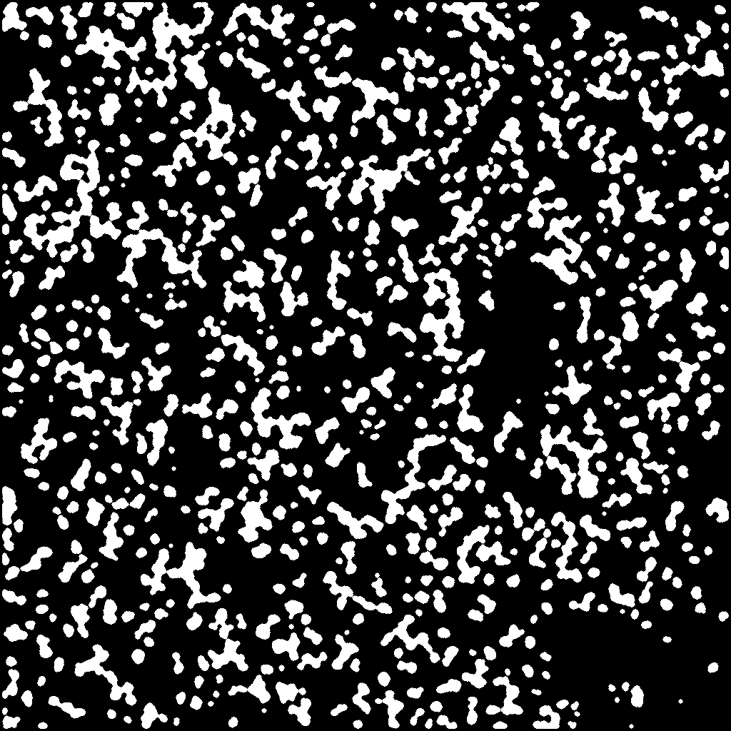
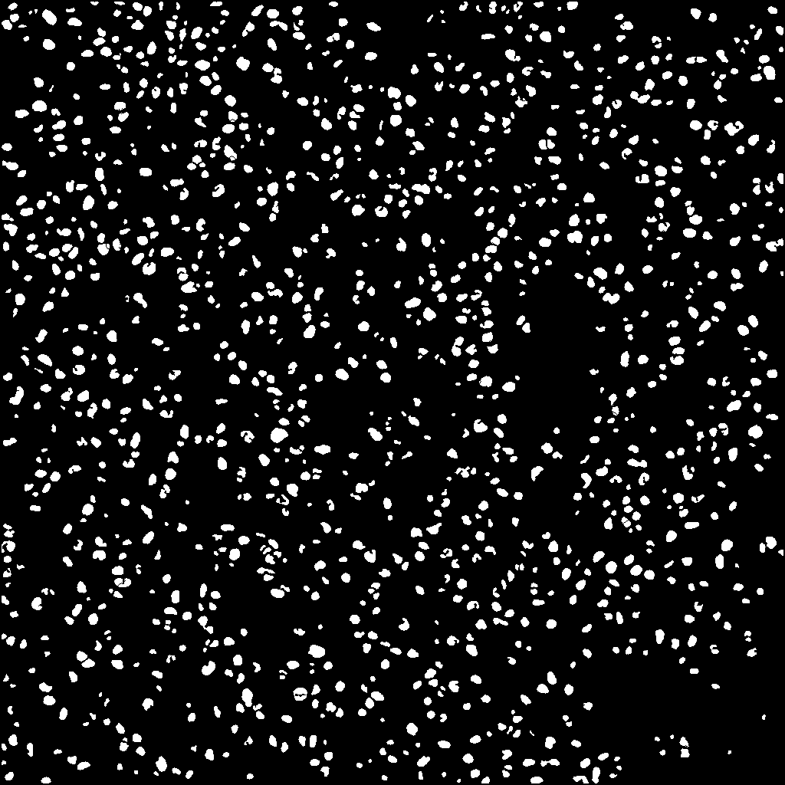
Dataset - Preprocessing
1
(a) Raw H&E stained image
(b) Raw Sox10 stained image
(c) Registered Sox10 stained image
2
3
(d) H&E patch
(e) Sox10 patch
(f) Rough mask
(g) Refined mask
Preprocessing steps:
First, we register raw Sox10 images (b) into aligned Sox10 images (c) using template H&E images (a) with the Histokat software [9].
Then, we apply a Random Forest classifier to classify pixels into melanocyte or non-melanocyte.
At last, the pretrained NuSeT [10] separates touching nuclei and refine the masks.

Slide 22
Dataset
To fit images into memory as well as keep adequate information, we crop the registered paired images into 256x256 patches with 10x magnification and exclude the background patches, leaving 25,314 patches to use.
Sub-dataset | From ? cases | # Patches
Train | 10 cases | 14,630
Validation |  | 1,032
Test | 5 cases | 9,652

Slide 23
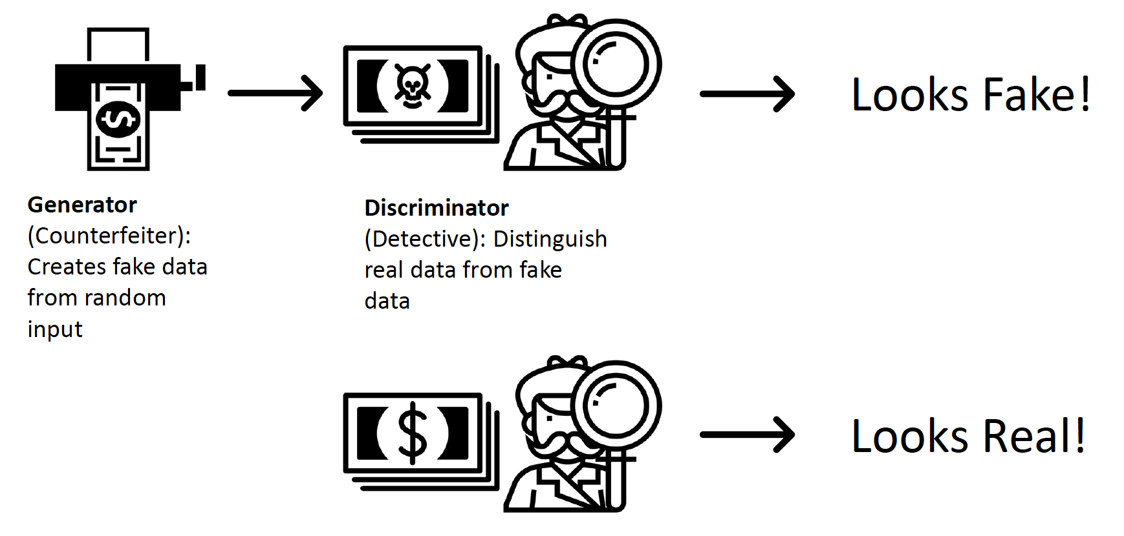
Intro to GAN

Slide 24
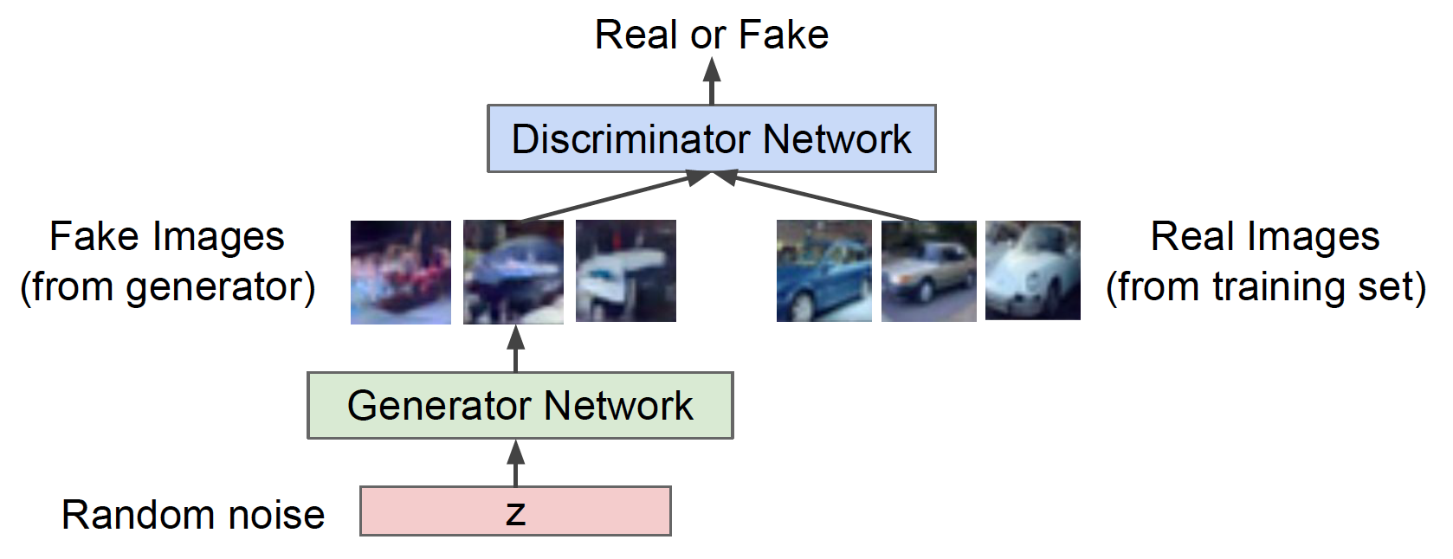
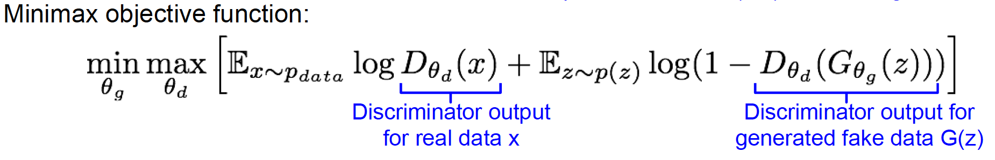
Intro to GAN

Slide 25
VSGD-Net
U-Net [2] with ResNet50
Inspired by Mask R-CNN [3]
Multi-scale discriminator

Slide 26
Attention module
Channel attention and spatial attention are consecutively computed to refine the features[12].

Slide 27
VSGD-Net
Features input to the detection branch?
  We assume decoder layers have higher correlation with the Sox10 than encoder layers.
  The ablation study validates this design.
Decoder features

Slide 28
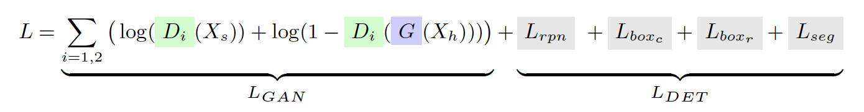
VSGD-Net

Slide 29

Evaluation Metrics
Precision = TP / (TP + FP)
Recall = TP / (TP + FN)
F1-score = $2×\frac{\text{(}\text{Precision} × \text{Recall}\text{)}}{\text{Precision}\text{ + }\text{Recall}}$
Jaccard Index = TP / (TP + FN + FP)

Slide 30
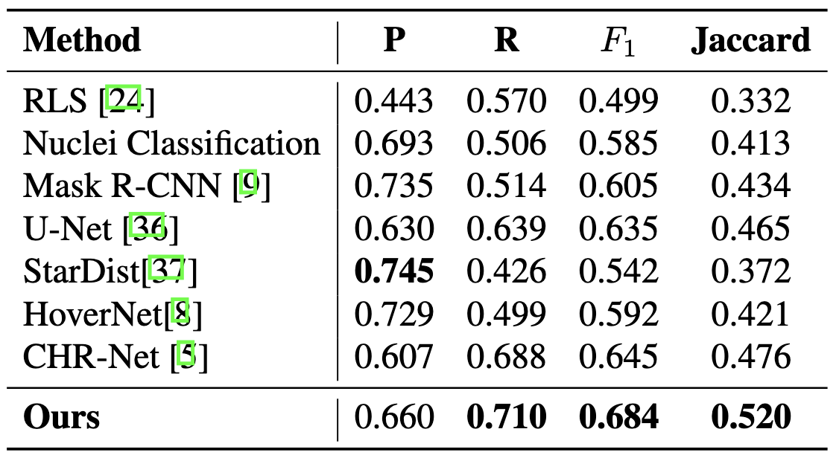
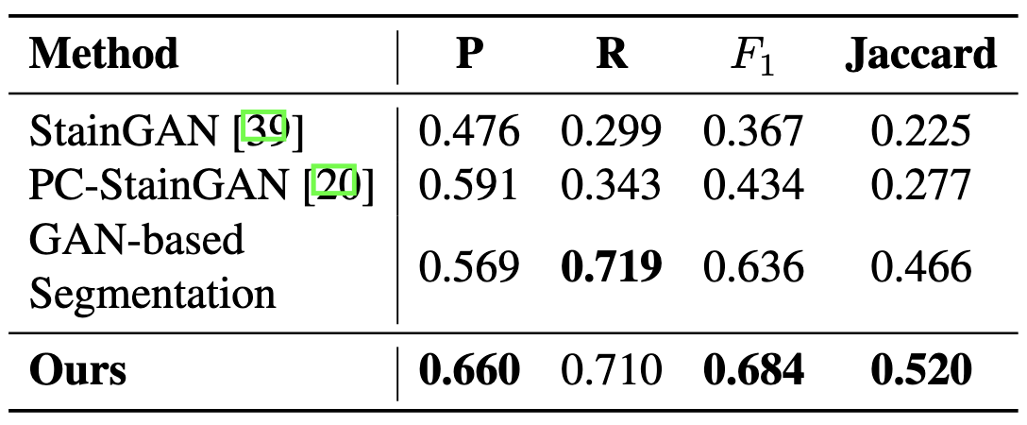
Melanocyte Detection Results
Comparison with nuclei detection methods
Comparison with GAN-based methods

Slide 31
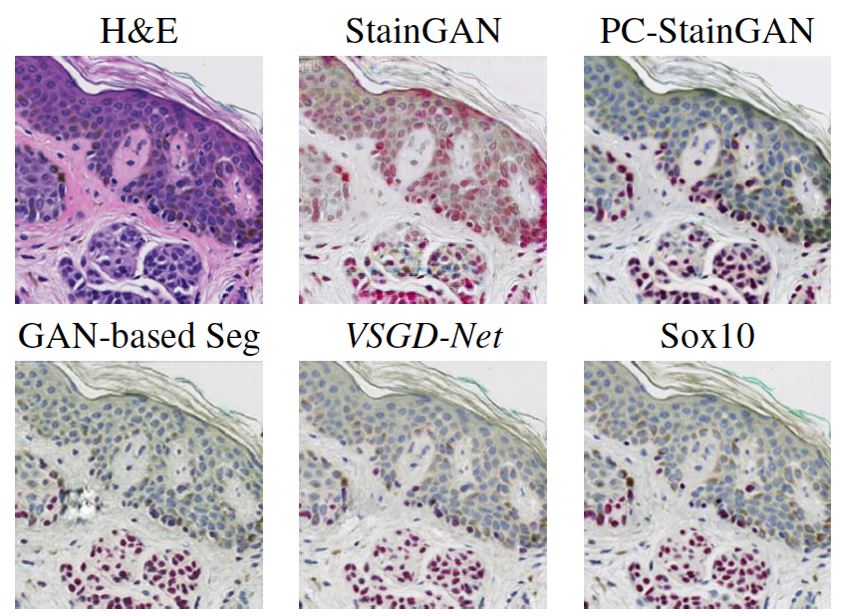
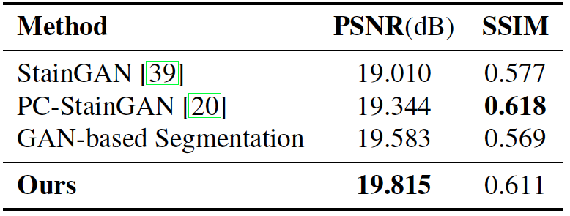
Image Synthesis Evaluation

Slide 32
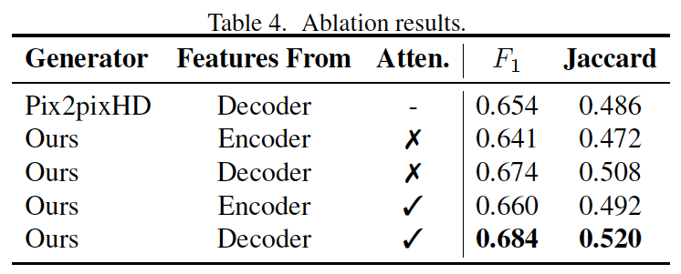
Ablation Study
Our VSGD-Net learning scheme can achieve comparable results even with the simpler generator.
Decoder layers have higher correlation with the Sox10 than encoder layers.
The attention module refines the intermediate features.

Slide 33
Conclusion
We propose a novel instance detection scheme that investigate the detection task using image synthesis features between two stainings.
During inference, the model can produce promising results from only the routine staining.
We anticipate that the proposed method can adapt to a broad category of diseases.

Slide 34
References
Lu, C., Mahmood, M., Jha, N., Mandal, M.: Detection of melanocytes in skin histopathological images using radial line scanning. Pattern Recognition 46(2), 509–518 (Feb 2013)
Ronneberger, O., Fischer, P., Brox, T.: U-Net: Convolutional Networks for Biomedical Image Segmentation. arXiv:1505.04597 [cs] (May 2015), arXiv: 1505.04597
He, K., Gkioxari, G., Doll ar, P., Girshick, R.: Mask R-CNN. arXiv:1703.06870 [cs] (Mar 2017)
Graham, S., Vu, Q.D., Raza, S.E.A., Azam, A., Tsang, Y.W., Kwak, J.T., Rajpoot, N.: Hover-net: Simultaneous segmentation and classification of nuclei in multitissue histology images. Medical Image Analysis 58, 101563 (2019)
Schmidt, U., Weigert, M., Broaddus, C., Myers, G.: Cell detection with starconvex polygons. In: International Conference on Medical Image Computing and Computer-Assisted Intervention. pp. 265–273. Springer (2018)
Gao, Z., Shi, J., Zhang, X., Li, Y., Zhang, H., Wu, J., Wang, C., Meng, D., Li, C.: Nuclei Grading of Clear Cell Renal Cell Carcinoma in Histopathological Image by Composite High-Resolution Network. In: de Bruijne, M., Cattin, P.C., Cotin, S., Padoy, N., Speidel, S., Zheng, Y., Essert, C. (eds.) Medical Image Computing and Computer Assisted Intervention – MICCAI 2021
Zhao, J., Li, D., Kassam, Z., Howey, J., Chong, J., Chen, B., Li, S.: Tripartite-GAN: Synthesizing liver contrast-enhanced MRI to improve tumor detection. Medical Image Analysis 63, 101667 (Jul 2020)
Piepkorn, M.W., Barnhill, R.L., Elder, D.E., Knezevich, S.R., Carney, P.A., Reisch, L.M., Elmore, J.G.: The mpath-dx reporting schema for melanocytic proliferations and melanoma. Journal of the American Academy of Dermatology 70(1) (2014)

Slide 35
References
Lotz, J., Weiss, N., van der Laak, J., StefanHeldmann: High-resolution Image Registration of Consecutive and Re-stained Sections in Histopathology. arXiv:2106.13150 [cs, eess] (Jun 2021)
Yang, L., Ghosh, R.P., Franklin, J.M., Chen, S., You, C., Narayan, R.R., Melcher, M.L., Liphardt, J.T.: NuSeT: A deep learning tool for reliably separating and analyzing crowded cells. PLOS Computational Biology 16(9), e1008193 (Sep 2020), publisher: Public Library of Science
Mehta, S., Rastegari, M., Shapiro, L., Hajishirzi, H.: ESPNetv2: A Light-Weight, Power Efficient, and General Purpose Convolutional Neural Network. In: 2019 IEEE/CVF Conference on Computer Vision and Pattern Recognition (CVPR). pp. 9182–9192. IEEE, Long Beach, CA, USA (Jun 2019)
Woo, Sanghyun, et al. "Cbam: Convolutional block attention module." Proceedings of the European conference on computer vision (ECCV). 2018.

Slide 36
Thanks!

