Slide 1
Pathologists' viewing behaviors contribute to diagnostic accuracy of melanocytic skin lesions
Fatemeh Ghezloo
February 28, 2022

Slide 2
Outline
Introduction
Material and Methods
Results
Application
Conclusions

Slide 3
Outline
Outline
Introduction
Material and Methods
Results
Application
Conclusions

Slide 4
Skin cancer is the most commonly diagnosed cancer in the United States!
1 in 5 Americans will develop skin cancer by the age of 70.¹
More than 2 people die of skin cancer in the U.S. every hour.¹
1. https://www.skincancer.org/skin-cancer-information/skin-cancer-facts/

Slide 5
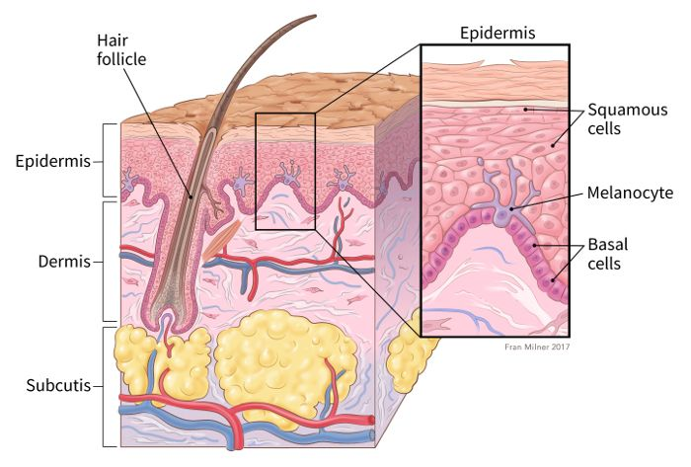
Where do skin cancers start?
Skin structure¹
Skin cancer types²
1. https://www.cancer.org/cancer/melanoma-skin-cancer/about/what-is-melanoma.html
2. https://smart.servier.com

Slide 6
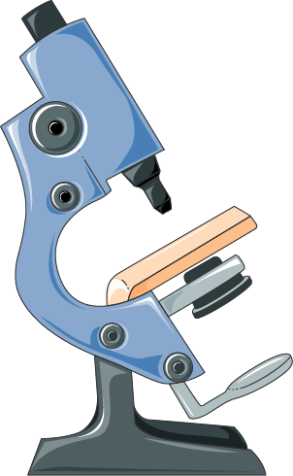
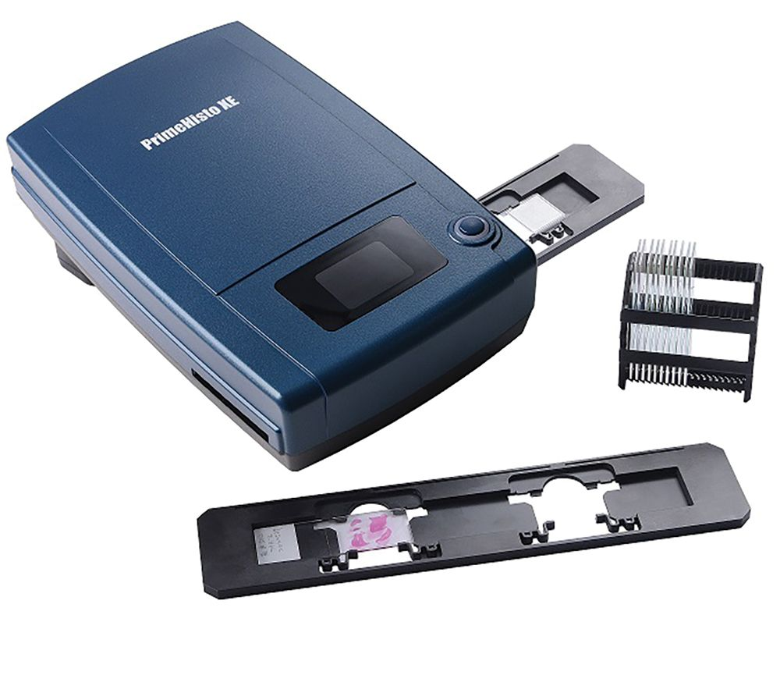
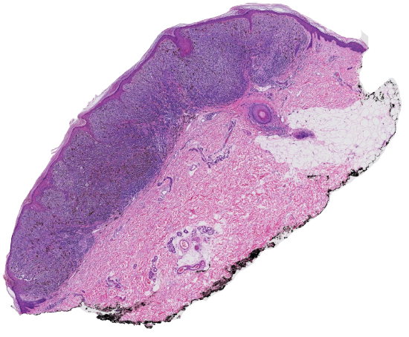
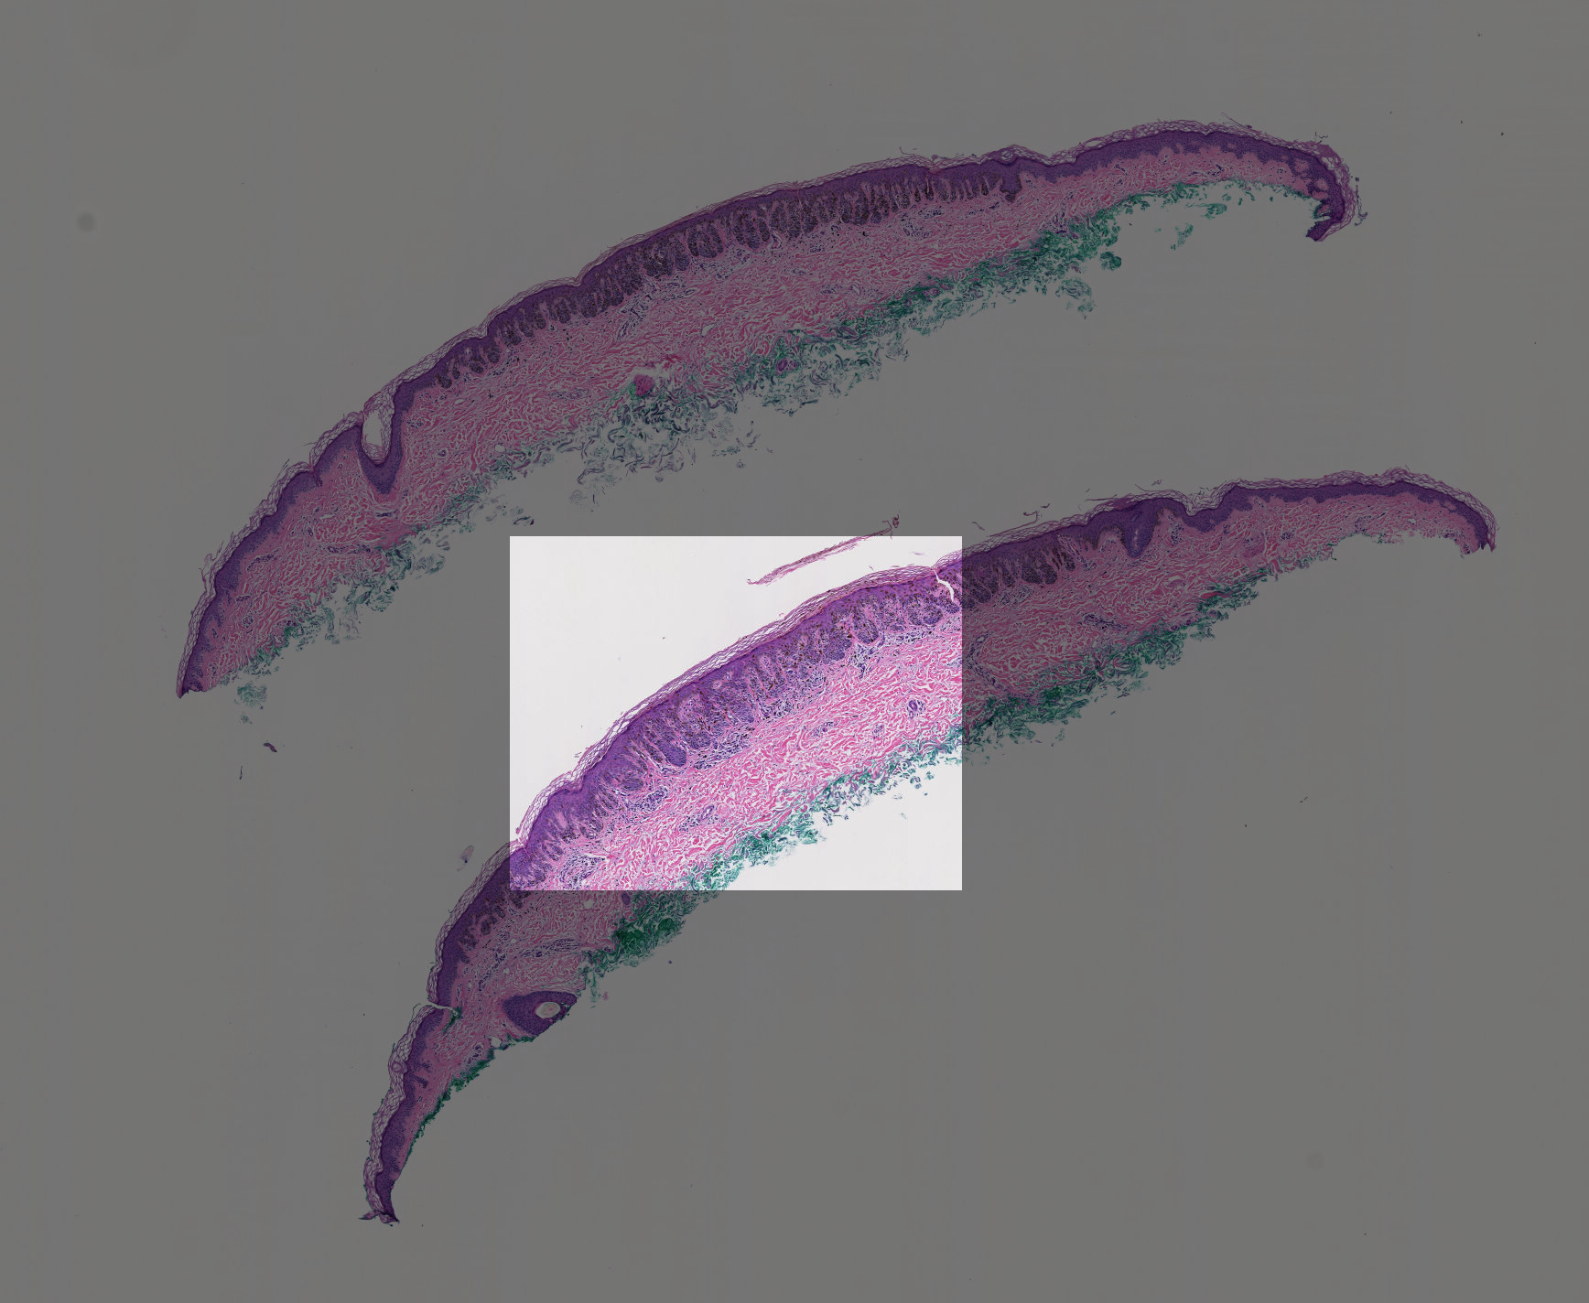
Melanoma diagnosis: Traditional Microscopy to Whole Slide Imaging
Region of Interest (ROI)
Whole Slide Imaging
Traditional Microscopy

Slide 7
Boyce, B., An update on the validation of whole slide imaging systems following FDA approval of a system for a routine pathology diagnostic service in the United States. Biotechnic & Histochemistry,2017.

Slide 8
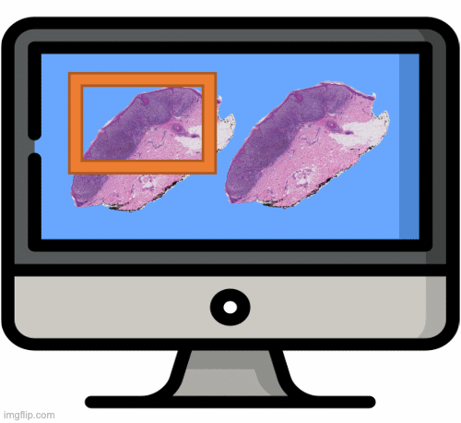
Pathologists’ Viewing behavior: Why is it important?
Pathological examination
More cases are being interpreted in digital format
Computer-based technologies are being developed for diagnosis
Digital pathology and Whole Slide Imaging
However,
There is discordance among pathologists' diagnoses even when they observe similar features on a biopsy sample slide.
Errors made in cancer diagnosis are one of the main reasons that cause death.
Diagnostic accuracy varies due to the interaction among
Case characteristics
Pathologist characteristics
Visual search process¹
Brunyé, T.T., et al., Accuracy is in the eyes of the pathologist: the visual interpretive process and diagnostic accuracy
with digital whole slide images. Journal of biomedical informatics, 2017. 66: p. 171-179.

Slide 9
Pathologists’ Viewing behavior:
Study workflow
Eye fixation
Saccade
Timestamp
Zoom level
Mouse click
Screen viewport
Tracking Devices
Interpretation session
Data Analysis

Slide 10
Study Goals
We outline the types of data points that can be gathered to describe pathologists’ viewing behavior using viewport data
How do specific viewing behaviors contribute to diagnostic accuracy?
How are pathologists’ characteristics associated with specific viewing patterns?

Slide 11
Outline
Outline
Introduction
Material and Methods
Results
Application
Conclusions

Slide 12
M-PATH data
1
2
3
4
5
Class |  | Count
Class 1 | ﻿Nevus | 15
Class 2 | ﻿Moderate atypia | 30
class 3 | ﻿Melanoma in situ | 45
Class 4 | ﻿Stage pT1a invasive melanoma | 45
Class 5 | ﻿Stage pT1b invasive melanoma | 45

Slide 13
Data collection
Digital skin biopsy images
3 Experts in dermatopathology
Consensus ROI and diagnosis
Viewport log
32 Pathologists
180 Cases
Divided into 5 groups of 36
Interpretation
Survey
Diagnosis

Slide 14
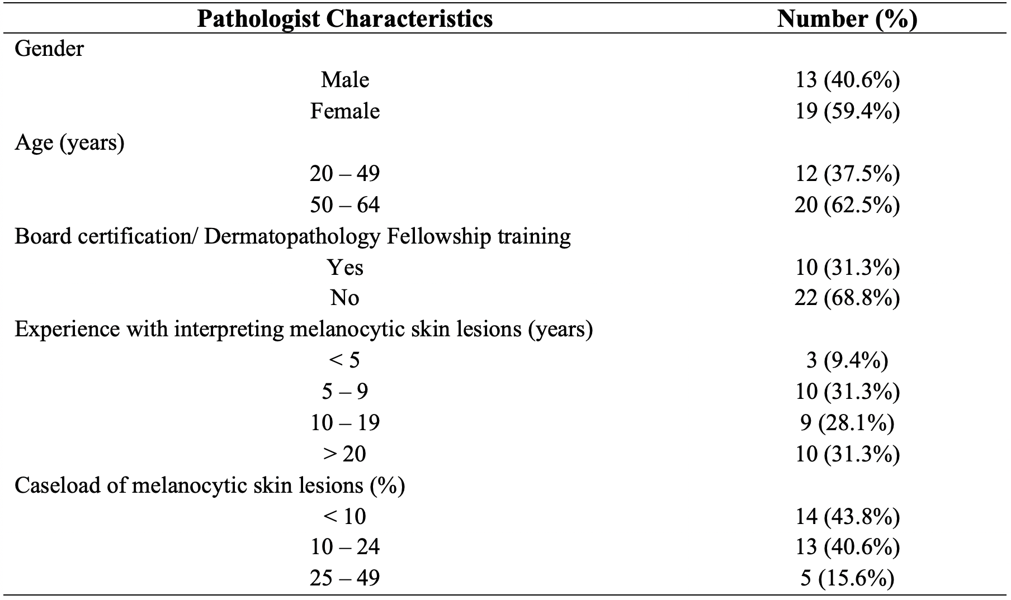
Pathologists’ characteristics

Slide 15
Viewport data
ID X Y Width Height Zoom Time
1 4 6 50 100 2 1:20:30
2 20 6 50 100 2 1:20:33
3 20 13 50 100 2 1:20:34
4 23 15 30 80 4 1:20:38
5 23 4 25 70 5 1:21:10
6 40 4 25 70 5 1:21:50
7 44 4 25 70 5 1:22:30
8 5 10 60 110 2 1:23:40
9 5 11 60 110 2 1:24:10
10 5 12 60 110 2 1:24:56

Slide 16
Viewing behaviors
Total interpretation time Duration of Interpretation
Average zoom level Average of zoom levels used during an interpretation
Maximum zoom level Maximum of zoom levels used during an interpretation
Zoom level variance Variance of zoom levels used during an interpretation
Magnification Percentage of viewports associated with consecutive zooming in
ROI time Percentage Percentage of time spent viewing consensus ROI to the total time
Scanning Percentage Percentage of viewports associated with fixed zoom level and panning

Slide 17
Statistical analysis
Crossed-level structure of cases and pathologists
Both case and pathologist contribute to the variation of the outcome
Cross-classified multilevel model¹
$$y_{i} = β_{0} + β_{1}x_{i}+ u_{pathologist(i)}+ u_{case(i)}+ e_{i}$$
1. Browne, W.J., H. Goldstein, and J. Rasbash, Multiple membership multiple classification (MMMC) models. Statistical Modelling, 2001. 1(2): p. 103-124.

Slide 18
Outline
Outline
Introduction
Material and Methods
Results
Application
Conclusions

Slide 19
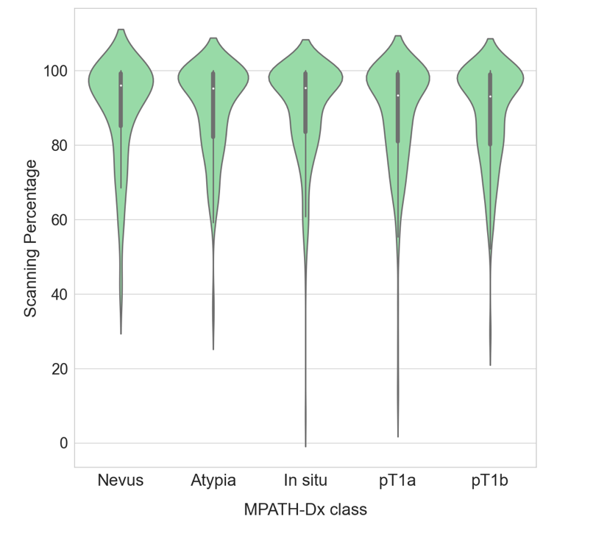
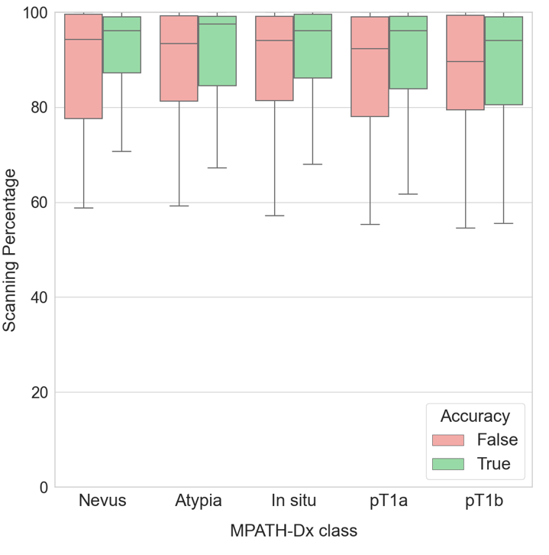
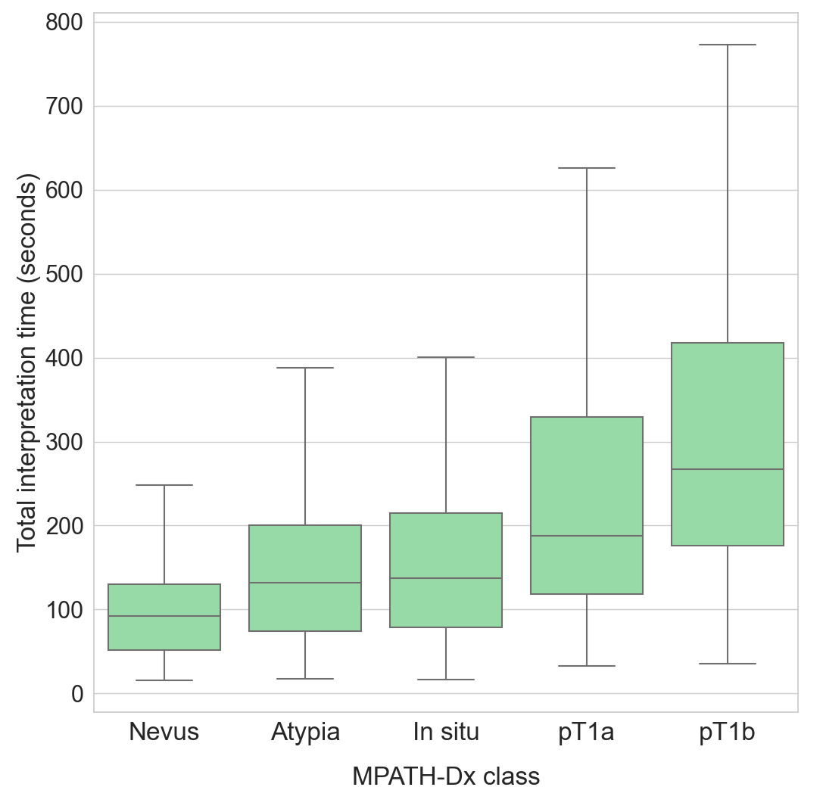
Viewing behaviors visualization

Slide 20
Statistical analysis:
Diagnostic accuracy
How do specific viewing behaviors contribute to diagnostic accuracy?
Diagnostic accuracy is the agreement of a pathologist's diagnosis with the consensus diagnosis
Separate models with each viewing behavior as the predictor variable
Diagnostic accuracy is the outcome
All models are adjusted for pathologists’ experience level and fellowship training
P-value < 0.05
OR > 1
P-value < 0.05
OR < 1
0.05 < P-value < 0.1
OR > 1

Slide 21
Statistical analysis:
Diagnostic accuracy - Multivariate model
Viewing Behaviors
PCA
Diagnostic accuracy is the outcome
Model is adjusted for pathologists’ experience level and fellowship training

Slide 22
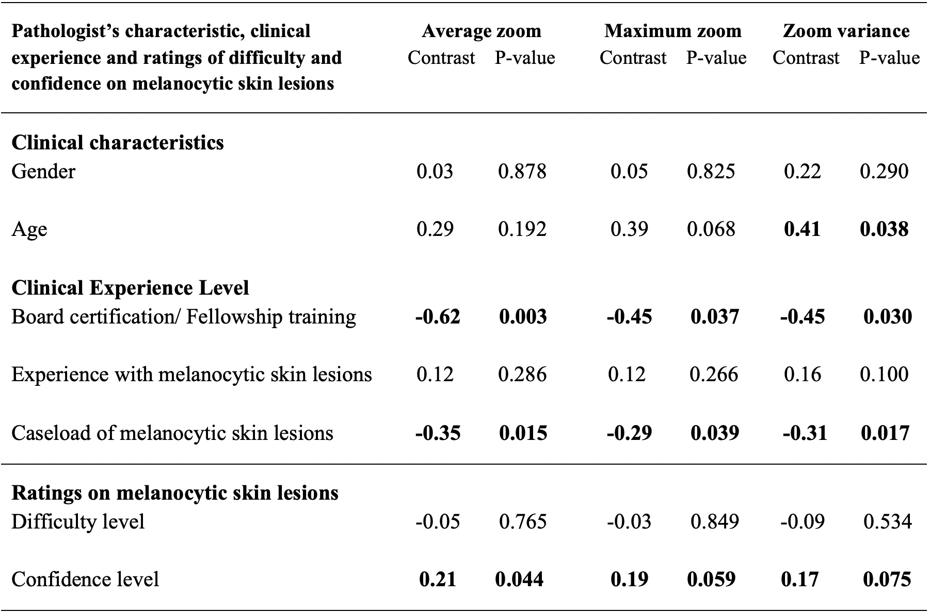
Statistical analysis:
Pathologists’ characteristics
How are pathologists’ characteristics associated with specific viewing patterns?
Separate models with each characteristic as the predictor variable
Pathologists’ viewing behaviors as the outcome

Slide 23
Discussion
How do specific viewing behaviors and search patterns contribute to diagnostic accuracy?
How are pathologists’ characteristics associated with specific viewing patterns?
How do viewing patterns change as pathologists gain more expertise in diagnosing melanocytic lesions?
More total time, zoom variables, and ROI time, and scanning percentage
Less magnification
Higher accuracy
Higher age category
Lower confidence level
Higher zoom variance
Higher average zoom, maximum zoom, and zoom variance
Having Board certification and/or fellowship training
Higher caseload of melanocytic skin lesions
Lower average zoom, maximum zoom, and zoom variance

Slide 24
Outline
Outline
Introduction
Material and Methods
Results
Application
Conclusions

Slide 25
ROI localization¹
Problem: Predicting and Localizing diagnostically relevant Regions of Interest (ROIs)
1
2
3
Extracting viewing ROIs
Bag of Words
Visual model
Binary classification
WSI
To
Image patches
Feature Extraction from each patch
Clustering patches
Using K-means
Mercan, Ezgi, et al. "Localization of diagnostically relevant regions of interest in whole slide images." 2014 22nd International Conference on Pattern Recognition. IEEE, 2014.

Slide 26
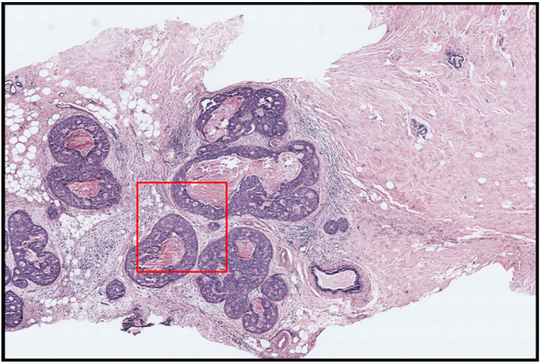
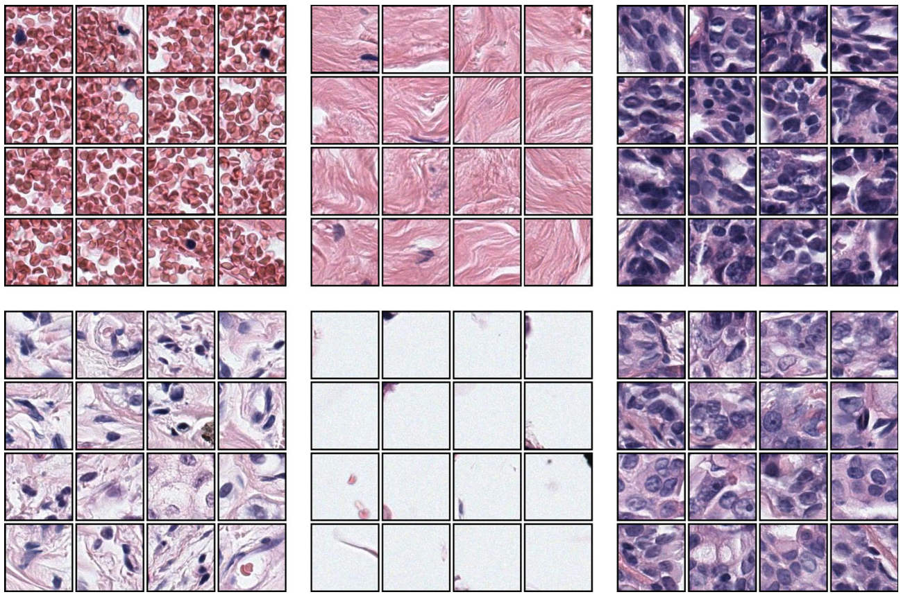
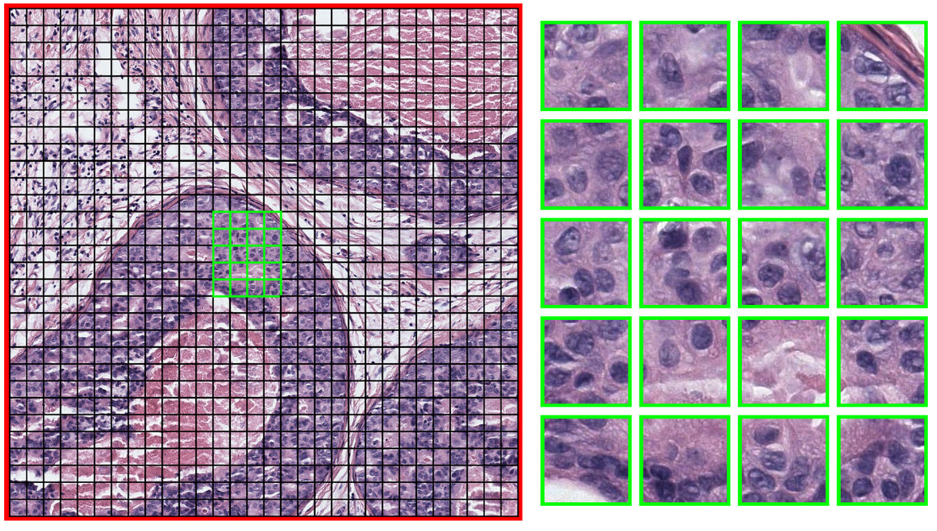
1
2
3
ROI localization Bag of Words
Extracting viewing ROIs
Bag of Words
Visual model
Binary classification
WSI
To
Image patches
Feature Extraction from each patch
Clustering patches
Using K-means
Whole slide image with a red Sliding window (3600 x 3600)
Clusters of Patches
L*a*b color and LBP texture histograms
Image Patches (120 * 120)

Slide 27
1
2
3
ROI localization
Training classifier
Extracting viewing ROIs
Bag of Words
Visual model
Binary classification
WSI
To
Image patches
Feature Extraction from each patch
Clustering patches
Using K-means
Binary classification (relevant vs non-relevant)
Logistic regression
SVM
Non-Relevant
Train the classifier
Relevant
Whole slide image with ROI selected by expert pathologists marked in red

Slide 28
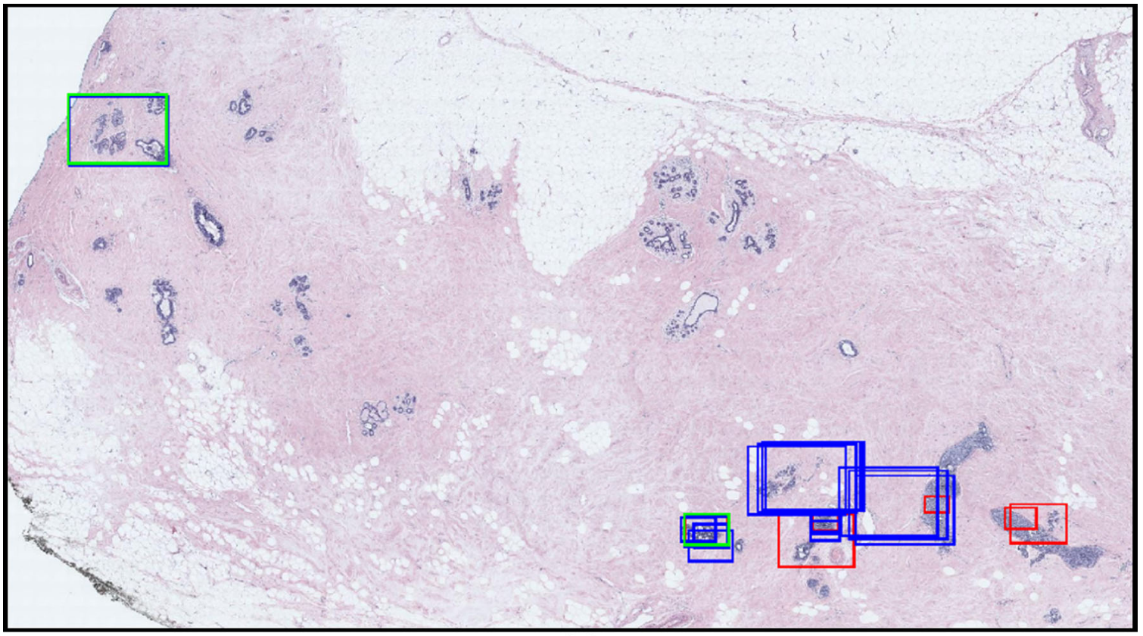
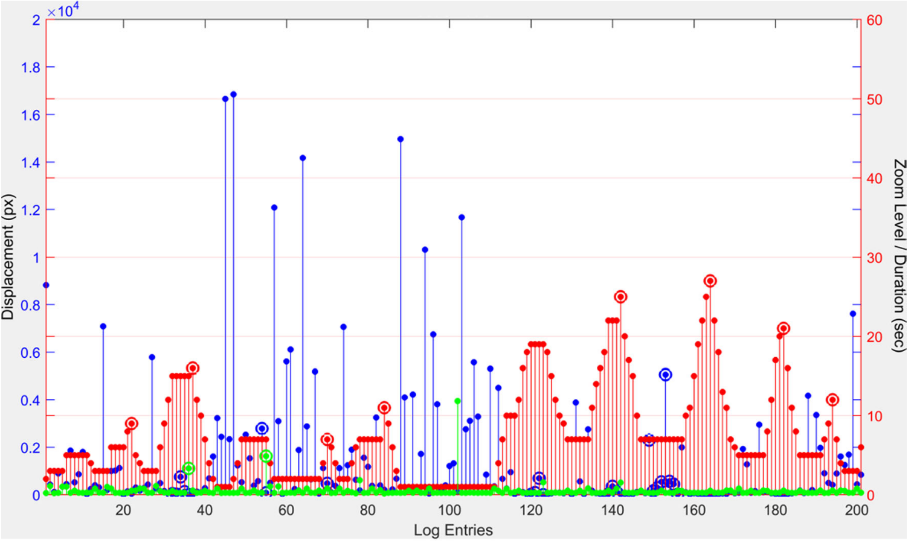
1
2
3
ROI localization Extracting Viewing ROIs
Extracting viewing ROIs
Bag of Words
Visual model
Binary classification
WSI
To
Image patches
Feature Extraction from each patch
Clustering patches
Using K-means
Use the viewing data from pathologists to extract regions
Use these regions as ground truth for testing the classifier
Zoom peaks are the log entries where the zoom level is higher than the previous and the next entries. A zoom peak identifies a region where the pathologist intentionally zoomed to look at a higher magnification.
Slow pannings are the log entries where the zoom level is the same as the previous entry, and the displacement is small. Slow pannings are intended for investigating a slightly larger and closer area without completely moving the viewport.
Fixations are the log entries where the duration is longer than 2 seconds. Fixations identify the areas to which a pathologist focused extra attention by looking at them longer.

Slide 29
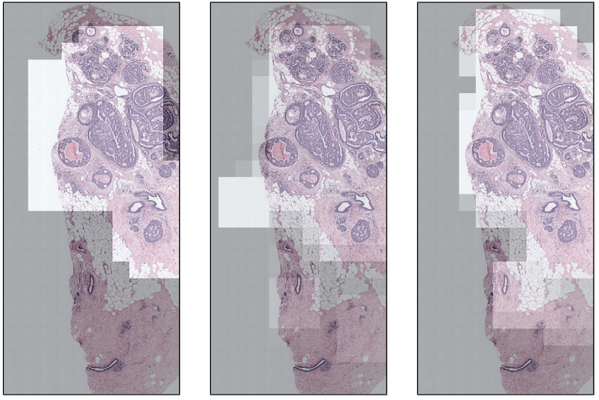
ROI localization - Results
Ground Truth Viewing ROIs
Logistic Regression
SVM

Slide 30
Outline
Outline
Introduction
Material and Methods
Results
Application
Conclusions

Slide 31
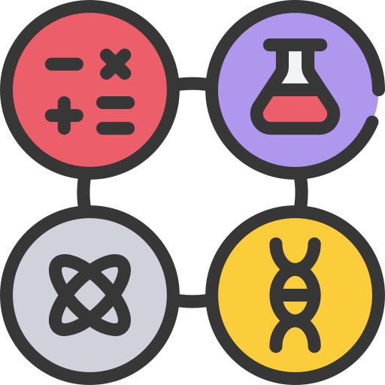
Limitations
High quality digital slide preparation is costly.
Ethical issues must be resolved when sharing patient information across larger platforms.
Experimental sample sizes in pathology studies are often small.
A thorough understanding of a variety of statistical principles is required.
Access to a multidisciplinary team of professionals, including statisticians and pathologists.

Slide 32
Conclusions
Diagnosis of pathology slides is a complex task and requires years of training
It is essential to study pathologists’ viewing behaviors
Digital pathology has made it possible to record and study these viewing behaviors
We showed various ways of quantifying these behaviors
We investigated the association of these viewing behaviors with accuracy
The results of such behavioral studies can be beneficial in various areas
Improving the training and education of younger pathologists
Determining the reasons for diagnostic errors
Assisting with the development of computer-aided tools for diagnosis purposes

Slide 33
All icons taken from https://www.flaticon.com/

