Slide 1
Convolutional Neural Networks for Computer Vision
Sachin Mehta

Slide 2
Outline
Brief overview of convolutions
  Parameters
  # of operations
  Receptive Field
  Efficient convolutions
Different Convolutional Units
Semantic Segmentation
Some visualizations

Slide 3
Convolutions

Slide 4












Convolution
$$24$$
$$12$$
$$∗$$
$$H$$
$$H$$
$$W$$
$$W$$
Output
Input
$$12$$
$$3$$
$$3$$
$$24$$
Convolutional Kernel

Slide 5
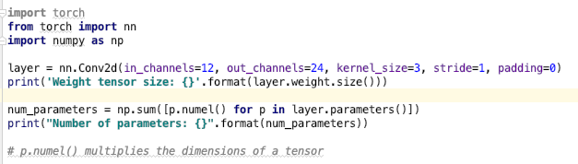


How many parameters did we learn?
Number of parameters:
  $$in_{channels}∗out_{channels}∗kernelHeight∗kernelWidth$$
For our example, we learned 12*24*3*3 = 2,616

Slide 6




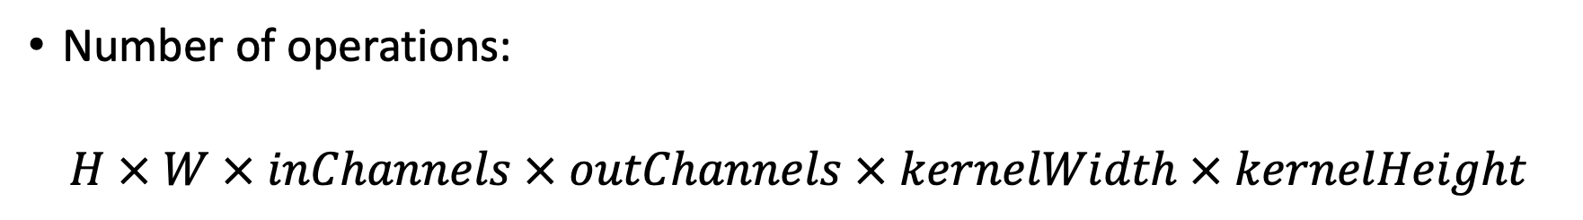


How many operations did we perform?
Number of operations:
$$H × W × inChannels × outChannels × kernelWidth × kernelHeight$$
$$24$$
$$12$$
$$∗$$
$$H$$
$$H$$
$$W$$
$$W$$
Output
Input
$$12$$
$$3$$
$$3$$
$$24$$
Convolutional Kernel

Slide 7
How can we reduce convolutional operations?
Apply convolution per channel
Standard Convolution

Slide 8










How can we reduce convolutional operations?
Apply convolution per channel
Standard Convolution
$$12$$
$$=$$
$$12$$
$$∗$$
$$n$$
Depth-wise Convolution
$$H$$
$$n$$
$$H$$
$$W$$
$$12$$
$$W$$
Input
Convolutional Kernel
Output

Slide 9
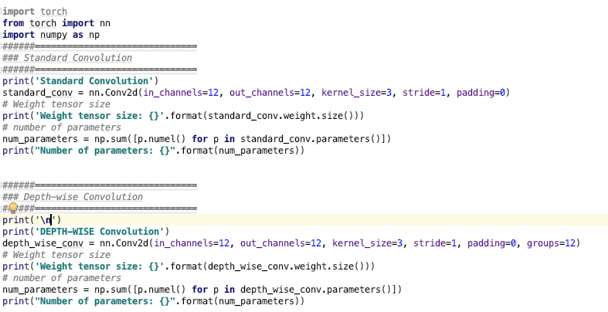


Standard vs Depth-wise convolution in PyTorch
Note the change in the size of weight tensor

Slide 10
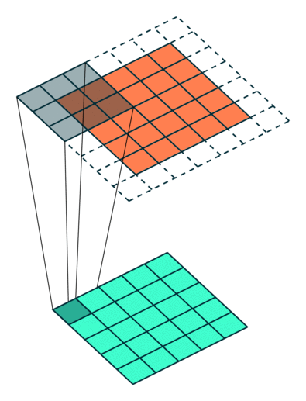
Receptive Field
Region in the input that particular convolutional kernel is looking at to produce an output

Slide 11
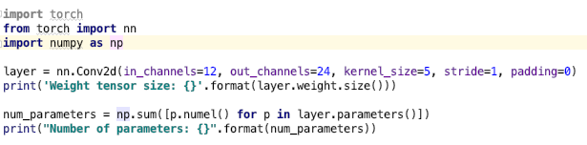
Receptive Field
Receptive field of the convolutional layer is: ??????
Notes:
5x5

Slide 12
How can we increase the receptive field without increasing parameters?
Dilated convolution:
  Insert zeros between kernel elements to increase the receptive field
Standard convolution
Kernel size: 3x3
Receptive field: 3x3
Weights: 9
Dilated convolution
Kernel size: 3x3
Receptive field: 5x5
Weights: 9

Slide 13
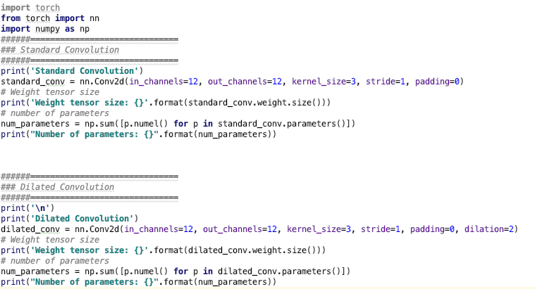


Standard vs Dilated convolutions in PyTorch
Note there is no change in the tensor size.
Zeros are added (input elements are skipped) during actual computation.
This is done for efficiency.

Slide 14
Convolution Blocks

Slide 15
CNN Structure
A typical image classification network is a stack of convolutional and pooling layers
Instead of using a single convolution layer, you can use a convolutional block
Image source: https://www.learnopencv.com/image-classification-using-convolutional-neural-networks-in-keras/

Slide 16
Convolutional block: VGG
Convolutional Layer
VGG block usually comprises of a stack of 2 or 3 convolutional layers
Convolutional Layer
VGG Block
Simonyan, Karen, and Andrew Zisserman. "Very deep convolutional networks for large-scale image recognition.”ICLR (2015).

Slide 17
Convolutional block: VGG
Convolutional Layer
VGG block usually comprises of a stack of 2 or 3 convolutional layers
Stacking increases effective receptive field while learning fewer parameters
Convolutional Layer
This pixel has information from 5x5 input region
VGG Block

Slide 18
Convolutional Block: Inception
Instead of stacking, this block process multiple convolutional layers in parallel.
Convolutional Layer
Convolutional Layer
Convolutional Layer
Concatenate
Inception Block
Szegedy, et al. "Going deeper with convolutions." CVPR 2015. (ImageNet challenge Winner, 2014)
Szegedy et al. "Rethinking the inception architecture for computer vision”, CVPR 2016.

Slide 19
Convolutional Block: ResNet
Same as the VGG block, but adds input and output
Improves gradient flow
Widely used CNN block
Convolutional Layer
Convolutional Layer
ResNet Block
He, Kaiming, Xiangyu Zhang, Shaoqing Ren, and Jian Sun. "Deep residual learning for image recognition." CVPR, 2016 (Best Paper)

Slide 20
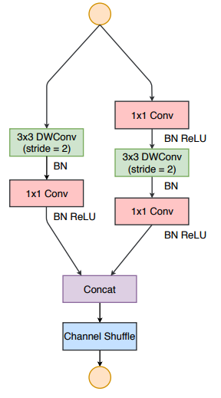
Convolutional Block: ShuffleNet
This block is the same as the ResNet block, but it uses
  Depth-wise Convolutions
  Channel-split and channel-shuffle to be efficient
Zhang et al. "Shufflenet: An extremely efficient convolutional neural network for mobile devices.”, CVPR, 2018
Ningning Ma, Xiangyu Zhang, Hai-Tao Zheng, and Jian Sun. "Shufflenet v2: Practical guidelines for efficient cnn architecture design." ECCV, 2018.

Slide 21
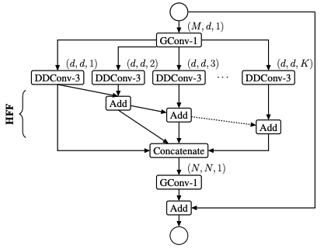
Convolutional Block: ESPNet
This block works on following principle:
  Reduce
  Split
  Transform
  Merge
This block uses depth-wise dilated convolutions (DDConv)
Looks similar to the Inception block, but it has higher receptive field
Sachin Mehta, Mohammad Rastegari, Anat Caspi, Linda Shapiro, and Hannaneh Hajishirzi. "Espnet: Efficient spatial pyramid of dilated convolutions for semantic segmentation." ECCV, 2018
Sachin Mehta, Mohammad Rastegari, Linda Shapiro, and Hannaneh Hajishirzi. "ESPNetv2: A Light-weight, Power Efficient, and General Purpose Convolutional Neural Network." CVPR, 2019

Slide 22
Semantic Segmentation

Slide 23
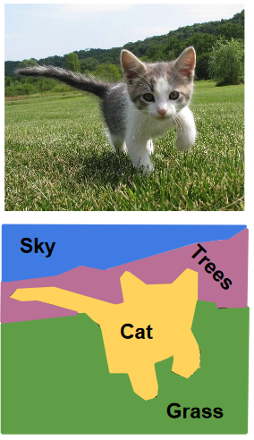
Semantic Segmentation
Image Classification
Semantic segmentation
CNN
Cat
CNN

Slide 24
Segmentation Networks: Vanilla
Pooling
Pooling
Global
pooling
Softmax
Cat

Slide 25
Segmentation Networks: Vanilla
Pooling
Pooling
Softmax
Standard Approach:
Remove the classification layer
Finetune for segmentation

Slide 26
Segmentation Networks: Vanilla
Pooling
Predictions are at low resolution
A lot of information is lost
Can we make it better?
Pooling
Softmax
Standard Approach:
Remove the classification layer
Finetune for segmentation

Slide 27
Segmentation Networks: Encoder-Decoder
Softmax
Pooling
Up-sample
Pooling
Up-sample
Standard Approach:
Remove the classification layer
Finetune for segmentation
Add a decoder

Slide 28
Segmentation Networks: Encoder-Decoder
Softmax
Cannot compensate the loss of information resulted in encoder
Can we improve it further?
Pooling
Up-sample
Pooling
Up-sample
Standard Approach:
Remove the classification layer
Finetune for segmentation
Add a decoder

Slide 29
Segmentation Networks: Encoder-Decoder with Skip-connections
Softmax
Pooling
Up-sample
Pooling
Standard Approach:
Remove the classification layer
Finetune for segmentation
Add a decoder
Share information between encoder and decoder
Up-sample

Slide 30
Semantic Segmentation Visualizations on Different Tasks

Slide 31
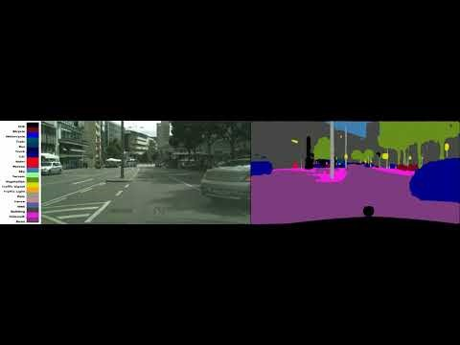
Semantic Segmentation results

Slide 32
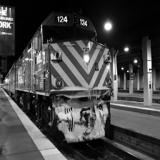
Semantic Segmentation results
(Background vs foreground)

Slide 33
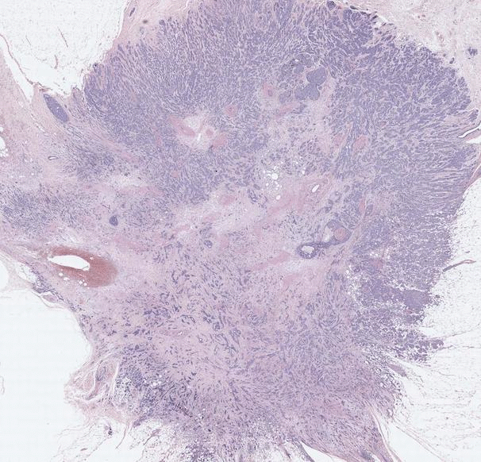

Tissue-level segmentation in Breast Biopsy Whole Slide Images
Sachin Mehta, Ezgi Mercan, Jamen Bartlett, Donald Weaver, Joann Elmore, and Linda Shapiro. "Learning to segment breast biopsy whole slide images." WACV, 2018.
Sachin Mehta, Ezgi Mercan, Jamen Bartlett, Donald Weaver, Joann G. Elmore, and Linda Shapiro. "Y-Net: joint segmentation and classification for diagnosis of breast biopsy images." MICCAI, 2018

Slide 34

Tumor Lesion Segmentation in 3D Brain Images
Enhancing tumor
Edema
Necrotic and non-enhancing tumor
Nicholas Nuechterlein*, and Sachin Mehta*. "3D-ESPNet with Pyramidal Refinement for Volumetric Brain Tumor Image Segmentation." In International MICCAI Brainlesion Workshop, 2018. (* Equal contribution)

Slide 35
Thank You!!

