Slide 1
Review Session II

Slide 2
Logic and Reasoning
John likes any food
Peanuts can be eaten.
Anything eaten is food.
Prove: John likes peanuts
food(x) => likes(John,x)
eatable(peanuts)
eatable(x) => food(x)
{¬food(x) , likes(John,x)
{eatable(peanuts)}
{¬eatable(x) , food(x)}
Conjecture: likes(John,peanuts)
Negation: {¬likes(John,peanuts)}
{¬likes(John,peanuts)}
{¬food(x) , likes(John,x)
{eatable(peanuts)}
{¬eatable(x) , food(x)}
{¬food(peanuts)}
{food(peanuts)}
NIL

Slide 3
Decision Trees with Information Gain
Gray Large LongNeck Class
Y Y N E
N Y Y G
N Y N E
Y Y N E
Entropy of root:
-3/4 log₂(3/4) – ¼ log₂(1/4)
-.75(-.415) -.25(-2)
= .811
Split on Gray:
Y: {E,E} Entropy 0
N: {G,E} Entropy 1
Gain: .811 -.5(0)-.5(1)
= .311
Split on Large:
Always Y
{E,G,E,E}, same as root.
Gain of Zero.
Split on LongNeck:
Y: {G} Entropy 0
N: {E,E,E} Entropy 0
Gain: .811 – 0 = .811***

Slide 4
Idea of Boosting

Slide 5
ADABoost
ADABoost boosts the accuracy of the original learning algorithm.
If the original learning algorithm does slightly better than 50% accuracy, ADABoost with a large enough number of classifiers is guaranteed to classify the training data perfectly.

Slide 6
ADABoost Weight Updating (from Fig 18.34 text)
/* First find the sum of the weights of the misclassified samples */
for j = 1 to N do /* go through training samples */
if h[m](x_{j}) <> y_{j} then error <- error + w_{j}
/* Now use the ratio of error to 1-error to change the
weights of the correctly classified samples */
for j = 1 to N do
if h[m](x_{j}) = y_{j} then w[j] <- w[j] * error/(1-error)

Slide 7
Example
Start with 4 samples of equal weight .25.
Suppose 1 is misclassified. So error = .25.
The ratio comes out .25/.75 = .33
The correctly classified samples get weight of .25*.33 = .0825
.2500
.0825
.0825
.0825
.5
.165
.165
.165
What’s wrong? What should we do?
We want them to add up to 1, not .4975.
Answer: To normalize, divide each
one by their sum (.4975).

Slide 8
Neural Nets
-2 * .5 + 2 * .4 = -.2
g(-.2) = -1
.5
-2
.4
.5
-1 * .4 + 1 * .2 = -.2
g(-.2) = -1
.4
.2
2
.6
-2 * .5 + 2 * .6 = .2
g(.2) = 1

Slide 9
SVMs

Slide 10
K-means: mean mu
EM: mean mu, covariance ∑, weight W

Slide 11
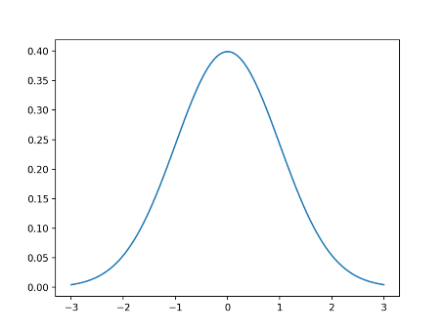
Yi Li’s EM Learning
Method 1: one Gaussian model per object class
Method 2: for each class, first use the positive instances to obtain Gaussian clusters in each feature space (color, texture, structure, etc)
Then use the CLUSTERS to obtain fixed length feature vectors for positive and negative instances of that class and train a neural net
Tree model Stadium Model Building Model …..

Slide 12
CNNs
Convolution
Pooling
ReLU

