Slide 1
Knowledge & Reasoning
Logical Reasoning: to have a computer automatically perform deduction or prove theorems
Knowledge Representations: modern ways of representing large bodies of knowledge

Slide 2
Logical Reasoning
In order to communicate, we need a formal language in which to express
axioms
theorems
hypotheses
rules
Common languages include
propositional logic
1st order predicate logic

Slide 3
Propositional Logic
Propositions are statements that are true or false.
P: Sierra is a dog
Q: Muffy is a cat
R: Sierra and Muffy are not friends
Propositions can be combined using logic symbols
P ∧ Q ⇒ R ¬P ∨ Q

Slide 4
Predicate Logic
Formulas have predicates with variables and constants:
man(Marcus)
Pompeian(Marcus)
born(Marcus, 40)
More symbols
∀ for every ∀x Pompeian(x) ⇒ died(x,79)
∃ there exists ∃x Pompeian(x)

Slide 5
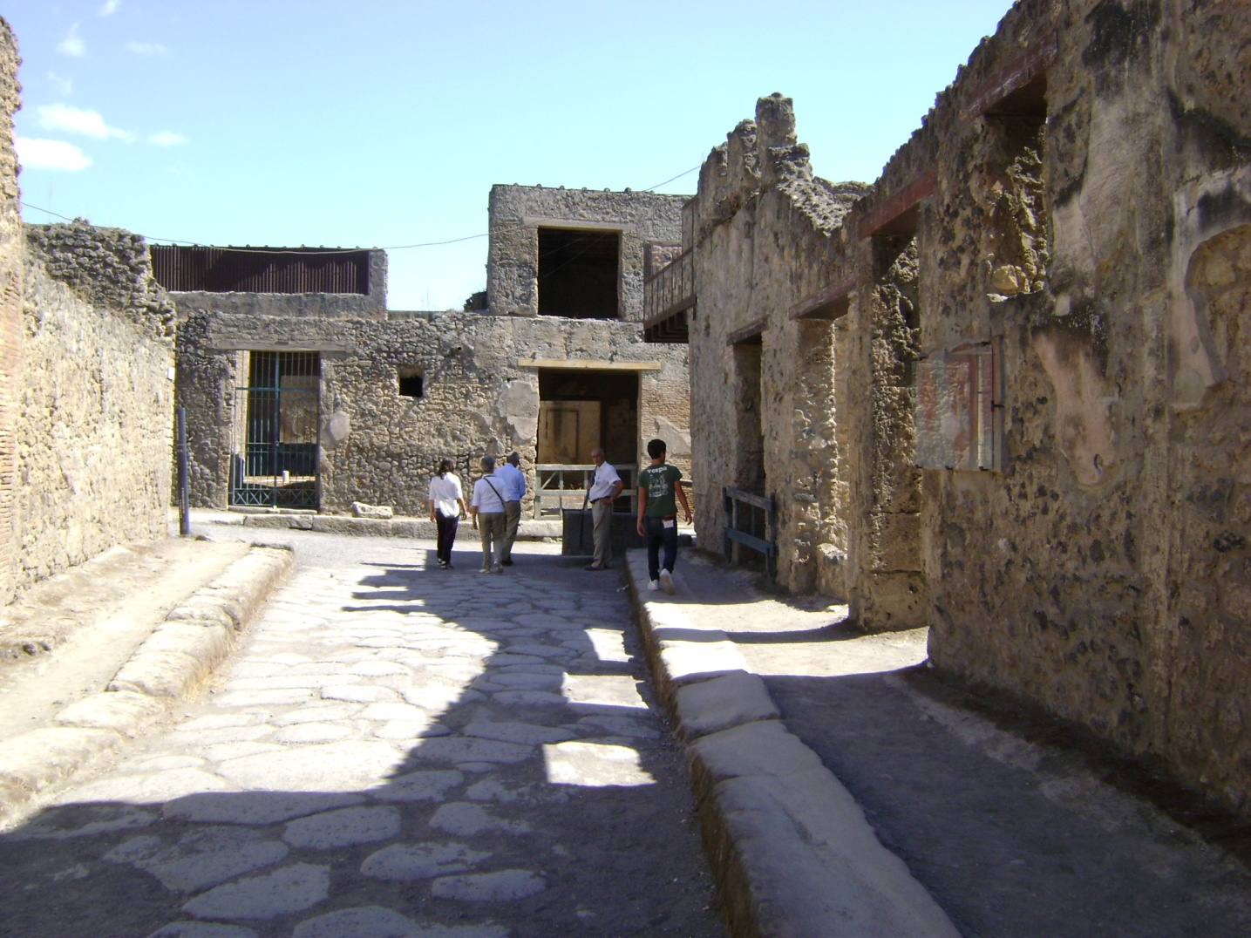
Ancient Pompei

Slide 6
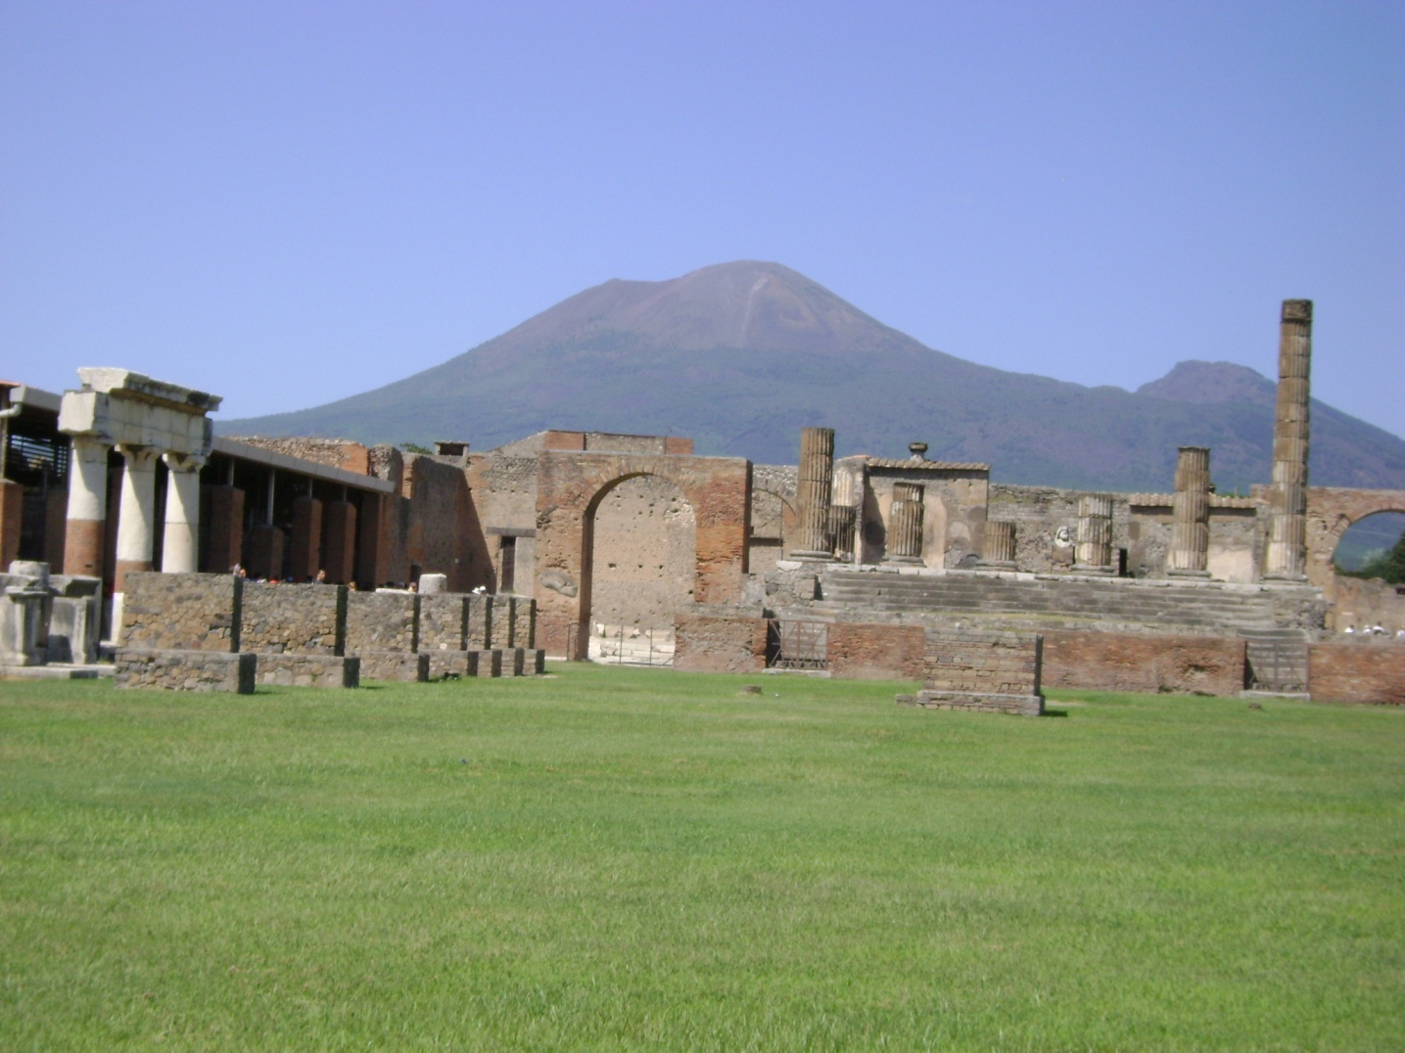
Vesuvius

Slide 7
Ancient Pompei and Vesuvius
What happened to ancient Pompei?
Vesuvius erupted and killed everyone.
When?
79 A.D.

Slide 8
Predicate Logic Example
Pompeian(Marcus)
born(Marcus,40)
man(Marcus)
∀x man(x) ⇒ mortal(x)
∀x Pompeian(x) ⇒ died(x,79)
erupted(Vesuvius,79)
∀x ∀t1 ∀t2 mortal(x) ∧ born(x,t1) ∧
gt(t2-t1,150)⇒ dead(x,t2)

Slide 9
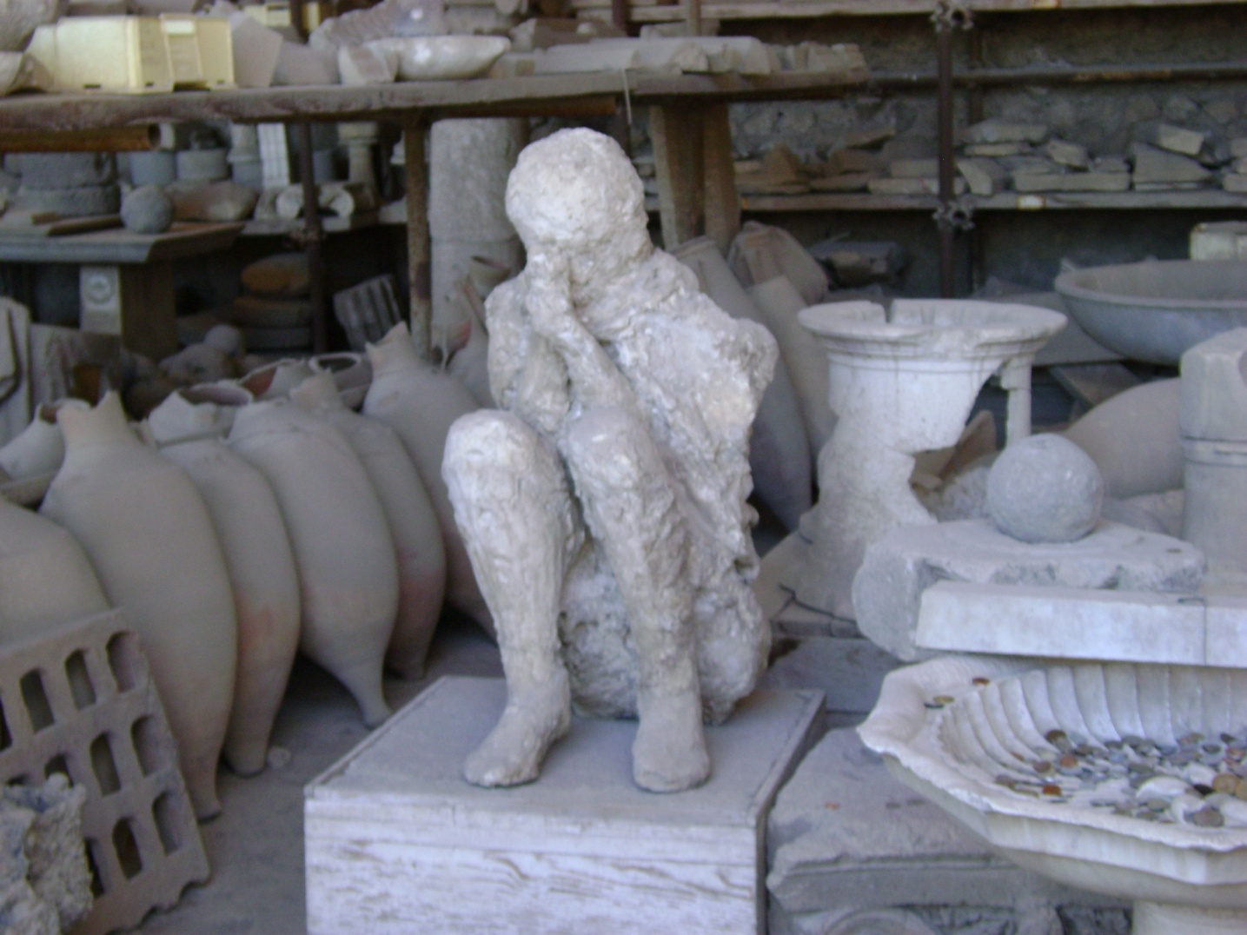
Dead Guy in 2009
8. gt(now,79)

Slide 10
Some Rules of Inference
9. ∀x ∀t [alive(x,t) ⇒ ¬dead(x,t)] ∧
[¬dead(x,t) ⇒ alive(x,t)]
If x is alive at time t, he’s not dead at time t, and vice versa.
10. ∀x ∀t1 ∀t2 died(x,t1) ∧ gt(t2,t1) ⇒ dead(x,t2)
If x died at time t1 and t2 is later, x is still dead at t2.

Slide 11
Prove dead(Marcus,now)
1. Pompeian(Marcus)
2. born(Marcus,40)
3. man(Marcus)
4. ∀x man(x) ⇒ mortal(x)
5. ∀x Pompeian(x) ⇒ died(x,79)
6. erupted(Vesuvius,79)
7. ∀x ∀t1 ∀t2 mortal(x) ∧ born(x,t1) ∧ gt(t2-t1,150)⇒ dead(x,t2)
8. gt(now,79)
9. ∀x ∀t [alive(x,t) ⇒ ¬dead(x,t)] ∧ [¬dead(x,t) ⇒ alive(x,t)]
10. ∀x ∀t1 ∀t2 died(x,t1) ∧ gt(t2,t1) ⇒ dead(x,t2)

Slide 12
Prove dead(Marcus,now) Direct Proof
1. Pompeian(Marcus)
5. ∀x Pompeian(x) ⇒ died(x,79)
8. gt(now,79)
7. ∀x ∀t1 ∀t2 died(x,t1) ∧ gt(t2,t1) ⇒ dead(x,t2)
died(Marcus,79)
died(Marcus,79) ∧ gt(now,79)
dead(Marcus,now)

Slide 13
Proof by Contradiction
¬ dead(Marcus,now)
∀x ∀t1 ∀t2 died(x,t1) ∧ gt(t2,t1) ⇒ dead(x,t2)
∀t1 ¬ [died(Marcus,t1) ∧ gt(now,t1)]
What substitutions were made here?
What rule of inference was used?
Marcus for x; now for t2
If x ⇒ y then ¬y ⇒ ¬x

Slide 14
Proof by Contradiction
¬ dead(Marcus,now)
∀x ∀t1 ∀t2 died(x,t1) ∧ gt(t2,t1) ⇒ dead(x,t2)
∀t1 ¬ [died(Marcus,t1) ∧ gt(now,t1)]
∀t1 ¬ died(Marcus,t1) ∨ ¬ gt(now,t1)
died(Marcus,79)*
¬ gt(now,79) gt(now,79)
contradiction
*assume we proved this separately

Slide 15
Resolution Theorem Provers for Predicate Logic
Given:
F: a set of axioms represented as formulas
S: a conjecture represented as a formula
Prove: F logically implies S
Technique
Construct ¬S, the negated conjecture
Show that F’ = F ∪ {¬S} leads to a contradiction
Conclude: ¬{¬S} or S

Slide 16
Part I: Preprocessing to express in Conjunctive Normal Form
Eliminate implication operator ⇒
Replace A ⇒ B by ∨(¬ A,B)
Example:
man(x) ⇒ mortal(x) is replaced by
∨(¬ man(x),mortal(x)) or in infix notation
¬ man(x) ∨ mortal(x)

Slide 17
Preprocessing Continued
2. Reduce the scope of each ¬ to apply to at most one predicate by applying rules:
Demorgan’s Laws
¬ ∨(x1,…,xn) is equivalent to ∧(¬x1,…, ¬xn)
¬ ∧(x1,…,xn) is equivalent to ∨(¬x1,…, ¬xn)
¬(¬x) ⇒ x
¬(∀x A) ⇒ ∃x(¬A)
¬(∃ x A) ⇒ ∀ x(¬A)

Slide 18
Preprocessing Continued
Example
[∀x ∀t1 ∀t2 [died(x,t1) ∧ gt(t2,t1)] ⇒ dead(x,t2)]
Get rid of the implication
¬ [∀x ∀t1 ∀t2 ¬ [died(x,t1) ∧ gt(t2,t1)]∨dead(x,t2)]
Apply the rule for ¬[∀
∃x ∃t1 ∃t2 ¬( ¬ [died(x,t1) ∧ gt(t2,t1)] ∨ dead(x,t2))
Apply DeMorgan’s Law
∃x ∃t1 ∃t2 ¬ ¬ [died(x,t1) ∧ gt(t2,t1)] ∧ ¬ dead(x,t2)
∃x ∃t1 ∃t2 died(x,t1) ∧ gt(t2,t1) ∧ ¬ dead(x,t2)]

Slide 19
Preprocessing Continued
3. Standardize Variables
Rename variables so that each quantifier binds a unique variable
∀x [P(x) ∧ ∃x Q(x)]
becomes
∀x [P(x) ∧ ∃y Q(y)]

Slide 20
Preprocessing Continued
4. Eliminate existential qualifiers by introducing Skolem functions.
Example
∀x ∀y ∃z P(x,y,z)
The variable z depends on x and y.
So z is a function of x and y.
We choose an arbitrary function name, say f, and replace z by f(x,y), eliminating the ∃.
∀x ∀y P(x,y,f(x,y))

Slide 21
Preprocessing Continued
5. Rewrite the result in Conjunctive Normal Form (CNF)
(x1,…,xn) where the xi can be
atomic formulas A(x)
negated atomic formulas ¬ A(x)
disjunctions A(x) ∨ P(y)
This uses the rule
∨(x1, ∧(x2, … , xn) = ∧(∨(x1,x2), … , ∨(x1,xn))

Slide 22
Preprocessing Continued
6. Since all the variables are now only universally quantified, eliminate the ∀ as understood.
∀x ∀t1 ∀t2 ¬died(x,t1) ∨ ¬ gt(t2,t1) ∨dead(x,t2)
becomes
¬died(x,t1) ∨ ¬ gt(t2,t1) ∨ dead(x,t2)

Slide 23
Clause Form
The clause form of a set of original formulas consists of a set of clauses as follows.
A literal is an atom or negation of atom.
A clause is a disjunction of literals.
A formula is a conjunction of clauses.
Example
Clause 1: {A(x), ¬P(g(x,y),z), ¬R(z)} (implicit or)
Clause 2: {C(x,y), Q(x,y,z)} (another implicit or)

Slide 24
Steps in Proving a Conjecture
Given a set of axioms F and a conjecture S, let F’ = F ∪ ¬S and find the clause form C of F’.
Iteratively try to find new clauses that are logically implied by C.
If NIL is one of these clauses you produce, then F’ is unsatisfiable and the conjecture is proved.
You get NIL when you produce something that has A and also has ¬A.

Slide 25
Resolution Procedure
Convert F to clause form: a set of clauses.
Negate S, convert it to clause form, and add it to your set of clauses.
Repeat until a contradiction or no progress
a. Select two parent clauses.
b. Produce their resolvent.
c. If the resolvent = NIL, we are done.
d. Else add the resolvent to the set of clauses.

Slide 26
Resolution for Propositions
Let C1 = L1 ∨ L2 ∨ … ∨ Ln
Let C2 = L1’ ∨ L2’ ∨ … ∨ Ln’
If C1 has a literal L and C2 has the opposite literal ¬L, they cancel each other and produce
resolvent(C1,C2) =
L1 ∨ L2 ∨ … ∨ Ln ∨ L1’ ∨ L2’ ∨ … ∨ Ln’
with both L and ¬L removed
If no 2 literals cancel, nothing is removed

Slide 27
Propositional Logic Example
Formulas: P ∨ Q, P ⇒ Q, Q ⇒ R
Conjecture: R
Negation of conjecture: ¬R
Clauses: {P ∨ Q, ¬P ∨ Q, ¬Q ∨ R, ¬R}
Resolvent(P ∨ Q, ¬P ∨ Q) is Q. Add Q to clauses.
Resolvent(¬Q ∨ R, ¬R) is ¬Q. Add ¬Q to clauses.
Resolvent(Q, ¬Q) is NIL.
The conjecture is proved.

Slide 28
Refutation Graph
Original Clauses: {P ∨ Q, ¬P ∨ Q, ¬Q ∨ R, ¬R}
P ∨ Q ¬P ∨ Q ¬Q ∨ R ¬R
Q ¬Q
NIL

Slide 29
Exercise
Given P ⇒ R and R ⇒ Q, prove that P ⇒ Q

Slide 30
Resolution for Predicates
Requires a matching procedure that compares 2 literals and determines whether there is a set of substitutions that makes them identical.
This procedure is called unification.
C1 = eats(Tom x) C2 = eats(Tom, ice cream)
The substituion ice cream/x (read “ice cream for x”) makes C1 = C2.
You can substitute constants for variables and variables for variables, but nothing for constants.

Slide 31
Proof Using Unification
Given ∀x P(x) ⇒ R(x) {¬P(x),R(x)}
∀z R(z) ⇒ Q(z) {¬R(z),Q(z)}
Prove ∀x P(x) ⇒ Q(x)
Negation ¬ ∀x P(x) ⇒ Q(x)
∃x ¬(P(x) ⇒ Q(x))
∃x ¬ (¬P(x) ∨ Q(x))
∃x P(x) ∧ ¬ Q(x)
P(a) ∧ ¬ Q(a)* {P(a)} {¬ Q(a)}
* Skolem function for a single variable is just a constant

Slide 32
Refutation Graph with Unification
{¬P(x),R(x)} {¬R(z),Q(z)}
Substitution
x/z
{¬P(x),Q(x)} {P(a)}
Substitution
a/x
Q(a) ¬Q(a)
NIL

Slide 33
Another Pompeian Example
man(Marcus)
Pompeian(Marcus)
¬Pompeian(x1) ∨ Roman(x1)
ruler(Caesar)
¬Roman(x2) ∨ loyalto(x2,Caesar) ∨ hate(x2,Caesar)
loyalto(x3,f1(x3))
¬man(x4) ∨ ¬ruler(y1) ∨ ¬tryassissinate(x4,y1) ∨
¬loyalto(x4,y1)
8. tryassissinate(Marcus,Caesar)
Prove: Marcus hates Caesar

Slide 34
Another Pompeian Example
5. ¬Roman(x2) ∨ loyalto(x2,Caesar) ∨ hate(x2,Caesar)
6. loyalto(x3,f1(x3))
7. ¬man(x4) ∨ ¬ruler(y1) ∨ ¬tryassissinate(x4,y1) ∨
¬loyalto(x4,y1)
8. tryassissinate(Marcus,Caesar)
5. If x2 is Roman and not loyal to Caesar then x2 hates Caesar.
6. For every x3, there is someone he is loyal to.
7. If x4 is a man and y1 is a ruler and x4 tries to assassinate x1
then x4 is not loyal to y1.
8. Marcus tried to assassinate Caesar.

Slide 35
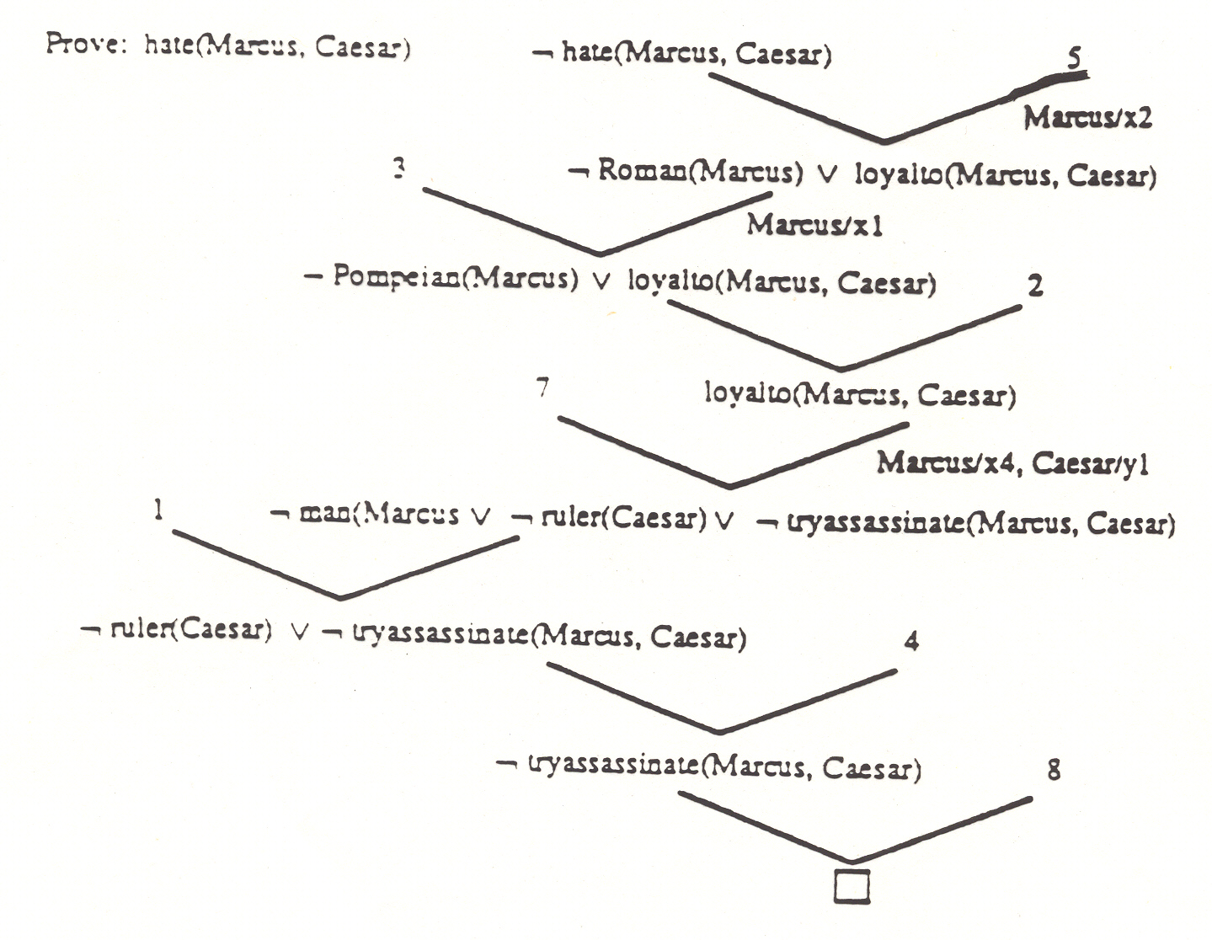

Slide 37
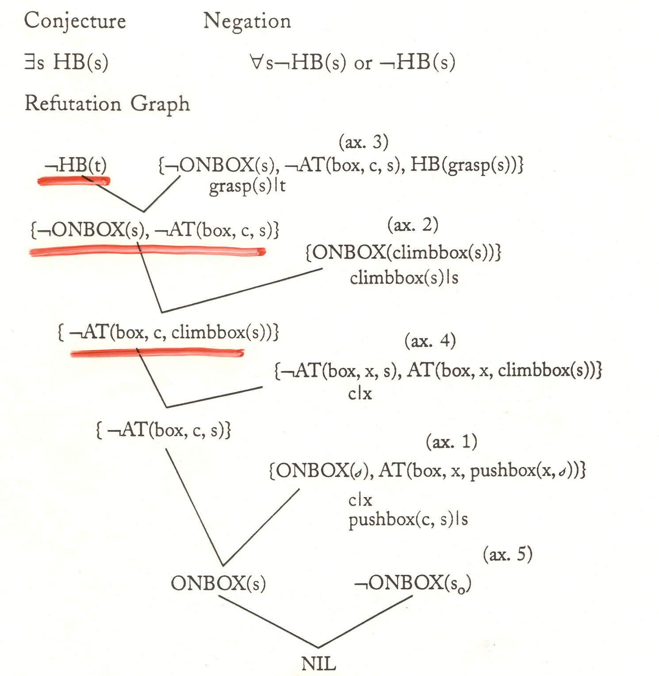

Slide 38
Monkey Solution
If we change the conjecture to {¬HB(s), HB(s)}
the result of the refutation becomes:
HB(grasp(climbbox(pushbox(c,s0)))

Slide 39
Propositional Logic Resolution Exercise
Given: P V Q
P -> R
Q -> R
Prove R

Slide 40
Predicate Logic Resolution Exercise
Given: Sierra is a dog
Muffy is a cat
All dogs chase all cats.
Prove: Sierra chases Muffy

Slide 41
Predicate Logic Resolution Exercise
Given: Sierra is a dog
Muffy is a cat
All dogs chase all cats.
Prove: Sierra chases Muffy
Negate: {¬chase(Sierra, Muffy)}
{dog(Sierra)}
{cat(Muffy)}
∀x ∀y (dog(x) ˄ cat(y)) -> chase(x,y)
∀x ∀y ¬(dog(x) ˄ cat(y)) ∨ chase(x,y)
∀x ∀y ¬dog(x) ∨ ¬cat(y) ∨ chase(x,y)
{¬dog(x), ¬cat(y), chase(x,y)}

Slide 42
{¬chase(Sierra, Muffy)}
{¬dog(x), ¬cat(y), chase(x,y)}
{¬dog(Sierra), ¬cat(Muffy)}
{dog(Sierra)}
{¬cat(Muffy)}
cat(Muffy)
NIL

