Slide 1
Introduction to Artificial Intelligence
CSE 473
Winter 2019

Slide 2
Administrative Details
Instructor: Linda Shapiro, 634 CSE, shapiro@cs.washington.edu
TAs: Dianqi Li, dianqili@uw.edu
Beibin Li, beibin@uw.edu
Bindita Chaudhur, bindita@uw.edu
Rajneil Rana, rajneil@uw.edu
Course Home Page: https://courses.cs.washington.edu/courses/cse473/19wi/
Text: Artificial Intelligence: A Modern Approach (3rd edition), Russell and Norvig

Slide 3
This Lecture
What is AI all about, roughly from Chapters 1 and 2.

Slide 4
What is intelligence?
What capabilities should a machine have for us to call it intelligent?

Slide 5
Turing’s Test
If the human cannot tell whether the responses from the other side of a wall are coming from a human or computer, then the computer is intelligent.

Slide 6
Performance vs. Humanlike
What is more important: how the program performs or how well it mimics a human?
Can you get a computer to do something that you don’t know how to do? Like what?
What about creativity?

Slide 7
Mundane Tasks
Perception
Vision
Speech
Natural Language
Understanding
Generation
Translation
Reasoning
Robot Control

Slide 8
Formal Tasks
Games
Chess
Checkers
Kalah, Othello
Mathematics
Logic
Geometry
Calculus
Proving properties of programs

Slide 9
Expert Tasks
Engineering
Design
Fault Finding
Manufacturing planning
Medical
Diagnosis
Medical Image Analysis
Financial
Stock market predictions

Slide 10
What is an intelligent agent?
What is an agent?
What does rational mean?
Are humans always rational?
Can a computer always do the right thing?
What can we substitute for the right thing?

Slide 11
Intelligent Agents
What kinds of agents already exist today?

Slide 12
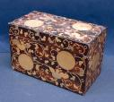
Problem Solving
C
A
B
Find a sequence of operations to produce the desired situation from the initial situation.

Slide 13
Game Playing
Given:
An initial position in the game
The rules of the game
The criteria for winning the game
WIN!

Slide 14
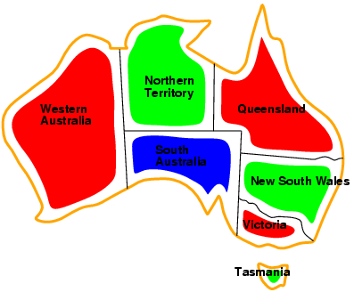
Constraint Satisfaction
Example: Map Coloring

Slide 15
Reasoning
Given:
∀x (human(x) -> animal(x))
∀x (animal(x) -> (eats(x) & drinks(x)))
Prove:
∀x (human(x) -> eats(x))

Slide 16
Learning
Example: Neural Network

Slide 17
Natural Language Understanding
Pick up a big red block.
OK.
While hunting in
Africa, I shot an
elephant in my
pajamas.
I don’t understand.

Slide 18
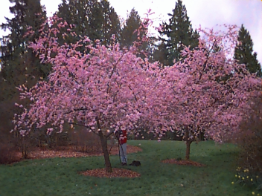
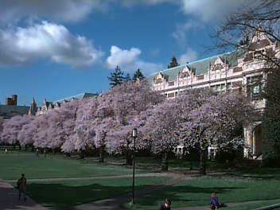
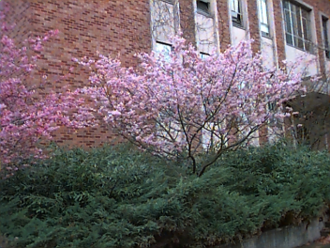
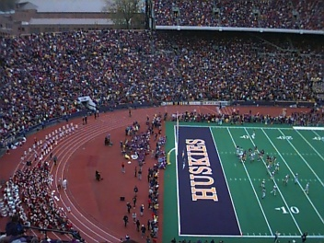
Computer Vision with Machine Learning
Given: Some images and their corresponding descriptions
•••
{trees, grass, cherry trees}
{cheetah, trunk}
{mountains, sky}
{beach, sky, trees, water}
To solve: What object classes are present in new images
•••
?
?
?
?
Notes:
Remove arrow
Dot!
Our
Give title/description of each system

Slide 19
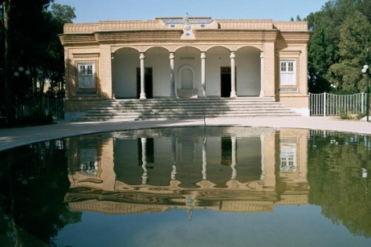
Groundtruth Data Set: Annotation Samples
tree(97.3), bush(91.6),
spring flowers(90.3),
flower(84.4), park(84.3),
sidewalk(67.5),
grass(52.5), pole(34.1)
sky(99.8),
Columbia gorge(98.8),
lantern(94.2), street(89.2),
house(85.8), bridge(80.8),
car(80.5), hill(78.3),
boat(73.1), pole(72.3),
water(64.3), mountain(63.8),
building(9.5)
sky(95.1), Iran(89.3),
house(88.6),
building(80.1),
boat(71.7), bridge(67.0),
water(13.5), tree(7.7)
Italy(99.9), grass(98.5),
sky(93.8), rock(88.8),
boat(80.1), water(77.1),
Iran(64.2), stone(63.9),
bridge(59.6), European(56.3),
sidewalk(51.1), house(5.3)

Slide 23
Stuart Russell’s “Potted History of AI”
1943 McCulloch & Pitts: neural nets model of the brain
1950 Turing’s “Computing Machinery and Intelligence”
1952-69 Look Ma, no hands
1950s Early AI Programs: Logic Theorist, Checker Player, Geom
1956 Term “Artificial Intelligence” adopted
1965 Robinson’s complete algorithm for logical reasoning
1966-74 AI discovers computational complexity; neural nets go
1969-79 Early development of knowledge-based “expert systems”
1980-88 Expert systems boom
1988-93 Expert systems bust: “AI Winter”
1985-95 Neural networks return
1988- AI and Statistics together
1995- Agents, agents everywhere
NOW- PROBABILITY EVERYWHERE!
NOW- Learning, Learning, Learning
NOW- DEEP Learning

Slide 24
Overview of Intended Topics
Introduction to AI (Chs. 1-2, done)
Problem Solving by Search (Ch 3) “Big Chapter”
Beyond Classical Search (Ch 4)
Adversarial Search (Ch 5) “Game Playing”
Constraint Satisfaction Problems (Ch 6)
Learning (related to Ch 18 and 20)
Computer Vision (not from book)
Knowledge and Reasoning (Loosely related to
Ch 8, 9, 14, 15)
9. Other Applications

Slide 25
Overview of Intended Assignments
Blind search (easy Python warmup)
Heuristic search for robot planning
Game playing with Kalah game
A computer vision assignment
A machine learning assignment

