Slide 1
8 Puzzle Using Number of Misplaced Tiles
2 3
4
7 6 5
g=0
h=4
f=4
8 3
6 4
7 5
goal
2 8 3
4
7 6 5
2 8 3
1 6 4
7 5
2 8 3
1 6 4
7 5

Slide 2
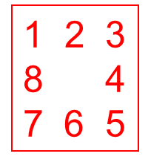
2 8 3
1 4
7 6 5
Exercise:
What are its children and their
f, g, h?

