Slide 1
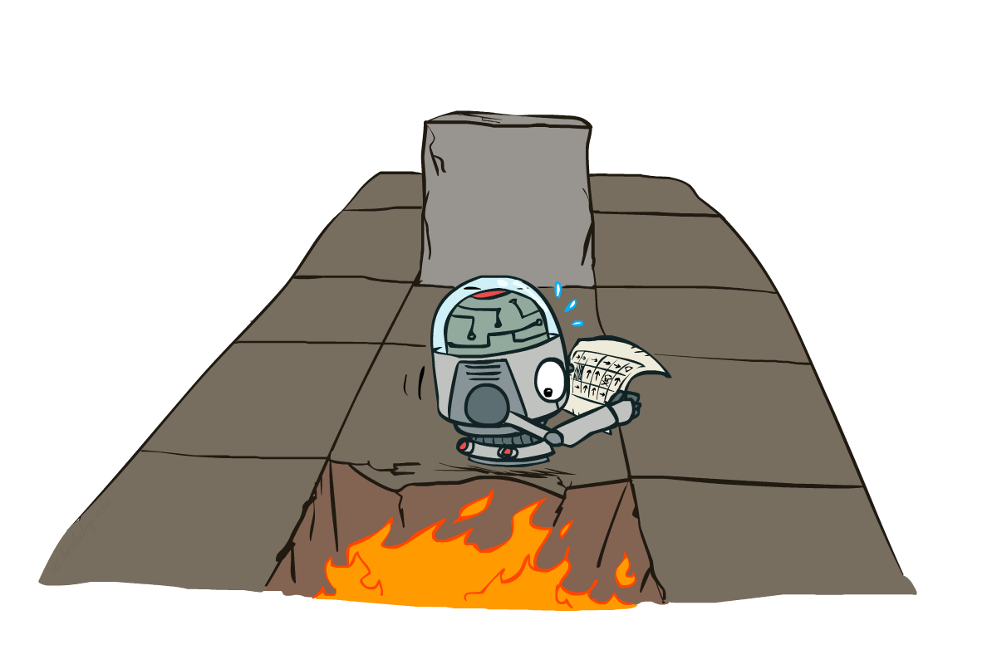
CS 188: Artificial Intelligence
Markov Decision Processes K+1
Instructors: Dan Klein and Pieter Abbeel --- University of California, Berkeley
[These slides were created by Dan Klein and Pieter Abbeel for CS188 Intro to AI at UC Berkeley. All CS188 materials are available at http://ai.berkeley.edu.]
Notes:
Please retain proper attribution, including the reference to ai.berkeley.edu. Thanks!

Slide 2
Note to self
Next time
Every instance of value iteration should be written using explicit Q functions! You need the q functions anyway to choose the action.
This equation is confusing – don’t ever show it!

Slide 3
Midterm Review
Agency: types of agents, types of environments
Search
  Formulating a problem in terms of search
  Algorithms: DFS, BFS, IDS, best-first, uniform-cost, A*, local
  Heuristics: admissibility, consistency, creation, pattern DBs
  Constraints: formulation, search, forward checking, arc-consistency, structure
  Adversarial: min/max, alpha-beta, expectimax
MDPs
  Formulation, Bellman eqns, V*, Q*, backups, value iteration, policy iteration

Slide 4
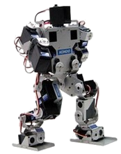
Stochastic Planning: MDPs
Static
Environment
Fully
Observable
Stochastic
What action next?
Instantaneous
Perfect
Percepts
Actions
Notes:
4

Slide 5





Example: Grid World
A maze-like problem
  The agent lives in a grid
  Walls block the agent’s path
Noisy movement: actions do not always go as planned
  80% of the time, the action North takes the agent North
  10% of the time, North takes the agent West; 10% East
  If there is a wall in the direction the agent would have been taken, the agent stays put
The agent receives rewards each time step
  Small “living” reward each step (can be negative)
  Big rewards come at the end (good or bad)
Goal: maximize sum of (discounted) rewards
Notes:
[cut demo of moving around in grid world program]

Slide 6
Recap: MDPs
Markov decision processes:
  States S
  Actions A
  Transitions P(s’|s,a) (or T(s,a,s’))
  Rewards R(s,a,s’) (and discount γ)
  Start state s₀
Quantities:
  Policy = map of states to actions
  Utility = sum of discounted rewards
  Values = expected future utility from a state (max node)
  Q-Values = expected future utility from a q-state (chance node)
s
a
s, a
s,a,s’
s’

Slide 7

Solving MDPs
Value Iteration
Policy Iteration
Reinforcement Learning

Slide 8
Optimal Quantities
The value (utility) of a state s:
  V*(s) = expected utility starting in s and acting optimally
The value (utility) of a q-state (s,a):
  Q*(s,a) = expected utility starting out having taken action a from state s and (thereafter) acting optimally
The optimal policy:
  π*(s) = optimal action from state s
s
s is a state
a
(s, a) is a q-state
s, a
s,a,s’
(s,a,s’) is a
transition
s’
[Demo: gridworld values (L9D1)]
Notes:
Demo just shows V and Q values, snapshots on next slides.

Slide 9

The Bellman Equations
How to be optimal:
Step 1: Take correct first action
Step 2: Keep being optimal

Slide 10


The Bellman Equations
Definition of “optimal utility” via expectimax recurrence gives a simple one-step lookahead relationship amongst optimal utility values
These are the Bellman equations, and they characterize optimal values in a way we’ll use over and over
s
a
s, a
s,a,s’
s’
Notes:
Let’s start by equations that characterize these quantities through mutual recursions. [step through this by writing on slide, one step at a time]
Recursive characterization of V* in terms of V*; not necessarily helpful; but it is a characterization.
Note: this is a set of equations that needs to be satisfied; but it could have multiple solutions (it does not, but at this stage of our knowledge it could).

Slide 11
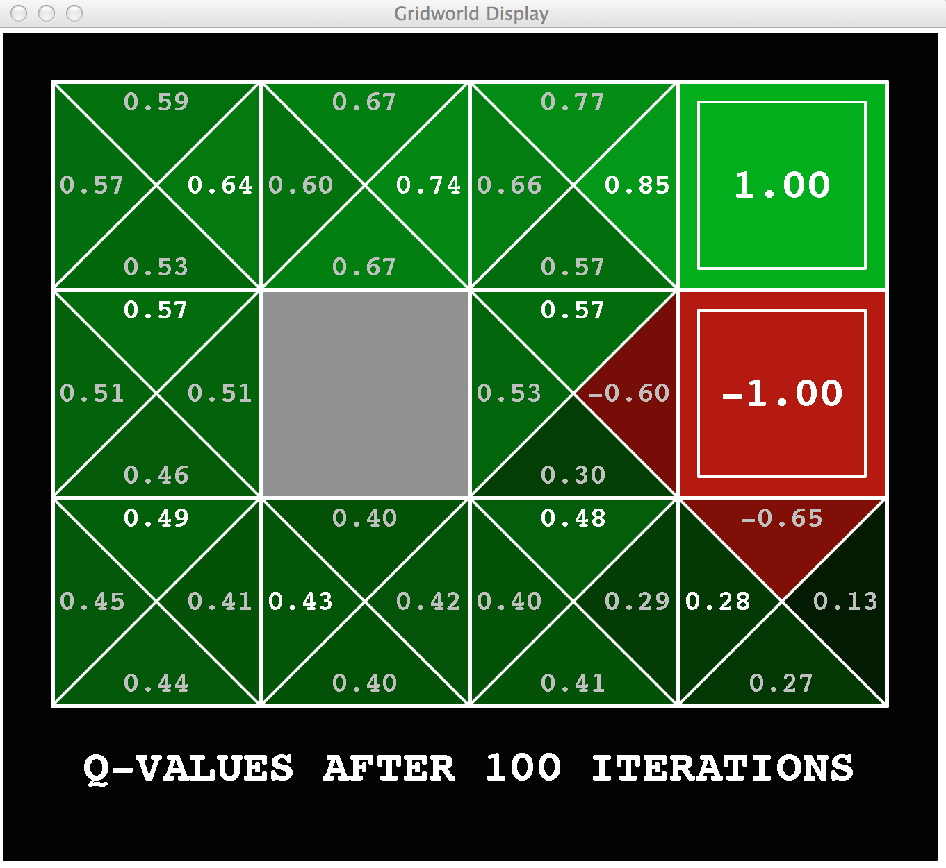
Gridworld: Q*

Slide 12
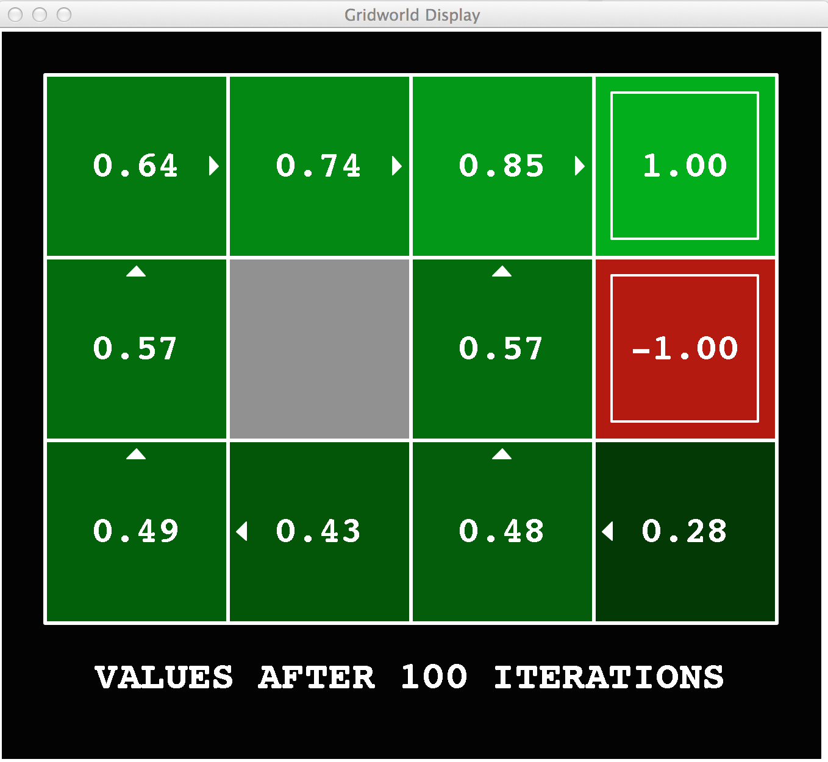
Gridworld Values V*

Slide 13




Racing Search Tree
We’re doing way too much work with expectimax!
Problem: States are repeated
  Idea: Only compute needed quantities once
Problem: Tree goes on forever
  Idea: Do a depth-limited computation, but with increasing depths until change is small
  Note: deep parts of the tree eventually don’t matter if γ < 1

Slide 14





Time-Limited Values
Key idea: time-limited values
Define V_{k}(s) to be the optimal value of s if the game ends in k more time steps
  Equivalently, it’s what a depth-k expectimax would give from s
[Demo – time-limited values (L8D6)]
Notes:
This demo generates the time-limited values for gridworld as snapshotted onto the next slides.

Slide 15





Time-Limited Values: Avoiding Redundant Computation

Slide 16

Value Iteration

Slide 17

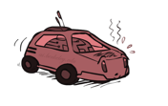

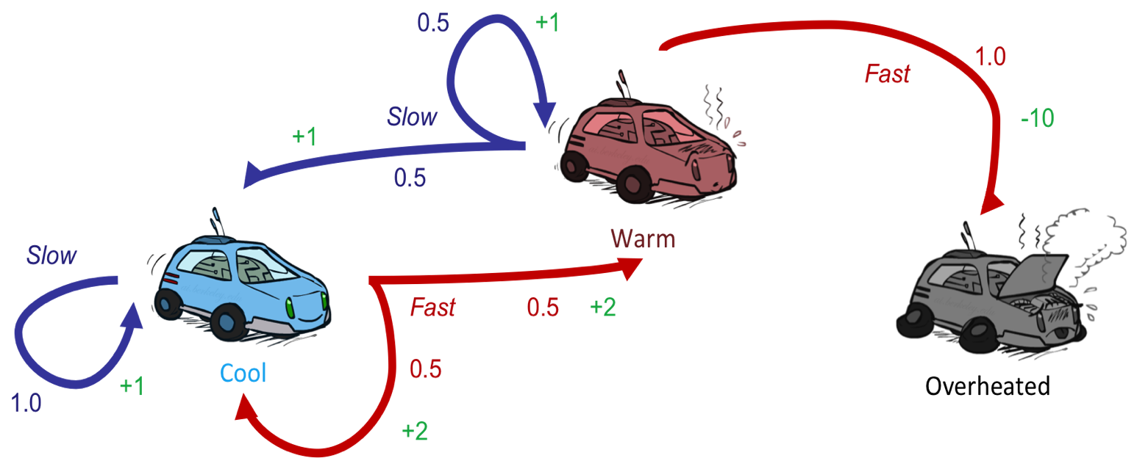



Example: Value Iteration
3.5 2.5 0
2 1 0
0 0 0
Assume no discount (gamma=1) to keep math simple!

Slide 18
Would help to write out bellman equations showing where
Numbers of last slide came from
Would also help if value iteration were explained in terms of q-values, so they were always stored – then policy extraction is more clear
Students didn’t understand that Q and V converge together!

Slide 19
Value Iteration
Called a
“Bellman Backup”
Start with V₀(s) = 0: no time steps left means an expected reward sum of zero
Given vector of V_{k}(s) values, do one ply of expectimax from each state:
Repeat until convergence
  (trust me, it does)
V_{k+1}(s)
a
s, a
s,a,s’
V_{k}(s’)
Notes:
Discuss computational complexity: S * A * S times number of iterations
Note: updates not in place [if in place, it means something else and not even clear what it means]

Slide 20
Value Iteration
Forall s, Initialize V₀(s) = 0 no time steps left means an expected reward of zero
Repeat do Bellman backups
  K += 1
Repeat until |V_{k+1}(s) – V_{k}(s) | < ε, forall s “convergence”
V_{k+1}(s)
Q_{k+1}(s, a) = Σ_{s’} T(s, a, s’) [ R(s, a, s’) + γ V_{k}(s’)]
V_{k+1}(s) = Max _{a} Q_{k+1} (s, a)
a
s, a
s,a,s’
V_{k}(s’)
Notes:
Discuss computational complexity: S * A * S times number of iterations
Note: updates not in place [if in place, it means something else and not even clear what it means]

Slide 21
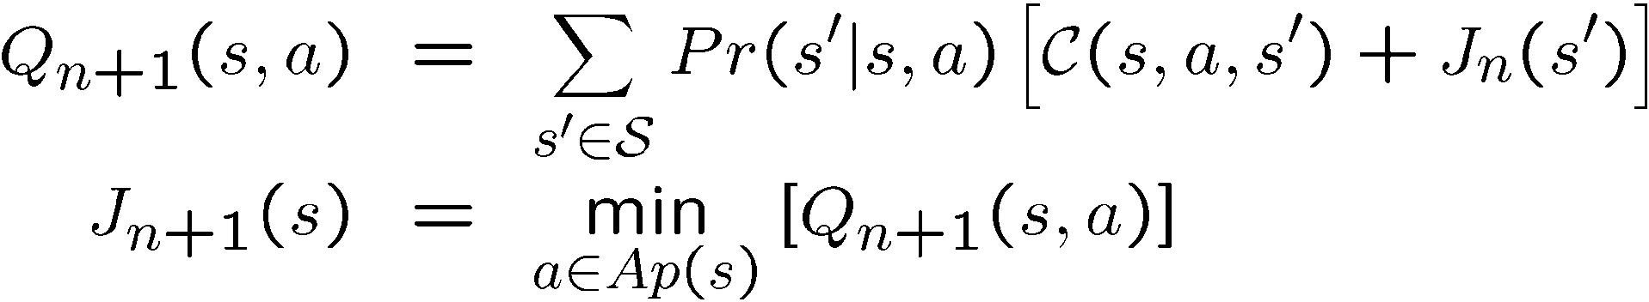
Bellman Backup (MDP)
Given an estimate of V* function (say V_{n})
Backup V_{n} function at state s
  calculate a new estimate (V_{n+1}) :
Q_{n+1}(s,a) : value/cost of the strategy:
  execute action a in s, execute π_{n} subsequently
  π_{n} = argmax_{a∈Ap(s)}Q_{n}(s,a)
R
γ
V
V
ax

Slide 22
Value iteration [Bellman’57]
assign an arbitrary assignment of V₀ to each state.
repeat
  for all states s
    compute V_{n+1}(s) by Bellman backup at s.
until max_{s} |V_{n+1}(s) – V_{n}(s)| < ε
Iteration n+1
Residual(s)
Theorem: will converge to unique optimal values
  Basic idea: approximations get refined towards optimal values
  Policy may converge long before values do

Slide 23

k=0
Noise = 0.2
Discount = 0.9
Living reward = 0
Notes:
Assuming zero living reward

Slide 24

k=1
If agent is in 4,3, it only has one legal action: get jewel. It gets a reward and the game is over.
If agent is in the pit, it has only one legal action, die. It gets a penalty and the game is over.
Agent does NOT get a reward for moving INTO 4,3.
Noise = 0.2
Discount = 0.9
Living reward = 0
Notes:
Assuming zero living reward

Slide 25

k=2
Noise = 0.2
Discount = 0.9
Living reward = 0
Notes:
Assuming zero living reward

Slide 26

k=3
Noise = 0.2
Discount = 0.9
Living reward = 0
Notes:
Assuming zero living reward

Slide 27

k=100
Noise = 0.2
Discount = 0.9
Living reward = 0
Notes:
Assuming zero living reward

Slide 28
Example: Bellman Backup
s₁
Q₁(s,a₁) = 2 + γ 0
~ 2
Q₁(s,a₂) = 5 + γ 0.9~ 1
+ γ 0.1~ 2
~ 6.1
Q₁(s,a₃) = 4.5 + γ 2
~ 6.5
2
a₁
V₀= 0
V₁= 6.5
s₀
5
a₂
4.5
s₂
0.9
V₀= 1
a₃
0.1
a_{greedy} = a₃
s₃
V₀= 2
max

Slide 29

k=4
Noise = 0.2
Discount = 0.9
Living reward = 0
Notes:
Assuming zero living reward

Slide 30

k=5
Noise = 0.2
Discount = 0.9
Living reward = 0
Notes:
Assuming zero living reward

Slide 31

k=6
Noise = 0.2
Discount = 0.9
Living reward = 0
Notes:
Assuming zero living reward

Slide 32

k=7
Noise = 0.2
Discount = 0.9
Living reward = 0
Notes:
Assuming zero living reward

Slide 33

k=8
Noise = 0.2
Discount = 0.9
Living reward = 0
Notes:
Assuming zero living reward

Slide 34

k=9
Noise = 0.2
Discount = 0.9
Living reward = 0
Notes:
Assuming zero living reward

Slide 35

k=10
Noise = 0.2
Discount = 0.9
Living reward = 0
Notes:
Assuming zero living reward

Slide 36

k=11
Noise = 0.2
Discount = 0.9
Living reward = 0
Notes:
Assuming zero living reward

Slide 37

k=12
Noise = 0.2
Discount = 0.9
Living reward = 0
Notes:
Assuming zero living reward

Slide 38
k=100
Noise = 0.2
Discount = 0.9
Living reward = 0
Notes:
Assuming zero living reward

Slide 39
Value Iteration
Start with V₀(s) = 0:
Given vector of V_{k}(s) values, do one ply of expectimax from each state:
Repeat until convergence
Complexity of each iteration: O(S²A)
  Number of iterations: poly(|S|, |A|, 1/(1-g))
Theorem: will converge to unique optimal values
V_{k+1}(s)
a
s, a
s,a,s’
V_{k}(s’)
Notes:
Discuss computational complexity: S * A * S times number of iterations
Note: updates not in place [if in place, it means something else and not even clear what it means]

Slide 40
Value Iteration
Bellman equations characterize the optimal values:
Value iteration computes them:
Value iteration is just a fixed point solution method
  … though the V_{k} vectors are also interpretable as time-limited values
V(s)
a
s, a
s,a,s’
V(s’)
Notes:
Discuss computational complexity: S * A * S times number of iterations
Note: updates not in place [if in place, it means something else and not even clear what it means]

Slide 41


Convergence*
How do we know the V_{k} vectors are going to converge?
Case 1: If the tree has maximum depth M, then V_{M} holds the actual untruncated values
Case 2: If the discount is less than 1
  Sketch: For any state V_{k} and V_{k+1} can be viewed as depth k+1 expectimax results in nearly identical search trees
  The difference is that on the bottom layer, V_{k+1} has actual rewards while V_{k} has zeros
  That last layer is at best all R_{MAX}
  It is at worst R_{MIN}
  But everything is discounted by γ^{k} that far out
  So V_{k} and V_{k+1} are at most γ^{k} max|R| different
  So as k increases, the values converge
Notes:
Theorem: will converge to unique optimal values
Basic idea: approximations get refined towards optimal values
Policy may converge long before values do

Slide 42
Convergence*
How do we know the V_{k} vectors will converge?
Case 1: If the tree has maximum depth M, then V_{M} holds the actual untruncated values
Case 2: If the discount is less than 1
  Sketch: For any state V_{k} and V_{k+1} can be viewed as depth k+1 expectimax results in nearly identical search trees
  The max difference happens if big reward at k+1 level
  That last layer is at best all R_{MAX}
  But everything is discounted by γ^{k} that far out
  So V_{k} and V_{k+1} are at most γ^{k} max|R| different
  So as k increases, the values converge
Notes:
Theorem: will converge to unique optimal values
Basic idea: approximations get refined towards optimal values
Policy may converge long before values do

Slide 43
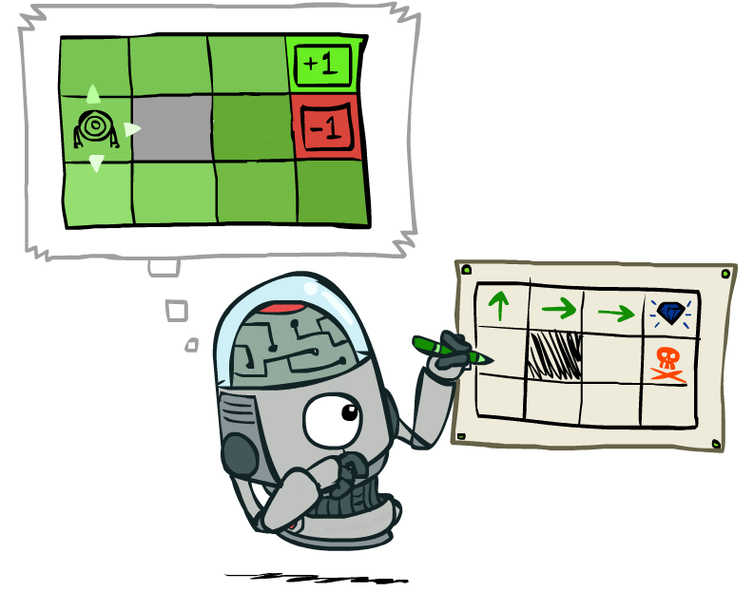
Policy Extraction

Slide 44
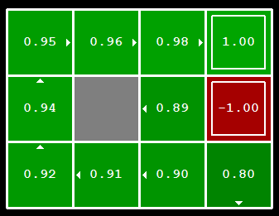


Computing Actions from Values
Let’s imagine we have the optimal values V*(s)
How should we act?
  It’s not obvious!
We need to do a mini-expectimax (one step)
This is called policy extraction, since it gets the policy implied by the values

Slide 45
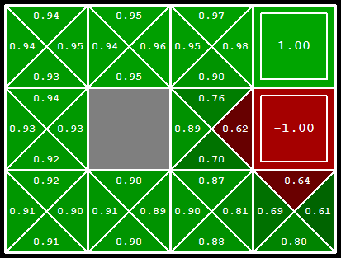
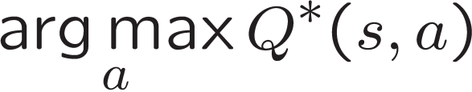
Computing Actions from Q-Values
Let’s imagine we have the optimal q-values:
How should we act?
  Completely trivial to decide!
Important lesson: actions are easier to select from q-values than values!

Slide 46
Problems with Value Iteration
Value iteration repeats the Bellman updates:
Problem 1: It’s slow – O(S²A) per iteration
Problem 2: The “max” at each state rarely changes
Problem 3: The policy often converges long before the values
s
a
s, a
s,a,s’
s’
[Demo: value iteration (L9D2)]
Notes:
Demo steps through value iteration; snapshots of values shown on next slides.

Slide 47
VI → Asynchronous VI
Is it essential to back up all states in each iteration?
  No!
States may be backed up
  many times or not at all
  in any order
As long as no state gets starved…
  convergence properties still hold!!

Slide 48
Prioritization of Bellman Backups
Are all backups equally important?
Can we avoid some backups?
Can we schedule the backups more appropriately?

Slide 49
k=1
Noise = 0.2
Discount = 0.9
Living reward = 0
Notes:
Assuming zero living reward

Slide 50
k=2
Noise = 0.2
Discount = 0.9
Living reward = 0
Notes:
Assuming zero living reward

Slide 51
k=3
Noise = 0.2
Discount = 0.9
Living reward = 0
Notes:
Assuming zero living reward

Slide 52
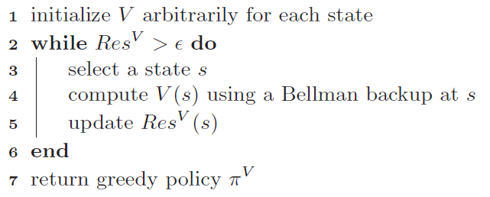
(General) Asynchronous VI

Slide 53
Asynch VI: Prioritized Sweeping
Why backup a state if values of successors same?
Prefer backing a state
  whose successors had most change
Priority Queue of (state, expected change in value)
Backup in the order of priority
After backing a state update priority queue
  for all predecessors

Slide 54

Solving MDPs
Value Iteration
Policy Iteration
Reinforcement Learning

Slide 55
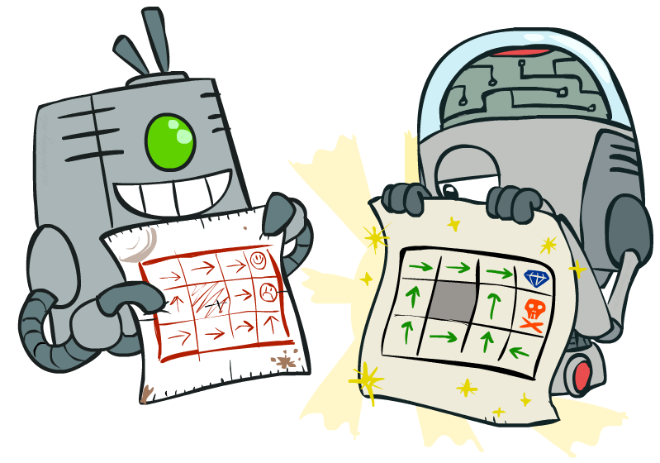
Policy Methods

Slide 56

Policy Evaluation

Slide 57
Fixed Policies
Do the optimal action
Do what π says to do
s
s
a
π(s)
s, a
s, π(s)
s,a,s’
s, π(s),s’
s’
s’
Expectimax trees max over all actions to compute the optimal values
If we fixed some policy π(s), then the tree would be simpler – only one action per state
  … though the tree’s value would depend on which policy we fixed

Slide 58
Utilities for a Fixed Policy
Another basic operation: compute the utility of a state s under a fixed (generally non-optimal) policy
Define the utility of a state s, under a fixed policy π:
  V^{π}(s) = expected total discounted rewards starting in s and following π
Recursive relation (one-step look-ahead / Bellman equation):
s
π(s)
s, π(s)
s, π(s),s’
s’

Slide 59
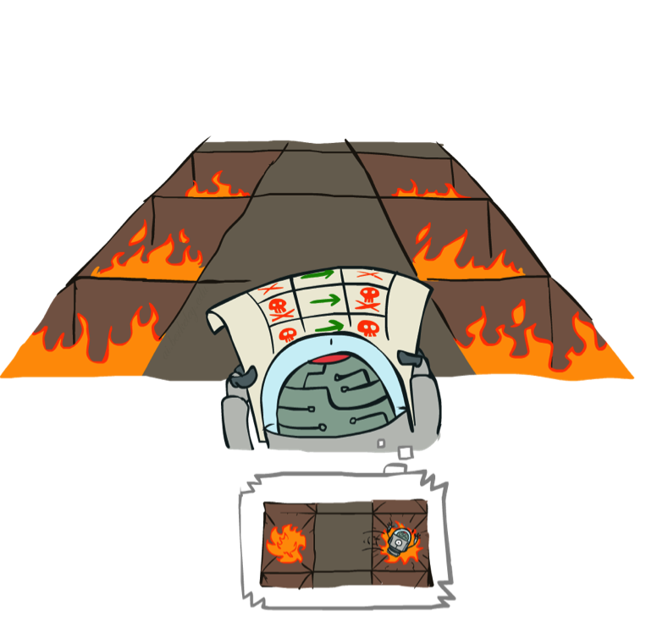
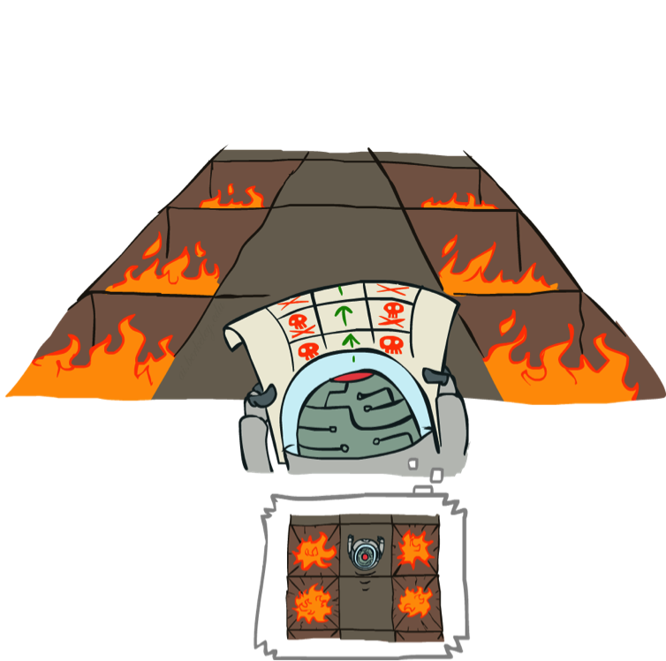
Example: Policy Evaluation
Always Go Right
Always Go Forward

Slide 60
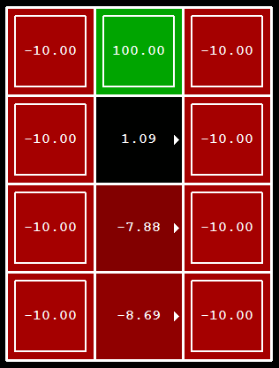
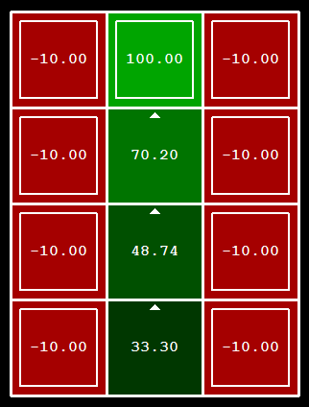
Example: Policy Evaluation
Always Go Right
Always Go Forward

Slide 61
Policy Iteration

Slide 62
Policy Iteration
Initialize π(s) to random actions
Repeat
  Step 1: Policy evaluation: calculate utilities of π at each s using a nested loop
  Step 2: Policy improvement: update policy using one-step look-ahead
  “For each s, what’s the best action I could execute, assuming I then follow π?
  Let π’(s) = this best action.
  π = π’
Until policy doesn’t change

Slide 63
Policy Iteration Details
Let i =0
Initialize π_{i}(s) to random actions
Repeat
  Step 1: Policy evaluation:
    Initialize k=0; Forall s, V₀^{π} (s) = 0
    Repeat until V^{π} converges
      For each state s,
      Let k += 1
  Step 2: Policy improvement:
    For each state, s,
    If π_{i} == π_{i+1} then it’s optimal; return it.
    Else let i += 1

Slide 64
Example
Initialize π₀ to “always go right”
Perform policy evaluation
Perform policy improvement
Iterate through states
?
Has policy changed?
?
Yes! i += 1
?

Slide 65
Example
π₁ says “always go up”
Perform policy evaluation
Perform policy improvement
Iterate through states
?
Has policy changed?
?
No! We have the optimal policy
?

Slide 66
Example: Policy Evaluation
Always Go Right
Always Go Forward

Slide 67
Policy Iteration Properties
Policy iteration finds the optimal policy, guarenteed!
Often converges (much) faster

Slide 68
Comparison
Both value iteration and policy iteration compute the same thing (all optimal values)
In value iteration:
  Every iteration updates both the values and (implicitly) the policy
  We don’t track the policy, but taking the max over actions implicitly recomputes it
In policy iteration:
  We do several passes that update utilities with fixed policy (each pass is fast because we consider only one action, not all of them)
  After the policy is evaluated, a new policy is chosen (slow like a value iteration pass)
  The new policy will be better (or we’re done)
Both are dynamic programs for solving MDPs

Slide 69
Summary: MDP Algorithms
So you want to….
  Compute optimal values: use value iteration or policy iteration
  Compute values for a particular policy: use policy evaluation
  Turn your values into a policy: use policy extraction (one-step lookahead)
These all look the same!
  They basically are – they are all variations of Bellman updates
  They all use one-step lookahead expectimax fragments
  They differ only in whether we plug in a fixed policy or max over actions

Slide 70
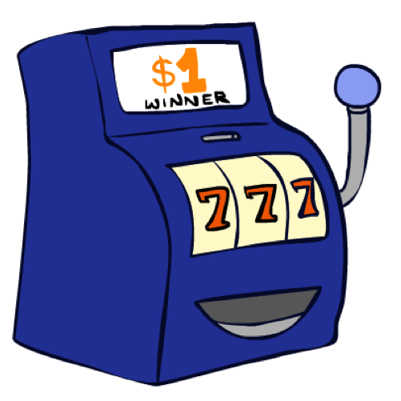
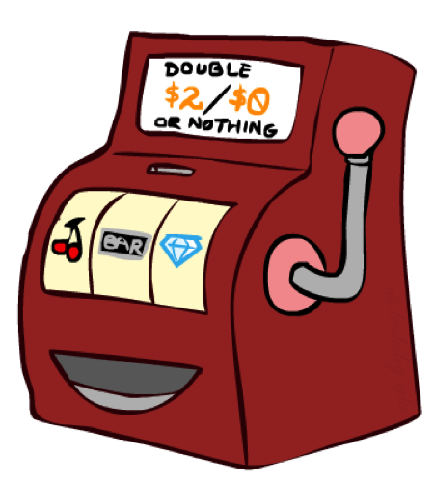

Double Bandits

Slide 71
Double-Bandit MDP
Actions: Blue, Red
States: Win, Lose
No discount
100 time steps
Both states have the same value
0.25 $0
0.75
$2
W
L
0.25
$0
$1
1.0
$1
1.0
0.75 $2

Slide 72
Offline Planning
Solving MDPs is offline planning
  You determine all quantities through computation
  You need to know the details of the MDP
  You do not actually play the game!
No discount
100 time steps
Both states have the same value
0.25 $0
Value
0.75
$2
W
0.25
$0
Play Red
150
L
$1
1.0
$1
1.0
0.75 $2
Play Blue
100

Slide 73
Let’s Play!
$2
$2
$0
$2
$2
$2
$2
$0
$0
$0

Slide 74
Online Planning
Rules changed! Red’s win chance is different.
?? $0
??
$2
W
L
??
$0
$1
1.0
$1
1.0
?? $2

Slide 75
Let’s Play!
$0
$0
$0
$2
$0
$2
$0
$0
$0
$0

Slide 76

Policy Evaluation
s
How do we calculate the V’s for a fixed policy π?
Idea 1: Turn recursive Bellman equations into updates
(like value iteration)
Efficiency: O(S²) per iteration
Idea 2: Without the maxes, the Bellman equations are just a linear system
  Solve with Matlab (or your favorite linear system solver)
π(s)
s, π(s)
s, π(s),s’
s’

Slide 77
What Just Happened?
That wasn’t planning, it was learning!
  Specifically, reinforcement learning
  There was an MDP, but you couldn’t solve it with just computation
  You needed to actually act to figure it out
Important ideas in reinforcement learning that came up
  Exploration: you have to try unknown actions to get information
  Exploitation: eventually, you have to use what you know
  Regret: even if you learn intelligently, you make mistakes
  Sampling: because of chance, you have to try things repeatedly
  Difficulty: learning can be much harder than solving a known MDP

Slide 78
Next Time: Reinforcement Learning!

Slide 79

Asynchronous Value Iteration*
In value iteration, we update every state in each iteration
  Actually, any sequences of Bellman updates will converge if every state is visited infinitely often
In fact, we can update the policy as seldom or often as we like, and we will still converge
Idea: Update states whose value we expect to change:
If is large then update predecessors of s

Slide 80
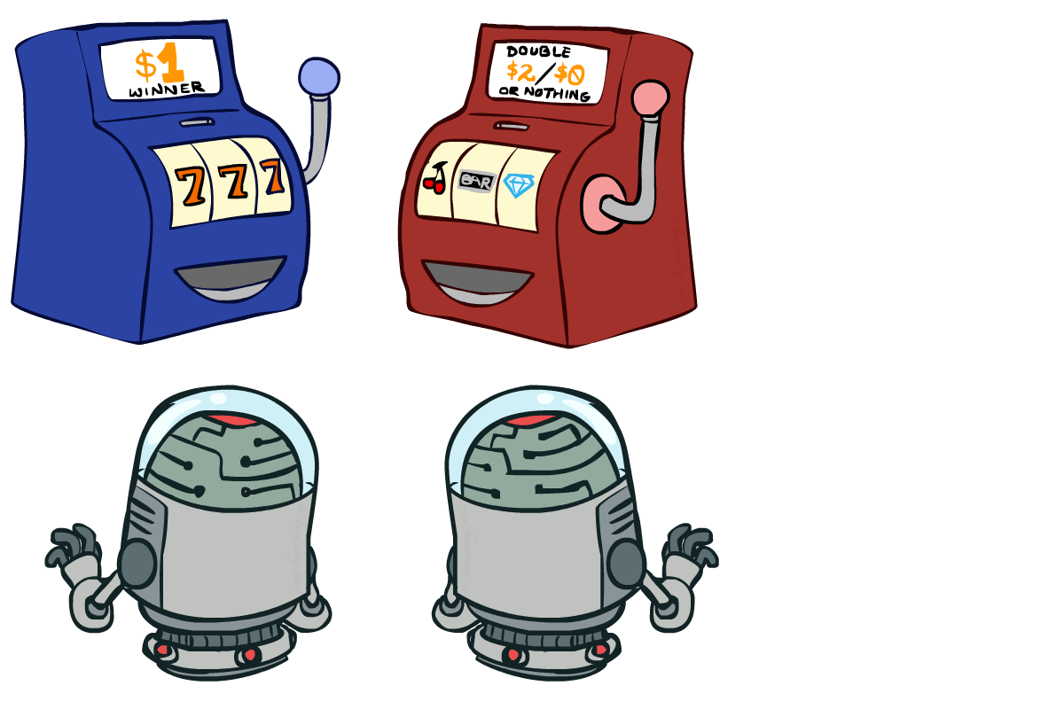
Interlude

