Slide 1


CSE 473: Artificial Intelligence
Constraint Satisfaction Problems
Presenter: Galen Andrew
[These slides were created by Dan Klein and Pieter Abbeel for CS188 Intro to AI at UC Berkeley. All CS188 materials are available at http://ai.berkeley.edu.]
Notes:
Please retain proper attribution, including the reference to ai.berkeley.edu. Thanks!

Slide 2
Announcements
Prof. Weld away today and Wednesday
  I will be beginning the lecture series on Constraint Satisfaction Problems (CSPs)
  Prof. Luke Zettlemoyer will continue on Wednesday.
Project 1: Search
  Due next week, Monday 10/13 at 11:59 PM.
  Start early and ask questions. It’s longer than most!
Come to TA office hours with questions or general help
  Galen: Wed 1:00-3:00
  Nao: Tue 1:30-2:30, Thu 1:00-2:00
  Travis: Fri 3:30-4:30
  Jeff: Wed 10:30-11:30

Slide 3

Constraint Satisfaction Problems

Slide 4


What is Search For?
Assumptions about the world: a single agent, deterministic actions, fully observed state, discrete state space
Planning: sequences of actions
  The path to the goal is the important thing
  Paths have various costs, depths
  Assume little about problem structure
Identification: assignments to variables
  The goal itself is important, not the path
  All paths at the same depth (for some formulations)
  CSPs are structured identification problems

Slide 5


Constraint Satisfaction Problems
Standard search problems:
  State is a “black box”: arbitrary data structure
  Goal test can be any function over states
  Successor function can also be anything
Constraint satisfaction problems (CSPs):
  A special subset of search problems
  State is defined by variables X_{i} with values from a domain D (sometimes D depends on i)
  Goal test is a set of constraints specifying allowable combinations of values for subsets of variables
Making use of CSP formulation allows for optimized algorithms
  Typical example of trading generality for utility (in this case, speed)
Notes:
Goal test has structure, it ‘s more like a manual describing a set of constraints that have to hold true

Slide 6
CSP Examples

Slide 7


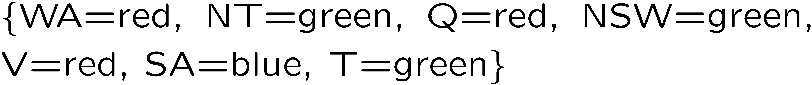
Example: Map Coloring
Variables:
Domains:
Constraints: adjacent regions must have different colors
Solutions are assignments satisfying all constraints, e.g.:
Implicit:
Explicit:

Slide 8
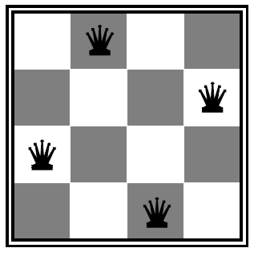

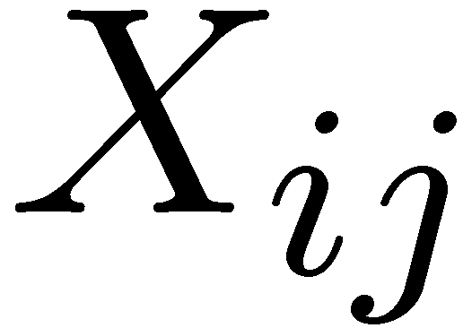

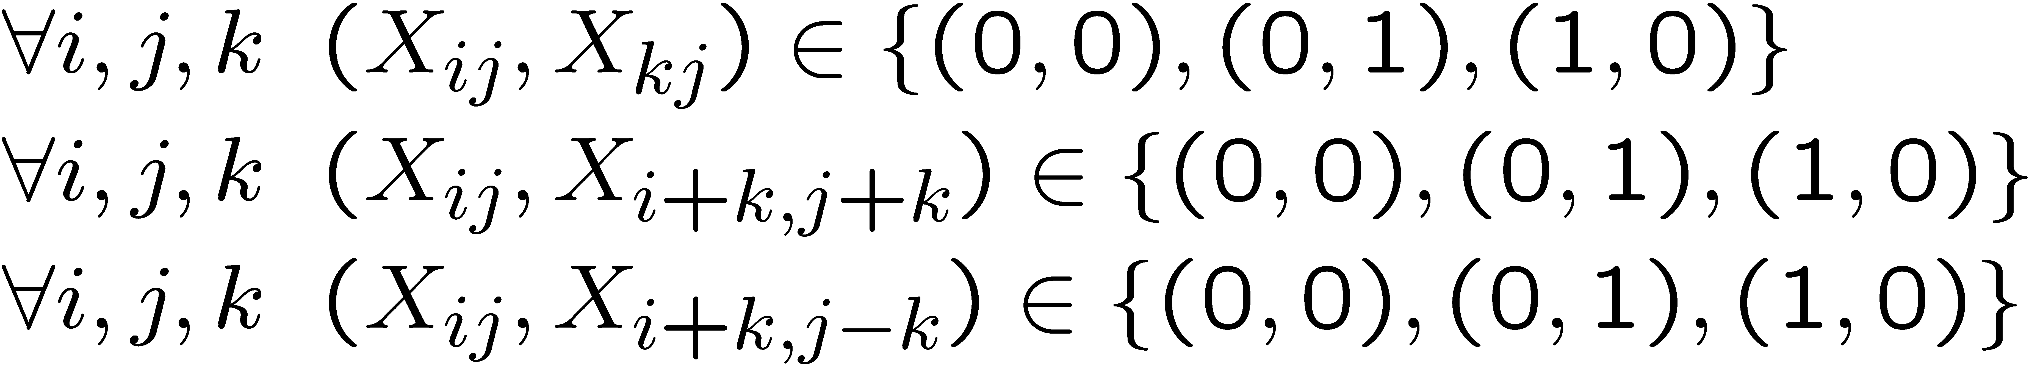
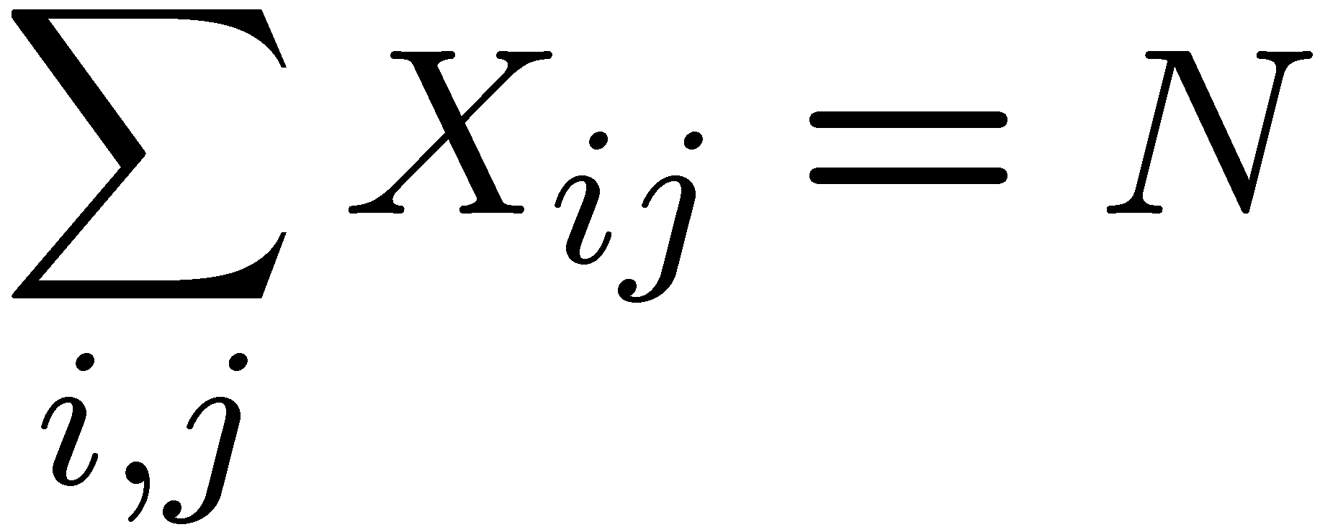
Example: N-Queens
Formulation 1:
  Variables:
  Domains:
  Constraints

Slide 9







Example: N-Queens
Formulation 2:
  Variables:
  Domains:
  Constraints:
Implicit:
Explicit:

Slide 10
Constraint Graphs

Slide 11
Constraint Graphs
Binary CSP: each constraint relates (at most) two variables
Binary constraint graph: nodes are variables, arcs show constraints
General-purpose CSP algorithms use the graph structure to speed up search. E.g., Tasmania is an independent subproblem!
Notes:
Demo:
Run constraint.jar or constraint.exe, load the 5 queens problem.
Demo is just showing the n-queens applet as illustration of constraint graph, but later in lecture we’ll interact with the applet.
aispace.org will have the latest version

Slide 12
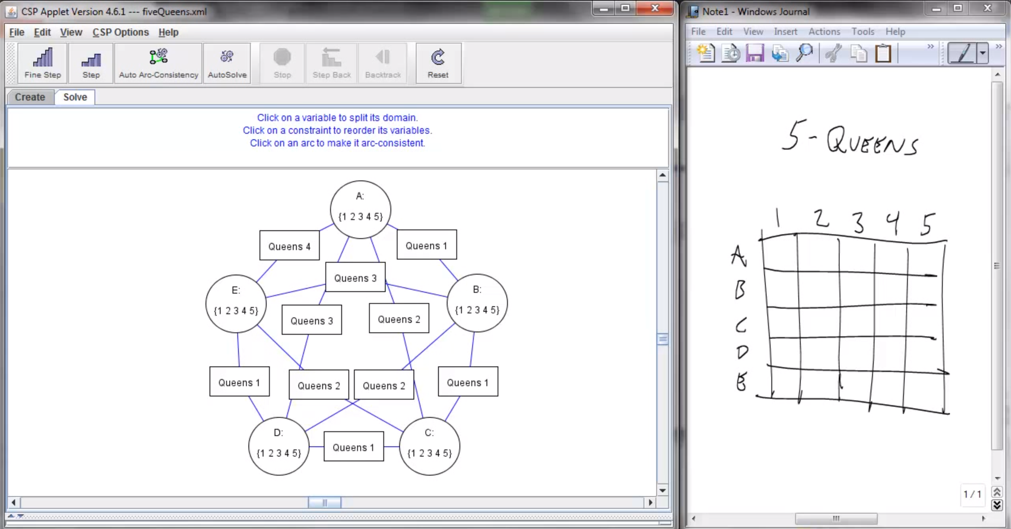
Screenshot of Demo N-Queens
Notes:
Note: the n-queens demo is used later as a demo; at this stage in lecture just the above is shown and talked about without engaging in any interaction with the applet.

Slide 13


Example: Cryptarithmetic
Variables:
Domains:
Constraints:
Notes:
0=7, R=4, W=6, U=2, T=8, F=1; 867 + 867 = 1734

Slide 14
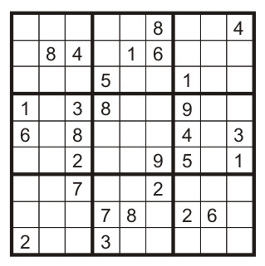
Example: Sudoku
Variables:
  Each (open) square
Domains:
  {1,2,…,9}
Constraints:
9-way alldiff for each column
9-way alldiff for each row
9-way alldiff for each region
(or can have a bunch of pairwise inequality constraints)

Slide 15

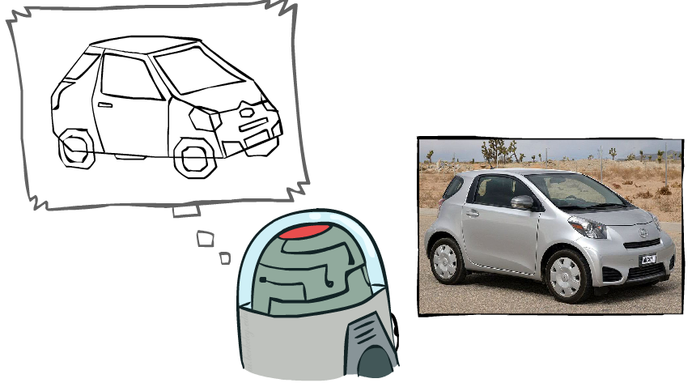
Example: The Waltz Algorithm
The Waltz algorithm is for interpreting line drawings of solid polyhedra as 3D objects
An early example of an AI computation posed as a CSP
?
Approach:
  Each intersection is a variable
  Adjacent intersections impose constraints on each other
  Solutions are physically realizable 3D interpretations

Slide 16


Example: The Waltz Algorithm
The Waltz algorithm is for interpreting line drawings of solid polyhedra as 3D objects
An early example of an AI computation posed as a CSP
?
Approach:
  Each intersection is a variable
  Adjacent intersections impose constraints on each other
  Solutions are physically realizable 3D interpretations

Slide 17

Varieties of CSPs

Slide 18


Varieties of CSP Variables
Discrete Variables
  Finite domains
    Size d means O(d^{n}) complete assignments
    E.g., Boolean CSPs, including Boolean satisfiability (NP-complete)
  Infinite domains (integers, strings, etc.)
    E.g., job scheduling, variables are start/end times for each job
    Linear constraints solvable, nonlinear undecidable
Continuous variables
  E.g., start/end times for Hubble Telescope observations
  Linear constraints solvable in polynomial time by linear program methods (see CSE 521 for a bit of LP theory)

Slide 19


Varieties of CSP Constraints
Varieties of Constraints
  Unary constraints involve a single variable (equivalent to reducing domains), e.g.:
  Binary constraints involve pairs of variables, e.g.:
  Higher-order constraints involve 3 or more variables:
  e.g., cryptarithmetic column constraints
Preferences (soft constraints):
  E.g., red is better than green
  Often representable by a cost for each variable assignment
  Gives constrained optimization problems
  (We’ll ignore these until we get to Bayes’ nets)

Slide 20
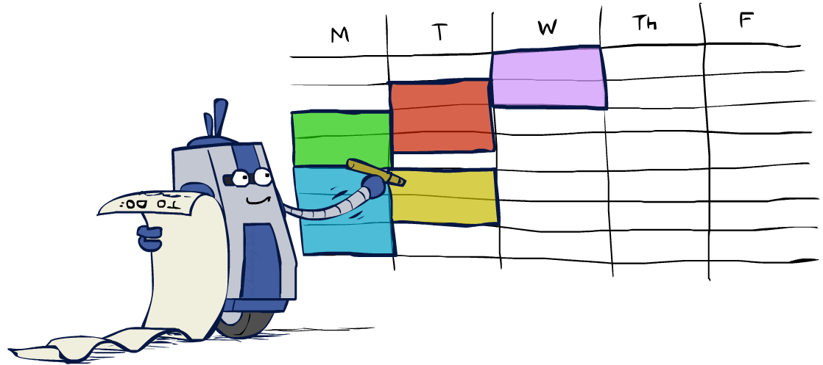
Real-World CSPs
Assignment problems: e.g., who teaches what class
Timetabling problems: e.g., which class is offered when and where?
Hardware configuration (VLSI layout)
Transportation scheduling
Factory scheduling
Circuit layout
Fault diagnosis
… lots more!
Many real-world problems involve real-valued variables…

Slide 21

Solving CSPs

Slide 22
Standard Search Formulation
Standard search formulation of CSPs
States defined by the values assigned so far (partial assignments)
  Initial state: the empty assignment, {}
  Successor function: assign a value to an unassigned variable
  Goal test: the current assignment is complete and satisfies all constraints
We’ll start with the straightforward, naïve approach, then improve it

Slide 23
Search Methods
What would DFS do?
What would BFS do?
What problems does naïve search have?
[Demo: coloring -- dfs]
Notes:
Demo:
CS188 javascript demos -> source -> exercises -> csps -> CSPs demos -> CSPs demos.html
Settings:
Graph = Simple
Algorithm = Naïve Search
Ordering = None
Filtering = None

Slide 24

Video of Demo Coloring -- DFS

Slide 25

Backtracking Search

Slide 26
Backtracking Search
Backtracking search is the basic uninformed algorithm for solving CSPs
Idea 1: One variable at a time
  Variable assignments are commutative, so fix ordering
  I.e., [WA = red then NT = green] same as [NT = green then WA = red]
  Only need to consider assignments to a single variable at each step
Idea 2: Check constraints as you go
  I.e. consider only values which do not conflict previous assignments
  Might have to do some computation to check the constraints
  “Incremental goal test”
Depth-first search with these two improvements
is called backtracking search
Can solve n-queens for n ≈ 25

Slide 27
Backtracking Example

Slide 28
Backtracking Search
What are the choice points?
[Demo: coloring -- backtracking]
Notes:
Demo:
CS188 javascript demos -> source -> exercises -> csps -> CSPs demos -> CSPs demos.html
Settings:
Graph = Simple
Algorithm = Backtracking
Ordering = None
Filtering = None

Slide 29
Video of Demo Coloring – Backtracking

Slide 30

Improving Backtracking
General-purpose ideas give huge gains in speed
Ordering:
  Which variable should be assigned next?
  In what order should its values be tried?
Filtering: Can we detect inevitable failure early?
Structure: Can we exploit the problem structure?

Slide 31

Filtering

Slide 32
Filtering: Forward Checking
Filtering: Keep track of domains for unassigned variables and cross off bad options
Forward checking: Cross off values that violate a constraint when added to the existing assignment
WA
NT
Q
SA
NSW
V
[Demo: coloring -- forward checking]
Notes:
Demo:
CS188 javascript demos -> source -> exercises -> csps -> CSPs demos -> CSPs demos.html
Settings:
Graph = Simple
Algorithm = Backtracking
Ordering = None
Filtering = Forward Checking

Slide 33
Video of Demo Coloring – Backtracking with Forward Checking

Slide 34
Filtering: Constraint Propagation
Forward checking only propagates information from assigned to unassigned
It doesn't catch when two unassigned variables have no consistent assignment:
NT and SA cannot both be blue!
Why didn’t we detect this yet?
Constraint propagation: reason from constraint to constraint
NT
Q
WA
SA
NSW
V

Slide 35

Consistency of a Single Arc
An arc X → Y is consistent iff for every x in the tail there is some y in the head which could be assigned without violating a constraint
Forward checking: Enforcing consistency of arcs pointing to each new assignment
NT
Q
WA
SA
NSW
V
Delete from the tail!

Slide 36
Arc Consistency of an Entire CSP
A simple form of propagation makes sure all arcs are consistent:
Important: If X loses a value, neighbors of X need to be rechecked!
Arc consistency detects failure earlier than forward checking
Can be run as a preprocessor or after each assignment
What’s the downside of enforcing arc consistency?
NT
Q
WA
SA
NSW
V
Remember: Delete from the tail!

Slide 37
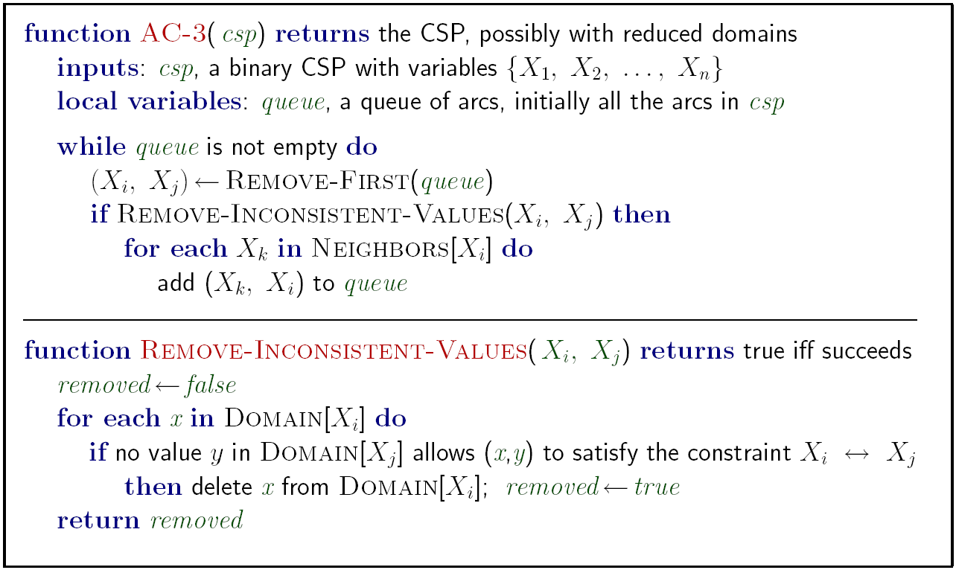
AC-3 algorithm for Arc Consistency
Runtime: O(n²d³), can be reduced to O(n²d²)
… but detecting all possible future problems is NP-hard – why?
[Demo: CSP applet (made available by aispace.org) -- n-queens]
Notes:
Auto-consistency (note initially nothing gets deleted/pruned since there are consistent options for all constraints for initial variable domains)
Flashes whenever something needs to be re-checked

Slide 38
Video of Demo Arc Consistency – CSP Applet – n Queens

Slide 39
Limitations of Arc Consistency
After enforcing arc consistency:
  Can have one solution left
  Can have multiple solutions left
  Can have no solutions left (and not know it)
Arc consistency still runs inside a backtracking search!
What went wrong here?
[Demo: coloring -- forward checking]
[Demo: coloring -- arc consistency]
Notes:
Demo:
CS188 javascript demos -> source -> exercises -> csps -> CSPs demos -> CSPs demos.html
Settings:
Graph = Complex
Algorithm = Backtracking
Ordering = None
Filtering = Forward Checking (first) / Arc Consistency (second)

Slide 40
Video of Demo Coloring – Backtracking with Forward Checking – Complex Graph

Slide 41
Video of Demo Coloring – Backtracking with Arc Consistency – Complex Graph

Slide 42

Ordering

Slide 43

Ordering: Minimum Remaining Values
Variable Ordering: Minimum remaining values (MRV):
  Choose the variable with the fewest legal left values in its domain
Why min rather than max?
Also called “most constrained variable”
“Fail-fast” ordering

Slide 44

Ordering: Maximum Degree
Tie-breaker among MRV variables
  What is the very first state to color? (All have 3 values remaining.)
Maximum degree heuristic:
  Choose the variable participating in the most constraints on remaining variables
Why most rather than fewest constraints?

Slide 45

Ordering: Least Constraining Value
Value Ordering: Least Constraining Value
  Given a choice of variable, choose the least constraining value
  I.e., the one that rules out the fewest values in the remaining variables
  Note that it may take some computation to determine this! (E.g., rerunning filtering)
Why least rather than most?
Combining these ordering ideas makes
1000 queens feasible

Slide 46
Rationale for MRV, MD, LCV
We want to enter the most promising branch, but we also want to detect failure quickly
MRV+MD:
  Choose the variable that is most likely to cause failure
  It must be assigned at some point, so if it is doomed to fail, better to find out soon
LCV:
  We hope our early value choices do not doom us to failure
  Choose the value that is most likely to succeed

Slide 47
Demo: Coloring -- Backtracking + Forward Checking + Ordering
Notes:
Demo:
CS188 javascript demos -> source -> exercises -> csps -> CSPs demos -> CSPs demos.html
Settings:
Graph = Complex
Algorithm = Backtracking
Ordering = MRV
Filtering = Forward Checking
Solves already without any need for backtracking
Note: need a bigger problem to illustrate relevance of backtracking+AC+MRV+MCV

