Slide 1
Layout
The Art of Knowing Where Things Are

Slide 2
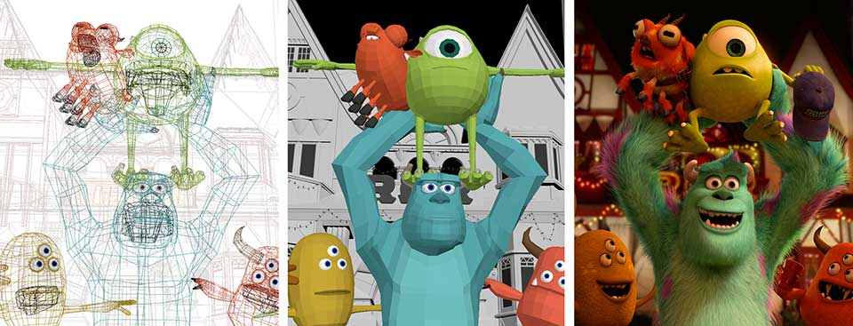
What is Layout?
storyboard
layout
final render

Slide 3
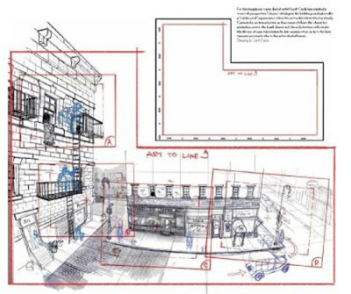
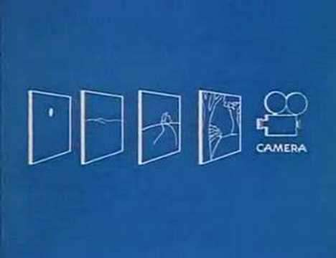
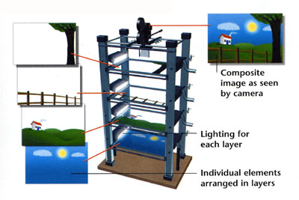
History
Began in 2D
Animated cinematography
Multiplane Camera!
An example of traditional layout, where a background has been laid out, and a camera move has been planned over it, as represented by red frames panning over the background.

Slide 4
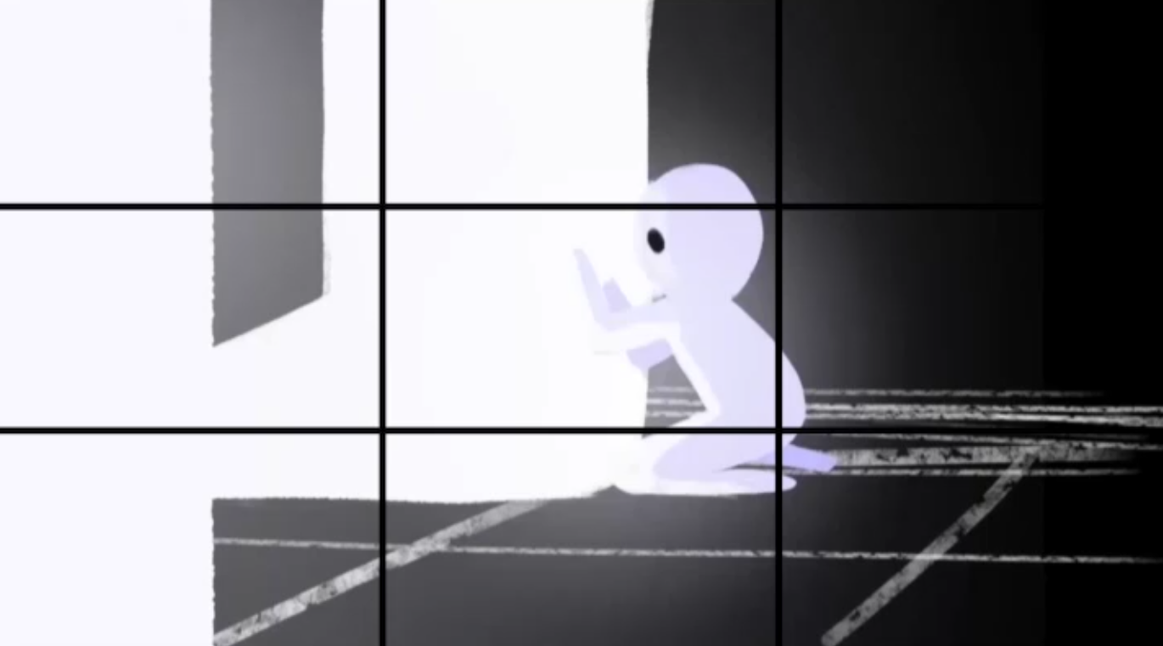
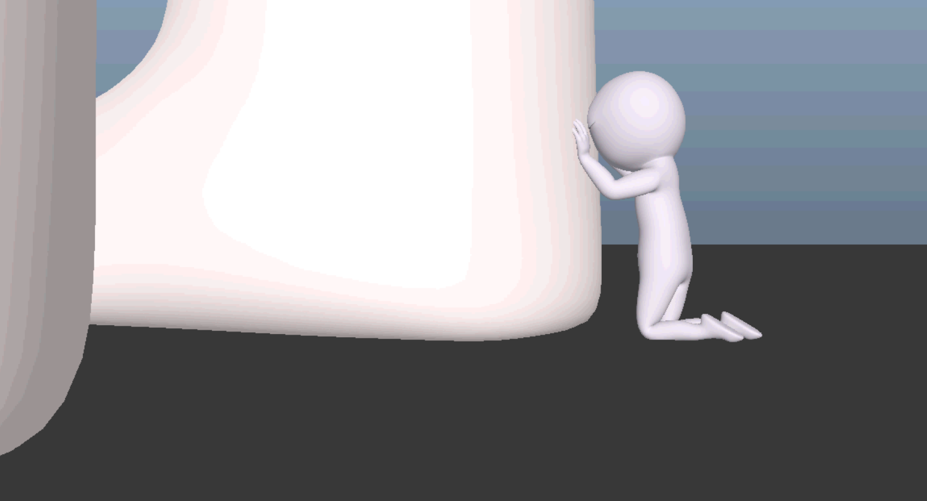
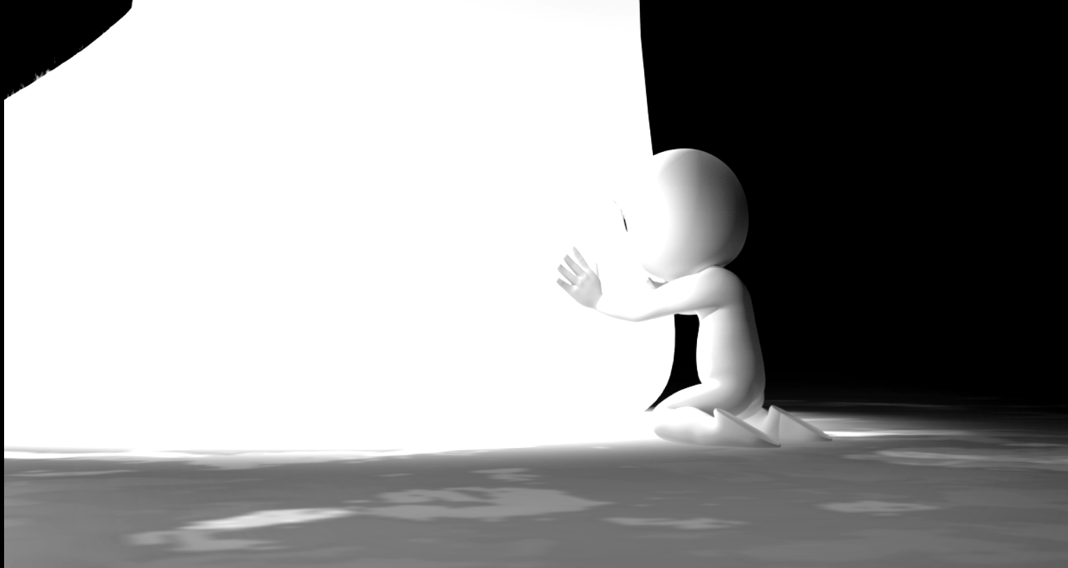
The Importance of 3D Layout
A lot of assets to keep track of in production!
Efficiency is important!
Consider these questions:
What assets are needed in the production?
How are the assets organized?
Where are the characters, props, settings, etc., in relation to the camera throughout the film?
Layout serves a function similar to a cinematographer
Layout falls between Storyboards/Animatics and Animation
Layout will translate 2D storyboards into 3D and find the issues before shots get too complex.
2D Storyboards
Layout Test
Final Render

Slide 5
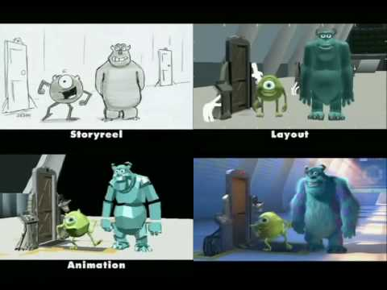
Monsters Inc - Progression Reel

Slide 6
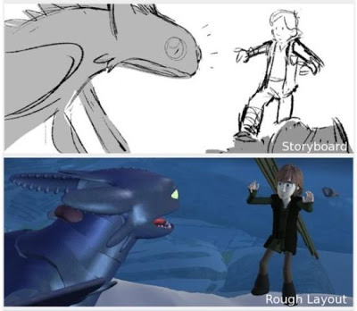
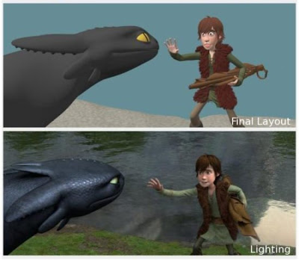
Layout vs. Animatics
Animatic .

Slide 7
Responsibilities for Layout Artists
Initial Responsibilities
Translate storyboards or animatics
Place characters, props, and environments in the camera view
Set characters in key poses to define actions and movements
Define camera angles for individual shots and animate if needed
Adapt shot staging according to the needs of the composition
Maintain timing to coincide with the animatic
Troubleshooting
Go back to do a final camera passing
For example: adding in reactionary camera adjustments to follow animation acting, adding camera shakes, or adding ambient motion to help prevent static shots!
Add padding and extra time if director calls for it
And more!
Notes:
Teams of layout artists will translate storyboards or animatics.
In charge of manipulating the camera to dictate what’s seen on screen and capture most important emotion/plot of the scene. Rule of thirds!
Layout artists position and pose according to action and dialogue, giving animators a starting point from which to fully flesh out the characters movements and expressions.

Slide 8
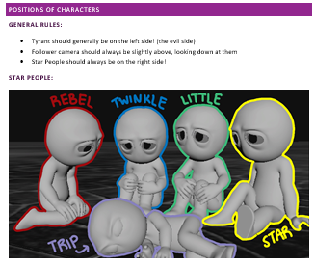
What you need to know
Shot composition
Lens choices and camera effects
Continuity
Screen direction
How to tell the story with your shots
How long the shots are and padding
Where the assets will be
All shots tell the story. Layout artists need to be aware of how compositions and assets will support the entire film.
Being good means being both imaginative AND grounded in reality!

Slide 10
Camera Tips!
Cameras need to be motivated in each shot.
The Tyrant is a good example of this. To make viewers understand the scale, the camera needs to react to its environment.
Make the camera shifts seem natural.

Slide 11
What is where?

Slide 12
Characters in relation to each other
What is the relative size of your characters?
What size does your set need to be?
Maintaining the “Family Tree”
Knowing the status and location of all current characters
“Short Changed” Family Tree
Notes:
Family tree is for scale and how objects will interact in their environment

Slide 13
Family Trees!

Slide 14
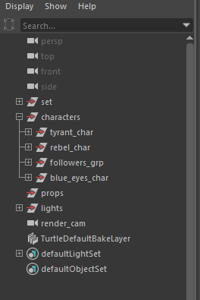
Characters in a Maya File
Is the outliner clean and easy for the animators to use?
Are the lights, effects, props and characters all grouped correctly?
Are all your shaders, materials, groups, assets, and elements properly named?
Are your Maya files running too slowly?
Are your characters and props all up to date with the latest version?
Is anything currently broken?
Typical “Tyrant” Outliner

Slide 15
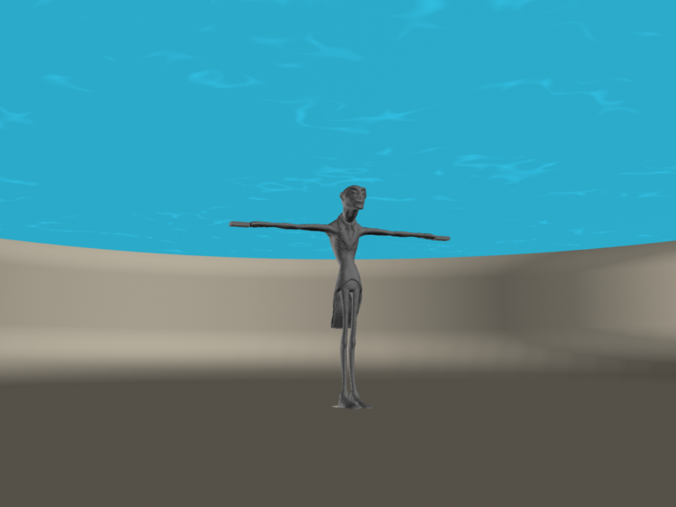
Characters in a Set
How do the characters fit with the scale of your set?
What size does your set need to be?
Are there any constraints on the size of your characters or props?
Do the right people know about those constraints?
“Short Changed” - Corruption scale in the fountain set

Slide 16
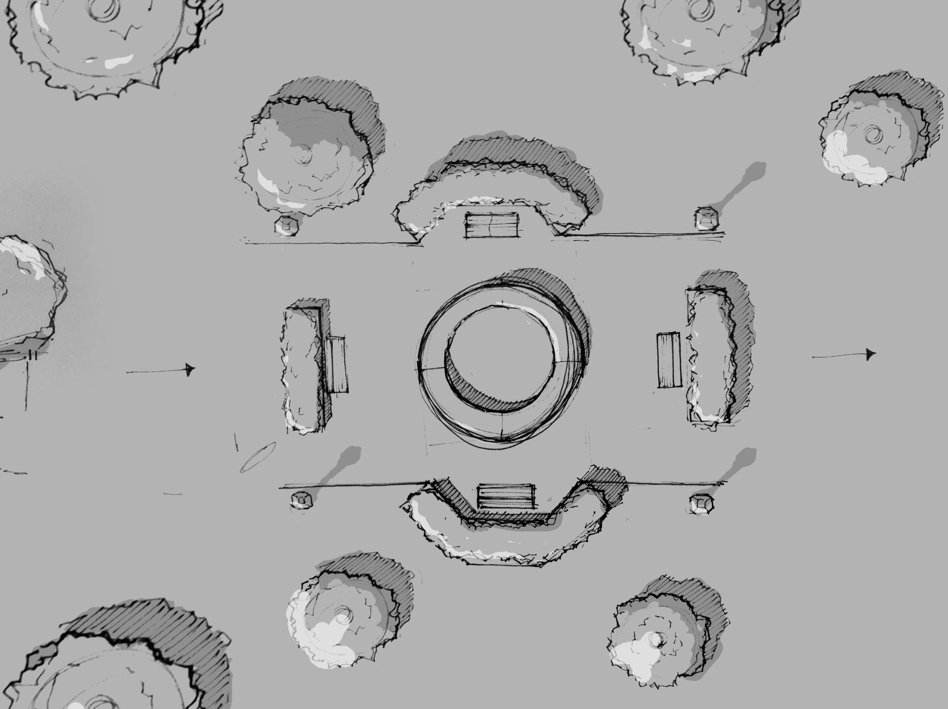
Set in Relation to Itself
What does the set look like?
Where are all the:
Props
Scenes
Locations
Main Lighting Points
Shots
Characters
Beginnings
Endings
Beats
And so on!
Maps!
Set layout from “Short Changed”

Slide 17
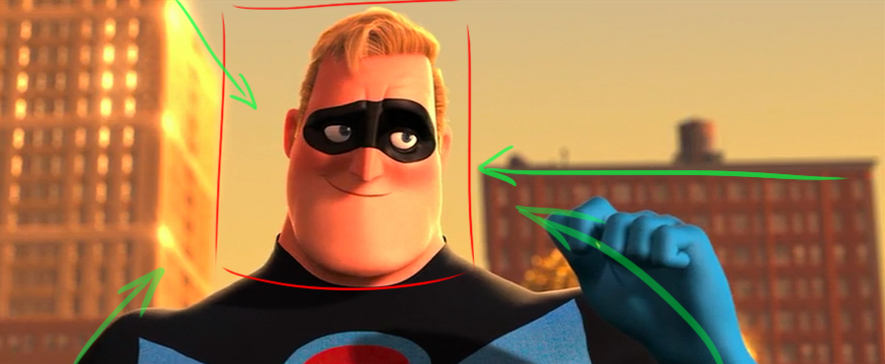
Characters in a Shot
Cinematography
Are you obeying basic laws of composition?
Is the camera correctly working for the storytelling?
Are all of the story beats visible?
Are all of characters correctly visible?
Are focus, blur, flare and other camera effects used correctly and efficiently?

Slide 18
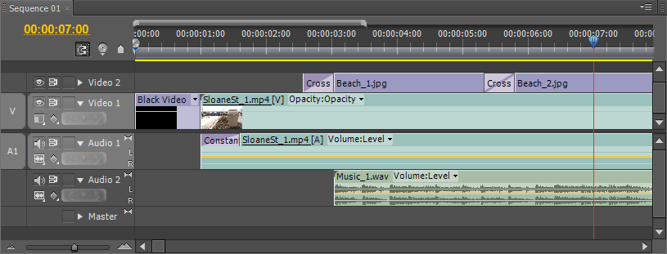
Shots in Relation To Each Other
How long are each of your shots?
Where is this information accessible?
Do your editors need buffer padding?
Are your animators working in padding?
Do the editors have the most updated version of the shots?
Is there any particular shot lagging behind?
Do people know it’s lagging behind?

Slide 19
Files in the File Hierarchy
Are all of your folders properly named?
Is there an appropriate number of branches in your file tree?
How long does it take someone not in a group to find a file from that group?
Are any teams using cloud storage?
Is everything on the server?
(It should be)
(It really, really, should be)
(Or layout will be very, very sad)
(This sad)

Slide 20
Files in the File Hierarchy
Are all of your folders properly named?
Is there an appropriate number of branches in your file tree?
How long does it take someone not in a group to find a file from that group?
Are any teams using cloud storage?
Is everything on the server?
(It should be)
(It really, really, should be)
(Or layout will be very, very sad)
(This sad)

Slide 21
Role of the Student Producer and Director
The Student Producer will ask questions like:
Where is the production team at now?
How is the entire production team functioning?
What are the next steps that need to be taken to make sure the team is functioning well?
The Director will ask questions like:
Where is the story at now?
Where is the development of the story?
What are the next steps that need to be taken to make sure the story is being told?

Slide 22
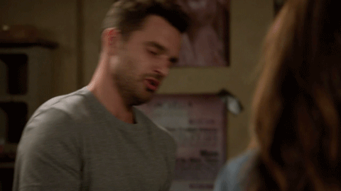
The Story Bible!
The central focus of the production
It’s a physical copy of the production, containing all the information about the story.
There’s always a section for layout, which includes:
Map of the Set Layout
Family tree of the characters
Descriptions of each shot
Camera and shot positions
Notes:
Story bible has the camera and shot positions!
Whether it was a medium close up or not will be in the bible!

Slide 23
Be Proactive!
The three rules of Layout:
Know where every asset and shot plan is.
Be able to tell people where the assets are that they need.
Be able to tell what assets people need without them asking - and then GO TELL THEM!
Understand what the people around you are working on
Attend as many meetings as you can
Take a lot of notes
Address problems before they happen
Be Nice!

Slide 24
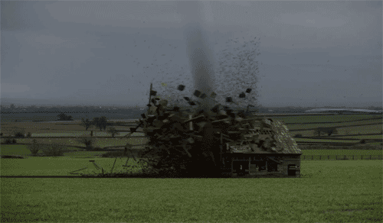
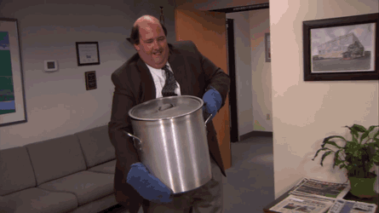
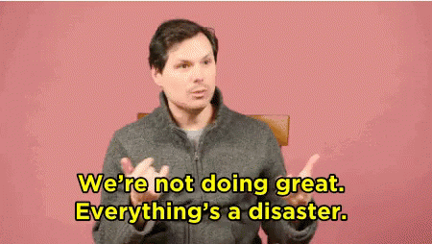
Also, Disaster Control
Sometimes things just go wrong
Google is your friend
Maya is not
Be the person people will go to
Know where to find backups of assets!
Assets will have iterations, so you may need to revert back
If you can’t find out where something is, it may as well not exist!

Slide 25
Resources
Pixar’s Khan Academy
David Badgerow’s Article on Layout
What the Heck is CG Layout?
Camera Animation Article
Cinematography
Autodesk's Camera Help
Disney’s Multiplane Camera

