Slide 1
Computer Vision CSE 455 Image Coordinates and Resizing Linda Shapiro Professor of Computer Science & Engineering Professor of Electrical Engineering

Slide 2
What is an image?

Slide 3
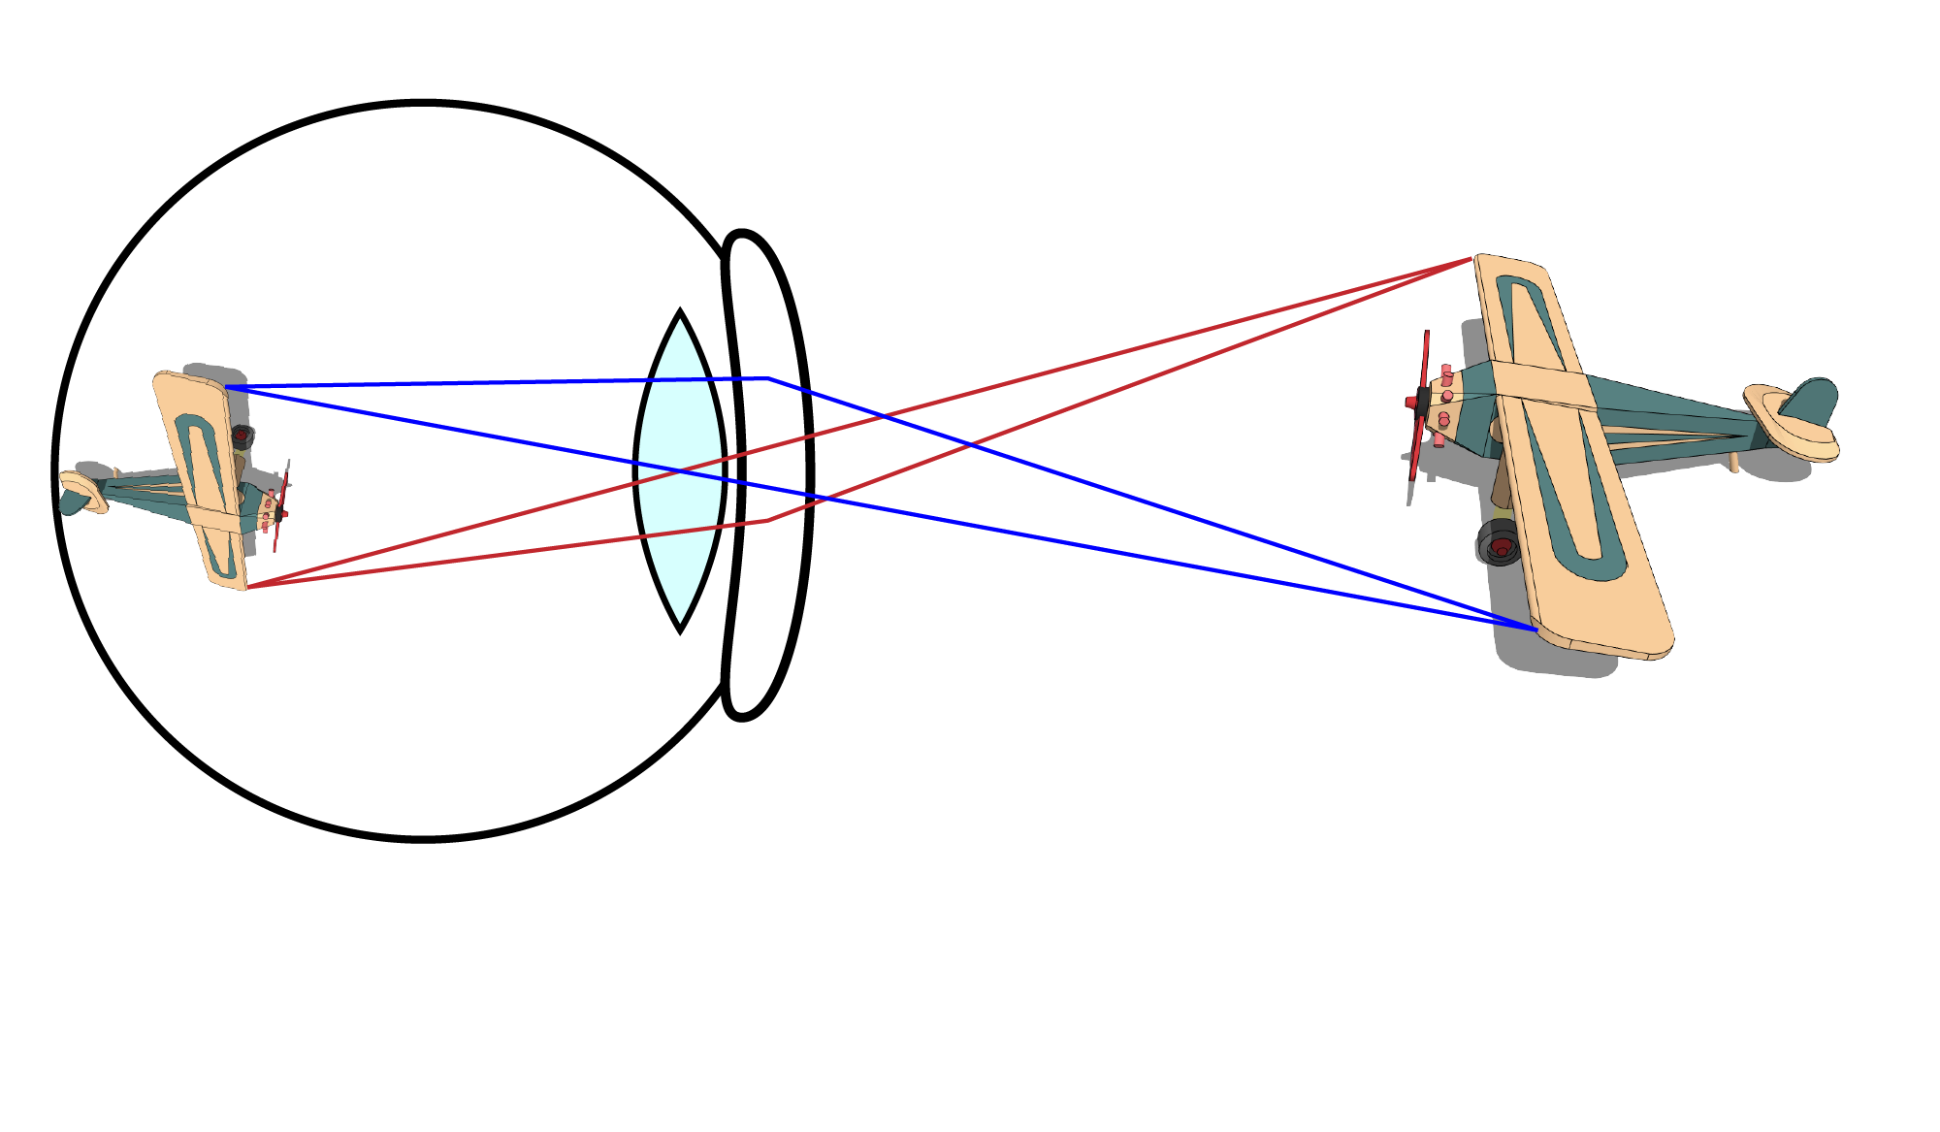
Eyes: projection onto retina

Slide 4
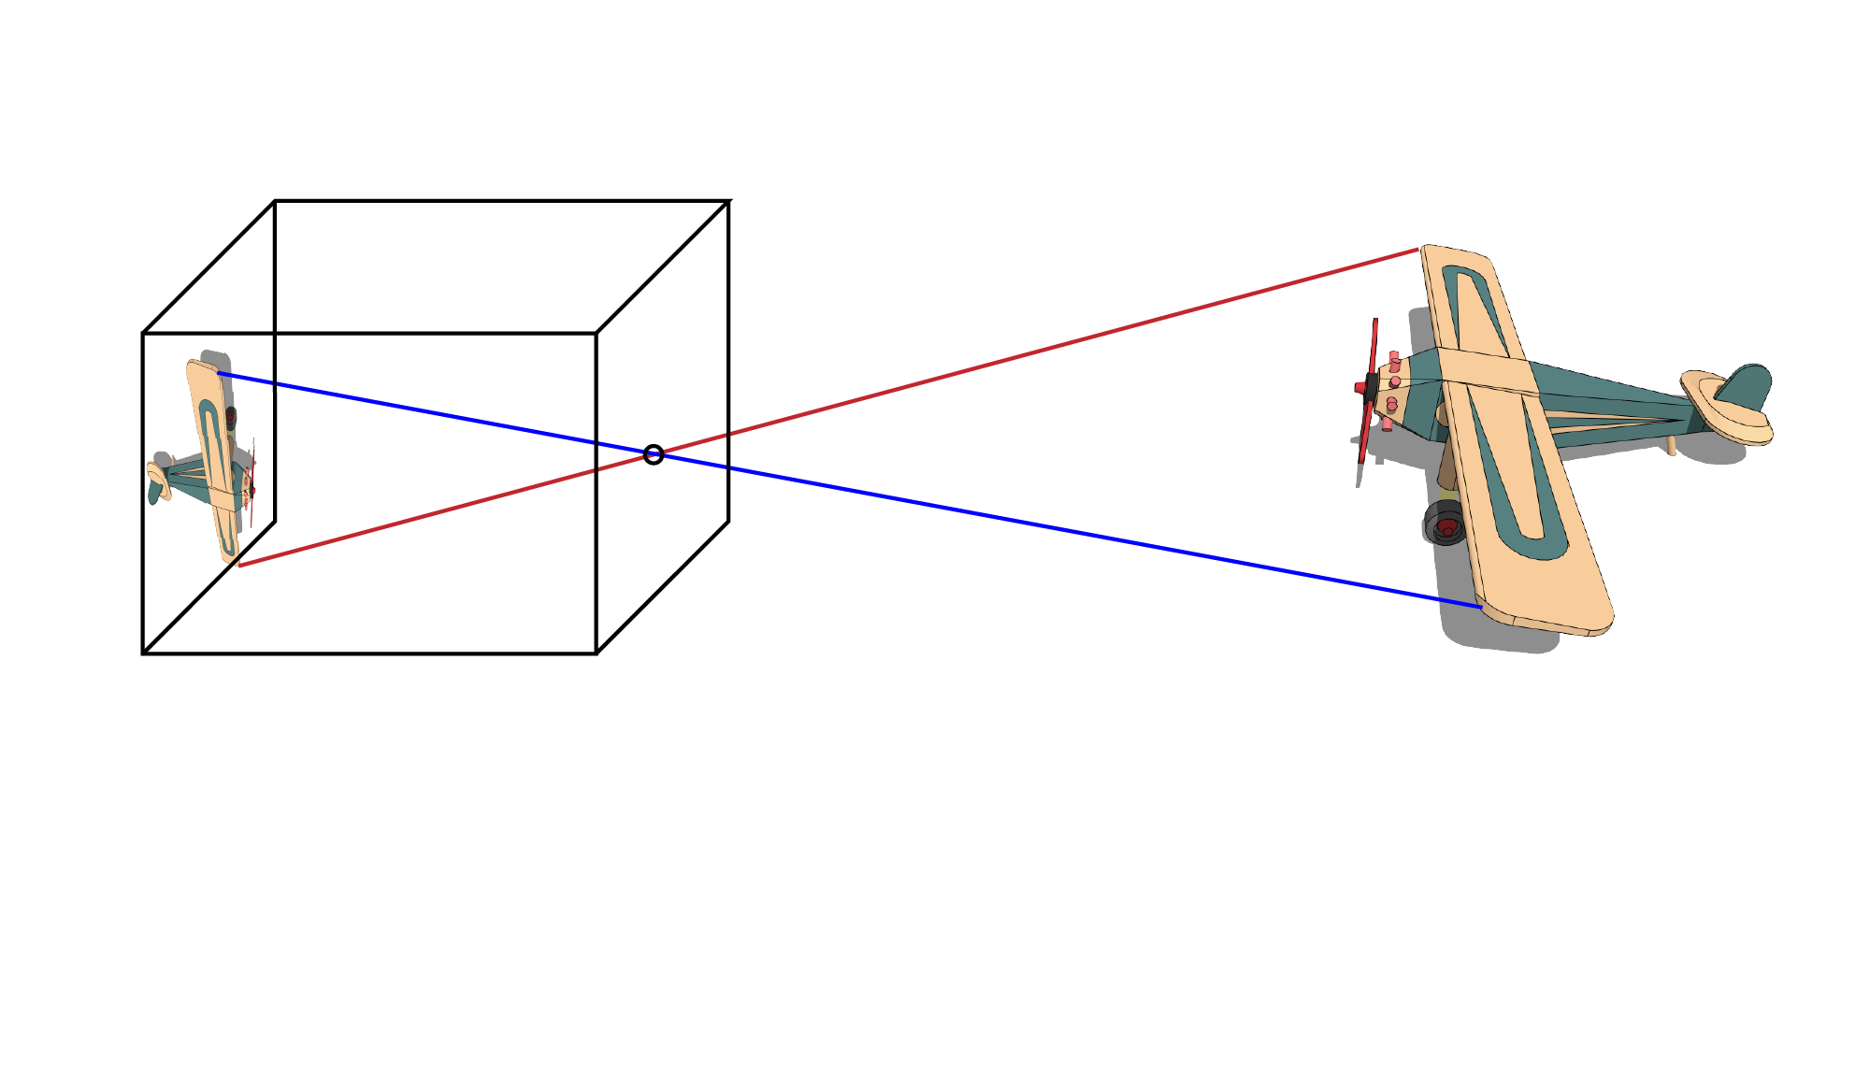
Model: pinhole camera

Slide 5
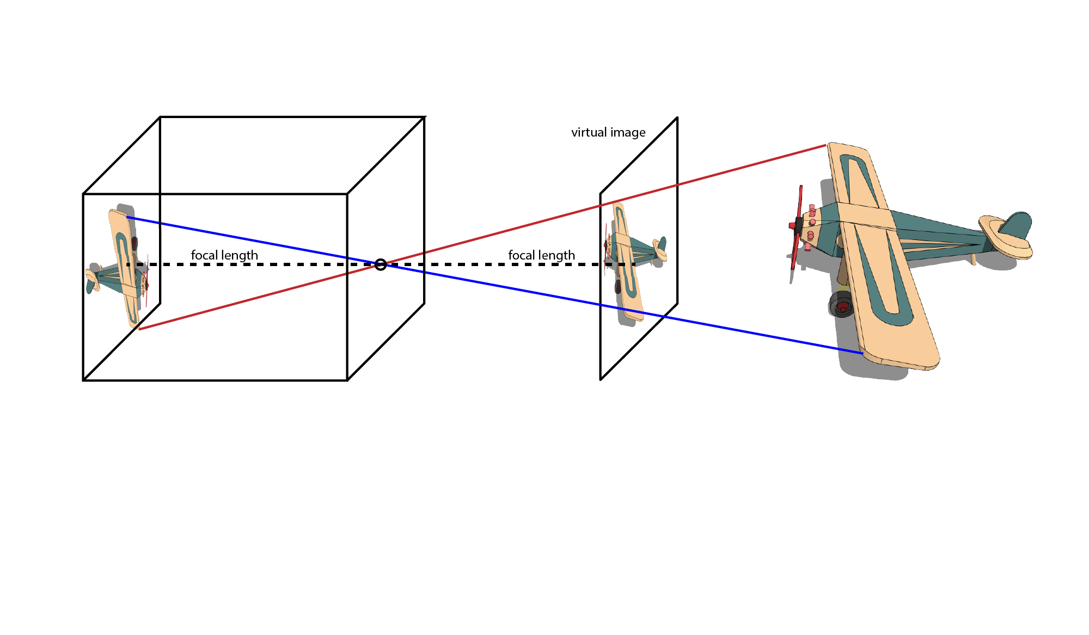
Model: pinhole camera

Slide 6
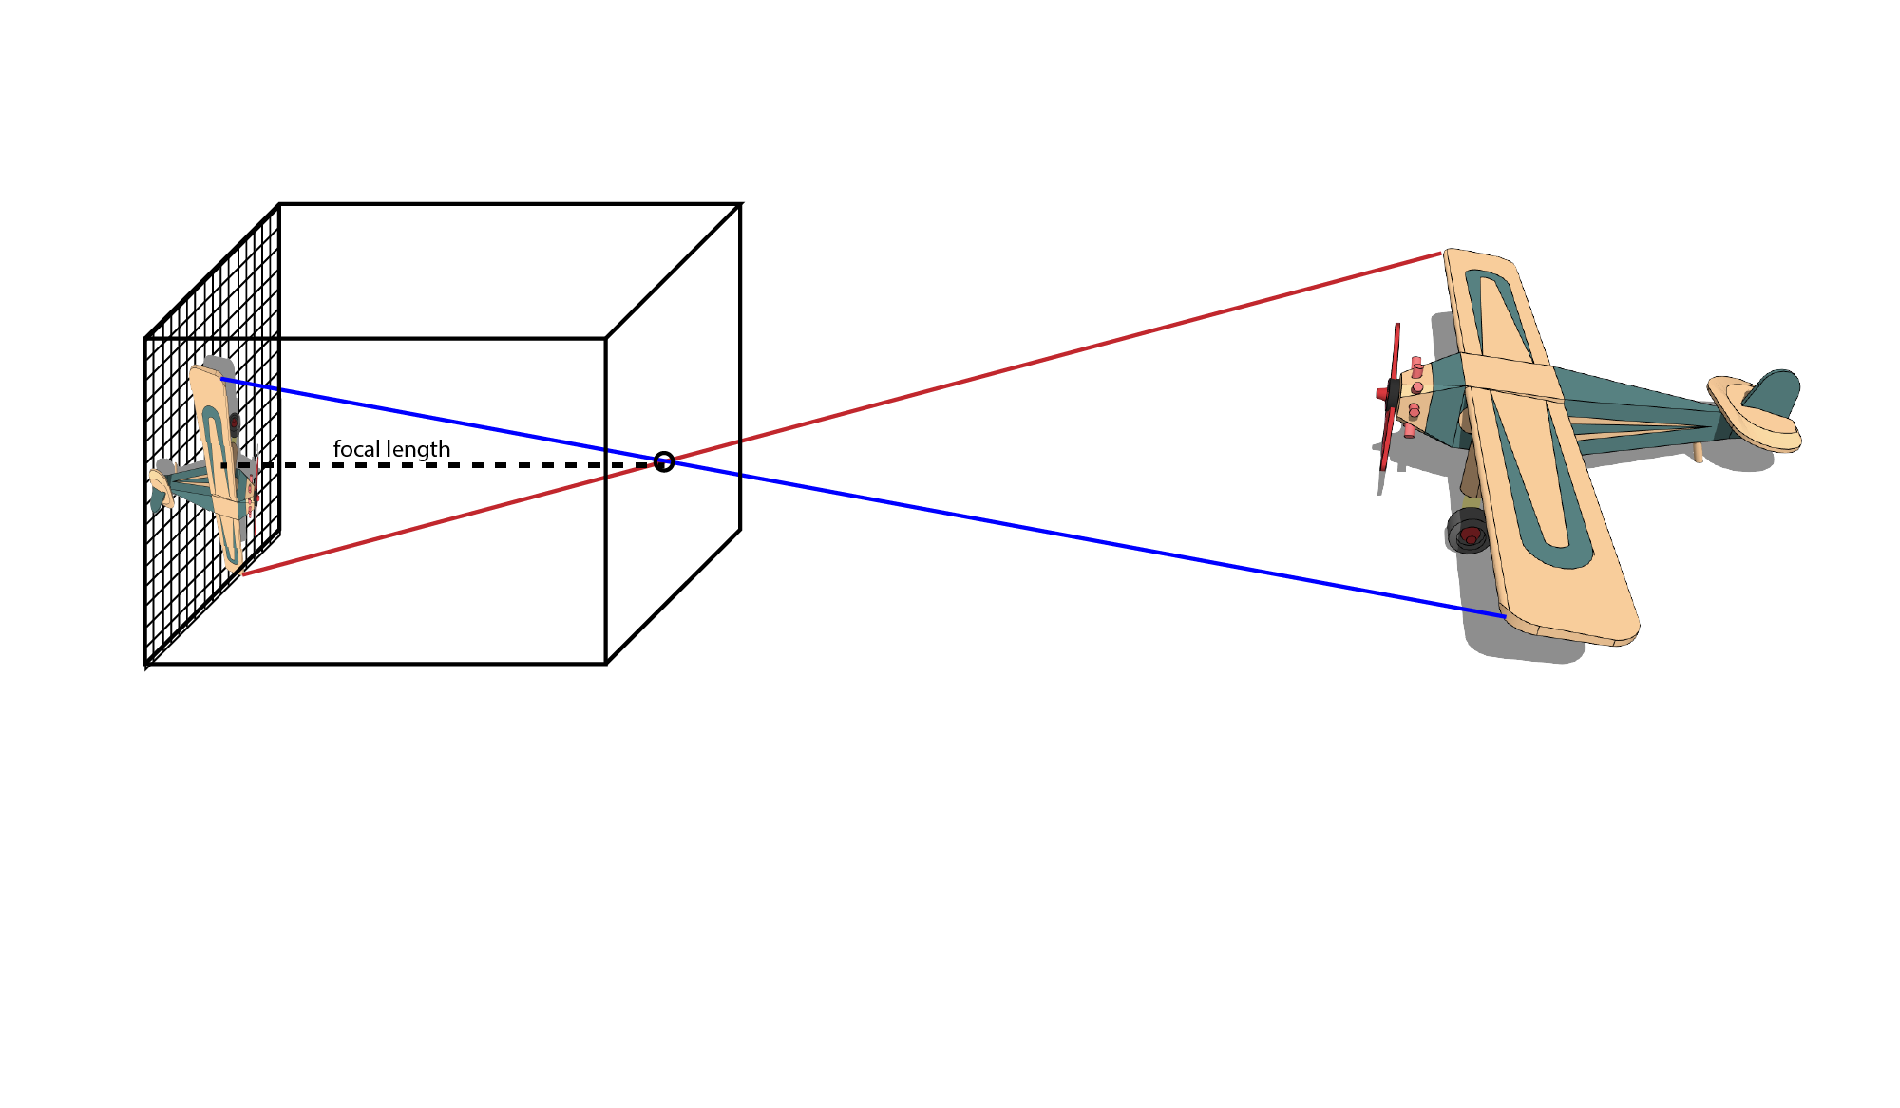
At each point we record incident light

Slide 7
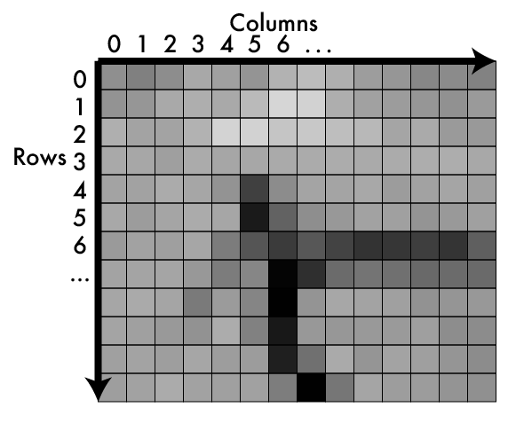
An image is a matrix of light

Slide 8
Values in matrix = how much light

Slide 9
Values in matrix = how much light
Higher = more light
Lower = less light
Bounded
No light = 0
Sensor/device limit = max
Typical ranges:
[0-255], fit into byte
[0-1], floating point
Called pixels

Slide 10
Addressing pixels
Ways to index:
(r,c)
Like matrix notation
(3,6) is row 3 column 6
(x,y)
Like cartesian coordinates (but from
the TOP)
(3,6) is column 3 row 6
We use (x,y)
So does your homework!
Arbitrary
Only thing that matters is consistency

Slide 11
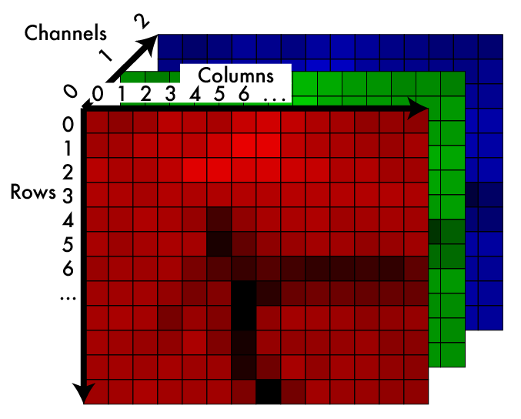
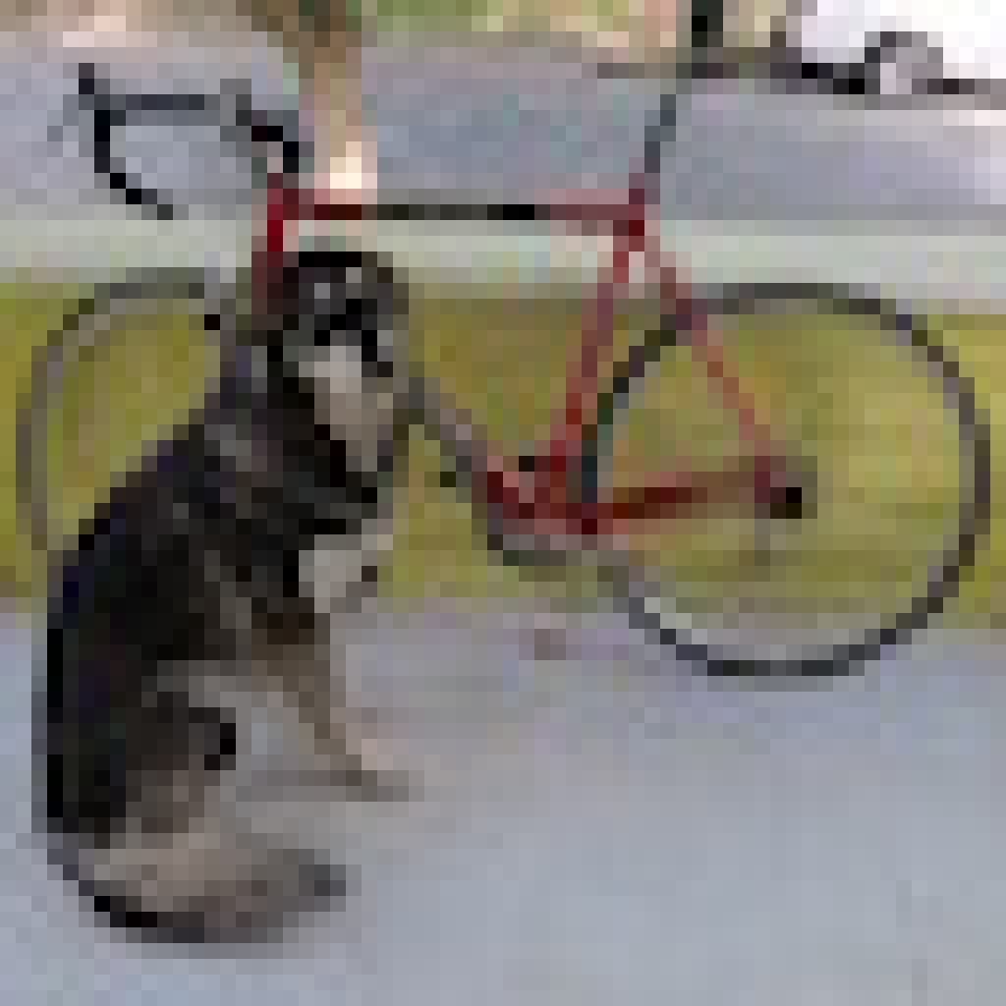
Color image: 3d tensor in colorspace

Slide 12
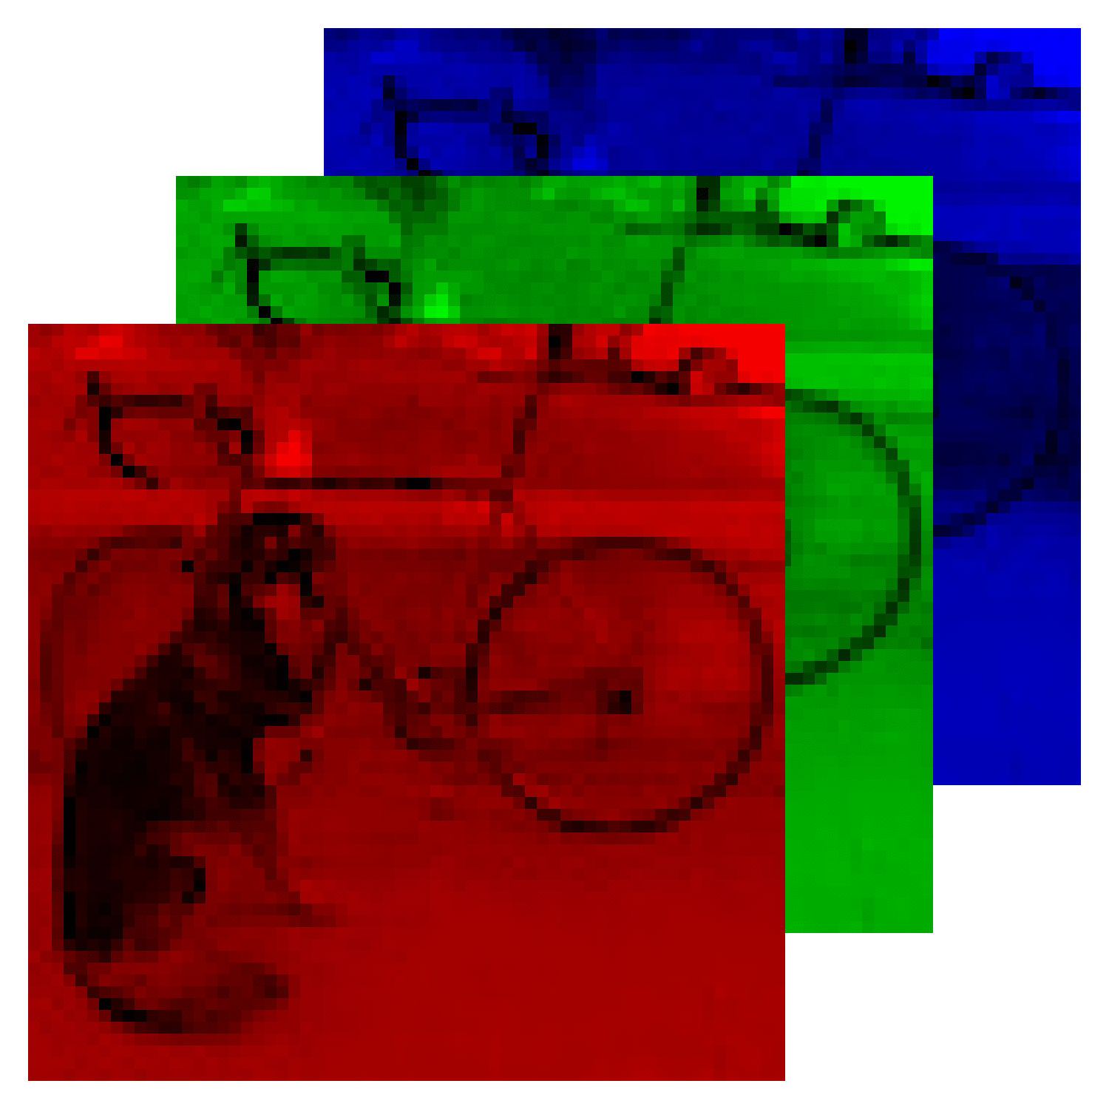
RGB information in separate “channels”
Remember: we can match “real” colors using a mix of primaries.
Each channel encodes one primary. Adding the light produced from each primary mimics the original color.

Slide 13
Addressing pixels
We use (x,y,c)
(1,2,0):
column 1, row 2, channel 0
Be consistent
But do what we do for homeworks :-)
Also for size:
1920 x 1080 x 3 image:
1920 px wide
1080 px tall
3 channels

Slide 14
How do we store them?
129 | 131 | 152 | 159 | 135 | 163 | 142 | 82 | 182 | ...

Slide 15
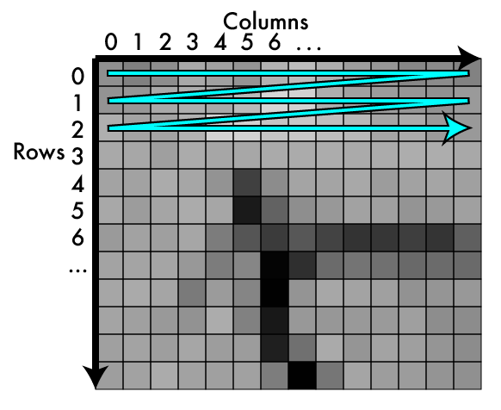
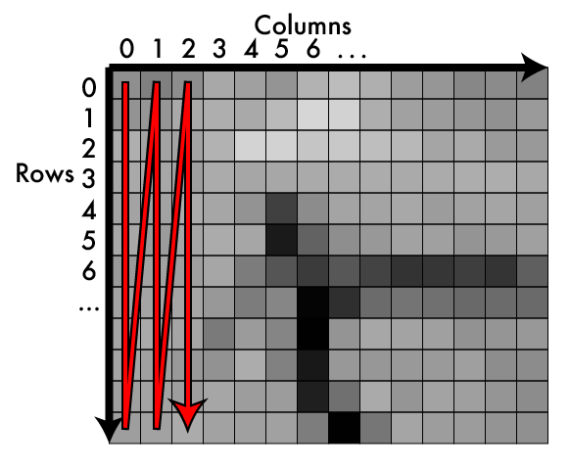
Storage: row major vs column major
Row Major Column Major

Slide 16
Storage: row major vs column major
HW
WH

Slide 17
Typically use row-major or HW

Slide 18
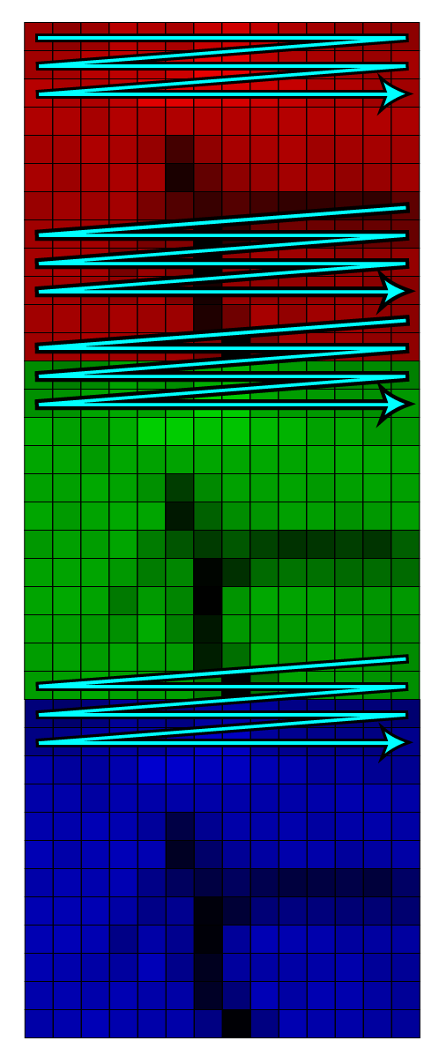
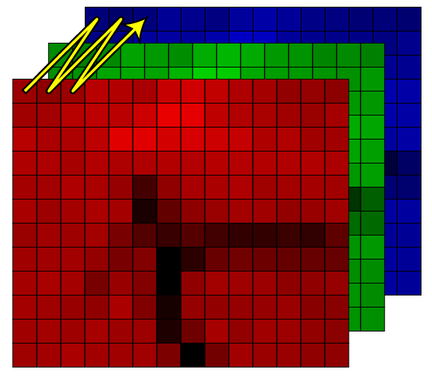
In 3d we have more choices!

Slide 19
HWC: channels interleaved
129 | 131 | 152 | 159 | 135 | 163 | 142 | 82 | 182 | ...

Slide 20
CHW: channels separated
129 | 131 | 152 | ... | 135 | 163 | 142 | ... | 182 | ...

Slide 21
CHW Pop quiz
We’ll use CHW, it’s what a lot of other libraries use.
In an array for a 1920 x 1080 x 3 image what entry would contain the pixel (15,192,2)?
Formula:
x + y*W + z*W*H
z
y
x
H
W

Slide 22
CHW Pop quiz
In an array for a 1920 x 1080 x 3 image what entry would contain the pixel (15,192,2)?
In general for (x,y,z) of image (W,H,C)
x + y*W + z*W*H
15 + 192*1920 + 2*1920*1080 = 4,515,855
Remember, everything is 0 indexed
Where does (0,0,0) go?
Position 0 + 0 + 0 = 0

Slide 23
In your homework
typedef struct {
int w,h,c;
float *data;
} image;

Slide 24
Image interpolation and resizing

Slide 25
An image is kinda like a function
An image is a mapping from indices to pixel value:
Im: I x I x I -> R
We may want to pass in
non-integers:
Im’: R x R x I -> R

Slide 26
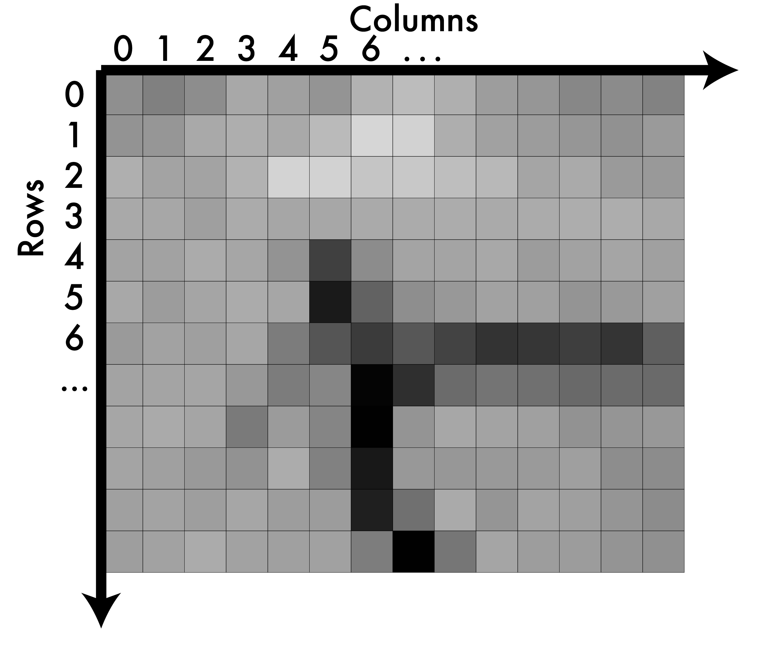
A note on coordinates in images
integer pixels

Slide 27
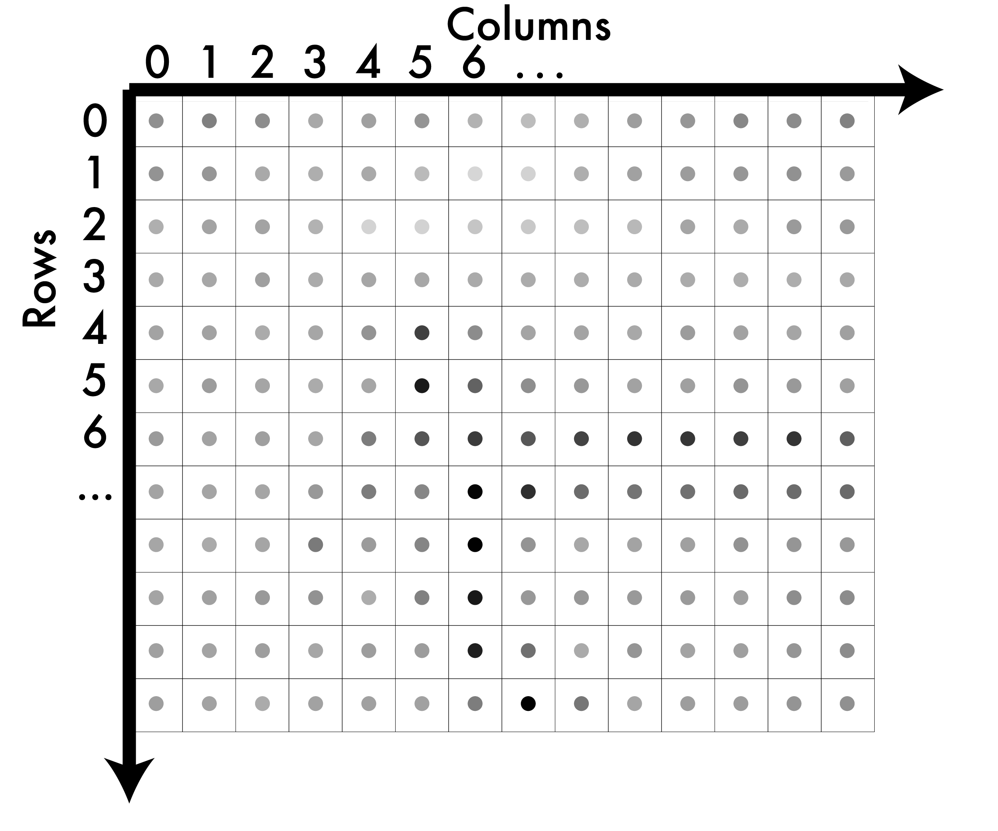
A note on coordinates in images
We can think of their
values as being at the
centers.

Slide 28
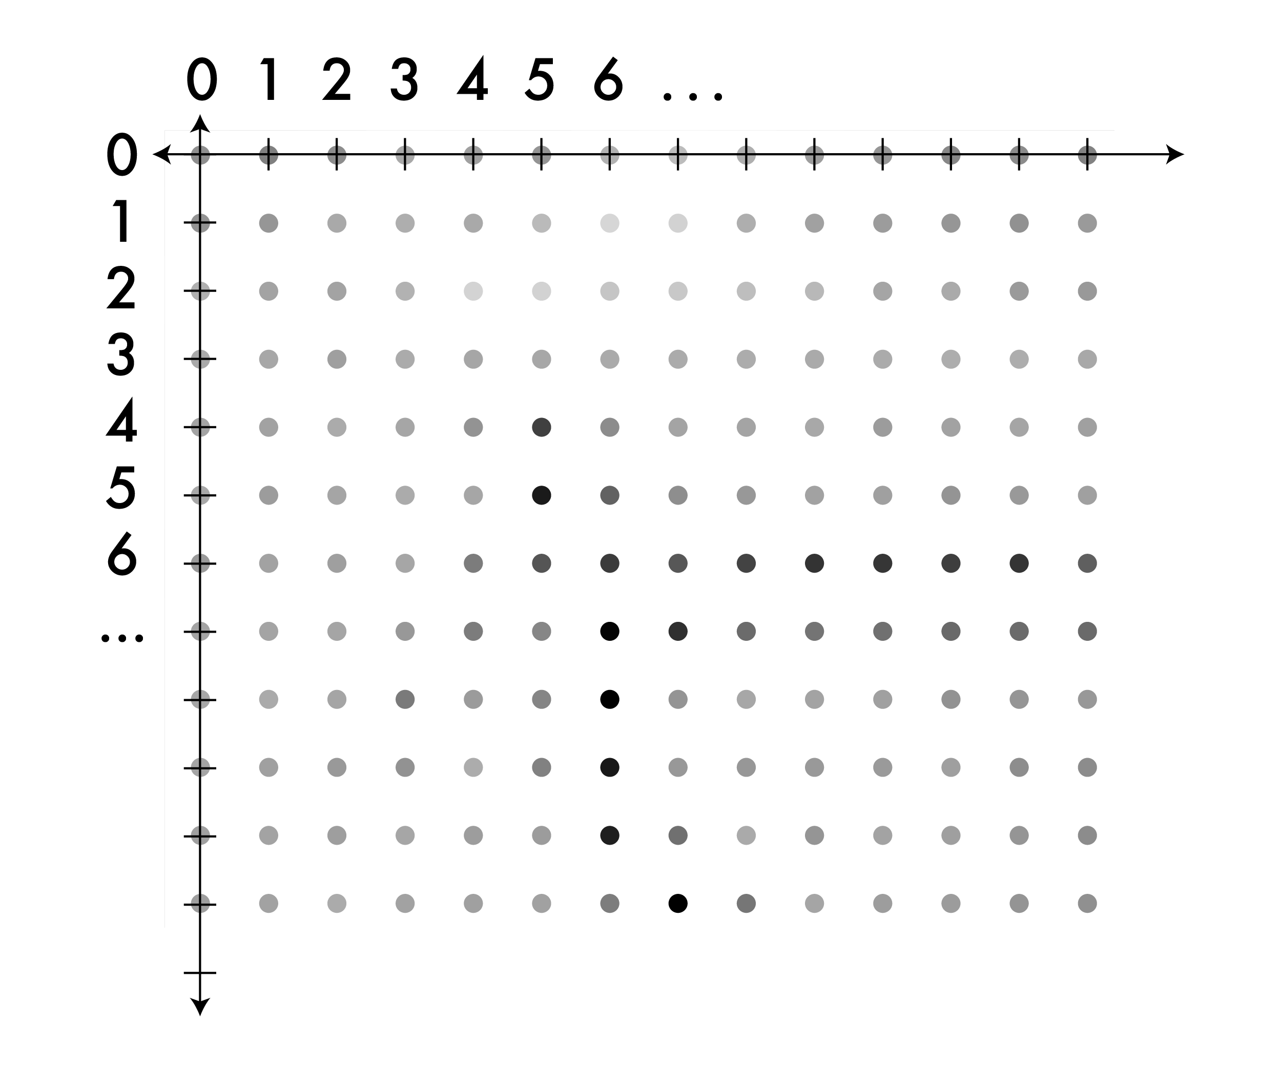
A note on coordinates in images
Now we can move to
a real coordinate
system.

Slide 29
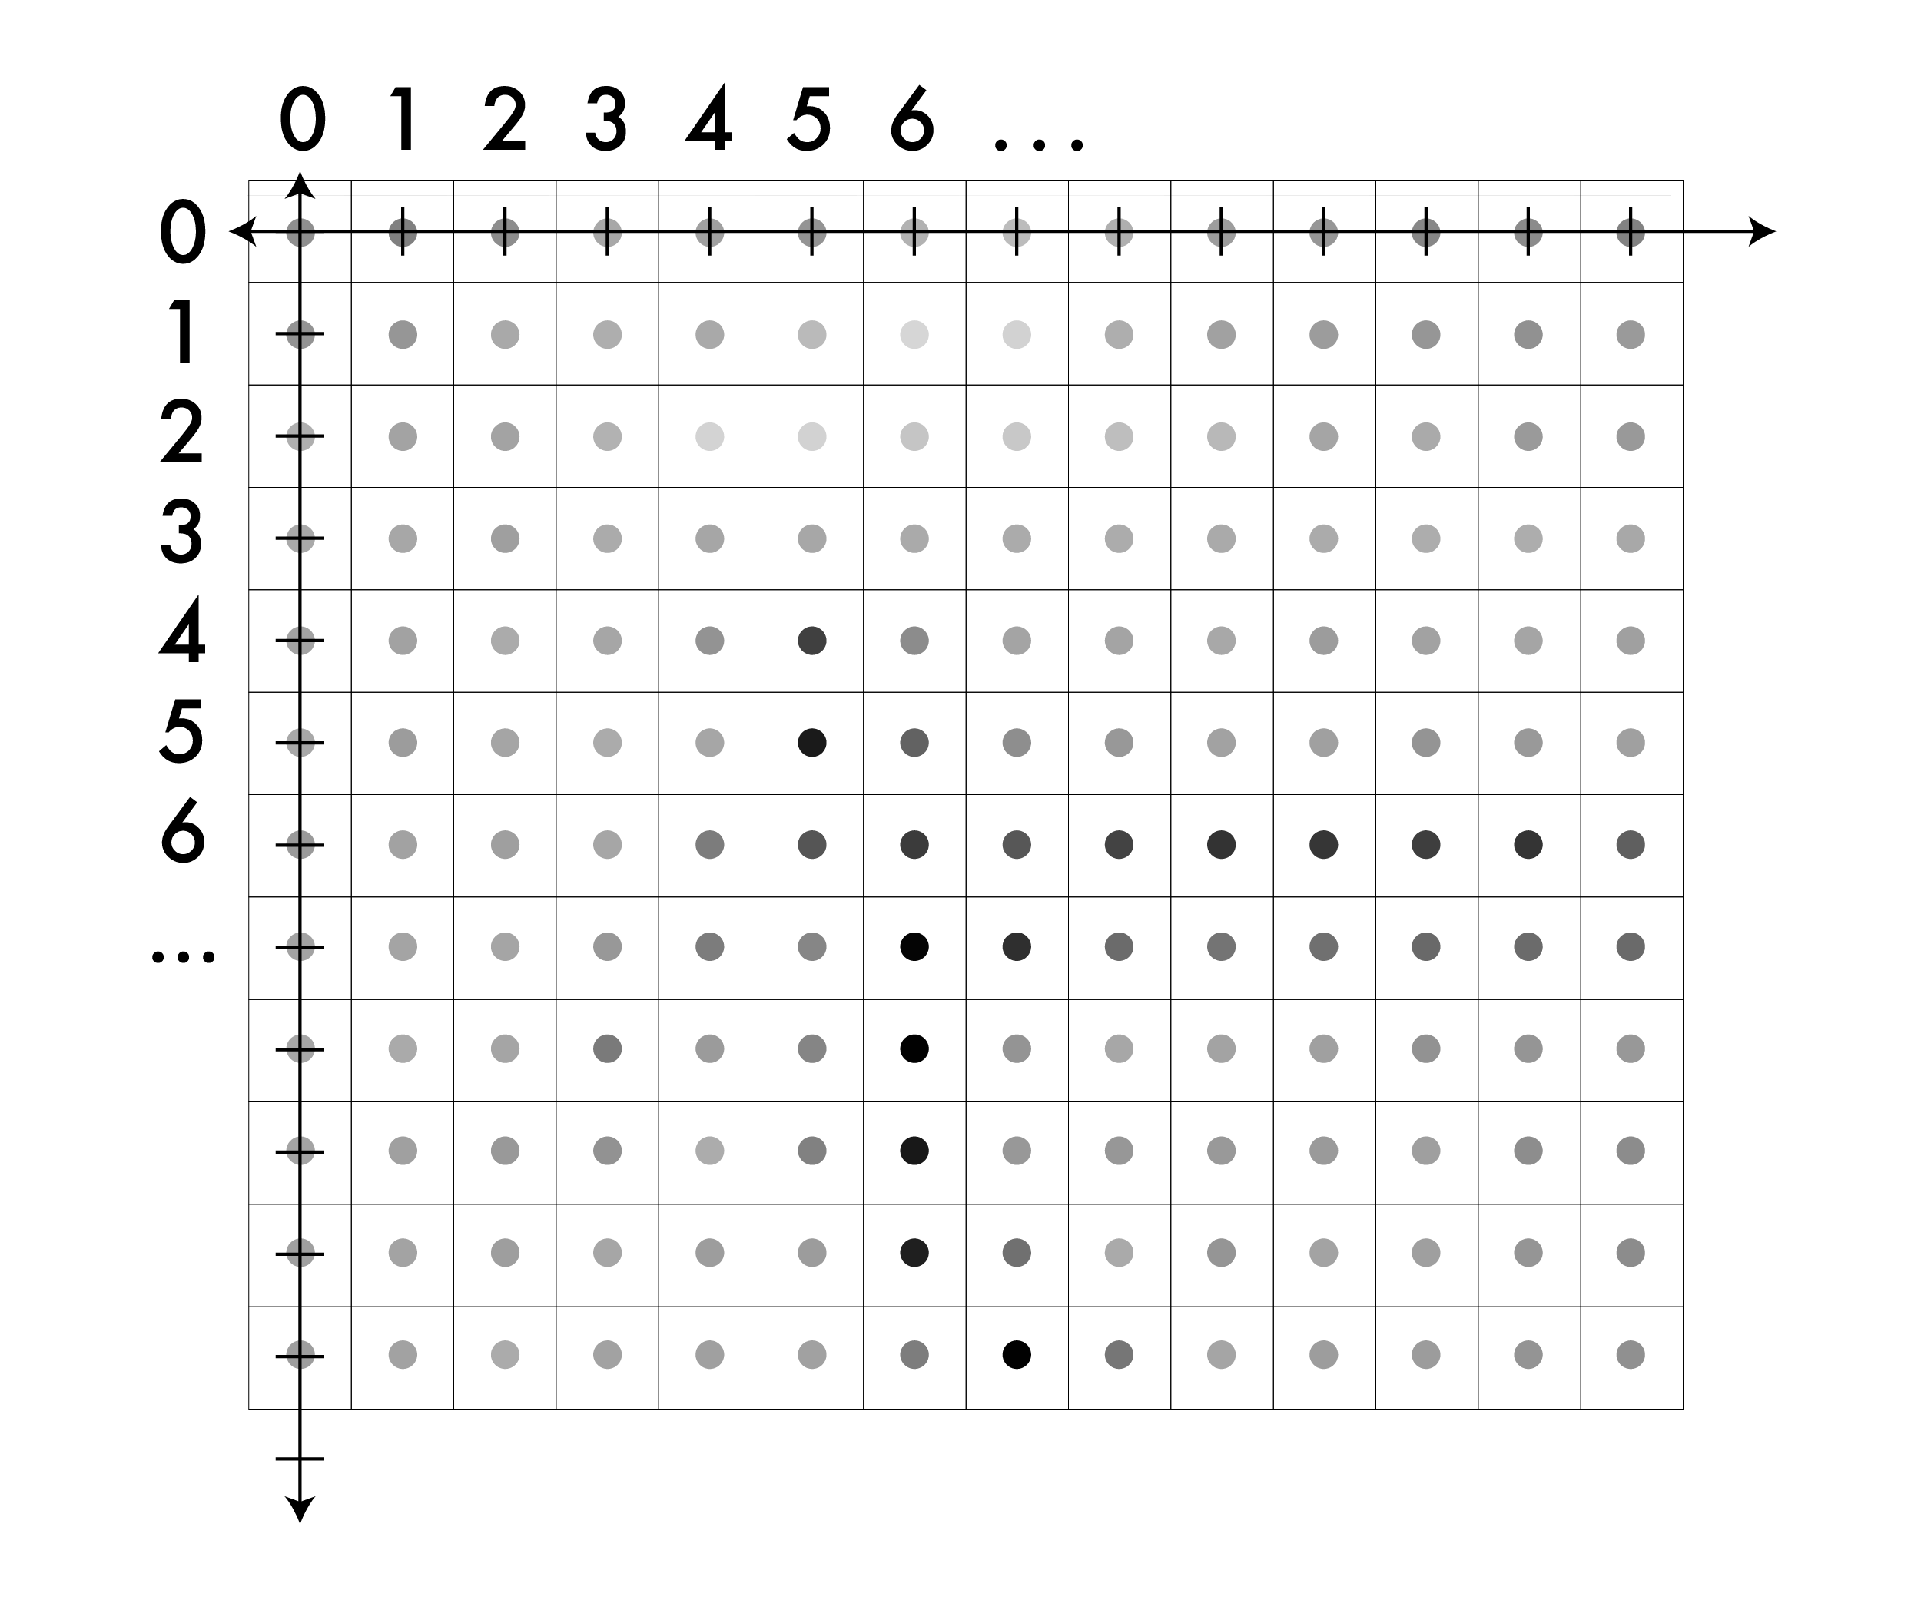
A note on coordinates in images
On the image

Slide 30
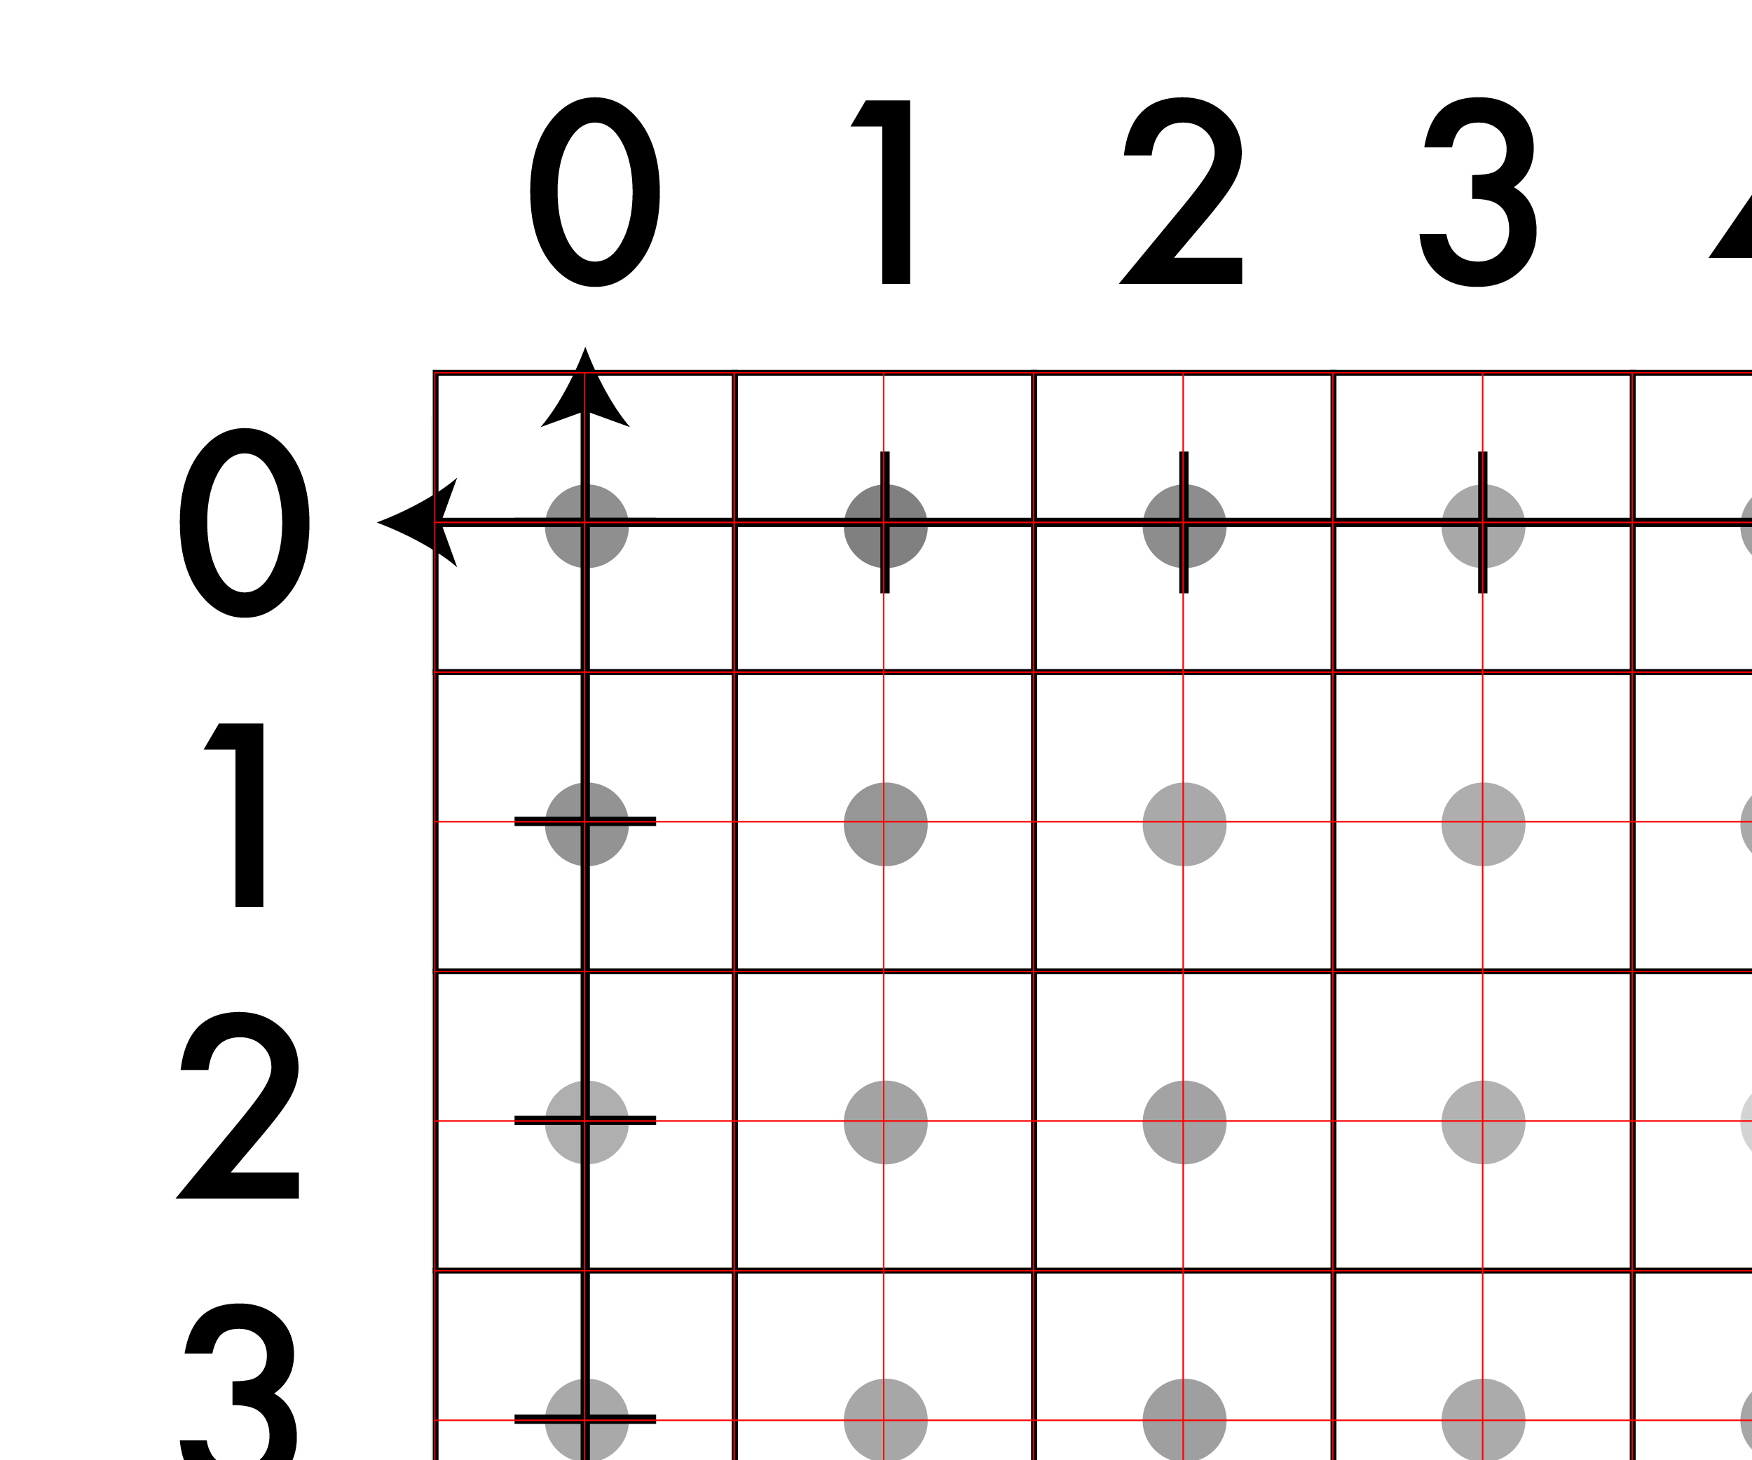
A note on coordinates in images
So, the value of the
pixel (x,y) is now
centered at (x,y).

Slide 31
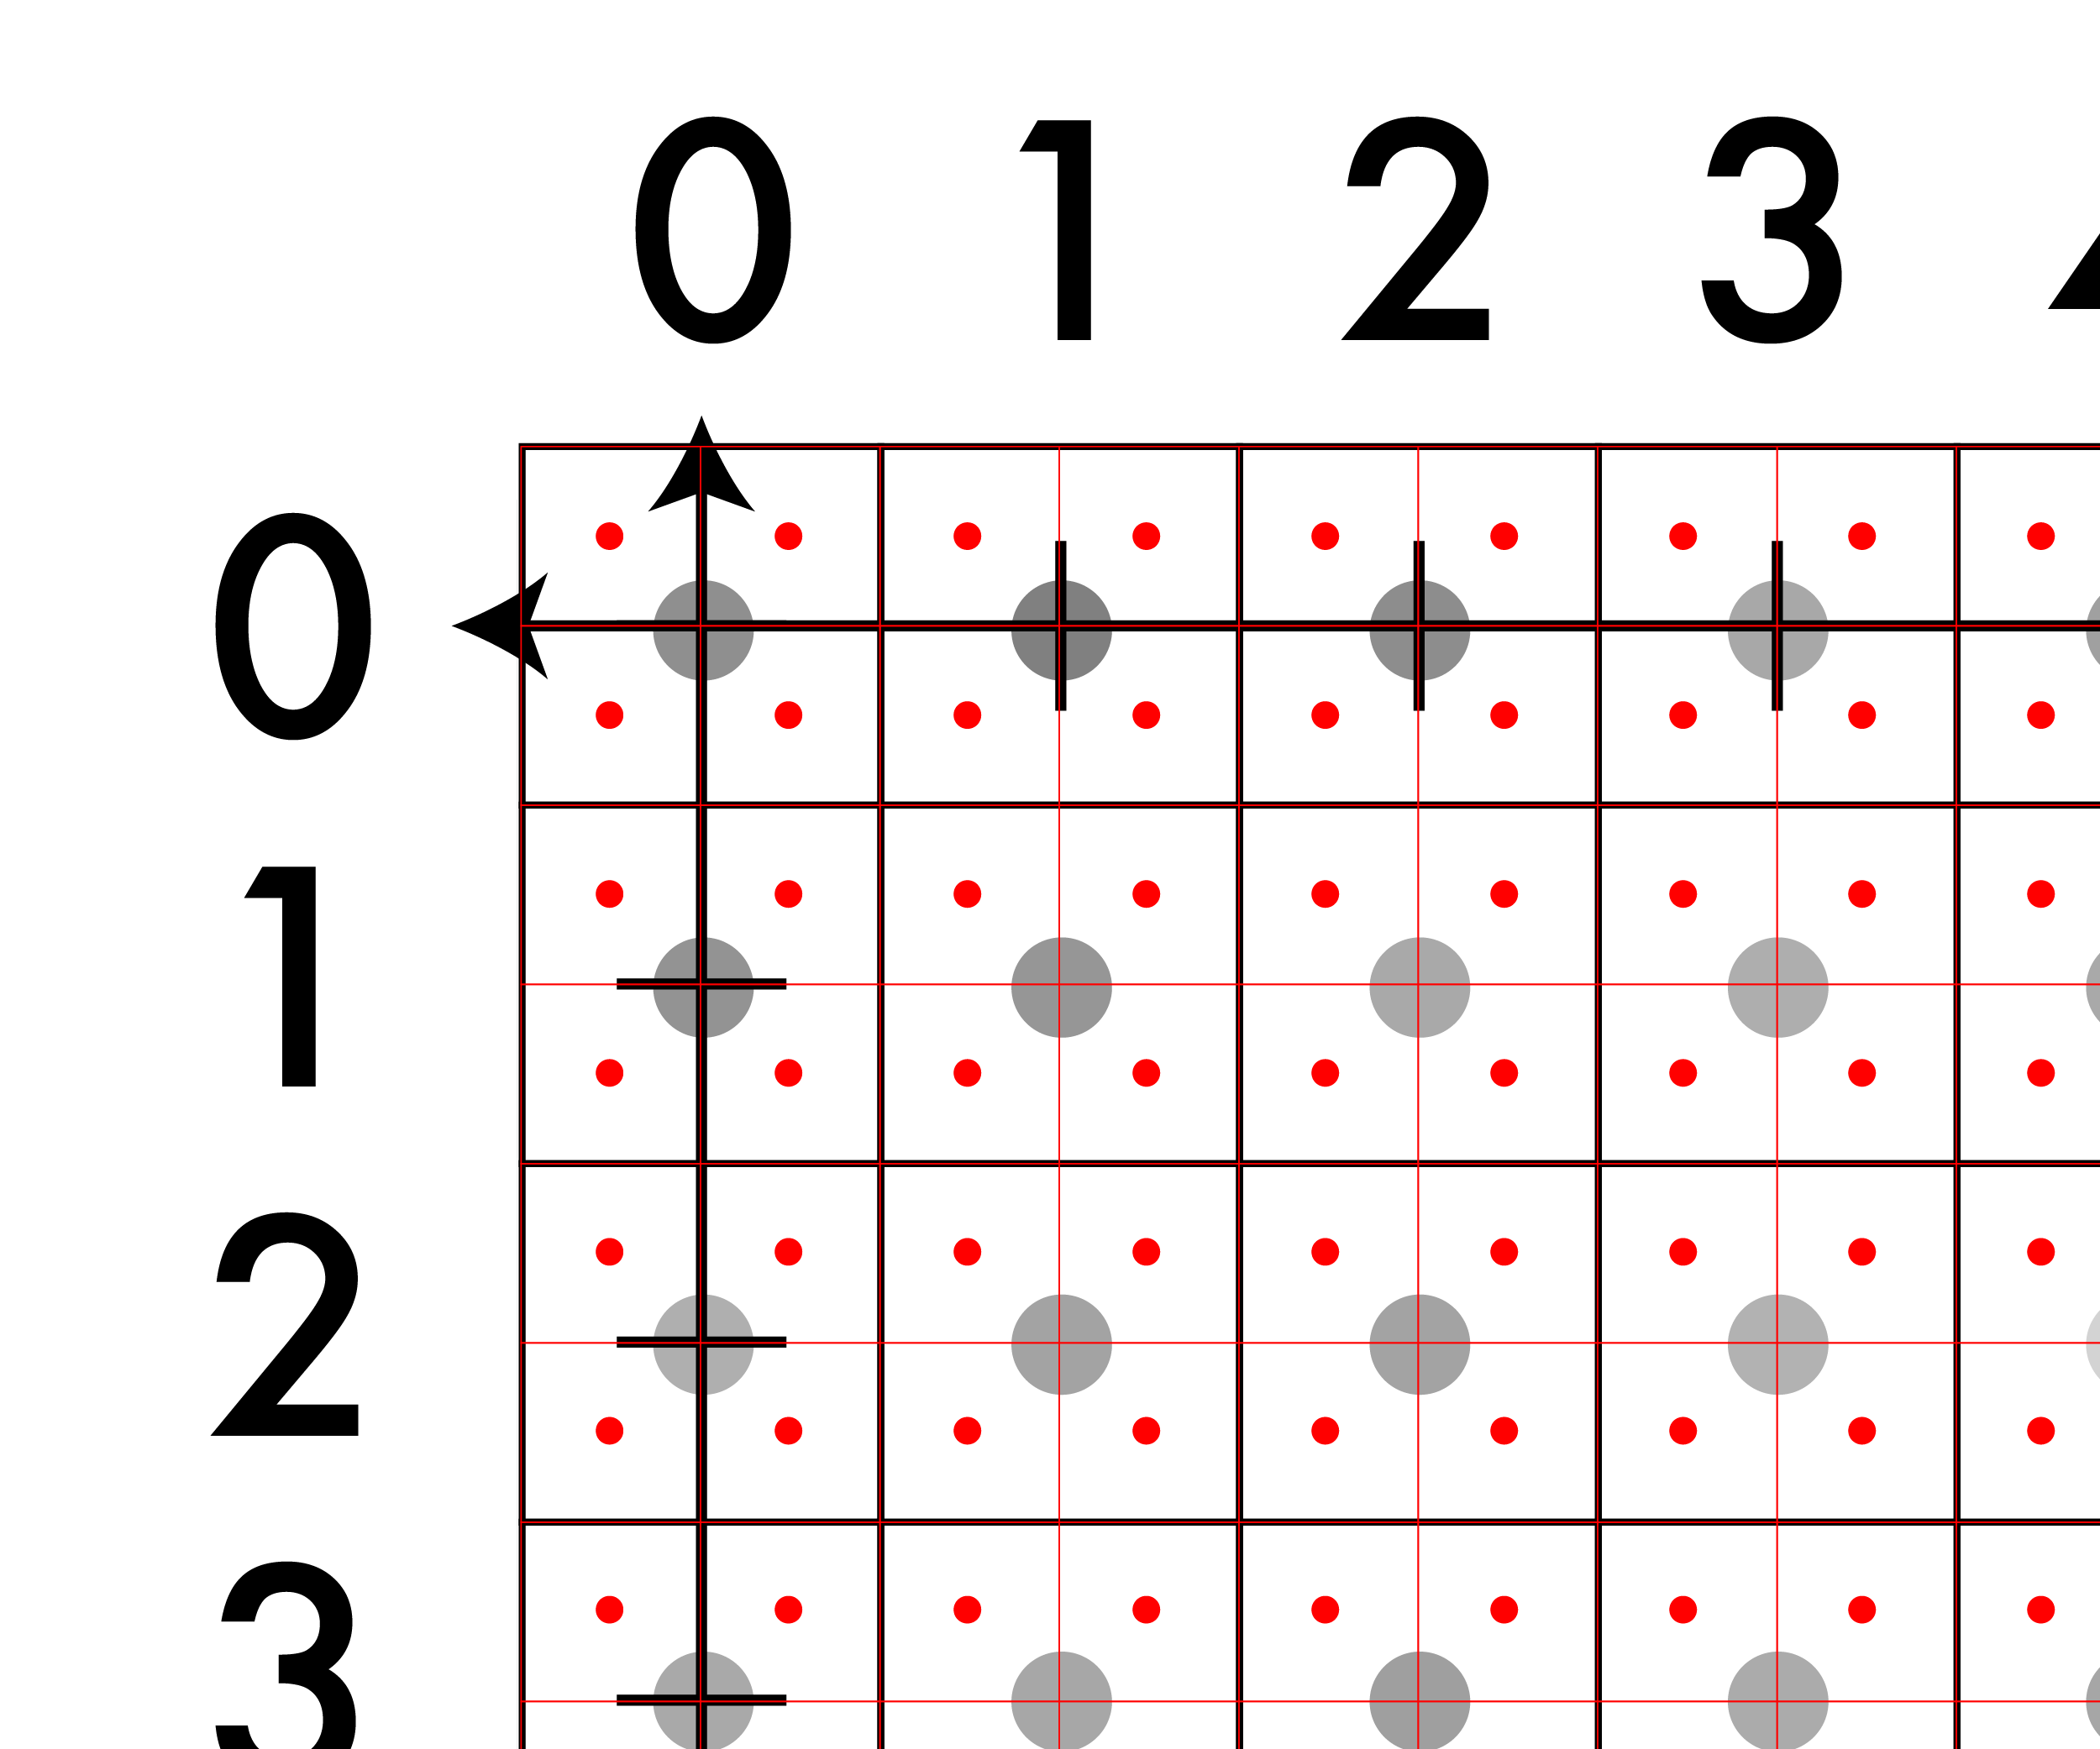
A note on coordinates in images
But there are other
real-valued points.

Slide 32
A note on coordinates in images
This point is:
(-.25, -.25)

Slide 33
Just be careful
This point is:
(-.25, -.25)

Slide 34
Interpolation
How do we find out the VALUE of a non-integer point, when the image only comes with integer points, ie (25,45,3).
For our assignment:
1. Nearest-Neighbor Interpolation
2. Bilinear Interpolation

Slide 35
Nearest neighbor: what it sounds like
f(x,y,z) = Im(round(x), round(y), z)
Looks blocky
Common pitfall: Integer division rounds down in C
Note: z is still int

Slide 36
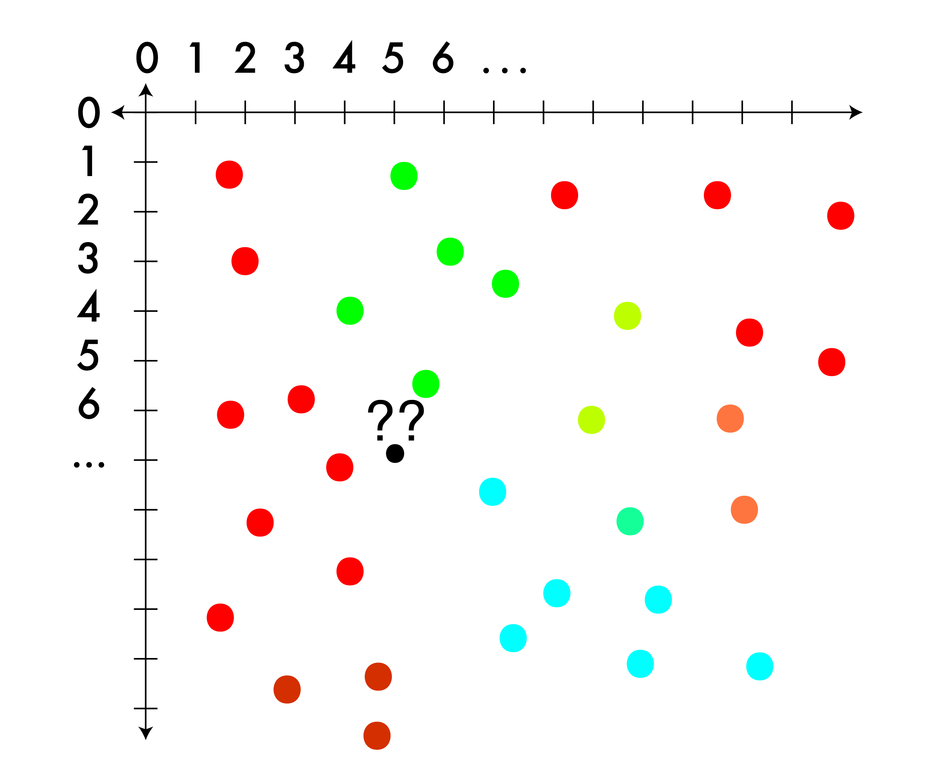
Triangle interpolation: for less structured image (alternate approach)
Sometimes you have a regular grid, sometimes you don’t.
When you don’t, you can look for triangles!

Slide 37
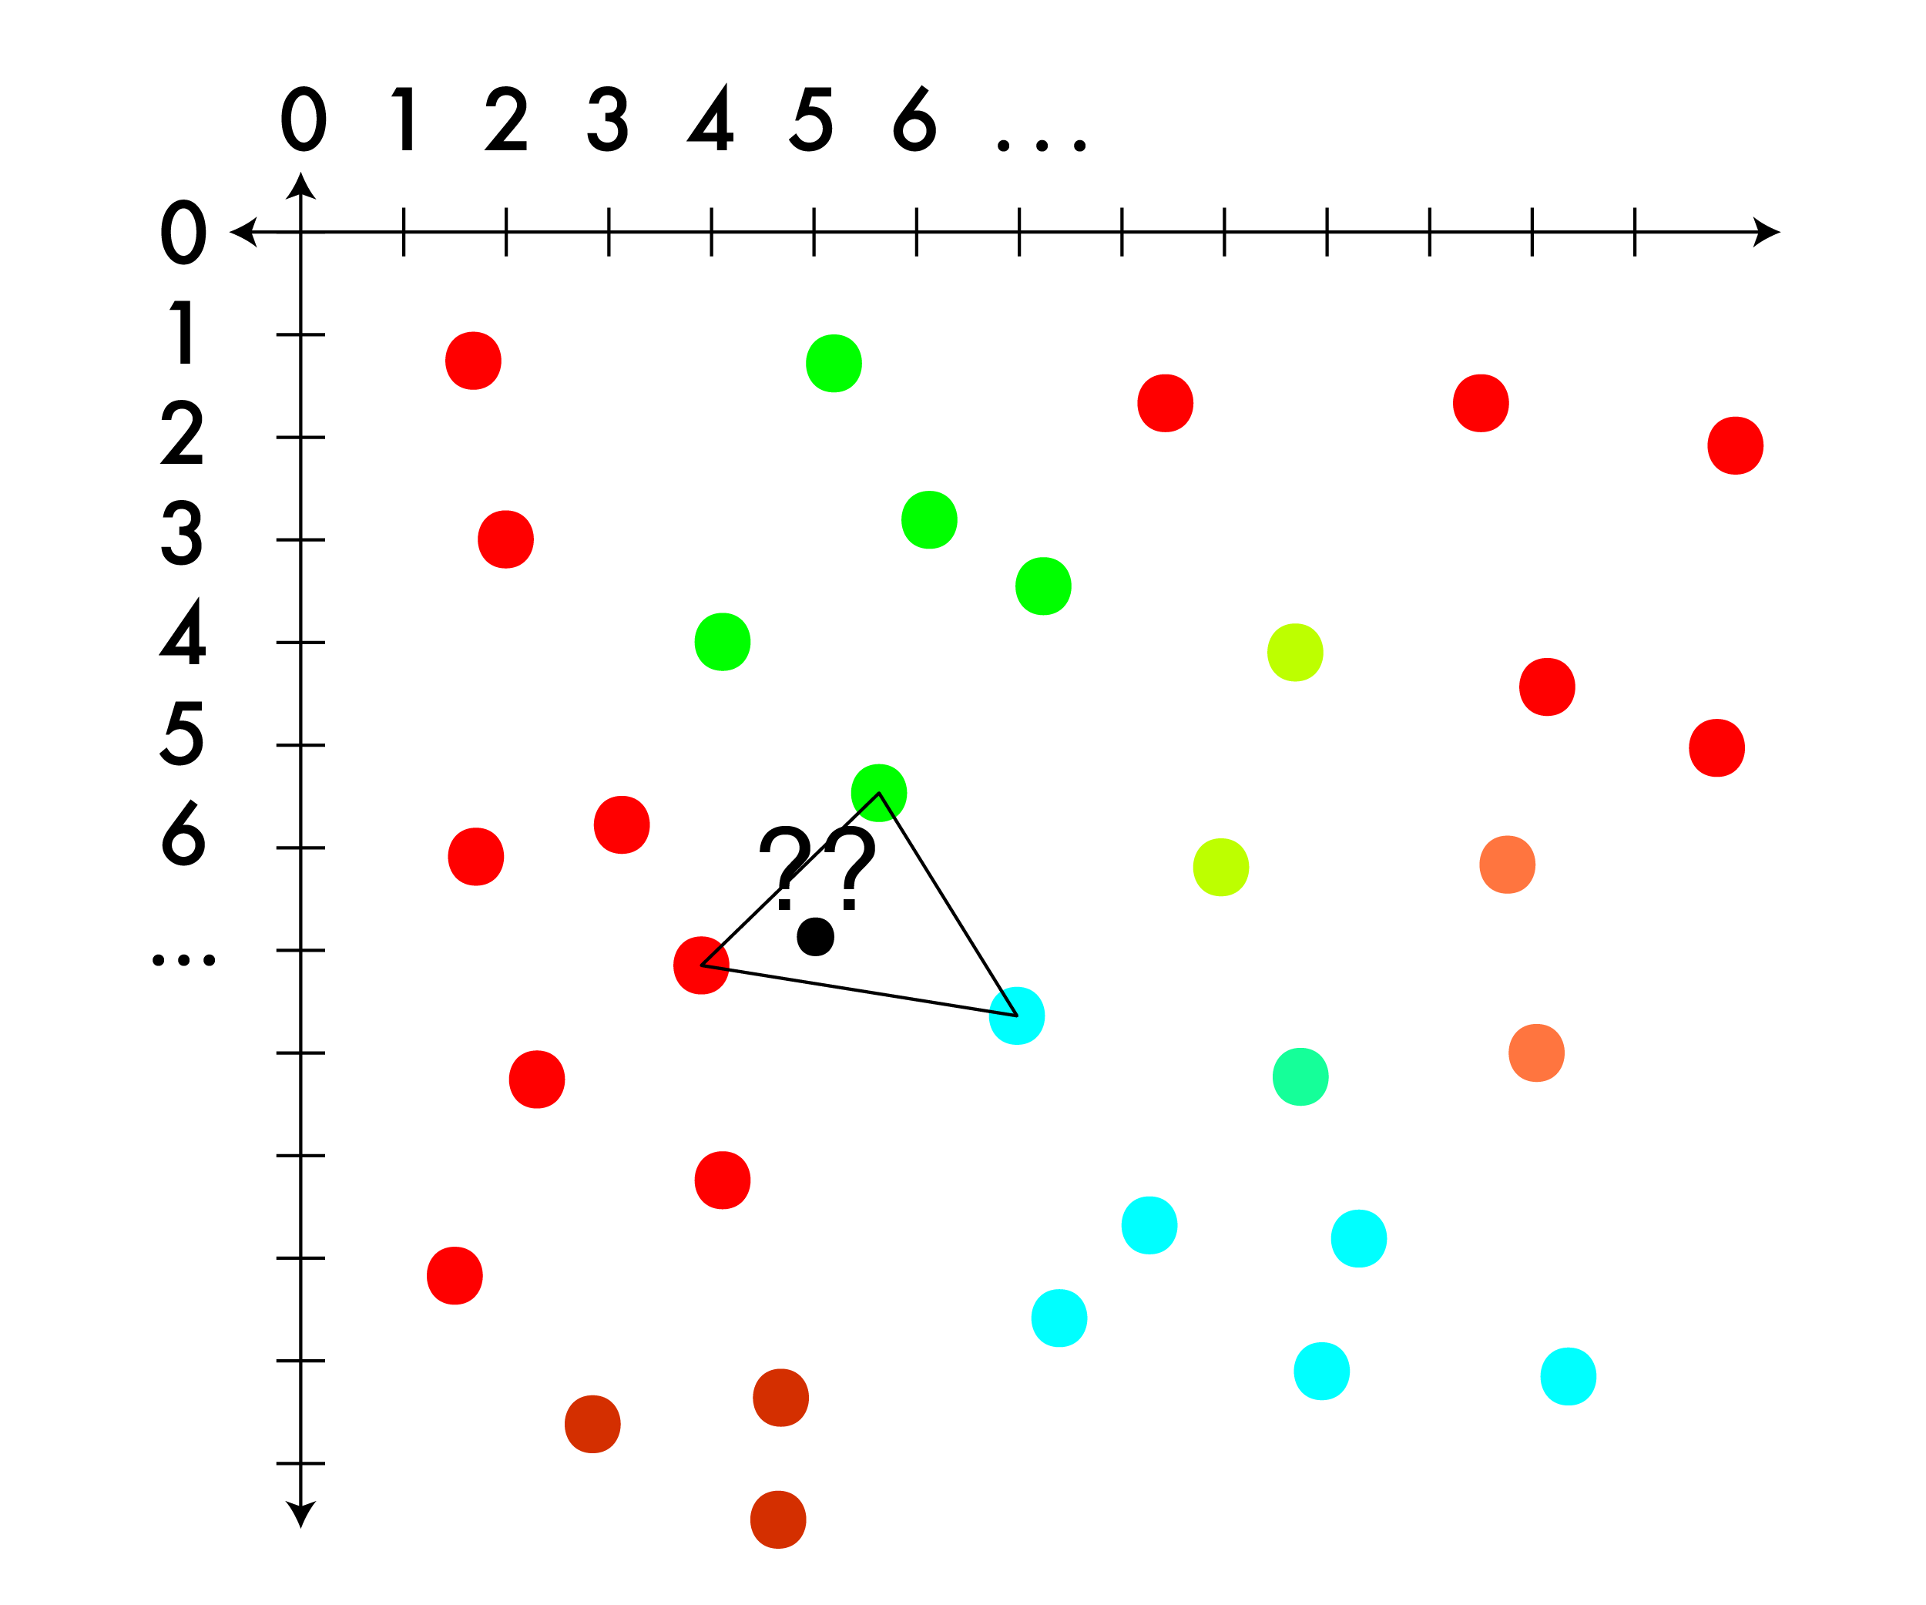
Triangle interpolation: for less structured image
Sometimes you have a regular grid, sometimes you don’t.
When you don’t look for triangles!

Slide 38
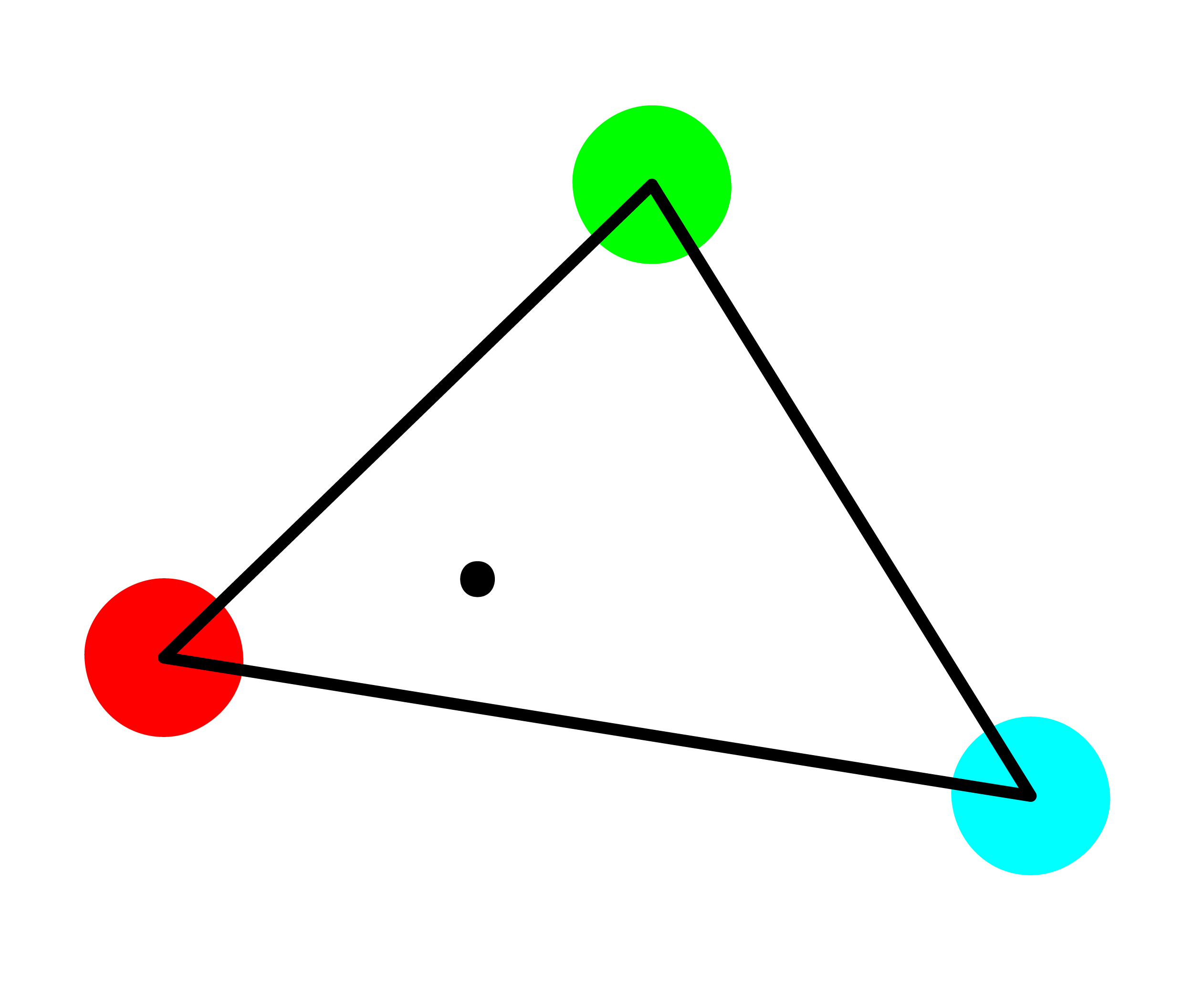
Triangle interpolation: for less structured image
Sometimes you have a regular grid, sometimes you don’t.
When you don’t look for triangles!

Slide 39
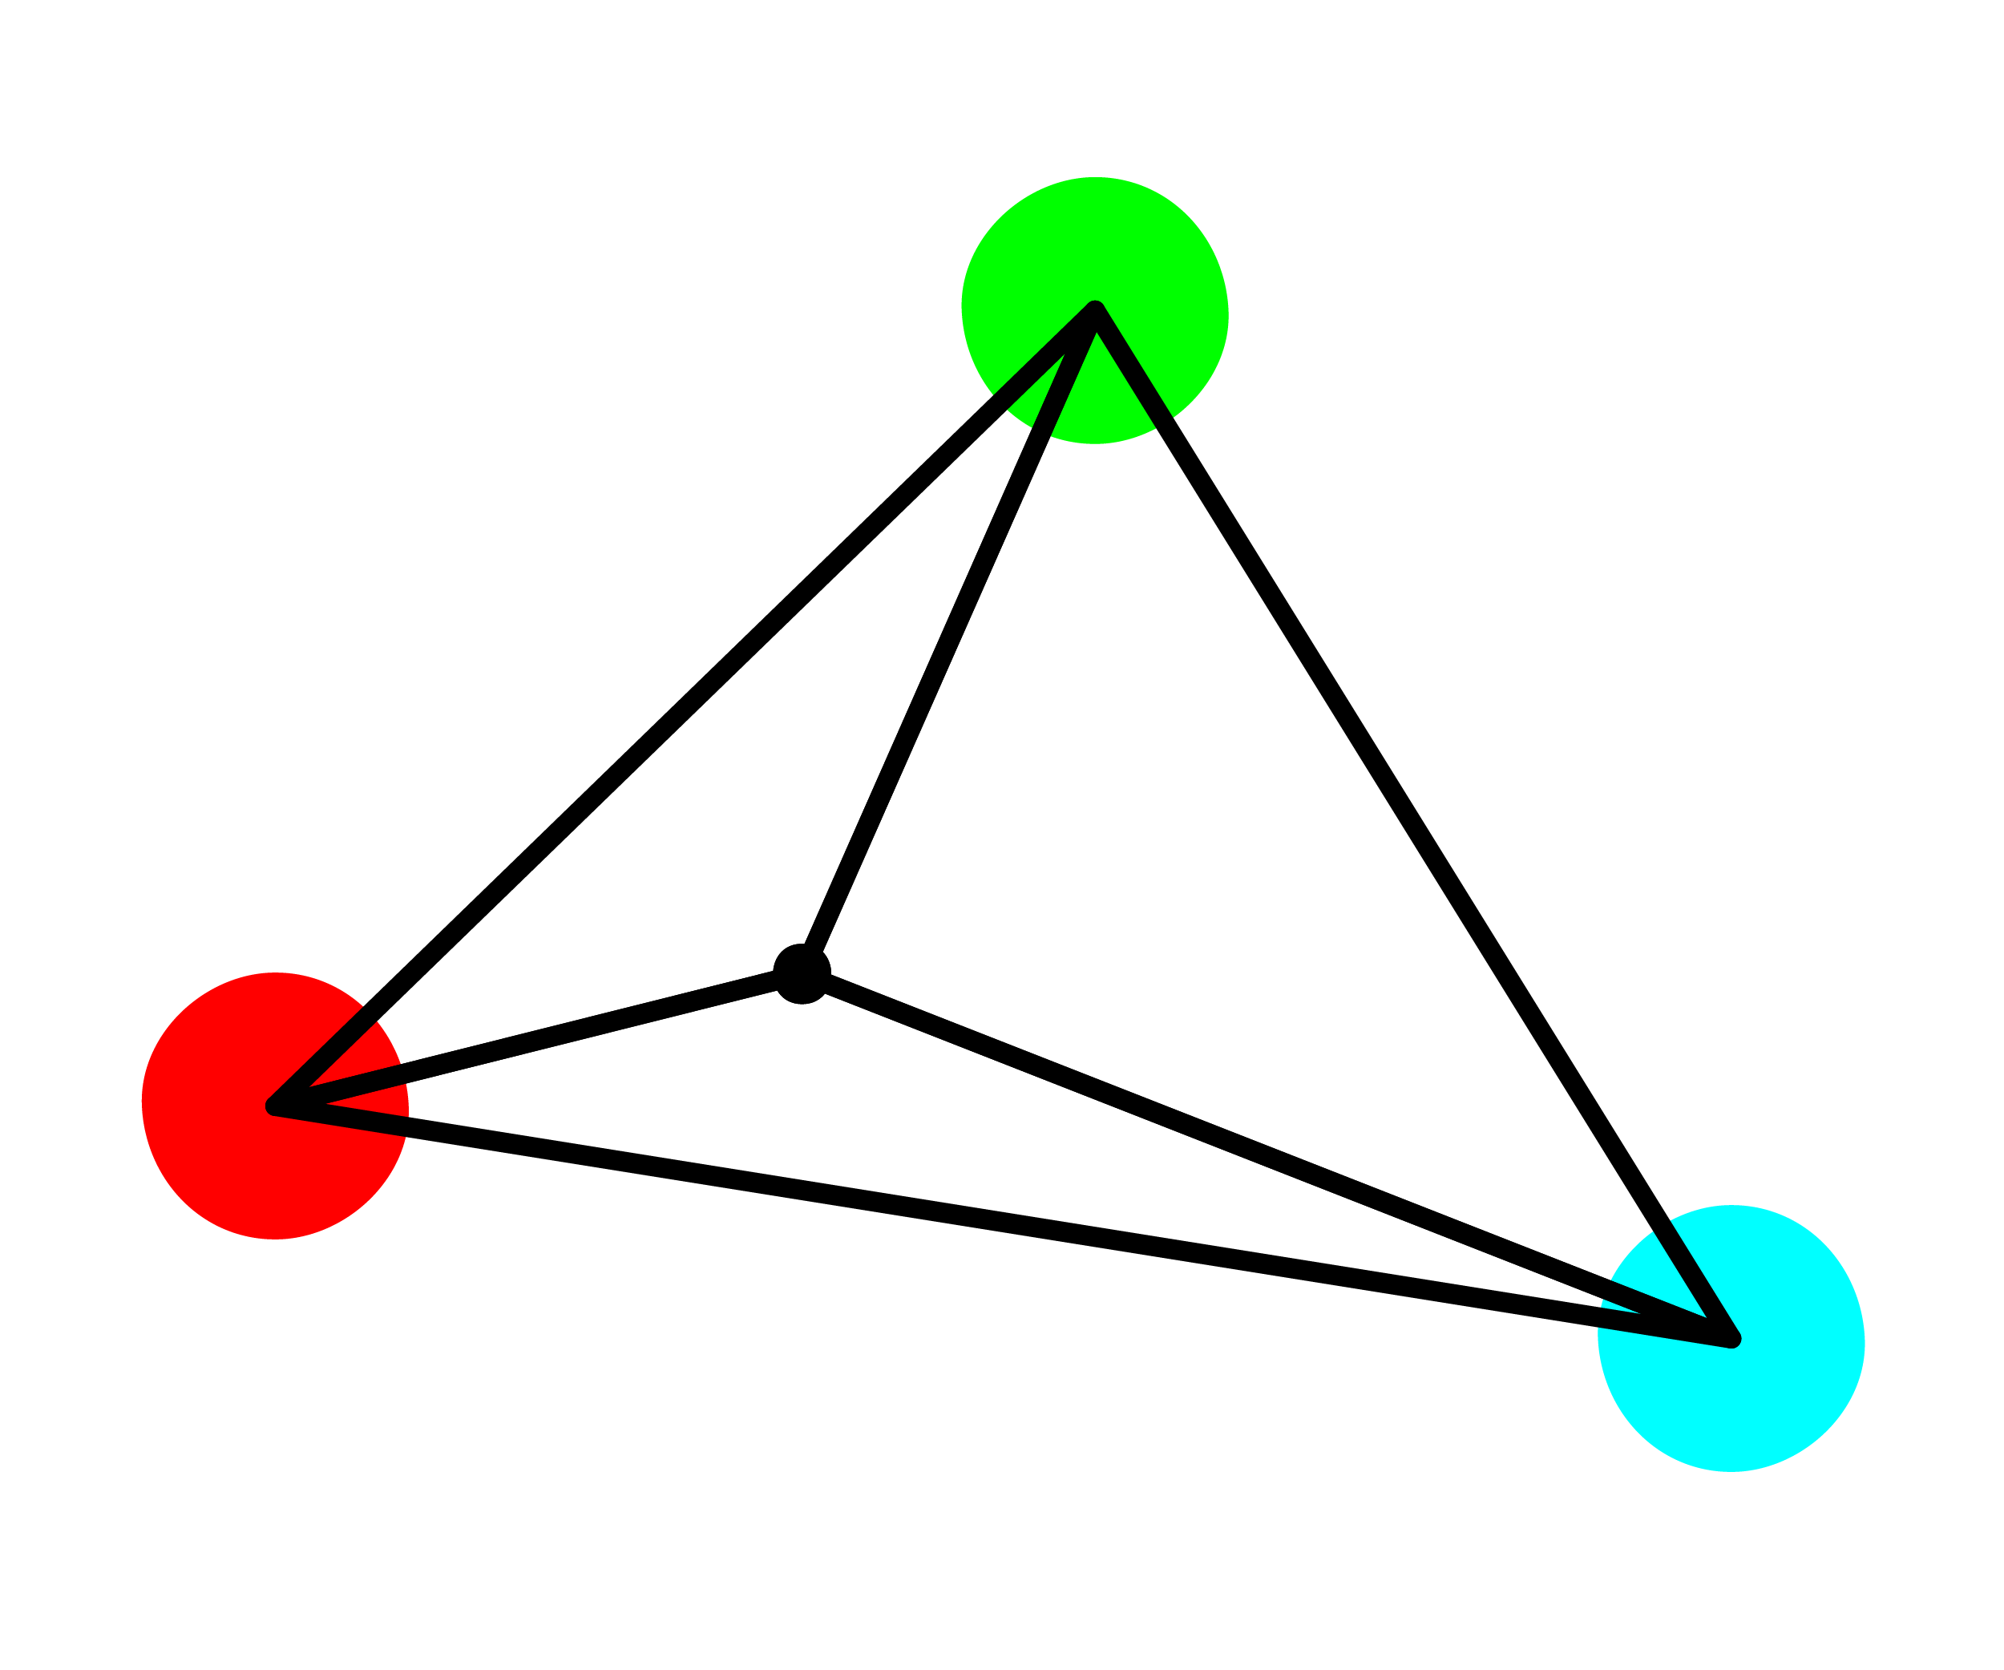
Triangle interpolation: for less structured image
Sometimes you have a regular grid, sometimes you don’t.
When you don’t look for triangles!

Slide 40
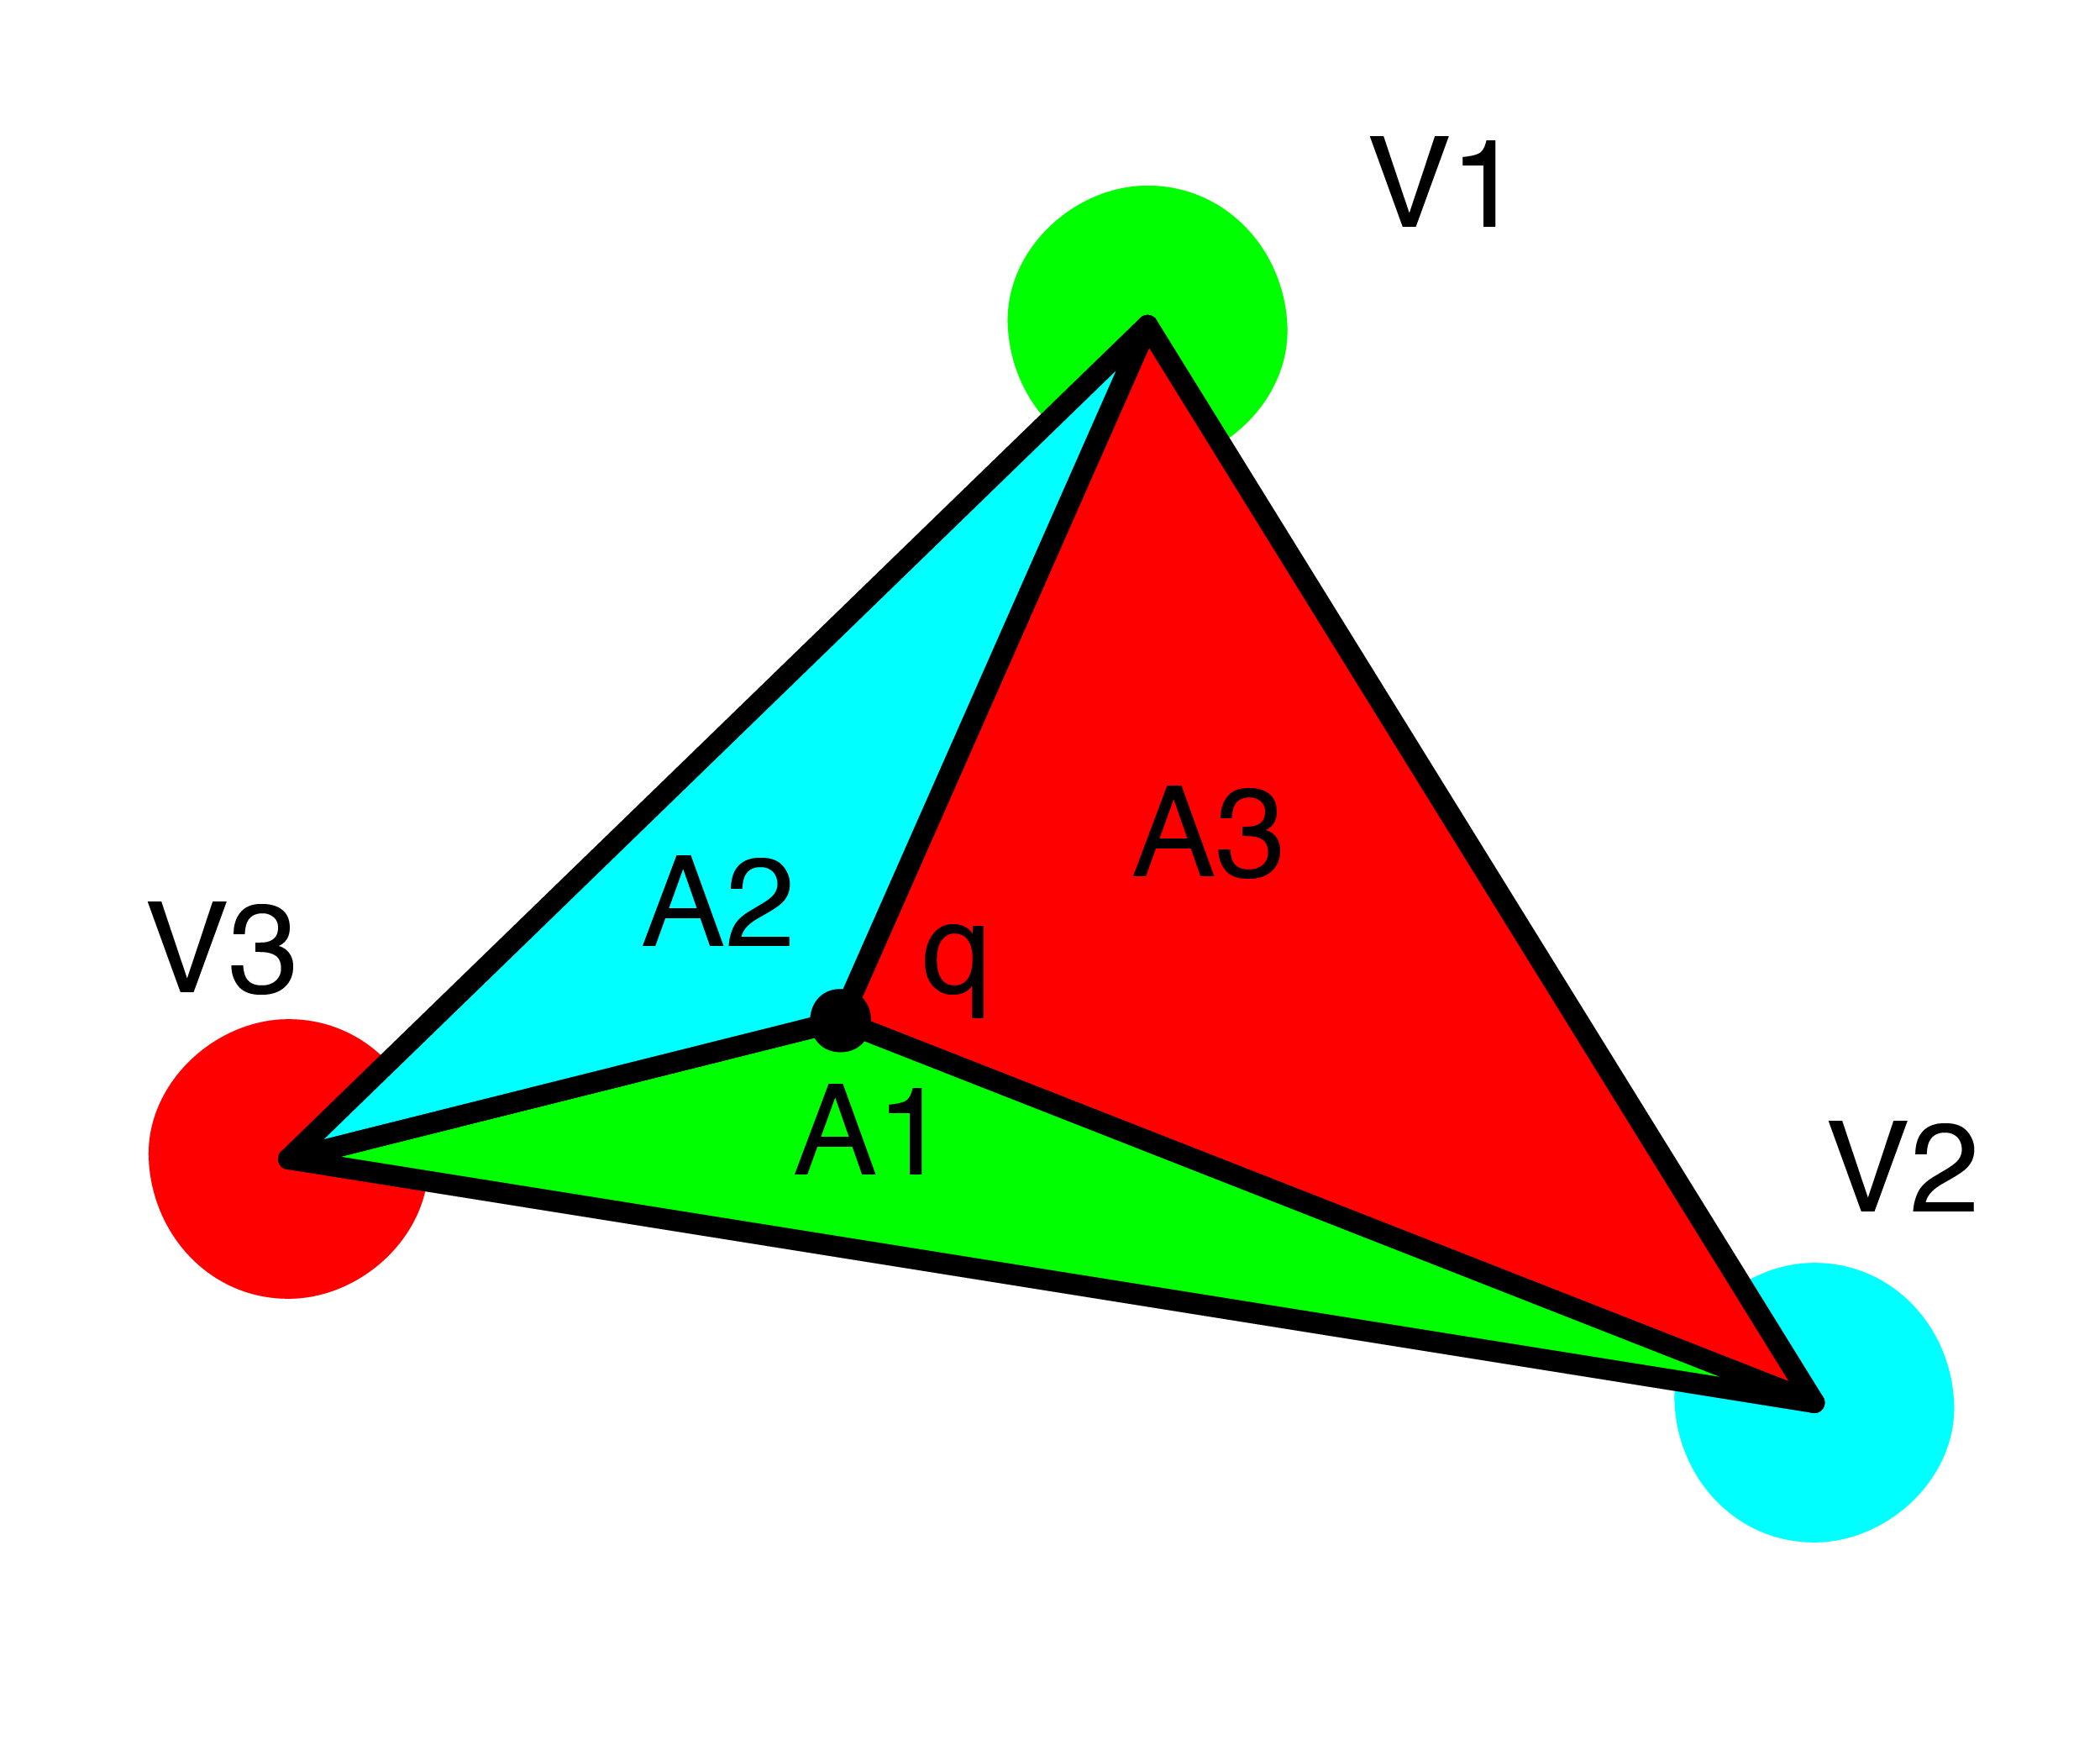
Triangle interpolation: for less structured image
Weighted sum using triangles:
Q = V1*A1 + V2*A2 + V3*A3
WHY?
V1 is the furthest from q and A1 gives the smallest area.
V2 is next furthest from 1 and A2 gives the next smallest area…
Should normalize this based on total area, but we won’t use this.

Slide 41
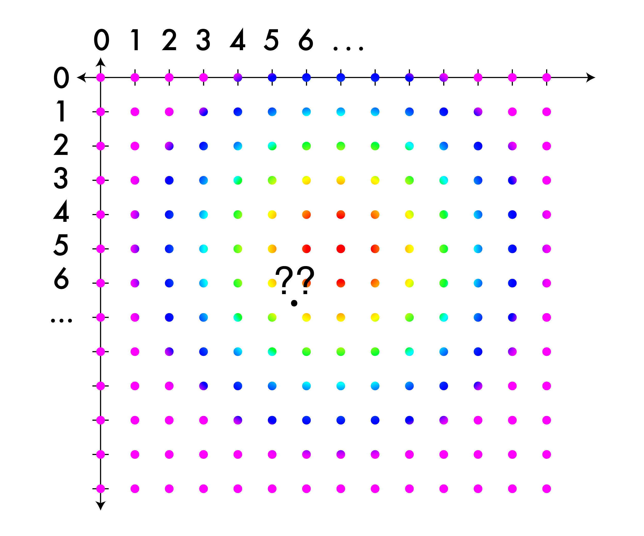
Bilinear interpolation: for grids, pretty good; easier than triangles
This time find the closest pixels in a box

Slide 42
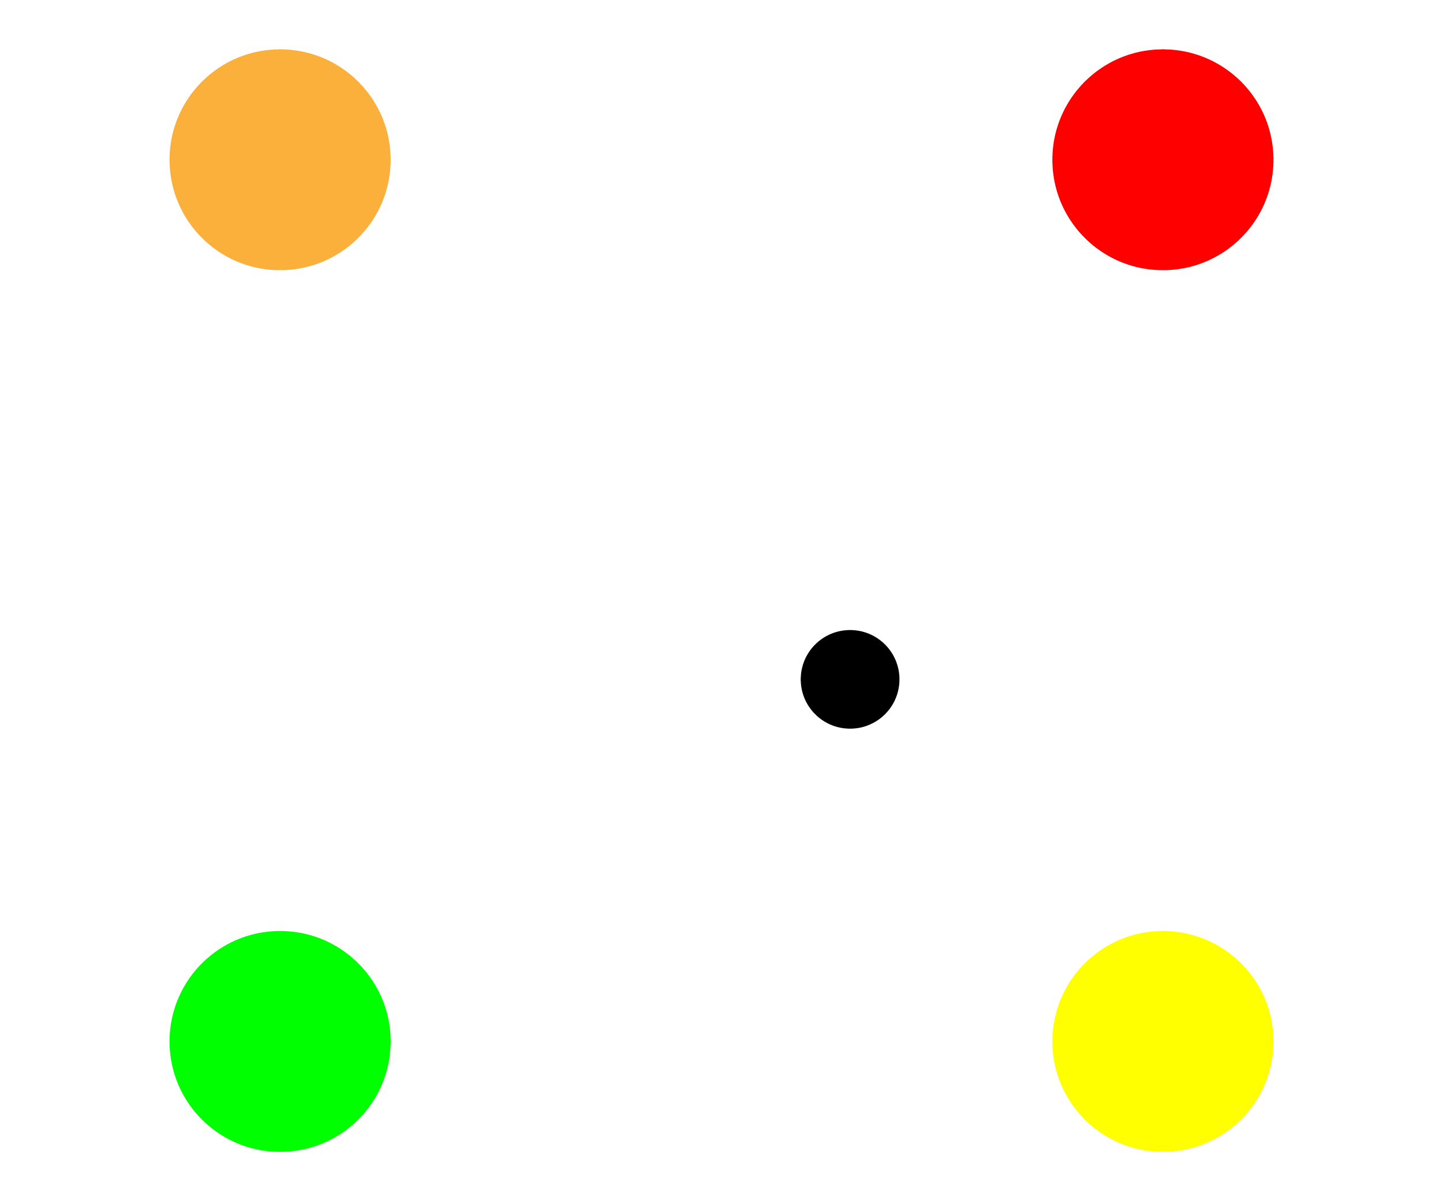
Bilinear interpolation: for grids, pretty good
This time find the closest pixels in a box

Slide 43
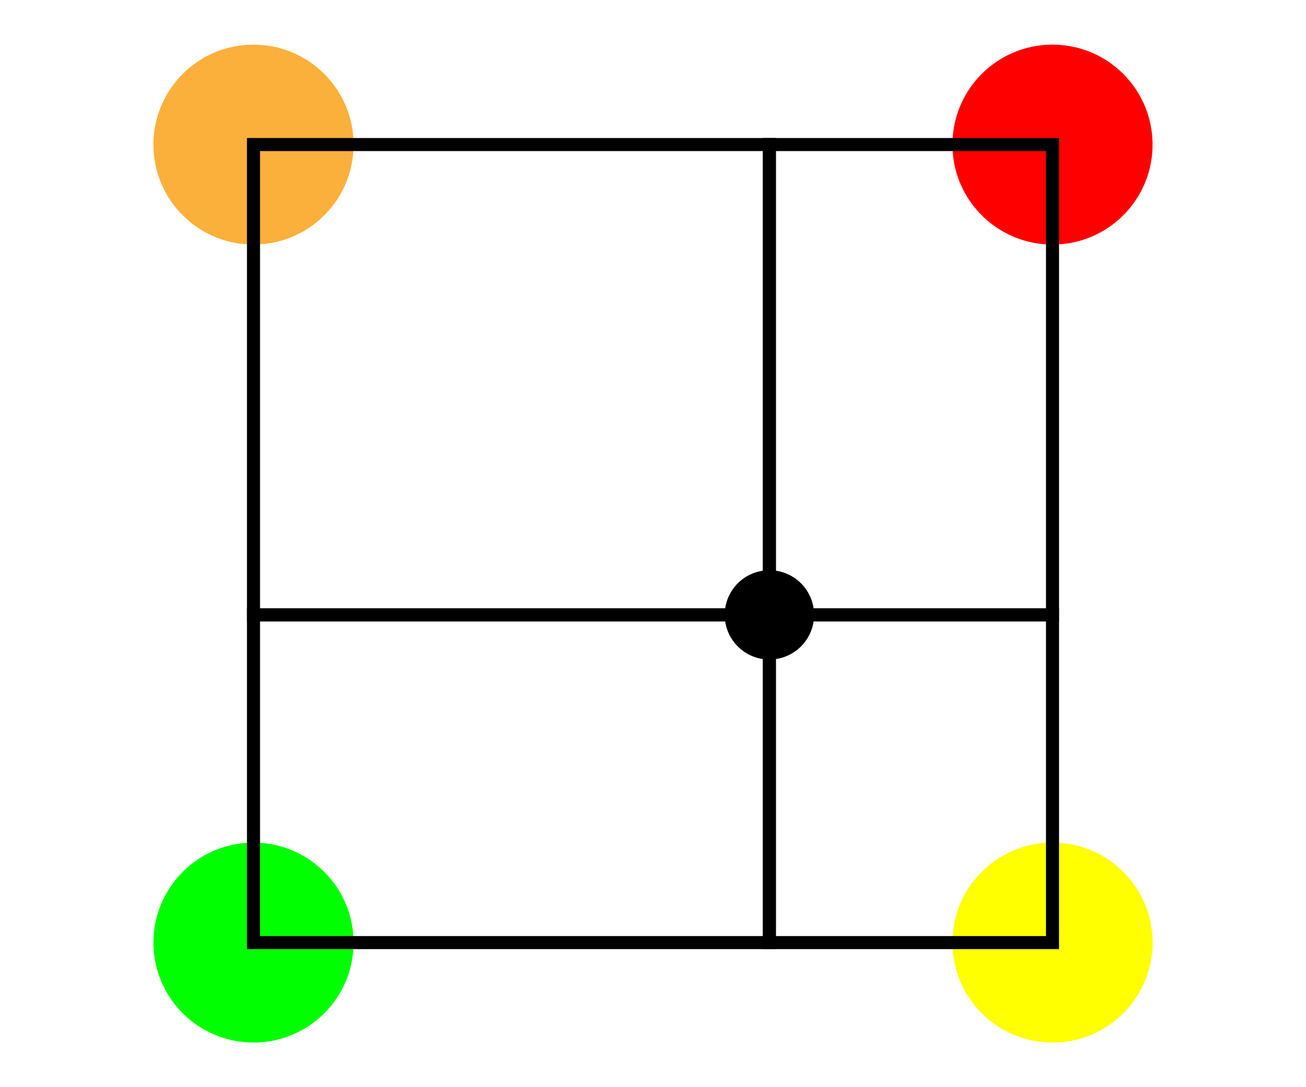
Bilinear interpolation: for grids, pretty good
This time find the closest pixels in a box

Slide 44
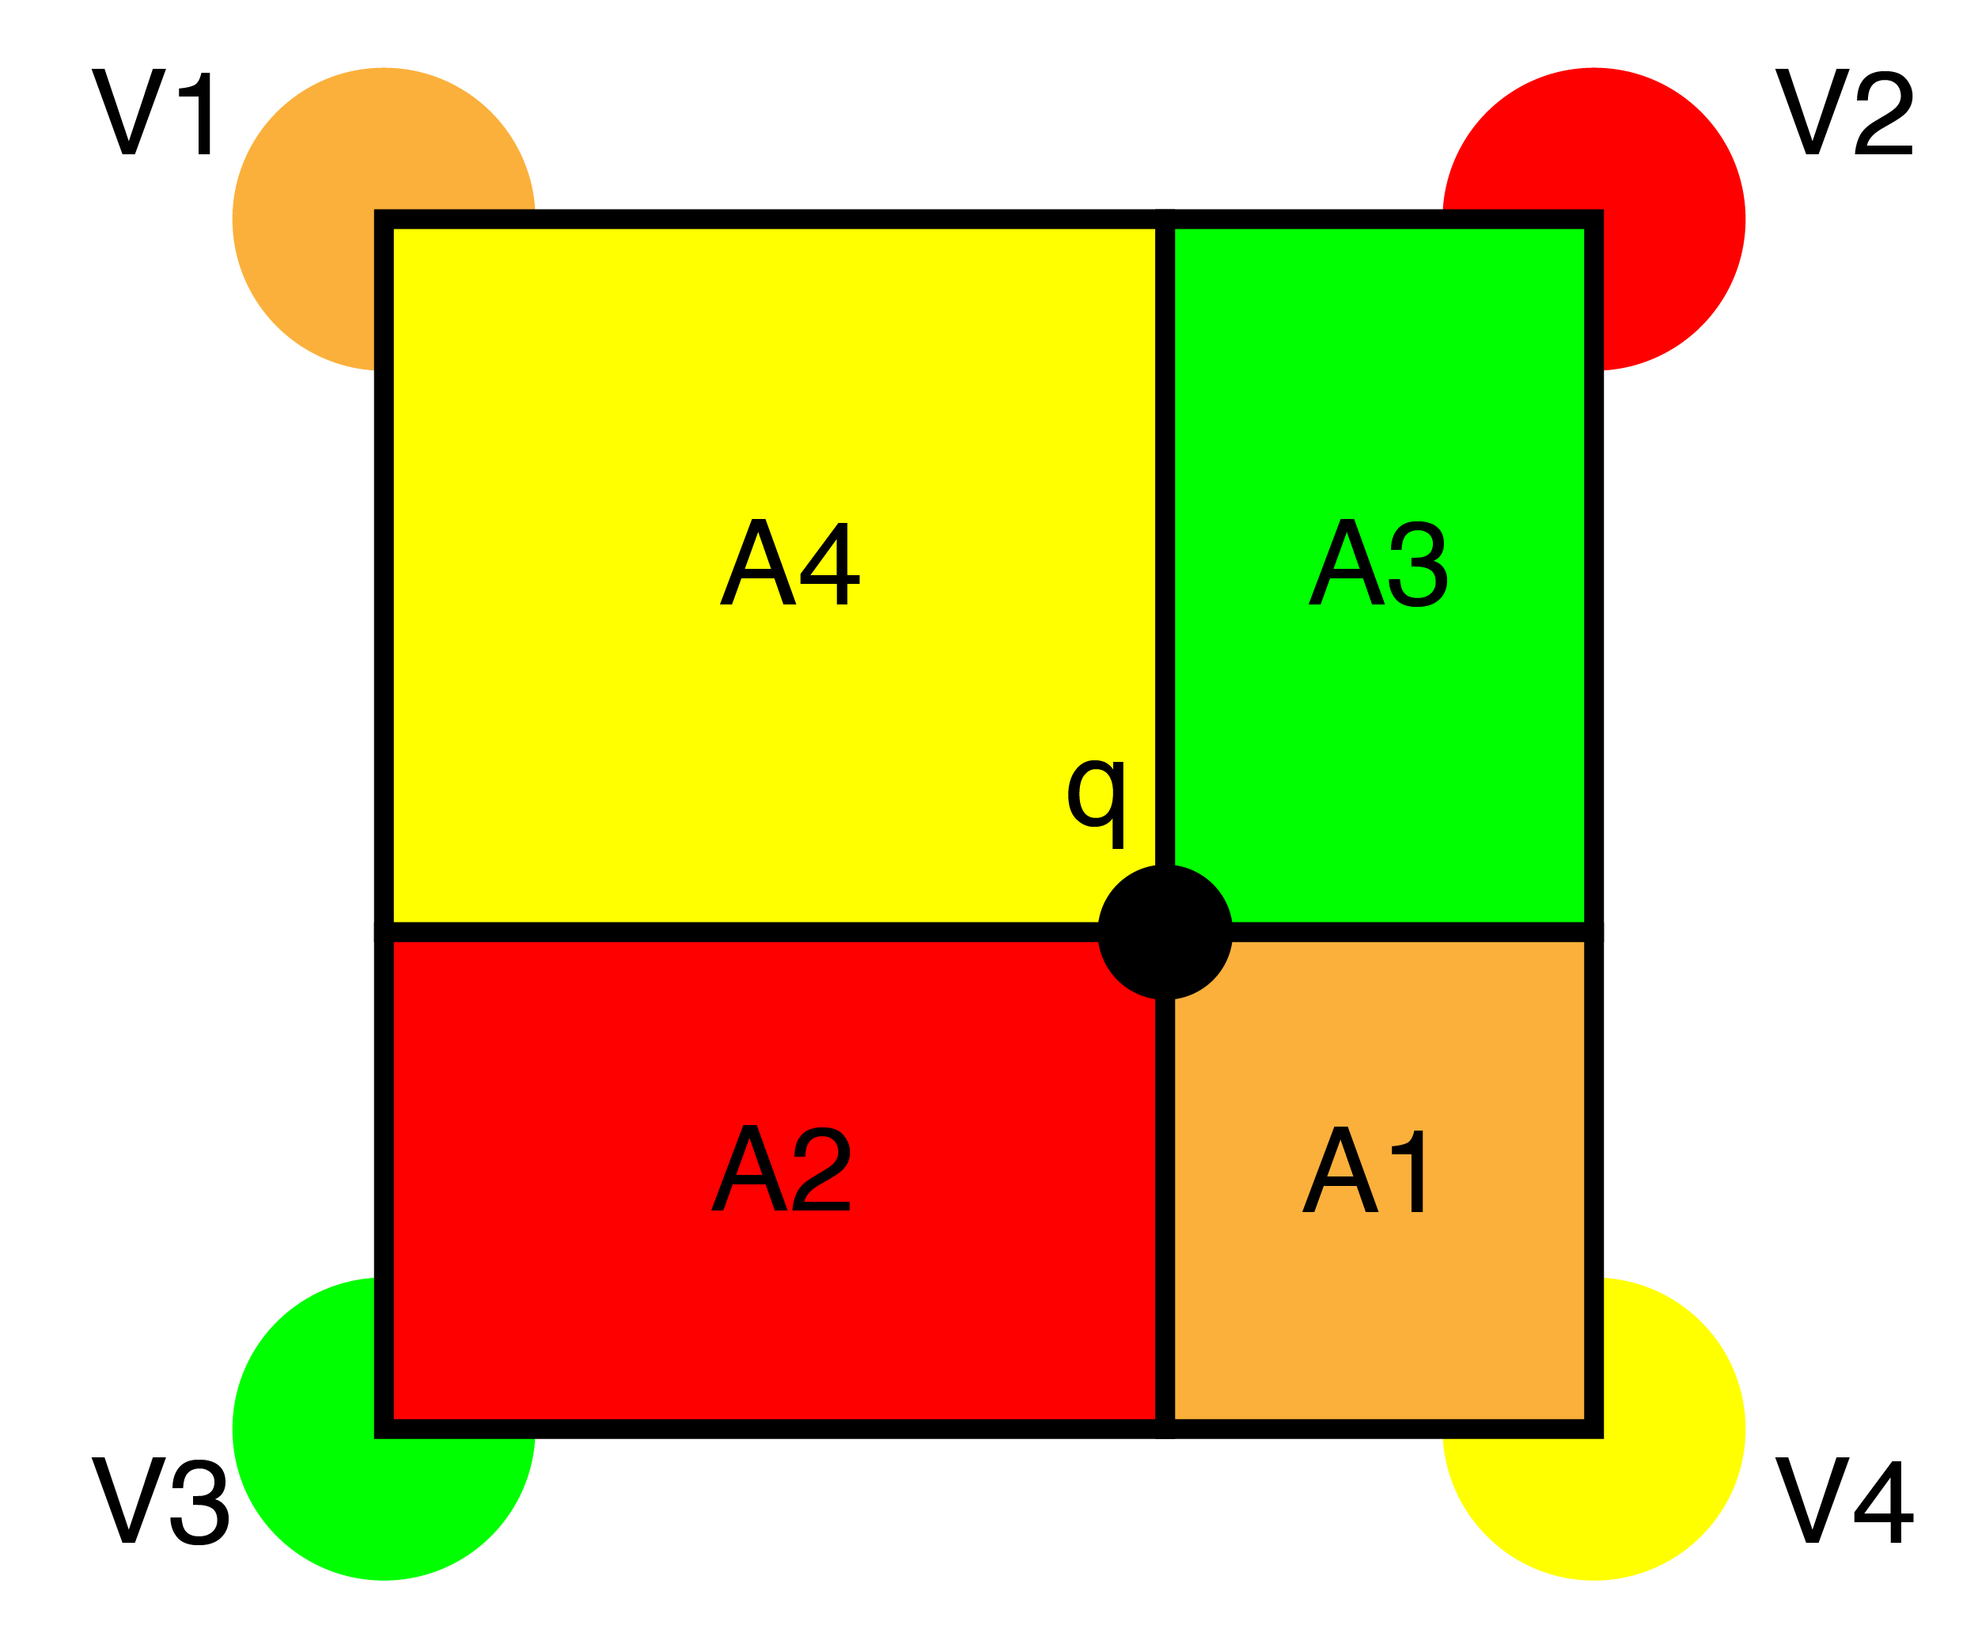
Bilinear interpolation: for grids, pretty good
This time find the closest pixels in a box
Same plan, weighted sum based on area of opposite rectangle
Q = V1*A1 + V2*A2 + V3*A3 + V4*A4

Slide 45
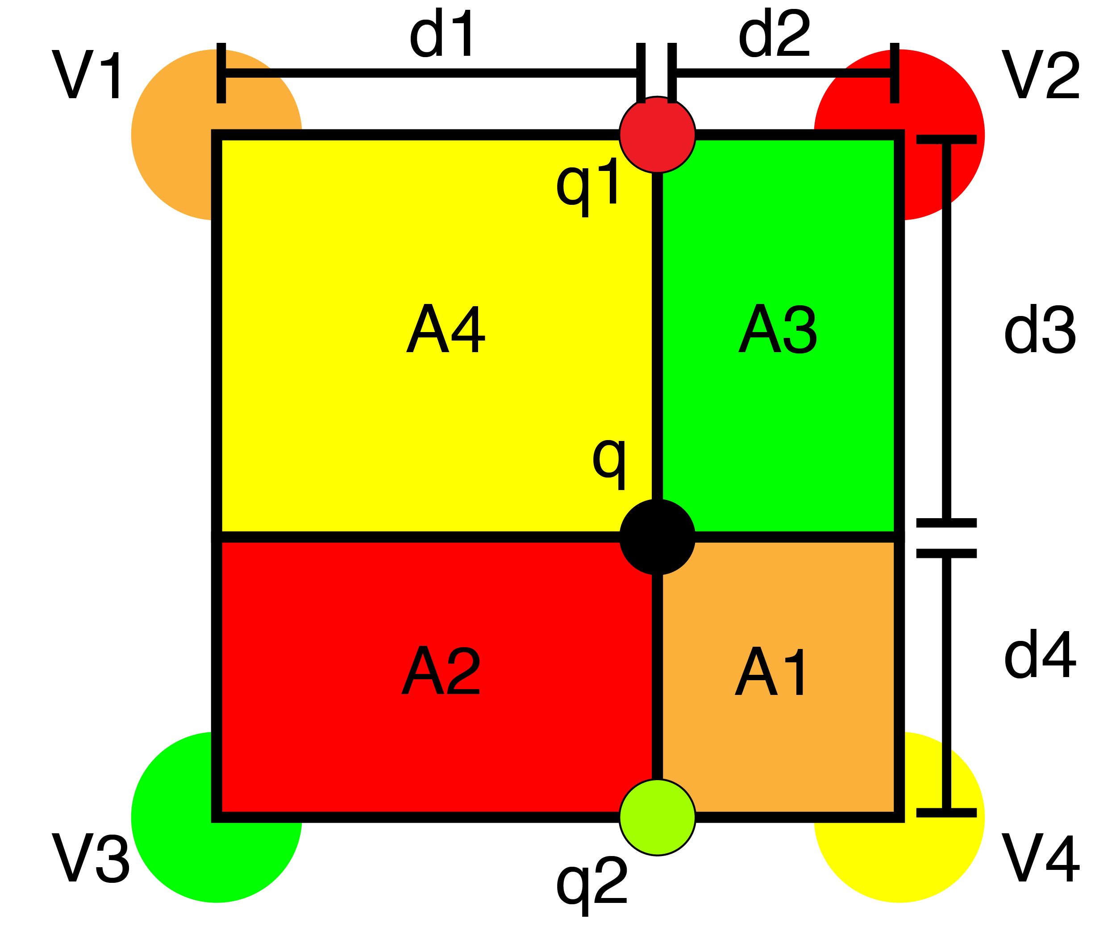
Bilinear interpolation: for grids, pretty good
A1 = d2*d4
A2 = d1*d4
A3 = d2*d3
A4 = d1*d3
q = V1*A1 + V2*A2 + V3*A3 + V4*A4

Slide 46
Bilinear interpolation: for grids, pretty good
Smoother than NN
More complex
4 lookups
Some math
Often the right tradeoff of speed vs final result

Slide 47
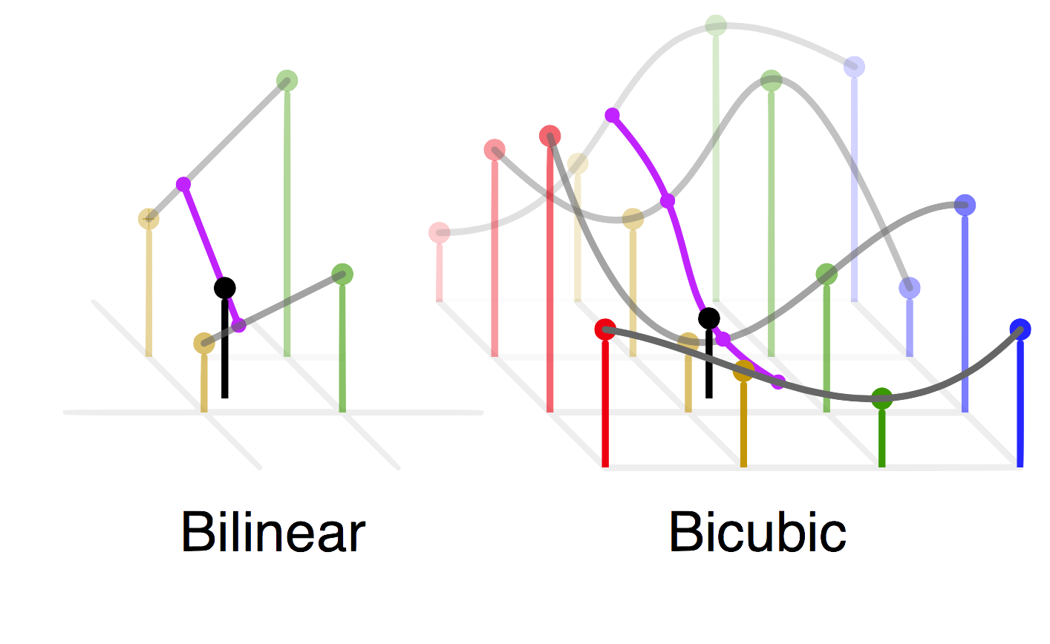
Bicubic sampling: more complex, maybe better?
A cubic interpolation of 4 cubic interpolations
Smoother than bilinear, no “star”
16 nearest neighbors
Fit 3rd order poly:
f(x) = a + bx + cx^2 + dx^3
Interpolate along axis
Fit another poly to interpolated values

Slide 48
Bicubic vs bilinear

Slide 49
Bicubic vs bilinear

Slide 50
Resize algorithm:
For each pixel in new image:
1. Map to old im coordinates
2. Interpolate value
3. Set new value in image

Slide 51
What about shrinking?
NN and Bilinear only look at small area
Lots of artifacting
Staircase pattern on diagonal lines
We’ll fix this next class with filters!

Slide 52
So what is this interpolation useful for?

Slide 53
Image resizing!
Say we want to increase the size of an image…
This is a beautiful image of a sunset… it’s just very small…

Slide 54
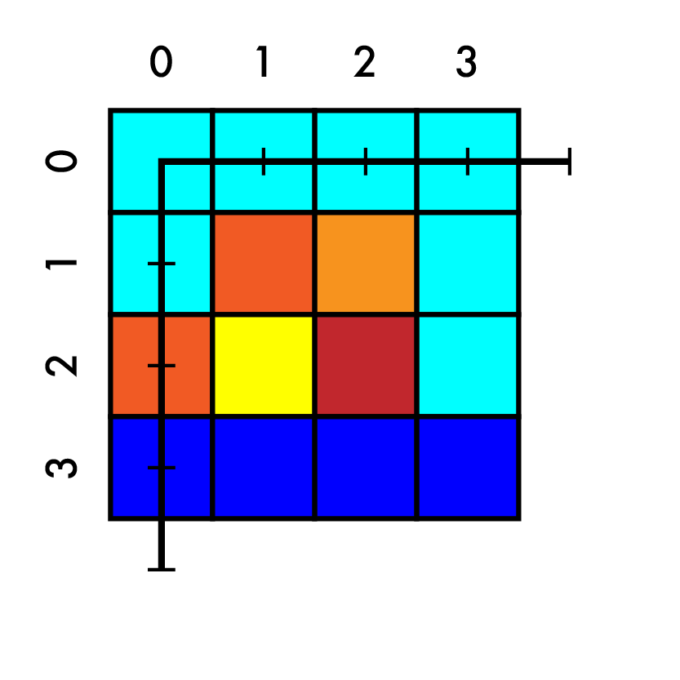
Image resizing!
Say we want to increase the size of an image…
This is a beautiful image of a sunset… it’s just very small…
Say we want to increase size 4x4 -> 7x7

Slide 55
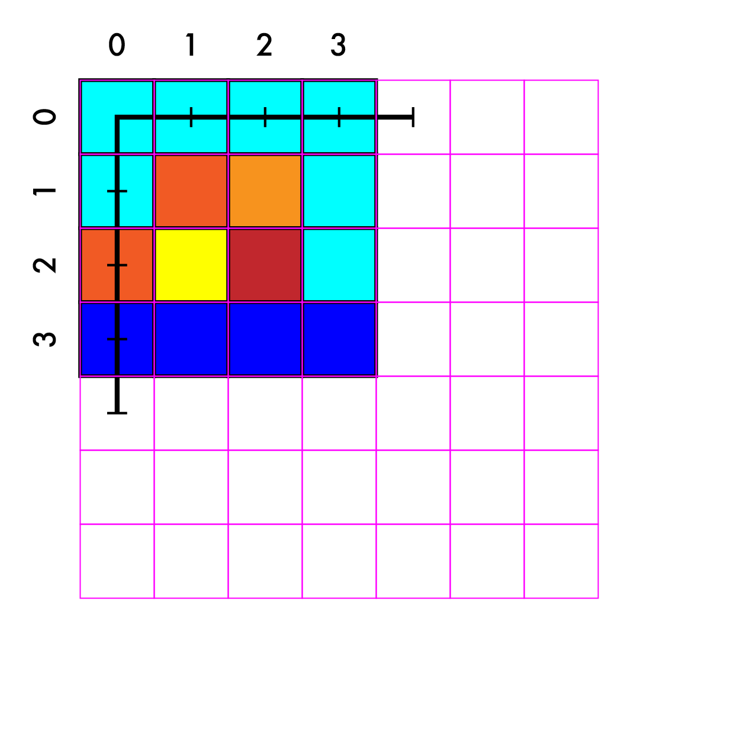
Resize 4x4 -> 7x7
Create our new image

Slide 56
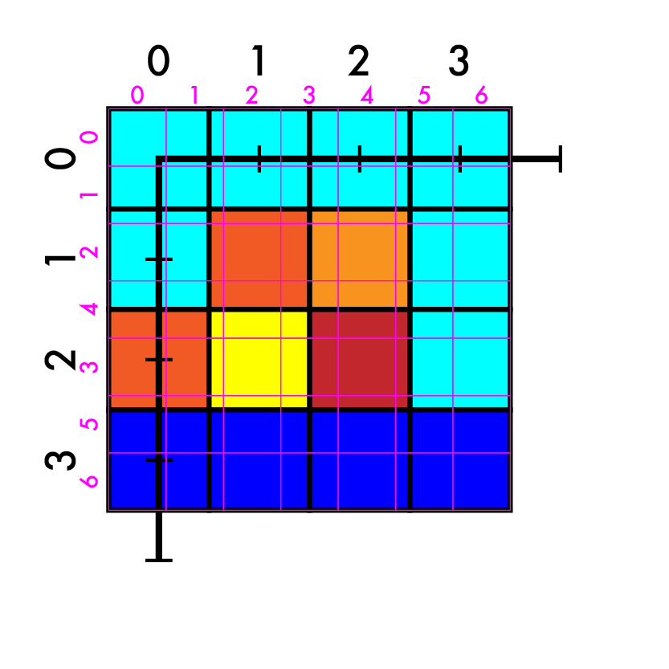
Resize 4x4 -> 7x7
Create our new image
Match up coordinates

Slide 57
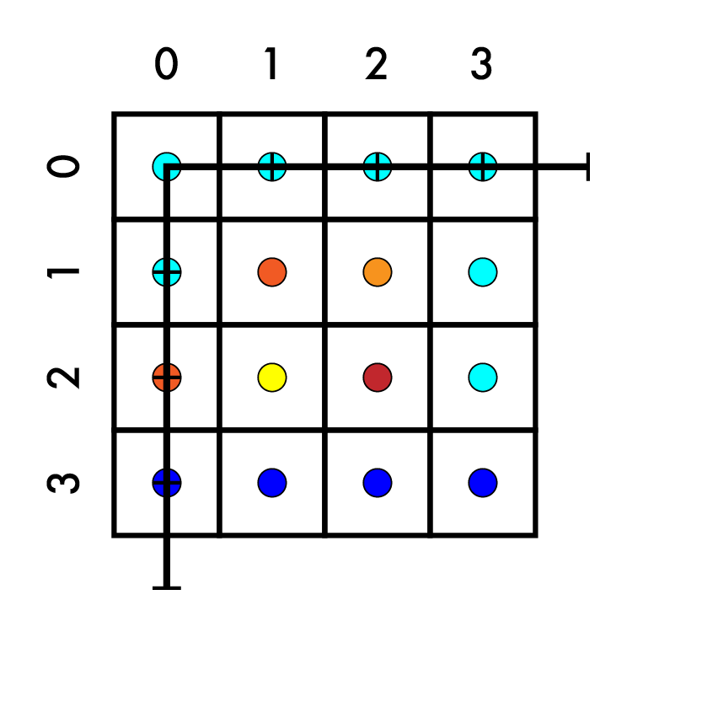
Resize 4x4 -> 7x7
Create our new image
Match up coordinates

Slide 58
Resize 4x4 -> 7x7
Create our new image
Match up coordinates
(-0.5, -0.5)
(3.5, 3.5)

Slide 59
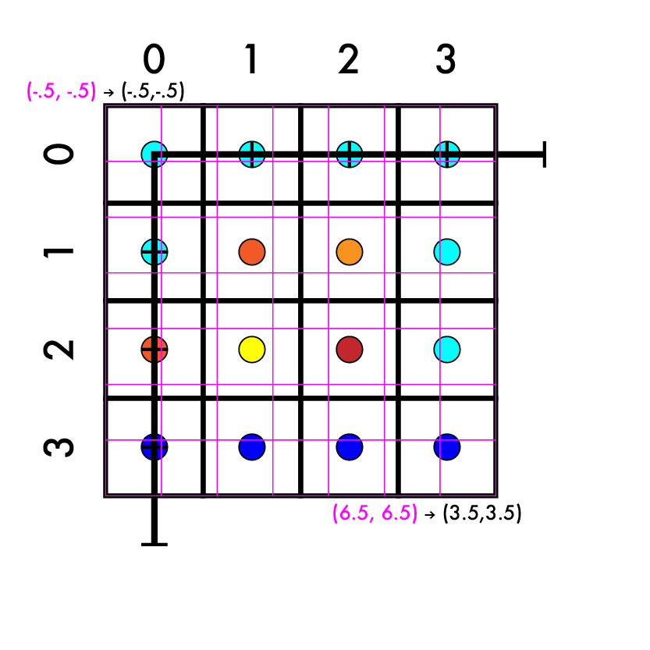
Resize 4x4 -> 7x7
Create our new image
Match up coordinates
System of equations
aX + b = Y
a*-.5 + b = -.5
a*6.5 + b = 3.5

Slide 60
Resize 4x4 -> 7x7
Create our new image
Match up coordinates
System of equations
aX + b = Y
a*-.5 + b = -.5
a*6.5 + b = 3.5
a*7 = 4

Slide 61
Resize 4x4 -> 7x7
Create our new image
Match up coordinates
System of equations
aX + b = Y
a*-.5 + b = -.5
a*6.5 + b = 3.5
a*7 = 4
a = 4/7

Slide 62
Resize 4x4 -> 7x7
Create our new image
Match up coordinates
System of equations
aX + b = Y
a*-.5 + b = -.5
a*6.5 + b = 3.5
a = 4/7

Slide 63
Resize 4x4 -> 7x7
Create our new image
Match up coordinates
System of equations
aX + b = Y
a*-.5 + b = -.5
a*6.5 + b = 3.5
a = 4/7
a*-.5 + b = -.5

Slide 64
Resize 4x4 -> 7x7
Create our new image
Match up coordinates
System of equations
aX + b = Y
a*-.5 + b = -.5
a*6.5 + b = 3.5
a = 4/7
a*-.5 + b = -.5
4/7*-1/2 + b = -1/2

Slide 65
Resize 4x4 -> 7x7
Create our new image
Match up coordinates
System of equations
aX + b = Y
a*-.5 + b = -.5
a*6.5 + b = 3.5
a = 4/7
a*-.5 + b = -.5
4/7*-1/2 + b = -1/2
-4/14 + b = -7/14

Slide 66
Resize 4x4 -> 7x7
Create our new image
Match up coordinates
System of equations
aX + b = Y
a*-.5 + b = -.5
a*6.5 + b = 3.5
a = 4/7
a*-.5 + b = -.5
4/7*-1/2 + b = -1/2
-4/14 + b = -7/14
b = -3/14

Slide 67
Resize 4x4 -> 7x7
Create our new image
Match up coordinates
System of equations
aX + b = Y
a*-.5 + b = -.5
a*6.5 + b = 3.5
a = 4/7
b = -3/14
So, we can start with any coordinate X of the big (new) image and use a and b to get Y on the smaller (old) image.

Slide 68
Resize 4x4 -> 7x7
Create our new image
Match up coordinates
4/7 X - 3/14 = Y

Slide 69
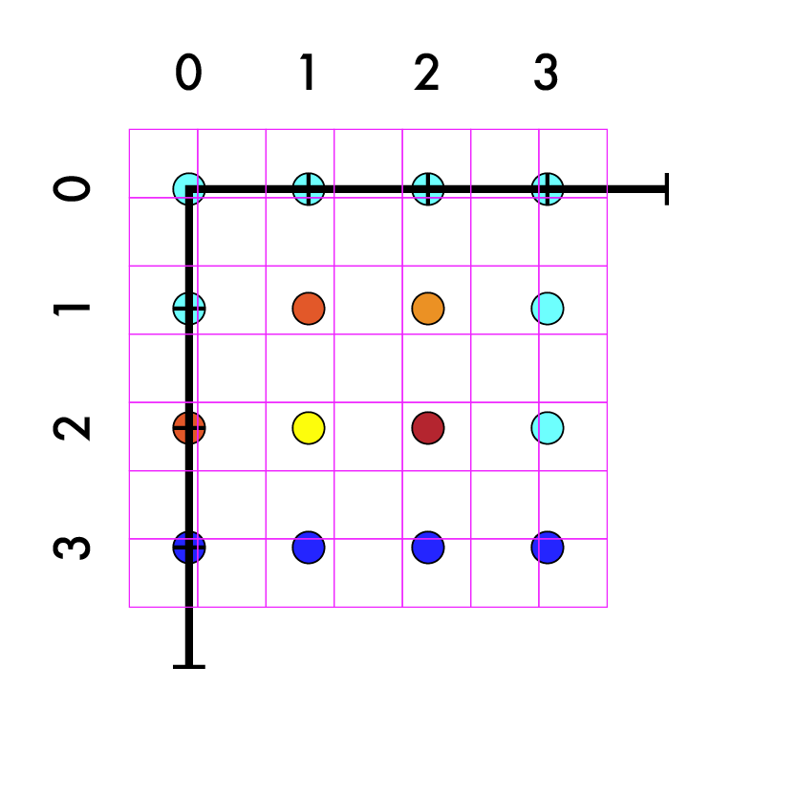
Resize 4x4 -> 7x7
Create our new image
Match up coordinates
4/7 X - 3/14 = Y

Slide 70
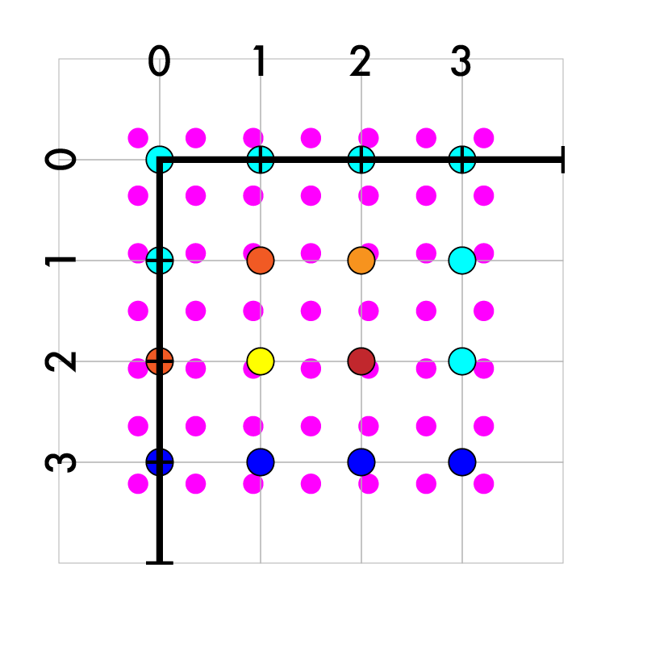
Resize 4x4 -> 7x7
Create our new image
Match up coordinates
4/7 X - 3/14 = Y
Iterate over new pts

Slide 71
Resize 4x4 -> 7x7
Create our new image
Match up coordinates
4/7 X - 3/14 = Y
Iterate over new pts
Map to old coords (Y is old)

Slide 72
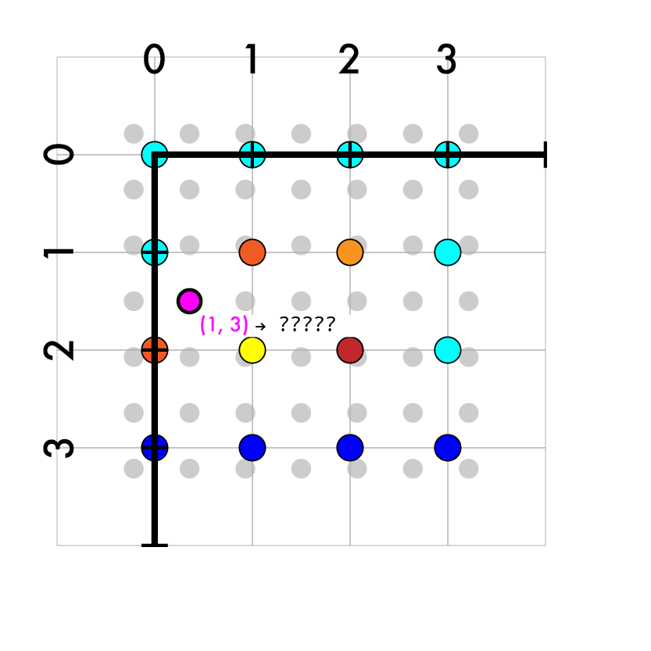
Resize 4x4 -> 7x7
Create our new image
Match up coordinates
4/7 X - 3/14 = Y
Iterate over new pts
Map to old coords (Y is old)
(1, 3)

Slide 73
Resize 4x4 -> 7x7
Create our new image
Match up coordinates
4/7 X - 3/14 = Y
Iterate over new pts
Map to old coords
(1, 3)
4/7*1 - 3/14
4/7*3 - 3/14

Slide 74
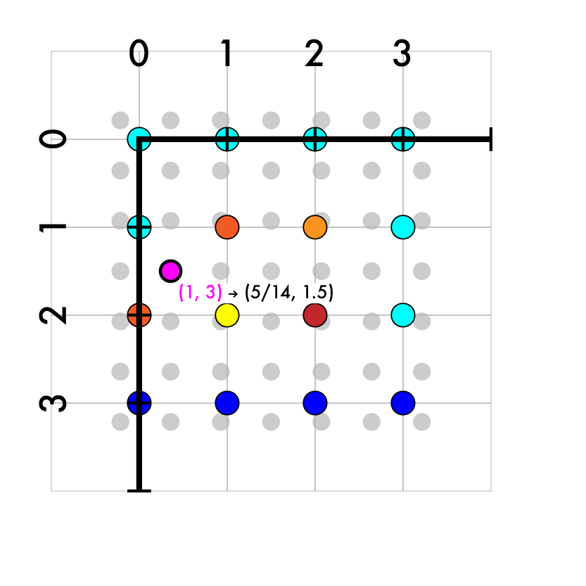
Resize 4x4 -> 7x7
Create our new image
Match up coordinates
4/7 X - 3/14 = Y
Iterate over new pts
Map to old coords
(1, 3)
4/7*1 - 3/14
4/7*3 - 3/14
(5/14, 21/14)

Slide 75
Resize 4x4 -> 7x7
Create our new image
Match up coordinates
4/7 X - 3/14 = Y
Iterate over new pts
Map to old coords
(1, 3) -> (5/14, 21/14)

Slide 76
Resize 4x4 -> 7x7
Create our new image
Match up coordinates
4/7 X - 3/14 = Y
Iterate over new pts
Map to old coords
(1, 3) -> (5/14, 21/14)
Interpolate old values

Slide 77
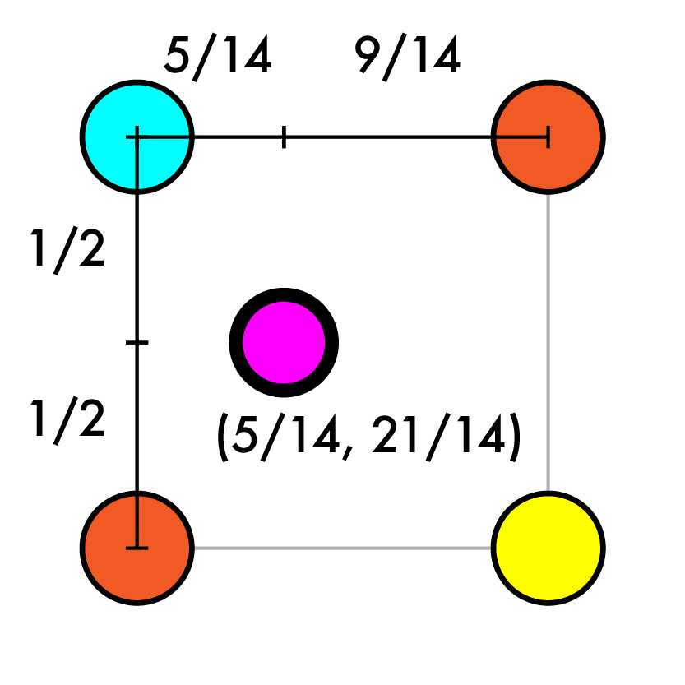
Resize 4x4 -> 7x7
Create our new image
Match up coordinates
4/7 X - 3/14 = Y
Iterate over new pts
Map to old coords
(1, 3) -> (5/14, 21/14)
Interpolate old values
(0,1) (1,1)
(0,2) (1,2)

Slide 78
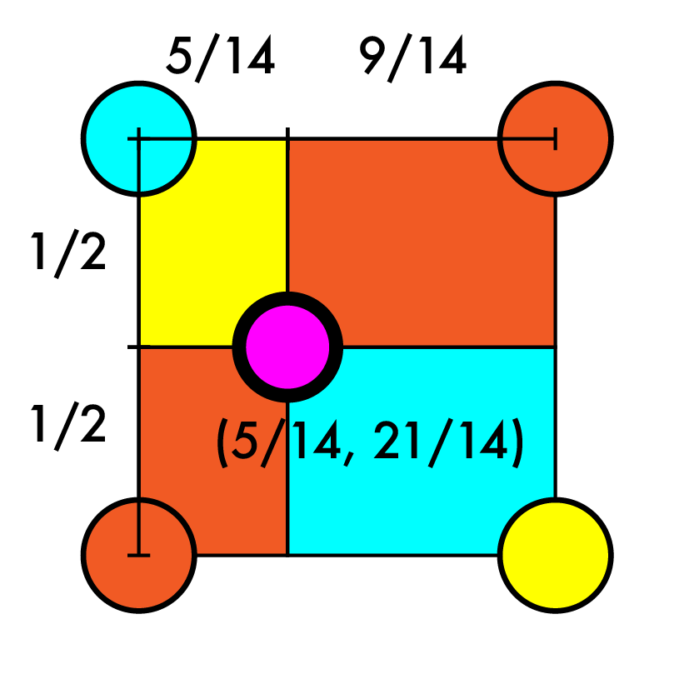
Resize 4x4 -> 7x7
Create our new image
Match up coordinates
4/7 X - 3/14 = Y
Iterate over new pts
Map to old coords
(1, 3) -> (5/14, 21/14)
Interpolate old values
Size of opposite rects
(0,1) (1,1)
(0,2) (1,2)

Slide 79
Resize 4x4 -> 7x7
Create our new image
Match up coordinates
4/7 X - 3/14 = Y
Iterate over new pts
Map to old coords
(1, 3) -> (5/14, 21/14)
Interpolate old values
Yar = (1/2)(5/14)
Bar = (1/2)(9/14)
R1ar = (1/2)(5/14)
R2ar = (1/2)(9/14)
V = Yval*Yar+Bval*Var+R1val*R1ar+R2val*R2ar
For each channel c, put the interpolated value from that channel in position (1,3,c).
(0,1) B (1,1) R1
(0,2) R2 (1,2) Y

Slide 80
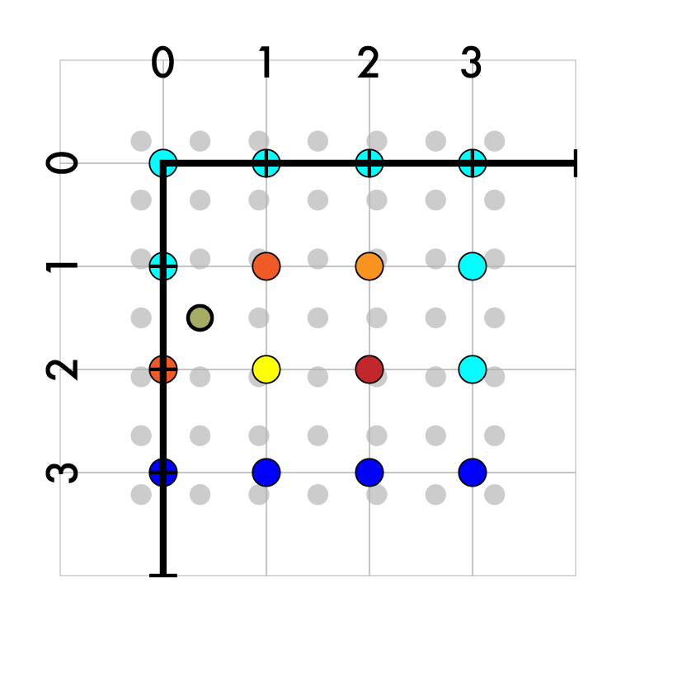
Resize 4x4 -> 7x7
Create our new image
Match up coordinates
4/7 X - 3/14 = Y
Iterate over new pts
Map to old coords
(1, 3) -> (5/14, 21/14)
Interpolate old values

Slide 81
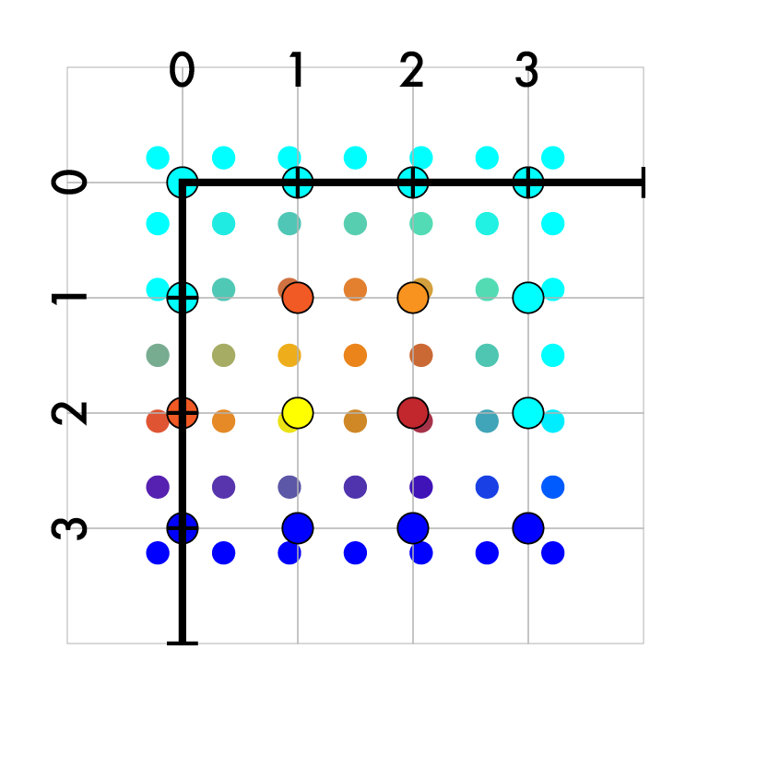
Resize 4x4 -> 7x7
Create our new image results
Match up coordinates
4/7 X - 3/14 = Y
Iterate over new pts
Map to old coords
(1, 3) -> (5/14, 21/14)
Interpolate old values

Slide 82
Resize 4x4 -> 7x7
Create our new image
Match up coordinates
4/7 X - 3/14 = Y
Iterate over new pts
Map to old coords
(1, 3) -> (5/14, 21/14)
Interpolate old values
Fill in the rest
On outer edges use padding!

Slide 83
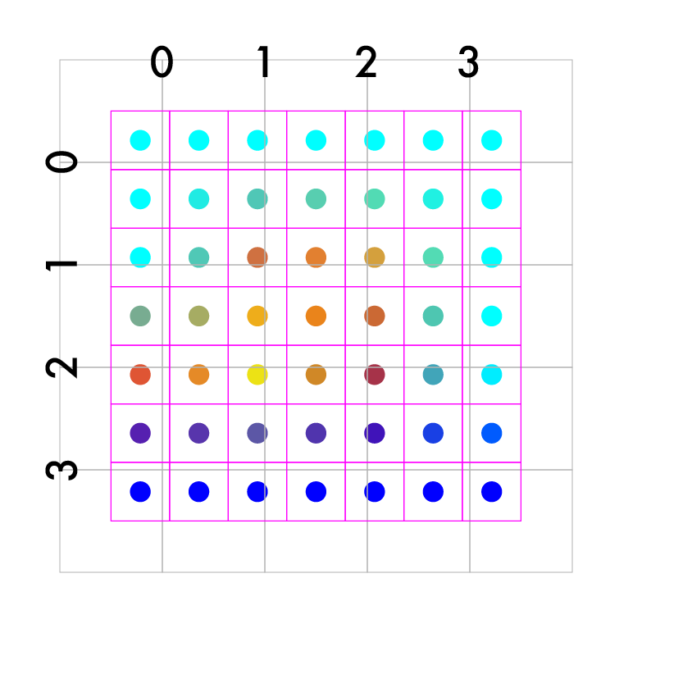
Resize 4x4 -> 7x7
Create our new image
Match up coordinates
4/7 X - 3/14 = Y
Iterate over new pts
Map to old coords
(1, 3) -> (5/14, 21/14)
Interpolate old values
Final result 7 x 7

Slide 84
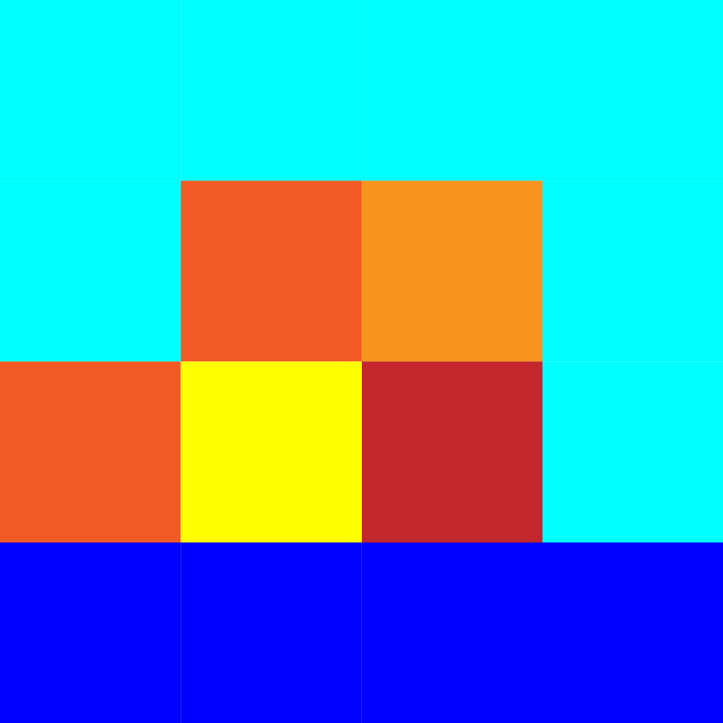
We did it!

Slide 85
Let’s do something interesting already!!

Slide 86
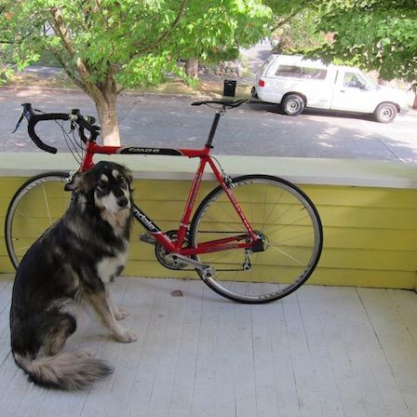
Want to make image smaller

Slide 87
448x448 -> 64x64

Slide 88
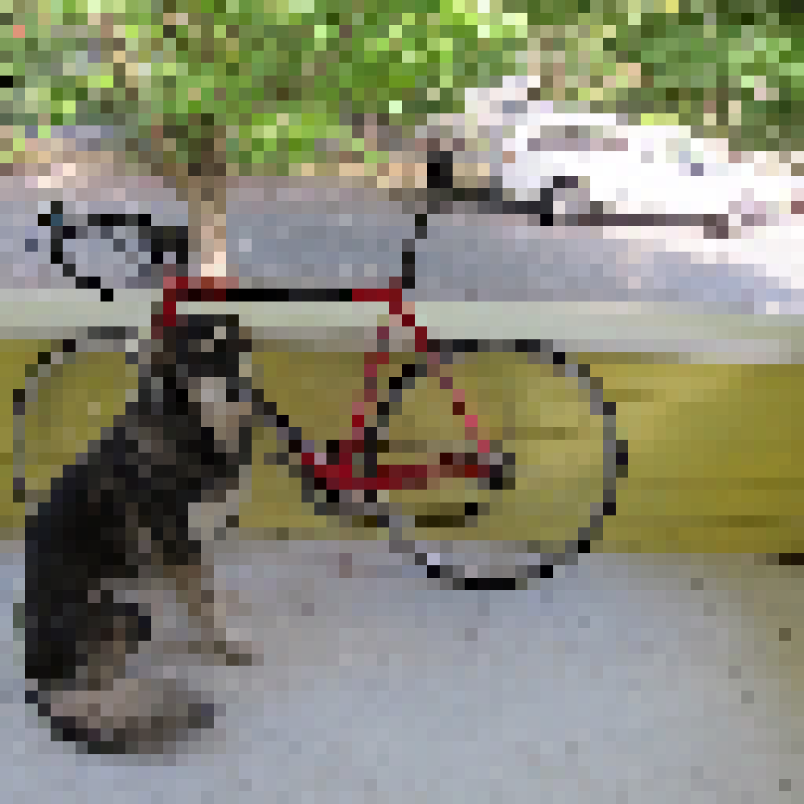
448x448 -> 64x64

Slide 89
448x448 -> 64x64

Slide 90
448x448 -> 64x64

Slide 91
448x448 -> 64x64

Slide 92
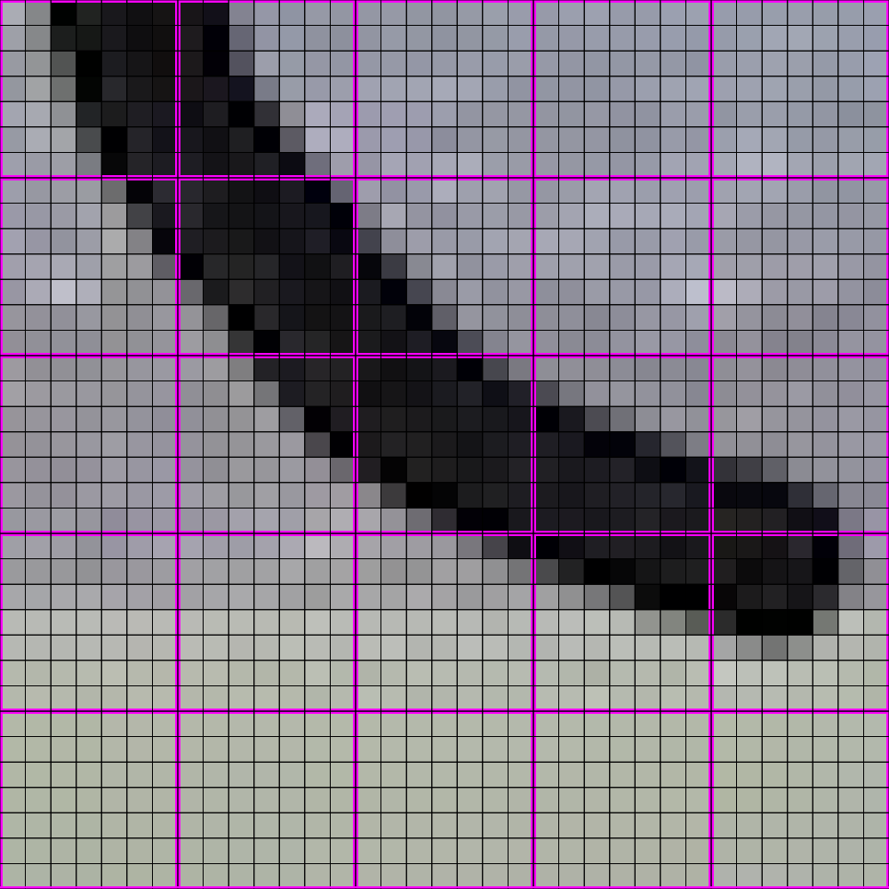
448x448 -> 64x64

Slide 93
448x448 -> 64x64

Slide 94
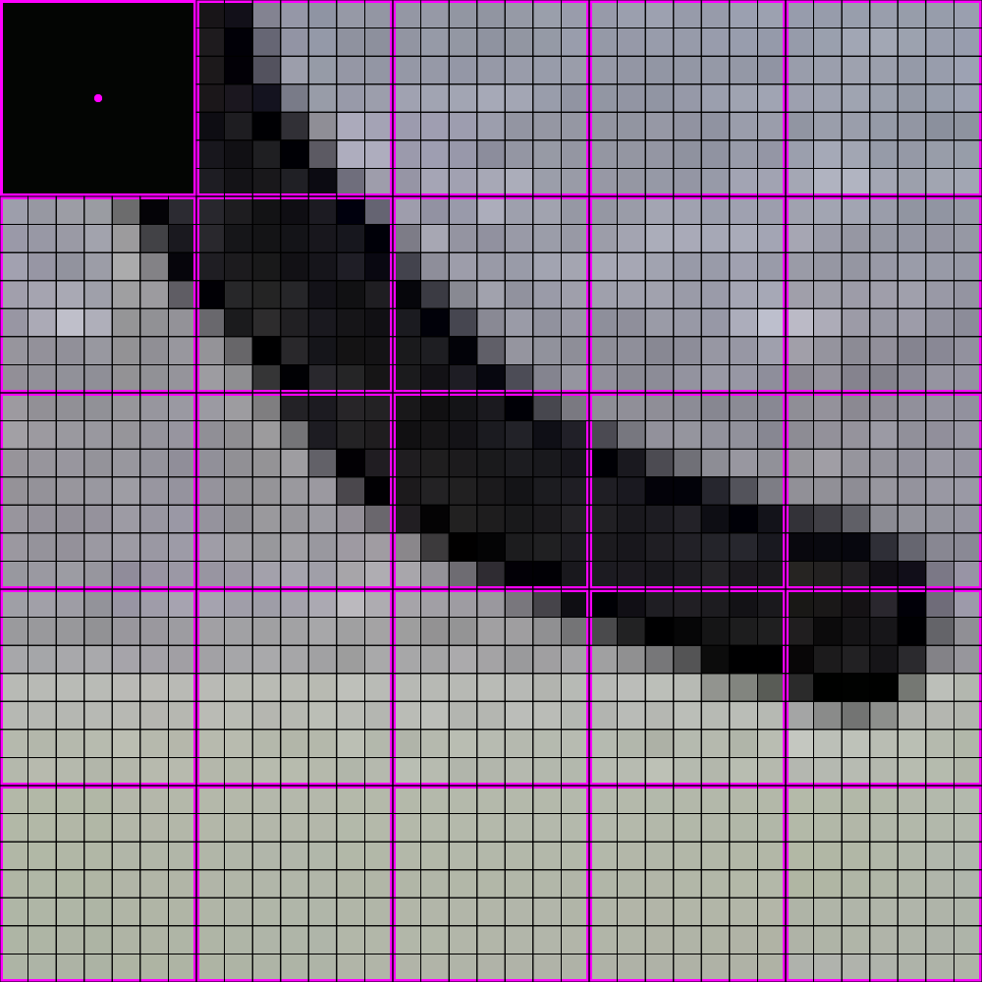
448x448 -> 64x64

Slide 95
448x448 -> 64x64

Slide 96
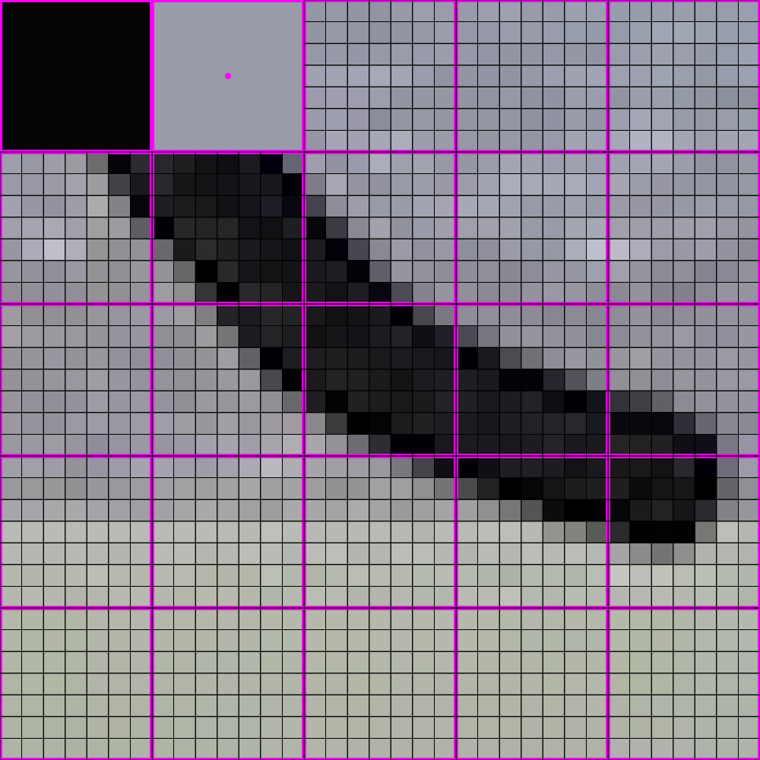
448x448 -> 64x64

Slide 97
448x448 -> 64x64

Slide 98
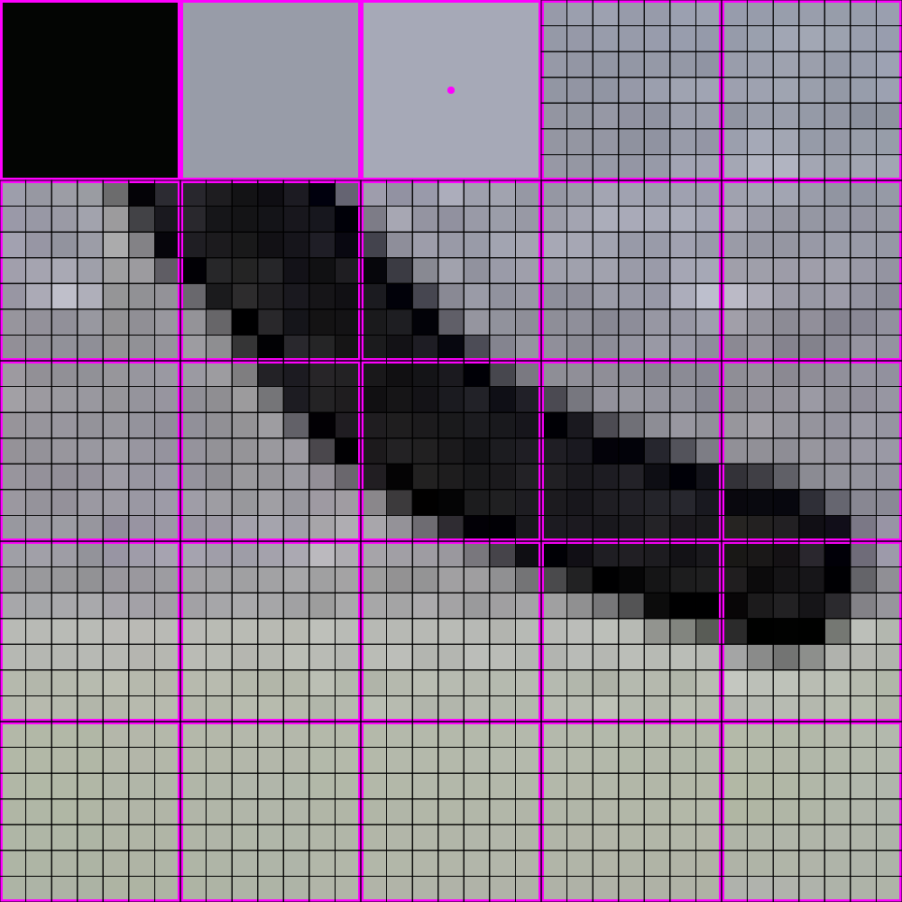
448x448 -> 64x64

Slide 99
448x448 -> 64x64

Slide 100
448x448 -> 64x64

Slide 101
448x448 -> 64x64

Slide 102
448x448 -> 64x64

Slide 103
448x448 -> 64x64

Slide 104
448x448 -> 64x64

Slide 105
448x448 -> 64x64

Slide 106
448x448 -> 64x64

Slide 107
448x448 -> 64x64

Slide 108
448x448 -> 64x64

Slide 109
448x448 -> 64x64

Slide 110
448x448 -> 64x64

Slide 111
448x448 -> 64x64

Slide 112
448x448 -> 64x64

Slide 113
448x448 -> 64x64

Slide 114
448x448 -> 64x64

Slide 115
448x448 -> 64x64

Slide 116
448x448 -> 64x64

Slide 117
448x448 -> 64x64

Slide 118
448x448 -> 64x64

Slide 119
448x448 -> 64x64

Slide 120
448x448 -> 64x64

Slide 121
448x448 -> 64x64

Slide 122
448x448 -> 64x64

Slide 123
448x448 -> 64x64

Slide 124
448x448 -> 64x64

Slide 125
448x448 -> 64x64

Slide 126
448x448 -> 64x64

Slide 127
IS THIS ALL THERE IS??

Slide 128
THERE IS A BETTER WAY!

Slide 129
Next Time: Filtering

