Slide 1
Recognition IV: Object Detection through Deep Learning and R-CNNs
Linda Shapiro
CSE 455
Most slides from Ross Girshick

Slide 2
Outline
Object detection
  the task, evaluation, datasets
Neural Net: how do they work?
Convolutional Neural Networks (CNNs)
  overview and history
Region-based Convolutional Networks (R-CNNs)
New Speedier R-CNNs

Slide 3
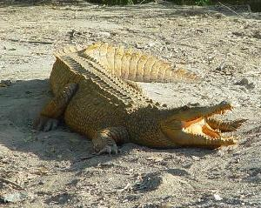
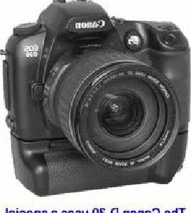

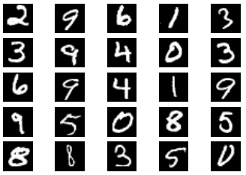
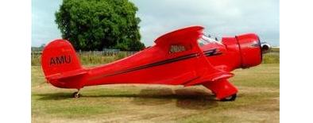
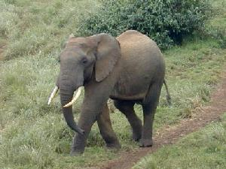


Image classification
$K$ classes
Task: assign correct class label to the whole image
Digit classification (MNIST)
Object recognition (Caltech-101)

Slide 4
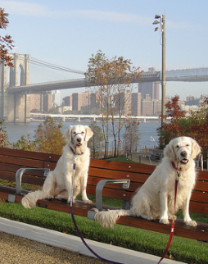
Classification vs. Detection
Dog
Dog
Dog

Slide 5
Problem formulation
{ airplane, bird, motorbike, person, sofa }
person
motorbike
Input
Desired output

Slide 6
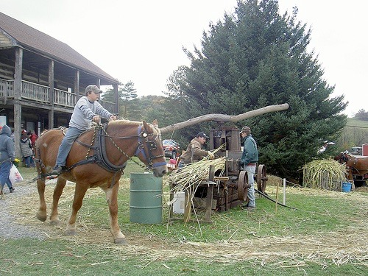
Evaluating a detector
Test image (previously unseen)

Slide 7
First detection ...
0.9
‘person’ detector predictions

Slide 8
Second detection ...
0.9
0.6
‘person’ detector predictions

Slide 9
Third detection ...
0.2
0.9
0.6
‘person’ detector predictions

Slide 10
Compare to ground truth
0.2
0.9
0.6
‘person’ detector predictions
ground truth ‘person’ boxes

Slide 11
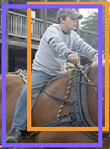


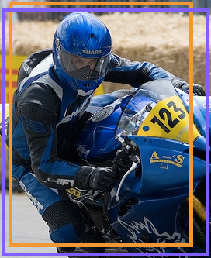


Sort by confidence
0.9
0.8
0.6
0.5
0.2
0.1
...
...
...
...
...
✓
X
✓
✓
X
X
true
positive
(high overlap)
false
positive
(no overlap,
low overlap, or
duplicate)
Notes:
Let’s define the problem a bit more so we’re all on the same page.

Slide 12

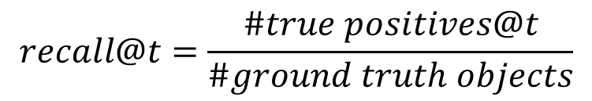
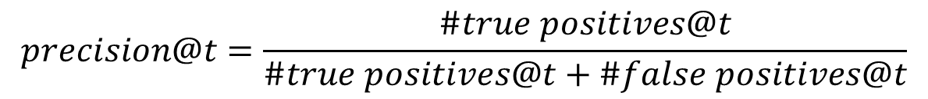
Evaluation metric
0.9
0.8
0.6
0.5
0.2
0.1
...
...
...
...
...
✓
X
✓
✓
X
X
$$t$$
$$precision@t=\frac{\#true positives@t}{\#true positives@t+\#false positives@t}$$
✓
✓ +
X
$$recall@t=\frac{\#true positives@t}{\#ground truth objects}$$
Notes:
Let’s define the problem a bit more so we’re all on the same page.

Slide 13
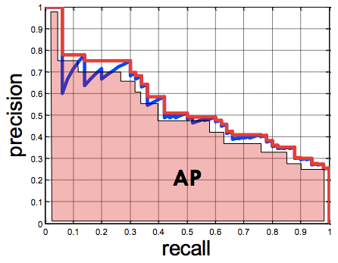
Evaluation metric
0.9
0.8
0.6
0.5
0.2
0.1
...
...
...
...
...
✓
X
✓
✓
X
X
Average Precision (AP)
0% is worst
100% is best
mean AP over classes
(mAP)
Notes:
Let’s define the problem a bit more so we’re all on the same page.

Slide 14
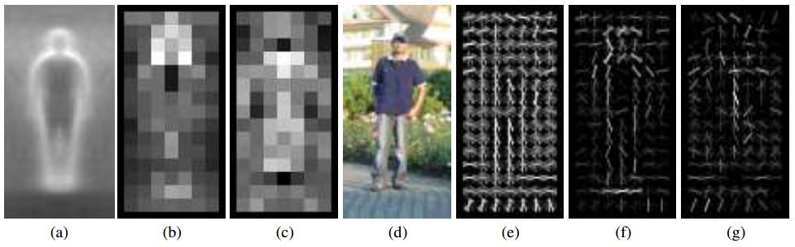
Pedestrians
Histograms of Oriented Gradients for Human Detection, Dalal and Triggs, CVPR 2005
AP ~77%
More sophisticated methods: AP ~90%
(a) average gradient image over training examples
(b) each “pixel” shows max positive SVM weight in the block centered on that pixel
(c) same as (b) for negative SVM weights
(d) test image
(e) its R-HOG descriptor
(f) R-HOG descriptor weighted by positive SVM weights
(g) R-HOG descriptor weighted by negative SVM weights

Slide 15
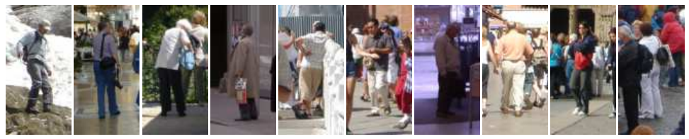
Why did it work?
Average gradient image

Slide 16
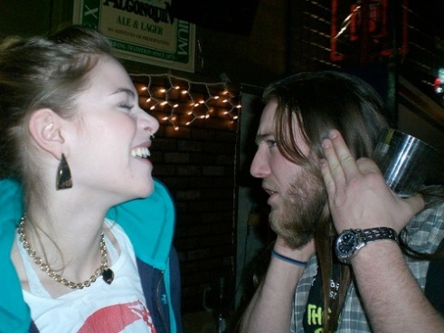
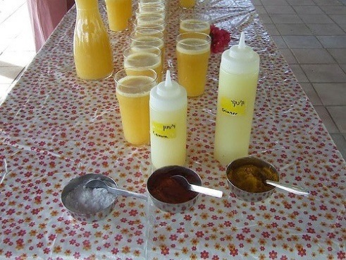
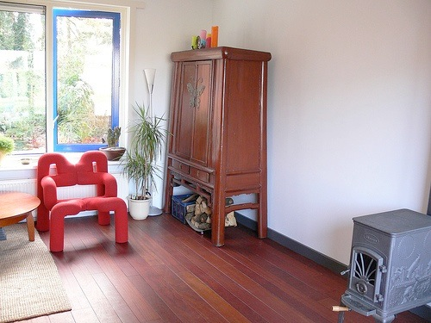
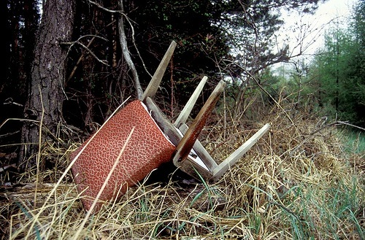
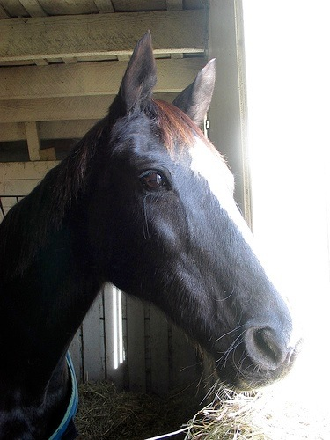
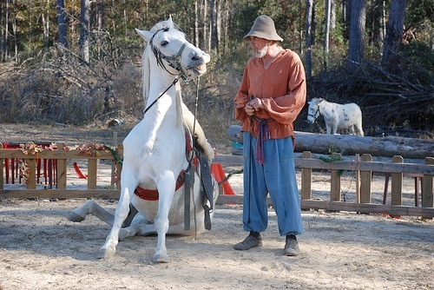
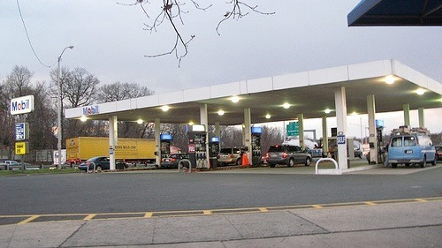
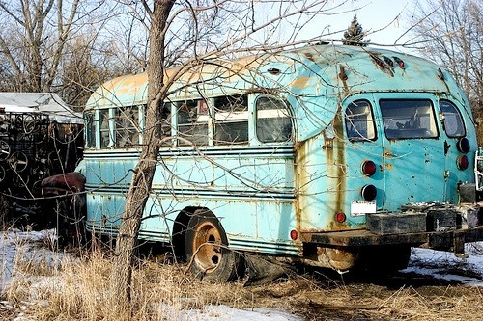
Generic categories
Can we detect people, chairs, horses, cars, dogs, buses, bottles, sheep …?
PASCAL Visual Object Categories (VOC) dataset

Slide 17
Generic categories
Why doesn’t this work (as well)?
Can we detect people, chairs, horses, cars, dogs, buses, bottles, sheep …?
PASCAL Visual Object Categories (VOC) dataset

Slide 18
Quiz time

Slide 19

Warm up
This is an average image of which object class?

Slide 20
Warm up
pedestrian

Slide 21
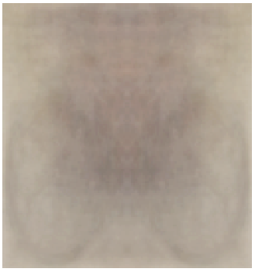
A little harder
?

Slide 22
A little harder
?
Hint: airplane, bicycle, bus, car, cat, chair, cow, dog, dining table

Slide 23
A little harder
bicycle (PASCAL)

Slide 24
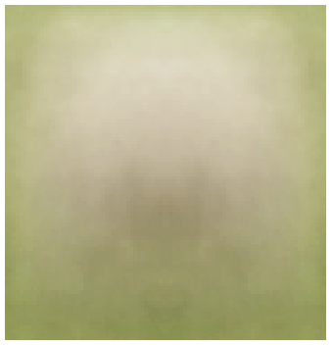
A little harder, yet
?

Slide 25
A little harder, yet
?
Hint: white blob on a green background

Slide 26
A little harder, yet
sheep (PASCAL)

Slide 27
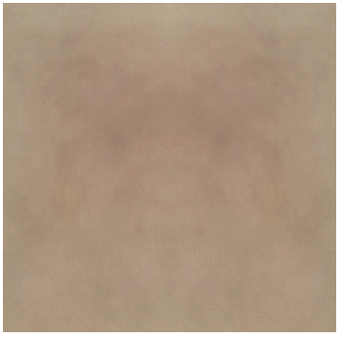
Impossible?
?

Slide 28
Impossible?
dog (PASCAL)

Slide 29
Impossible?
dog (PASCAL)
Why does the mean look like this?
There’s no alignment between the examples!
How do we combat this?

Slide 30
PASCAL VOC detection history
41%
41%
37%
DPM++,
MKL,
Selective
Search
Selective
Search,
DPM++,
MKL
28%
DPM++
23%
DPM,
MKL
17%
DPM,
HOG+
BOW
DPM

Slide 31
Part-based models & multiple features (MKL)
41%
41%
37%
rapid performance improvements
DPM++,
MKL,
Selective
Search
Selective
Search,
DPM++,
MKL
28%
DPM++
23%
DPM,
MKL
17%
DPM,
HOG+
BOW
DPM

Slide 32
Kitchen-sink approaches
increasing complexity & plateau
41%
41%
37%
DPM++,
MKL,
Selective
Search
Selective
Search,
DPM++,
MKL
28%
DPM++
23%
DPM,
MKL
17%
DPM,
HOG+
BOW
DPM

Slide 33
Region-based Convolutional Networks (R-CNNs)
62%
53%
R-CNN v2
R-CNN v1
41%
41%
37%
DPM++,
MKL,
Selective
Search
Selective
Search,
DPM++,
MKL
28%
DPM++
23%
DPM,
MKL
17%
DPM,
HOG+
BOW
DPM
[R-CNN. Girshick et al. CVPR 2014]

Slide 34
Region-based Convolutional Networks (R-CNNs)
~1 year
~5 years
[R-CNN. Girshick et al. CVPR 2014]

Slide 35
Convolutional Neural Networks
Overview

Slide 36
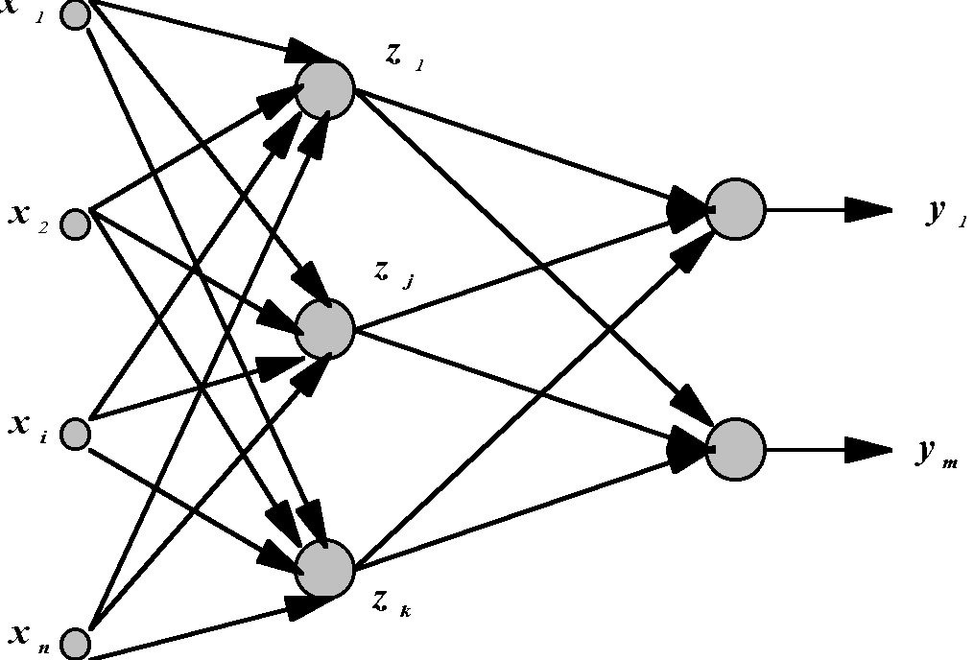
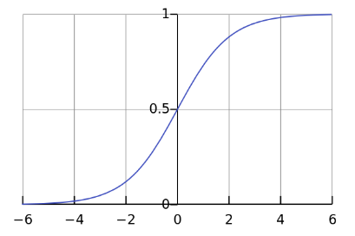



Standard Neural Networks
hidden layer
“Fully connected”
outputs
inputs
g(sum of weights w times inputs x)
$$x={\left(x_{1},…,x_{784}\right)}^{T}$$
$$z_{j}={g(w}_{j }^{T}x)$$
$$g\left(t\right)=\frac{1}{1+e^{−t}}$$

Slide 37
Let’s look at how these work

Slide 38
Perceptrons
Initial proposal of connectionist networks
Rosenblatt, 50’s and 60’s
Essentially a linear discriminant composed of nodes, weights
I1
W1
I1
W1
or
W2
W2
O
I2
O
I2
W3
W3
I3
Activation Function: g
I3
1

Slide 39
Perceptron Example
2
.5
.3
=-1
1
2(0.5) + 1(0.3) + -1 = 0.3 > 0 , so O=1
Learning Procedure:
Randomly assign weights (between 0 and1)
Present inputs from training data
Get output O, nudge weights to gives results toward our desired output T
Repeat; stop when no errors, or enough epochs completed

Slide 40
Perception Training
2
.5
θ=-1
1
.3
Weights include Threshold. T=Desired, O=Actual output.
Example: T=0, O=1, W1=0.5, W2=0.3, I1=2, I2=1, θ=-1
If we present this input again, we’d output 0 instead

Slide 41
Perceptrons are not powerful
Essentially a linear discriminant
Perceptron theorem: If a linear discriminant exists that can separate the classes without error, the training procedure is guaranteed to find that line or plane.
Class1
Class2

Slide 42
LMS Learning
LMS = Least Mean Square Learning Systems, more general than the previous perceptron learning rule. The concept is to minimize the total error, as measured over all training examples, P. O is the raw output, as calculated by
E.g. if we have two patterns and
T1=1, O1=0.8, T2=0, O2=0.5 then D=(0.5)[(1-0.8)²+(0-0.5)²]=.145
We want to minimize the LMS:
C-learning rate
E
W(old)
W(new)
W

Slide 43
Activation Function
To apply the LMS learning rule, also known as the delta rule, we need a differentiable activation function.
see next slide!
Old:
New:

Slide 44
Gradient Descent Learning from
Russell and Norvig AI Text
examples is the training set
Each input x is a a tuple x₁, … , x_{n} and has true output y.
Weights are in vector W; activation function is g.
repeat
for each e in examples do
in = ∑ W_{j} x_{j}[e]
Err = y[e] – g(in)
W_{j} = W_{j} + α x Err x g’(in) x x_{j}[e]
until some stopping criterion is satisfied

Slide 45
LMS vs. Limiting Threshold
With the new sigmoidal function that is differentiable, we can apply the delta rule toward learning.
Perceptron Method
  Forced output to 0 or 1, while LMS uses the net output
  Guaranteed to separate, if no error and is linearly separable
    Otherwise it may not converge
Gradient Descent Method:
  May oscillate and not converge
  May converge to wrong answer
  Will converge to some minimum even if the classes are not linearly separable, unlike the earlier perceptron training method

Slide 46
Backpropagation Networks
Attributed to Rumelhart and McClelland, late 70’s
To bypass the linear classification problem, we can construct multilayer networks. Typically we have fully connected, feedforward networks.
Input Layer
Hidden Layer
Output Layer
I1
O1
H1
I2
H2
O2
I3
W_{i,j}
1
W_{j,k}
1
1’s - bias

Slide 47
Backprop - Learning
Learning Procedure:
Randomly assign weights (between 0-1)
Present inputs from training data, propagate to outputs
Compute outputs O, adjust weights according to the delta rule, backpropagating the errors. The weights will be nudged closer so that the network learns to give the desired output.
Repeat; stop when no errors, or enough epochs completed

Slide 48
Backprop - Modifying Weights
See Russell and Norvig algorithm in Figure 20.25 for
details.
Lots of nested for loops for all the layers.
This is the idea from NN slides.
I
H
O
W_{i,j}
W_{j,k}

Slide 49
Backprop
Very powerful - can learn any function, given enough hidden units! With enough hidden units, we can generate any function.
Have the same problems of Generalization vs. Memorization. With too many units, we will tend to memorize the input and not generalize well. Some schemes exist to “prune” the neural network.
Networks require extensive training, many parameters to fiddle with. Can be extremely slow to train. May also fall into local minima.
Inherently parallel algorithm, ideal for multiprocessor hardware.
Despite the cons, a very powerful algorithm that has seen widespread successful deployment.

Slide 50
From NNs to Convolutional NNs
Local connectivity
Shared (“tied”) weights
Multiple feature maps
Pooling

Slide 51
Convolutional NNs
Local connectivity
compare
Each green unit is only connected to (3)
neighboring blue units

Slide 52



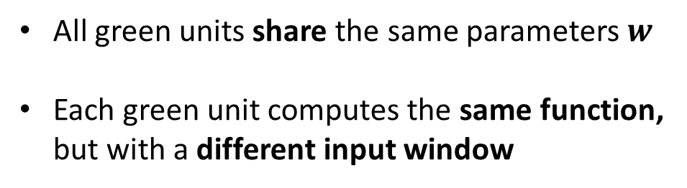



Convolutional NNs
Shared (“tied”) weights
$$w_{1}$$
$$w_{2}$$
$$w_{3}$$
All green units share the same parameters $w$
Each green unit computes the same function,
but with a different input window
$$w_{1}$$
$$w_{2}$$
$$w_{3}$$

Slide 53

Convolutional NNs
Convolution with 1-D filter: $[w_{3},w_{2},w_{1}]$
$$w_{1}$$
$$w_{2}$$
$$w_{3}$$
All green units share the same parameters $w$
Each green unit computes the same function,
but with a different input window

Slide 54



Convolutional NNs
Convolution with 1-D filter: $[w_{3},w_{2},w_{1}]$
$$w_{1}$$
$$w_{2}$$
All green units share the same parameters $w$
Each green unit computes the same function,
but with a different input window
$$w_{3}$$

Slide 55



Convolutional NNs
Convolution with 1-D filter: $[w_{3},w_{2},w_{1}]$
All green units share the same parameters $w$
Each green unit computes the same function,
but with a different input window
$$w_{1}$$
$$w_{2}$$
$$w_{3}$$

Slide 56



Convolutional NNs
Convolution with 1-D filter: $[w_{3},w_{2},w_{1}]$
All green units share the same parameters $w$
Each green unit computes the same function,
but with a different input window
$$w_{1}$$
$$w_{2}$$
$$w_{3}$$

Slide 57



Convolutional NNs
Convolution with 1-D filter: $[w_{3},w_{2},w_{1}]$
All green units share the same parameters $w$
Each green unit computes the same function,
but with a different input window
$$w_{1}$$
$$w_{2}$$
$$w_{3}$$

Slide 58



Convolutional NNs
Multiple feature maps
$${w′}_{1}$$
$${w′}_{2}$$
All orange units compute the same function
but with a different input windows
Orange and green units compute
different functions
$${w′}_{3}$$
$$w_{1}$$
Feature map 2
(array of orange
units)
$$w_{2}$$
$$w_{3}$$
Feature map 1
(array of green
units)

Slide 59
Convolutional NNs
Pooling (max, average)
1
4
Pooling area: 2 units
Pooling stride: 2 units
Subsamples feature maps
4
0
3
3

Slide 60
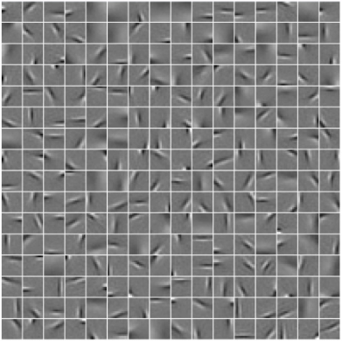
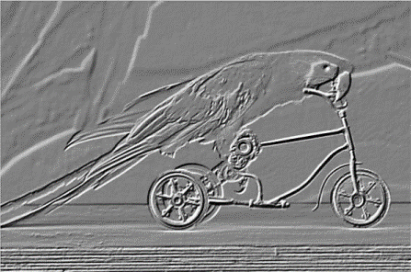
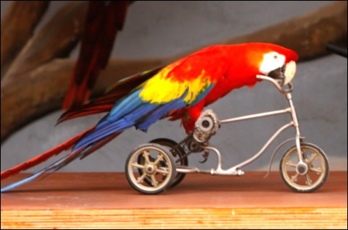
2D input
Pooling
Convolution
Image

Slide 61
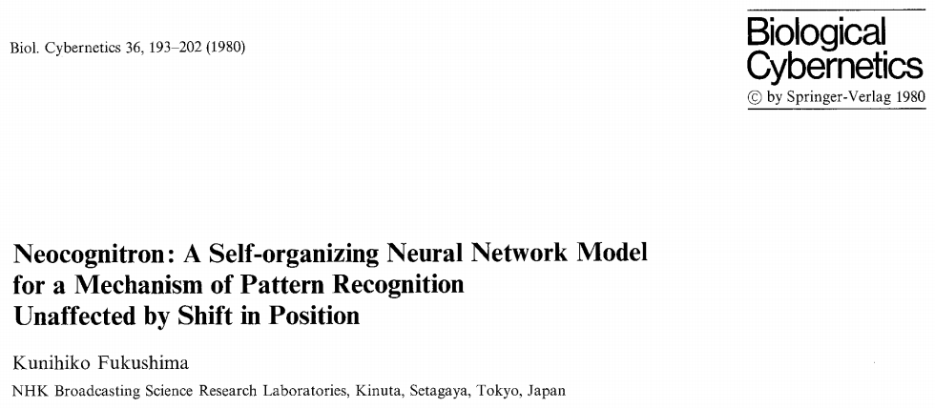
Historical perspective – 1980

Slide 62
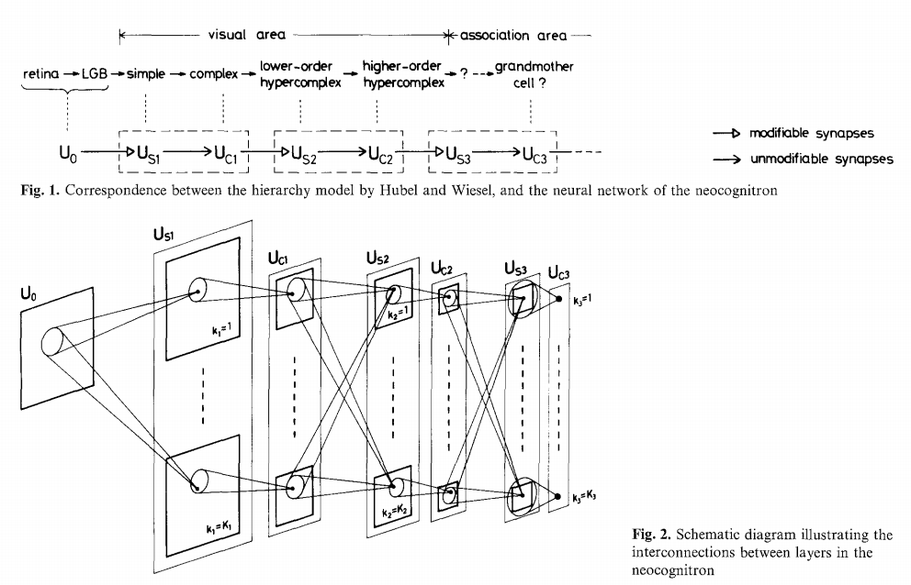
Historical perspective – 1980
Hubel and Wiesel
1962
Included basic ingredients of ConvNets, but no supervised learning algorithm

Slide 63
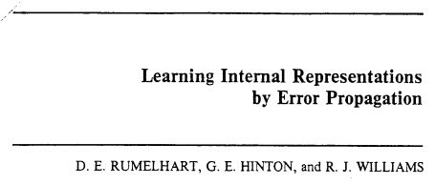
Supervised learning – 1986
Gradient descent training with error backpropagation
Early demonstration that error backpropagation can be used
for supervised training of neural nets (including ConvNets)

Slide 64
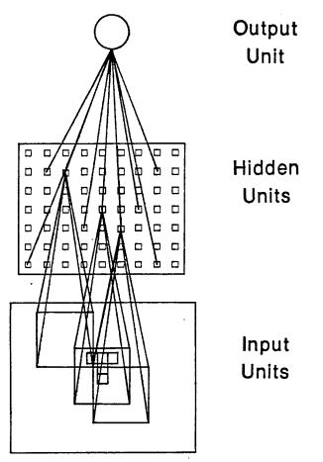
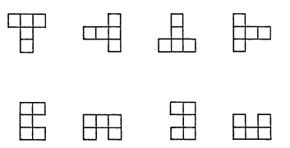
Supervised learning – 1986
“T” vs. “C” problem
Simple ConvNet

Slide 65
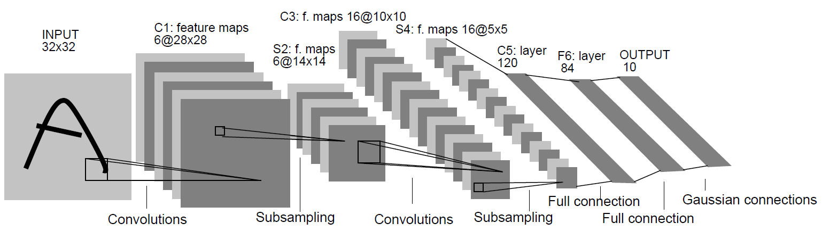
Practical ConvNets
Gradient-Based Learning Applied to Document Recognition,
Lecun et al., 1998

Slide 66
The fall of ConvNets
The rise of Support Vector Machines (SVMs)
Mathematical advantages (theory, convex optimization)
Competitive performance on tasks such as digit classification
Neural nets became unpopular in the mid 1990s

Slide 67
The key to SVMs
It’s all about the features
HOG features
SVM weights
(+) (-)
Histograms of Oriented Gradients for Human Detection, Dalal and Triggs, CVPR 2005

Slide 68
Core idea of “deep learning”
Input: the “raw” signal (image, waveform, …)
Features: hierarchy of features is learned from the raw input

Slide 69
If SVMs killed neural nets, how did they come back (in computer vision)?

Slide 70

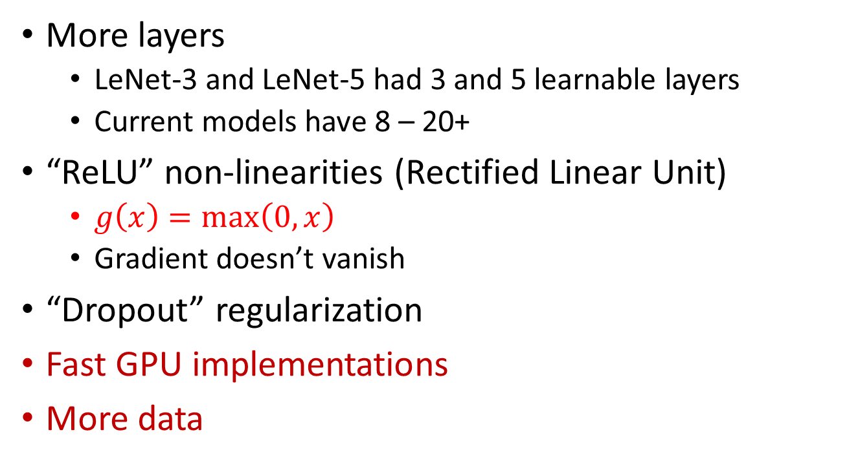

What’s new since the 1980s?
More layers
  LeNet-3 and LeNet-5 had 3 and 5 learnable layers
  Current models have 8 – 20+
“ReLU” non-linearities (Rectified Linear Unit)
  $g\left(x\right)=\max\left(0, x\right)$
  Gradient doesn’t vanish
“Dropout” regularization
Fast GPU implementations
More data
$$g(x)$$
$$x$$

Slide 71
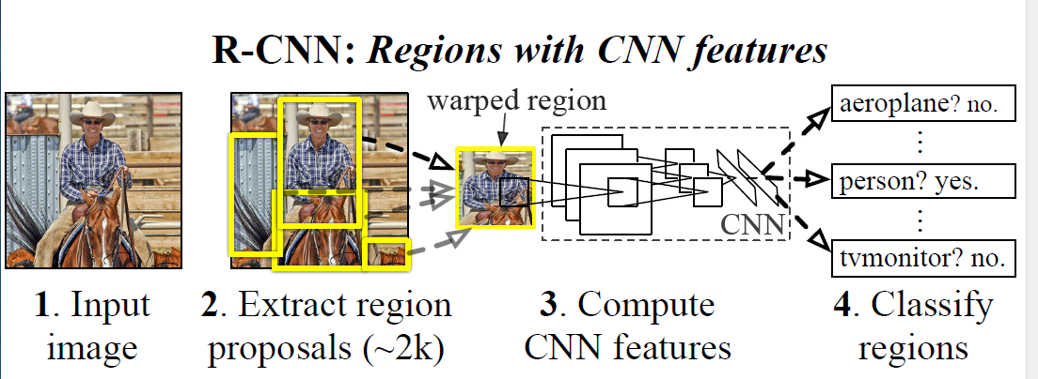
Ross’s Own System: Region CNNs

Slide 72
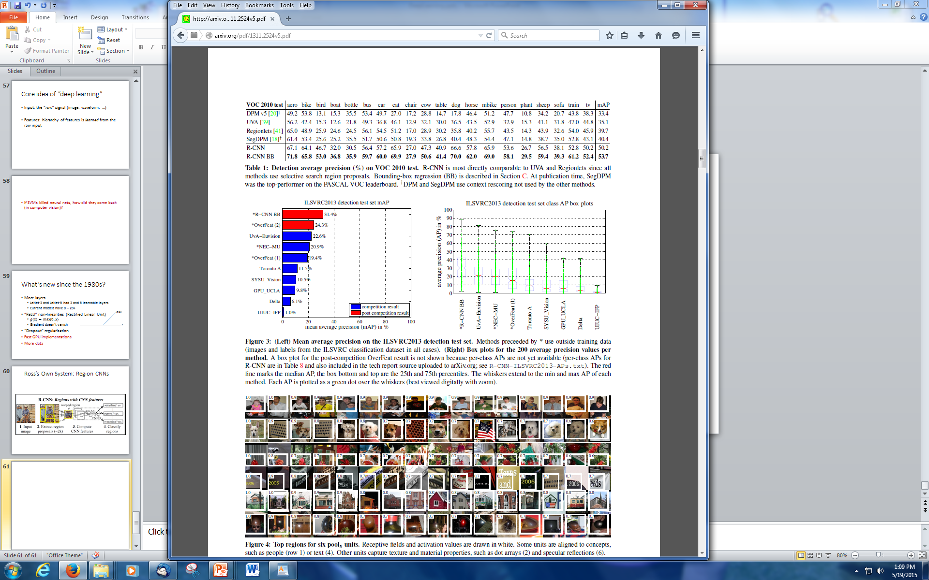
Competitive Results

Slide 73
Top Regions for Six Object Classes

Slide 74
But it wasn’t fast enough! So we have:
Fast Region-based ConvNets (R-CNNs) for Object Detection
Localization
Where?
Recognition
What?
Figure adapted from Kaiming He
Notes:
Thanks for attending my talk. It’s about a fast region-based convnet for the classic computer vision problem of generic category object detection.

Slide 75
Object detection renaissance (2013-present)
PASCAL VOC
Fast R-CNN
R-CNNv1
+ Accurate
+ Fast
+ Streamlined
+ Accurate
- Slow
- Inelegant
Notes:
The R-CNN method, however accurate, has several problems.
The foremost being that it’s woefully slow
The second being that training an R-CNN detector is a complex, multi-stage pipeline
The goal of this work is to make detectors faster to train and faster to test, without sacrificing accuracy

Slide 76
Region-based convnets (R-CNNs)
R-CNN (aka “slow R-CNN”) [Girshick et al. CVPR14]
SPP-net [He et al. ECCV14]
Notes:
Our work builds on two recent object detection methods, so let’s start by reviewing what I’ll call “slow” R-CNN and SPP-net.

Slide 77
Slow R-CNN
Input image
Girshick et al. CVPR14.
Notes:
Here’s how a slow R-CNN detects objects.
It starts with an input image.

Slide 78
Slow R-CNN
Regions of Interest (RoI) from a proposal method
(~2k)
Input image
Girshick et al. CVPR14.
Notes:
Then it takes about 2000 region proposals from an external region proposal algorithm.

Slide 79
Slow R-CNN
Warped image regions
Regions of Interest (RoI) from a proposal method
(~2k)
Input image
Girshick et al. CVPR14.
Notes:
The image patch under each proposal is cropped from the image and warped to a fixed size, say 224x224 pixels.

Slide 80
Slow R-CNN
ConvNet
ConvNet
Forward each region through ConvNet
ConvNet
Warped image regions
Regions of Interest (RoI) from a proposal method
(~2k)
Input image
Girshick et al. CVPR14.
Notes:
Those resized image windows are then passed through a ConvNet, each one independently.

Slide 81
Slow R-CNN
SVMs
Classify regions with SVMs
SVMs
ConvNet
SVMs
ConvNet
Forward each region through ConvNet
ConvNet
Warped image regions
Regions of Interest (RoI) from a proposal method
(~2k)
Input image
Girshick et al. CVPR14.
Post hoc component
Notes:
The features computed by the convnet are then passed to linear SVMs that classify the regions as one of the object categories or background.

Slide 82
Slow R-CNN
Apply bounding-box regressors
Bbox reg
SVMs
Classify regions with SVMs
Bbox reg
SVMs
ConvNet
Bbox reg
SVMs
ConvNet
Forward each region through ConvNet
ConvNet
Warped image regions
Regions of Interest (RoI) from a proposal method
(~2k)
Input image
Girshick et al. CVPR14.
Post hoc component
Notes:
The features are also sent to a linear regressor that improves object localization.
The components outlined in purple are “post hoc” in the sense that they are learned after the convnet weights are trained and forever frozen.

Slide 83
What’s wrong with slow R-CNN?
Notes:
So, what’s wrong with slow R-CNN? Quite a lot, in fact.

Slide 84
What’s wrong with slow R-CNN?
Ad hoc training objectives
  Fine-tune network with softmax classifier (log loss)
  Train post-hoc linear SVMs (hinge loss)
  Train post-hoc bounding-box regressors (squared loss)
Notes:
First, training involves separately optimizing three different objective functions.
To begin with, a convnet with a softmax classifier is fine-tuned for detection with log loss
Second, linear SVMs are trained with hinge loss
Third, linear bounding box regressors are trained with squared loss

Slide 85
What’s wrong with slow R-CNN?
Ad hoc training objectives
  Fine-tune network with softmax classifier (log loss)
  Train post-hoc linear SVMs (hinge loss)
  Train post-hoc bounding-box regressors (squared loss)
Training is slow (84h), takes a lot of disk space
Notes:
This process is very slow due to costly feature extraction and multiple training stages.
For example, when using the 16-layer deep VGG16 network slow R-CNN takes 84 hours to train.

Slide 86
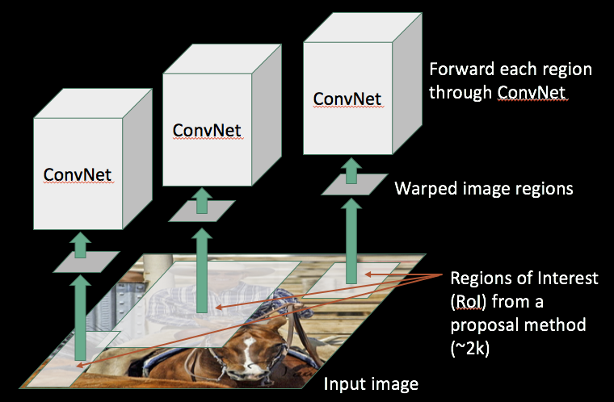
What’s wrong with slow R-CNN?
Ad hoc training objectives
  Fine-tune network with softmax classifier (log loss)
  Train post-hoc linear SVMs (hinge loss)
  Train post-hoc bounding-box regressions (least squares)
Training is slow (84h), takes a lot of disk space
Inference (detection) is slow
  47s / image with VGG16 [Simonyan & Zisserman. ICLR15]
  Fixed by SPP-net [He et al. ECCV14]
~2000 ConvNet forward passes per image
Notes:
Finally, test-time object detection is slow, taking 47s / image.
Fortunately slow inference is fixed by SPP-net, which I’ll cover next.

Slide 87
SPP-net
Input image
He et al. ECCV14.
Notes:
Detection with SPP-net starts from an input image

Slide 88
SPP-net
“conv5” feature map of image
ConvNet
Forward whole image through ConvNet
Input image
He et al. ECCV14.
Notes:
Then, the convolutional layers of the detection network are applied to the entire input image, producing a feature map of the image.

Slide 89
SPP-net
Regions of
Interest (RoIs)
from a proposal
method
“conv5” feature map of image
ConvNet
Forward whole image through ConvNet
Input image
He et al. ECCV14.
Notes:
The region proposals are then projected onto the feature map

Slide 90
SPP-net
Spatial Pyramid Pooling (SPP) layer
Regions of
Interest (RoIs)
from a proposal
method
“conv5” feature map of image
ConvNet
Forward whole image through ConvNet
Input image
He et al. ECCV14.
Notes:
And a spatial pyramid pooling layer is used to transform the features under each region proposal into a fixed length feature vector.

Slide 91
SPP-net
SVMs
Classify regions with SVMs
FCs
Fully-connected layers
Spatial Pyramid Pooling (SPP) layer
Regions of
Interest (RoIs)
from a proposal
method
“conv5” feature map of image
ConvNet
Forward whole image through ConvNet
Input image
He et al. ECCV14.
Post hoc component
Notes:
These pooled features are then passed to post hoc SVMs for object category classification

Slide 92
SPP-net
Apply bounding-box regressors
Bbox reg
SVMs
Classify regions with SVMs
FCs
Fully-connected layers
Spatial Pyramid Pooling (SPP) layer
Regions of
Interest (RoIs)
from a proposal
method
“conv5” feature map of image
ConvNet
Forward whole image through ConvNet
Input image
He et al. ECCV14.
Post hoc component
Notes:
And post hoc bounding box regressors for object localization.

Slide 93
What’s good about SPP-net?
Fixes one issue with R-CNN: makes testing fast
Bbox reg
SVMs
Region-wise
computation
FCs
ConvNet
Image-wise
computation
(shared)
Post hoc component
Notes:
The good thing about SPP-net is that it makes testing very fast by sharing feature computation between overlapping region proposals.

Slide 94
What’s wrong with SPP-net?
Inherits the rest of R-CNN’s problems
  Ad hoc training objectives
  Training is slow (25h), takes a lot of disk space
Notes:
However, SPP-net inherits the rest of slow R-CNN’s problems:
It uses three independent training stages and even though training is faster, it still takes 25h.

Slide 95
What’s wrong with SPP-net?
Inherits the rest of R-CNN’s problems
  Ad hoc training objectives
  Training is slow (though faster), takes a lot of disk space
Introduces a new problem: cannot update parameters below SPP layer during training
Notes:
SPP-net also introduces one new problem, which is that during training it cannot update any of the convolutional layers below the spatial pyramid pooling.

Slide 96
SPP-net: the main limitation
Bbox reg
SVMs
Trainable
(3 layers)
FCs
ConvNet
Frozen
(13 layers)
He et al. ECCV14.
Post hoc component
Notes:
Schematically, we see that the top few layers are trainable, but the majority of a very deep network, for example 13 of 16 layers, will remain fixed at their initialization, which is likely suboptimal.

Slide 97
Fast R-CNN
Fast test-time, like SPP-net
Notes:
We propose the Fast R-CNN detection method to fix most of the aforementioned problems.
It’s fast at test time-time, like SPP-net.

Slide 98
Fast R-CNN
Fast test-time, like SPP-net
One network, trained in one stage
Notes:
The model is trained as one network, end-to-end, in a single stage.
This makes training fast and simple to implement.

Slide 99
Fast R-CNN
Fast test-time, like SPP-net
One network, trained in one stage
Higher mean average precision than slow R-CNN and SPP-net
Notes:
And it achieves higher mean average precision, so nothing is sacrificed.
So, how does it work?

Slide 100
Fast R-CNN (test time)
Regions of
Interest (RoIs)
from a proposal
method
“conv5” feature map of image
ConvNet
Forward whole image through ConvNet
Input image
Notes:
At test time, it functions similarly to SPP-net. The differences are highlighted in red.

Slide 101
Fast R-CNN (test time)
“RoI Pooling” (single-level SPP) layer
Regions of
Interest (RoIs)
from a proposal
method
“conv5” feature map of image
ConvNet
Forward whole image through ConvNet
Input image
Notes:
Instead of Spatial Pyramid Pooling, Fast R-CNN uses a simplified pooling method that uses a single pooling grid. Since it doesn’t have a pyramid of grids, we call it Region of Interest, or RoI, pooling.

Slide 102
Fast R-CNN (test time)
Softmax classifier
Linear +
softmax
FCs
Fully-connected layers
“RoI Pooling” (single-level SPP) layer
Regions of
Interest (RoIs)
from a proposal
method
“conv5” feature map of image
ConvNet
Forward whole image through ConvNet
Input image
Notes:
Rather than using post-hoc SVMs for classification, the final classifier is a linear layer followed by a softmax.

Slide 103
Fast R-CNN (test time)
Softmax classifier
Linear +
softmax
Linear
Bounding-box regressors
FCs
Fully-connected layers
“RoI Pooling” (single-level SPP) layer
Regions of
Interest (RoIs)
from a proposal
method
“conv5” feature map of image
ConvNet
Forward whole image through ConvNet
Input image
Notes:
Rather than using post-hoc bounding-box regressors, bounding-box regression is implemented as an additional linear layer in the network

Slide 104
Fast R-CNN
(training)
Linear +
softmax
Linear
FCs
ConvNet
Notes:
Fast R-CNN training, however, is substantially different from either R-CNN or SPP-net.
In Fast R-CNN, training is done with a single SGD optimization that trains all components of the detector jointly.
Starting from the test-time network, we obtain the training network by ….

Slide 105
Fast R-CNN
(training)
Log loss + smooth L1 loss
Multi-task loss
Linear +
softmax
Linear
FCs
ConvNet
Notes:
… adding a multi-task loss layer.
The first term is log loss on object classification.
The second term is a robust L1 loss on the predicted object locations.

Slide 106
Main results
 | Fast R-CNN | R-CNN [1] | SPP-net [2]
Train time (h) | 9.5 | 84 | 25
- Speedup | 8.8x | 1x | 3.4x
Test time / image | 0.32s | 47.0s | 2.3s
Test speedup | 146x | 1x | 20x
mAP | 66.9% | 66.0% | 63.1%
Timings exclude object proposal time, which is equal for all methods.
All methods use VGG16 from Simonyan and Zisserman.
[1] Girshick et al. CVPR14.
[2] He et al. ECCV14.
Notes:
After training, our main result is an object detector that’s faster to train, faster to test, and achieves higher accuracy.
Training a 16-layer deep model takes 9.5 hours with Fast R-CNN, making it almost 9x faster than slow R-CNN and 2.5x faster than SPP-net.

Slide 107
Main results
 | Fast R-CNN | R-CNN [1] | SPP-net [2]
Train time (h) | 9.5 | 84 | 25
- Speedup | 8.8x | 1x | 3.4x
Test time / image | 0.32s | 47.0s | 2.3s
Test speedup | 146x | 1x | 20x
mAP | 66.9% | 66.0% | 63.1%
Timings exclude object proposal time, which is equal for all methods.
All methods use VGG16 from Simonyan and Zisserman.
[1] Girshick et al. CVPR14.
[2] He et al. ECCV14.
Notes:
Test-time detection takes 320ms / image, excluding object proposal time, making it roughly 150x faster than slow R-CNN and 7x faster than SPP-net when testing with multiple scales, which is necessary for competitive mAP.

Slide 108
Main results
 | Fast R-CNN | R-CNN [1] | SPP-net [2]
Train time (h) | 9.5 | 84 | 25
- Speedup | 8.8x | 1x | 3.4x
Test time / image | 0.32s | 47.0s | 2.3s
Test speedup | 146x | 1x | 20x
mAP | 66.9% | 66.0% | 63.1%
Timings exclude object proposal time, which is equal for all methods.
All methods use VGG16 from Simonyan and Zisserman.
[1] Girshick et al. CVPR14.
[2] He et al. ECCV14.
Notes:
These speed improvements do not sacrifice object detection accuracy. In fact, mean average precision is better than the baseline methods due to our improved training.

