Slide 1
Image Stitching II
Linda Shapiro
CSE 455

Slide 2
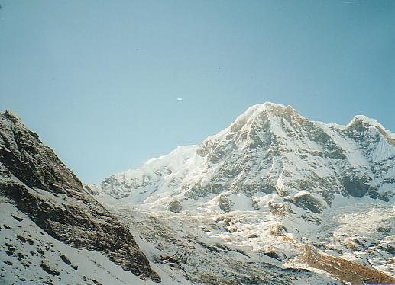
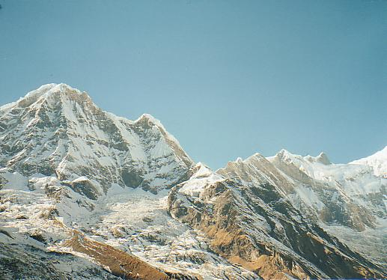
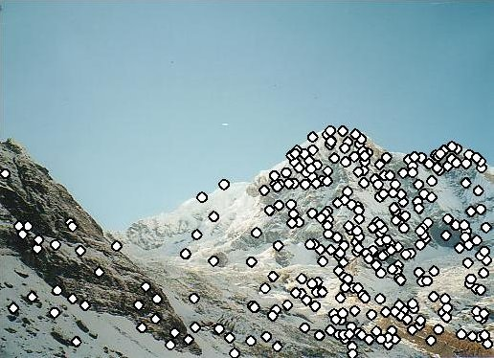
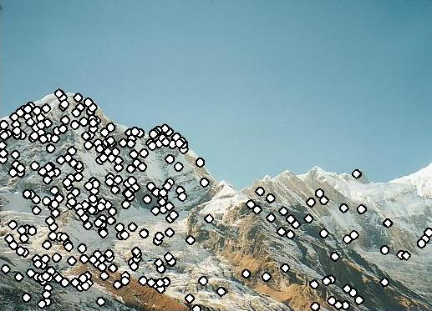
RANSAC for Homography
Initial Matched Points

Slide 3
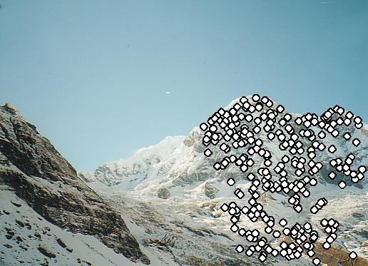
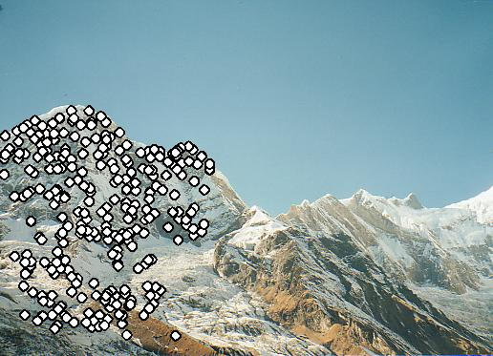
RANSAC for Homography
Final Matched Points

Slide 4
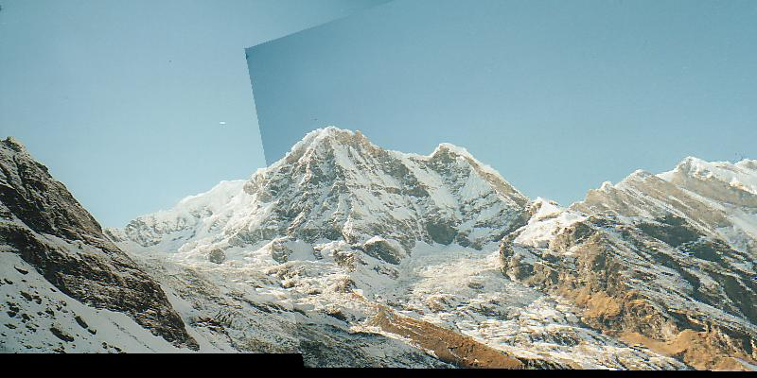
RANSAC for Homography

Slide 5
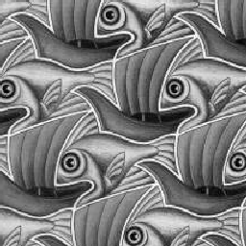
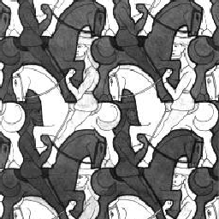
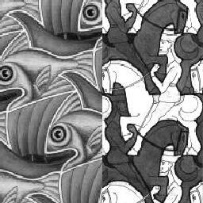
Image Blending
What’s wrong?

Slide 6
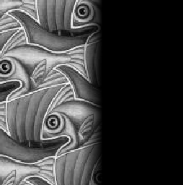
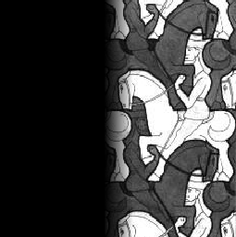
Feathering
+
1
1
0
0
=

Slide 7
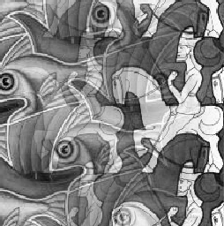
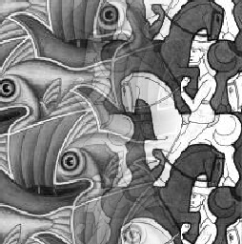
Effect of window (ramp-width) size
1
left
1
right
0
0

Slide 8
Effect of window size
1
1
0
0

Slide 9
Good window size
1
What can we do
instead?
0
“Optimal” window: smooth but not ghosted
Doesn’t always work...

Slide 10
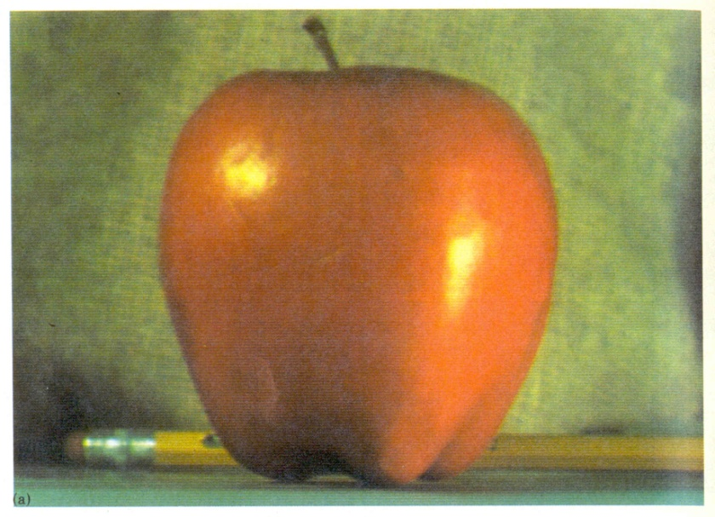
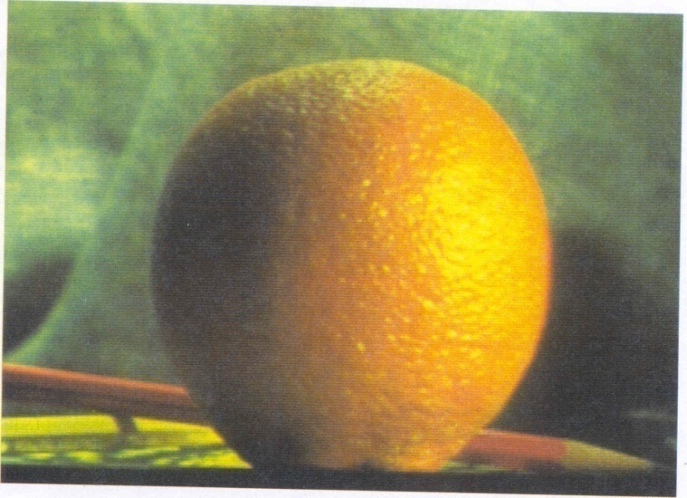
Pyramid blending
apple
orange
Create a Laplacian pyramid, blend each level
Burt, P. J. and Adelson, E. H., A Multiresolution Spline with Application to Image Mosaics, ACM Transactions on Graphics, 42(4), October 1983, 217-236. http://persci.mit.edu/pub_pdfs/spline83.pdf

Slide 11
Forming a Gaussian Pyramid
Start with the original image G₀
Perform a local Gaussian weighted averaging function in a neighborhood about each pixel, sampling so that the result is a reduced image of half the size in each dimension.
Do this all the way up the pyramid
G_{l} = REDUCE(G_{l-1})
Each level l node will represent a weighted average of a subarray of level l.

Slide 12
Making the Laplacians
We want to subtract each level of the pyramid from the next lower one.
But they are different sizes!
In order to do the subtraction, we perform an interpolation process.
We interpolate new samples between those of a given image to make it big enough to subtract.
The operation is called EXPAND.

Slide 13
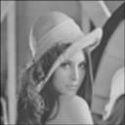
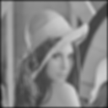
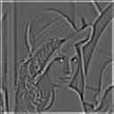
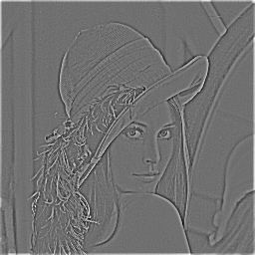
The Laplacian Pyramid
Gaussian Pyramid
Laplacian Pyramid
-
=
-
=
-
=

Slide 14
To blend two images, We’ll combine two Laplacian pyramids
Laplacian Pyramid LA Laplacian Pyramid LS Laplacian Pyramid LB
to be filled in

Slide 15
Forming the New Pyramid
Laplacian pyramids LB and LB are constructed for images A and B, respectively.
A third Laplacian pyramid LS is constructed by copying nodes from the left half of LA to the corresponding nodes of LS and nodes from the right half of LB to the right half of LS.
Nodes along the center line are set equal to the average of corresponding LA and LB nodes

Slide 16
Using the new Laplacian Pyramid
Use the new Laplacian pyramid with the reverse of how it was created to create a Gaussian pyramid.
The lowest level of the new Gaussian pyramid gives the final result.

Slide 17
Laplacian
level
4
Laplacian
level
2
Laplacian
level
0
left pyramid
right pyramid
blended pyramid
Notes:
with the ramp function

Slide 18
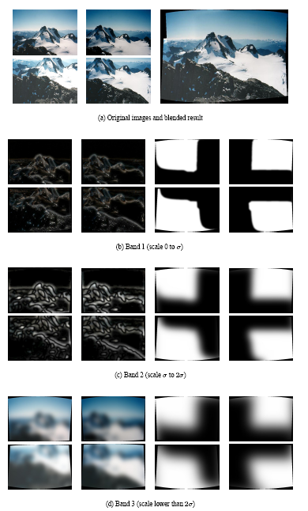
Multiband blending (IJCV 2007)
Laplacian pyramids
Compute Laplacian pyramid of images and mask
Create blended image at each level of pyramid
Reconstruct complete image
Notes:
3 different frequency levels of blending; mask is blurred in lower levels

Slide 19
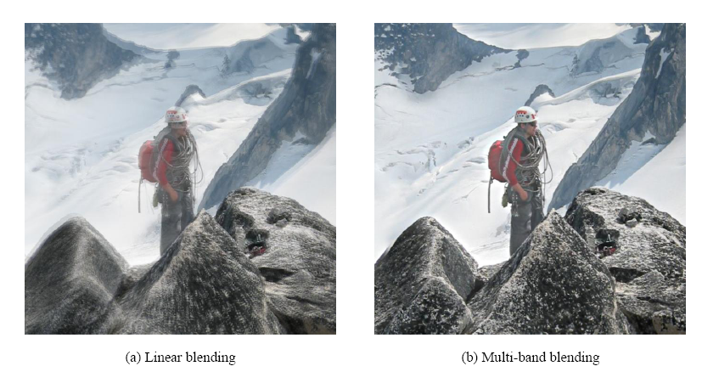
Blending comparison (IJCV 2007)

Slide 20
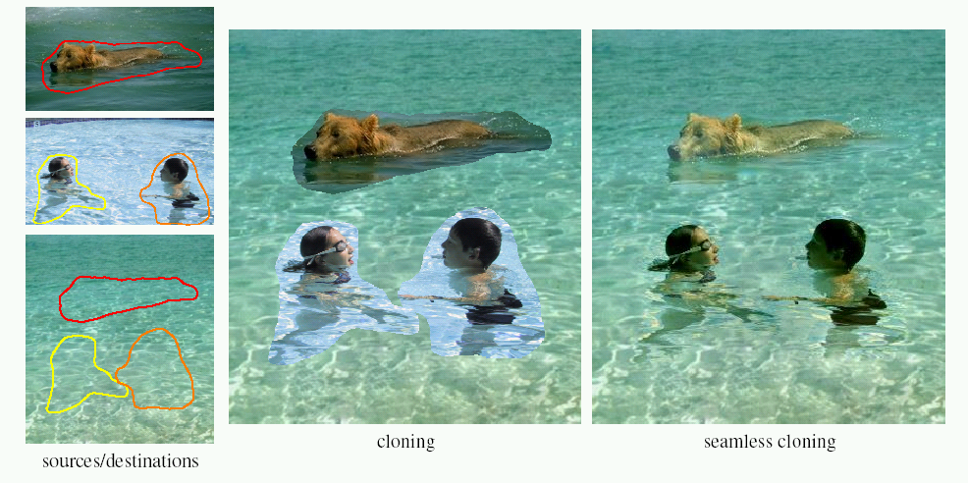
Poisson Image Editing
For more info: Perez et al, SIGGRAPH 2003
http://research.microsoft.com/vision/cambridge/papers/perez_siggraph03.pdf

Slide 21
Alpha Blending
I₃
p
I₁
Optional: see Blinn (CGA, 1994) for details:
http://ieeexplore.ieee.org/iel1/38/7531/00310740.pdf?isNumber=7531&prod=JNL&arnumber=310740&arSt=83&ared=87&arAuthor=Blinn%2C+J.F.
I₂
Encoding blend weights: I(x,y) = (αR, αG, αB, α )
color at p =
Implement this in two steps:
1. accumulate: add up the (α premultiplied) RGB values at each pixel
2. normalize: divide each pixel’s accumulated RGB by its α value
Notes:
A: render as black

Slide 22
Choosing Seams: Where do we stitch?
Easy method
Assign each pixel to image with nearest center
im1
im2
x
x
Image 2
Image 1

Slide 23
Choosing seams
Easy method
Assign each pixel to image with nearest center
Create a mask:
Smooth boundaries ( “feathering”):
Composite
im1
im2
x
x
Image 2
Image 1
Notes:
No mask, just get pixels from the images they are closest to the center of

Slide 24
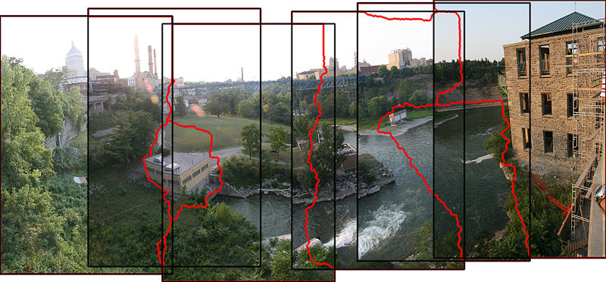
Choosing seams
Better method: dynamic program to find seam along well-matched regions
Illustration: http://en.wikipedia.org/wiki/File:Rochester_NY.jpg

Slide 25
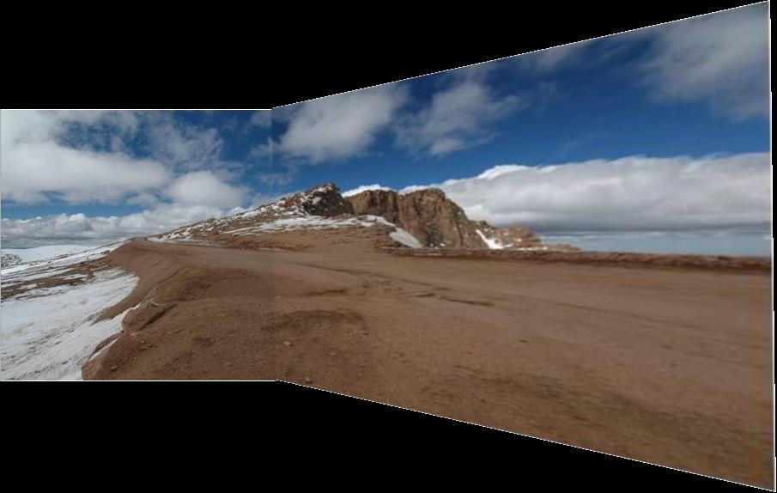
Gain Compensation: Getting rid of artifacts
Simple gain adjustment
Compute average RGB intensity of each image in overlapping region
Normalize intensities by ratio of averages

Slide 26
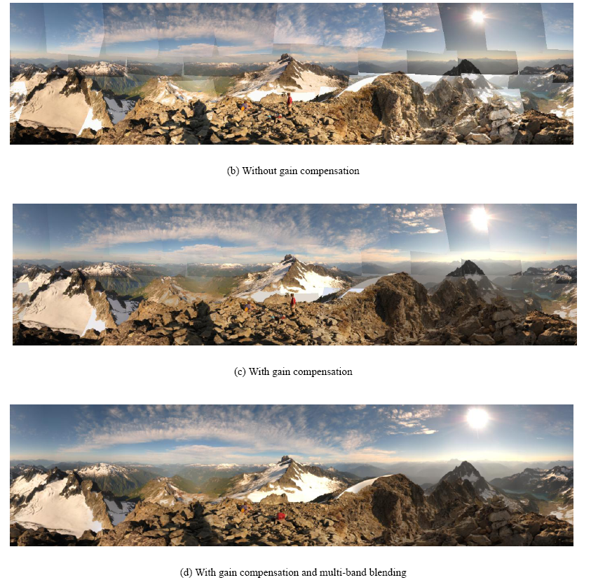
Blending Comparison

Slide 27
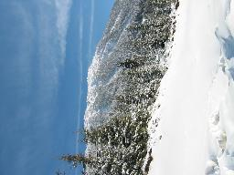
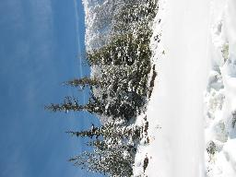
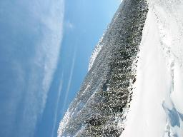
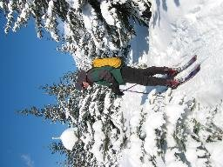
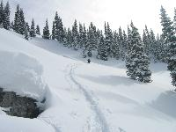
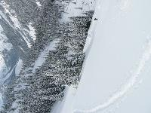
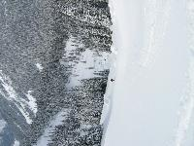
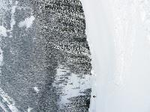
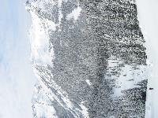
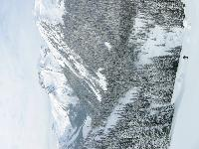
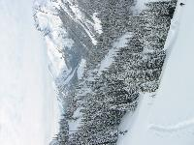
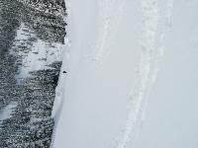
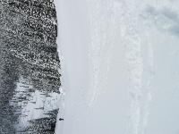
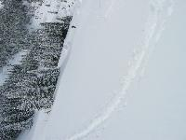
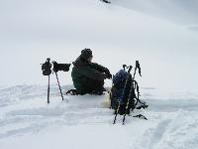
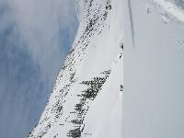
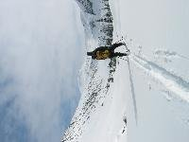
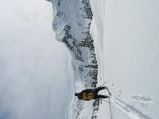
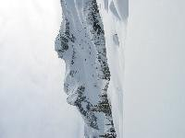
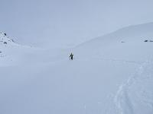
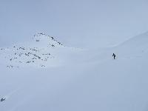
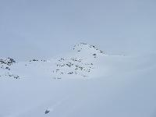
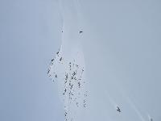
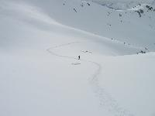
Recognizing Panoramas
Some of following material from Brown and Lowe 2003 talk
Brown and Lowe 2003, 2007

Slide 28
Recognizing Panoramas
Input: N images
Extract SIFT points, descriptors from all images
Find K-nearest neighbors for each point (K=4)
For each image
Select M candidate matching images by counting matched keypoints (m=6)
Solve homography H_{ij} for each matched image

Slide 29
Recognizing Panoramas
Input: N images
Extract SIFT points, descriptors from all images
Find K-nearest neighbors for each point (K=4)
For each image
Select M candidate matching images by counting matched keypoints (m=6)
Solve homography H_{ij} for each matched image
Decide if match is valid (n_{i} > 8 + 0.3 n_{f} )
# inliers
# keypoints in overlapping area

Slide 30
Recognizing Panoramas (cont.)
(now we have matched pairs of images)
Make a graph of matched pairs
Find connected components of the graph

Slide 31
Finding the panoramas

Slide 32
Finding the panoramas

Slide 33
Recognizing Panoramas (cont.)
(now we have matched pairs of images)
Find connected components
For each connected component
Solve for rotation and f
Project to a surface (plane, cylinder, or sphere)
Render with multiband blending

Slide 34
Finding the panoramas

