Slide 1
Recognition III EM, G/D, and SVMs
Linda Shapiro
CSE 455

Slide 2
What’s Coming
How does EM clustering work?
How can it be used for generating features for image classification?
A generative/discriminative system that uses both EM and neural nets
How do support vector machines (SVMs) work?
How are they used with the HOG feature for detection people (and other things)?
What is the Deformable Parts Model (DPM)?

Slide 3
K-Means and EM Clustering
K-Means
Clusters are represented by their means μ
A vector is assigned to a single cluster whose mean it
is closest to.
EM (Expectation-Maximization) Clustering
Clusters are represented by their means, covariance
matrices and weights μ, Σ, w
A vector is soft assigned to each cluster (components)
according to its probability of belonging to that cluster
Usually we assume each cluster has a Gaussian distribution

Slide 4
K-Means and EM Clustering
Both K-Means and EM start with a given K
Both iterate between
assigning (or soft assigning) each vector to a (each) cluster
recalculating the parameters of each cluster
The result of EM is called a mixture model and when using Gaussian components, it is a mixture of Gaussians

Slide 5
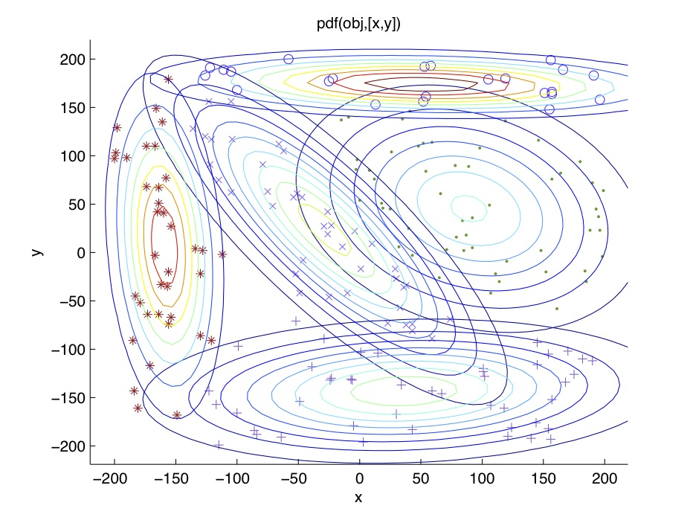
Mixture of Gaussians

Slide 6
Full EM Algorithm Multi-Dimensional
Boot Step:
Initialize K clusters: C₁, …, C_{K}
Iteration Step:
Expectation Step
Maximization Step
(μ_{j,} Σ_{j}) and P(C_{j}) for each cluster j.

Slide 7
Yi Li’s Generative Discriminative Classification: a BOW Approach
Uses EM clustering with each component represented by a Gaussian distribution in feature space (color, texture, structure)
Uses the K EM clusters to construct fixed length feature vectors representing positive and negative samples of the object class being learned.
Feeds these vectors into a neural net to learn the class.

Slide 8
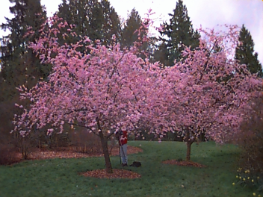
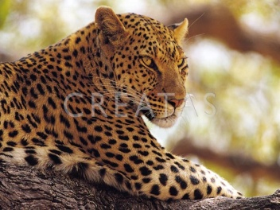
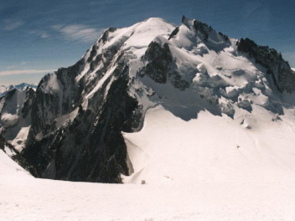
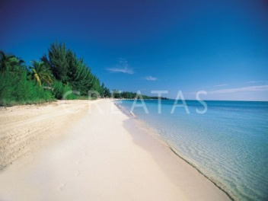
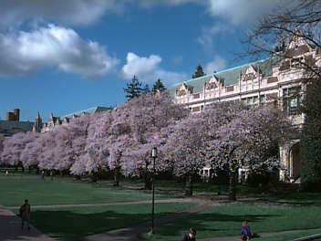
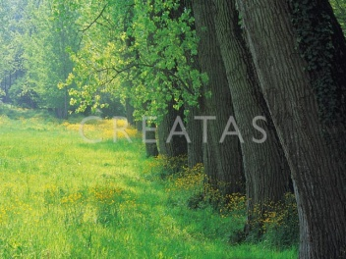
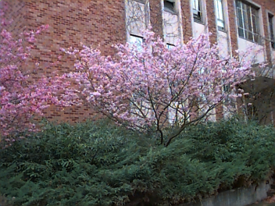
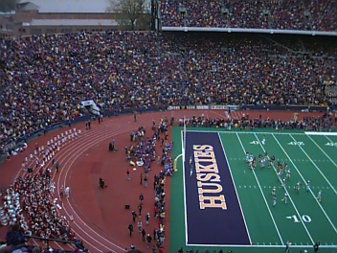
Problem Statement
Given: Some images and their corresponding descriptions
•••
{trees, grass, cherry trees}
{cheetah, trunk}
{mountains, sky}
{beach, sky, trees, water}
To solve: What object classes are present in new images
•••
?
?
?
?
Notes:
Remove arrow
Dot!
Our
Give title/description of each system

Slide 9
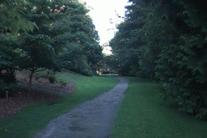
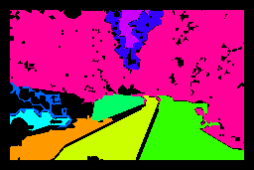
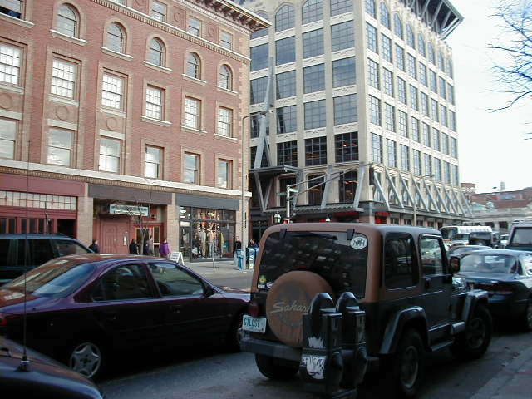
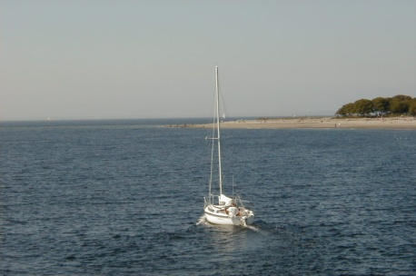
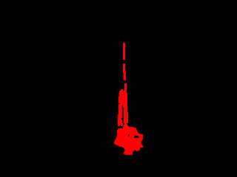
Image Features for Object Recognition
Color
Texture
Structure
Context

Slide 10
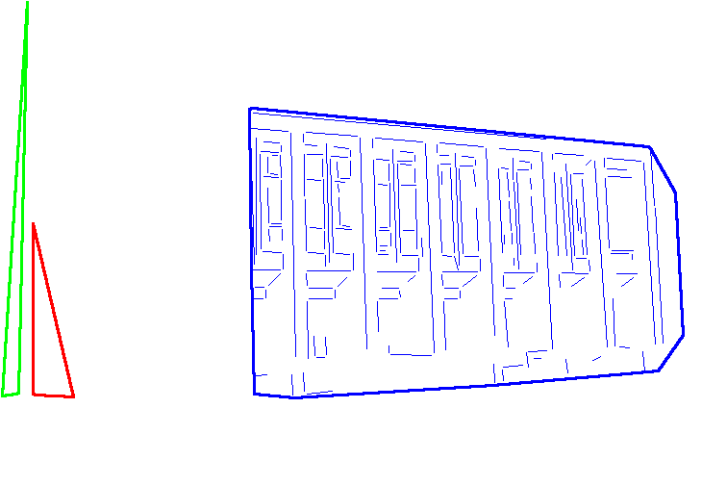
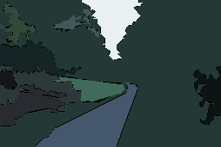
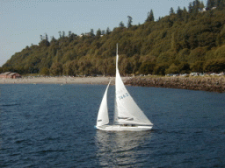
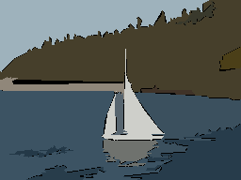
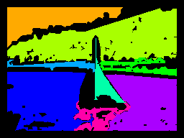
Abstract Regions
Original Images
Color Regions
Texture Regions
Line Clusters
Notes:
Caption!

Slide 11
Approach to Combining Different Feature Types
Phase 1:
Treat each type of abstract region separately
For abstract region type a and for object class o, use the EM algorithm to construct a model that is a mixture of multivariate Gaussians over the features for type a regions.

Slide 12
Consider only abstract region type color (c) and object class object (o)
At the end of Phase 1, we can compute the distribution of color feature vector X in an image containing object o.
P(X | o) = Σ w_{k} N(X, μ_{k}, Σ_{k})
K is the number of Gaussian components.
The w’s are the weights of the components.
The µ’s and ∑’s are the parameters of the Gaussians
P(X | o) is the probability of vector X given object o.
k=1 to K

Slide 13
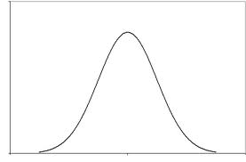
Color Clusters for Class o We call them components.
P(X | o) = Σ w_{k} N(X, μ_{k}, Σ_{k})
component 1 component 2 component K
µ₁ , ∑₁ , w₁ µ₂ , ∑₂ , w₂ µ_{K} , ∑_{K} , w_{K}
r
color feature vector
X for some region r

Slide 14
Now we can determine which components are likely to be present in an image.
The probability that the feature vector X
from color region r of image I_{i} comes
from component k is given by
P(X,k) = w_{k} * N(X, μ_{k}, Σ_{k})
?
r
X
component k

Slide 15
And determine the probability that the whole image is related to component k as a function of the feature vectors of all its regions.
Then the probability that image I has a region r that comes from component k is
P(I, k) = max(P(X_{r} , k | r = 1,2,....)
probabilities
for compo-
nent 1
3 feature
vectors
image with 3 regions
2 components
r₁
r₂
X₁
P(X₁,1)
P(X₂,1)
P(X₃,1)
component 1
component 2
max
X₂
r₃
X₃

Slide 16
Aggregate Scores for Color
maximum probability
of all regions in first
beach image belonging
to component 1
Components
1 2 3 4 5 6 7 8
beach
beach
not
beach
.93 | .16 | .94 | .24 | .10 | .99 | .32 | .00
.66 | .80 | .00 | .72 | .19 | .01 | .22 | .02
.43 | .03 | .00 | .00 | .00 | .00 | .15 | .00
beach
training
images
not beach
training
images

Slide 17
We now use positive and negative training images, calculate for each the probabilities of regions of each component, and form a training matrix.
P(beach₁,1) P(beach₁,2) .... P(beach₁,K)
P(beach₂,1) P(beach₂,2) .... P(beach₂,K)
P(beach_{n},1) P(beach_{n},2) ..... P(beach_{n},K)
P(nbeach₁,1) P(nbeach₁,2) .... P(nbeach₁,K)
P(nbeach₂,1) P(nbeach₂,2) .... P(nbeach₂,K)
P(nbeach_{m},1) P(nbeach_{m},2) .... P(nbeach_{m},K)

Slide 18
Phase 2 Learning
Let C_{i} be row i of the training matrix.
Each such row is a feature vector for the color features of regions of image I_{i} that relates them to the Phase 1 components.
Now we can use a second-stage classifier to learn P(o|I_{i} ) for each object class o and image I_{i} .
neural
net
classifier
training
matrix

Slide 19
Multiple Feature Case
We calculate separate Gaussian mixture models for each different features type:
Color: C_{i}
Texture: T_{i}
Structure: S_{i}
and any more features we have (motion).

Slide 20
Now we concatenate the matrix rows from the different region types to obtain a multi-feature-type training matrix.
color texture structure everything
C₁⁺
C₂⁺
.
.
C₁⁻
C₂⁻
.
.
T₁⁺
T₂⁺
.
.
T₁⁻
T₂⁻
.
.
S₁⁺
S₂⁺
.
.
S₁⁻
S₂⁻
.
.
C₁⁺ T₁⁺ S₁⁺
C₂⁺ T₂⁺ S₂⁺
. . .
. . .
C₁⁻ T₁⁻ S₁⁻
C₂⁻ T₂⁻ S₂⁻
. . .
. . .

Slide 21
Final Neural Net Classifier
C₁⁺ T₁⁺ S₁⁺
C₂⁺ T₂⁺ S₂⁺
. . .
. . .
C₁⁻ T₁⁻ S₁⁻
C₂⁻ T₂⁻ S₂⁻
. . .
. . .
Training
Testing
Neural Net
for beach
Neural Net
for beach
NOT BEACH

Slide 22
ICPR04 Data Set with General Labels
 | EM-variant with single Gaussian per object | EM-variant extension to mixture models | Gen/Dis with Classical EM clustering | Gen/Dis with EM-variant extension
African animal | 71.8% | 85.7% | 89.2% | 90.5%
arctic | 80.0% | 79.8% | 90.0% | 85.1%
beach | 88.0% | 90.8% | 89.6% | 91.1%
grass | 76.9% | 69.6% | 75.4% | 77.8%
mountain | 94.0% | 96.6% | 97.5% | 93.5%
primate | 74.7% | 86.9% | 91.1% | 90.9%
sky | 91.9% | 84.9% | 93.0% | 93.1%
stadium | 95.2% | 98.9% | 99.9% | 100.0%
tree | 70.7% | 79.0% | 87.4% | 88.2%
water | 82.9% | 82.3% | 83.1% | 82.4%
MEAN | 82.6% | 85.4% | 89.6% | 89.3%

Slide 23
Comparison to ALIP: the Benchmark Image Set
 | ALIP | cs | ts | st | ts+st | cs+st | cs+ts | cs+ts+st
African | 52 | 69 | 23 | 26 | 35 | 79 | 72 | 74
beach | 32 | 44 | 38 | 39 | 51 | 48 | 59 | 64
buildings | 64 | 43 | 40 | 41 | 67 | 70 | 70 | 78
buses | 46 | 60 | 72 | 92 | 86 | 85 | 84 | 95
dinosaurs | 100 | 88 | 70 | 37 | 86 | 89 | 94 | 93
elephants | 40 | 53 | 8 | 27 | 38 | 64 | 64 | 69
flowers | 90 | 85 | 52 | 33 | 78 | 87 | 86 | 91
food | 68 | 63 | 49 | 41 | 66 | 77 | 84 | 85
horses | 60 | 94 | 41 | 50 | 64 | 92 | 93 | 89
mountains | 84 | 43 | 33 | 26 | 43 | 63 | 55 | 65
MEAN | 63.6 | 64.2 | 42.6 | 41.2 | 61.4 | 75.4 | 76.1 | 80.3

Slide 24
Groundtruth Data Set
UW Ground truth database (1224 images)
31 elementary object categories: river (30), beach (31), bridge (33), track (35), pole (38), football field (41), frozen lake (42), lantern (42), husky stadium (44), hill (49), cherry tree (54), car (60), boat (67), stone (70), ground (81), flower (85), lake (86), sidewalk (88), street (96), snow (98), cloud (119), rock (122), house (175), bush (178), mountain (231), water (290), building (316), grass (322), people (344), tree (589), sky (659)
20 high-level concepts: Asian city , Australia, Barcelona, campus, Cannon Beach, Columbia Gorge, European city, Geneva, Green Lake, Greenland, Indonesia, indoor, Iran, Italy, Japan, park, San Juans, spring flowers, Swiss mountains, and Yellowstone.

Slide 25
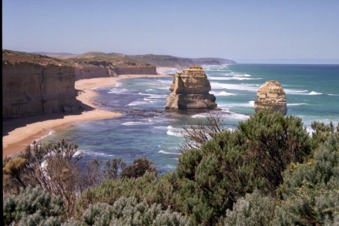
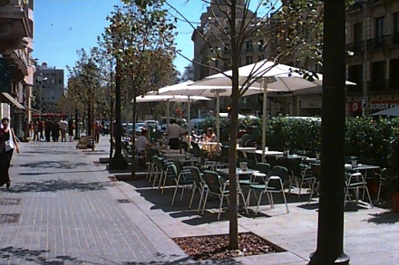
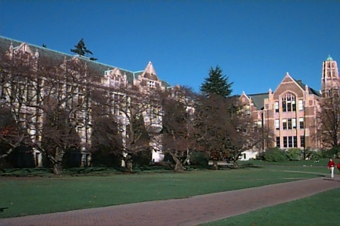
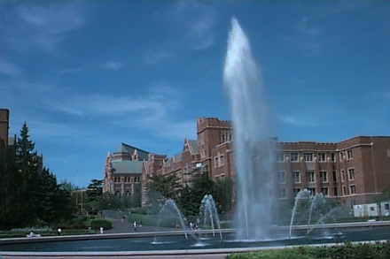
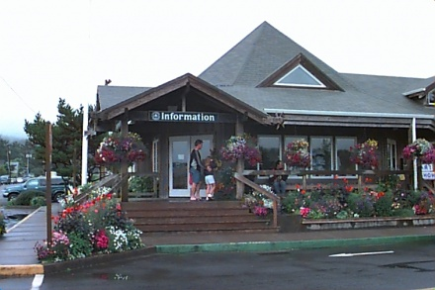
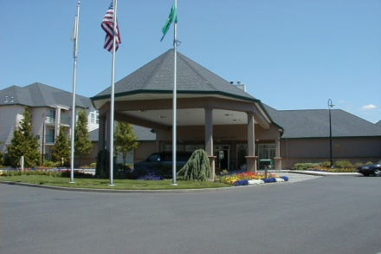
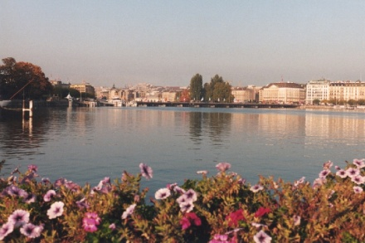
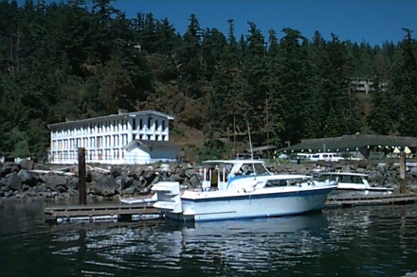
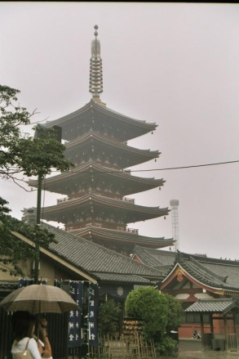
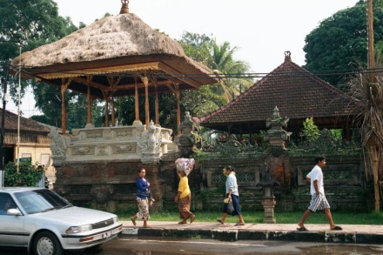
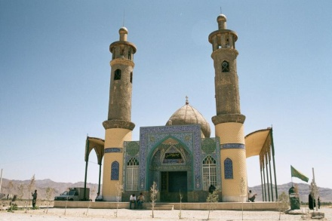
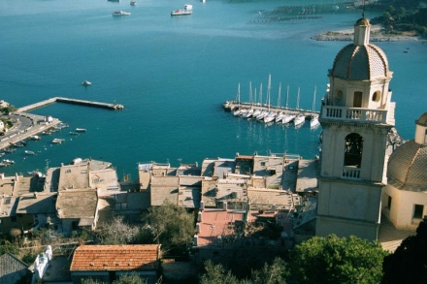
beach, sky, tree, water
people, street, tree
building, grass, people,
sidewalk, sky, tree
building, bush, sky,
tree, water
flower, house, people,
pole, sidewalk, sky
flower, grass, house,
pole, sky, street, tree
building, flower, sky,
tree, water
boat, rock, sky,
tree, water
building, car, people, tree
car, people, sky
boat, house, water
building

Slide 26
Groundtruth Data Set: ROC Scores
street | 60.4 | tree | 80.8 | stone | 87.1 | columbia gorge | 94.5
people | 68.0 | bush | 81.0 | hill | 87.4 | green lake | 94.9
rock | 73.5 | flower | 81.1 | mountain | 88.3 | italy | 95.1
sky | 74.1 | iran | 82.2 | beach | 89.0 | swiss moutains | 95.7
ground | 74.3 | bridge | 82.7 | snow | 92.0 | sanjuans | 96.5
river | 74.7 | car | 82.9 | lake | 92.8 | cherry tree | 96.9
grass | 74.9 | pole | 83.3 | frozen lake | 92.8 | indoor | 97.0
building | 75.4 | yellowstone | 83.7 | japan | 92.9 | greenland | 98.7
cloud | 75.4 | water | 83.9 | campus | 92.9 | cannon beach | 99.2
boat | 76.8 | indonesia | 84.3 | barcelona | 92.9 | track | 99.6
lantern | 78.1 | sidewalk | 85.7 | geneva | 93.3 | football field | 99.8
australia | 79.7 | asian city | 86.7 | park | 94.0 | husky stadium | 100.0
house | 80.1 | european city | 87.0 | spring flowers | 94.4

Slide 27
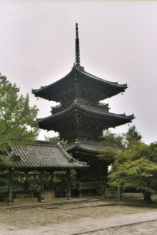
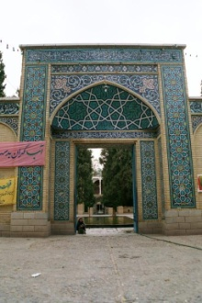
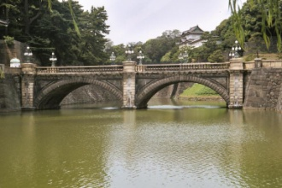
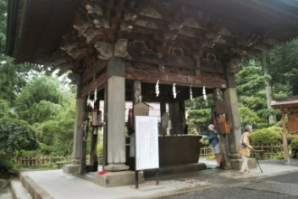
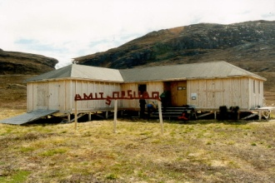
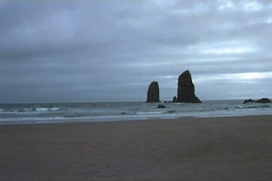
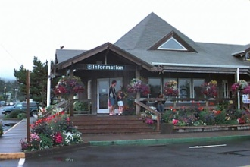
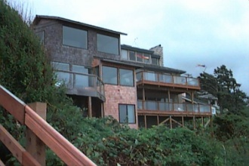
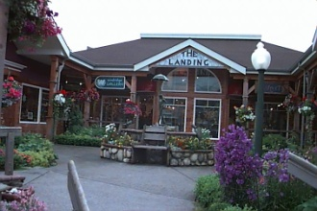
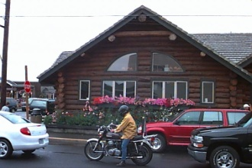
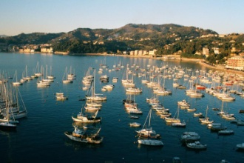
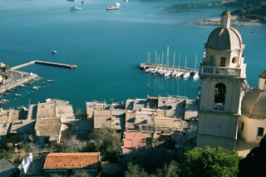
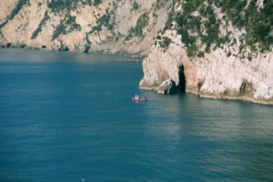
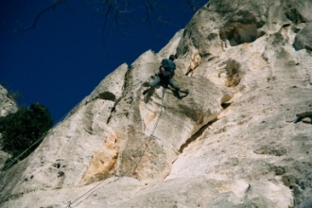
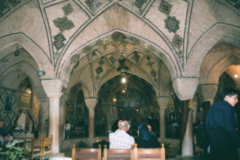
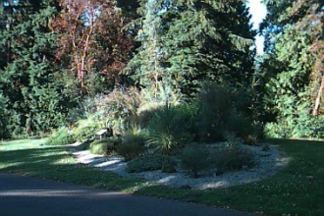
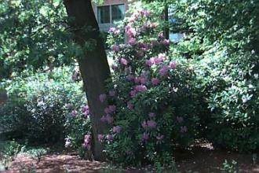
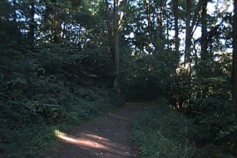
Groundtruth Data Set: Top Results
Asian city
Cannon beach
Italy
park

Slide 28
Groundtruth Data Set: Top Results
sky
spring flowers
tree
water

Slide 29
Groundtruth Data Set: Annotation Samples
tree(97.3), bush(91.6),
spring flowers(90.3),
flower(84.4), park(84.3),
sidewalk(67.5),
grass(52.5), pole(34.1)
sky(99.8),
Columbia gorge(98.8),
lantern(94.2), street(89.2),
house(85.8), bridge(80.8),
car(80.5), hill(78.3),
boat(73.1), pole(72.3),
water(64.3), mountain(63.8),
building(9.5)
sky(95.1), Iran(89.3),
house(88.6),
building(80.1),
boat(71.7), bridge(67.0),
water(13.5), tree(7.7)
Italy(99.9), grass(98.5),
sky(93.8), rock(88.8),
boat(80.1), water(77.1),
Iran(64.2), stone(63.9),
bridge(59.6), European(56.3),
sidewalk(51.1), house(5.3)

Slide 30
Comparison to Fergus and to Dorko/Schmid using their Features
Using their features and image sets, we compared our generative /
discriminative approach to those of Fergus and Dorko/Schmid.
The image set contained 1074 airplane images, 826 motor bike images,
450 face images, and 900 background. Half were used to train and half
to test. We added half the background images to the training set for
our negative examples.

Slide 31
Structure Feature Experiments (from other data sets with more manmade structures)
1,951 total from freefoto.com
bus (1,013) house/building skyscraper (329)
(609)

Slide 32
Structure Feature Experiments: Area Under the ROC Curves
1. Structure (with color pairs)
Attributes (10)
Color pair
Number of lines
Orientation of lines
Line overlap
Line intersection
2. Structure (with color pairs) + Color Segmentation
3. Structure (without color pairs) + Color Segmentation
 | bus | house/ building | skyscraper
Structure only | 0.900 | 0.787 | 0.887
Structure + Color Seg | 0.924 | 0.853 | 0.926
Structure² + Color Seg | 0.940 | 0.860 | 0.919

Slide 33
Support Vector Machines
2 class problem
n-dimensional feature vectors
We want to separate the two classes with an
(n-1)-dimensional hyperplane

Slide 34
Linear SVM
Given a training dataset
(X₁,y₁), ... , (X_{n},yn)
where y_{i} is 1 or -1, find the
maximum-margin hyperplane
that divides the y=1 group from
the y=-1 group.
The hyperplane will have an
equation of the form
w x + b = 0
where w is the normal vector
to the hyperplane.
w.x + b = 1
w.x + b = 0
w.x + b = -1
modified from https://commons.wikimedia.org/w/index.php?curid=3566688

Slide 35
Hard Margin SVM
If the training data are linearly separable, we select two parallel hyperplanes that separate the two classes and maximize the distance between them.
The region between them is called the margin.
The two hyperplanes are:
w · x + b = 1
w · x + b = -1
The distance between them is 2/||w||
To prevent data points falling into the
margin, we add constraints:
w · x_{i} +b ≥ 1 if y_{i} = 1
w · x_{i} +b ≤ 1 if y_{i} = -1
y_{i} (w · x_{i} + b) ≥ 1
1 ≤ i ≤ n
Solution: minimize w,b subject to y_{i} (w · x_{i} +b) ≥ 1
Classifier: class(x) = sgn(w · x + b)

Slide 36
Support vector machines (SVMs)
w.x + b = +1
w.x + b = 0
w.x + b = -1
Solve efficiently by quadratic programming (QP)
Well-studied solution algorithms
Not simple gradient ascent, but close
Hyperplane defined by support vectors
margin 2γ
jj
Non-support Vectors:
everything else
moving them will not change w
Support Vectors:
data points on the canonical lines

Slide 37
What if the data is not linearly separable?

Slide 38
What if the data is still not linearly separable?
+ C #(mistakes)
First Idea: Jointly minimize w.w and number of training mistakes
How to tradeoff two criteria?
Pick C on development / cross validation
Tradeoff #(mistakes) and w.w
0/1 loss
Not QP anymore
Also doesn’t distinguish near misses and really bad mistakes
NP hard to find optimal solution!!!

Slide 39
Slack variables – Hinge loss
+ C Σ_{j} ξ_{j}
w.x + b = +1
w.x + b = 0
w.x + b = -1
- ξ_{j}
ξ_{j}≥0
ξ
ξ
Slack Penalty C > 0:
C=∞ → have to separate the data!
C=0 → ignore data entirely!
Select on dev. set, etc.
ξ
ξ
For each data point:
If margin ≥ 1, don’t care
If margin < 1, pay linear penalty

Slide 40
What if the data is not linearly separable?
A more powerful technique is to construct a
nonlinear SVM using a kernel function to
transform the original feature vectors into
a different feature space.
Some common kernels:
k(x_{i}, x_{j}) = (x_{i} · x_{j})^{d}
k(x_{i}, x_{j}) = exp(-γ||x_{i} – x_{j}||²) for γ > 0

Slide 41
A bit of the theory
We want to transform vectors x to another space ϕ(x) where the classes can be separated.
The kernel is related to this transform by
k(x_{i}, x_{j}) = ϕ(x_{i}) · ϕ(x_{j})
When performing classification that needs w, instead of w · ϕ(x) for some vector x, we use the kernel trick of replacing it with
Σ_{i} α_{i} y_{i} k(x_{i},x) where w = Σ_{i} α_{i} y_{i} ϕ(x_{i})

Slide 42
Classification
The results for classification of a vector z becomes
class = sgn(w ·ϕ(z)+b)
= sgn( Σ c_{i}y_{i}k(x_{i},z) + b )
i=1 to n

Slide 44
Histograms of Oriented Gradients for Human Detection
Another Descriptor
Navneet Dalal and Bill Triggs
CVPR 2005

Slide 45
Overview
1. Compute gradients in the region to be described
2. Put them in bins according to orientation
3. Group the cells into large blocks
4. Normalize each block
5. Train classifiers to decide if these are parts of a human

Slide 46
Details
Gradients
[-1 0 1] and [-1 0 1]^{T} were good enough.
Cell Histograms
Each pixel within the cell casts a weighted vote for an
orientation-based histogram channel based on the values
found in the gradient computation. (9 channels worked)
Blocks
Group the cells together into larger blocks, either R-HOG
blocks (rectangular) or C-HOG blocks (circular).

Slide 47
More Details
Block Normalization
They tried 4 different kinds of normalization.
Let υ be the block to be normalized and e be a small constant.

Slide 48
R-HOG compared to SIFT Descriptor
R-HOG blocks appear quite similar to the SIFT descriptors.
But, R-HOG blocks are computed in dense grids at some
single scale without orientation alignment.
SIFT descriptors are computed at sparse, scale-invariant
key image points and are rotated to align orientation.

Slide 49
Example: Dalal-Triggs pedestrian detector
Extract fixed-sized (64x128 pixel) window at each position and scale
Compute HOG (histogram of gradient) features within each window
Score the window with a linear SVM classifier
Perform non-maxima suppression to remove overlapping detections with lower scores
Navneet Dalal and Bill Triggs, Histograms of Oriented Gradients for Human Detection, CVPR05

Slide 50
Pictorial Example
*
average gradient image over training examples
each “pixel” shows max positive SVM weight in the block centered on that pixel
same as (b) for negative SVM weights
test image
its R-HOG descriptor
R-HOG descriptor weighted by positive SVM weights
R-HOG descriptor weighted by negative SVM weights

Slide 51
Slides by Pete Barnum
Navneet Dalal and Bill Triggs, Histograms of Oriented Gradients for Human Detection, CVPR05

Slide 52
Tested with
RGB
LAB
Grayscale
Slightly better performance vs. grayscale

Slide 53
Outperforms
centered
diagonal
uncentered
cubic-corrected
Sobel
Slides by Pete Barnum
Navneet Dalal and Bill Triggs, Histograms of Oriented Gradients for Human Detection, CVPR05

Slide 54
Histogram of gradient orientations
Votes weighted by magnitude
Bilinear interpolation between cells
Orientation: 9 bins (for unsigned angles)
Histograms in 8x8 pixel cells
Slides by Pete Barnum
Navneet Dalal and Bill Triggs, Histograms of Oriented Gradients for Human Detection, CVPR05

Slide 55
Normalize with respect to surrounding cells
Slides by Pete Barnum
Navneet Dalal and Bill Triggs, Histograms of Oriented Gradients for Human Detection, CVPR05

Slide 56
# orientations
# features = 15 x 7 x 9 x 4 = 3780
X=
# cells
# normalizations by neighboring cells
Slides by Pete Barnum
Navneet Dalal and Bill Triggs, Histograms of Oriented Gradients for Human Detection, CVPR05

Slide 57
Training set

Slide 58
pos w
neg w
Slides by Pete Barnum
Navneet Dalal and Bill Triggs, Histograms of Oriented Gradients for Human Detection, CVPR05

Slide 59
pedestrian
Slides by Pete Barnum
Navneet Dalal and Bill Triggs, Histograms of Oriented Gradients for Human Detection, CVPR05

Slide 60
Detection examples

Slide 62
Each window is separately classified

Slide 64
Deformable Parts Model
Takes the idea a little further
Instead of one rigid HOG model, we have multiple HOG models in a spatial arrangement
One root part to find first and multiple other parts in a tree structure.

Slide 65
The Idea
Articulated parts model
Object is configuration of parts
Each part is detectable
Images from Felzenszwalb

Slide 66
Deformable objects
Images from Caltech-256
Slide Credit: Duan Tran

Slide 67
Deformable objects
Images from D. Ramanan’s dataset
Slide Credit: Duan Tran

Slide 68
How to model spatial relations?
Tree-shaped model

Slide 70
Hybrid template/parts model
Detections
Template Visualization
Felzenszwalb et al. 2008

Slide 71
Pictorial Structures Model
Appearance likelihood
Geometry likelihood

Slide 72
Results for person matching

Slide 73
Results for person matching

Slide 74
BMVC 2009

Slide 75
2012 State-of-the-art Detector: Deformable Parts Model (DPM)
Lifetime
Achievement
Strong low-level features based on HOG
Efficient matching algorithms for deformable part-based models (pictorial structures)
Discriminative learning with latent variables (latent SVM)
Felzenszwalb et al., 2008, 2010, 2011, 2012
Notes:
For the local window detector implementation, we used the publicly available implementation of the DPM detector. This is the best performing sliding window implementation and has consistently performed well in the VOC challenge receiving the lifetime achievement award.

