Slide 1
Recognition
Part I: Machine Learning
CSE 455
Linda Shapiro

Slide 2
Visual Recognition
What does it mean to “see”?
  “What” is “where”, Marr 1982
Get computers to “see”

Slide 3
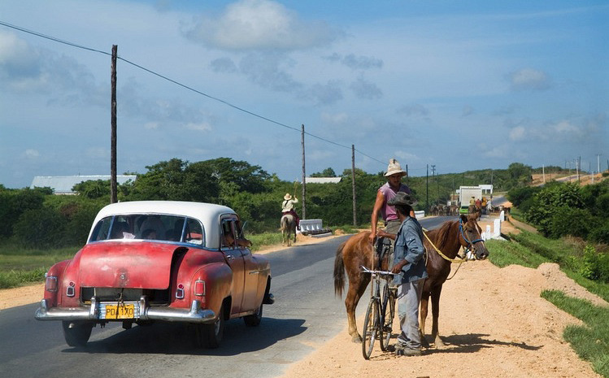
Visual Recognition
Verification
Is this a car?

Slide 4
Visual Recognition
Classification:
Is there a car in this picture?

Slide 5
Visual Recognition
Detection:
Where is the car in this picture?

Slide 6
Visual Recognition
Pose Estimation:

Slide 7
Visual Recognition
Activity Recognition:
What is he doing?
What is he doing?

Slide 8
Visual Recognition
Object Categorization:
Sky
Person
Tree
Horse
Car
Person
Bicycle
Road

Slide 9
Visual Recognition
Segmentation
Sky
Tree
Car
Person

Slide 10
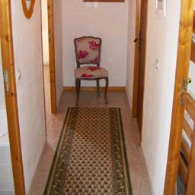
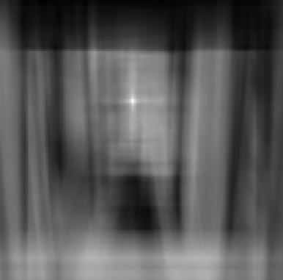
Object recognition
Is it really so hard?
Find the chair in this image
Output of normalized correlation
This is a chair

Slide 11
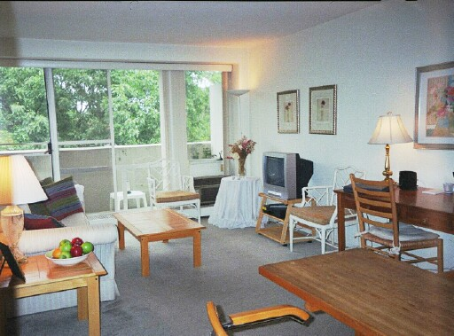
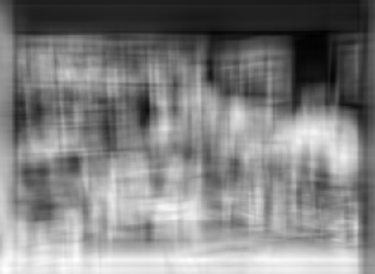
Object recognition
Is it really so hard?
Find the chair in this image
Pretty much garbage
Simple template matching is not going to make it

Slide 12
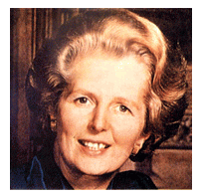
Let’s start with
Face detection
How to tell if a face is present?

Slide 13


One simple method: skin detection
skin
Skin pixels have a distinctive range of colors
  Corresponds to region(s) in RGB color space
    for visualization, only R and G components are shown above
Skin classifier
  A pixel X = (R,G,B) is skin if it is in the skin region
  But how to find this region?

Slide 14

Skin detection
Learn the skin region from examples
  Manually label pixels in one or more “training images” as skin or not skin
  Plot the training data in RGB space
    skin pixels shown in orange, non-skin pixels shown in blue
    some skin pixels may be outside the region, non-skin pixels inside. Why?
Skin classifier
  Given X = (R,G,B): how to determine if it is skin or not?

Slide 15
Skin classification techniques
Skin
Skin
Skin classifier
  Given X = (R,G,B): how to determine if it is skin or not?
  Nearest neighbor classifier
    find labeled pixel closest to X
    choose the label for that pixel
  Data modeling
    Model the distribution that generates the data (Generative)
    Model the boundary (Discriminative)

Slide 16
Generative vs. Discriminative
Generative Model: We learn the parameters of a distribution that fit the object class we are trying to learn. Most common is the Gaussian distribution.
Discriminative Model: We learn a classifier that can predict whether a sample is in our class or not.

Slide 17
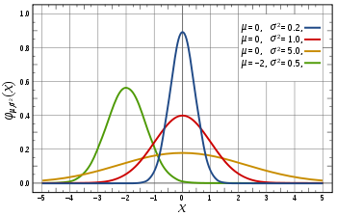
We like Gaussians because
Affine transformation (multiplying by scalar and adding a constant) are Gaussian
  X ~ N(μ,σ²)
  Y = aX + b → Y ~ N(aμ+b,a²σ²)
Sum of Gaussians is Gaussian
  X ~ N(μ_{X},σ²_{X})
  Y ~ N(μ_{Y},σ²_{Y})
  Z = X+Y → Z ~ N(μ_{X}+μ_{Y}, σ²_{X}+σ²_{Y})
Easy to differentiate

Slide 18
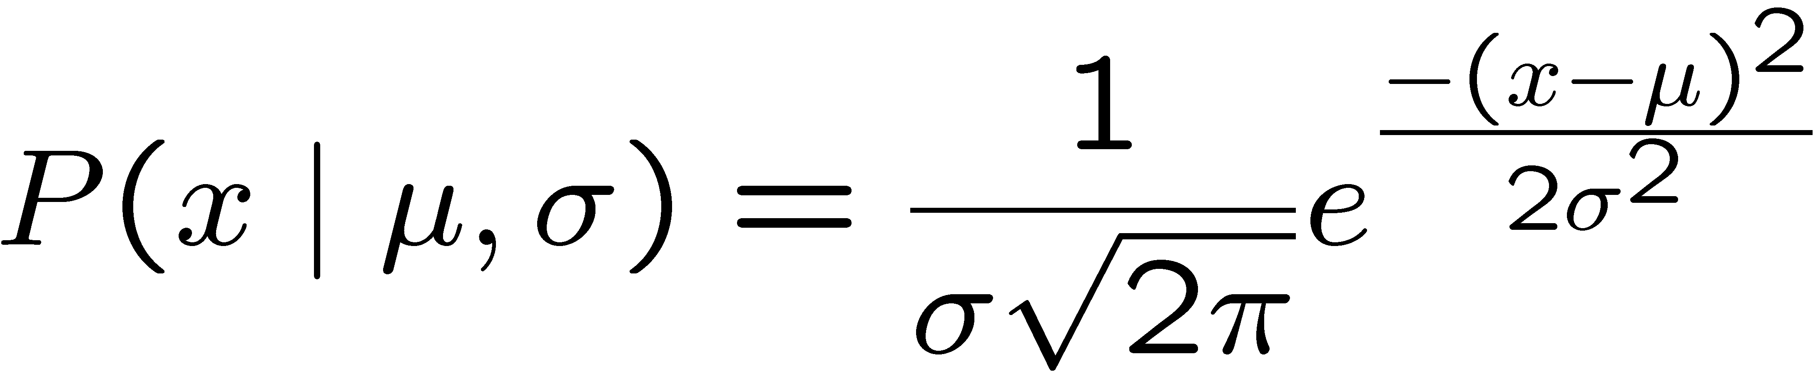
Learning a Gaussian
x_{i} i = | Exam Score
0 | 85
1 | 95
2 | 100
3 | 12
… | …
99 | 89
Collect a bunch of data
  Hopefully, i.i.d. samples
  e.g., exam scores
Learn parameters
  Mean: μ
  Variance: σ
These refer to the true
mean and variance of
the underlying distribution.

Slide 19
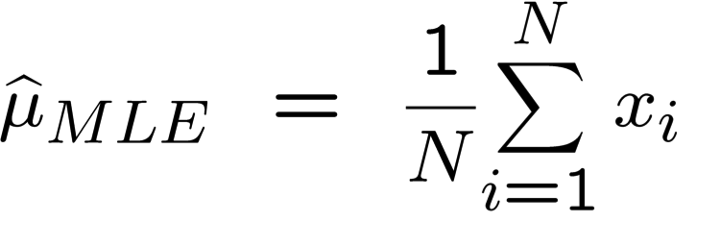
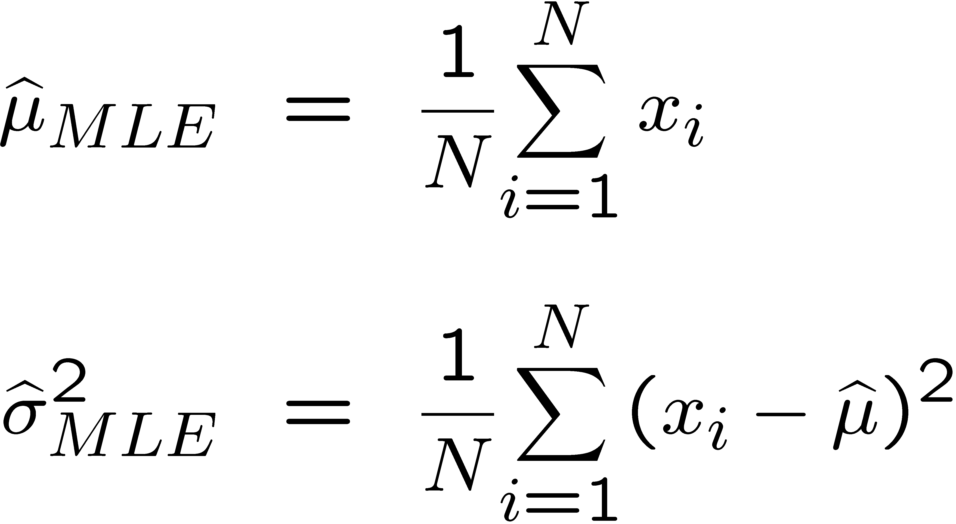
MLE for mean and variance of a Gaussian
The maximum likelihood estimate (MLE) for the mean of a Gaussian distribution is its sample mean.
The maximum likelihood estimate for the variance of a Gaussian is its sample variance.

Slide 20


Fitting a Gaussian to Skin samples
What is being
over simplified here?
This is a 2D distribution, so we need
a mean of vectors
a covariance matrix Σ instead of a variance

Slide 21
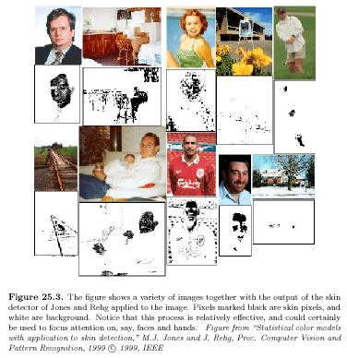
Skin detection results

Slide 22
Generative vs. Discriminative
Generative Model: We learn the parameters of a distribution that fit the object class we are trying to learn. Most common is the Gaussian distribution. We look at the probability of a sample belonging to that distribution.
Discriminative Model: We learn a classifier that can predict whether a sample is in our class or not.
What is a classifier?
Mathematically, it is a function f that when given a sample can predict its class.
sample 0 or 1

Slide 23
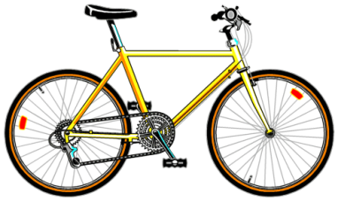
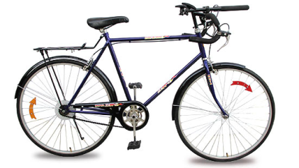
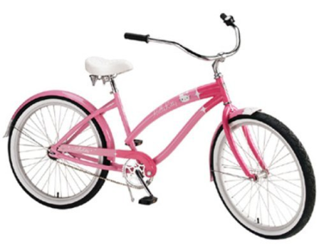

Classification
A class is a set of objects having some important
properties in common.
A feature extractor is a program that inputs the
data (image) and extracts features that can be
used in classification.
A classifier is a program that inputs the feature
vector and assigns it to one of a set of designated
classes or to the “reject” class.

Slide 24
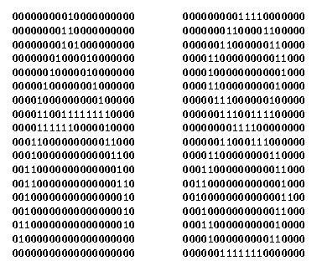
Feature Vector Representation
X=[x₁, x₂, … , x_{n}], each x_{j} a real number
x_{j} may be an object measurement
x_{j} may be a count of object parts
Example: [area, height, width, #holes, #strokes, cx, cy]

Slide 25
Some Terminology
Classes: set of m known categories of objects
(a) might have a known description for each
(b) might have a set of samples for each
Reject Class:
a generic class for objects not in any of
the designated known classes
Classifier:
Assigns object to a class based on features

Slide 26
Supervised Learning: find f
Given: Training set {(X_{i}, y_{i}) | i = 1 … n}
Find: A good approximation to f : X → Y
What is each X_{i}?
What is y_{i}?

Slide 27
Naive Bayes Classifier
Uses Bayes rule for classification
One of the simpler classifiers
Part of the free WEKA suite of classifiers

Slide 28
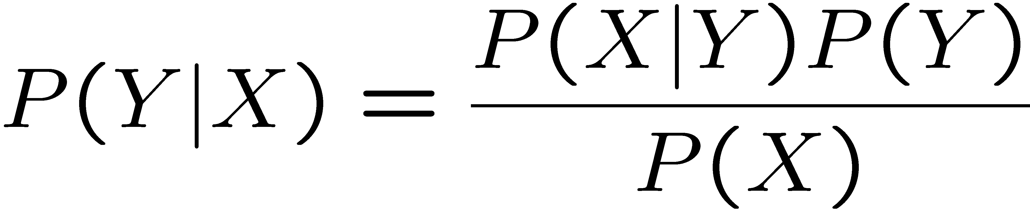
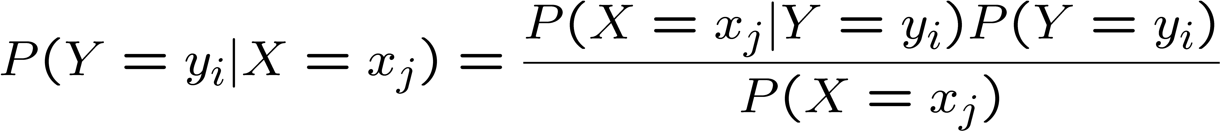
Bayes Rule
Which is shorthand for:
This slide and those following are from Tom Mitchell’s course in Machine Learning.

Slide 29
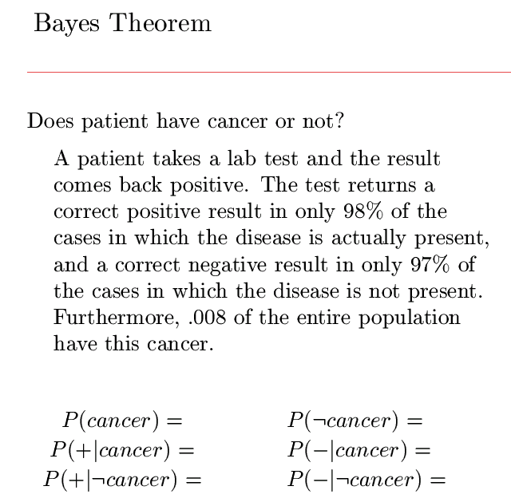
.008
.992
.980
.020
.030
.970

Slide 30
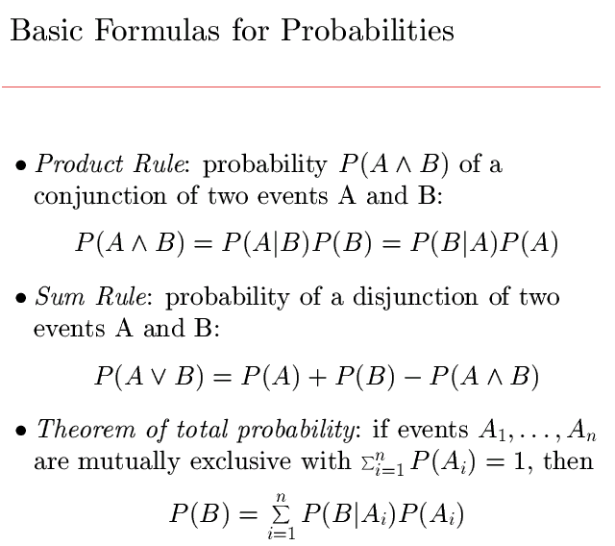

Slide 31
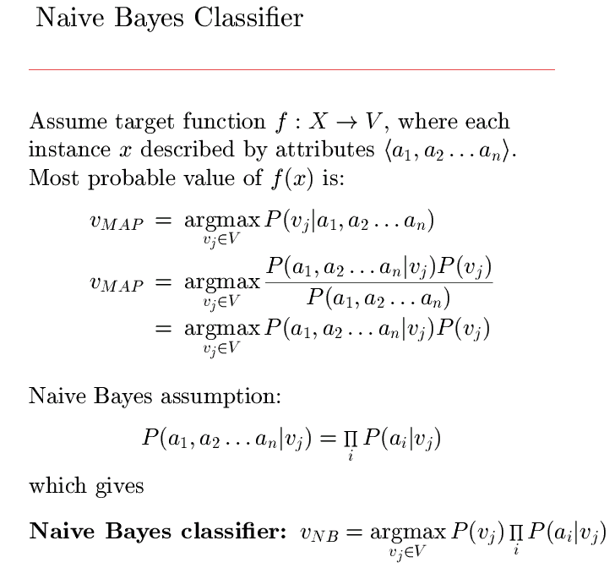
V is set of possible classes
MAP: maximum
a posteriori probability.
most
probable
class
by Bayes Rule
Assume P(a₁,...,a_{n})
same for all a₁,...a_{n}.
Conditional independence

Slide 32
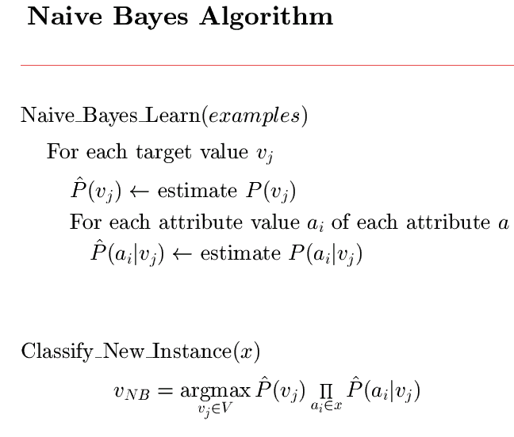
for each class
estimate its probability
and estimate the
probability of that class
for each attribute value

Slide 33
Elaboration
The set of examples is actually a set of preclassified feature vectors called the training set.
From the training set, we can estimate the a priori probability of each class:
P(C) = # training vectors from class C / total # of training vectors
For each class C, attribute a, and possible value for that attribute a_{i}, we can estimate the conditional probability:
P(a_{i}| C_{j}) = # training vectors from class C_{j} in which value(a) = a_{i}

Slide 34
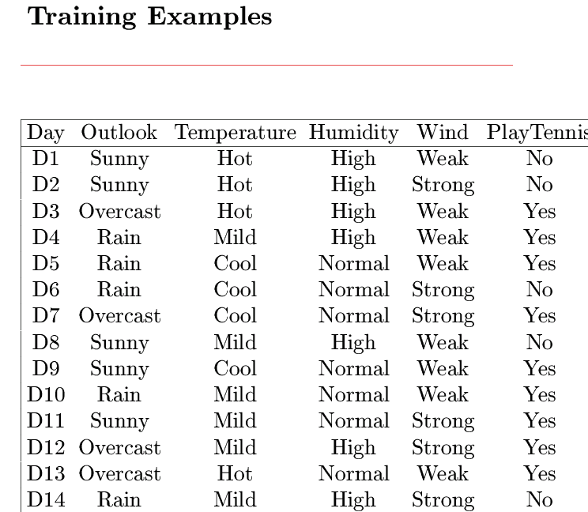
features
class some estimates
P(y) =
P(n) =
P(sun | y) =
P(cool | y) =
P(high | y) =
P(strong | y) =
9/14
5/14
2/9
3/9
3/9
3/9
(probability of class Yes times product of probabilities of certain values for
each of its attributes.)
P(y)P(sun | y)P(cool | y)P(high | y)P(strong | y) =
(9/14) * (2/9) * (3/9) * (3/9) * (3/9) =
.005

Slide 35
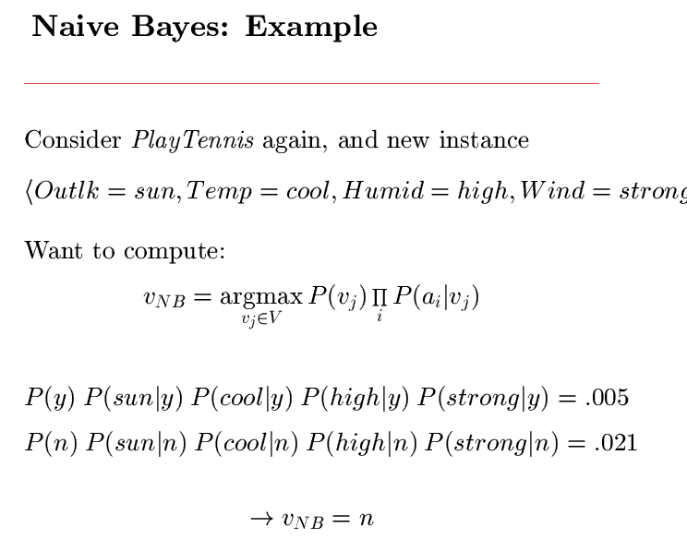
v₁ is y
v₂ is n
This is a prediction. If it is sunny, cool, highly humid, and strong wind,
it is more likely that we won’t play tennis than that we will.

Slide 36





A Digit Recognizer
Input: pixel grids
Output: a digit 0-9

Slide 37


Naïve Bayes for Digits (Binary Inputs)
Simple version:
  One feature F_{ij} for each grid position <i,j>
  Possible feature values are on / off, based on whether intensity is more or less than 0.5 in underlying image
  Each input maps to a feature vector, e.g.
  Here: lots of features, each is binary valued
Naïve Bayes model:
Are the features independent given class?
What do we need to learn?

Slide 38
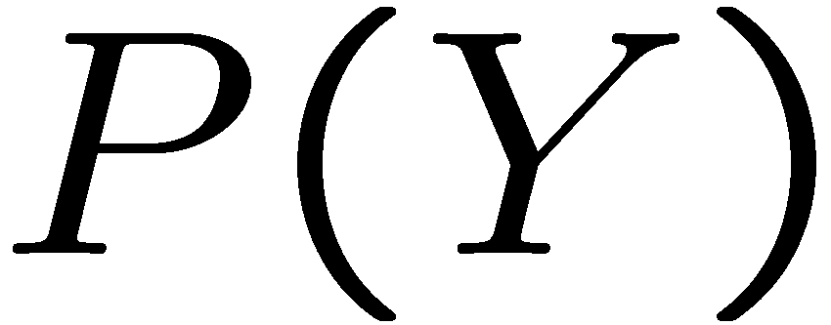


Example Distributions
1 | 0.1
2 | 0.1
3 | 0.1
4 | 0.1
5 | 0.1
6 | 0.1
7 | 0.1
8 | 0.1
9 | 0.1
0 | 0.1
1 | 0.01
2 | 0.05
3 | 0.05
4 | 0.30
5 | 0.80
6 | 0.90
7 | 0.05
8 | 0.60
9 | 0.50
0 | 0.80
1 | 0.05
2 | 0.01
3 | 0.90
4 | 0.80
5 | 0.90
6 | 0.90
7 | 0.25
8 | 0.85
9 | 0.60
0 | 0.80

Slide 39
MLE for the parameters of NB
Given dataset
  Count(A=a,B=b) number of examples where A=a and B=b
MLE for discrete NB, simply:
  Prior:
  Likelihood:

Slide 40
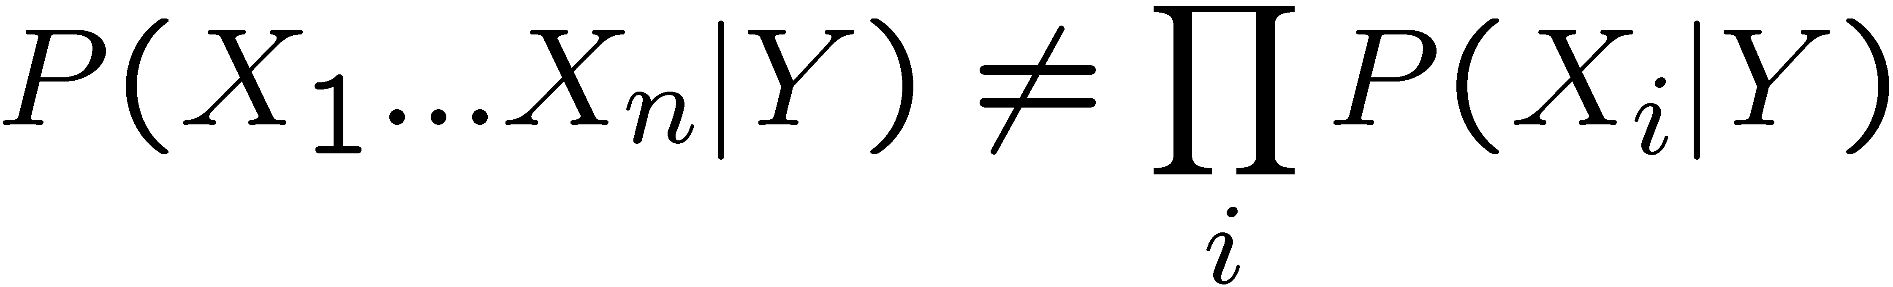
Violating the NB assumption
Usually, features are not conditionally independent:
  NB often performs well, even when assumption is violated
  [Domingos & Pazzani ’96] discuss some conditions for good performance
But it’s not the only trick in our bag.

Slide 41
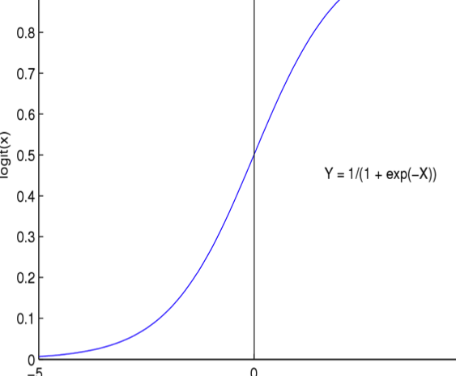
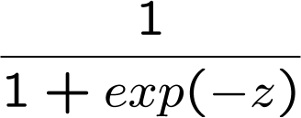
Logistic Regression
Logistic function (Sigmoid):
Learn P(Y|X) directly!
  Assume a particular functional form
  Sigmoid applied to a linear function of the data:
Z

Slide 42
Logistic Regression: decision boundary
Prediction: Output the Y with highest P(Y|X)
  For binary Y, output Y=0 if
w.X+w₀ = 0
A Linear Classifier!

Slide 43
What you should know about Logistic Regression (LR)
Gaussian Naïve Bayes with class-independent variances representationally equivalent to LR
  Solution differs because of objective (loss) function
In general, NB and LR make different assumptions
  NB: Features independent given class ! assumption on P(X|Y)
  LR: Functional form of P(Y|X), no assumption on P(X|Y)
LR is a linear classifier
  decision rule is a hyperplane
LR optimized by conditional likelihood
  no closed-form solution
  concave ! global optimum with gradient ascent
  Maximum conditional a posteriori corresponds to regularization
Convergence rates
  GNB (usually) needs less data
  LR (usually) gets to better solutions in the limit

Slide 44
Decision Trees
#holes
0
2
1
moment of
inertia
#strokes
#strokes
< t
≥ t
0
1
best axis
direction
#strokes
0
1
0
90
2
4
60
- / 1 x w 0 A 8 B

Slide 45
Decision Tree Characteristics
Training
How do you construct one from training data?
Entropy-based Methods
2. Strengths
Easy to Understand
3. Weaknesses
Overfitting (the classifier fits the training data
very well, but not new unseen data)

Slide 46
Entropy-Based Automatic Decision Tree Construction
Training Set S
x1=(f11,f12,…f1m)
x2=(f21,f22, f2m)
.
.
xn=(fn1,f22, f2m)
Node 1
What feature
should be used?
What values?
Quinlan suggested information gain in his ID3 system
and later the gain ratio, both based on entropy.

Slide 47
Entropy
Given a set of training vectors S, if there are c classes,
Entropy(S) = ∑ -p_{i} log (p_{i})
Where p_{i} is the proportion of category i examples in S.
c
i=1
2
If all examples belong to the same category, the entropy
is 0 (no discrimination).
The greater the discrimination power, the larger the
entropy will be.

Slide 48
Information Gain
The information gain of an attribute A is the expected
reduction in entropy caused by partitioning on this attribute.
|Sv|
Gain(S,A) = Entropy(S) - ∑ ----- Entropy(S_{v})
|S|
v ∈ Values(A)
where S_{v} is the subset of S for which attribute A has
value v.
Choose the attribute A that gives the maximum
information gain.

Slide 49
Information Gain (cont)
Set S
Attribute A
v1
v2
vk
Set S ′
S′={s∈S | value(A)=v1}
repeat
recursively
The attribute A selected at the top of the tree is
the one with the highest information gain.
Subtrees are constructed for each possible
value vi of attribute A.
The rest of the tree is constructed in the same way.

Slide 50
Summary: Decision Trees
Limitations
  Often produce noisy (bushy) or weak (stunted) classifiers.
  Do not generalize too well.
  Training data fragmentation:
    As tree progresses, splits are selected based on less and less data.
  Overtraining and undertraining:
    Deep trees: fit the training data well, will not generalize well to new test data.
    Shallow trees: not sufficiently refined.
  Stability
    Trees can be very sensitive to details of the training points.
    If a single data point is only slightly shifted, a radically different tree may come out!
    ⇒ Result of discrete and greedy learning procedure.
  Expensive learning step
    Mostly due to costly selection of optimal split.

Slide 51
Randomized Decision Trees (Amit & Geman 1997)
Decision trees: main effort on finding good split
  Training runtime:
  This is what takes most effort in practice.
  Especially cumbersome with many attributes (large D).
Idea: randomize attribute selection
  No longer look for globally optimal split.
  Instead randomly use subset of K attributes on which to base the split.
  Choose best splitting attribute e.g. by maximizing the information gain (= reducing entropy):

Slide 52
Randomized Decision Trees
Randomized splitting
  Faster training: .
  Use very simple binary feature tests.
  Typical choice
    K = 10 for root node.
    K = 100d for node at level d.
Effect of random split
  Of course, the tree is no longer as powerful as a single classifier…
  But we can compensate by building several trees.

Slide 53
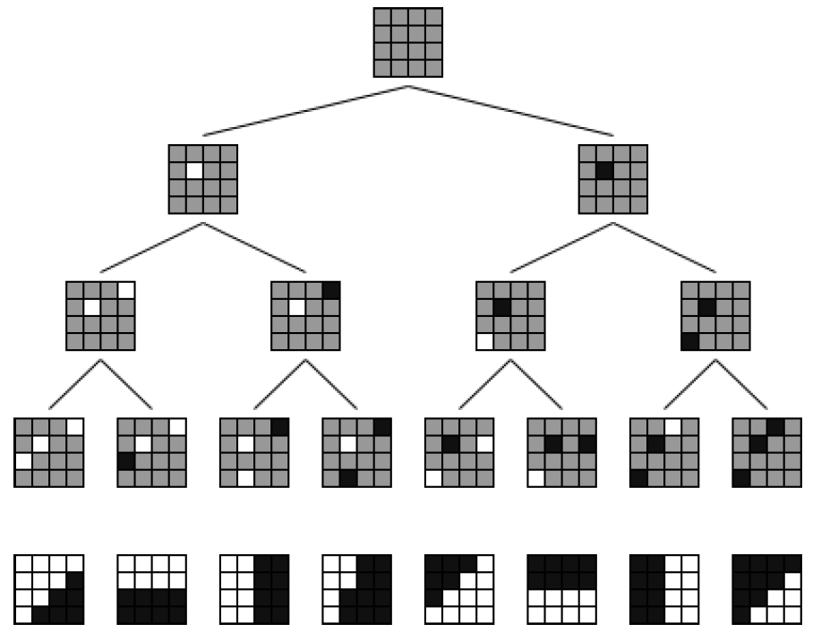
Applications
Computer Vision: Optical character recognition
  Classify small (14x20) images of hand-written characters/digits
  into one of 10 or 26 classes.
Simple binary features
  Tests for individual binary pixel
  values.
  Organized in randomized tree.
  Y. Amit, D. Geman, Shape Quantization and Recognition with Randomized Trees,
  Neural Computation, Vol. 9(7), pp. 1545-1588, 1997.

Slide 54
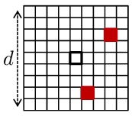
Applications
Computer Vision: fast keypoint detection
  Detect keypoints: small patches in the image used for matching
  Classify into one of ~200 categories (visual words)
Extremely simple features
  E.g. pixel value in a color channel (CIELab)
  E.g. sum of two points in the patch
  E.g. difference of two points in the patch
  E.g. absolute difference of two points
Create forest of randomized decision trees

Slide 55
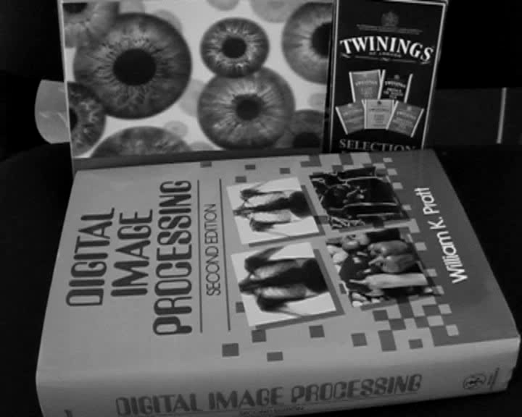
Application: Fast Keypoint Detection
M. Ozuysal, V. Lepetit, F. Fleuret, P. Fua, Feature Harvesting for
Tracking-by-Detection. In ECCV’06, 2006.

Slide 56
Random Forests (Breiman 2001)
General ensemble method
  Idea: Create “forest” of many (very simple) trees.
Empirically very good results
Standard decision trees: main effort on finding good split
  Random Forests trees put very little effort in this.
  Each split is only made based on a random subset of the available attributes.
  Trees are grown fully (important!).
Main secret
  Injecting the “right kind of randomness”. See next slide.
multiple classifiers

Slide 57
Random Forests – Algorithmic Goals
Create many trees (50 – 1,000)
Inject randomness into trees such that
  Each tree has maximal strength
    I.e. a fairly good model on its own
  Each tree has minimum correlation with the other trees.
    I.e. the errors tend to cancel out.
Ensemble of trees votes for final result
  Simple majority vote for category.
T₁
T₂
T₃
α
α
β
α
α
β
α
β
β
α
β

Slide 58
Other Important Classifiers
Neural Nets: We will look at these in detail in the lecture on deep neural nets, so only a quick look now
Support Vector Machines: These are important in certain object recognition systems, so we will look at them only briefly now and more thoroughly later

Slide 59
Artificial Neural Nets
Artificial Neural Nets (ANNs) are networks of
artificial neuron nodes, each of which computes
a simple function.
An ANN has an input layer, an output layer, and
“hidden” layers of nodes.
.
.
.
.
.
.
Outputs
Inputs

Slide 60
Node Functions
a1
a2
aj
an
w(1,i)
neuron i
output
w(j,i)
output = g (∑ aj * w(j,i) )
Function g is commonly a step function, sign function,
or sigmoid function.

Slide 61
Support Vector Machines (SVM)
Support vector machines are learning algorithms
that try to find a hyperplane that separates
the differently classified data the most.
They are based on two key ideas:
Maximum margin hyperplanes
A kernel ‘trick’.

Slide 62
Maximal Margin
1
Margin
0
1
1
0
0
1
Hyperplane
0
Find the hyperplane with maximal margin for all
the points. This originates an optimization problem
which has a unique solution (convex problem).

Slide 63
Non-separable data
0
1
0
0
0
1
1
0
1
0
1
0
1
0
1
1
0
0
0
1
0
What can be done if data cannot be separated with a
hyperplane?

Slide 64
The kernel trick
The SVM algorithm maps the original data to a
a different feature space in which data (which is not
separable in the original space) becomes separable
in the feature space.
Original space R^{k}
Feature space R^{n}
1
0
1
1
0
0
1
0
0
1
0
Kernel
trick
0
1
0
0
0
1
1

Slide 65
Ensembles
When single classifiers alone are not good enough, we turn to ensembles.
An ensemble is a set of classifiers that together produce the final decision.
There are multiple different ways of arranging the classifiers and of combining the results.

Slide 66
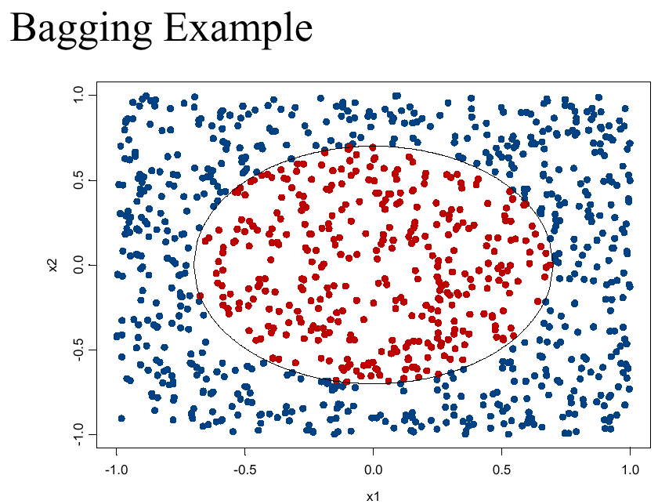
Nonlinear Classification Problem

Slide 67
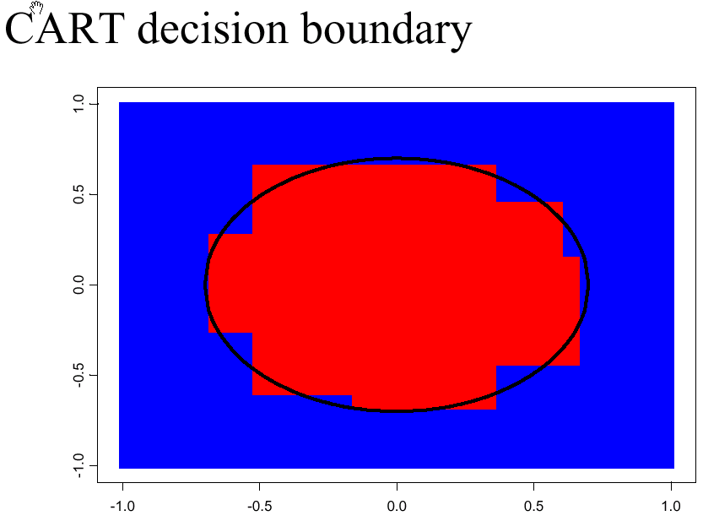
Decision Boundary

Slide 68
Voting (Ensemble Methods)
Instead of learning a single classifier, learn many weak classifiers that are good at different parts of the data
Output class: (Weighted) vote of each classifier
  Classifiers that are most “sure” will vote with more conviction
  Classifiers will be most “sure” about a particular part of the space
  On average, do better than single classifier!
But how???
  force classifiers to learn about different parts of the input space? different subsets of the data?
  weigh the votes of different classifiers?

Slide 69
BAGGing = Bootstrap AGGregation
(Breiman, 1996)
for i = 1, 2, …, K:
  T_{i} ← randomly select M training instances
  with replacement
  h_{i} ← learn(T_{i}) [ID3, NB, kNN, neural net, …]
Now combine the T_{i} together with uniform voting (w_{i}=1/K for all i)

Slide 71
Decision Boundary

Slide 72
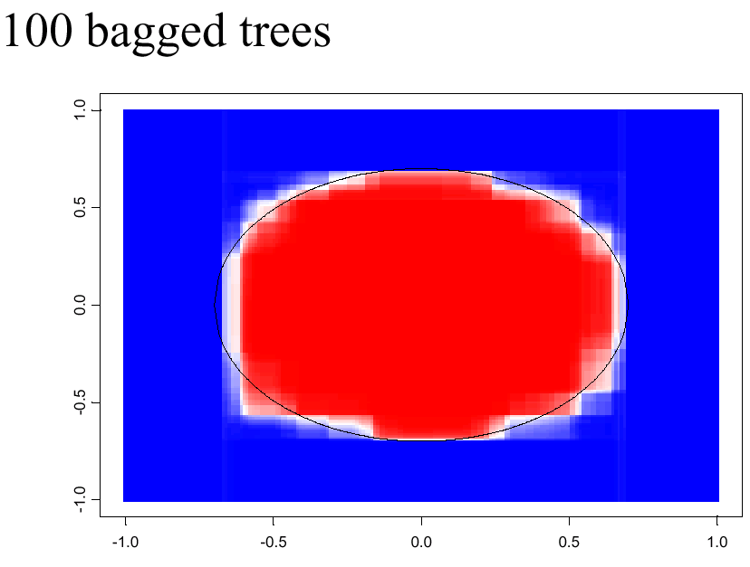
shades of blue/red indicate strength of vote for particular classification

Slide 73
Boosting
[Schapire, 1989]
Idea: given a weak learner, run it multiple times on (reweighted) training data, then let learned classifiers vote
On each iteration t:
  weight each training example by how incorrectly it was classified
  Learn a hypothesis – h_{t}
  A strength for this hypothesis – α_{t}
Final classifier:
Practically useful
Theoretically interesting

Slide 74
AdaBoost
A very popular boosting algorithm
Can boost learning with an kind of weak
learners, ie. decision stumps, decision trees, neural
nets, SVMs
Theoretically proven to boost results if the weak learners are good enough (> 50%)
Used in the face detection algorithm for HW 4

