Slide 1
Image Formation and Cameras
CSE 455
Linda Shapiro

Slide 2
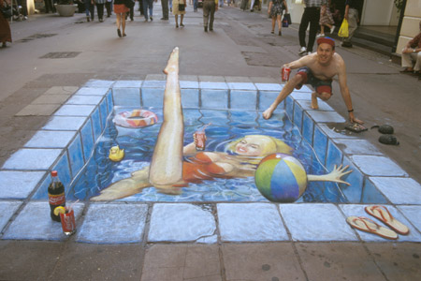
Projection
http://www.julianbeever.net/pave.htm
Do sizes, lengths seem accurate?
How do you know?

Slide 3
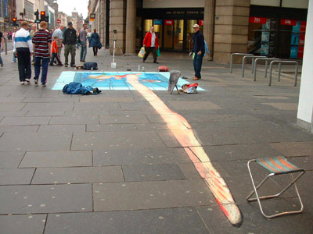
Projection
http://www.julianbeever.net/pave.htm
What’s wrong?
Why do you think it’s wrong?

Slide 4

Müller-Lyer Illusion
http://www.michaelbach.de/ot/sze_muelue/index.html
What do you know about perspective projection?
Vertical lines?
Other lines?

Slide 5
Image formation
Object
Film
Let’s design a camera
  Idea 1: put a piece of film in front of an object
  Do we get a reasonable image?

Slide 6
Pinhole camera
Object
Barrier
Film
Add a barrier to block off most of the rays
  This reduces blurring
  The opening known as the aperture
  How does this transform the image?

Slide 7
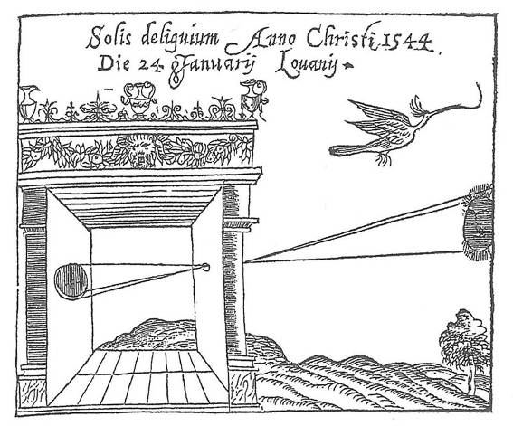
Camera Obscura
Basic principle known to Mozi (470-390 BC), Aristotle (384-322 BC)
Drawing aid for artists: described by Leonardo da Vinci (1452-1519)
Gemma Frisius, 1558

Slide 8
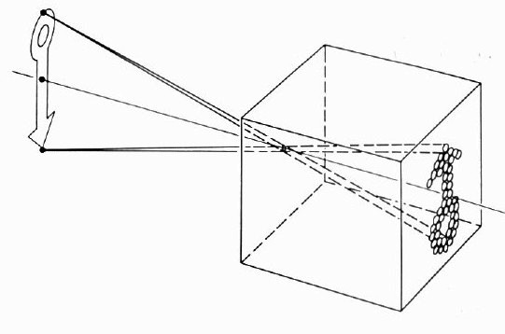
Camera Obscura
The first camera
  How does the aperture size affect the image?

Slide 9
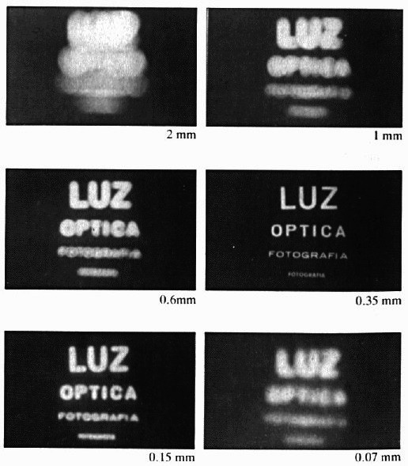
Shrinking the aperture
Why not make the aperture as small as possible?
Less light gets through
Diffraction effects...

Slide 10
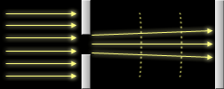
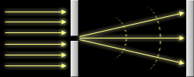
Diffraction
Light rays passing through a small aperture will begin to diverge and interfere with one another.
This becomes more significant as the size of the aperture decreases relative to the wavelength of light passing through.
This effect is normally negligible, since smaller apertures often improve sharpness.
But at some point, your camera becomes diffraction limited, and the quality goes down.

Slide 11
Shrinking the aperture

Slide 12
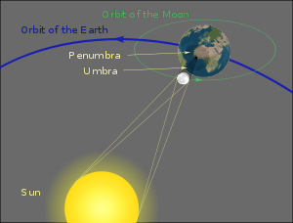
Pinhole Cameras: Total Eclipse
A total eclipse occurs when the moon comes between the
earth and the sun, obscuring the sun.

Slide 13

Pinhole cameras everywhere
Sun “shadows” during a solar eclipse
by Henrik von Wendt http://www.flickr.com/photos/hvw/2724969199/
The holes between fingers work like a camera obscura and
show the eclipsed sun

Slide 14

Pinhole cameras everywhere
Sun “shadows” during a partial solar eclipse
http://www.flickr.com/photos/73860948@N08/6678331997/

Slide 15
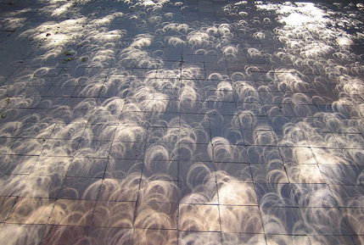
Pinhole cameras everywhere
Tree shadow during a solar eclipse
photo credit: Nils van der Burg
http://www.physicstogo.org/index.cfm

Slide 16
Adding a lens
“circle of
confusion”
A lens focuses light onto the film
  There is a specific distance at which objects are “in focus”
    other points project to a “circle of confusion” in the image
  Changing the shape of the lens changes this distance

Slide 17

Lenses
F
focal point
optical center
(Center Of Projection)
A lens focuses parallel rays onto a single focal point
  focal point at a distance f beyond the plane of the lens
    f is a function of the shape and index of refraction of the lens
  Aperture of diameter D restricts the range of rays
    aperture may be on either side of the lens
  Lenses are typically spherical (easier to produce)
  Real cameras use many lenses together (to correct for aberrations)

Slide 18
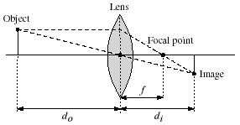
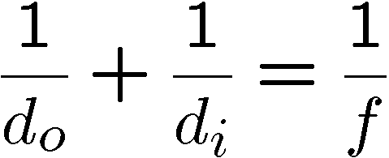
Thin lenses
Thin lens equation:
  Any object point satisfying this equation is in focus
Notes:
manipulate eq to show shape of focus region

Slide 19

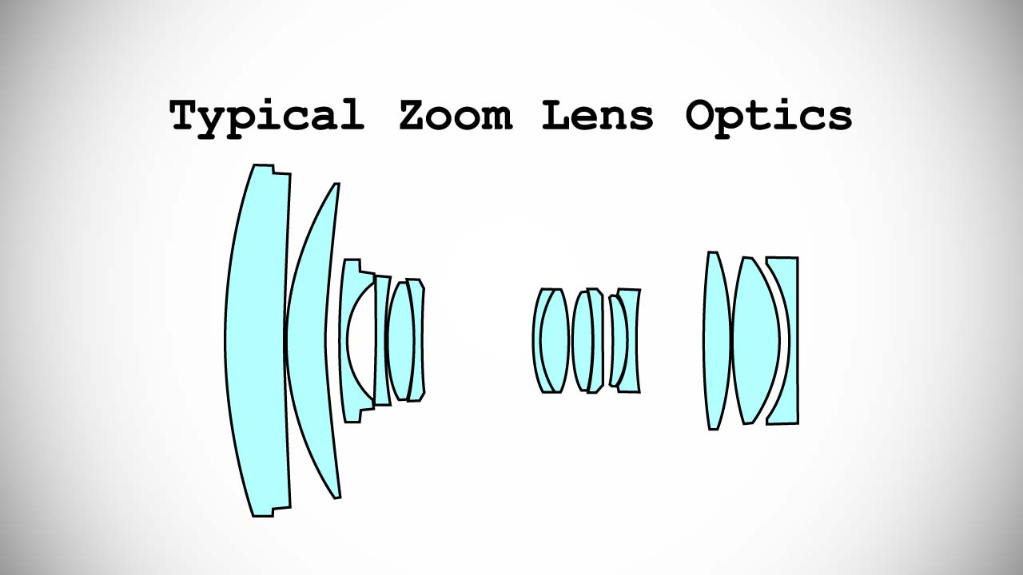
Thin lens assumption
The thin lens assumption assumes the lens has no thickness, but this isn’t true…
Object
Lens
Film
Focal point
By adding more elements to the lens, the distance at which a scene is in focus can be made roughly planar.

Slide 20


Depth of field
Aperture
Film
f / 5.6
f / 32
Changing the aperture size affects depth of field
  A smaller aperture increases the range in which the object is approximately in focus
Flower images from Wikipedia http://en.wikipedia.org/wiki/Depth_of_field

Slide 21
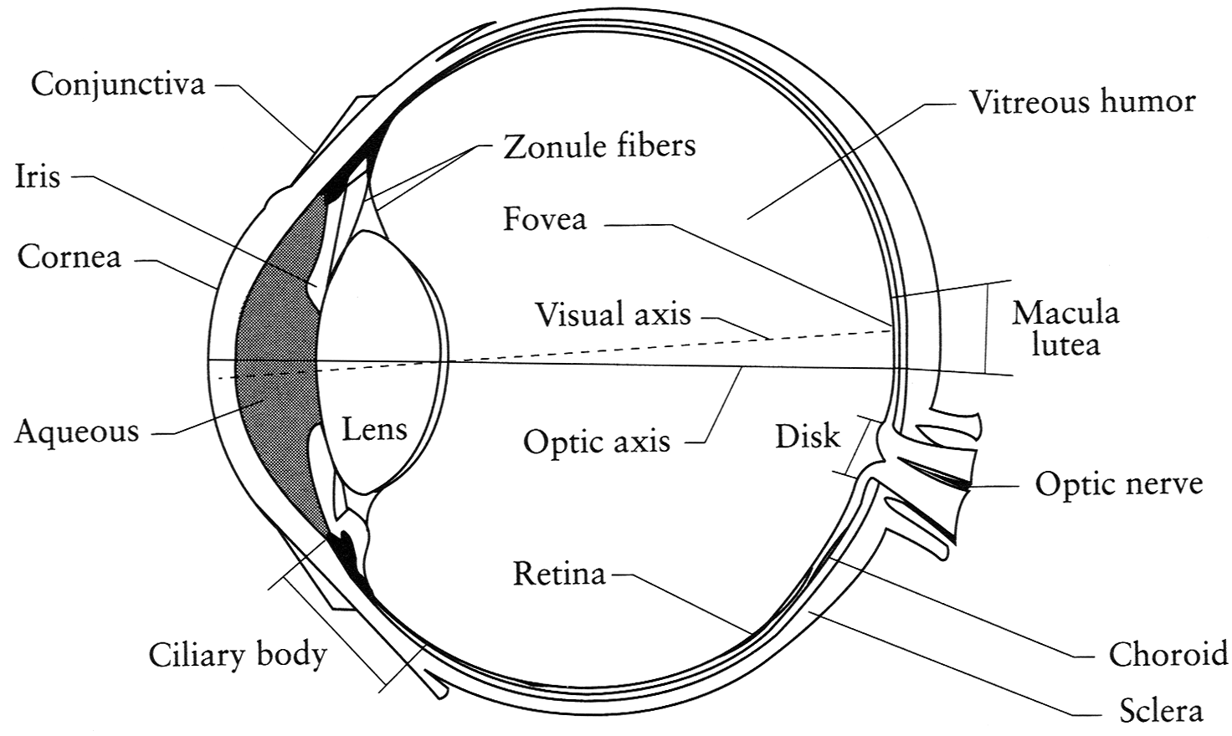
The eye
The human eye is a camera
  Iris - colored annulus with radial muscles
  Pupil - the hole (aperture) whose size is controlled by the iris
  What’s the “film”?
    photoreceptor cells (rods and cones) in the retina
  How do we refocus?
    Change the shape of the lens

Slide 22

Digital camera
A digital camera replaces film with a sensor array
  Each cell in the array is a Charge Coupled Device (CCD)
    light-sensitive diode that converts photons to electrons
  CMOS is becoming more popular (esp. in cell phones)
    http://electronics.howstuffworks.com/digital-camera.htm

Slide 23
Issues with digital cameras
Noise
    big difference between consumer vs. SLR-style cameras
    low light is where you most notice noise
Compression
    creates artifacts except in uncompressed formats (tiff, raw)
Color
    color fringing artifacts from Bayer patterns
Blooming
    charge overflowing into neighboring pixels
In-camera processing
    oversharpening can produce halos
Interlaced vs. progressive scan video
    even/odd rows from different exposures
Are more megapixels better?
    requires higher quality lens
    noise issues
Stabilization
    compensate for camera shake (mechanical vs. electronic)
More info online, e.g.,
http://electronics.howstuffworks.com/digital-camera.htm
http://www.dpreview.com/

Slide 24
Projection
Mapping from the world (3d) to an image (2d)
Can we have a 1-to-1 mapping?
How many possible mappings are there?
An optical system defines a particular projection. We’ll talk about 2:
Perspective projection (how we see “normally”)
Orthographic projection (e.g., telephoto lenses)

Slide 25
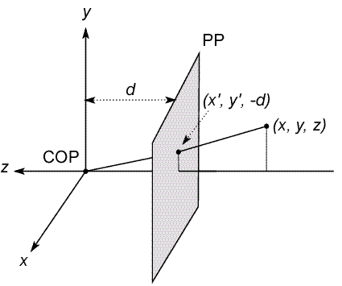
Modeling projection
3D point
negative z axis
The coordinate system
  We will use the pin-hole model as an approximation
  Put the optical center (Center Of Projection) at the origin
  Put the image plane (Projection Plane) in front of the COP
  The camera looks down the negative z axis
    we need this if we want right-handed-coordinates

Slide 26
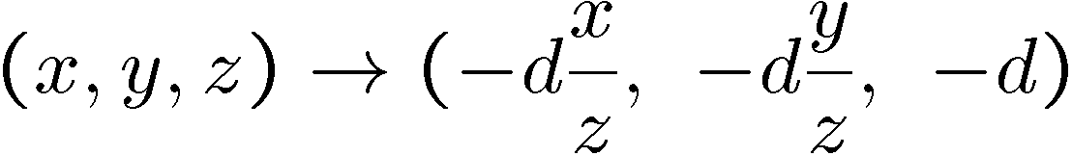
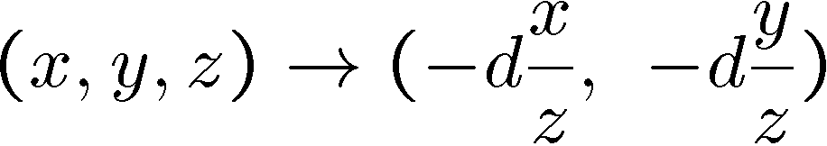
Modeling projection
Projection equations
  Compute intersection with PP of ray from (x,y,z) to COP
  Derived using similar triangles
We get the projection by throwing out the last coordinate:

Slide 27




Homogeneous coordinates
Is this a linear transformation?
no—division by z is nonlinear
Trick: add one more coordinate:
homogeneous image
coordinates
homogeneous scene
coordinates
Converting from homogeneous coordinates

Slide 28
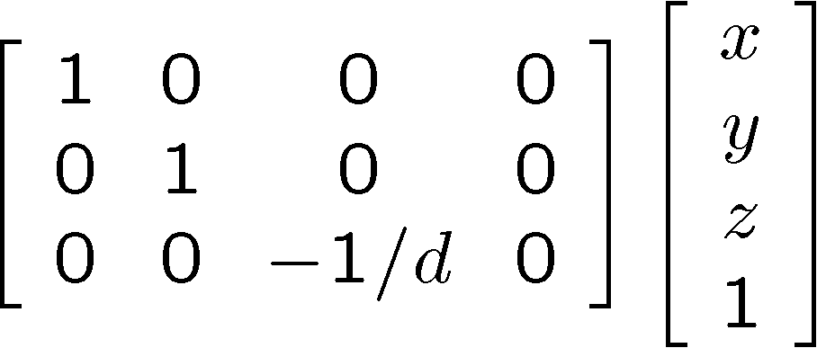
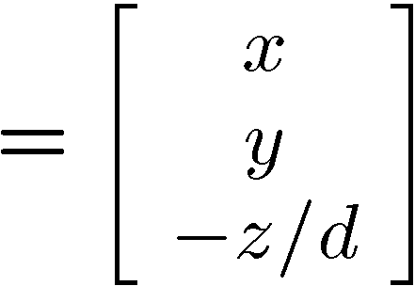
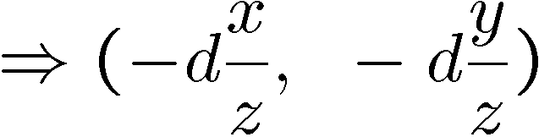
Perspective Projection
Projection is a matrix multiply using homogeneous coordinates:
divide by third coordinate
projection matrix 3D point 2D point
This is known as perspective projection
The matrix is the projection matrix

Slide 29
Perspective Projection Example
1. Object point at (10, 6, 4), d=2
2. Object point at (25, 15, 10)
Perspective projection is not 1-to-1!

Slide 30
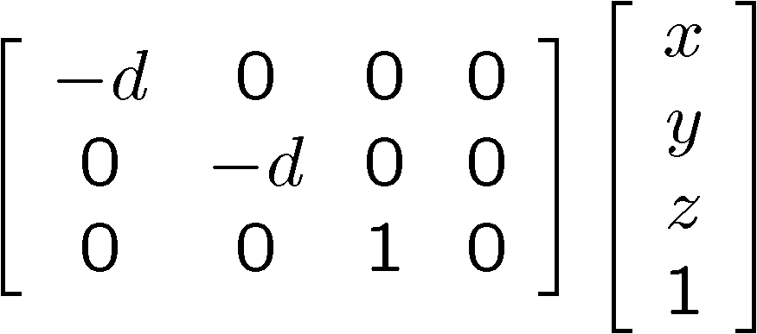
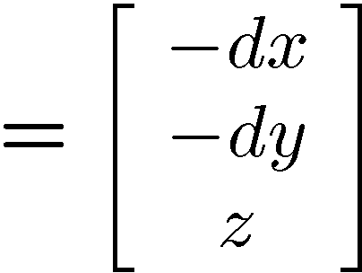
Perspective Projection
How does scaling the projection matrix change the transformation?

Slide 31
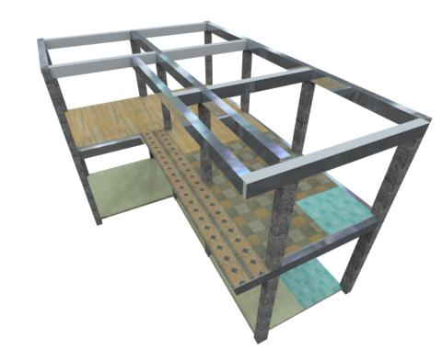

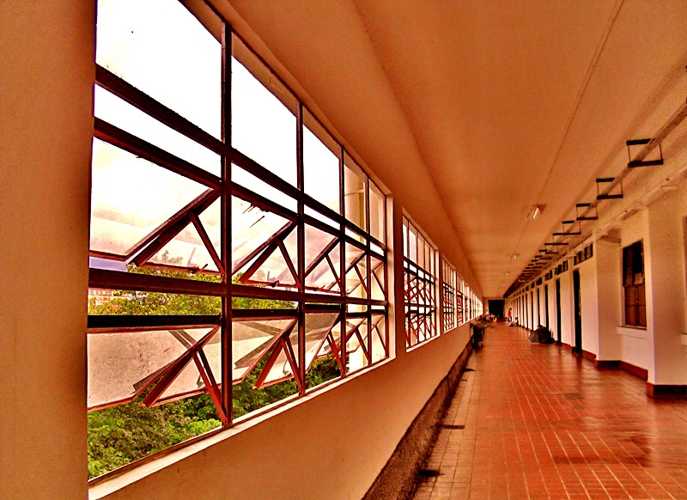
Perspective Projection
What happens to parallel lines?
What happens to angles?
What happens to distances?

Slide 32
Perspective Projection
What happens when d➔∞?

Slide 33
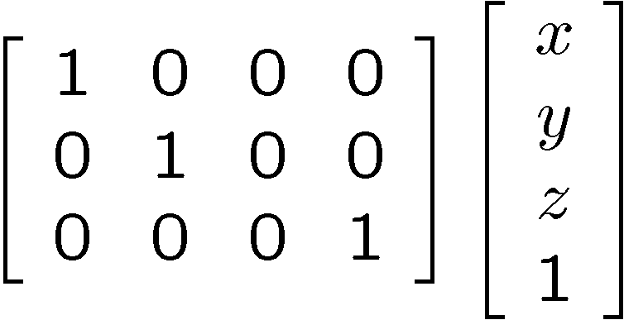
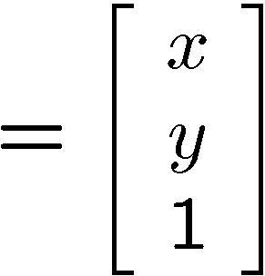

Orthographic projection
Special case of perspective projection
  Distance from the COP to the PP is infinite
  Good approximation for telephoto optics
  Also called “parallel projection”: (x, y, z) → (x, y)
  What’s the projection matrix?
Image
World

Slide 34

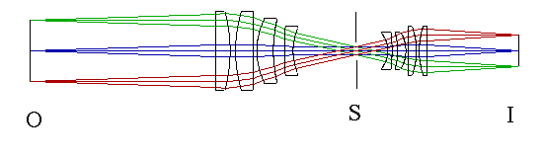
Orthographic (“telecentric”) lenses
Navitar telecentric zoom lens
http://www.lhup.edu/~dsimanek/3d/telecent.htm

Slide 35




Orthographic Projection
What happens to parallel lines?
What happens to angles?
What happens to distances?

Slide 36
Camera parameters
How many numbers do we need to describe a camera?
We need to describe its pose in the world
We need to describe its internal parameters

Slide 37

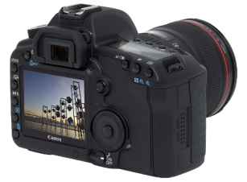
A Tale of Two Coordinate Systems
v
y
COP
u
Camera
w
o
x
Two important coordinate systems:
1. World coordinate system
2. Camera coordinate system
z
“The World”

Slide 38
Camera parameters
To project a point (x,y,z) in world coordinates into a camera
First transform (x,y,z) into camera coordinates
Need to know
  Camera position (in world coordinates)
  Camera orientation (in world coordinates)
Then project into the image plane
  Need to know camera intrinsics
These can all be described with matrices

Slide 39
3D Translation
3D translation is just like 2D with one more coordinate
x′ 1 0 0 tx x
y′ = 0 1 0 ty y
z′ 0 0 1 tz z
1 0 0 0 1 1
= [x+tx, y+ty, z+tz, 1]^{T}

Slide 40
3D Rotation (just the 3 x 3 part shown)
About X axis: 1 0 0 About Y: cosθ 0 sinθ
0 cosθ –sinθ 0 1 0
0 sinθ cosθ -sinθ 0 cosθ
About Z axis: cosθ –sinθ 0
sinθ cosθ 0
0 0 1
General (orthonormal) rotation matrix used in practice:
r11 r12 r13
r21 r22 r23
r31 r32 r33

Slide 41

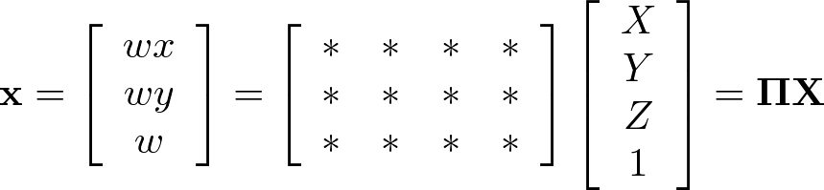




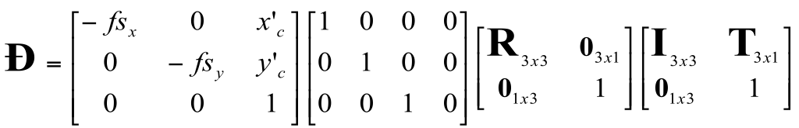
Camera parameters
A camera is described by several parameters
Translation T of the optical center from the origin of world coords
Rotation R of the image plane
focal length f, principle point (x’_{c}, y’_{c}), pixel size (s_{x}, s_{y})
blue parameters are called “extrinsics,” red are “intrinsics”
Projection equation
The projection matrix models the cumulative effect of all parameters
Useful to decompose into a series of operations
identity matrix
[tx, ty, tz]^{T}
intrinsics
projection
rotation
translation
The definitions of these parameters are not completely standardized
especially intrinsics—varies from one book to another

Slide 42







Extrinsics
How do we get the camera to “canonical form”?
  (Center of projection at the origin, x-axis points right, y-axis points up, z-axis points backwards)
Step 1: Translate by -c
image
plane
0
camera

Slide 43
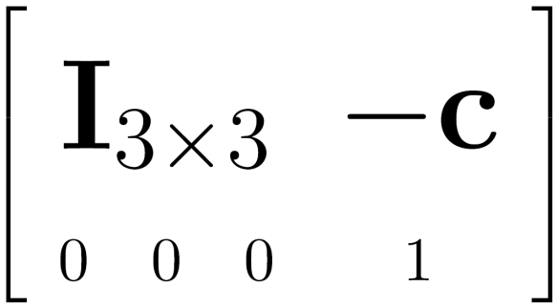

Extrinsics
How do we get the camera to “canonical form”?
  (Center of projection at the origin, x-axis points right, y-axis points up, z-axis points backwards)
Step 1: Translate by -c
How do we represent translation as a matrix multiplication?
0

Slide 44
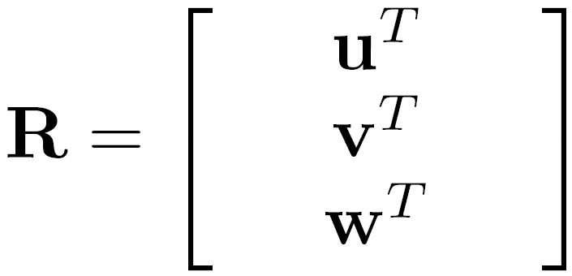
Extrinsics
How do we get the camera to “canonical form”?
  (Center of projection at the origin, x-axis points right, y-axis points up, z-axis points backwards)
Step 1: Translate by -c
Step 2: Rotate by R
0
3x3 rotation matrix

Slide 45
Extrinsics
How do we get the camera to “canonical form”?
  (Center of projection at the origin, x-axis points right, y-axis points up, z-axis points backwards)
Step 1: Translate by -c
Step 2: Rotate by R
0

Slide 46
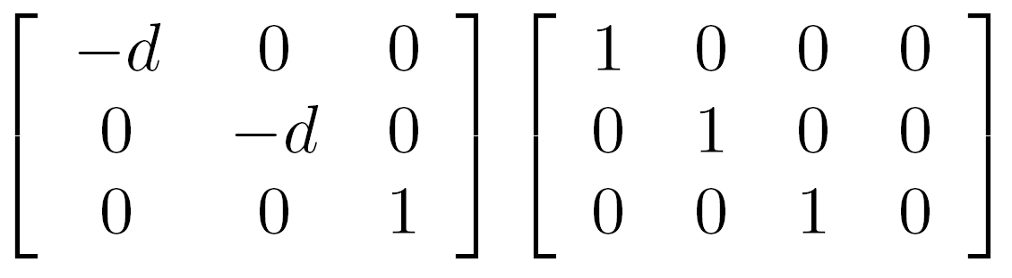
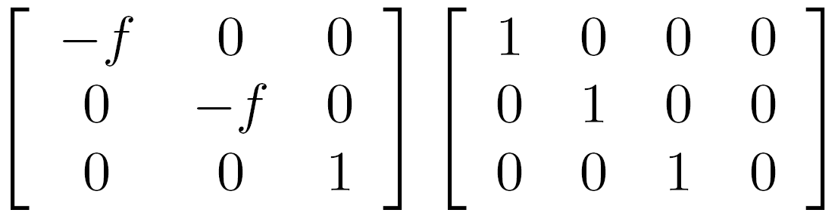

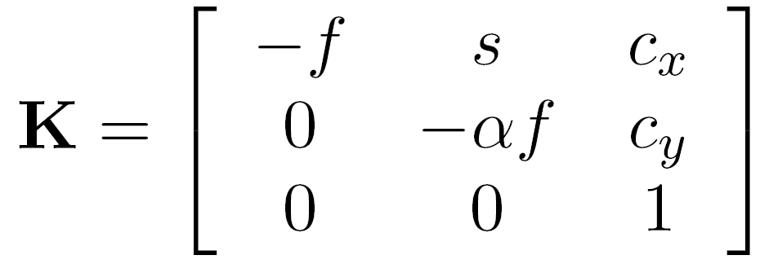



Perspective projection
(converts from 3D rays in camera coordinate system to pixel coordinates)
(intrinsics)
in general,
f is the focal
length of the camera
: aspect ratio (1 unless pixels are not square)
: skew (0 unless pixels are shaped like rhombi/parallelograms)
: principal point ((0,0) unless optical axis doesn’t intersect projection plane at origin)

Slide 47
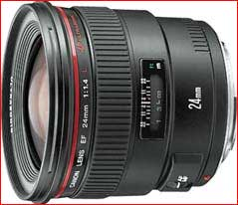




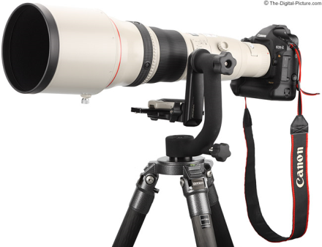
Focal length
Can think of as “zoom”
Related to field of view
24mm
50mm
200mm
800mm

Slide 48
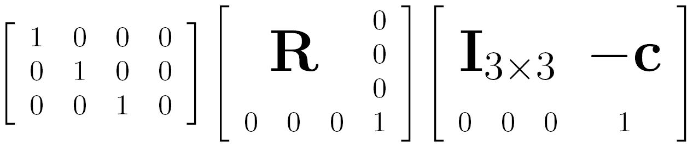

Projection matrix
intrinsics
projection
rotation
translation

Slide 49



Projection matrix
arbitrary 3D point
=
image plane
0
(in homogeneous image coordinates)

Slide 50
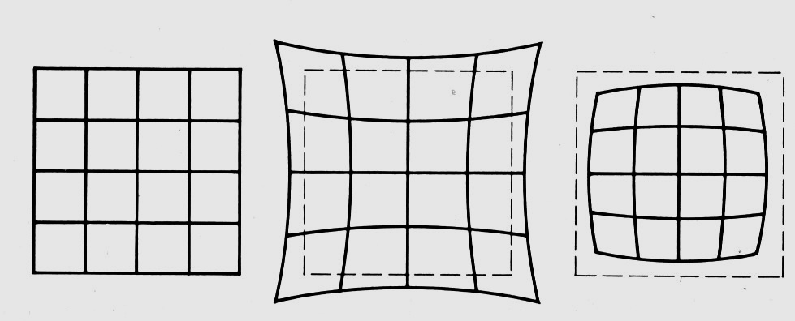
Distortion
No distortion
Pin cushion
Barrel
Radial distortion of the image
  Caused by imperfect lenses
  Deviations are most noticeable for rays that pass through the edge of the lens
Notes:
Many wide –angle lenses have radial distortion – visible curvature in the projection of straight lines. To create good reconstructions / panoramas etc. this distortion shouldbe taken into account. Barrel usually a product of wide angle lenses and pincushion usually in telephoto lenses.

Slide 51
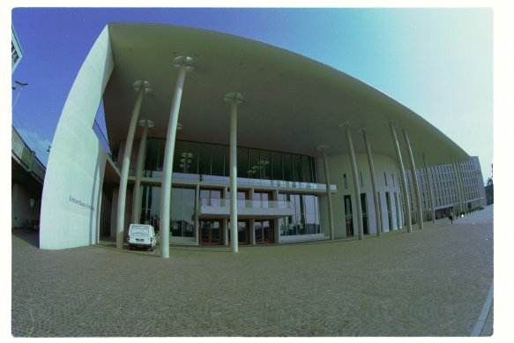
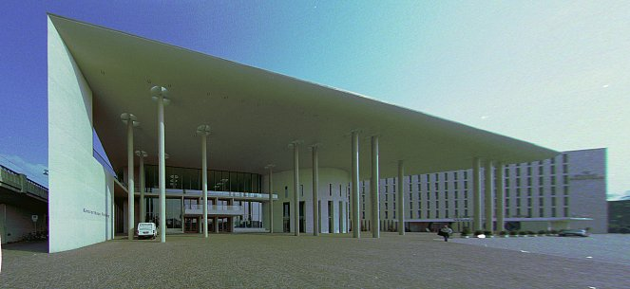
Correcting radial distortion
from Helmut Dersch

Slide 52

http://blog.photoshopcreative.co.uk/general/fix-barrel-distortion/

Slide 54
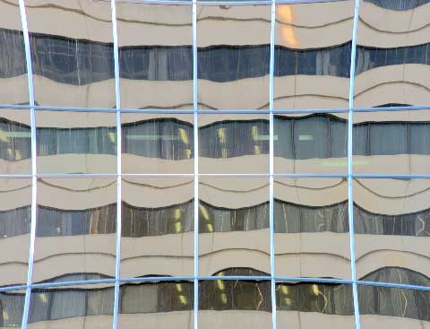

Slide 55
Many other types of projection exist...

Slide 56
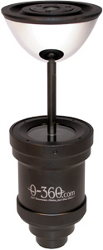
360 degree field of view…
Basic approach
  Take a photo of a parabolic mirror with an orthographic lens (Nayar)
    http://www.cs.columbia.edu/CAVE/projects/cat_cam_360/gallery1/index.html
  Or buy one a lens from a variety of omnicam manufacturers…
    See http://www.cis.upenn.edu/~kostas/omni.html

Slide 57
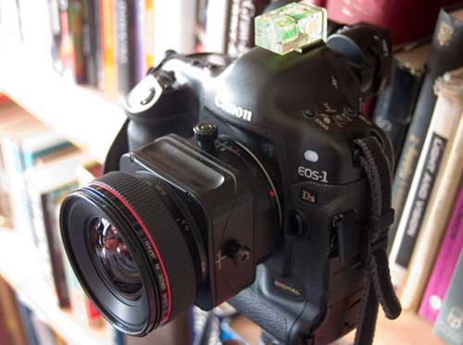
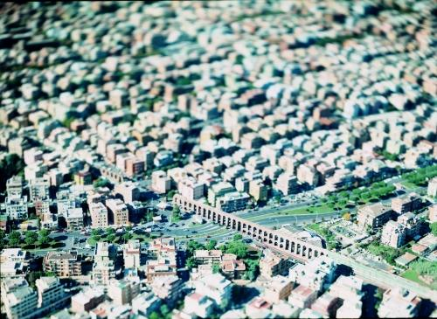
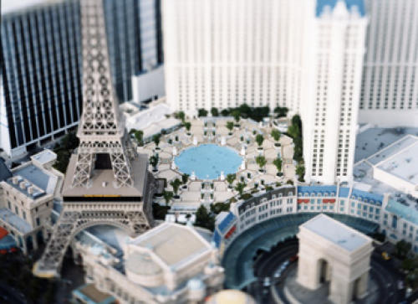
Tilt-shift
http://www.northlight-images.co.uk/article_pages/tilt_and_shift_ts-e.html
Tilt-shift images from Olivo Barbieri
and Photoshop imitations
Notes:
Simulates a miniature scene

Slide 58


Rotating sensor (or object)
Rollout Photographs © Justin Kerr
http://research.famsi.org/kerrmaya.html
Also known as “cyclographs”, “peripheral images”

Slide 59
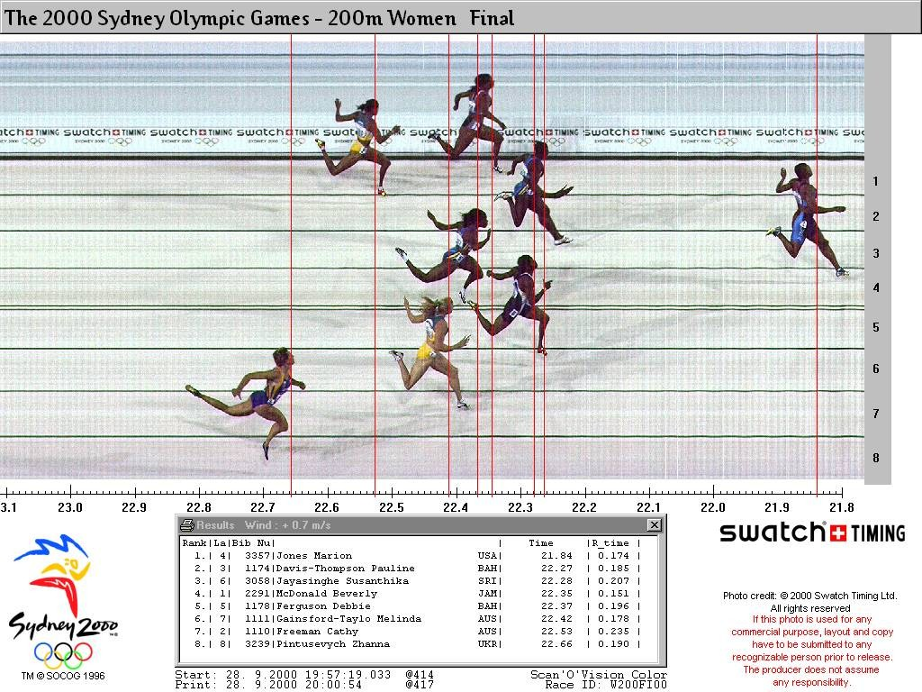
Photofinish

Slide 60
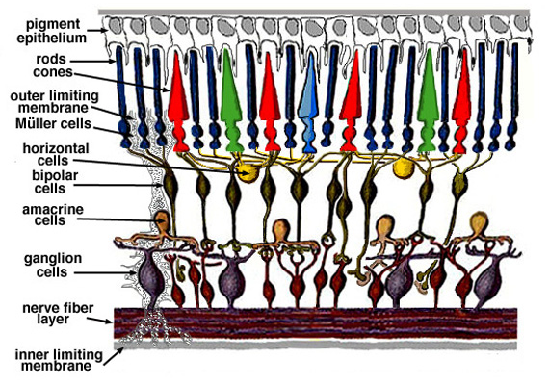
Human eye

Slide 61
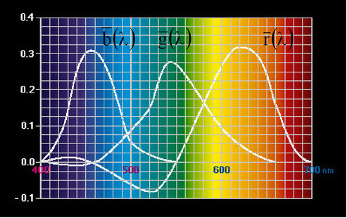
Colors
What colors do humans see?
RGB tristimulus values, 1931 RGB CIE

Slide 62
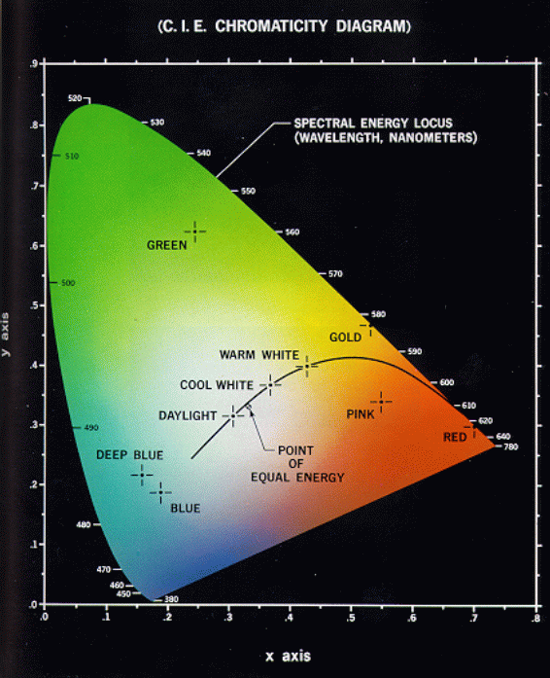
Colors
Plot of all visible colors (Hue and saturation):

Slide 63
Where does all this lead?
We need it to understand stereo
And 3D reconstruction
It also leads into camera calibration, which is usually done in factory settings to solve for the camera parameters before performing an industrial task.
The extrinsic parameters must be determined.
Some of the intrinsic are given, some are solved for, some are improved.

Slide 64
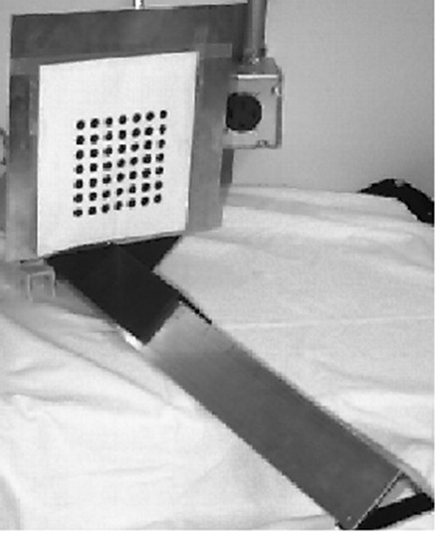
Camera Calibration
The idea is to snap
images at different
depths and get a
lot of 2D-3D point
correspondences.
x1, y1, z1, u1, v1
x2, y2, z1, u2, v2
.
.
xn, yn, zn, un, vn
Then solve a system
of equations to get
camera parameters.

