Slide 1
Tremor Detection Using Motion Filtering and SVM Bilge Soran, Jenq-Neng Hwang, Linda Shapiro, ICPR, 2012

Slide 2
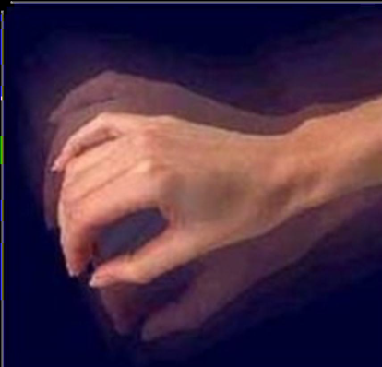
Tremor Detection Using Motion Filtering and SVM [Soran et al., ICPR’12]
Problem: Automatic hand tremor detection using a static camera
Motivation: Providing doctors objective information for diagnosis
Notes:
The problem we are interested in this work is automatic hand detection using a static camera.
We believe that such as system can be very beneficial to doctors by providing objective information for diagnosis purposes.

Slide 3
Related Work
[Garg et al., 2009] categorize the hand gesture recognition approaches into 3D model-based and appearance-based.
[Murthy and Jadon, 2009] adopted an appearance based approach based on low-level hand features from intensity images.
[Uhrikova et al., 2009] measures the hand tremor frequencies. They compared their calculated frequencies with those measured by an accelerometer.
Notes:
[Aggarwal and Ryoo, 2011] reduces the problem to object matching when actions are represented as 3-D (X, Y, T) volumes.
The most similar work to ours was done by Uhrikova et al., who also worked on hand tremors, but their purpose was to …
A straightforward method used in appearance-based approaches is to extract
skin-colored regions from the image. Another method is to use the eigenspace
to produce a compact description of a large set of high-dimensional data using a
small set of eigenvectors [44].
Aggarwal et al. suggests that if each action is represented by 3-D (X, Y, T) volumes, they can be recognized by solving an object matching problem.
Uhrikova instead of classifying tremor instances from non-tremors

Slide 4
Method
Optical Flow Calculation & Feature Extraction
Classification with SVM
Personalized Skin Detection & Blob Extraction
Notes:
Background and Shadow Removal ->

Slide 5
Optical Flow Calculation & Feature Extraction
Classification
with SVM
Personalized Skin Detection & Blob Extraction
Input:
Video of a patient waving his hand for ~3 sec
Method:
Apply skin color thresholds
Compute optical-flow and extract moving regions
Merge regions and compute color histograms
Fit Gaussian function to use as personalized skin model
Perform Blob Detection, discard small regions.
Notes:
Maybe converted to a chart
Blob Detection is performed, regions smaller than some size are discarded.

Slide 6
Classification
with SVM
Personalized Skin Detection & Blob Extraction
Optical Flow Calculation & Feature Extraction
For each blob compute optical-flow direction and direction change using 3 consecutive frames:
85 ° 87°
+2
60° 77°
+17
… …
Calculate sum of motion direction change: +19
The sign of the sum shows the general direction change of the flow: up or down.
Notes:
In a tremor movement, the main discriminative features are not the motion directions
themselves, but the motion directional changes between consecutive frames. While
directional features are sensitive to rotation, directional change features are more
Rotation invariant.
Note that while one part of the hand can move upward, another part can move downward,
and a tremor can exist in any region of a hand. We assume (and have observed
through experiments) that if a tremor occurs, the directional change of the tremor
dominates all directional changes that can exist in any region of the hand. Moreover,
not all hand regions exhibit tremor behavior, and averaging the MDC features over
the whole hand can smooth the values while decreasing the discriminative power of
the features. Therefore, we need to identify the hand regions that exhibit significant
MDCs related to the tremor. For this purpose, the MDC values in the hand blob
are sorted from the most positive to the most negative. If the sum of the MDC in
the hand blob is positive, we take the average of the top P% of the sorted values
as our representative MDC; otherwise, if it is negative, we take the average of the
bottom P% of the sorted values. The result of this process gives us the representative
feature component of one frame.
The procedure is repeated until all the frames in
the video are processed, to get a 118-dimensional feature vector, out of 120 frames,
which represents the temporal evolution of dominating motion directional changes.
To detect tremor, the frequency of the MDC is more useful. Therefore, we apply the
Discrete Cosine Transform (DCT), as defined in Equation 1, to the feature vectors.

Slide 7
This becomes our feature vector from one video
+32.28 -25.41 …
Sort the direction changes descending. If sum is (-) use average direction change of the last 25% points, else use that of the first 25% points as the feature component.
Start the process from the next frame with a new blob extraction, since optical flow accumulates error.
Apply Discrete Cosine Transform
Apply MDL Discretization [Fayyad and Irani, 1993] obtaining final Motion Direction Change (MDC) features.
Notes:
The feature vector from each video has one number for each three frames.
DCT because, frequency of MDC is more helpful for discriminating tremors from other periodic movements.
MDL: recursive entropy minimization heuristic and couple this with minimum description length criterion to control the number of intervals produced over continuous space.
Minimum description length of an object is defined to be the minimum number of bits required to uniquely specify that object out of the universe of all objects.

Slide 8
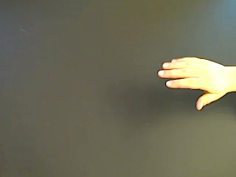
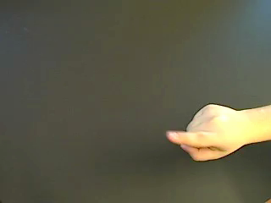
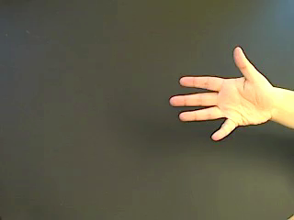
Dataset
90 positive (simulating tremor), 83 negative
Static camera, 30 fps
Indoors, static background
6 human subjects
Notes:
Negative (ordinary movements)
Some videos contain challenging movements or very subtle motions

Slide 9
Classification
with SVM
Personalized Skin Detection & Blob Extraction
Optical Flow Calculation & Feature Extraction
% of MDC Features from Hand Region | LOOCV
10 % | 79.2 %
10 % with MDL discretization | 89.6 %
25 % | 86.7 %
25 % with MDL discretization | 95.4 %

Slide 10
Discussion
Requires a single short video, minimizes diagnostic discomfort
Automatically detects hand tremors with 95.4% accuracy using LOOCV
Distinguishes very subtle motions and tremor-like movements from tremors
False negative rate is close to zero
Notes:
, such as tapping fingers or waving hand very quickly, from tremor movements.
Although tremor detection is a hard problem, in this pilot study, with the described methodology a
A dataset of simulated tremor/non-tremor hand motions is prepared and the methodology tested on that.
False negatives are close to zero, which means, tremors are detected almost 100%.
The error usually results from false positives, which means false signaling of tremor.
The negative dataset consists of many challenging videos. This is good for handling real cases.
It’s probable that the highly accurate segmentation of the videos has also contributed to this high accuracy.

