Slide 1
Pattern Recognition
Pattern recognition is:
1. The name of the journal of the Pattern Recognition
Society.
2. A research area in which patterns in data are
found, recognized, discovered, …whatever.
3. A catchall phrase that includes
classification
clustering
data mining
….

Slide 2
Two Schools of Thought
Statistical Pattern Recognition
The data is reduced to vectors of numbers
and statistical techniques are used for
the tasks to be performed.
2. Structural Pattern Recognition
The data is converted to a discrete structure
(such as a grammar or a graph) and the
techniques are related to computer science
subjects (such as parsing and graph matching).

Slide 3
In this course
1. How should objects to be classified be
represented?
2. What algorithms can be used for recognition
(or matching)?
3. How should learning (training) be done?

Slide 4
Classification in Statistical PR
A class is a set of objects having some important
properties in common
A feature extractor is a program that inputs the
data (image) and extracts features that can be
used in classification.
A classifier is a program that inputs the feature
vector and assigns it to one of a set of designated
classes or to the “reject” class.
What kinds of object classes?

Slide 5
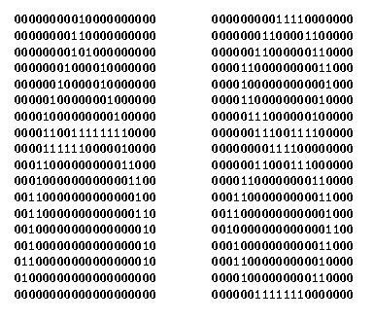
Feature Vector Representation
X=[x1, x2, … , xn], each xj a real number
xj may be an object measurement
xj may be count of object parts
Example: object rep. [#holes, #strokes, moments, …]

Slide 6
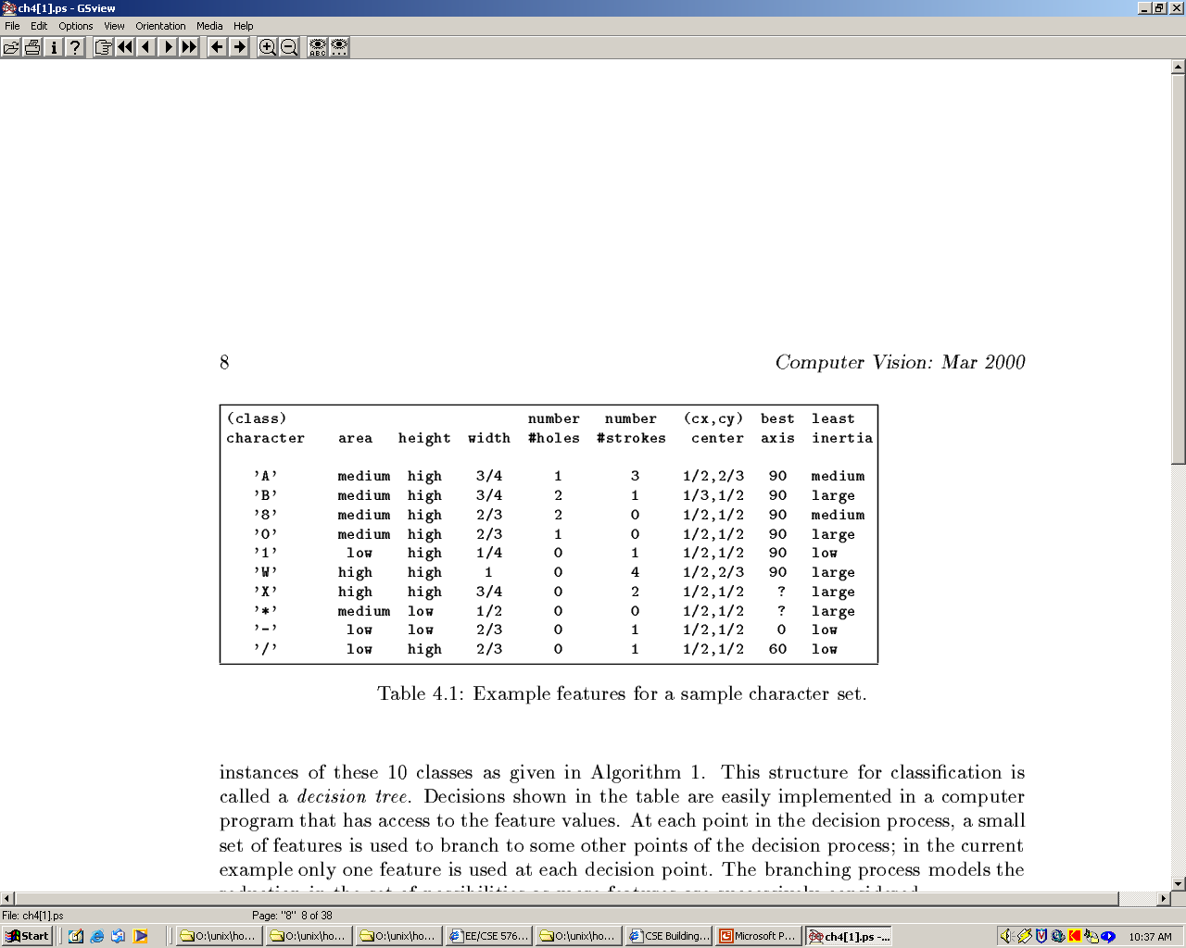
Possible features for char rec.

Slide 7
Some Terminology
Classes: set of m known categories of objects
(a) might have a known description for each
(b) might have a set of samples for each
Reject Class:
a generic class for objects not in any of
the designated known classes
Classifier:
Assigns object to a class based on features

Slide 8
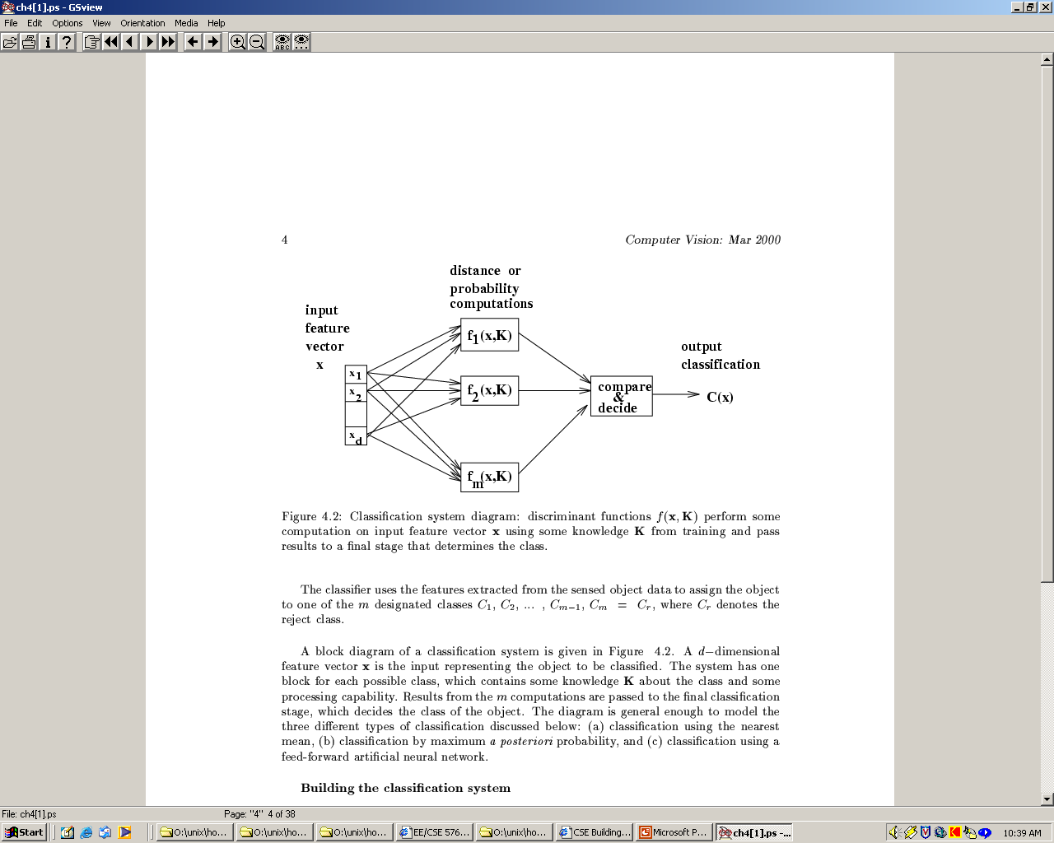
Discriminant functions
Functions f(x, K) perform some computation on feature vector x
Knowledge K from training or programming is used
Final stage determines class

Slide 9
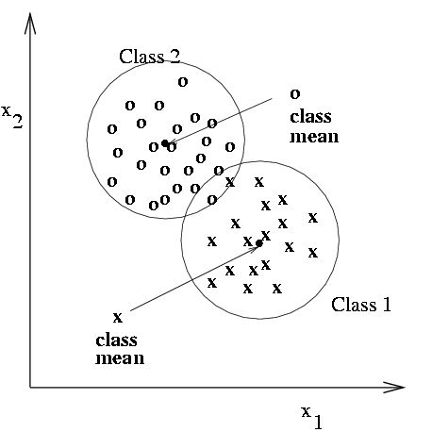
Classification using nearest class mean
Compute the Euclidean distance between feature vector X and the mean of each class.
Choose closest class, if close enough (reject otherwise)

Slide 10
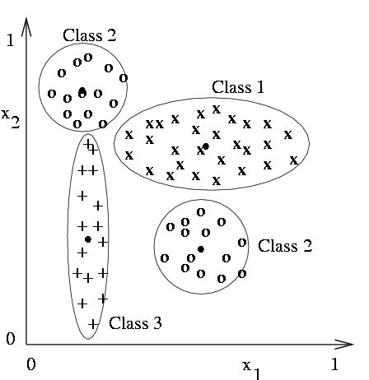
Nearest mean might yield poor results with complex structure
Class 2 has two modes; where is
its mean?
But if modes are detected, two subclass mean vectors can be used

Slide 11
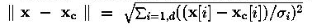
Scaling coordinates by std dev
We can compute a modified distance from
feature vector x to class mean vector x
by scaling by the spread or standard deviation
σ of class c along each dimension i.
scaled Euclidean distance from x to class mean x
c
i
c

Slide 12
Nearest Mean
What’s good about the nearest mean approach?

Slide 13
Nearest Neighbor Classification
Keep all the training samples in some efficient
look-up structure.
Find the nearest neighbor of the feature vector
to be classified and assign the class of the neighbor.
Can be extended to K nearest neighbors.

Slide 14
Nearest Neighbor
Pros
Cons

Slide 15
Evaluating Results
We need a way to measure the performance of any classification task.
Binary classifier: Face or not Face
  We can talk about true positives, false positives, true negatives, false negatives
Multiway classifier: ‘a’ or ‘b’ or ‘c’ .....
  For each class, what percentage correct and what percentage for each of the wrong classes

Slide 16
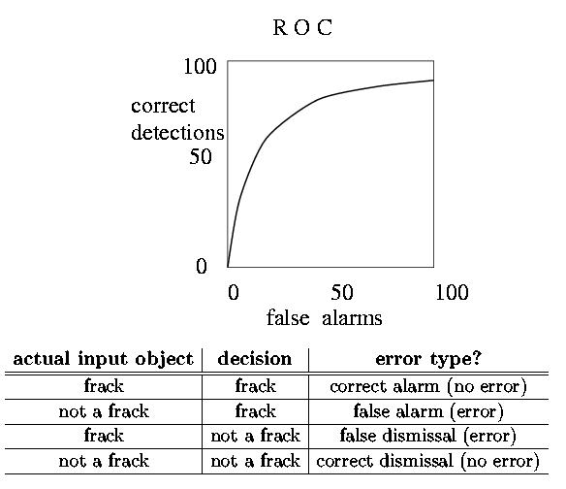
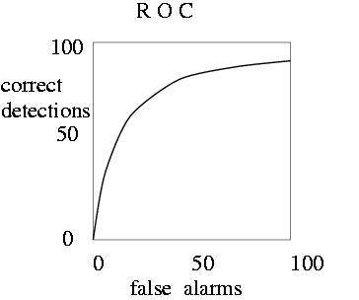
Receiver Operating Curve ROC
Plots correct detection rate versus false alarm rate
Generally, false alarms go up with attempts to detect higher percentages of known objects

Slide 17
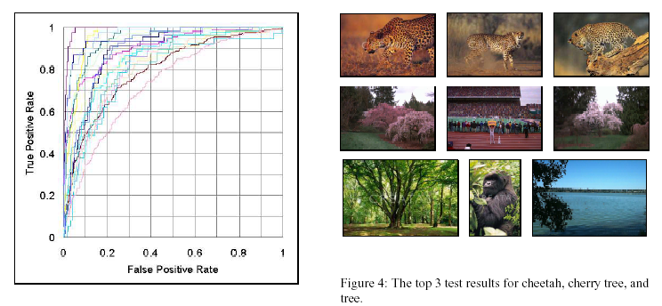
An ROC from our work:

Slide 18
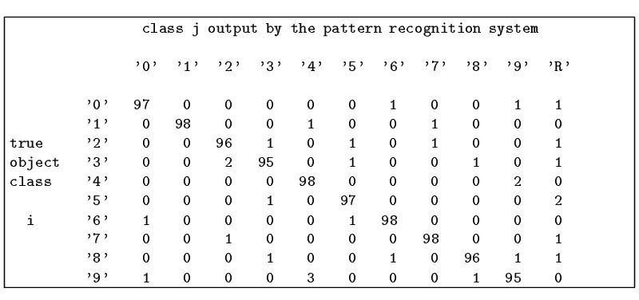
Confusion matrix shows empirical performance for multiclass problems
Confusion may be unavoidable between some classes,
for example, between 9’s and 4’s.

Slide 19
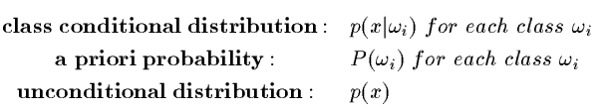

Bayesian decision-making
Classify into class w that is most likely based on
observations X. The following distributions are
needed.
Then we have:

Slide 20
Classifiers often used in CV
Decision Tree Classifiers
Artificial Neural Net Classifiers
Bayesian Classifiers and Bayesian Networks
(Graphical Models)
Support Vector Machines

Slide 21
Decision Trees
#holes
0
2
1
moment of
inertia
#strokes
#strokes
< t
≥ t
0
1
best axis
direction
#strokes
0
1
0
90
2
4
60
- / 1 x w 0 A 8 B

Slide 22
Decision Tree Characteristics
Training
How do you construct one from training data?
Entropy-based Methods
2. Strengths
Easy to Understand
3. Weaknesses
Overtraining

Slide 23
Entropy-Based Automatic Decision Tree Construction
Training Set S
x₁=(f₁₁,f₁₂,…f_{1m})
x₂=(f₂₁,f₂₂, f_{2m})
.
.
x_{n}=(f_{n1},f₂₂, f_{2m})
Node 1
What feature
should be used?
What values?
Quinlan suggested information gain in his ID3 system
and later the gain ratio, both based on entropy.
We’ll look at a variant called information content.

Slide 24
Entropy
Given a set of training vectors S, if there are c classes,
Entropy(S) = ∑ -p_{i} log (p_{i})
Where p_{i} is the proportion of category i examples in S.
c
i=1
2
If all examples belong to the same category, the entropy
is 0 (no discrimination).
The greater the discrimination power, the larger the
entropy will be.

Slide 25
Entropy
Two class problem: class I and class II
Suppose ½ the set belongs to class I and ½ belongs to class II?
Then
entropy = -½ log₂ ½ -½ log₂ ½
= (-½) (-1) -½ (-1)
= 1

Slide 26
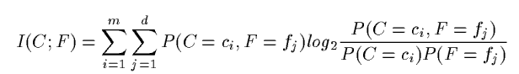
Information Content
The information content I(C;F) of the class variable C
with possible values {c₁, c₂, … c_{m}} with respect to
the feature variable F with possible values {f₁, f₂, … , f_{d}}
is defined by:
P(C = c_{i}) is the probability of class C having value c_{i}.
P(F=f_{j}) is the probability of feature F having value f_{j}.
P(C=c_{i},F=f_{j}) is the joint probability of class C = c_{i}
and variable F = f_{j}.
These are estimated from frequencies in the training data.

Slide 27
Example (from text)
X Y Z C
1 1 I
1 1 0 I
0 0 1 II
1 0 0 II
How would you distinguish class I from class II?

Slide 28
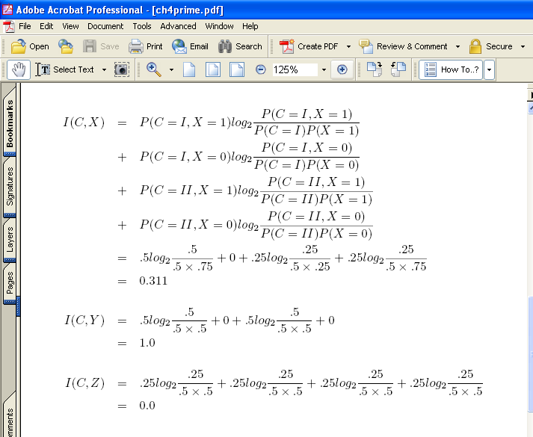
Example (cont)

Slide 29
Using Information Content
Start with the root of the decision tree and the whole
training set.
Compute I(C,F) for each feature F.
Choose the feature F with highest information
content for the root node.
Create branches for each value f of F.
On each branch, create a new node with reduced
training set and repeat recursively.

Slide 30
Using Information Content
X Y Z C
1 1 1 I
1 1 0 I
0 0 1 II
1 0 0 II
What would the optimal tree look like for features X, Y, and Z and class I and II in the small example?

Slide 31
Artificial Neural Nets
Artificial Neural Nets (ANNs) are networks of
artificial neuron nodes, each of which computes
a simple function.
An ANN has an input layer, an output layer, and
“hidden” layers of nodes.
.
.
.
.
.
.
Outputs
Inputs

Slide 32
Node Functions
a1
a2
aj
an
w(1,i)
neuron i
output
w(j,i)
output = g (∑ aj * w(j,i) )
Function g is commonly a step function, sign function,
or sigmoid function (see text).

Slide 33
Neural Net Learning
That’s beyond the scope of this text; only
simple feed-forward learning is covered.
The most common method is called back propagation.
We’ve used a free package called NevProp or just
The WEKA machine learning package.

Slide 34
Convolutional Neural Nets
CNNs were invented in the 90s, but they have returned and become very popular in computer vision in the last few years, because they have been used to achieve higher than competitor accuracy on several benchmark data sets in object recognition.
They are related to “deep learning”.
They have multiple layers, some of them do convolutions instead of having full connections.

Slide 35
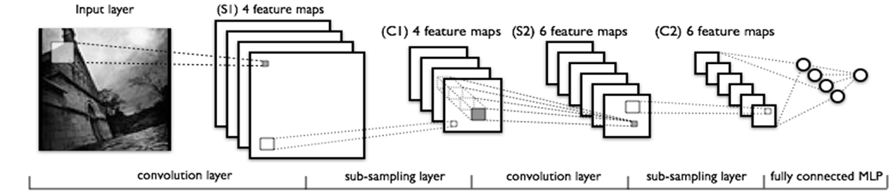
Simple CNN

Slide 36
Support Vector Machines (SVM)
Support vector machines are learning algorithms
that try to find a hyperplane that separates
the differently classified data the most.
They are based on two key ideas:
Maximum margin hyperplanes
A kernel ‘trick’.

Slide 37
Maximal Margin
1
Margin
0
1
1
0
0
1
Hyperplane
0
Find the hyperplane with maximal margin for all
the points. This originates an optimization problem
which has a unique solution (convex problem).

Slide 38
Non-separable data
0
1
0
0
0
1
1
0
1
0
1
0
1
0
1
1
0
0
0
1
0
What can be done if data cannot be separated with a
hyperplane?

Slide 39
The kernel trick
The SVM algorithm implicitly maps the original
data to a feature space of possibly infinite dimension
in which data (which is not separable in the
original space) becomes separable in the feature space.
Original space R^{k}
Feature space R^{n}
1
0
1
1
0
0
1
0
0
1
0
Kernel
trick
0
1
0
0
0
1
1

Slide 40
The kernel trick
What is this space?
The user defines it.
It’s usually a dot product space.
Example: If we have 2 vectors X and Y,
we can work with (X·Y) or exp(X· Y)

Slide 41
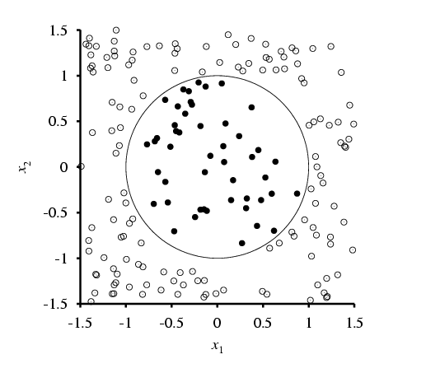
Example from AI Text
True decision boundary
is x₁² + x₂² < 1 .
For this problem F(x_{i}) • F(x_{j}) is just (x_{i} • x_{j})^{2,}
which is called a kernel function.

Slide 42
Application
Sal Ruiz used support vector machines in his
work on 3D object recognition.
He trained classifiers on data representing deformations
of a 3D model of a class of objects.
The classifiers learned what kinds of surface patches
are related to key parts of the model
(ie. A snowman’s face)

Slide 43
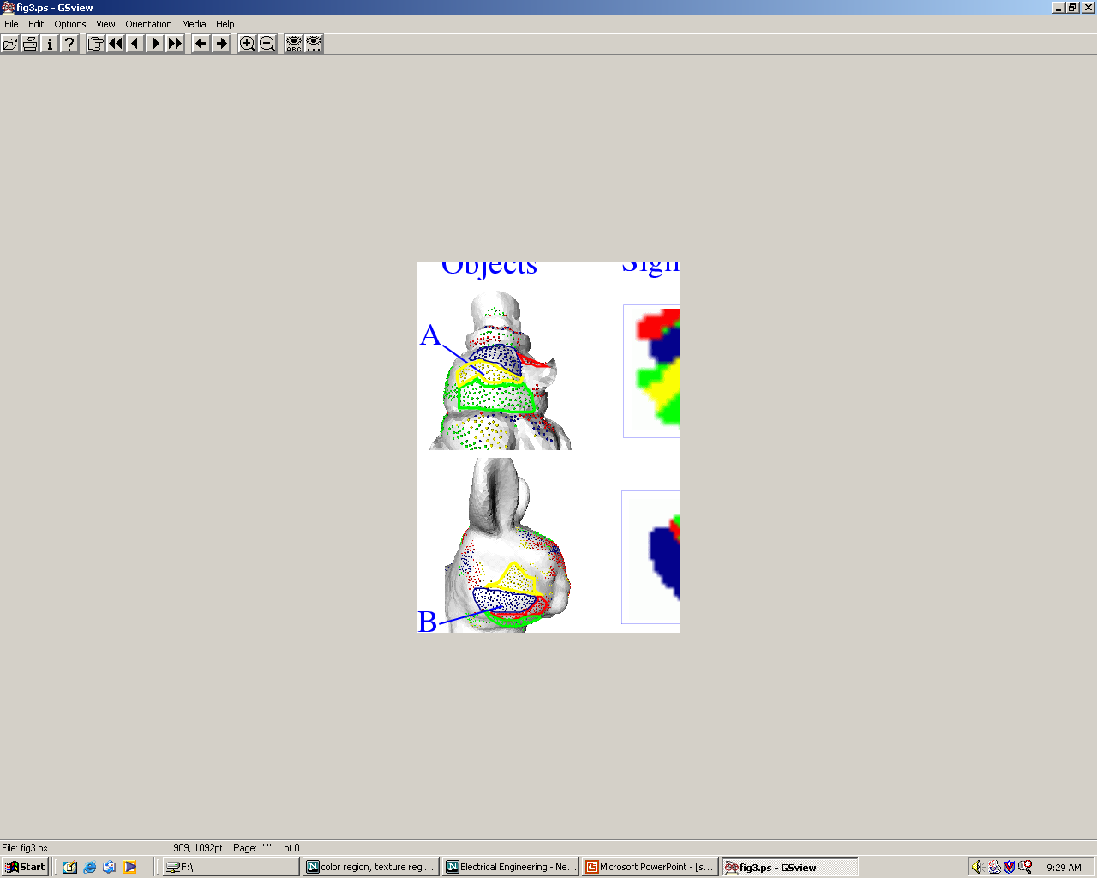
Kernel Function used in our 3D Computer Vision Work
k(A,B) = exp(-θ²_{AB}/σ²)
A and B are shape descriptors (big vectors).
θ is the angle between these vectors.
σ² is the “width” of the kernel.

Slide 44
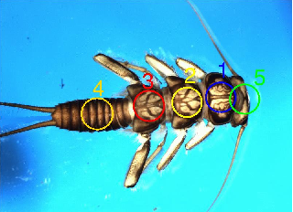
We used SVMs for Insect Recognition

Slide 45
EM for Classification
The EM algorithm was used as a clustering algorithm for image segmentation.
It can also be used as a classifier, by creating a Gaussian “model” for each class to be learned.

Slide 46
Summary
There are multiple kinds of classifiers developed in machine learning research.
We can use and have used pretty much all of them in computer vision classification, detection, and recognition tasks.

