Slide 1
Zoetrope: Interacting with the Ephemeral Web
Eytan Adar, Mira Dontcheva
James Fogarty, Dan Weld
University of Washington & Adobe Systems

Slide 2
The Dynamic Web
WWW

Slide 3
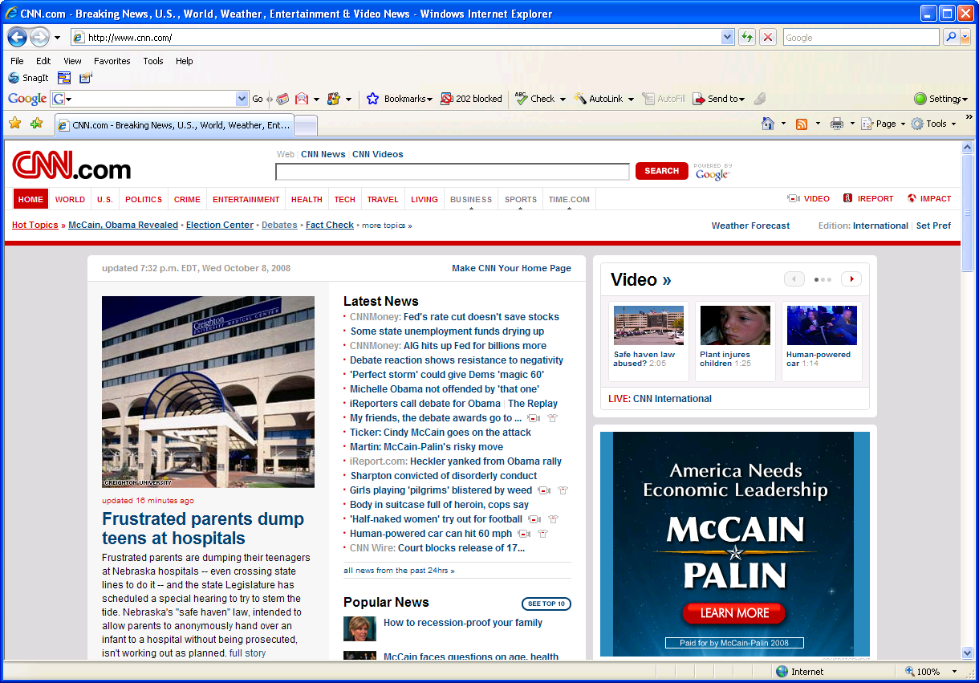
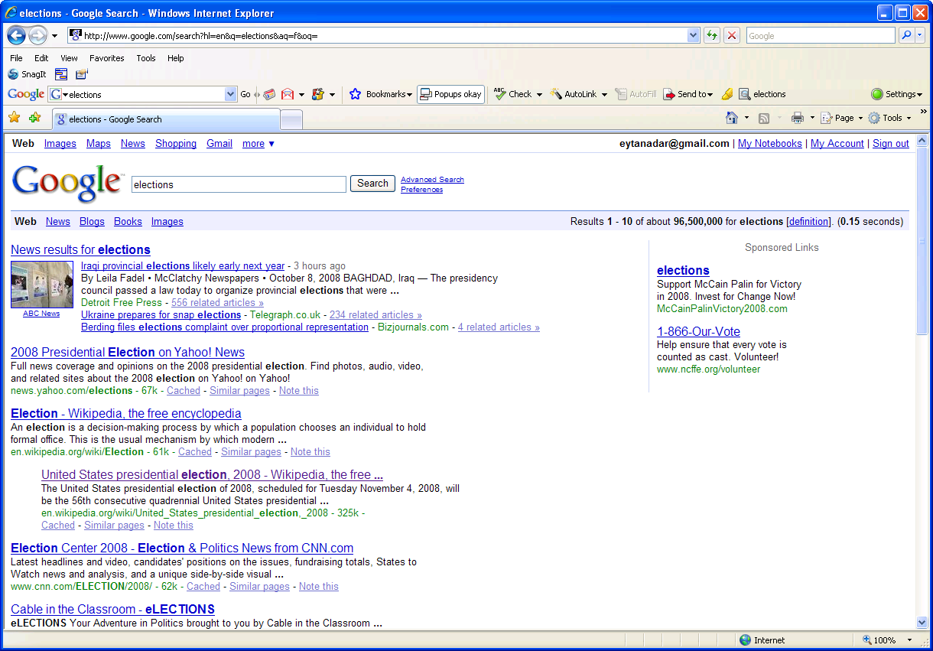
The Now Web
See the web through a browser of “now”
Access services through an index of “now”
Temporally insensitive
(ignore temporal context and historical values)

Slide 4
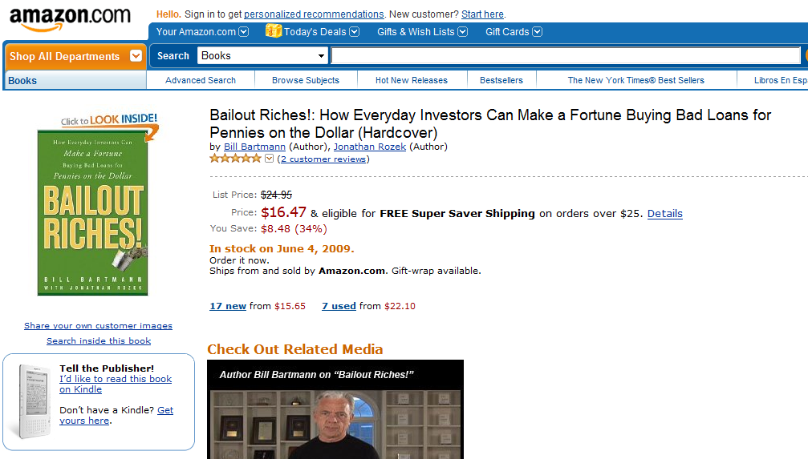
Is this really a good price?

Slide 5
Is this really a good price?
When is really the right time to buy?

Slide 6
What is the relationship between weather and traffic in Seattle?

Slide 7
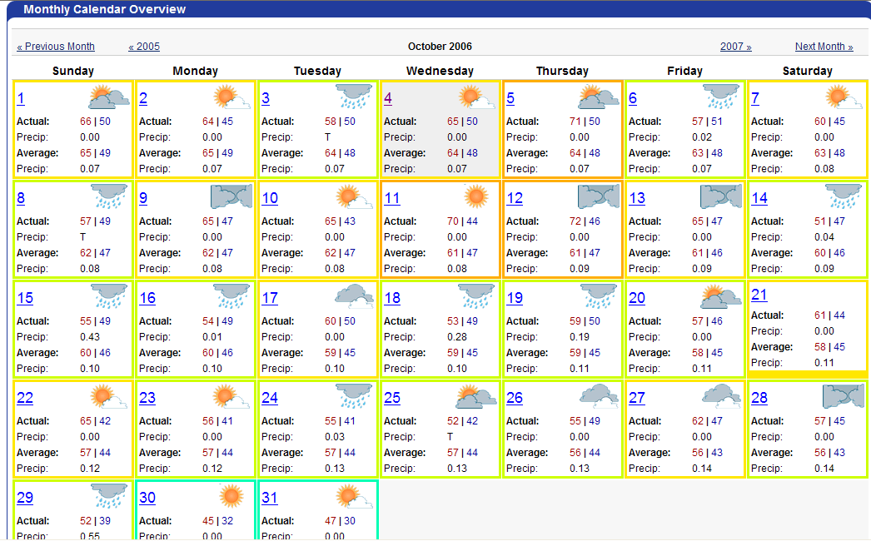
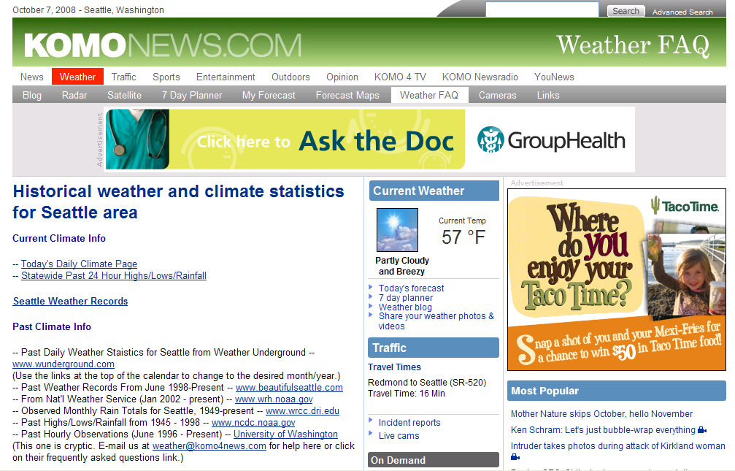
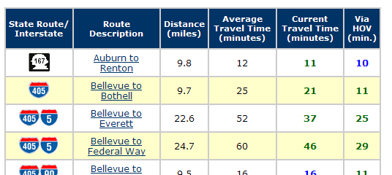
What is the relationship between
traffic and temperature in Seattle?
Manually collect, page by page
Now what?

Slide 8
traffic and temperature in Seattle?
an alternative…
Temp
t
Travel time
t

Slide 9
Related Work
Evolution of the Web
[Fetterly et al., WWW ‘03]
[Ntoulas et al., WWW ‘04]
Internet Archives
Photo

Slide 10
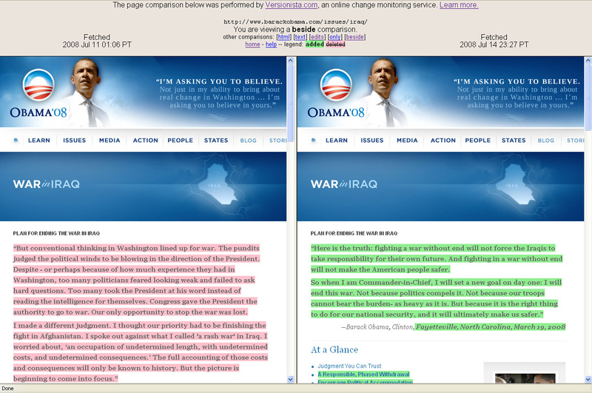
Related Work
Evolution of the Web
Monitoring
[Sugiura & Koseki, UIST ’98]
[Greenberg & Boyle, GI ‘06]
Photo

Slide 11
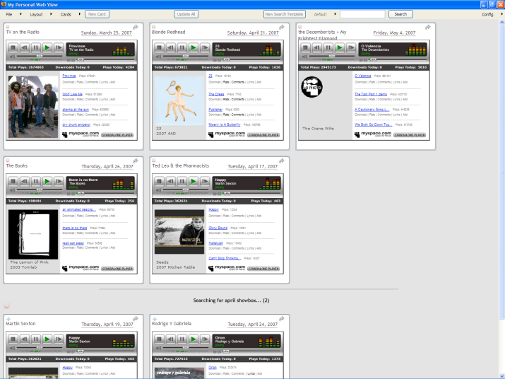
Related Work
Evolution of the Web
Monitoring
Clipping & Aggregating
[schraefel et al., WWW ‘02]
[Dontcheva et al., UIST ‘07]
Photo

Slide 12
Our Approach

Slide 13
Zoetrope Architecture
Zoetrope Front End
R₁
R₂
R₃
O₁
O₂
O₃
Zoetrope Engine
…
…
Data Store
XML/Images/Text/…
Web
Crawler

Slide 14
Content Streams & Operators
{… <T_{i} , C_{i}> , <T_{i+1} , C_{i+1}> , …}
Time stamp
Content (typed, but can be anything: HTML, images)

Slide 15
Content Streams & Operators
Input: Content Stream
Transform Operator
Filter Operator
Render Operator
{… <T_{i} , C_{i}> …}
Output: Content stream with modified data payloads (C_{i}’)
Output: Subset of Content Stream
Output: “Visual” Output

Slide 16
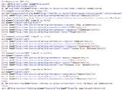
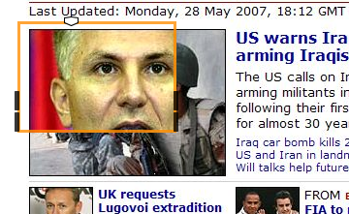
Construct everything from operators
Generate Images
Crop to Rectangle
Pick image based on slider
{… <T_{i} , C_{i}> …}
Render into lens
Lens, locked to coordinate

Slide 17
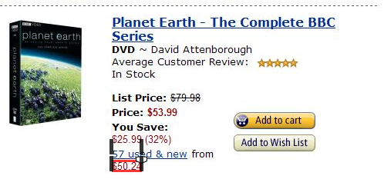
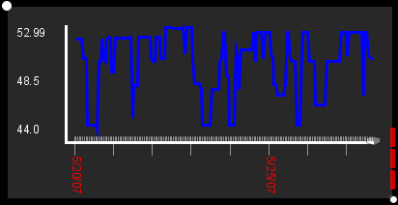
Construct everything from operators
44.10
<…> $44.10 <…>
<…> $50.20 <…>
49.10
43.10
<…> $4310 <…>
<…> $49.10 <…>
Select DOM forest
50.20
Extract numerical value
Render into time series
{… <T_{i} , C_{i}> …}

Slide 18
Lenses

Slide 19
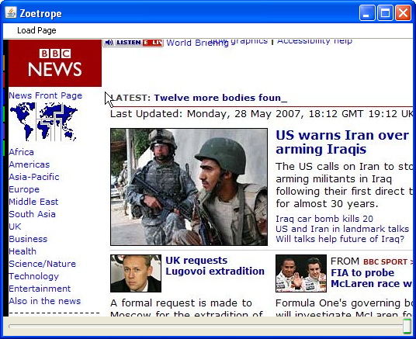
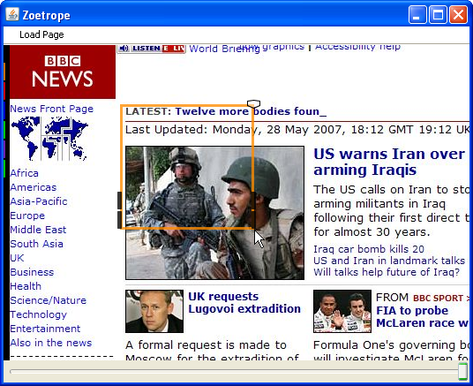
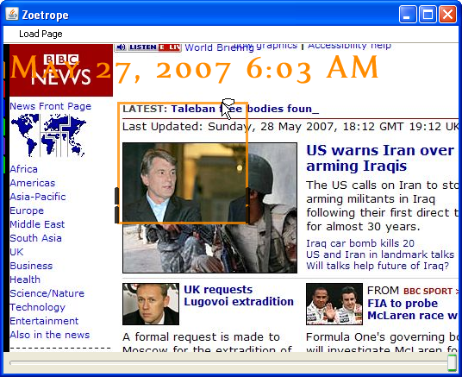
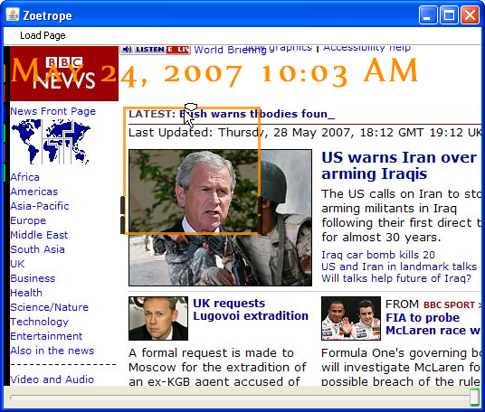
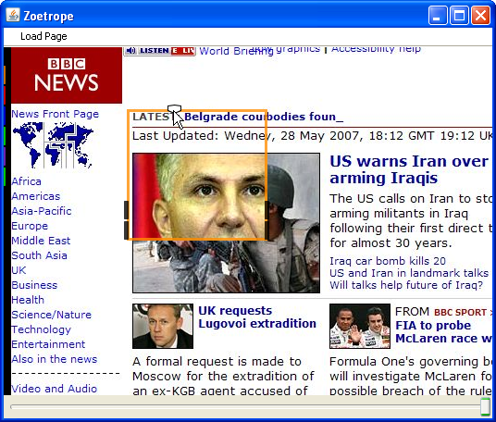
Visual (same place on screen)

Slide 20
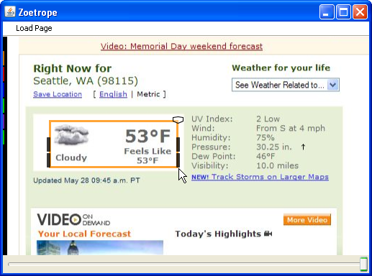
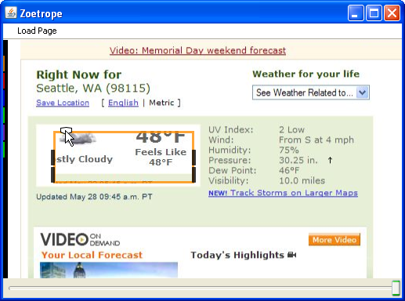
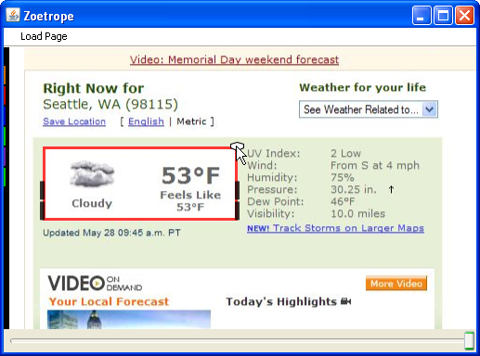
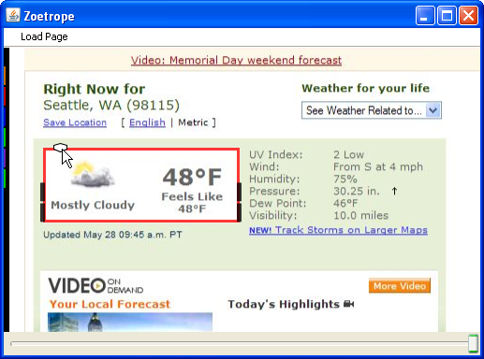
Structural (same place in HTML)
DOM Structure

Slide 21
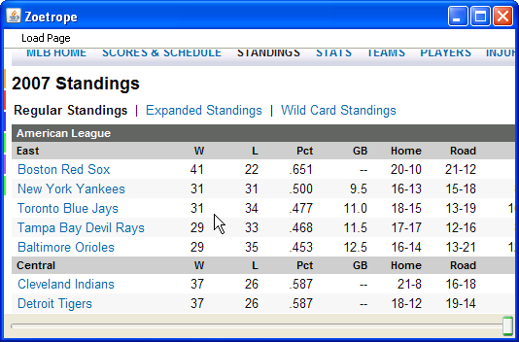
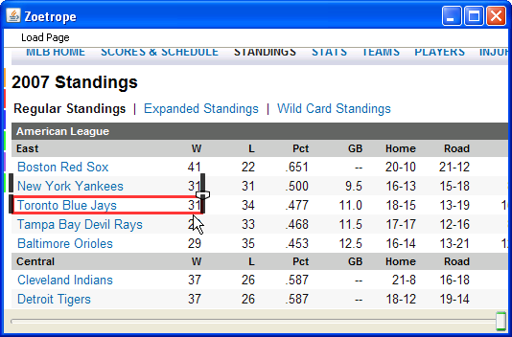
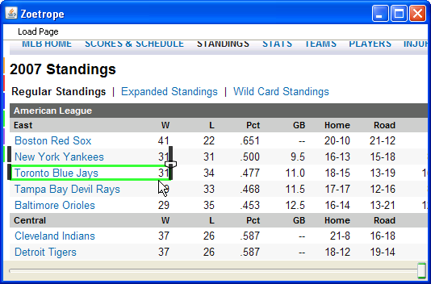
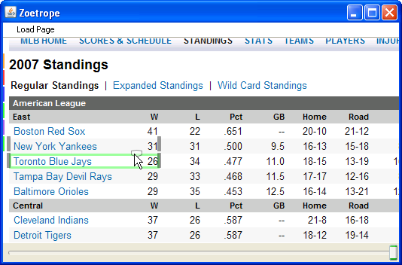
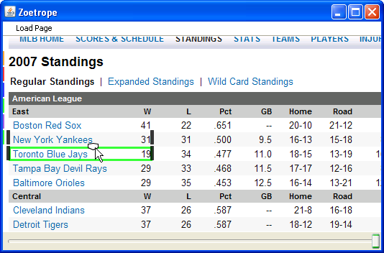
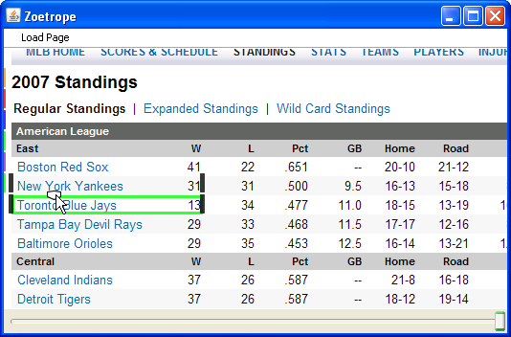
Content (same text)

Slide 22
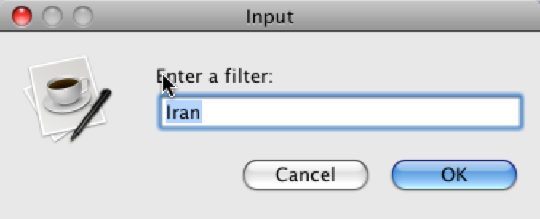
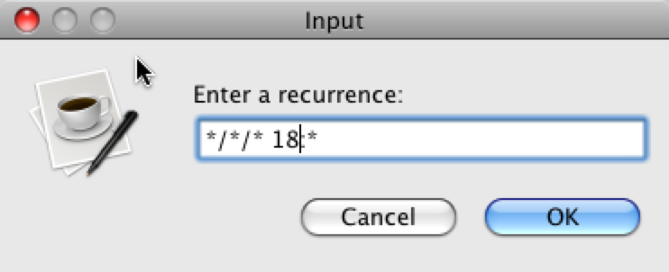
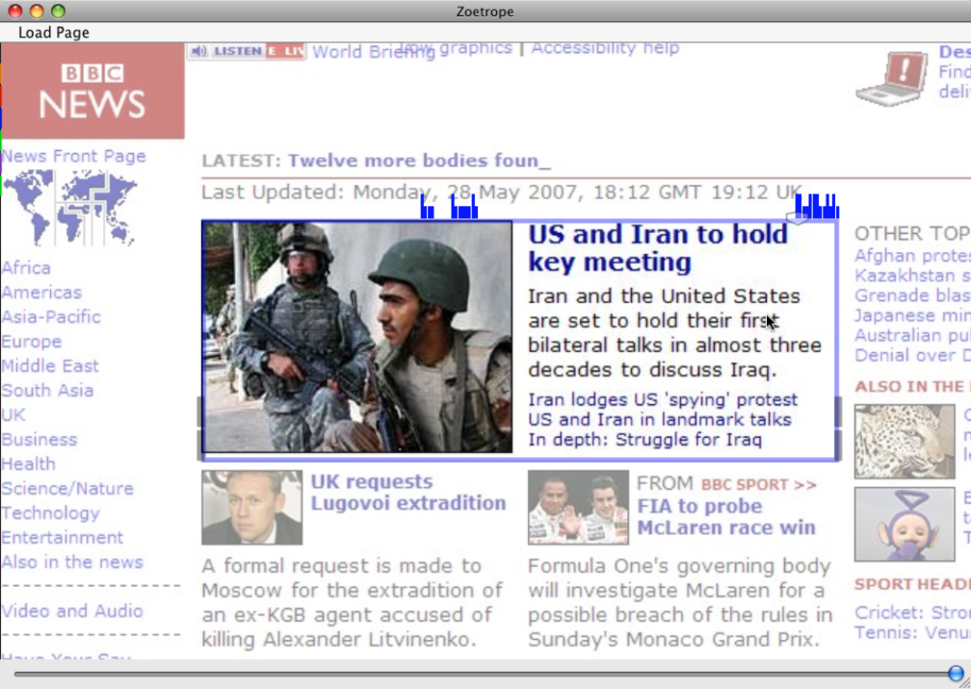
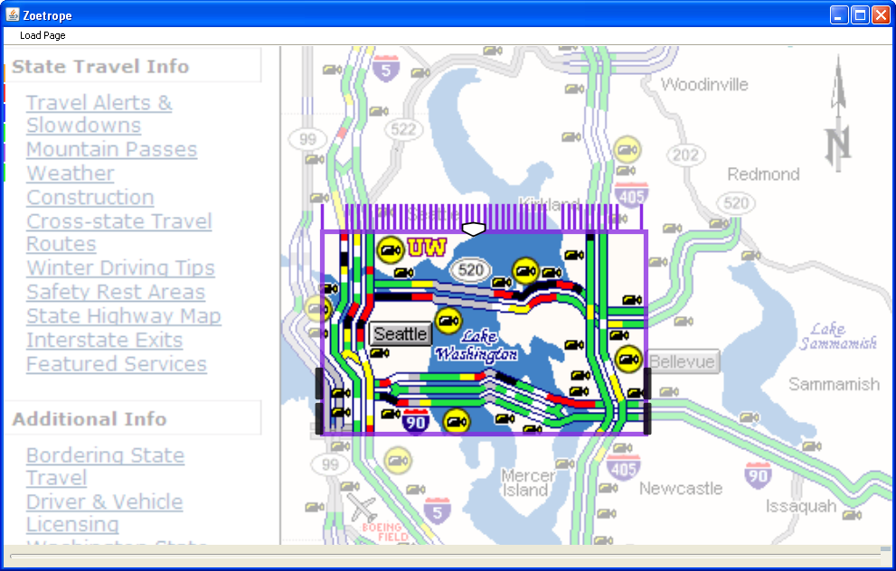
Filters

Slide 23
Renderers

Slide 24
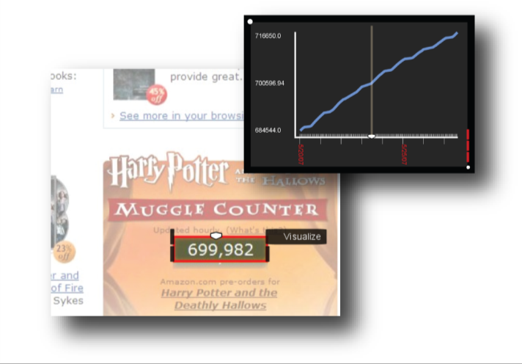

Slide 27
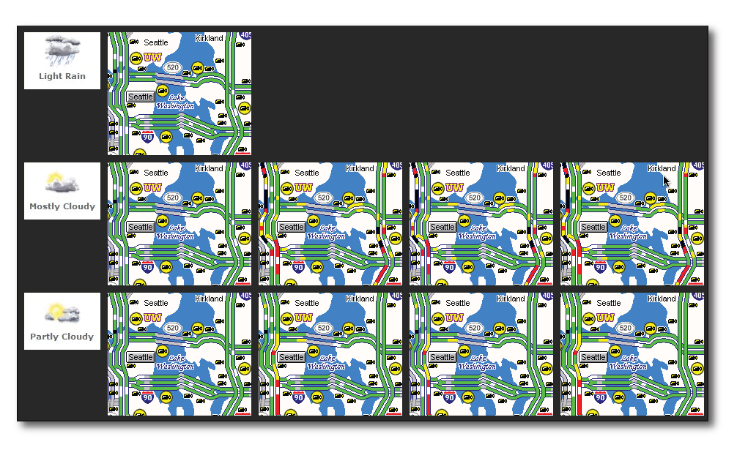
Binding Lenses

Slide 28
Demo

Slide 29
Contributions
Visual programming toolkit for temporal Web content
Semantics for temporal data streams
Operators for fast processing of temporal data streams
Indexing structures for fast processing and interaction with Web content over time

Slide 30
Future Work
Evaluation
User Study
Performance

Slide 31
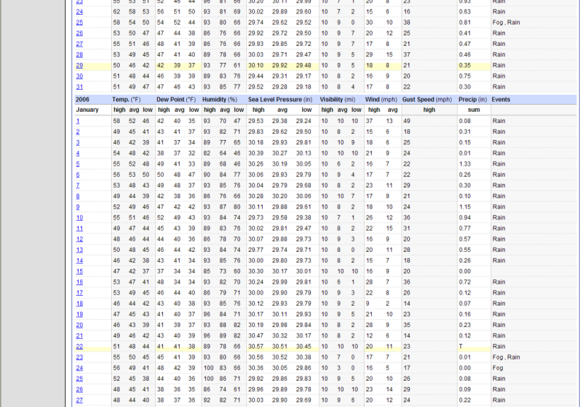
Future Work
Evaluation
User Study
Performance
Data gathering

Slide 32
Information Arbitrage
Combine observations to improve granularity
cnn.com
time
Weather.com

Slide 33
Future Work
Evaluation
User Study
Performance
Data gathering
Scaling up

Slide 34
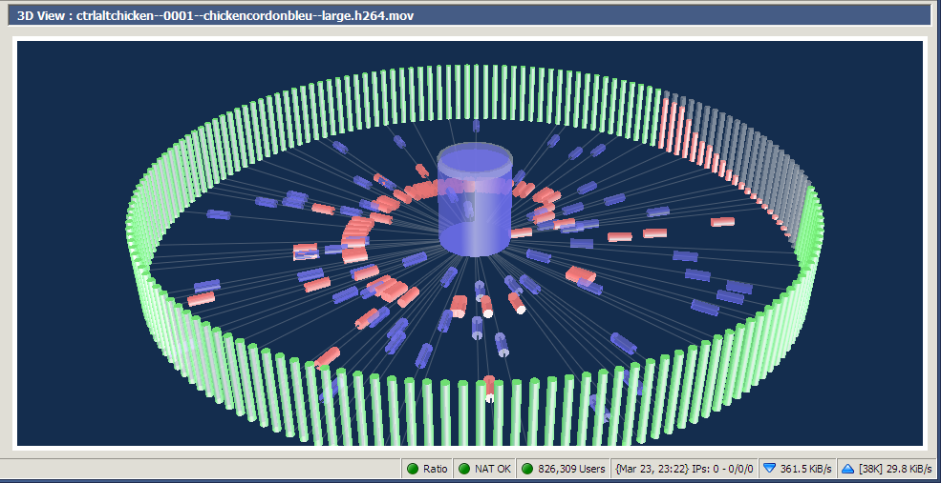
Possible Distributed Architecture
Server collects snapshots
Client collects finer resolution
Gaps?
DHT for collected data (good for intervals)
Query: operator chain + data
Release on similarity threshold
Repeat

Slide 35
Thanks!
Jaime Teevan, Susan Dumais, Rob Miller , GRAIL, DUB
NSF Graduate Fellowship, ARCS, WRF/TJ Cable Professorship
?

