Slide 1
Part-of-Speech Tagging & Parsing
Chloé Kiddon
(slides adapted and/or stolen outright from Andrew McCallum, Christopher Manning, and Julia Hockenmaier)

Slide 2
Announcements
We do have a Hadoop cluster!
It’s offsite. I need to know all groups who want it!
You all have accounts for MySQL on the cubist machine (cubist.cs.washington.edu)
Your folder is /projects/instr/cse454/a-f
I’ll have a better email out this afternoon I hope
Grading HW1 should be finished by next week.

Slide 3
Timely warning
POS tagging and parsing are two large topics in NLP
Usually covered in 2-4 lectures
We have an hour and twenty minutes. ☺

Slide 4
Part-of-speech tagging
Often want to know what part of speech (POS) or word class (noun,verb,…) should be assigned to words in a piece of text
Part-of-speech tagging assigns POS labels to words
JJ JJ NNS VBP RB
Colorless green ideas sleep furiously.
Notes:
Second line first. Why?

Slide 5
Why do we care?
Parsing (come to later)
Speech synthesis
INsult or inSULT, overFLOW or OVERflow,
REad or reAD
Information extraction: entities, relations
Romeo loves Juliet vs. lost loves found again
Machine translation

Slide 6
Penn Treebank Tagset
1. CC Coordinating conjunction
2. CD Cardinal number
3. DT Determiner
4. EX Existential there
5. FW Foreign word
6. IN Preposition or subordinating
conjunction
7. JJ Adjective
8. JJR Adjective, comparative
9. JJS Adjective, superlative
10. LS List item marker
11. MD Modal
12. NN Noun, singular or mass
13. NNS Noun, plural
14. NP Proper noun, singular
15. NPS Proper noun, plural
16. PDT Predeterminer
17. POS Possessive ending
18. PP Personal pronoun
19. PP$ Possessive pronoun
20. RB Adverb
21. RBR Adverb, comparative
22. RBS Adverb, superlative
23. RP Particle
24. SYM Symbol
25. TO to
26. UH Interjection
27. VB Verb, base form
28. VBD Verb, past tense
29. VBG Verb, gerund or
present participle
30. VBN Verb, past participle
31. VBP Verb, non-3rd person
singular present
32. VBZ Verb, 3rd person
singular present
33. WDT Wh-determiner
34. WP Wh-pronoun
35. WP$ Possessive wh-pronoun
36. WRB Wh-adverb
Notes:
1992

Slide 7
Ambiguity
Buffalo buffalo buffalo.
Notes:
What makes this task hard?
THE buffalo FROM Buffalo WHO ARE buffaloed BY buffalo FROM Buffalo ALSO buffalo THE buffalo FROM Buffalo.

Slide 8
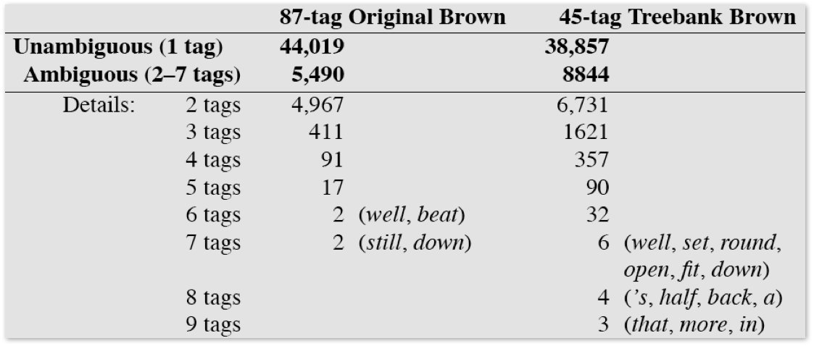
How many words are ambiguous?
Hockenmaier
Notes:
These are just the tags words appeared with in the corpus. There may be unseen word/tag combinations.
The main problem in the task of part of speech tagging is how to differentiate between the tags for ambiguous words

Slide 9
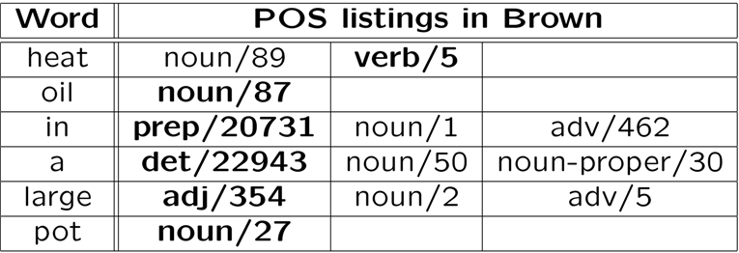
Naïve approach!
Pick the most common tag for the word
91% success rate!
Andrew McCallum

Slide 10
We have more information
We are not just tagging words, we are tagging sequences of words
For a sequence of words W:
W = w₁w₂w₃…w_{n}
We are looking for a sequence of tags T:
T = t₁ t₂ t₃ … t_{n}
where P(T|W) is maximized
Andrew McCallum

Slide 11
In an ideal world…
Find all instances of a sequence in the dataset and pick the most common sequence of tags
Count(“heat oil in a large pot”) = 0 ????
Uhh…
Spare data problem
Most sequences will never occur, or will occur too few times for good predictions

Slide 12
Bayes’ Rule
To find P(T|W), use Bayes’ Rule:
We can maximize P(T|W) by maximizing
P(W|T)*P(T)
Andrew McCallum
Notes:
? What is Bayes rule?
P(W) won’t change. Words don’t change.

Slide 13
Finding P(T)
Generally,
Usually not feasible to accurately estimate more than tag bigrams (possibly trigrams)
Notes:
In some way (supervised or unsupervised, we are going to need to learn these probabilities.

Slide 14
Markov assumption
Assume that the probability of a tag only depends on the tag that came directly before it
Then,
Only need to count tag bigrams.

Slide 15
Putting it all together
We can similarly assume
So:
And the final equation becomes:

Slide 16
Process as an HMM
Start in an initial state t₀ with probability π(t₀)
Move from state t_{i} to t_{j} with transition probability a(t_{j}|t_{i})
In state t_{i}, emit symbol w_{k} with emission probability b(w_{k}|t_{i})
.02
.3
.3
Det
.47
Adj
.6
Noun
.7
Verb
.51
.1
P(w|Det)
P(w|Adj)
P(w|Noun)
a
.4
good
.02
price
.001
the
.4
low
.04
deal
.0001

Slide 17
Three Questions for HMMs
Evaluation – Given a sequence of words W = w₁w₂w₃…w_{n} and an HMM model Θ, what is P(W|Θ)
Decoding – Given a sequence of words W and an HMM model Θ, find the most probable parse T = t₁ t₂ t₃ … t_{n}
Learning – Given a tagged (or untagged) dataset, find the HMM Θ that maximizes the data
Notes:
? Remember the three questions

Slide 18
Three Questions for HMMs
Evaluation – Given a sequence of words W = w₁w₂w₃…w_{n} and an HMM model Θ, what is P(W|Θ)
Tagging – Given a sequence of words W and an HMM model Θ, find the most probable parse T = t₁ t₂ t₃ … t_{n}
Learning – Given a tagged (or untagged) dataset, find the HMM Θ that maximizes the data
Notes:
? Remember the three questions

Slide 19
Tagging
Need to find the most likely tag sequence given a sequence of words
maximizes P(W|T)*P(T) and thus P(T|W)
Use Viterbi!

Slide 20
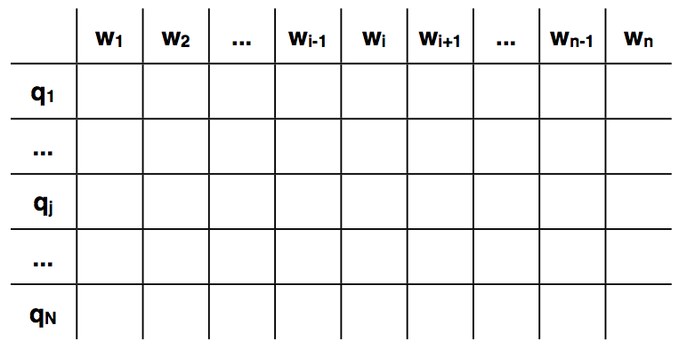
Trellis
Evaluation Task:
P(w₁,w₂,…,w_{i}) given in t_{j} at time i
t₁
Decoding Task:
max P(w₁,w₂,…,w_{i}) given in t_{j} at time i
Decoding Task:
tags
t_{j}
t_{N}
time steps
Notes:
At every one of the n time steps (=words), the HMM can be in one of N states (=tags)

Slide 21
Trellis
Evaluation Task:
P(w₁,w₂,…,w_{i}) given in t_{j} at time i
t₁
Decoding Task:
max log P(w₁,w_{2,}…,w_{i}) given in t_{j} at time i
tags
t_{j}
t_{N}
time steps
Notes:
At every one of the n time steps (=words), the HMM can be in one of N states (=tags)

Slide 22
Tagging initialization
t₁
tags
= log P(w₁|t_{j}) + log P(t_{j})
t_{j}
t_{N}
time steps
Notes:
At every one of the n time steps (=words), the HMM can be in one of N states (=tags)

Slide 23
Tagging recursive step
t₁
tags
t_{j}
t_{N}
time steps
Notes:
At every one of the n time steps (=words), the HMM can be in one of N states (=tags)

Slide 24
Tagging recursive step
t₁
tags
t_{j}
t_{N}
time steps
Notes:
At every one of the n time steps (=words), the HMM can be in one of N states (=tags)

Slide 25
Pick best trellis cell for last word
t₁
tags
t_{j}
t_{N}
time steps
Notes:
At every one of the n time steps (=words), the HMM can be in one of N states (=tags)

Slide 26
Use back pointers to pick best sequence
t₁
tags
t_{j}
t_{N}
time steps
Notes:
At every one of the n time steps (=words), the HMM can be in one of N states (=tags)

Slide 27
Learning a POS-tagging HMM
Estimate the parameters in the model using counts
With smoothing, this model can get 95-96% correct tagging
Notes:
With models of 40-80 tags

Slide 28
Problem with supervised learning
Requires a large hand-labeled corpus
Doesn’t scale to new languages
Expensive to produce
Doesn’t scale to new domains
Instead, apply unsupervised learning with Expectation Maximization (EM)
Expectation step: calculate probability of all sequences using set of parameters
Maximization step: re-estimate parameters using results from E-step
Notes:
? reasons
Expensive to produce in both time and money. Unless get undergrads to do the tagging.
Compute the forward and backward probabilities for given model parameters and our observations
With EM, you need to know your tagset beforehand

Slide 29
Lots of other techniques!
Trigram models (more common)
Text normalization
Error-based transformation learning
(“Brill learning”)
Rule-based system
Calculate initial states: proper noun detection, tagged corpus
Acquire transformation rules
Change VB to NN when prev word was adjective
The long race finally ended
Minimally supervised learning
Unlabeled data but have a dictionary

Slide 30
Seems like POS-tagging is solved
Penn Treebank POS-tagging accuracy ≈ human ceiling
Human agreement 97%
In other languages, not so much
Notes:
Interannotator agreement
Other languages with more complex morphology need much larger tagsets for tagging to be useful, and will contain many more distinct word forms in corpora of the same size

Slide 31
So now we are HMM Masters
We can use HMMs to…
Tag words in a sentence with their parts of speech
Extract entities and other information from a sentence
Can we use them to determine syntactic categories?

Slide 32
Syntax
Refers to the study of the way words are arranged together, and the relationship between them.
Prescriptive vs. Descriptive
Goal of syntax is to model the knowledge of that people unconsciously have about the grammar of their native language
Parsing extracts the syntax from a sentence
Notes:
? Pres vs desc?
That was an epic fail
Cs getting too mainstream ? Star trek intro: to boldly go where no man has gone before.
A precise way to define and describe the structure of sentences.

Slide 33
Parsing applications
High-precision Question-Answering systems
Named Entity Recognition (NER) and information extraction
Opinion extraction in product reviews
Improved interaction during computer applications/games
Notes:
Fill in examples

Slide 34
Basic English sentence structure
Ike
eats
cake
Noun
(subject)
Noun
(object)
Verb
(head)
Hockenmaier

Slide 35
Can we build an HMM?
Noun
(subject)
Verb
(head)
Noun
(object)
Ike, dogs, …
eat, sleep, …
cake, science, …
Hockenmaier

Slide 36
Words take arguments
I eat cake. ☺
I sleep cake. ☹
I give you cake. ☺
I give cake. Hmm…
I eat you cake??? ☹☹
Subcategorization
Intransitive verbs: take only a subject
Transitive verbs: take a subject and an object
Ditransitive verbs: take a subject, object, and indirect object
Selectional preferences
The object of eat should be edible
Hockenmaier

Slide 37
A better model
Transitive Verb
(head)
Noun
(subject)
Noun
(object)
eat, like, …
Intransitive Verb
(head)
Ike, dogs, …
cake, science, …
sleep, run, …
Hockenmaier

Slide 38
Language has recursive properties
Coronel Mustard killed Mrs. Peacock
*
Coronel Mustard killed Mrs. Peacock in the library
*
Coronel Mustard killed Mrs. Peacock in the library with the candlestick
*
Coronel Mustard killed Mrs. Peacock in the library with the candlestick at midnight
Noun
Preposition

Slide 39
HMMs can’t generate hierarchical structure
Coronel Mustard killed Mrs. Peacock in the library with the candlestick at midnight.
Does Mustard have the candlestick?
Or is the candlestick just sitting in the library?
Memoryless
Can’t make long range decisions about attachments
Need a better model

Slide 40
Words work in groups
Constituents – words or groupings of words that function as single units
Noun phrases (NPs)
The computer science class
Peter, Paul, and Mary
PAC10 Schools, such as UW,
He
The reason I was late
Notes:
? How can you tell that something is a noun phrase

Slide 41
Words work in groups
Constituents – words or groupings of words that function as single units
Noun phrases (NPs)
The computer science class listened …
Peter, Paul, and Mary sing …
PAC10 Schools, such as UW, dominate …
He juggled …
The reason I was late was …
*the listened
*such sing
*late was
NPs can appear before a verb.

Slide 42
Many different constituents
S - simple declarative clause
SBAR - Clause introduced by a (possibly empty) subordinating conjunction
SBARQ - Direct question introduced by a wh-word or a wh-phrase
SINV - Inverted declarative sentence
SQ - Inverted yes/no question, or main clause of a wh-question
ADJP - Adjective Phrase.
ADVP - Adverb Phrase.
CONJP - Conjunction Phrase.
FRAG - Fragment.
INTJ - Interjection.
LST - List marker.
NAC - Not a Constituent; used to show the scope of certain prenominal modifiers within an NP.
NP - Noun Phrase.
NX - Used within certain complex NPs to mark the head of the NP. Corresponds very roughly to N-bar level but used quite differently.
PP - Prepositional Phrase.
PRN - Parenthetical.
PRT - Particle.
QP - Quantifier Phrase (i.e. complex measure/amount phrase); used within NP.
RRC - Reduced Relative Clause.
UCP - Unlike Coordinated Phrase.
VP - Vereb Phrase.
WHADJP - Wh-adjective Phrase.
WHAVP - Wh-adverb Phrase.
WHNP - Wh-noun Phrase.
WHPP - Wh-prepositional Phrase.
X - Unknown, uncertain, or unbracketable. X is often used for bracketing typos and in bracketing the...the-constructions.

Slide 43
Many different constituents
1. CC Coordinating conjunction
2. CD Cardinal number
3. DT Determiner
4. EX Existential there
5. FW Foreign word
6. IN Preposition or subordinating
conjunction
7. JJ Adjective
8. JJR Adjective, comparative
9. JJS Adjective, superlative
10. LS List item marker
11. MD Modal
12. NN Noun, singular or mass
13. NNS Noun, plural
14. NP Proper noun, singular
15. NPS Proper noun, plural
16. PDT Predeterminer
17. POS Possessive ending
18. PP Personal pronoun
19. PP$ Possessive pronoun
20. RB Adverb
21. RBR Adverb, comparative
22. RBS Adverb, superlative
23. RP Particle
24. SYM Symbol
25. TO to
26. UH Interjection
27. VB Verb, base form
28. VBD Verb, past tense
29. VBG Verb, gerund or
present participle
30. VBN Verb, past participle
31. VBP Verb, non-3rd person
singular present
32. VBZ Verb, 3rd person
singular present
33. WDT Wh-determiner
34. WP Wh-pronoun
35. WP$ Possessive wh-pronoun
36. WRB Wh-adverb

Slide 44
Attachment ambiguities
Teacher Strikes Idle Kids
Squad Helps Dog Bite Victim
Complaints About NBA Referees Getting Ugly
Soviet Virgin Lands Short of Goal Again
Milk Drinkers are Turning to Powder
Notes:
Teacher Strikes Idle Kids
Vocal cues

Slide 45
Attachment ambiguities
The key parsing decision: How do we ‘attach’ various kinds of constituents – PPs, adverbial or participial phrases, coordinations, etc.
Prepositional phrase attachment
I saw the man with the telescope.
What does with a telescope modify?
The verb saw?
The noun man?
Very hard problem. AI Complete.
Notes:
In the V NP PP context, right attachment usually gets right 55–67% of cases.
But that means it gets wrong 33–45% of cases…

Slide 46
Parsing
We want to run a grammar backwards to find possible structures for a sentence
Parsing can be viewed as a search problem
Parsing is a hidden data problem
Notes:
Search problem: search place - set of trees consistent with a gramma. Goal is a tree or set of trees whose fringe is the sentence

Slide 47
Context-free grammars (CFGs)
Specifies a set of tree structures that capture constituency and ordering in language
A noun phrase can come before a verb phrase
S → NP VP
S
NP
VP

Slide 48
Phrase structure grammars = Context-free grammars
G = (T, N, S, R)
T is the set of terminals (i.e. words)
N is the set of non-terminals
Usually separate the set P of preterminals (POS tags) from the rest of the non-terminals
S is the start symbol
R is the set of rules/productions of the form X → γ where X is a nonterminal and γ is a sequence of terminals and nonterminals (possibly empty)
A grammer G generates a language L
Manning

Slide 49
A phrase structure grammar
By convention, S is the start symbol
S → NP VP NN → boy
NP → DT NN NNS → sports
NP → NNS NN → bruise
VP → V NP V → sports
VP → V V → likes
... DT → a
S
NP
VP
DT
NN
V
NP
But since a sentence can have more than one parse…
a
bruise
likes
sports
Notes:
Some sentences?
What about “sports sports”?
Uses proof systems to prove a parse from a sequence of words

Slide 50
Probabilistic context-free grammars (PCFGs)
G = (T, N, S, R, P)
T is the set of terminals (i.e. words)
N is the set of non-terminals
Usually separate the set P of preterminals (POS tags) from the rest of the non-terminals
S is the start symbol
R is the set of rules/productions of the form X → γ where X is a nonterminal and γ is a sequence of terminals and nonterminals (possibly empty)
P(R) gives the probability of each rule
A grammer G generates a language L
Manning

Slide 51
How to parse
Top-down: Start at the top of the tree with an S node, and work your way down to the words.
Bottom-up: Look for small pieces that you know how to assemble, and work your way up to larger pieces.
Notes:
Top down is goal driven. You know you have a sentence. What are the ways you can parse that sentence.
- problems with recursion he said that she said, A top-down parser will do badly if there are many different rules for the same LHS. Consider if there are 600 rules for S, 599 of which start with NP, but one of which starts with V, and the sentence starts with V.
Hopeless for going from POS to word
Bottom up is data driven. You have a sequence of words. How can we build those words into a sentence structure.
Has its own problems with creating local structure that doesn’t benefit the global structure
Parsing is finished when the goal list contains just the start category.

Slide 52
Given a sentence S…
We want to find the most likely parse τ
How are we supposed to find P(τ)?
Infinitely many trees in the language!
If S = yield(τ)

Slide 53
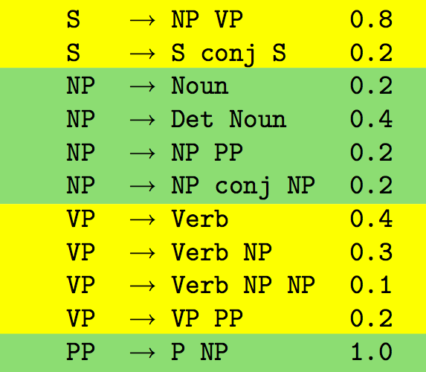
Finding P(τ)
Define probability distributions over the rules in the grammar
Context free!
Hockenmaier
Notes:
Context free!

Slide 54
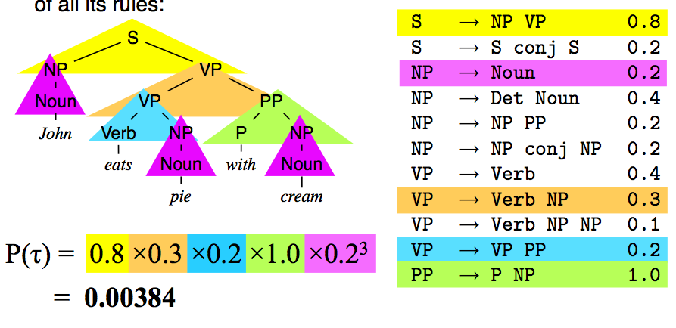
Finding P(τ)
The probability of a tree is the product of the probability of the rules that created it
Hockenmaier

Slide 55
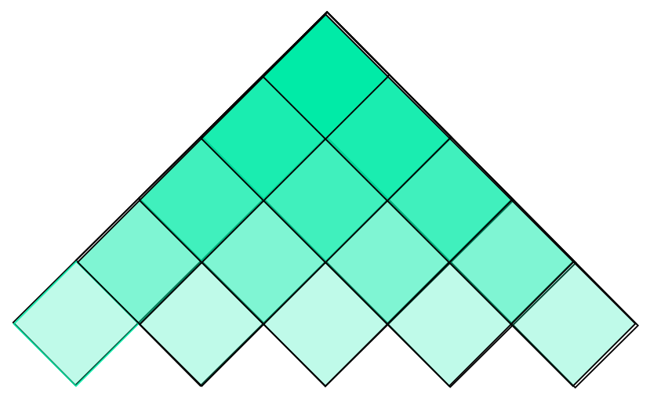
Parsing – Cocke-Kasami-Younger (CKY)
Like Viterbi but for trees
Guaranteed to find the most likely parse
This is the tree yield
For each nonterminal:
max probability of the subtree it encompasses

Slide 56
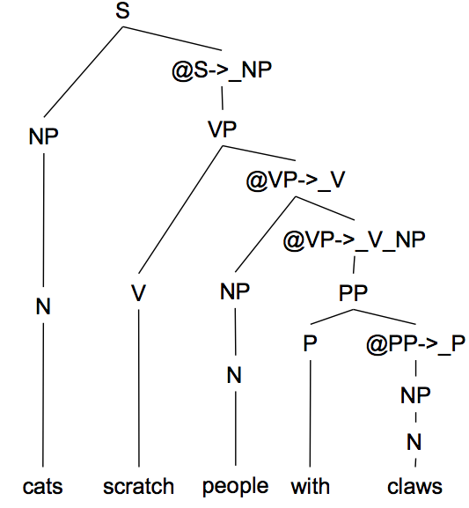
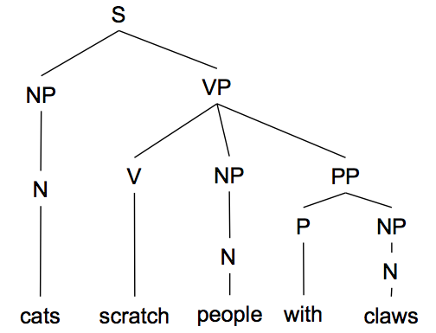
Chomsky Normal Form
All rules are of the form X → Y Z or X → w.
n-ary rules introduce new nonterminals (n > 2)
VP → V NP PP
becomes:
VP → V @VP-V and
@VP-V → NP PP
Manning
Notes:
Unaries can be incorporated into the algorithmfunction

Slide 57
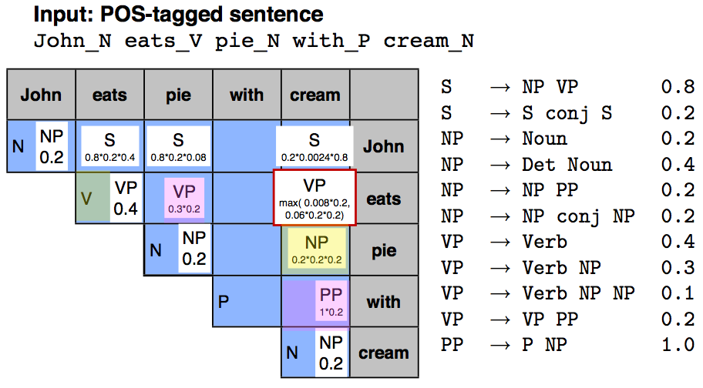
CKY Example
Hockenmaier

Slide 58
Estimating P(X→α)
Supervised
Relative frequency estimation
Count what is seen in a treebank corpus
Unsupervised
Expected relative frequency estimation
Use Inside-Outside Algorithm (EM variant)
Notes:
Supervised from a tree bank

Slide 59
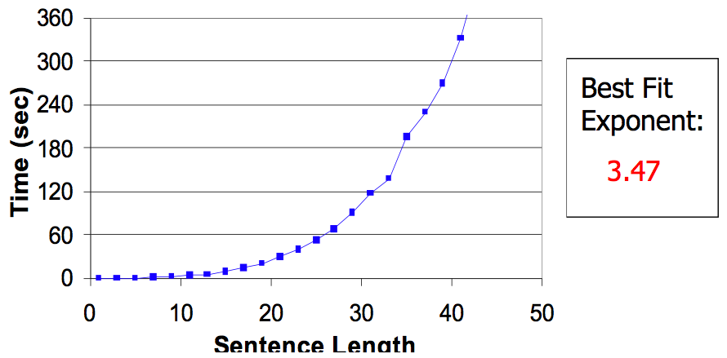
How well do PCFGs perform?
Runtime – supercubic!
Manning

Slide 60
How well do PCFGs perform?
+ Robust to variations in language
- Strong independence assumptions
? WSJ parsing accuracy: about 73% LP/LR F1
Lack of lexicalization
A PCFG uses the actual words only to determine the probability of parts-of-speech (the preterminals)
I like to eat cake with white frosting.
I like to eat cake with a spork.

Slide 61
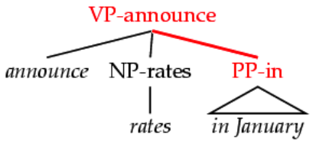
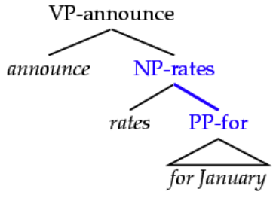
Lexicalization
Lexical heads are important for certain classes of ambiguities (e.g., PP attachment):
Lexicalizing grammar creates a much larger grammar.
Sophisticated smoothing needed
Smarter parsing algorithms needed
More DATA needed
Manning

Slide 62
Huge area of research
Coarse-to-fine parsing
Parse with a simpler grammar
Refine with a more complex one
Dependency parsing
A sentence is parsed by relating each word to other words in the sentence which depend on it.
Discriminative parsing
Given training examples, learn a function that classifies a sentence with its parse tree
and more!

Slide 63
The good news!
Part of speech taggers and sentence parsers are freely available!
So why did we sit through this lecture?
Maybe you’ll be interested in this area
Useful ideas to be applied elsewhere
Write a parser to parse web tables
PCFGs for information extraction
Like to know how things work

Slide 64
It’s over!
Thanks!

