Slide 1
CSE 451: Operating Systems
Winter 2014
Module 2
Architectural Support for
Operating Systems
Mark Zbikowski
mzbik@cs.washington.edu
476 Allen Center
Notes:
1

Slide 2
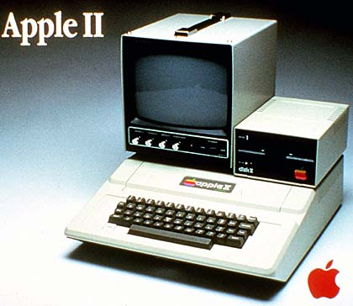
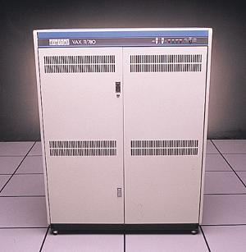
Even coarse architectural trends impact tremendously the design of systems
Processing power
  doubling every 18 months
  60% improvement each year
  factor of 100 every decade
  1980: 1 MHz Apple II+ = $2,000 (~$5,000 today)
    1980 also 1 MIPS VAX-11/780 = $120,000 (~$300,000 today)
  2006: 3.0GHz Pentium D = $800
  2010: 3.0GHz Dual Core = $500
  2013: 2.7GHz Quad Core = $369

Slide 3
Even coarse architectural trends impact tremendously the design of systems
Processing power
  doubling every 18 months
  60% improvement each year
  factor of 100 every decade
  1980: 1 MHz Apple II+ = $2,000 (~$5,000 today)
    1980 also 1 MIPS VAX-11/780 = $120,000 (~$300,000 today)
  2006: 3.0GHz Pentium D = $800
  2010: 3.0GHz Dual Core = $500
  2013: 2.7GHz Quad Core = $369

Slide 4
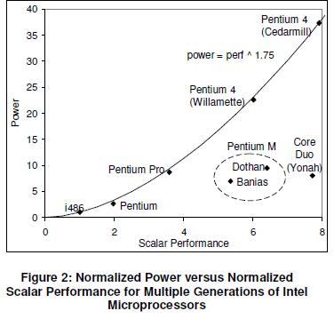
Power Consumption
http://www.intel.com/pressroom/kits/core2duo/pdf/epi-trends-final2.pdf

Slide 5
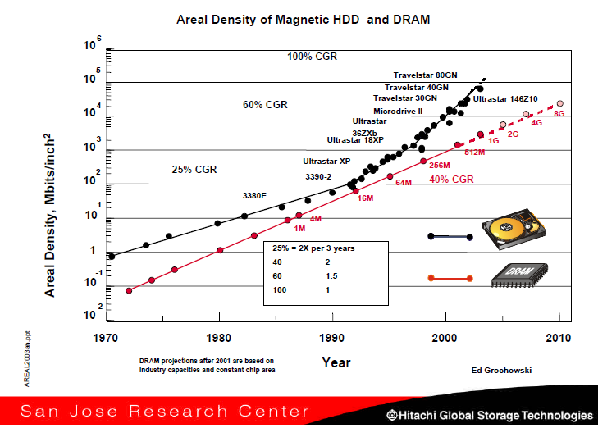
Primary Memory / Disk Capacity

Slide 6
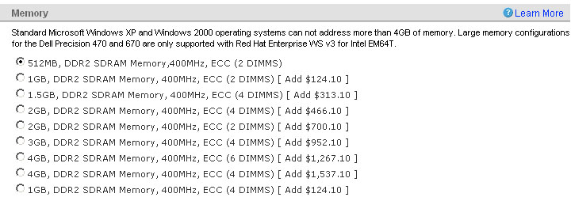
Primary memory cost
  1972: 1MB = $1,000,000
  1982: I remember pulling all kinds of strings to get a special deal: 512K of VAX-11/780 memory for $30,000
  2005:
4GB vs. 2GB (@400MHz) = $800

Slide 7
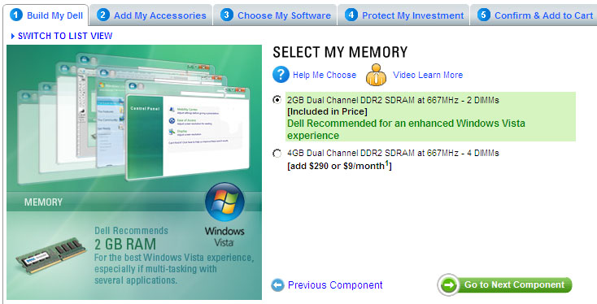
    2007:
4GB vs. 2GB (@667MHz) = $290

Slide 8
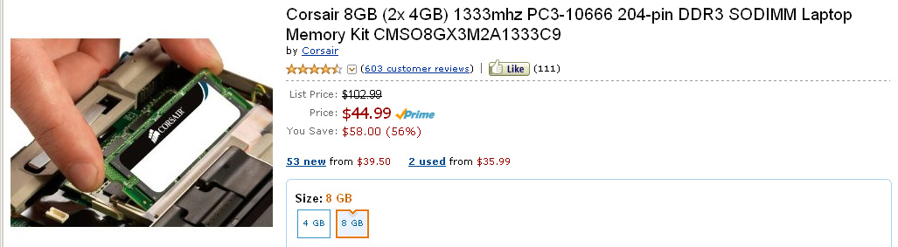
Today:
8GB (@1333MHz) = $44.99

Slide 9
Disk cost:
  Only a few years ago, we purchased disks by the megabyte (and it hurt!)
  Today, 1 GB (a billion bytes) costs $1 $0.50 $0.05 from Dell (except you have to buy in increments of 40 80 250 GB)
    => 1 TB costs $1K $500 $20, 1 PB costs $1M $500K $20K

Slide 10
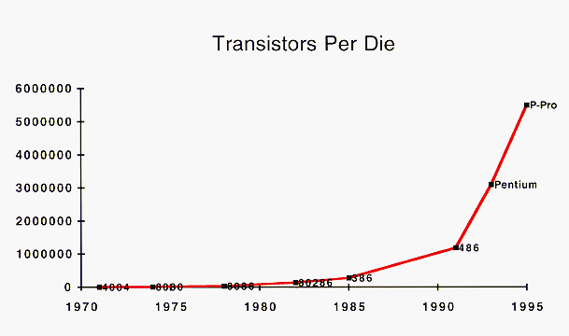
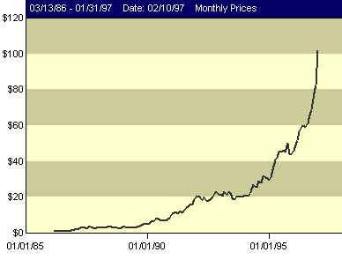
Aside: Where does it all go?
  Facetiously: “What Gordon giveth, Bill taketh away”
  Realistically: our expectations for what the system will do increase relentlessly
    e.g., GUI
  “Software is like a gas – it expands to fill the available space” – Nathan Myhrvold (1960-)
Microsoft Stock Price

Slide 11
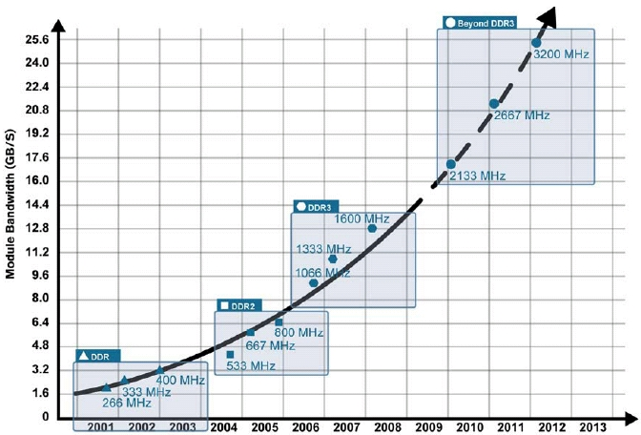
Primary Memory Bandwidth

Slide 12
Optical bandwidth today
  Doubling every 9 months
  150% improvement each year
  Factor of 10,000 every decade
  10x as fast as disk capacity!
  100x as fast as processor performance!!
What are some of the implications of these trends?
  Just one example: We have always designed systems so that they “spend” processing power in order to save “scarce” storage and bandwidth!

Slide 13
© 2004 Jim Gray, Microsoft Corporation

Slide 14
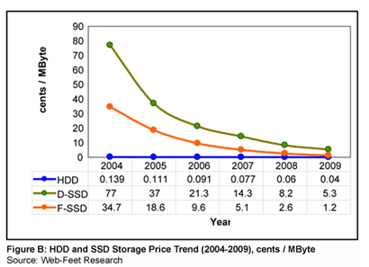
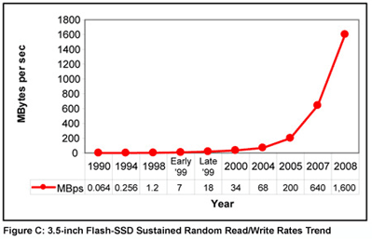
A Current Trend: Solid State Disks
http://www.embeddedstar.com/articles/2005/2/article20050207-4.html

Slide 15
Lower-level architecture affects the OS even more dramatically
The operating system supports sharing and protection
  multiple applications can run concurrently, sharing resources
  a buggy or malicious application can’t nail other applications or the system
There are many approaches to achieving this
The architecture determines which approaches are viable (reasonably efficient, or even possible)
  includes instruction set (synchronization, I/O, …)
  also hardware components like MMU or DMA controllers

Slide 16
Architectural support can vastly simplify (or complicate!) OS tasks
  e.g.: early PC operating systems (DOS, MacOS) lacked support for virtual memory, in part because at that time PCs lacked necessary hardware support
    Apollo workstation used two CPUs as a bandaid for non-restartable instructions!
  Until very recently, Intel-based PCs still lacked support for 64-bit addressing (which has been available for a decade on other platforms: MIPS, Alpha, IBM, etc…)
    Changed driven by AMD’s 64-bit architecture

Slide 17
Architectural features affecting OS’s
These features were built primarily to support OS’s:
  timer (clock) operation
  synchronization instructions (e.g., atomic test-and-set)
  memory protection
  I/O control operations
  interrupts and exceptions
  protected modes of execution (kernel vs. user)
  privileged instructions
  system calls (and software interrupts)
  virtualization architectures
    Intel: http://www.intel.com/technology/itj/2006/v10i3/1-hardware/7-architecture-usage.htm
    AMD: http://sites.amd.com/us/business/it-solutions/usage-models/virtualization/Pages/amd-v.aspx

Slide 18
Privileged instructions
some instructions are restricted to the OS
  known as privileged instructions
e.g., only the OS can:
  directly access I/O devices (disks, network cards)
    why?
  manipulate memory state management
    page table pointers, TLB loads, etc.
    why?
  manipulate special ‘mode bits’
    interrupt priority level
    why?

Slide 19
OS protection
So how does the processor know if a privileged instruction should be executed?
  the architecture must support at least two modes of operation: kernel mode and user mode
    VAX, x86 support 4 protection modes
  mode is set by status bit in a protected processor register
    user programs execute in user mode
    OS executes in kernel (privileged) mode (OS == kernel)
Privileged instructions can only be executed in kernel (privileged) mode
  what happens if code running in user mode attempts to execute a privileged instruction?

Slide 20
Crossing protection boundaries
So how do user programs do something privileged?
  e.g., how can you write to a disk if you can’t execute an I/O instructions?
User programs must call an OS procedure – that is, get the OS to do it for them
  OS defines a set of system calls
  User-mode program executes system call instruction
Syscall instruction
  Like a protected procedure call

Slide 21
The syscall instruction atomically:
  Saves the current PC
  Sets the execution mode to privileged
  Sets the PC to a handler address
With that, it’s a lot like a local procedure call
  Caller puts arguments in a place callee expects (registers or stack)
    One of the args is a syscall number, indicating which OS function to invoke
  Callee (OS) saves caller’s state (registers, other control state) so it can use the CPU
  OS function code runs
    OS must verify caller’s arguments (e.g., pointers)
  OS returns using a special instruction
    Automatically sets PC to return address and sets execution mode to user

Slide 22
A kernel crossing illustrated
Firefox: read(int fileDescriptor, void *buffer, int numBytes)
Save user PC
PC = trap handler address
Enter kernel mode
user mode
kernel mode
trap handler
PC = saved PC
Enter user mode
Save app state
Verify syscall number
Find sys_read( ) handler in vector table
sys_read( ) kernel routine
Verify args
Initiate read
Choose next process to run
Setup return values
Restore app state
ERET instruction

Slide 23
System call issues
What would be wrong if a syscall worked like a regular subroutine call, with the caller specifying the next PC?
What would happen if kernel didn’t save state?
Why must the kernel verify arguments?
How can you reference kernel objects as arguments to or results from system calls?

Slide 24
Exception Handling and Protection
All entries to the OS occur via the mechanism just shown
  Acquiring privileged mode and branching to the trap handler are inseparable
Terminology:
  Interrupt: asynchronous; caused by an external device
  Exception: synchronous; unexpected problem with instruction
  Trap: synchronous; intended transition to OS due to an instruction
Privileged instructions and resources are the basis for most everything: memory protection, protected I/O, limiting user resource consumption, …

Slide 25
Memory protection
OS must protect user programs from each other
  maliciousness, ineptitude
OS must also protect itself from user programs
  integrity and security
  what about protecting user programs from OS?
Simplest scheme: base and limit registers
  are these protected?
Prog A
base reg
base and limit registers are loaded by OS before starting program
Prog B
limit reg
Prog C

Slide 26
More sophisticated memory protection
coming later in the course
paging, segmentation, virtual memory
  page tables, page table pointers
  translation lookaside buffers (TLBs)
  page fault handling

Slide 27
I/O control
Issues:
  how does the OS start an I/O?
    special I/O instructions
    memory-mapped I/O
  how does the OS notice an I/O has finished?
    polling
    Interrupts
  how does the OS exchange data with an I/O device?
    Programmed I/O (PIO)
    Direct Memory Access (DMA)

Slide 28
Asynchronous I/O
Interrupts are the basis for asynchronous I/O
  device performs an operation asynchronously to CPU
  device sends an interrupt signal on bus when done
  in memory, a vector table contains list of addresses of kernel routines to handle various interrupt types
    who populates the vector table, and when?
  CPU switches to address indicated by vector index specified by interrupt signal
What’s the advantage of asynchronous I/O?

Slide 29
Timers
How can the OS prevent runaway user programs from hogging the CPU (infinite loops?)
  use a hardware timer that generates a periodic interrupt
  before it transfers to a user program, the OS loads the timer with a time to interrupt
    “quantum” – how big should it be set?
  when timer fires, an interrupt transfers control back to OS
    at which point OS must decide which program to schedule next
    very interesting policy question: we’ll dedicate a class to it
Should access to the timer be privileged?
  for reading or for writing?

Slide 30
Synchronization
Interrupts cause a wrinkle:
  may occur any time, causing code to execute that interferes with code that was interrupted
  OS must be able to synchronize concurrent processes
Synchronization:
  guarantee that short instruction sequences (e.g., read-modify-write) execute atomically
  one method: turn off interrupts before the sequence, execute it, then re-enable interrupts
    architecture must support disabling interrupts
      Privileged???
  another method: have special complex atomic instructions
    read-modify-write
    test-and-set
    load-linked store-conditional

Slide 31
“Concurrent programming”
Management of concurrency and asynchronous events is biggest difference between “systems programming” and “traditional application programming”
  modern “event-oriented” application programming is a middle ground
  And in a multi-core world, more and more apps have internal concurrency
Arises from the architecture
  Can be sugar-coated, but cannot be totally abstracted away
Huge intellectual challenge
  Unlike vulnerabilities due to buffer overruns, which are just sloppy programming

Slide 32
Architectures are still evolving
New features are still being introduced to meet modern demands
  Support for virtual machine monitors
  Hardware transaction support (to simplify parallel programming)
  Support for security (encryption, trusted modes)
  Increasingly sophisticated video / graphics
  Other stuff that hasn’t been invented yet…
In current technology transistors are free – CPU makers are looking for new ways to use transistors to make their chips more desirable
Intel’s big challenge: finding applications that require new hardware support, so that you will want to upgrade to a new computer to run them
© 2013 Gribble, Lazowska, Levy, Zahorjan
32

Slide 33
Some questions
Why wouldn’t you want a user program to be able to access an I/O device (e.g., the disk) directly?
OK, so what keeps this from happening? What prevents user programs from directly accessing the disk?
So, how does a user program cause disk I/O to occur?
What prevents a user program from scribbling on the memory of another user program?
What prevents a user program from scribbling on the memory of the operating system?
What prevents a user program from running away with the CPU?

