Slide 1
CSE 451: Asst. 1 Preparation
Section 3

Slide 2
Locks
lock_acquire(lock)
Wait until lock is free, then take it
lock_release(lock)
Release lock, waking up someone waiting for it (if any)
At most one lock holder at a time (safety)
If no one holding, acquire gets lock (progress)
If all lock holders finish and no higher priority waiters, waiter eventually gets lock (progress)

Slide 3
Locks – Best Practices
Lock is initially free
Always acquire before accessing shared data structure
Beginning of procedure!
Always release after finishing with shared data
End of procedure!
DO NOT throw lock for someone else to release
Never access shared data without lock
Danger!

Slide 4
Condition Variables API
Waiting inside a critical section
Called only when holding a lock
cv_wait(cv, lock)
Atomically release lock and relinquish processor
Reacquire the lock when wakened
cv_signal(cv, lock)
Wake up a waiter, if any
cv_broadcast(cv, lock)
Wake up all waiters, if any

Slide 5
Condition Variables Cont.
ALWAYS hold lock when calling wait, signal, broadcast
Condition variable is sync FOR shared state
ALWAYS hold lock when accessing shared state
Condition variable is memoryless
If signal when no one is waiting, no op
Wait atomically releases lock
What if wait, then release?
What if release, then wait?

Slide 6
Condition Variables Semantics
When a thread is woken up from wait, it may not run immediately
Signal/broadcast puts thread(s) on ready list
When lock is released, anyone might acquire it
Wait MUST be in a loop
while (need_to_wait()) {
cv.wait(lock);
}
Simplifies implementation
Of condition variables and locks
Of code that uses condition variables and locks

Slide 7
Semaphores
Semaphores have a non-negative integer value
P() atomically waits for value to become > 0, then decrements
V() atomically increments value (waking up waiter if needed)
Semaphores are like integers except:
Only operations are P and V
Operations are atomic
If value is 1, two P’s will result in value 0 and one waiter
Semaphores are useful for
“Stateful” wait: interrupt handlers, fork/join
But otherwise don’t use them

Slide 8
General Synchronization Advice
When to synchronize?
Modifying global variable in different threads
Protecting state during forced sleep (i.e. I/O)
Pick the right primitives
Locks – Critical sections, modifying shared state
CVs – Waiting for a condition to be satisfied
Semaphores – Stateful waiting
Mix and match when necessary
Organize and limit conflicts
Try to modularize code to minimize critical sections
Keep related synchronization close together
When in doubt, draw pictures
Draw graphs of resources and consumers
List the order in which things are acquired
Look for inconsistent orders of acquisition and circular dependencies

Slide 9
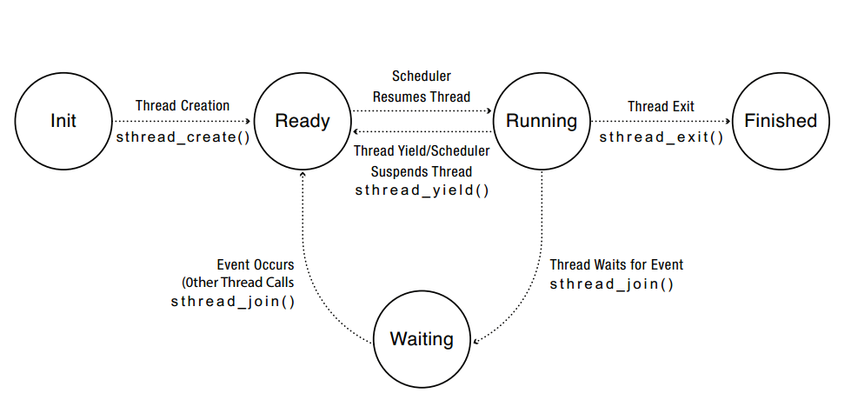
Thread Lifecycle
thread_create(thread, func, args)
Create a new thread to run func(args)
OS/161: thread_fork()
thread_yield()
Relinquish processor voluntarily
thread_join(thread)
In parent, wait for forked thread to exit, then return
OS/161: Your job
thread_exit(ret)
Quit thread and clean up, wake up joiner if any

Slide 10
Thread Join
Parent thread creates child thread and calls thread_join()
Enters the waiting list
Can only join on (joinable) child threads
Cannot join on detached threads
When a child finishes, thread_join() returns
Parent enters the ready list
Can only join once
What should happened if…
The parent joins before the child finishes?
The parent joins after the child finishes?
The parent joins just as the child is finishing?
The parent joins before the child even starts?

Slide 11
Spinlocks
Processor waits in a loop for the lock to become free
Assumes lock will be held for a short time
Used to protect CPU scheduler and to implement waiting locks
Uses read-modify-write instructions
Atomically read a value from memory, operate on it, and then write it back to memory
Intervening instructions prevented in hardware
Need spinlocks to implement locks on multiprocessor machines
Turning off interrupts is not enough!

Slide 12
Lock Implementation - Multiprocessor
Lock::acquire() {
disableInterrupts();
spinlock.acquire();
if (value == BUSY) {
waiting.add(myTCB);
suspend(&spinlock);
} else {
value = BUSY;
}
spinlock.release();
enableInterrupts();
}
Lock::release() {
disableInterrupts();
spinlock.acquire();
if (!waiting.Empty()) {
next = waiting.remove();
scheduler->makeReady(next);
} else { value = FREE;
}
spinlock.release();
enableInterrupts();
}

Slide 13
Wait Channels
Primitive designed for holding sleeping threads
Protected by a spinlock, not a lock
Caller must hold the spinlock for any wchan function call
wchan_sleep(wc, lk)
Put the current thread to sleep and place it in the wchan
Spinlock is released upon sleep
wchan_wakeone(wc, lk)
Pull a thread off of the wchan and place it in the ready list
wchan_wakeall(wc, lk)
Pull all threads off of the wchan and place them in the ready list

