Slide 1
CSE 451: Operating Systems
Section 5
Midterm review

Slide 2
Kernel/userspace separation
Userspace processes cannot interact directly with hardware (non-privileged mode)
Attempting to execute a system call instruction causes a trap to the kernel (privileged mode), which handles the request
Why is it necessary to have both privileged and non-privileged mode?
How is privileged mode enforced, and how do virtual machine monitors work inside this model?

Slide 3
IO from userspace
Userspace processes interact with disks and other devices via open(), read(), write(), and other system calls
Multiple levels of abstraction: kernel surfaces filesystem to userspace, and device drivers surface (mostly) unified interface to reading and writing data to kernel
What are the benefits and drawbacks of designing a system in this way?

Slide 4
Monolithic and microkernels
Monolithic kernels encapsulate all aspects of functionality aside from hardware and user programs
Pro: Low communication cost, since everything is in the same address space
Cons: No isolation between modules, not easy to tack on new features
Microkernels separate functionality into separate modules that each expose an API
Pros and cons are opposite those of monolithic kernels
Amazon’s internal reorganization of services a few years ago had very much a microkernel vibe

Slide 5
Processes versus threads
Processes have multiple pieces of state associated with them
Program counter, registers, virtual memory, open file handles, mutexes, registered signal handlers, the text and data segment of the program, and so on
Threads are “lightweight” versions of processes
Which pieces of state listed above do threads not maintain individually?

Slide 6
Process creation
fork(): create and initialize a new process control block
Copy resources of current process but assign a new address space
Calls to fork() return twice—once to parent (with pid of child process) and once to child
What makes this system call fast even for large processes? vfork() versus copy-on-write
exec(): stop the current process and begin execution of a new one
Existing process image is overwritten
No new process is created
Is there a reason why fork() and exec() are separate system calls?

Slide 7
Threads
How is a kernel thread different from a userspace thread?
Kernel thread: managed by OS, can run on a different CPU core than parent process
Userspace thread: managed by process/thread library, provides concurrency but no parallelism (can’t have two userspace threads within a process executing instructions at the same time)
CPU sharing
Threads share CPU either implicitly (via preemption) or explicitly via calls to yield()
What happens when a userspace thread blocks on IO?

Slide 8
Synchronization
Critical sections are sequences of instructions that may produce incorrect behavior if two threads interleave or execute them at the same time
E.g. the banking example that everyone loves to use
Mutexes are constructs that enforce mutual exclusion
mutex.lock()/acquire(): wait until no other thread holds the lock and then acquire it
mutex.unlock()/release(): release the Kraken! Er, lock
Mutexes rely on hardware support such as an atomic test-and-set instruction or being able to disable interrupts (why?)

Slide 9
Synchronization constructs
Spinlocks are mutexes where lock() spins in a loop until the lock can be acquired
High CPU overhead, but no expensive context switches are necessary
In what type of scenario are spinlocks useful?
Semaphores are counters that support atomic increments and decrements
P(sem): block until semaphore count is positive, then decrement and continue
V(sem): increment semaphore count
How are semaphores different from spinlocks?

Slide 10
Synchronization constructs
Condition variables associated with mutexes allow threads to wait for events and to signal when they have occurred
cv.wait(mutex* m): release mutex m and block until the condition variable cv is signaled. m will be held when wait() returns
cv.signal(): unblock one of the waiting threads. m must be held during the call but released sometime afterward
Why is it necessary to associate a mutex with a condition variable?
What happens if signal() is invoked before a call to wait()?

Slide 11
Monitors
Monitors are souped-up condition variables that support enter(), exit(), wait(), and signal() routines
When one thread enters a monitor, no other thread can enter until the first thread exits
The exception is that a thread can wait on a condition after entering a monitor, permitting another thread to enter (which will potentially signal and unblock the first thread)
Hoare monitors: signal() causes a waiting thread to run immediately
Mesa monitors: signal() returns to the caller and a waiting thread will unblock some time later

Slide 12
Deadlock
What is an example of deadlock?
Methods for preventing and avoiding deadlock
Have threads block until all required locks are available
Have all threads acquire locks in the same global ordering
Run banker’s algorithm to simulate what would happen if this thread and others made maximum requests: no deadlock = continue, deadlock = block and check again later
Can resolve deadlock by breaking cycles in the dependency graph: choose a thread, kill it, and release its locks
What are the potential problems related to doing this?

Slide 13
Scheduling
Operating systems share CPU time between processes by context-switching between them
In systems that support preemption, each process runs for a certain quantum (time slice) before the OS switches contexts to another process
Which process runs next depends on the scheduling policy
Scheduling policies can attempt to maximize CPU utilization or throughput or minimize response time, for example
There are always tradeoffs between performance and fairness

Slide 14
Scheduling laws
Utilization law: utilization is constant regardless of scheduling policy as long as the workload can be processed
Little’s law: the better the average response time, the fewer processes there will be in the scheduling system
Kleinrock’s conservation law: improving the response time of one class of task by increasing its priority hurts the response time of at least one other class of task

Slide 15
Scheduling policies
FIFO: first in first out
Schedule processes in the order they arrive
SPT: shortest processing time first
Schedule process with smallest time requirement
RR: round robin
Cycle through processes, executing each for a fixed amount of time
Priority
Assign a priority to each process and execute higher-priority processes first
What are the benefits and drawbacks of each type of scheduling policy?

Slide 16
Virtual memory
Each process has the illusion of use of the complete address space
Facilitates isolation and also sharing (how?)
The OS manages a mapping of virtual address to physical addresses
Address translation
High bits of virtual address map to physical page
Low bits of address determine offset within page

Slide 17
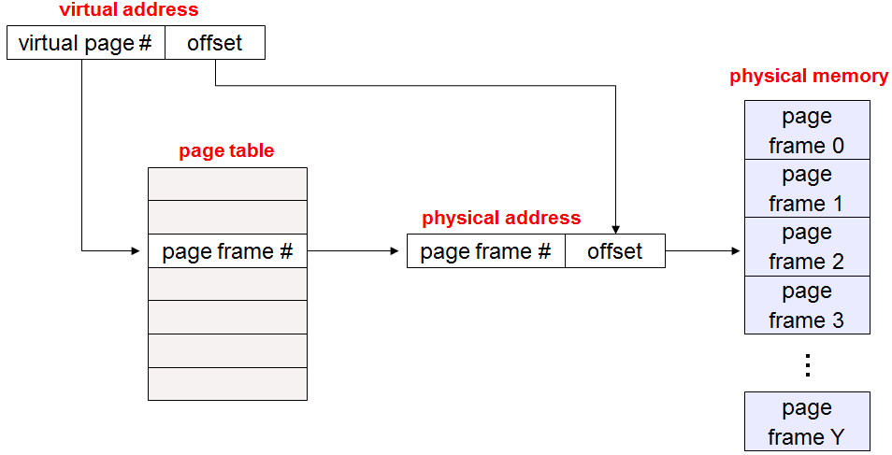
Page tables
Per-process constructs that map virtual pages to physical pages
Diagram from Ed Lazowska

Slide 18
Page table entries
Page table entries contain bits that describe whether a page is valid, whether it has been referenced, whether it is dirty, its protection flags (read, write, execute), and the physical page number
Diagram from Ed Lazowska

Slide 19
Segmentation
What are the advantages and disadvantages of using virtual memory?
Pros: isolation, reduced (virtual) memory fragmentation
Cons: additional overhead in address lookups, page tables themselves require memory
Segmentation: break up regions of virtual memory by usage
E.g. stack, heap, and text (instructions)
Virtual addresses have the form <segment number, offset> under this scheme
Can combine paging and segmentation: keep page table per segment as opposed to per process
Addresses take the form <segment number, virtual page number, offset>

Slide 20
Paged virtual memory
Memory is limited, so operating systems will often evict pages to disk to make room for others
Can mark page table entry to indicate that page is actually on disk
If a page that is on disk is referenced, a page fault occurs and the operating system reads the page back into memory

Slide 21
Page replacement algorithms
Page replacement algorithms describe which page should be evicted to disk in order to bring another into memory
Belady’s algorithm: evict the page that won’t be used for the longest time in the future
Useful for comparison, but impossible to implement
FIFO: evict page brought in the longest time ago
LRU: evict the least recently used page

Slide 22
Page replacement algorithms
LRU clock: sweep through pages like the hand of a clock
Whenever a page is accessed, set its reference bit
When looking for a page to evict, clear the bit for any page passed
Return the first page seen with an unset bit
Working set: keep a certain working set of pages in memory for each process
Page fault frequency: attempt to equalize page fault rate between processes

