Slide 1
CSE 451: Operating Systems
Section 4
Scheduling, Project 2 Intro, Threads

Slide 2
Priority Inversion
A problem that arises when tasks (e.g. threads) have priorities and shared resource conflicts
Typically involves tasks that operate periodically
You won’t have to worry about this in Project 2.

Slide 3
Priority Inversion
J1
Normal execution
J2
J3
Critical region
Say we have 3 tasks where priority(J1) > priority(J2) > priority(J3)
J1 and J3 each need exclusive access to the same shared resource
When could there be problem?

Slide 4
Priority Inversion
J1 blocked
J1
J2
J3
Normal execution
Critical region
A higher priority task can interrupt a lower priority one.
Unbounded time of priority inversion, if J3 is interrupted by tasks with priority between J1 and J3 during its critical region.

Slide 5
The Mars Pathfinder problem
“But a few days into the mission, not long after Pathfinder started gathering meteorological data, the spacecraft began experiencing total system resets, each resulting in losses of data. The press reported these failures in terms such as ‘software glitches’ and ‘the computer was trying to do too many things at once’”

Slide 6
What happened?
Relevant components:
Information Bus (IB) – a buffer for exchanging data between tasks
Meteorological data gathering task (M) – infrequent, low priority, locks the IB
Communication task (C) – medium priority, doesn’t use the IB
Bus management (B) – frequent, high priority, locks the IB
Watchdog timer (W) – Resets the system if B is not activated for a certain amount of time

Slide 7
Pathfinder woes
Reset by watchdog timer!
Bus management blocked
B
C
M
Normal execution
Information Bus in use
Oh noes! Is that $280M down the drain?
What can be done?

Slide 8
A Solution to priority inversion
Any thoughts?

Slide 9
Priority Inheritance
If a task J1 blocks because some other task J3 with lower priority owns the requested resource, the J3 temporarily inherits the priority of J1
J3 loses its elevated priority when it releases the resource
Rule: Tasks always inherit the highest priority of other tasks they are blocking

Slide 10
Mars Pathfinder solution
The Mars Pathfinder uses a real-time OS called VxWorks
VxWorks has a flag to set priority inheritance “on”
How do you think this flag was set when Pathfinder was launched?

Slide 11
Priority Inheritance on Mars
NO reset by watchdog timer!
B blocked
B
C
M
Normal execution
Information Bus in use
Luckily, that flag in VxWorks could be set remotely

Slide 12
Not all roses yet
Priority inheritance solves the biggest problem, but 2 more remain:
Deadlock
Chained Blocking
They are solved by the Priority Ceiling Protocol extension
You can read about this on your own because now it is time for…

Slide 13
Project 1
Congratulations, you’re all kernel hackers now!
Any Final Questions?
We’re going to give you a break and have you do some userspace work ☺

Slide 14
Project 2: user-level threads
Part A: due Sunday, Nov 3 at 11:59pm
Implement part of a user thread library
Add synchronization primitives
Solve a synchronization problem
Part B: due Sunday, Nov 17 at 11:59pm
Implement a multithreaded web server
Add preemption
Get some results and write a (small) report

Slide 15
Project 2 notes
Start EARLY!
It’s loooooooong
Read the assignment carefully
Read it again
Understand the skeleton code
Use the same groups as for project 1

Slide 16
Project 2 tips
Understand what the provided code does for you
Division of work
Part 3 can be completed without parts 1 and 2
More tools
gdb
(Or ddd if you’re not a fan of CLIs)

Slide 17
Simplethreads
We give you:
Skeleton functions for thread interface
Machine-specific code (x86, i386)
Support for creating new stacks
Support for saving regs/switching stacks
A queue data structure (why?)
Very simple test programs
You should write more, and include them in the turnin
A single-threaded web server

Slide 18
Simplethreads code structure
test/*.c
Web server (web/sioux.c)
Other apps
include/sthread.h
You write this
lib/sthread_user.c
lib/sthread_user.h
lib/sthread_queue.h
lib/sthread_ctx.h
lib/sthread_preempt.h
lib/sthread_queue.c
lib/sthread_ctx.c
lib/sthread_preempt.c
lib/sthread_switch.S
sthread_switch_i386.h
sthread_switch_powerpc.h

Slide 19
Pthreads
Pthreads (POSIX threads) is a preemptive, kernel-level thread library
Simplethreads is similar to Pthreads
Project 2: compare your implementation against Pthreads
./configure --with-pthreads

Slide 20
Thread operations
What functions do we need for a userspace thread library?

Slide 21
Simplethreads API
void sthread_init()
Initialize the whole system
sthread_t sthread_create(func start_func,
void *arg)
Create a new thread and make it runnable
void sthread_yield()
Give up the CPU
void sthread_exit(void *ret)
Exit current thread
void* sthread_join(sthread_t t)
Wait for specified thread to exit

Slide 22
Simplethreads internals
Structure of the TCB:
struct _sthread {
sthread_ctx_t *saved_ctx;
/**
* Add your fields to the thread
* data structure here.
*/
};

Slide 23
Sample multithreaded program
(this slide and next – see test-create.c)
void *thread_start(void *arg) {
if (arg) {
printf(“in thread_start, arg = %p\n”,
arg);
}
return 0;
}
...

Slide 24
Sample multithreaded program
int main(int argc, char *argv[]) {
sthread_init();
for(i = 0; i < 3; i++) {
if (sthread_create(thread_start,
(void *)&i) == NULL) {
printf("sthread_create failed\n");
exit(1);
}
}
// needs to be called multiple times
sthread_yield();
printf("back in main\n");
return 0;
}

Slide 25
Managing contexts
(Provided for you in project 2)
Thread context = thread stack + stack pointer
sthread_new_ctx(func_to_run)
creates a new thread context that can be switched to
sthread_free_ctx(some_old_ctx)
Deletes the supplied context
sthread_switch(oldctx, newctx)
Puts current context into oldctx
Takes newctx and makes it current

Slide 26
How sthread_switch works
Xsthread_switch:
(push all regs)
movq %rsp,(%rax)
movq %rdx,%rsp
(pop all regs)
ret
Thread 1 TCB
… SP
Thread 2 TCB
… SP
Thread 2
registers
CPU
RSP
Thread 1 running
Thread 2 ready
Thread 1 regs
Want to switch to thread 2…

Slide 27
Push old context
Xsthread_switch:
(push all regs)
movq %rsp,(%rax)
movq %rdx,%rsp
(pop all regs)
ret
Thread 1 TCB
… SP
Thread 2 TCB
… SP
Thread 1
registers
Thread 2
registers
CPU
RSP
Thread 1 running
Thread 2 ready
Thread 1 regs

Slide 28
Save old stack pointer
Xsthread_switch:
(push all regs)
movq %rsp,(%rax)
movq %rdx,%rsp
(pop all regs)
ret
Thread 1 TCB
… SP
Thread 2 TCB
… SP
Thread 1
registers
Thread 2
registers
CPU
RSP
Thread 1 running
Thread 2 ready
Thread 1 regs

Slide 29
Change stack pointers
Xsthread_switch:
(push all regs)
movq %rsp,(%rax)
movq %rdx,%rsp
(pop all regs)
ret
Thread 1 TCB
… SP
Thread 2 TCB
… SP
Thread 1
registers
Thread 2
registers
CPU
RSP
Thread 1 ready
Thread 2 running
Thread 1 regs

Slide 30
Pop off new context
Xsthread_switch:
(push all regs)
movq %rsp,(%rax)
movq %rdx,%rsp
(pop all regs)
ret
Thread 1 TCB
… SP
Thread 2 TCB
… SP
Thread 1
registers
CPU
RSP
Thread 1 ready
Thread 2 running
Thread 2 regs

Slide 31
Done; return
Xsthread_switch:
(push all regs)
movq %rsp,(%rax)
movq %rdx,%rsp
(pop all regs)
ret
Thread 1 TCB
… SP
Thread 2 TCB
… SP
Thread 1
registers
What got switched?
RSP
PC (how?)
Other registers
CPU
RSP
Thread 1 ready
Thread 2 running
Thread 2 regs

Slide 32
Adjusting the PC
Thread 1 TCB
… SP
Thread 2 TCB
… SP
ret pops off the new return address!
Thread 1
registers
ra=0x400
ra=0x800
CPU
RSP
Thread 1 (stopped):
sthread_switch(t1,t2);
0x400: printf(“test 1”);
Thread 2 (running):
sthread_switch(t2,...);
0x800: printf(“test 2”);
PC

Slide 33
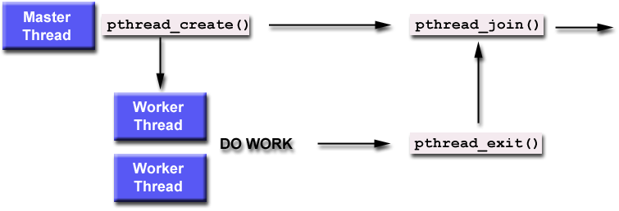
Thread joining
With Pthreads (and Sthreads):
Master thread calls join on worker thread
Join blocks until worker thread exits.
Join returns the return value of the worker thread.
Notes:
man pthread_join: “There is no pthreads analog of waitpid(-1, &status, 0), that is, "join with any terminated thread”. If you believe you need this functionality, you probably need to rethink your application design.”

Slide 34
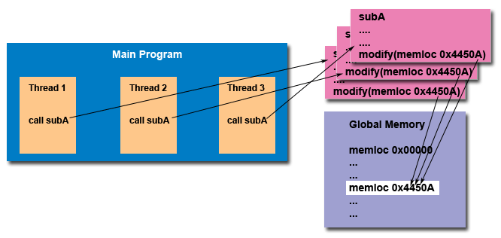
The need for synchronization
Thread safety:
An application's ability to execute multiple threads simultaneously without "clobbering" shared data or creating "race" conditions

Slide 35
Synchronization primitives: mutexes
sthread_mutex_t sthread_mutex_init()
void sthread_mutex_free(sthread_mutex_t lock)
void sthread_mutex_lock(sthread_mutex_t lock)
When returns, thread is guaranteed to acquire lock
void sthread_mutex_unlock(
sthread_mutex_t lock)
Notes:
Initialization and cleanup:
Mutex operations:
See sthread.h

Slide 36
Synchronization primitives: condition variables
sthread_cond_t sthread_cond_init()
void sthread_cond_free(sthread_cond_t cond)
void sthread_cond_signal(sthread_cond_t cond)
Wake-up one waiting thread, if any
void sthread_cond_broadcast(
sthread_cond_t cond)
Wake-up all waiting threads, if any
void sthread_cond_wait(sthread_cond_t cond,
sthread_mutex_t lock)
Wait for given condition variable
Returning thread is guaranteed to hold the lock
Notes:
https://computing.llnl.gov/tutorials/pthreads/#ConditionVariables
http://man.yolinux.com/cgi-bin/man2html?cgi_command=pthread_cond_init

Slide 37
Things to think about
How do you create a thread?
How do you pass arguments to the thread’s start function?
Function pointer passed to sthread_new_ctx() doesn’t take any arguments
How do you deal with the initial (main) thread?
How do you block a thread?

Slide 38
Things to think about
When and how do you reclaim resources for a terminated thread?
Can a thread free its stack itself?
Where does sthread_switch return?
Who and when should call sthread_switch?
What should be in struct _sthread_mutex, struct _sthread_cond?

Slide 39
Things to think about
Working with synchronization: When does it make sense to disable interrupts?
Which actions are atomic at the application level versus at the thread level?
When using forkbomb, run “ulimit -Su 64” to limit the number of processes/threads
Allows you to log in from another session even if you hit the above limit
Add it to your .bash_profile so it happens automatically

Slide 40
Final Thoughts
Want to learn about real-time scheduling? Take CSE466

