Slide 1
CSE 451: Operating Systems Spring 2012 Module 26 Cloud Computing
Ed Lazowska
lazowska@cs.washington.edu
Allen Center 570
Notes:
1

Slide 2
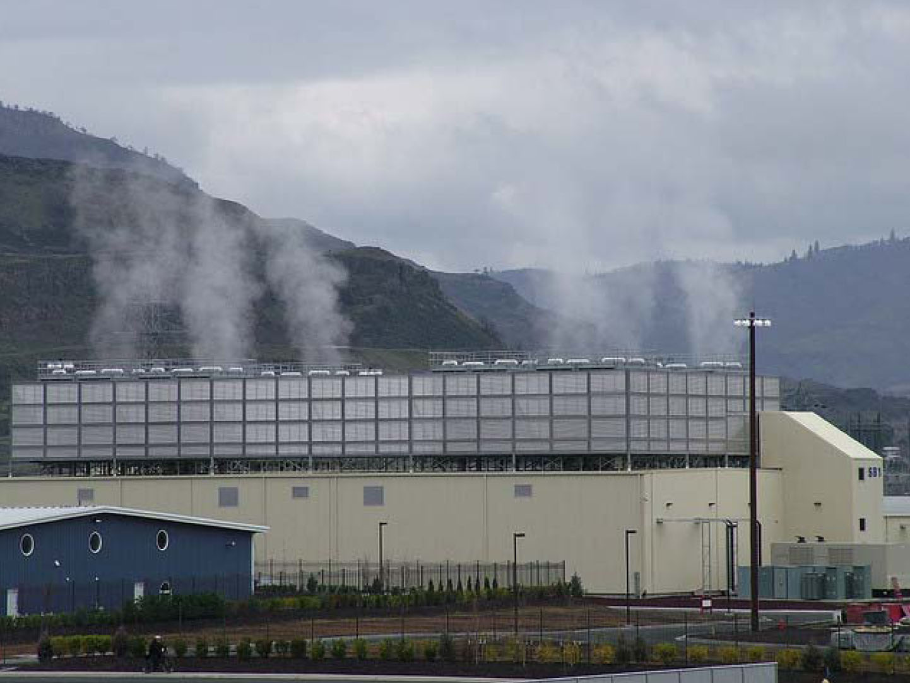
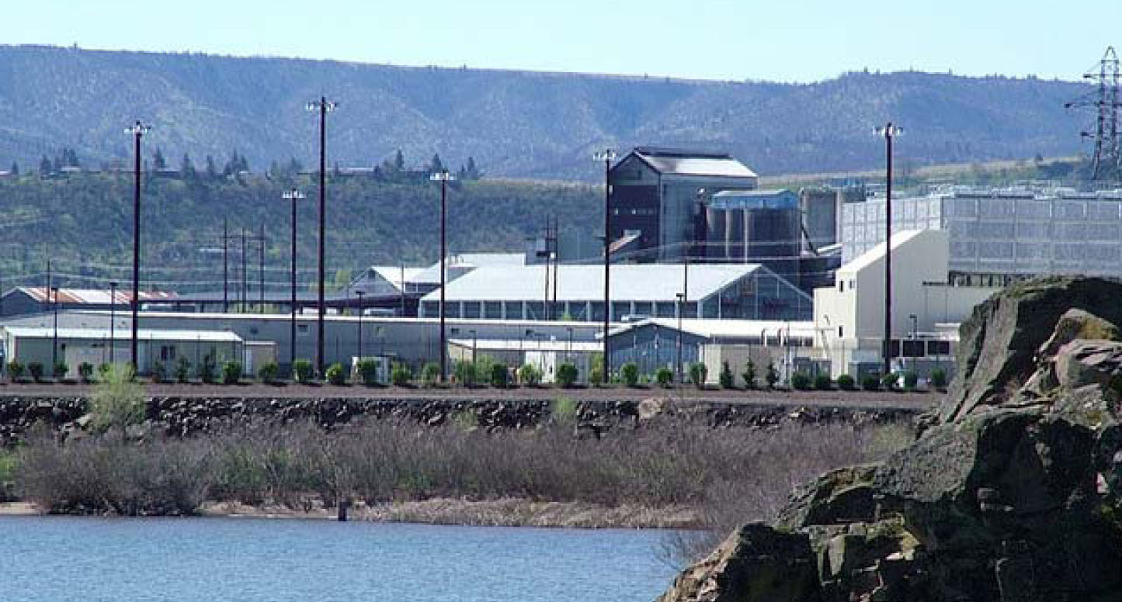
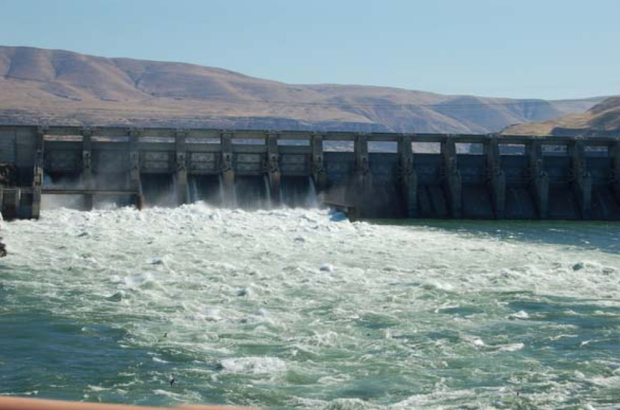

Slide 3
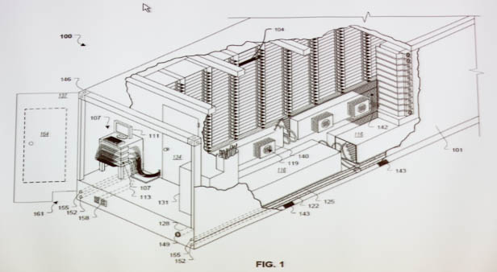
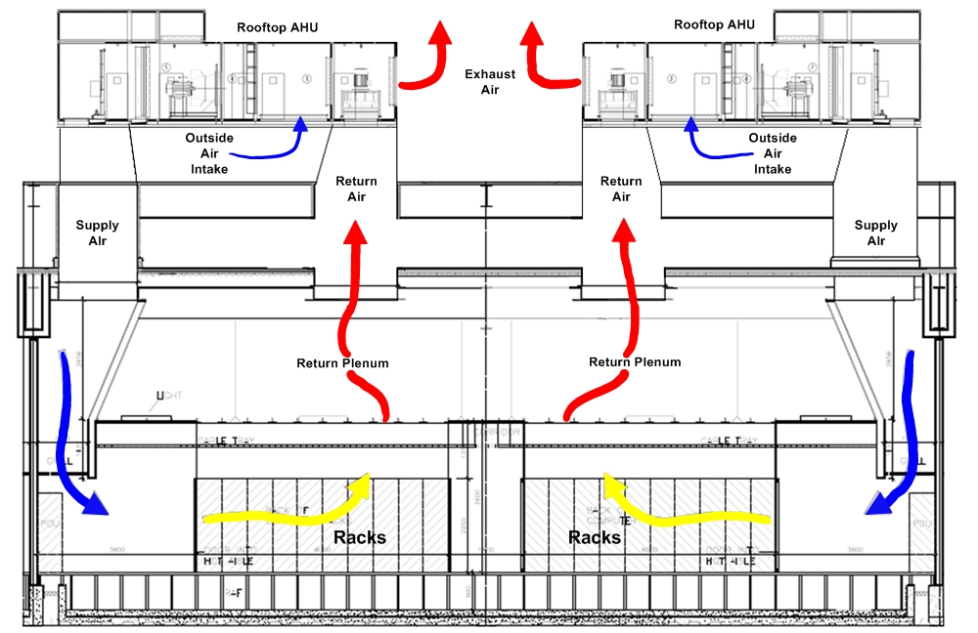

Slide 4
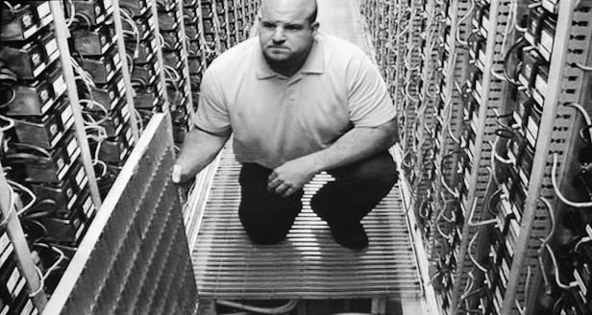
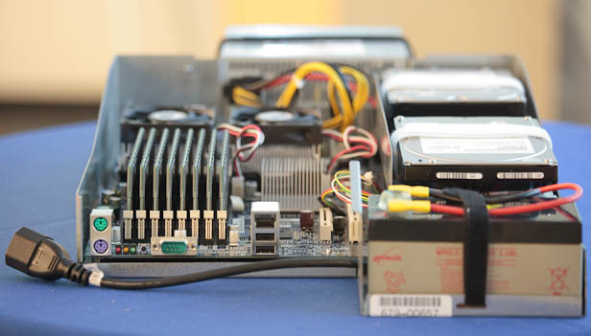
Velcro

Slide 5
A datacenter has 50 - 250 containers
A container has 1,000 - 2,000 servers
A server has two processors, 2 disks, tons of memory, battery backup
Processors are chosen for power efficiency, not performance

Slide 6
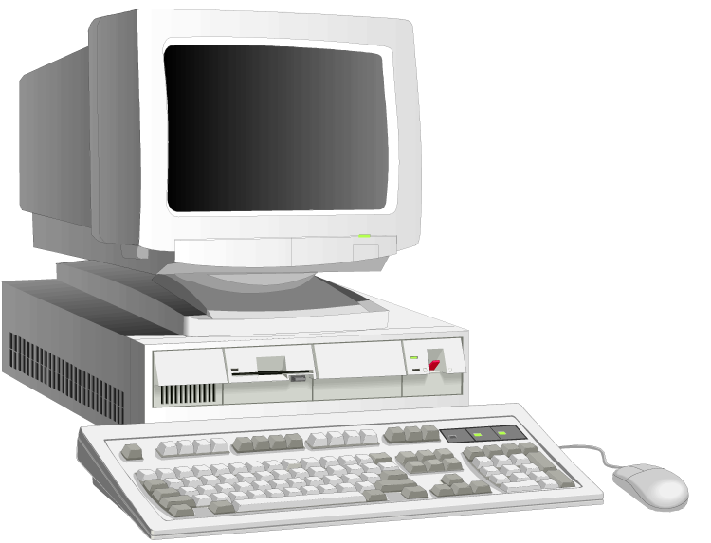
Personal computing
Office applications
Math and science
Web browser
Databases and storage
Email

Slide 7
Cloud email accessed through the browser
Office applications
Math and science
Web browser
Databases and storage
Email
Email

Slide 8
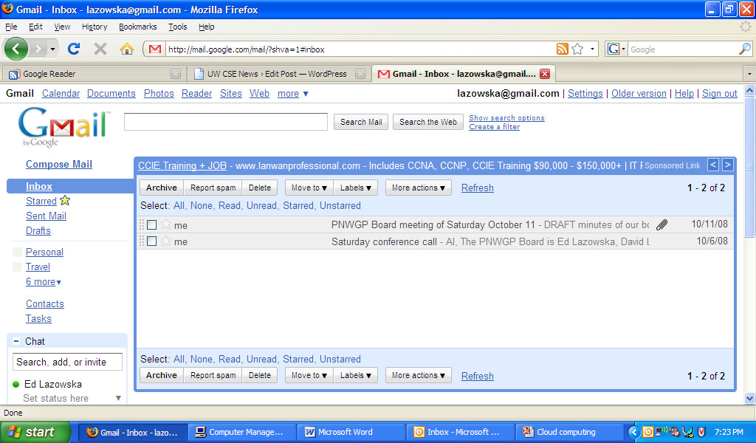
… with the cloud provider’s domain name …

Slide 9
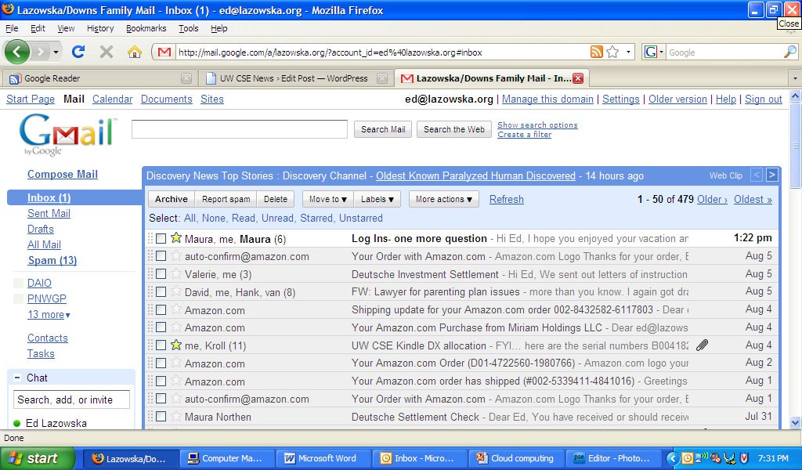
… or with your own

Slide 10
Why not office applications too?
Office applications
Math and science
Web browser
Databases and storage
Email
Email

Slide 11
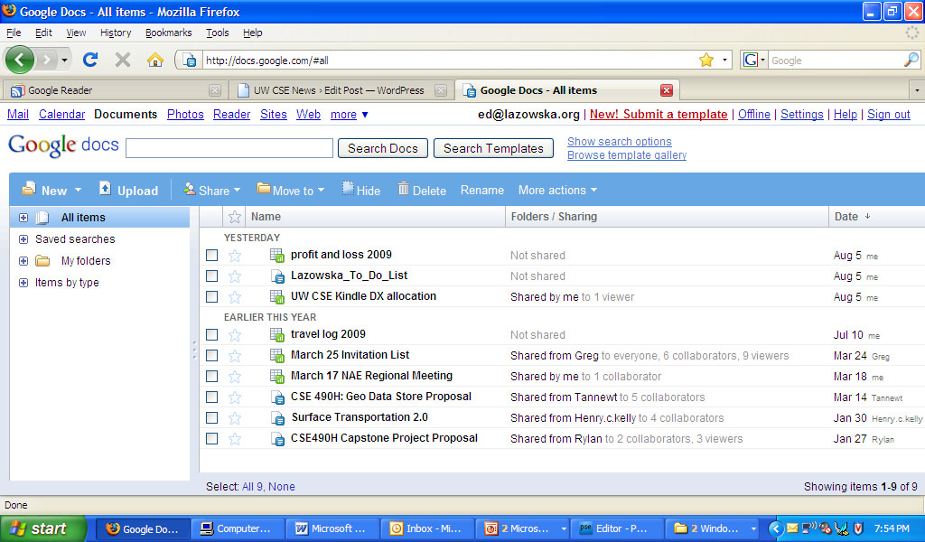

Slide 12
Why not everything else?
Office applications
Math and science
Web browser
Databases and storage
Email
Email

Slide 13
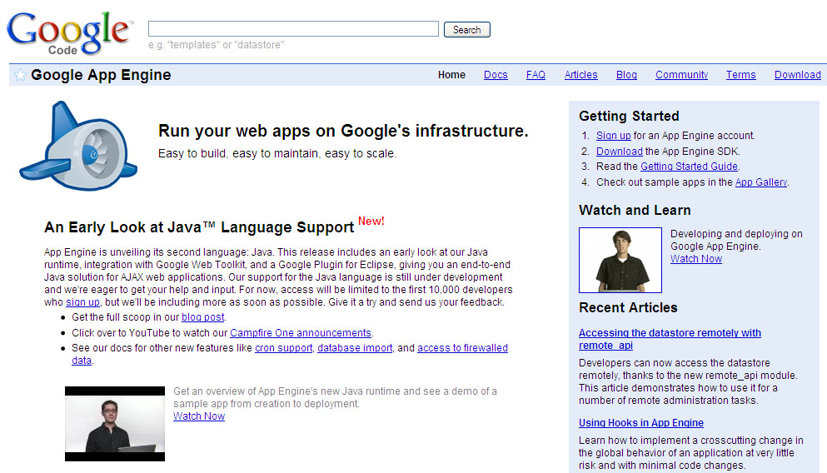
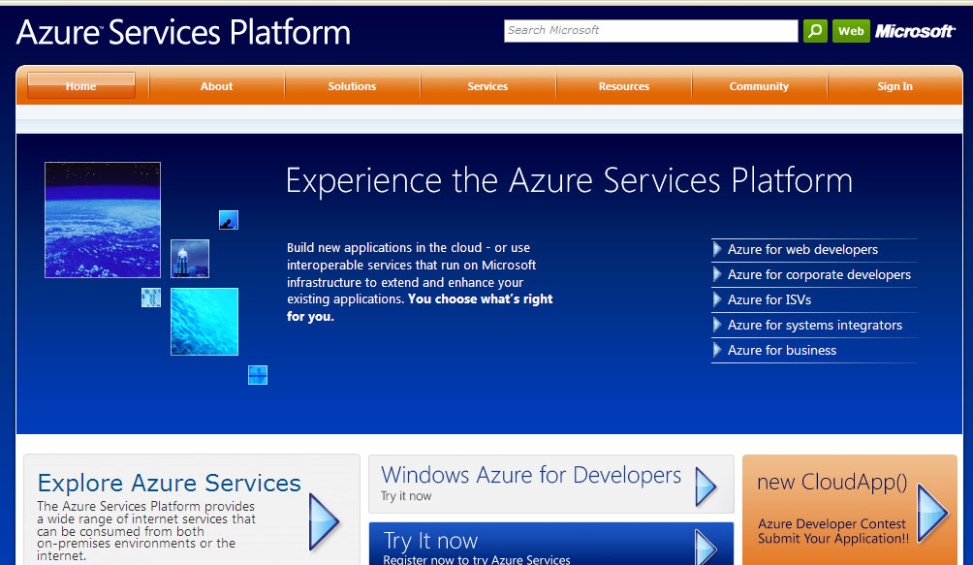
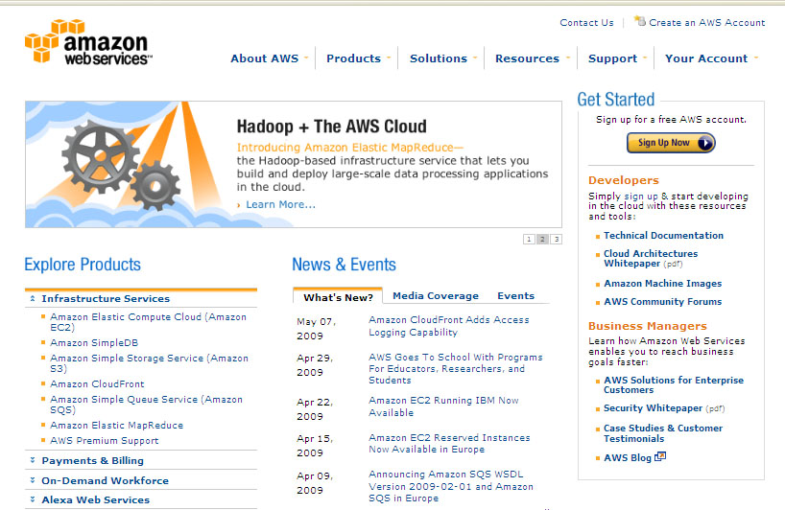

Slide 14
Consider …
Sharing is easy
Someone else does backup
Someone else handles software updates
There’s 7x24x365 operations support, auxiliary power, redundant network connections, geographical diversity
Scalability – both up and down – is instantaneous
Many fewer demands on the local operating system and machine

Slide 15
Amazon Elastic Compute Cloud (EC2)
$0.68 per hour for
4 cores of 2.5 GHz 64-bit 2007 Xeon or Opteron
15 GB memory
1.69 TB scratch storage
Need it 24x7 for a year?
$3900
$0.085 per hour for
1 core of 1.2 GHz 32-bit Intel or AMD
1.7 GB memory
160 GB scratch storage
Need it 24x7 for a year?
$490

Slide 16
This includes
Purchase + replacement
Housing
Power
Operation
Reliability
Security
Instantaneous expansion and contraction
1000 processors for 1 day costs the same as 1 processor for 1000 days!

Slide 17
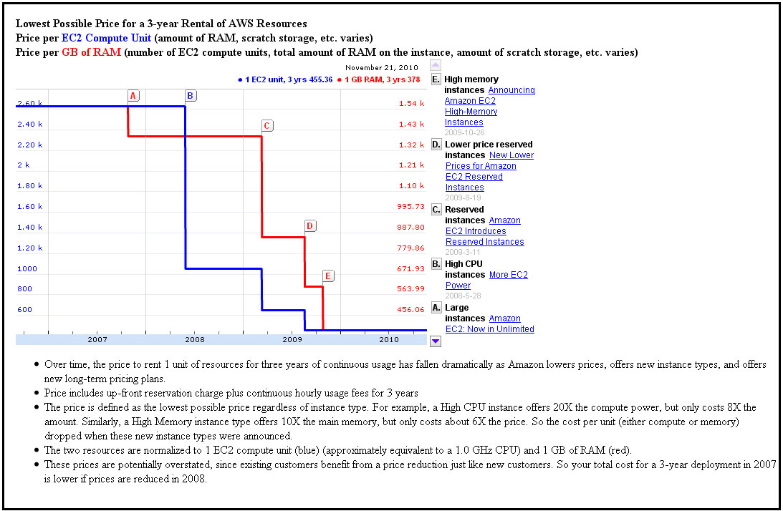

Slide 18
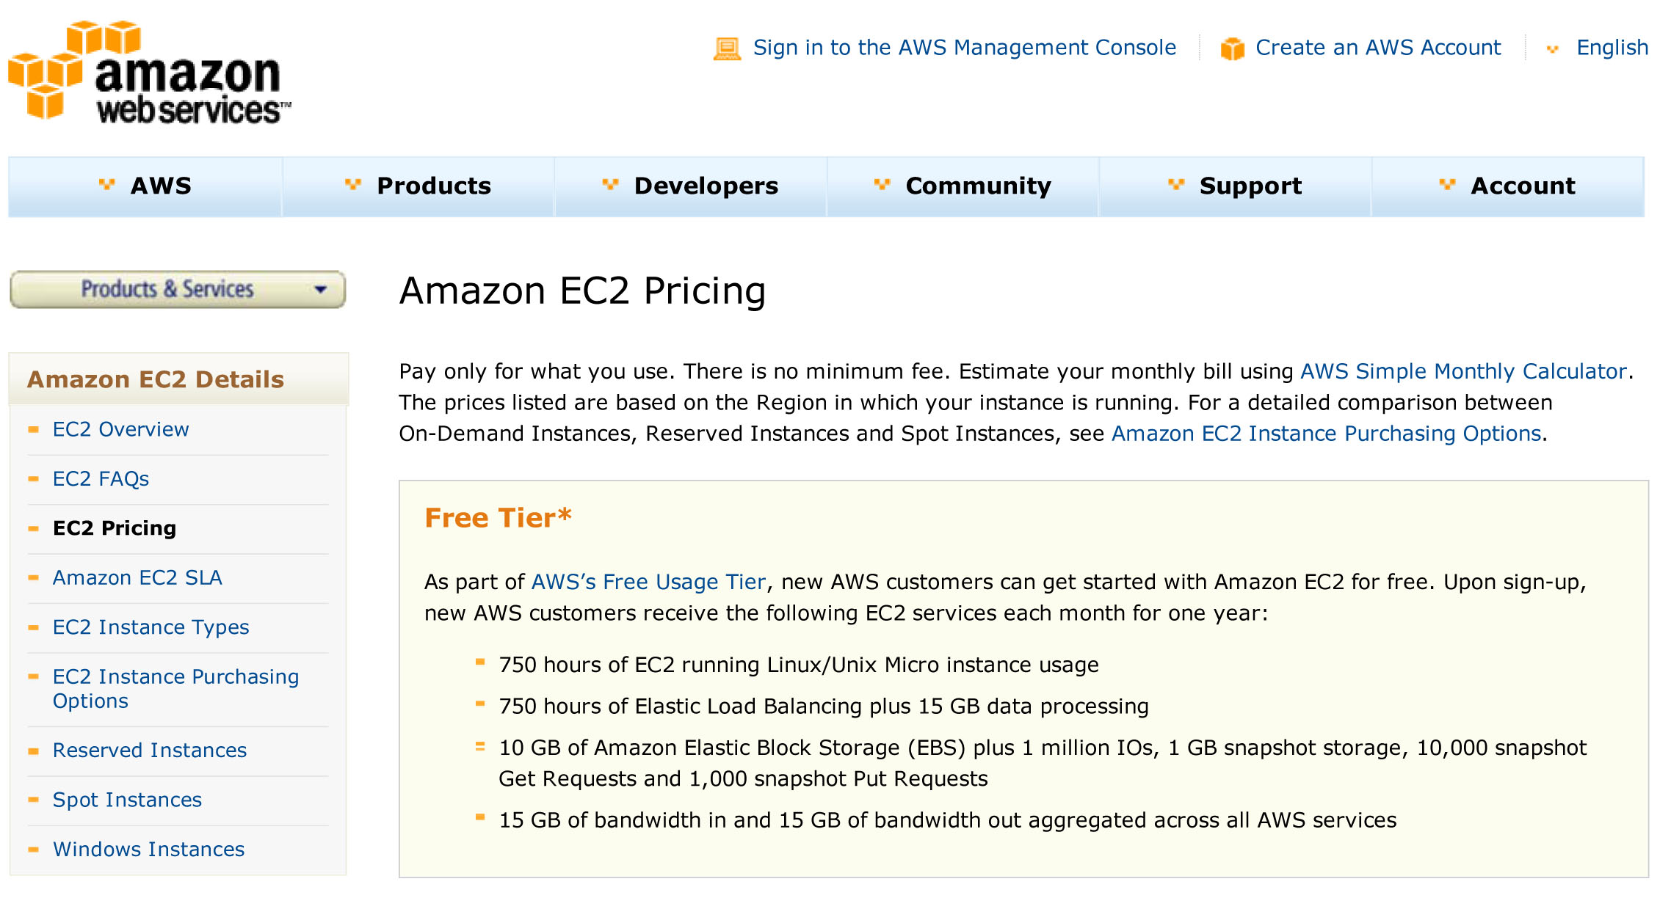

Slide 19
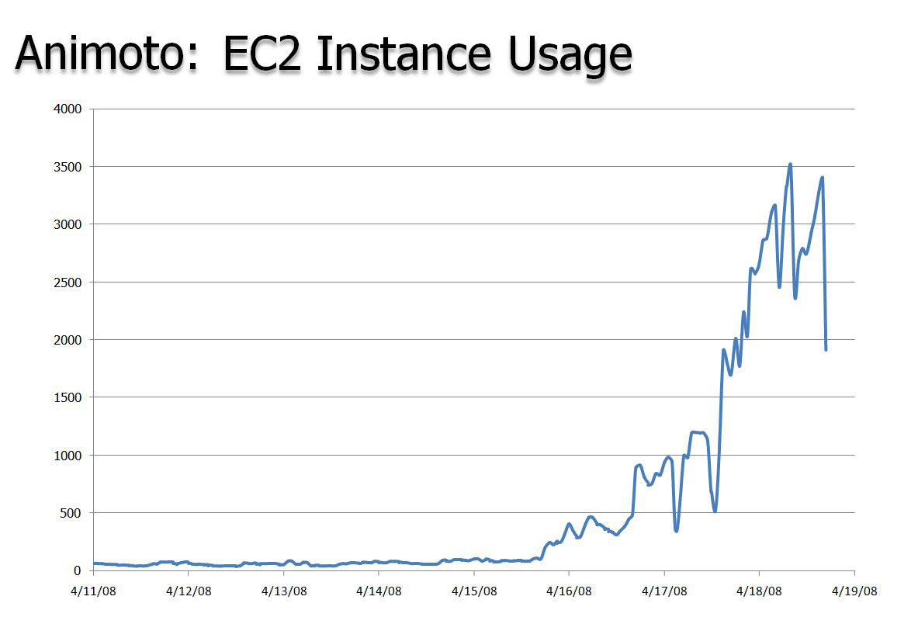
Slide courtesy of Werner Vogels

Slide 20
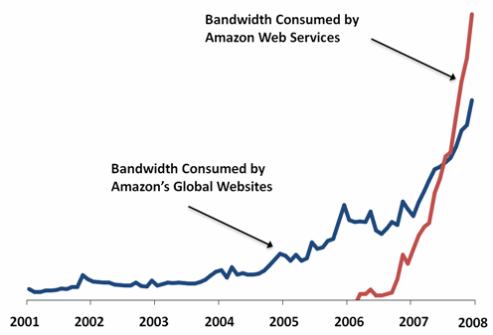
Slide courtesy of Werner Vogels

Slide 21
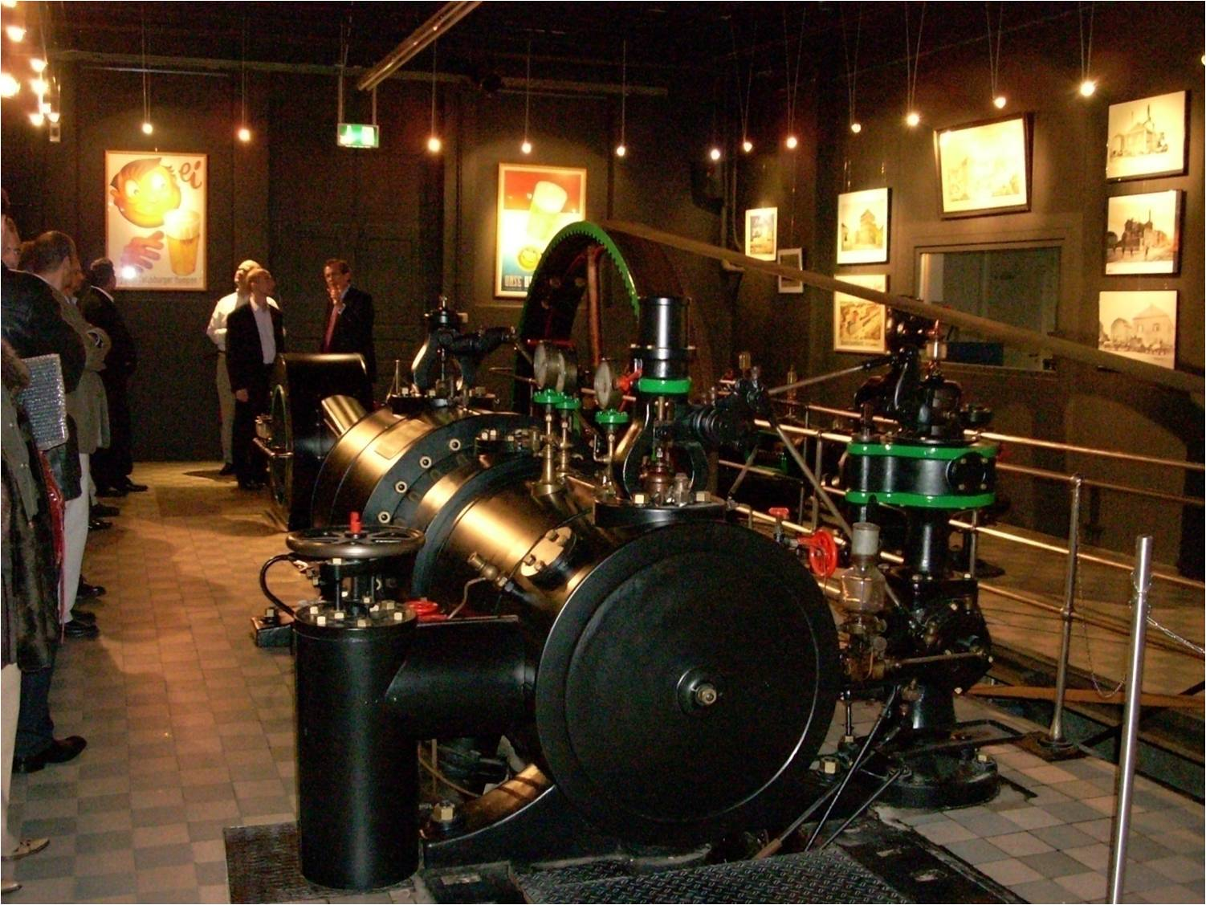
Slide courtesy of Werner Vogels

