Slide 1
CSE 451: Operating Systems Spring 2012 Module 21 461 in 9 slides
Ed Lazowska
lazowska@cs.washington.edu
Allen Center 570
Notes:
1

Slide 2
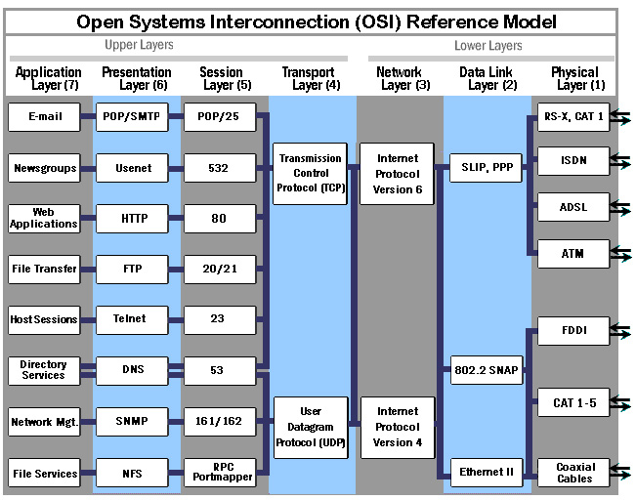

Slide 3
Data link layer: Ethernet
Broadcast network
CSMA-CD: Carrier Sense Multiple Access with Collision Detection
recall the “standing in a circle, drinking beer and telling stories” analogy
Packetized – fixed
Every computer has a unique physical address
00-08-74-C9-C8-7E

Slide 4
Packet format
Interface listens for its address, interrupts OS when a packet is received
physical address
payload

Slide 5
Network layer: IP
Internet Protocol (IP)
routes packets across multiple networks, from source to destination
Every computer has a unique Internet address
172.30.192.251
Individual networks are connected by routers that have physical addresses (and interfaces) on each network

Slide 6
A really hairy protocol lets any node on a network find the physical address on that network of a router that can get a packet one step closer to its destination
Packet format
physical address
payload
IP address
payload

Slide 7
A separate really hairy protocol, DNS (the Domain Name Service), maps from intelligible names (lazowska.org) to IP addresses (174.61.234.236)
So to send a packet to a destination
use DNS to convert domain name to IP address
prepare IP packet, with payload prefixed by IP address
determine physical address of appropriate router
encapsulate IP packet in Ethernet packet with appropriate physical address
blast away!
Detail: port number gets you to a specific address space on a system
a process can “register” for a port, and some are always used: 25=SMTP, 80=web server, 20=FTP, 22=ssh, etc.

Slide 8
Transport layer: TCP
TCP: Transmission Control Protocol
manages to fabricate reliable multi-packet messages out of unreliable single-packet datagrams
analogy: sending a book via postcards – what’s required?
physical address
payload
IP address
payload
TCP info
payload

Slide 9
Summary
Using TCP/IP and lower layers, we can get multi-packet messages delivered reliably from address space A on machine B to address space C on machine D, where machines B and D are many heterogeneous network hops apart, without knowing any of the underlying details
Higher protocol layers facilitate specific services
email: smtp
web: http
file transfer: ftp
remote login: telnet

