Slide 1
CSE 451: Operating Systems Spring 2012 Module 1 Course Introduction
Ed Lazowska
lazowska@cs.washington.edu
570 Allen Center
Notes:
1

Slide 2
Today’s agenda
Administrivia
Course overview
course staff
general structure
the text(s)
policies
your to-do list
OS overview
Trying to make sense of the topic

Slide 3
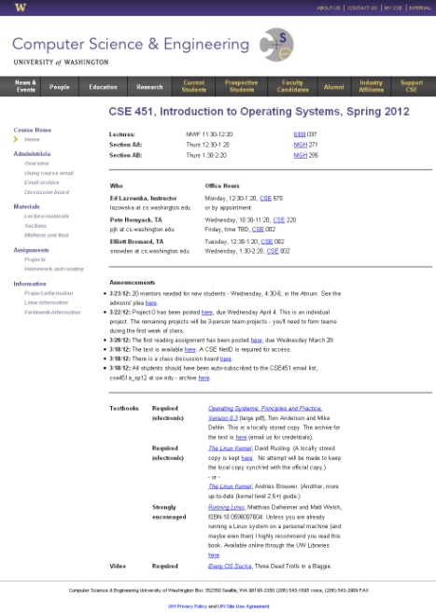
Course overview
Operationally, everything you need to
know will be on the course web page:
http://www.cs.washington.edu/451/
Or in the course email and email archive:
https://mailman1.u.washington.edu/mailman/private/cse451a_sp12/
Or on the course discussion board:
https://catalyst.uw.edu/gopost/board/lazowska/26879/

Slide 4
But to tide you over for the next hour …
Course staff
Ed Lazowska
Pete Hornyack
Elliott Brossard
General Course Structure
Read the text prior to class
Class doesn't aim to repeat the text
Homework exercises to motivate reading by non-saints
Sections will focus on projects
You're paying for interaction

Slide 5
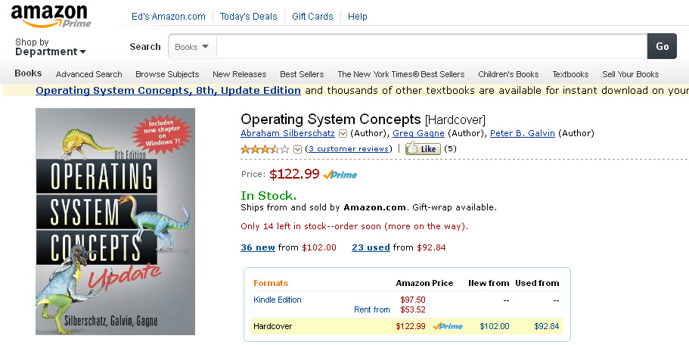
The text
X

Slide 6
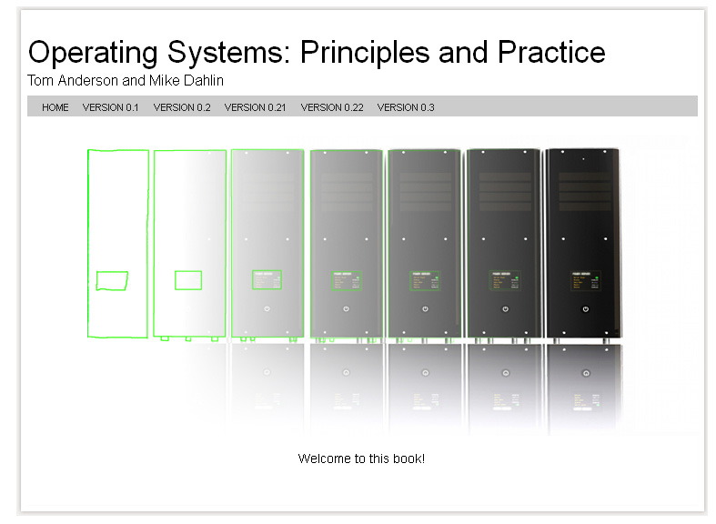
The text

Slide 7
The text
Not quite all there
Really outstanding – written by current experts
Do not ignore it – read it and ask questions about it!
Other resources
Many online; some of them are essential
Policies
Collaboration vs. cheating
Projects: late policy

Slide 8
Projects
Project 0: a warmup
Projects 1-3: significant OS “internals” projects to be done in teams of 3
You’re likely to be happier if you form a team on your own than if we form one for you!
You’ll need to do this over the weekend
Project 1 will begin next Wednesday
We’ll ask for your input by Sunday night and create teams as needed

Slide 9
Your to-do list …
Please read the entire course web thoroughly, today
Be sure you’re on the cse451 email list, and check your email daily
Please keep up with the reading
Homework 1 (reading) is posted on the web now
Due at the start of class Wednesday
Project 0 (“warmup”) is posted on the web now
Will be discussed in section Thursday
Due at the end of the day next Wednesday
Begin coming up with a 3-person team for Projects 1-3

Slide 10
Course registration
If you’re going to drop, please do it soon!
If you want to get into the class, be sure you’ve registered with the advisors
They run the show
I have a registration sheet here!

Slide 11
More about 451
This is really two “linked” classes:
A classroom/textbook part (mainly run by me)
A project part (mainly run by the TA(s))
In a perfect world, we would do this as a two-quarter sequence
The world isn’t perfect ☺
By the end of the course, you’ll see how it all fits together!
There will be a lot of work
You’ll learn a lot
In the end, you’ll understand much more deeply how computer systems work
“There is no magic”

Slide 12
What is an Operating System?
Answers:
I don't know.
Nobody knows.
The book claims to know – read Chapter 1.
They’re programs – big hairy programs
The Linux source you'll be compiling has over 1.7M lines of C

Slide 13
What is an Operating System?
Answers:
I don't know.
Nobody knows.
The book claims to know – read Chapter 1.
They’re programs – big hairy programs
The Linux source you'll be compiling has over 1.7M lines of C
Okay. What are some goals of an OS?

Slide 14
The traditional picture
Applications
OS
Hardware
“The OS is everything you don’t need to write in order to run your application”
This depiction invites you to think of the OS as a library; we’ll see that
In some ways, it is:
all operations on I/O devices require OS calls (syscalls)
In other ways, it isn't:
you use the CPU/memory without OS calls
it intervenes without having been explicitly called

Slide 15
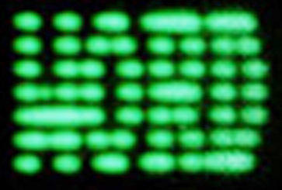
“Everything you don’t have to write” What is Windows?
Application
DOS
© John DeTreville, Microsoft Corp.

Slide 16
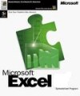
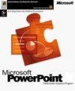
“Everything you don’t have to write” What is Windows?
Application
…
Application
…
Browser
TCP/IP
File system
COM
…
Installer
Printing
DOS
Windows
© John DeTreville, Microsoft Corp.

Slide 17
“Everything you don’t have to write” What is .NET?
Application
Internet
© John DeTreville, Microsoft Corp.

Slide 18
“Everything you don’t have to write” What is .NET?
Application
Bank
eBay
FedEx
Extensibility
Asynchrony
…
magic
XML
…
Device
independence
Identity
& security
Internet
.NET
© John DeTreville, Microsoft Corp.

Slide 19
The OS and hardware
An OS mediates programs’ access to hardware resources (sharing and protection)
computation (CPU)
volatile storage (memory) and persistent storage (disk, etc.)
network communications (TCP/IP stacks, Ethernet cards, etc.)
input/output devices (keyboard, display, sound card, etc.)
The OS abstracts hardware into logical resources and well-defined interfaces to those resources (ease of use)
processes (CPU, memory)
files (disk)
programs (sequences of instructions)
sockets (network)

Slide 20
The text says an OS is …
A Referee
Mediate resource sharing
An Illusionist
Mask hardware limitations
Glue
Provide common services

Slide 21
Why bother with an OS?
Application benefits
programming simplicity
see high-level abstractions (files) instead of low-level hardware details (device registers)
abstractions are reusable across many programs
portability (across machine configurations or architectures)
device independence: 3com card or Intel card?
User benefits
safety
program “sees” its own virtual machine, thinks it “owns” the computer
OS protects programs from each other
OS fairly multiplexes resources across programs
efficiency (cost and speed)
share one computer across many users
concurrent execution of multiple programs

Slide 22
The major OS issues
structure: how is the OS organized?
sharing: how are resources shared across users?
naming: how are resources named (by users or programs)?
security: how is the integrity of the OS and its resources ensured?
protection: how is one user/program protected from another?
performance: how do we make it all go fast?
reliability: what happens if something goes wrong (either with hardware or with a program)?
extensibility: can we add new features?
communication: how do programs exchange information, including across a network?

Slide 23
More OS issues…
concurrency: how are parallel activities (computation and I/O) created and controlled?
scale: what happens as demands or resources increase?
persistence: how do you make data last longer than program executions?
distribution: how do multiple computers interact with each other?
accounting: how do we keep track of resource usage, and perhaps charge for it?
There are tradeoffs, not right and wrong!

Slide 24
Hardware/Software Changes with Time
1960s: mainframe computers (IBM)
1970s: minicomputers (DEC)
1980s: microprocessors and workstations (SUN), local-area networking, the Internet
1990s: PCs (rise of Microsoft, Intel, Dell), the Web
2000s:
Internet Services / Clusters (Amazon)
General Cloud Computing (Google, Amazon, Microsoft)
Mobile/ubiquitous/embedded computing (iPod, iPhone, iPad, Android)
2010s: sensor networks, “data-intensive computing,” computers and the physical world
2020: it’s up to you!!

Slide 25
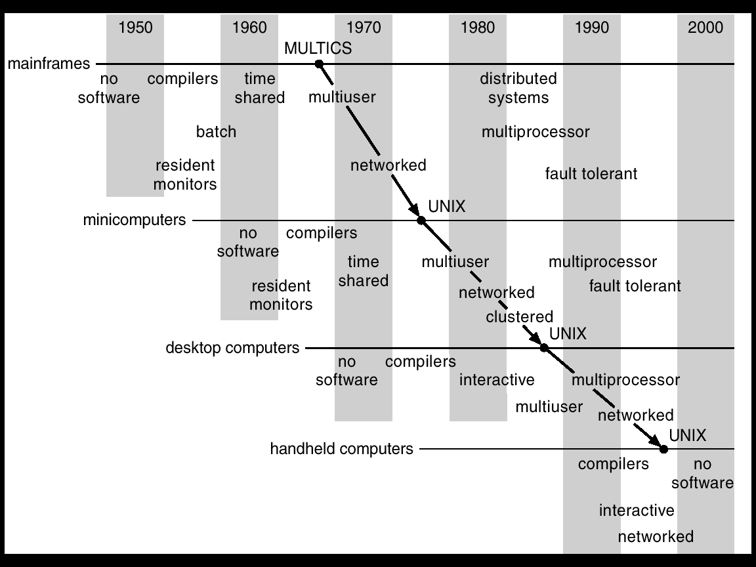
Progression of concepts and form factors
© Silberschatz, Galvin and Gagne

Slide 26
Has it all been discovered?
New challenges constantly arise
embedded computing (e.g., iPod)
sensor networks (very low power, memory, etc.)
peer-to-peer systems
ad hoc networking
scalable server farm design and management (e.g., Google)
software for utilizing huge clusters (e.g., MapReduce, Bigtable)
overlay networks (e.g., PlanetLab)
worm fingerprinting
finding bugs in system code (e.g., model checking)
Old problems constantly re-define themselves
the evolution of smart phones recapitulated the evolution of PCs, which had recapitulated the evolution of minicomputers, which had recapitulated the evolution of mainframes
but the ubiquity of PCs re-defined the issues in protection and security, as phones are doing once again

Slide 27
Protection and security as an example
none
OS from my program
your program from my program
my program from my program
access by intruding individuals
access by intruding programs
denial of service
distributed denial of service
spoofing
spam
worms
viruses
stuff you download and run knowingly (bugs, trojan horses)
stuff you download and run obliviously (cookies, spyware)

Slide 28
An OS history lesson
Operating systems are the result of a 60 year long evolutionary process.
They were born out of need
We'll follow a bit of their evolution
That should help make clear what some of their functions are, and why

Slide 29
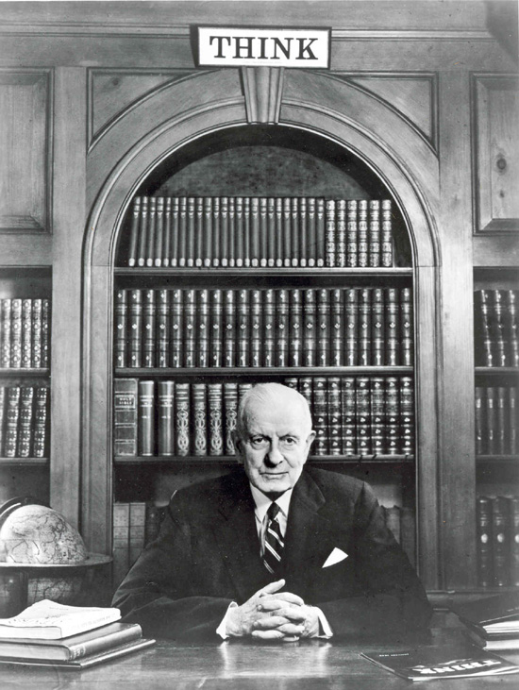
In the Beginning...
1943
T.J. Watson (created IBM): “ I think there is a world market for maybe five
computers.”
Fast forward … 1950
There are maybe 20 computers in the world
They were unbelievably expensive
Imagine this: machine time is more valuable than person time!
Ergo: efficient use of the hardware is paramount
Operating systems are born
They carry with them the vestiges of these ancient forces

Slide 30
The Primordial Computer
Printer
Diskosaurus
CPU
Input Device
Memory

Slide 31
The OS as a linked library
In the very beginning…
OS was just a library of code that you linked into your program; programs were loaded in their entirety into memory, and executed
“OS” had an “API” that let you control the disk, control the printer, etc.
Interfaces were literally switches and blinking lights
When you were done running your program, you’d leave and turn the computer over to the next person

Slide 32
Asynchronous I/O
The diskosaurus was really slow
Add hardware so that the disk could operate without tying up the CPU
Disk controller
Hotshot programmers could now write code that:
Starts an I/O
Goes off and does some computing
Checks if the I/O is done at some later time
Upside
Helps increase (expensive) CPU utilization
Downsides
It's hard to get right
The benefits are job specific

Slide 33
The OS as a “resident monitor”
Everyone was using the same library of code
Why not keep it in memory?
While we’re at it, make it capable of loading Program 4 while running Program 3 and printing the output of Program 2
SPOOLing – Simultaneous Peripheral Operations On-Line
What new requirements does this impose?

Slide 34
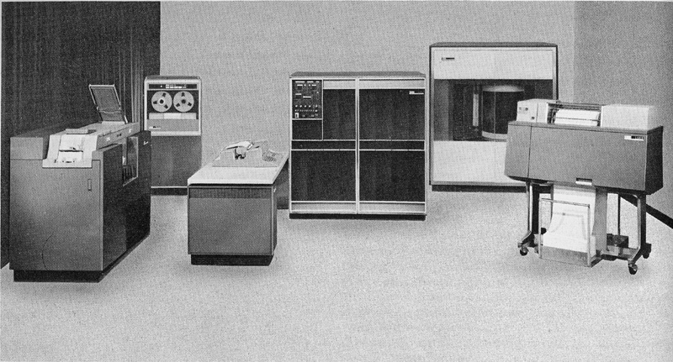
IBM 1401

Slide 35
Multiprogramming
To further increase system utilization, multiprogramming OSs were invented
keeps multiple runnable jobs loaded in memory at once
overlaps I/O of one job with computing of another
while one job waits for I/O completion, another job uses the CPU
Can get rid of asynchronous I/O within individual jobs
Life of application programmer becomes simpler; only the OS programmer needs to deal with asynchronous events
How do we tell when devices are done?
Interrupts
Polling
What new requirements does this impose?

Slide 36
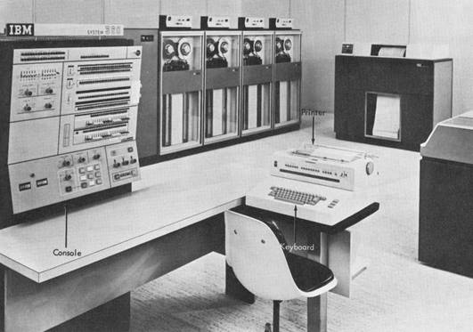
IBM System 360

Slide 37
(An aside on protection)
Applications/programs/jobs execute directly on the CPU, but cannot touch anything except “their own memory” without OS intervention

Slide 38
(An aside on concurrency)
CPU architects tell us that individual cores aren't going to be getting faster (very fast), but that they can double the number of cores on the old 18 month cycle (or so)
The burden is on the programmer to use an ever increasing number of cores
A lot of this course is about concurrency
It used to be a bit esoteric
It has now become one of the most important things you'll learn (in any of our courses)

Slide 39
Timesharing
To support interactive use, create a timesharing OS:
multiple terminals into one machine
each user has illusion of entire machine to him/herself
optimize response time, perhaps at the cost of throughput
Timeslicing
divide CPU equally among the users
if job is truly interactive (e.g., editor), then can jump between programs and users faster than users can generate load
permits users to interactively view, edit, debug running programs

Slide 40
MIT CTSS system (operational 1961) was among the first timesharing systems
only one user memory-resident at a time (32KB memory!)
MIT Multics system (operational 1968) was the first large timeshared system
nearly all OS concepts can be traced back to Multics!
“second system syndrome”

Slide 41
CTSS as an illustration of architectural and OS functionality requirements
User program
OS

Slide 42
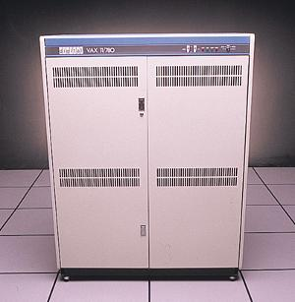
In early 1980s, a single timeshared VAX-11/780 (like the one in the Allen Center atrium) ran computing for all of CSE.
A typical VAX-11/780 was 1 MIPS (1 MHz) and had 1MB of RAM and 100MB of disk.
An Apple iPhone 4 is 1GHz (x1000), has 512MB of RAM (x512), and 32GB of flash (x320).

Slide 43
Parallel systems
Some applications can be written as multiple parallel threads or processes
can speed up the execution by running multiple threads/processes simultaneously on multiple CPUs [Burroughs D825, 1962]
need OS and language primitives for dividing program into multiple parallel activities
need OS primitives for fast communication among activities
degree of speedup dictated by communication/computation ratio
many flavors of parallel computers today
SMPs (symmetric multi-processors)
MPPs (massively parallel processors)
NOWs (networks of workstations)
Massive clusters (Google, Amazon.com, Microsoft)
Computational grid (SETI @home)

Slide 44
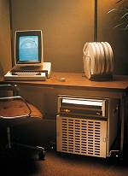
Personal computing
Primary goal was to enable new kinds of applications
Bit mapped display [Xerox Alto,1973]
new classes of applications
new input device (the mouse)
Move computing near the display
why?
Window systems
the display as a managed resource
Local area networks [Ethernet]
why?
Effect on OS?

Slide 45
Distributed OS
Distributed systems to facilitate use of geographically distributed resources
workstations on a LAN
servers across the Internet
Supports communications between programs
interprocess communication
message passing, shared memory
networking stacks
Sharing of distributed resources (hardware, software)
load balancing, authentication and access control, …
Speedup isn’t the issue
access to diversity of resources is goal

Slide 46
Client/server computing
Mail server/service
File server/service
Print server/service
Compute server/service
Game server/service
Music server/service
Web server/service
etc.

Slide 47
Peer-to-peer (p2p) systems
Napster
Gnutella
example technical challenge: self-organizing overlay network
technical advantage of Gnutella?
er … legal advantage of Gnutella?

Slide 48
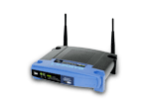
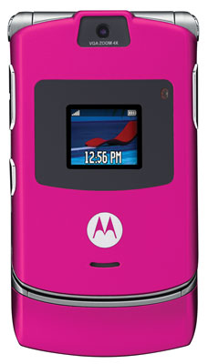
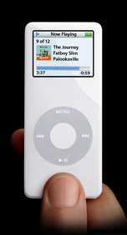
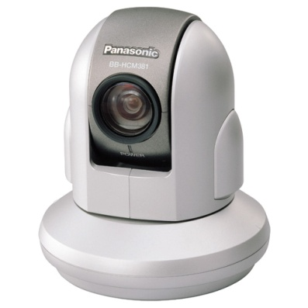
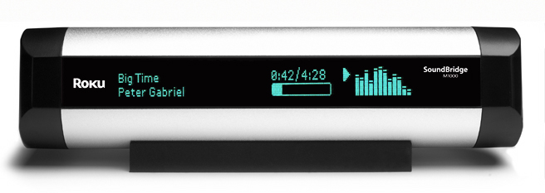
Embedded/mobile/pervasive computing
Pervasive computing
cheap processors embedded everywhere
how many are on your body now? in your car?
cell phones, PDAs, network computers, …
Often constrained hardware resources
slow processors
small amount of memory
no disk
often only one dedicated application
limited power
But this is changing rapidly!

Slide 49
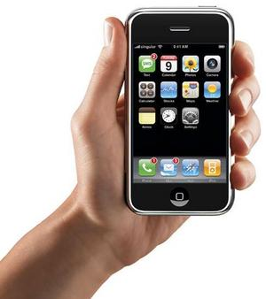
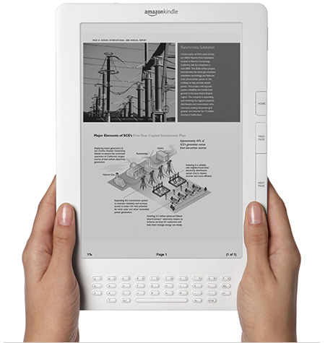

Slide 50
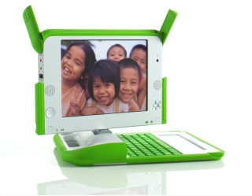
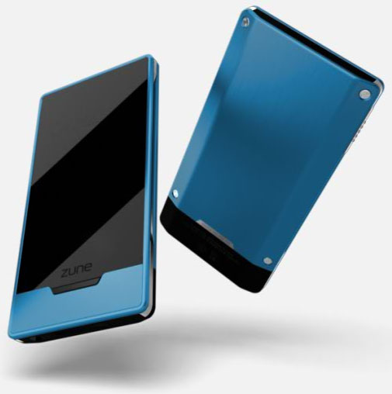
Ad hoc networking

Slide 51
The major OS issues
structure: how is the OS organized?
sharing: how are resources shared across users?
naming: how are resources named (by users or programs)?
security: how is the integrity of the OS and its resources ensured?
protection: how is one user/program protected from another?
performance: how do we make it all go fast?
reliability: what happens if something goes wrong (either with hardware or with a program)?
extensibility: can we add new features?
communication: how do programs exchange information, including across a network?

Slide 52
More OS issues…
concurrency: how are parallel activities (computation and I/O) created and controlled?
scale: what happens as demands or resources increase?
persistence: how do you make data last longer than program executions?
distribution: how do multiple computers interact with each other?
accounting: how do we keep track of resource usage, and perhaps charge for it?
There are tradeoffs, not right and wrong!

Slide 53
CSE 451
In this class we will learn:
what are the major components of most OS’s?
how are the components structured?
what are the most important (common?) interfaces?
what policies are typically used in an OS?
what algorithms are used to implement policies?
Philosophy
you may not ever build an OS
but as a computer scientist or computer engineer you need to understand the foundations
most importantly, operating systems exemplify the sorts of engineering design tradeoffs that you’ll need to make throughout your careers – compromises among and within cost, performance, functionality, complexity, schedule …
you will love this course!

