Slide 1
OptiCue Speech Tool
Justin Lee
Alireza Hashemloo
Ying Qing Set

Slide 2
Why communicate?
Communication Influences Your Thinking about Yourself and Others
You share meaning in what you say and how you say it, both in oral and written forms
Communication Influences How You Learn
Your speaking and writing are reflections of your thoughts, experience, and education
Oral and written communication proficiencies are consistently ranked in the top ten desirable skills by employer surveys year after year
Communication Skills Are Desired by Business and Industry

Slide 3
The fact is many people are not wholly effective at communicating
They may not have the right things to say
They may not know how to say it
knowing both might still botch their delivery

Slide 4
Contextual Inquiry
Things we learnt during our inquiries.
Speech habits are universal
Social context is a big factor
Practice is the way to improve

Slide 5
Professor Matt McGarrity
PhD Communication and Culture, Indiana University, 2005;
UW Senior Lecturer, Introduction to Public Speaking; Founder and Director of the UW Public Speaking Center
Good speaking equals good judgment.
naturally decide speed, cadence, intonation, pitch, tone, cues, and more in order to speak appropriately and effectively for the context at hand.
To teach someone to be a good speaker, it requires a humanistic approach and much practice to develop that judgment.
It is analogous to sports.

Slide 6
6 Tasks
Monitoring and optionally recording, replaying user’s speech
Collect speech data and present it in human readable way.
Determining what makes someone an effective speaker, and what detracts from being an effective speaker
Provide a platform for users to get feedback on their speech
Allow users to practice and learn the native cadences.
Improves users’ speaking vocabulary

Slide 7
3 Design Sketches
This design allow users to have a private display to have notes on what they plan to say, notifications they wish to see in order to become a better speaker.
This device is intended to passively record the user's speech data to be reviewed at a later time.
This design provides platform for connecting people who need feedback on their talking, and those willing to provide that feedback.

Slide 8
Why Glass
1
A clear user base
2
Solving a specific problem
3
Ability to find and see information in real-time on a head’s-up display

Slide 9
How Does it Help?
Monitoring and recording one's speech
gathering information on how the user talks, and allowing them to view that information, and also guide and improve their speaking ability
determine what makes someone an effective or ineffective speaker
The user can improve their speaking ability and be better prepared, and this tackles the major want and need of becoming a better speaker.

Slide 10
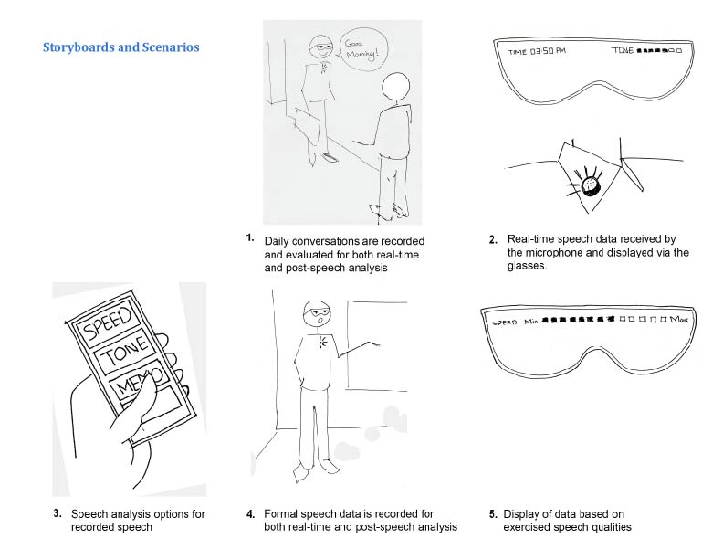
Scenario

Slide 11
At the End of the Day
Good speaking equals good judgment.
Speech habits are universal.
Social context is a big factor.
Practice is the way to improve.

