Slide 1
Heuristic Evaluation

Slide 2
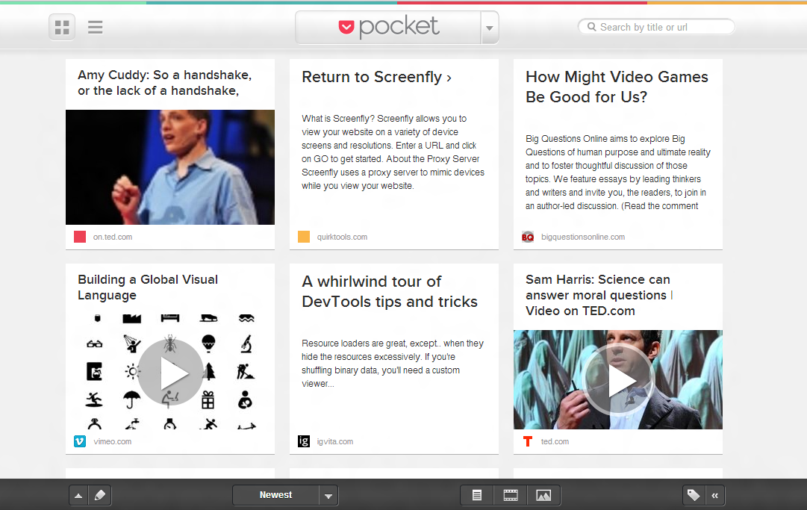
Hall of Fame or Shame?
Pocket
By Read It Later
Notes:
MUST DEMO THIS LIVE to really show it

Slide 3
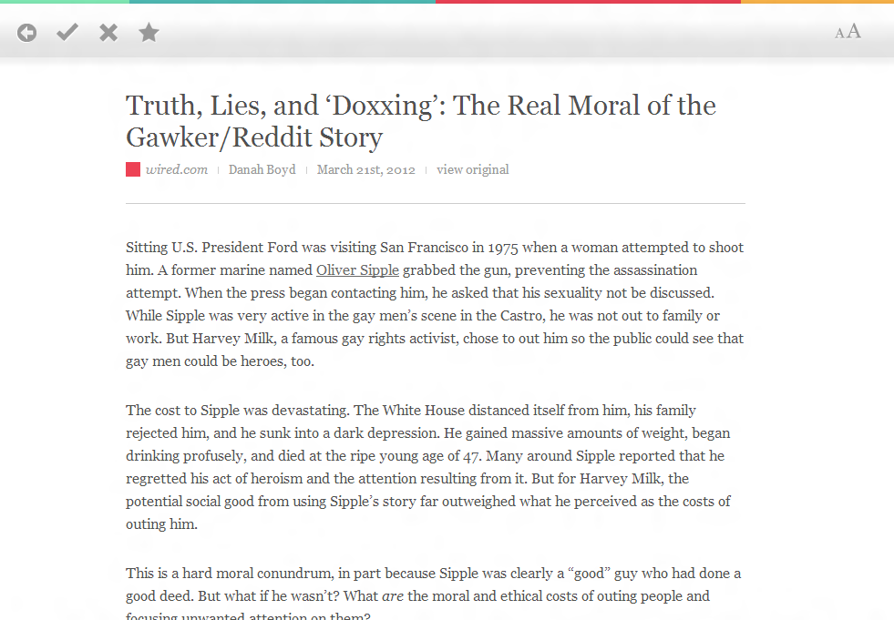
Hall of Fame or Shame?
Minimalist reading mode.
Notes:
3 gestures:
pinching in & out to go forward and back
swipe up from the bottom for tools
rotate two fingers to undo/redo

Slide 4
Hall of Fame or Shame?
Items can be saved from iPhone, iPad, Android devices, web app, Chrome/Firefox extension, or email.
Notes:
3 gestures:
pinching in & out to go forward and back
swipe up from the bottom for tools
rotate two fingers to undo/redo

Slide 5
Hall of Fame!
Good
beautiful visual design
support across a large number of devices means you can always use it
optimized for quickly and easily saving and reading articles
Bad
significantly reformats content
saves link from tweets, but not the message
Pocket
By Read It Later

Slide 6
Heuristic Evaluation

Slide 7
Outline
HE Process Overview
The Heuristics
How to Perform Heuristic Evaluation
Heuristic Evaluation vs. Usability Testing

Slide 8
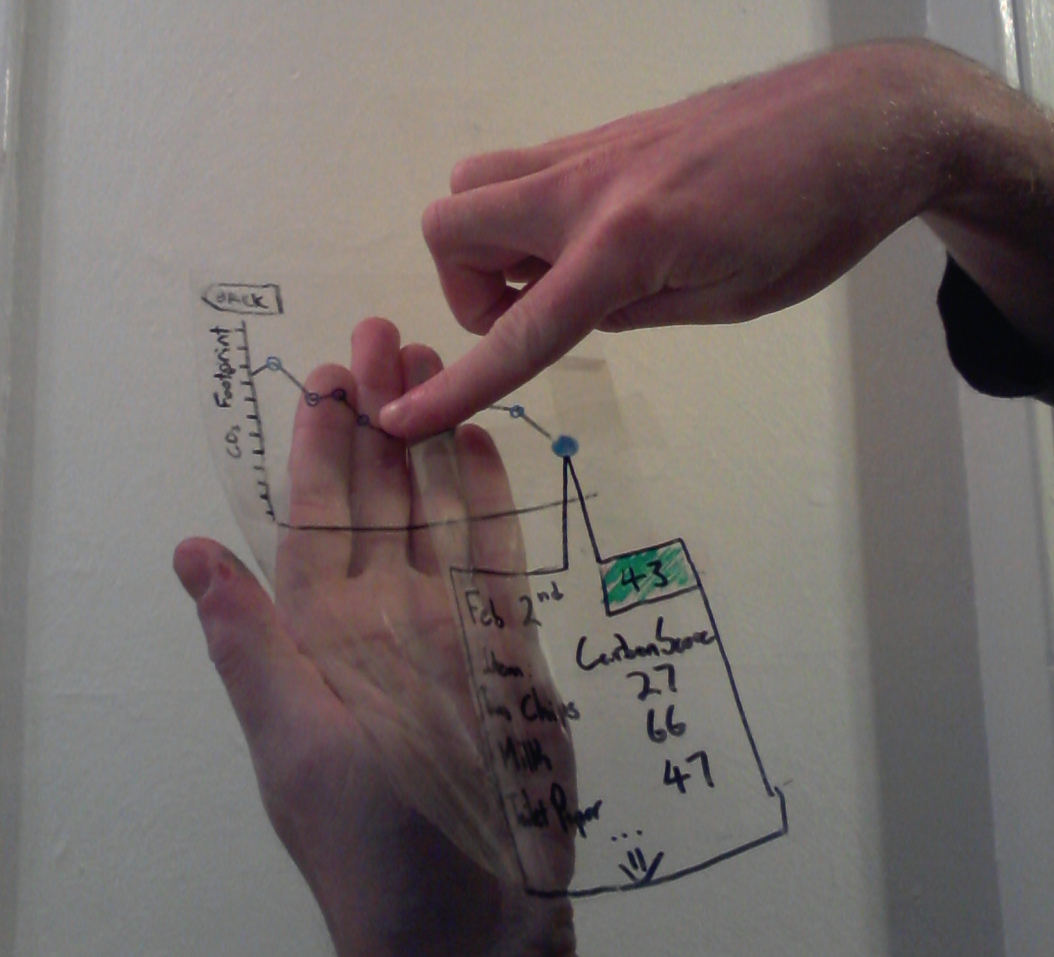
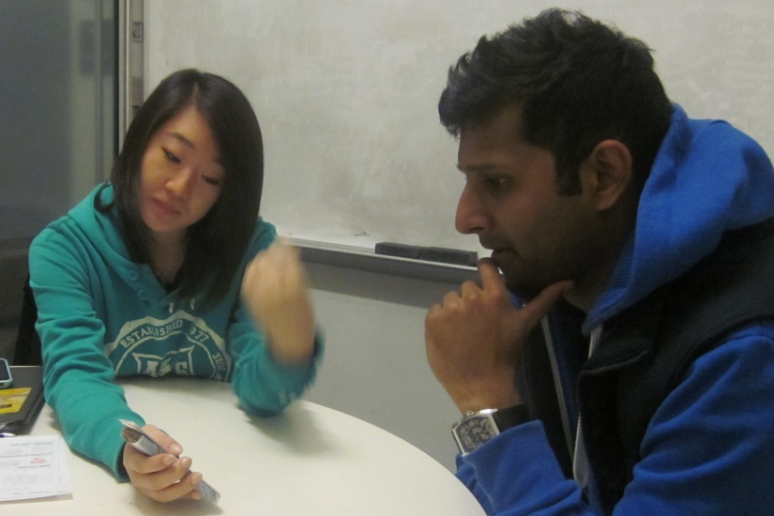
Evaluation
About figuring out how to improve design
Issues with lo-fi tests?

Slide 9
Heuristic Evaluation
Developed by Jakob Nielsen
Helps find usability problems in a UI design
Small set (3-5) of evaluators examine UI
independently check for compliance with usability principles (“heuristics”)
different evaluators will find different problems
evaluators only communicate afterwards
findings are then aggregated
Can perform on working UI or on sketches

Slide 10
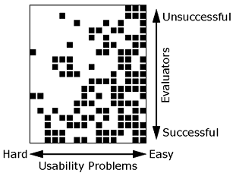
Why Multiple Evaluators?
Every evaluator doesn’t find every problem
Good evaluators find both easy & hard ones

Slide 11
Heuristic Evaluation Process
Evaluators go through UI several times
inspect various dialogue elements
compare with list of usability principles
consider other principles/results that come to mind
Usability principles
Nielsen’s “heuristics”
supplementary list of category-specific heuristics
competitive analysis & user testing of existing products
Use violations to redesign/fix problems

Slide 12
Heuristics (original)
H1-1: Simple & natural dialog
H1-2: Speak the users’ language
H1-3: Minimize users’ memory load
H1-4: Consistency
H1-5: Feedback
H1-6: Clearly marked exits
H1-7: Shortcuts
H1-8: Precise & constructive error messages
H1-9: Prevent errors
H1-10: Help and documentation

Slide 13
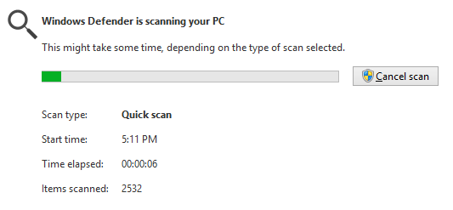
Heuristics (revised set)
H2-1: Visibility of system status
keep users informed about what is going on
example: pay attention to response time
0.1 sec: no special indicators needed, why?
1.0 sec: user tends to lose track of data
10 sec: max. duration if user to stay focused on action
for longer delays, use percent-done progress bars

Slide 14
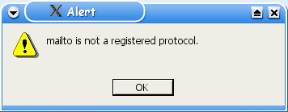
Heuristics (cont.)
Bad example: Mac desktop
Dragging disk to trash
should delete it, not eject it
H2-2: Match between system & real world
speak the users’ language
follow real world conventions

Slide 15
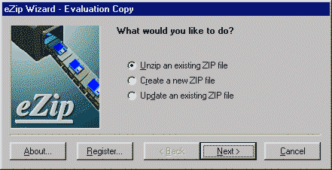
Heuristics (cont.)
Wizards
must respond to Q before going to next
for infrequent tasks
(e.g., modem config.)
not for common tasks
good for beginners
have 2 versions (WinZip)
H2-3: User control & freedom
“exits” for mistaken choices, undo, redo
don’t force down fixed paths
like that BART machine…

Slide 16
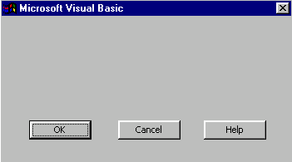
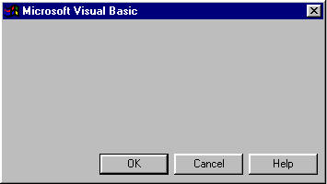
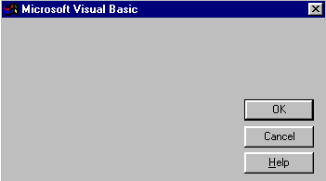
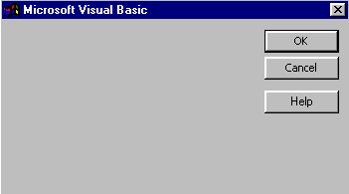
Heuristics (cont.)
H2-4: Consistency & standards

Slide 17
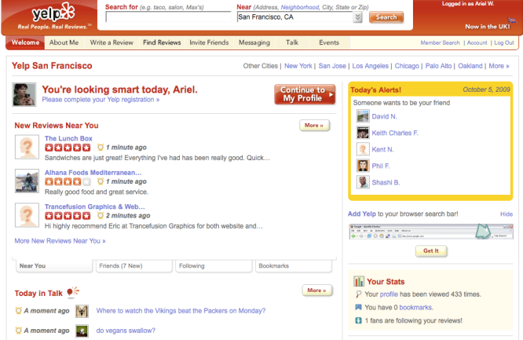
Heuristics (cont.)
H2-4: Consistency & standards
use the same language, placement, etc. everywhere
follow platform conventions
H2-4: Consistency & standards

Slide 18
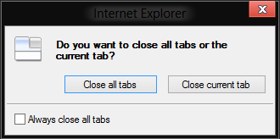
Heuristics (cont.)
H2-5: Error prevention
H2-6: Recognition rather than recall
make objects, actions, options, & directions visible/easily retrievable
% rm –rf *
%

Slide 19
Heuristics (cont.)
H2-7: Flexibility and efficiency of use
accelerators for experts (e.g., gestures, kb shortcuts)
allow users to tailor frequent actions (e.g., macros)

Slide 20
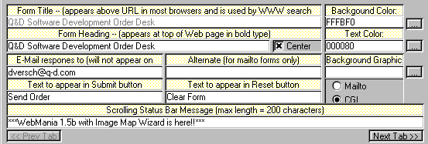
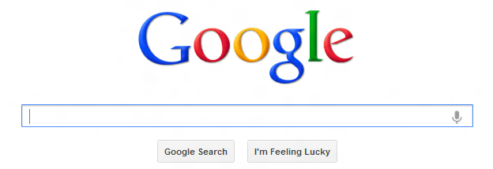
Heuristics (cont.)
H2-8: Aesthetic & minimalist design
no irrelevant information in dialogues

Slide 21
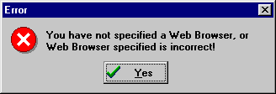
Heuristics (cont.)
H2-9: Help users recognize, diagnose, & recover from errors
error messages in plain language
precisely indicate the problem
constructively suggest a solution

Slide 22
Good Error Messages
Clearly indicate something has gone wrong
Be human readable
Be polite
Describe the problem
Explain how to fix it
Be highly noticeable

Slide 23
Heuristics (cont.)
H2-10: Help and documentation
easy to search
focused on the user’s task
list concrete steps to carry out
not too large

Slide 24
Mobile Heuristics
Enrico Bertini, Silvia Gabrielli, and Stephen Kimani. 2006. Appropriating and assessing heuristics for mobile computing. In Proceedings of the working conference on Advanced visual interfaces (AVI '06). ACM, New York, NY, USA, 119-126. DOI=10.1145/1133265.1133291 http://doi.acm.org/10.1145/1133265.1133291

Slide 25
Phases of Heuristic Evaluation
1) Pre-evaluation training
give evaluators needed domain knowledge & information on the scenario
2) Evaluation
individuals evaluates UI & makes list of problems
3) Severity rating
determine how severe each problem is
4) Aggregation
group meets & aggregates problems (w/ ratings)
5) Debriefing
discuss the outcome with design team

Slide 26
How to Perform Evaluation
At least two passes for each evaluator
first to get feel for flow and scope of system
second to focus on specific elements
If system is walk-up-and-use or evaluators are domain experts, no assistance needed
otherwise might supply evaluators with scenarios
Each evaluator produces list of problems
explain why with reference to heuristic or other information
be specific & list each problem separately

Slide 27
Examples
Can’t copy info from one window to another
violates “Minimize the users’ memory load” (H1-3)
fix: allow copying
Typography uses different fonts in 3 dialog boxes
violates “Consistency and standards” (H2-4)
slows users down
probably wouldn’t be found by user testing
fix: pick a single format for entire interface

Slide 28
How to Perform Heuristic Evaluation
Why separate listings for each violation?
risk of repeating problematic aspect
may not be possible to fix all problems
Where problems may be found
single location in UI
two or more locations that need to be compared
problem with overall structure of UI
something that is missing
common problem with paper prototypes
note: sometimes features are implied by design docs and just haven’t been “implemented” – relax on those

Slide 29
Severity Rating
Used to allocate resources to fix problems
Estimates of need for more usability efforts
Combination of
frequency
impact
persistence (one time or repeating)
Should be calculated after all evals. are in
Should be done independently by all judges

Slide 30
Severity Ratings (cont.)
0 – don’t agree that this is a usability problem
1 - cosmetic problem
2 - minor usability problem
3 - major usability problem; important to fix
4 - usability catastrophe; imperative to fix

Slide 31
Debriefing
Conduct with evaluators, observers, and development team members
Discuss general characteristics of UI
Suggest potential improvements to address major usability problems
Dev. team rates how hard things are to fix
Make it a brainstorming session
little criticism until end of session

Slide 32
Severity Ratings Example
1. [H1-4 Consistency] [Severity 3][Fix 0]
The interface used the string "Save" on the first screen for saving the user's file, but used the string "Write file" on the second screen. Users may be confused by this different terminology for the same function.

Slide 33
HE vs. User Testing
HE is much faster
1-2 hours each evaluator vs. days-weeks
HE doesn’t require interpreting user’s actions
User testing is far more accurate (by def.)
takes into account actual users and tasks
HE may miss problems & find “false positives”
Good to alternate between HE & user testing
find different problems
don’t waste participants

Slide 34
Results of Using HE
Discount: benefit-cost ratio of 48 [Nielsen94]
cost was $10,500 for benefit of $500,000
value of each problem ~15K (Nielsen & Landauer)
how might we calculate this value?
in-house → productivity; open market → sales
Correlation between severity & finding w/ HE
Single evaluator achieves poor results
only finds 35% of usability problems
5 evaluators find ~ 75% of usability problems
why not more evaluators???? 10? 20?
adding evaluators costs more & won’t find more probs

Slide 35
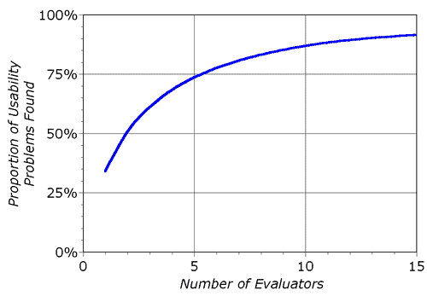
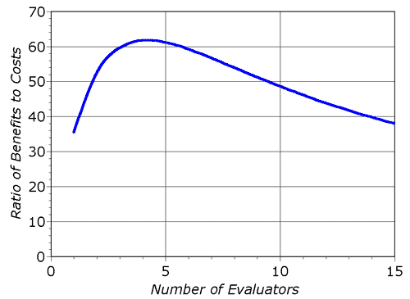
Decreasing Returns
problems found
benefits / cost
* Caveat: graphs for a specific example

Slide 36
Summary
Have evaluators go through the UI twice
Ask them to see if it complies with heuristics
note where it doesn’t & say why
Combine the findings from 3 to 5 evaluators
Have evaluators independently rate severity
Alternate with user testing

Slide 37
Further Reading Evaluation
Books
Usability Engineering, by Nielsen, 1994
Web Sites & mailing lists
useit.com
UTEST mail list

