Slide 1
Concept Videos &
Video Prototypes
Notes:
Some videos work only on PC (without proper Mac plugin) and some work only on PC
Greenbean/CarbonShopper only PC and UpLift only Mac
Test that ALL WORK ON BOTH!

Slide 2
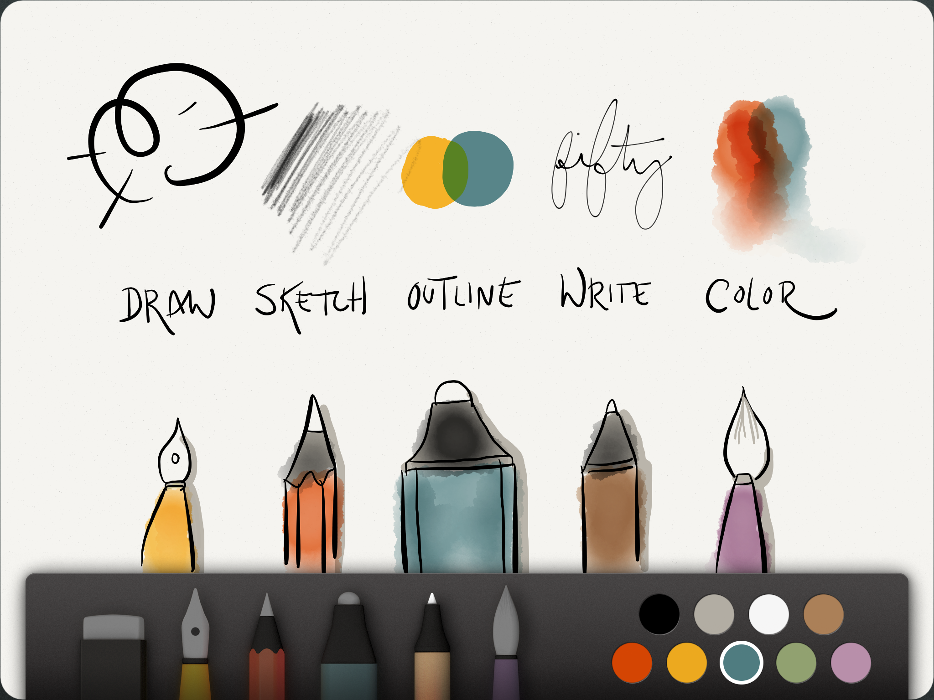
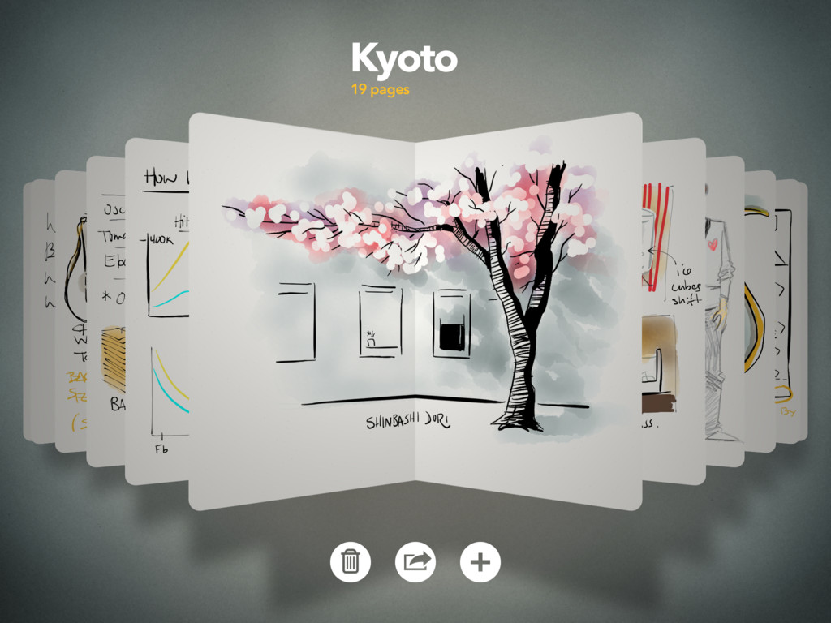

Hall of Fame or Shame?
Paper iPad App
By 53
Notes:
MUST DEMO THIS LIVE to really show it

Slide 3
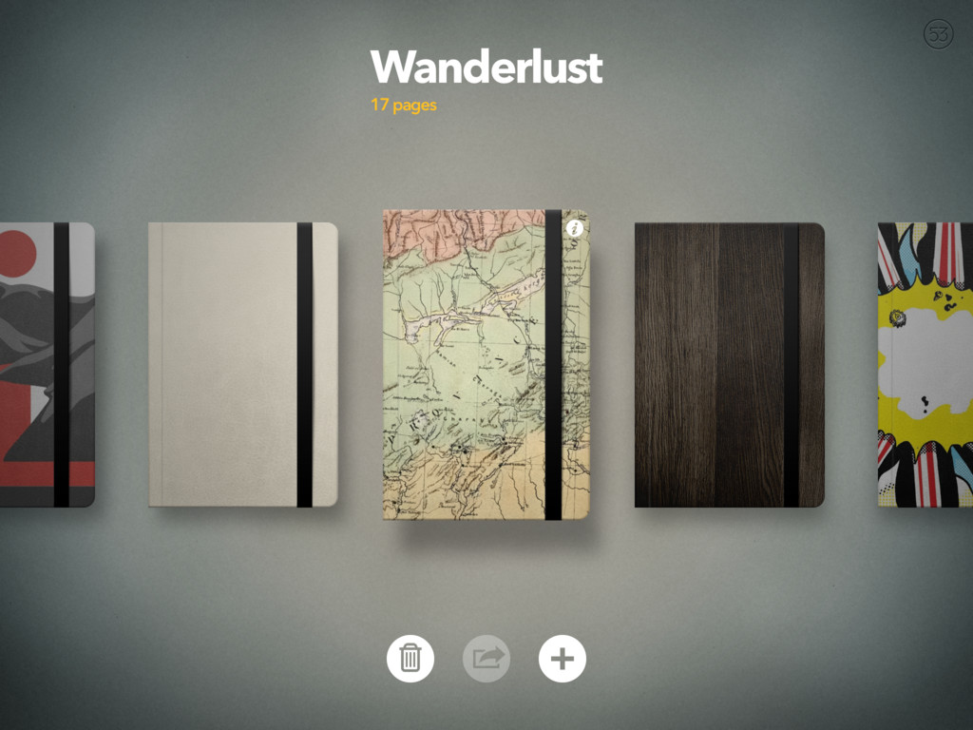

Gestures like Pinching out to move forward, inwards to go back – as if you were opening or closing a book
Notes:
3 gestures:
pinching in & out to go forward and back
swipe up from the bottom for tools
rotate two fingers to undo/redo

Slide 4
Hall of Fame!
Good
  pens feel natural & the app is extremely good for its only real purpose: idea generation / notation
  once 3 basic gestures are learned, they become a natural part of rapid ideation
  look & feel is important here as the tools are “pleasurable” & work as expected
Bad
  gestures are not easily discoverable and require a short initial tutorial
Paper iPad App
By 53
Notes:
3 gestures:
pinching in & out to go forward and back
swipe up from the bottom for tools
rotate two fingers to undo/redo

Slide 5
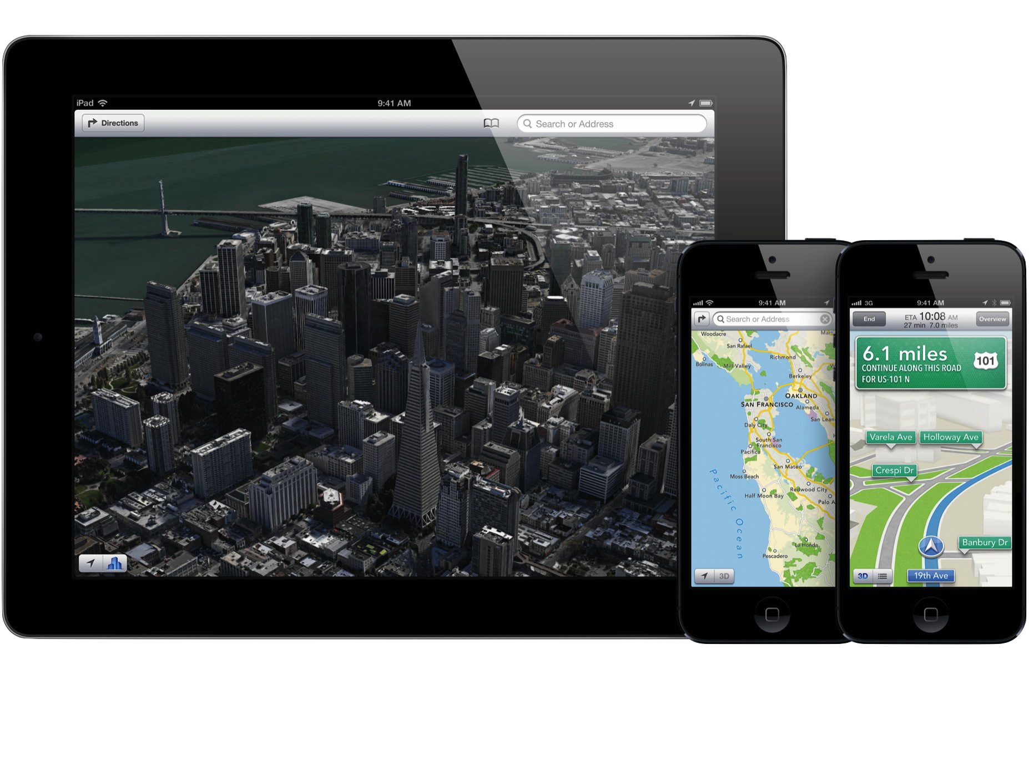
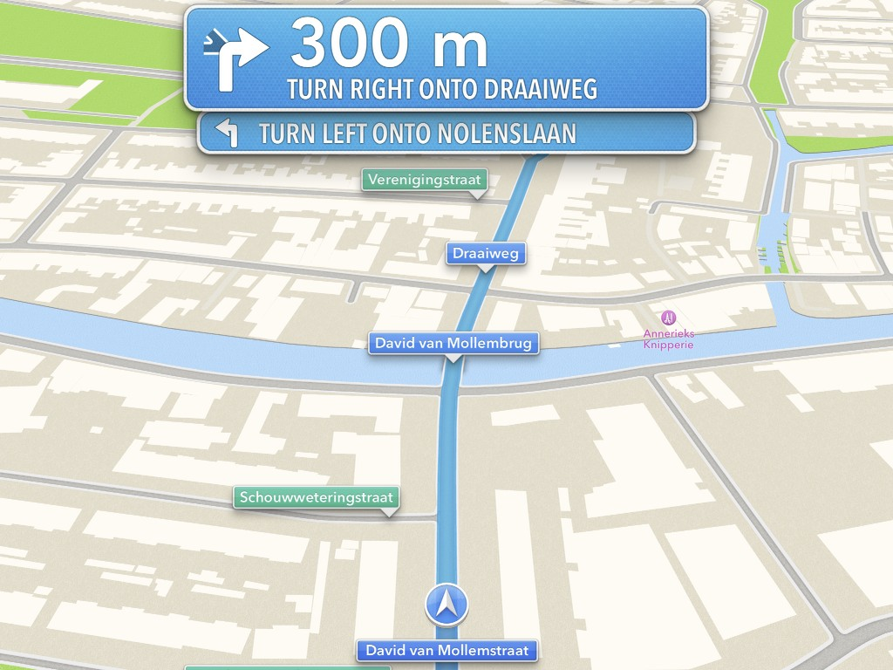
Hall of Fame or Shame?
iOS 6 Maps
By Apple Inc.

Slide 6
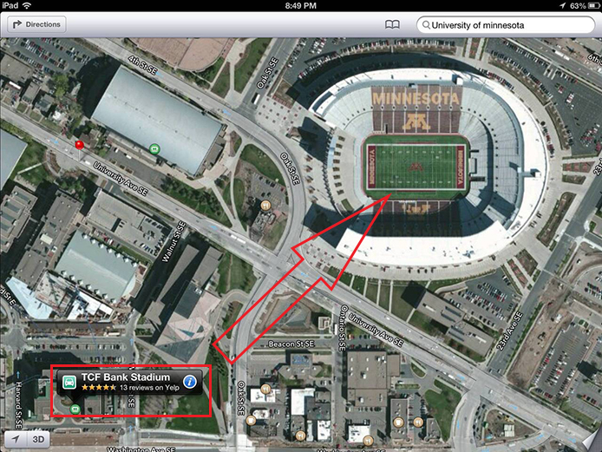

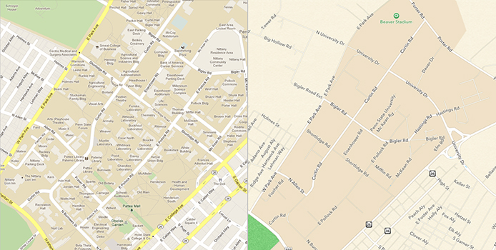
Hall of Shame!
Good
  beautiful alternative to the competition & generally easier to read
  turn by turn directions are efficient, clear & functions well – in general
Bad
  despite any aesthetics, the data is WRONG & SPARSE, meaning, it does not perform the one task it should do well – getting from A to B
iOS 6 Maps
By Apple Inc.

Slide 7
Hall of Shame!
Google Maps Data vs iOS6 Maps Data

Slide 8
Hall of Shame!
A clear example of where no matter how good a design may be, without its most important function in this case, correct data, the interface is useless
iOS 6 Maps
By Apple Inc.

Slide 9
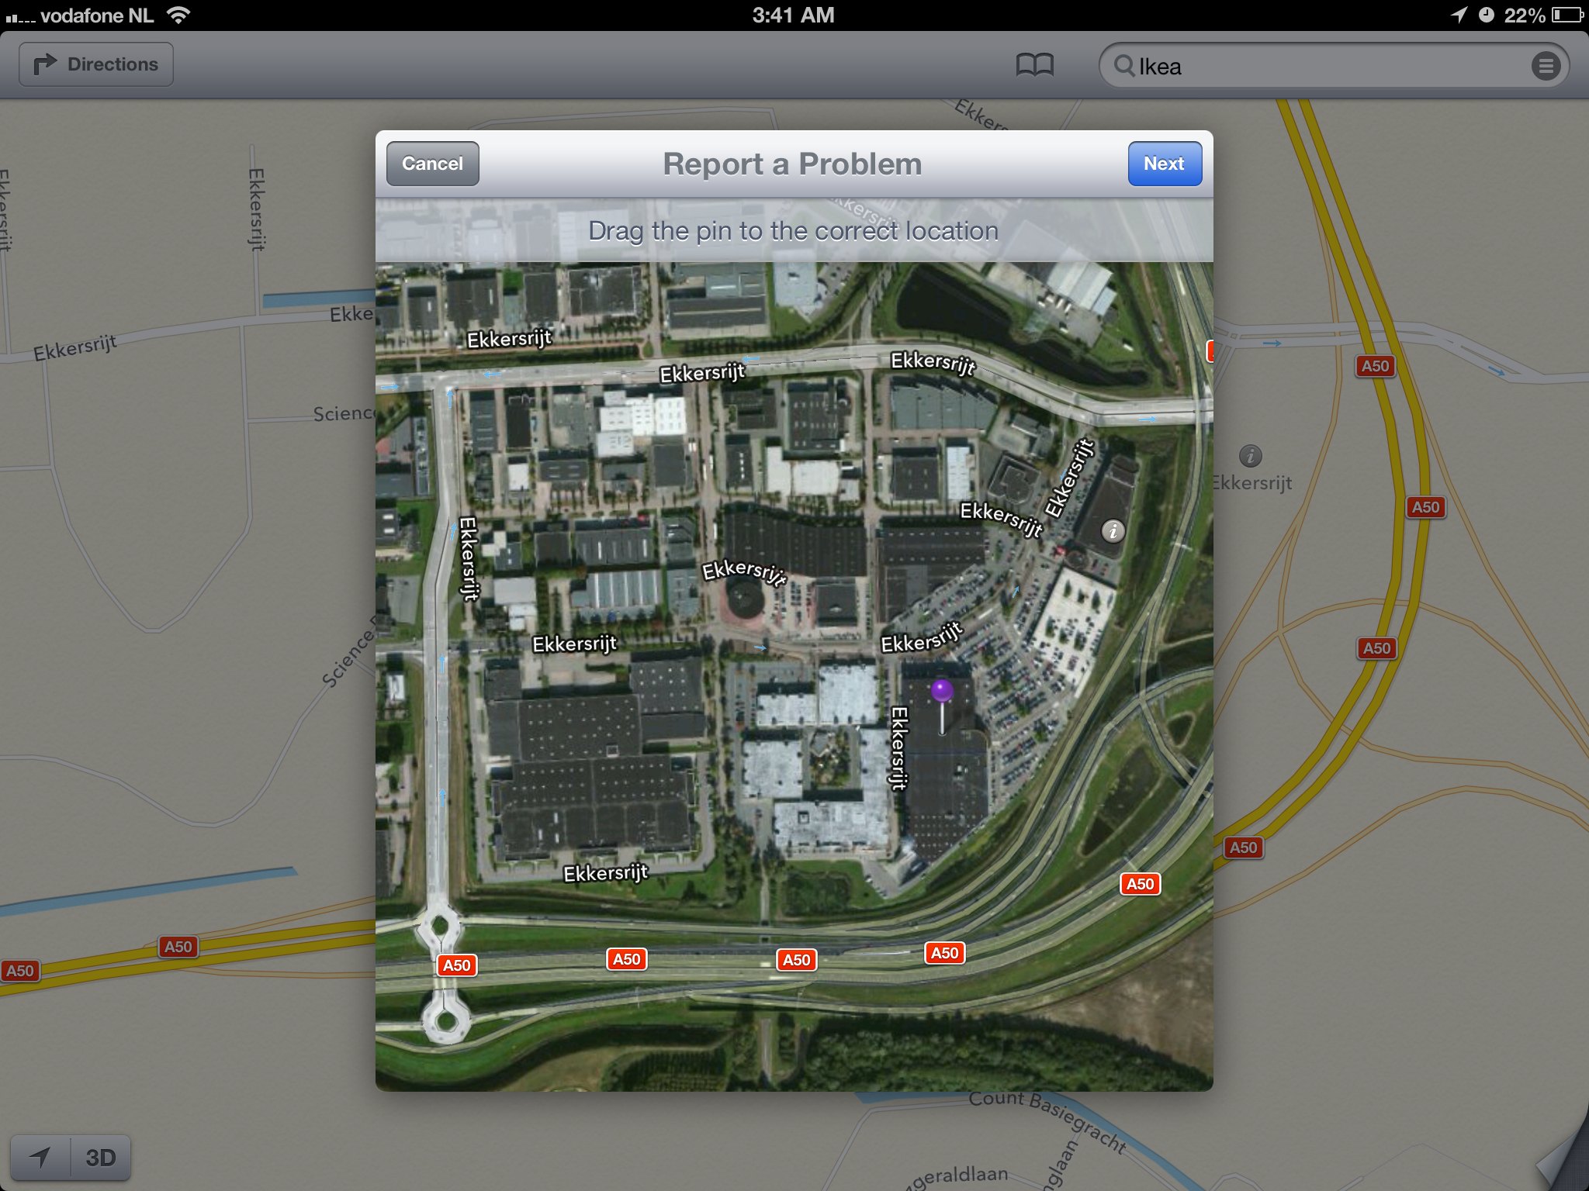
Potentially Hall of Fame
Apple is working to crowd source data
The UI for problem reporting is well designed
With so many users have potential to fix data rapidly

Slide 10
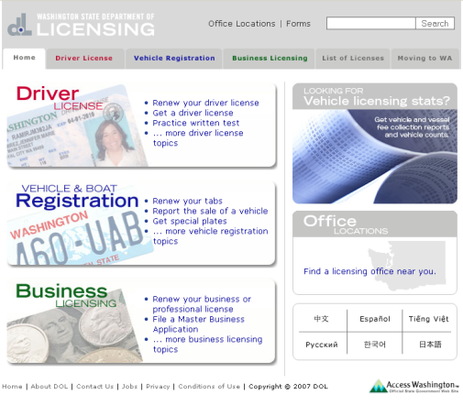
Hall of Fame or Shame?
http://www.dol.wa.gov/

Slide 12
Hall of Fame!
http://www.dol.wa.gov/
UI is clean & uncluttered
Multiple language options are clearly indicated
Similarity & connectedness gives strong aesthetic & indicates nav
  ex. of Gestalt Principles
Use of red/green troubling, but not an issue in this UI

Slide 13
Concept Videos &
Video Prototypes

Slide 14
Outline
Review Design Exploration
Types of Prototypes
Video Brainstorming
Video Prototyping
Concept Videos

Slide 15
Design Exploration Review
Selecting tasks ?
  real tasks with reasonable functionality coverage
  complete, specific tasks of what customer wants to do
Sketching allows exploration of many concepts in the very early stages of design
As investment goes up, need to use more and more formal criteria for evaluation
Informal prototyping tools bridge the gap between paper & high-fi tools

Slide 16
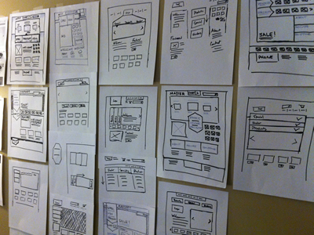
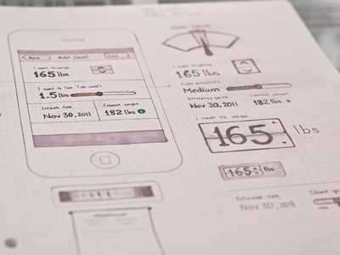
Types of Prototypes
Prototypes are concrete representations of a design
Prototype dimensions
  representation: form of the prototype
    off-line (paper) or on-line (software)
  precision: level of detail (e.g., informal or polished)
  interactivity: watch-only vs. fully interactive
    fixed prototype (video clips)
    fixed-path prototype (each step triggered by specified actions)
      at extreme could be 1 path or possibly more open (e.g., Denim)
    open prototype (real, but limited error handling or performance)
  evolution: expected life cycle of prototype
    e.g., throw away or iterative
PJ McCormick
Karem Suer
Notes:
PJ McCormick (left)
Kerem Suer (right)

Slide 17
Types of Prototypes
Prototypes are concrete representations of a design
Prototype dimensions
  representation: form of the prototype
    off-line (paper) or on-line (software)
  precision: level of detail (e.g., informal or polished)
  interactivity: watch-only vs. fully interactive
    fixed prototype (video clips)
    fixed-path prototype (each step triggered by specified actions)
      at extreme could be 1 path or possibly more open (e.g., Denim)
    open prototype (real, but limited error handling or performance)
  evolution: expected life cycle of prototype
    e.g., throw away or iterative

Slide 18
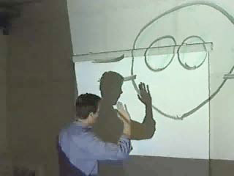
Video Brainstorming
Participants act ideas out in front of a video camera
Goal is to create as many new ideas as possible
  each should take 2-5 minutes to generate & capture
  run standard brainstorming session first for ideas
Advantages
  video easier to understand later than notes
  participants actively experience interaction & preserve record of the idea
Video brainstorming of an animated character in Prototyping Tools & Techniques by Beaudouin-Lafon & Mackay.
Character follows user with its eyes.

Slide 19
Video Prototyping
Illustrate how users will interact w/ system
Unlike brainstorming, video prototyping contracts the design space
Quick to build
Inexpensive
Forces designers to consider details of how users will react to the design
May better illustrate context of use

Slide 20



Forms of Video Prototypes
Paper Protoypes, Exisiting Software or Projected Images as a background
Optional Narration, Conversation preferred
narrator explains events & others move images/illustrate interaction actors perform movements & viewer expected to understand w/o voice-over
Usually fixed prototypes, but can also use in open prototypes
EG: Live video as a Wizard of Oz tool & 2nd camera to capture
With good storyboards, a good short film can be shot in 1 hour

Slide 21
Wizard of Oz Video Prototype
Image from Beaudouin-Lafon & Mackay

Slide 22
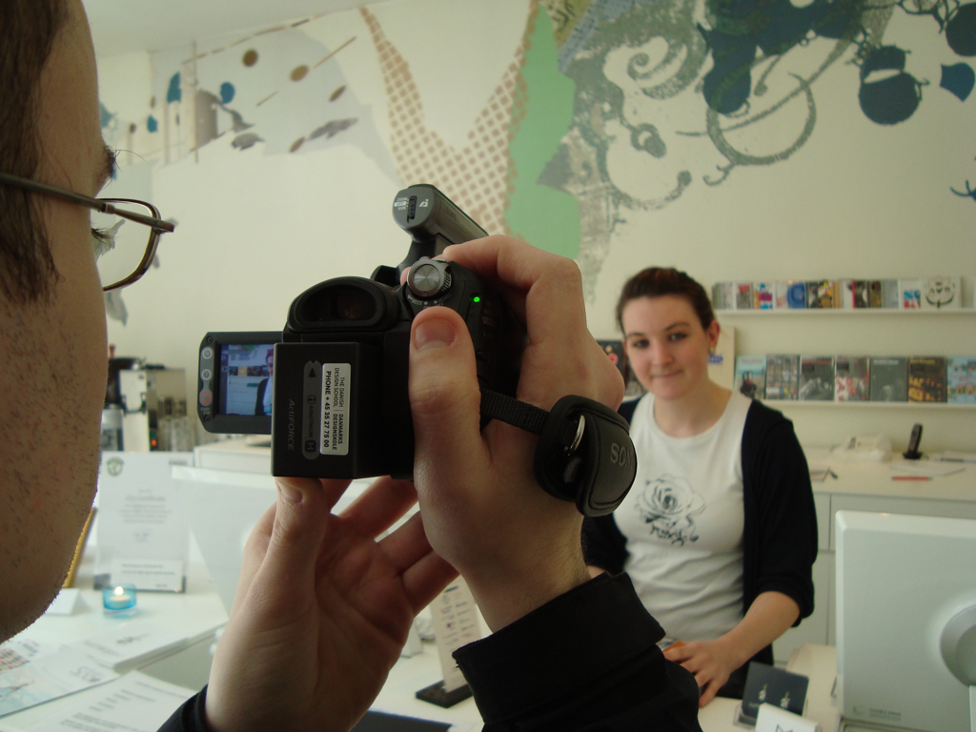
Concept
+ Vision
Videos
How to capture an early concept and tell a story
Notes:
Concept videos are similar to Video Prototypes but focus even MORE on the STORY and Context and LESS on the UI.
Fine line about what is a concept video and WHAT is a video prototype

Slide 23
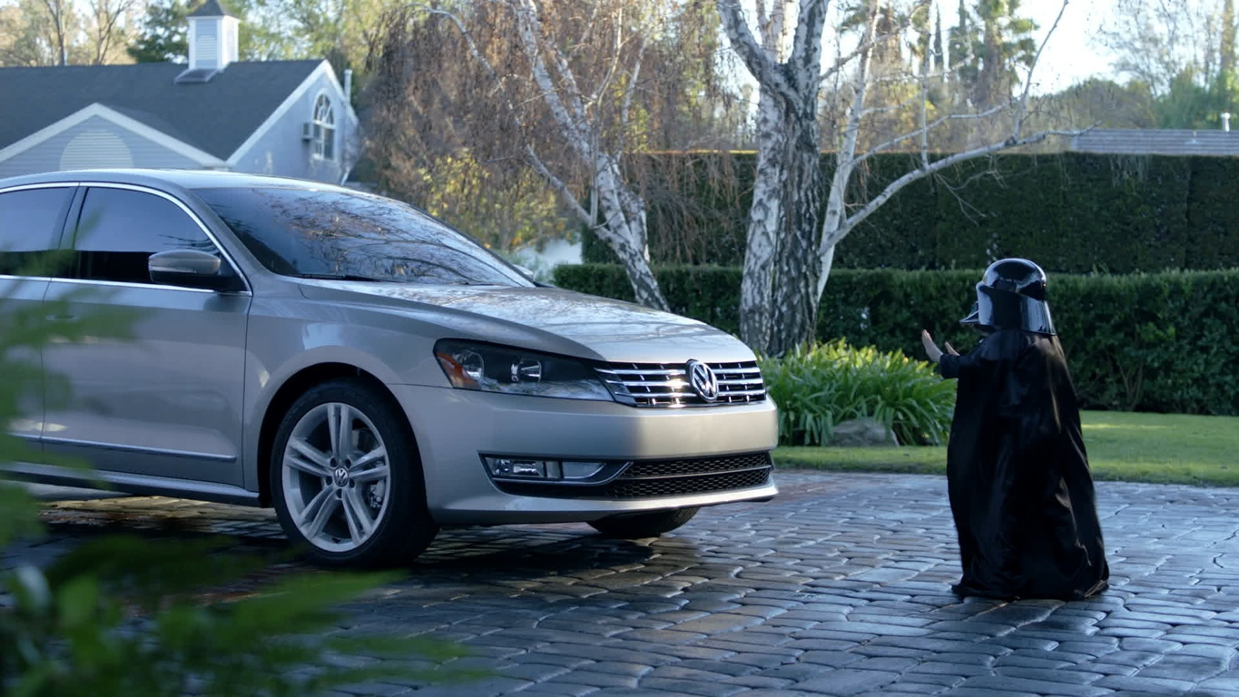
It’s About Stories

Slide 24



People
Context
The Solution

Slide 25
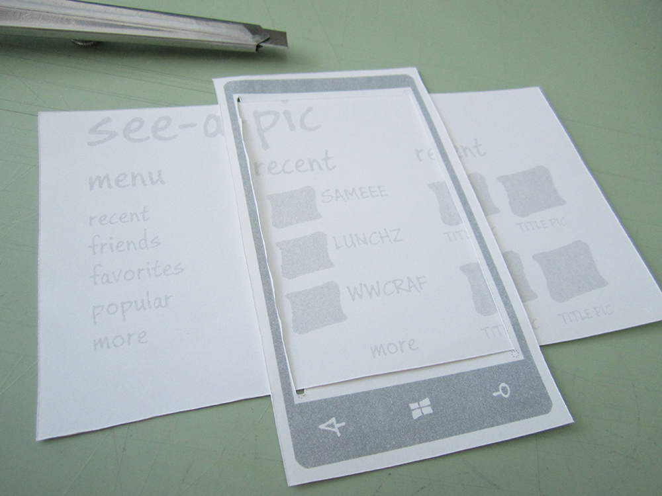
Keep it Simple

Slide 26






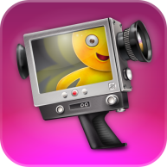
Use what you KNOW and what you HAVE

Slide 27
Examples

Slide 28

greenBean

Slide 29

Carbon Shopper

Slide 30

upLift

Slide 31

The Goal of any good conceptual film…

Slide 32
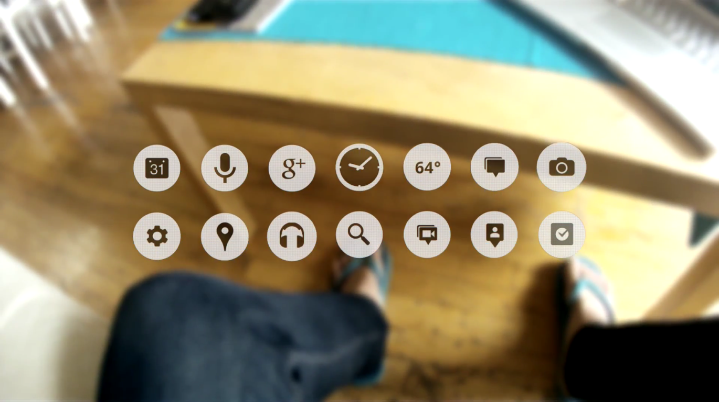
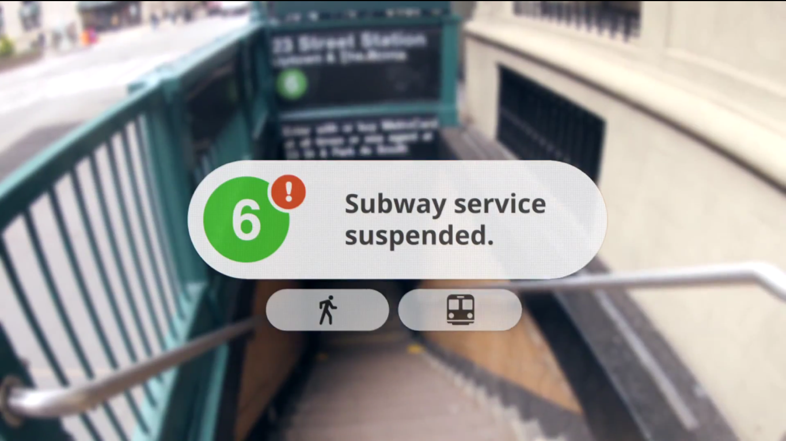
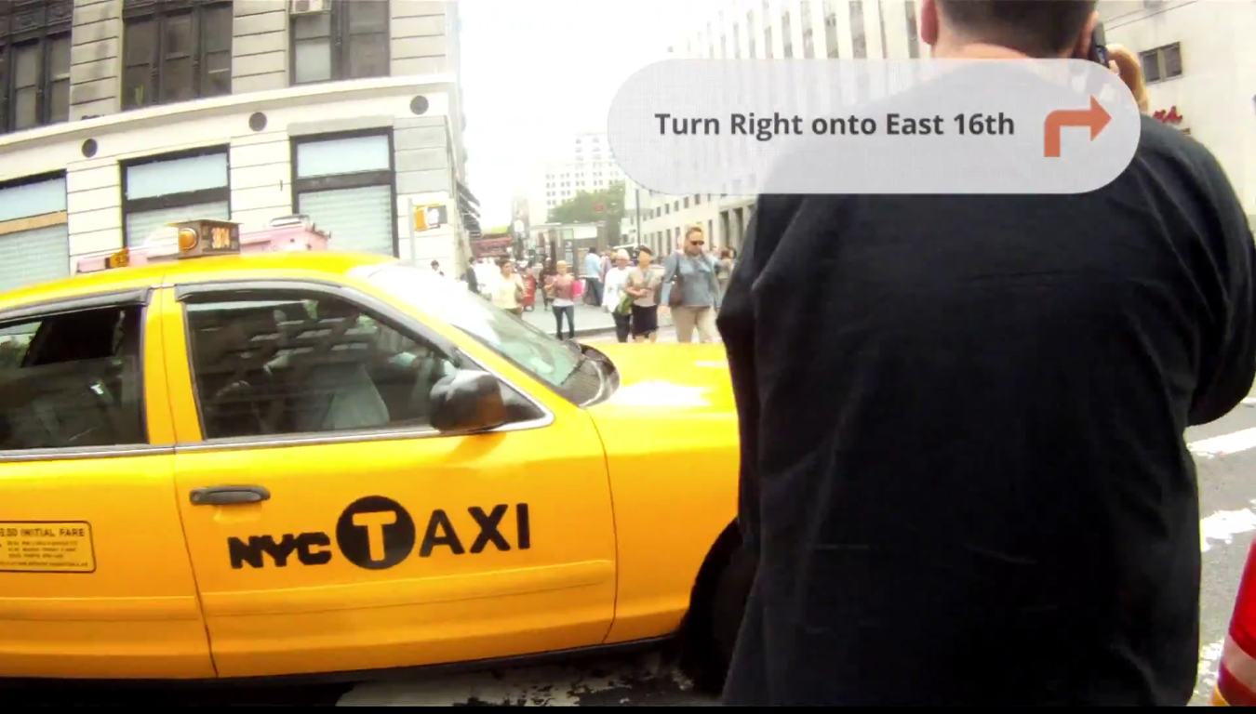
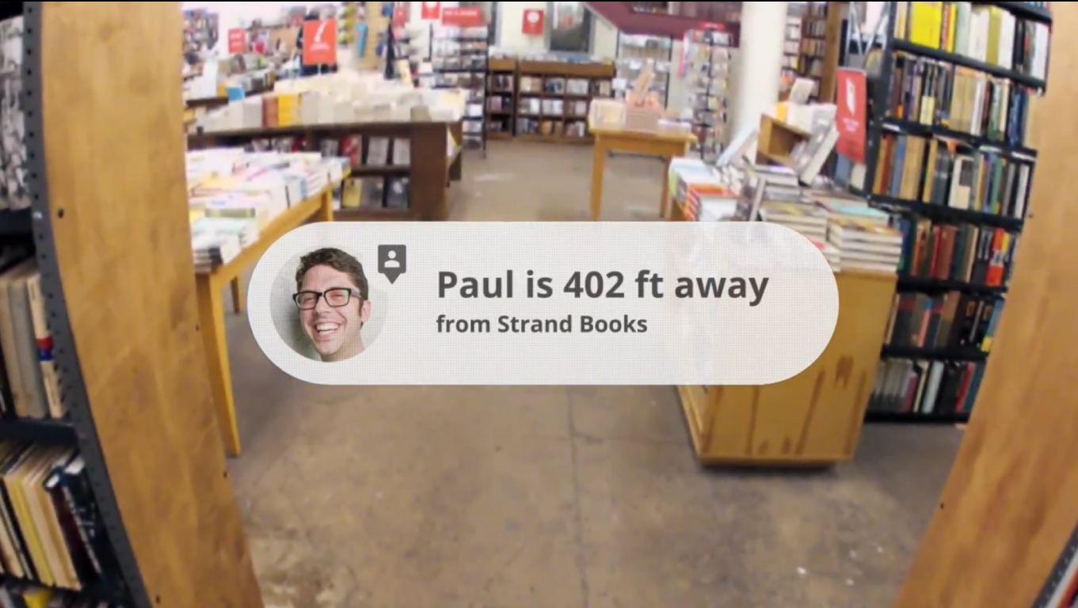
Someone should be able to understand your project simply by watching your film.

Slide 33



Define
What is the message of the film?
Can you describe it in a few lines?
Make a basic Plot
Discuss plot ideas until you get a few that really make sense, decide characters
Storyboard
Turn these into multiple boards of scenes to plan how you will film it

Slide 34
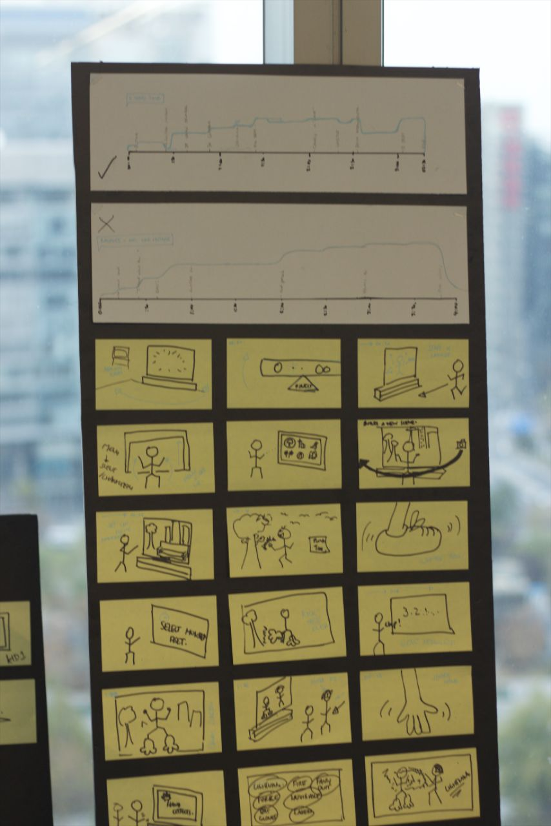
Storyboarding
Use sticky notes so scenes can be moved
Include lines to be spoken if necessary
Use appropriate angles
Notes:
Define: Make a statement about your project, refer back to it throughout the entire process.
Make a Plot: Create several plotlines, mix and match and decide on a few to storyboard
Storyboarding: Draw pictures, label the kind of shot you might have and what the actor should do.

Slide 35



If you choose to use music
Now might be a good time to pick some songs. Music can be very powerful if chosen well.
Shoot your Film
Get as many shots as you can! you never know what might be useful later.
Edit your Film
Use your storyboard! This part should be simple if you have storyboarded correctly.

Slide 36

High Quality Video Prototypes
By Pedro Andrade, CIID
Notes:
Another example: http://www.gizmodo.com/search/cellphones%20nokia-design-concept-videos-show-f/bydate/uture-of-cellphoning-229739.php

Slide 37
More Example Videos
Video Prototypes
  cluster
  dont_forget
  dont_forget2
  dont_forget_russian
  Cell Phone Music Player (Nick Kong, UC Berkeley CS160)
  CarbonShopper
  StyleEye
Concept Videos
  LingoImmersion
  MicroHealth
  Perspective
Final Hi-Fi Videos
  MicroHealth
  Perspective
  Rii
  Hero
  Paintora

Slide 38
Summary
Video prototypes allow us to quickly communicate how a user will use a design
Concept videos set up more of the story of use
Both techniques are useful

Slide 39
Next Time
Human Abilities (Jake Wobbrock)
Reading
  Ch. 2: The Human Information Processor, from The Psychology of Human-Computer Interaction By Stuart K. Card, Thomas P. Moran, & Allen Newell, 1983, pp. 23-83

