Slide 1
CSE 421 Introduction to Algorithms
Lecture 13, Winter 2024
Dynamic Programming

Slide 2
Announcements
Dynamic Programming Reading:
6.1-6.2, Weighted Interval Scheduling
6.3 Segmented Least Squares
6.4 Knapsack and Subset Sum
6.6 String Alignment
6.8 Shortest Paths (Bellman-Ford)
6.9 Negative cost cycles
Midterm, Friday, Feb 9
Material through 6.3 and HW 5
Feb 8 Section will be Midterm review

Slide 3
Dynamic Programming
Key ideas
Express solution in terms of a polynomial number of sub problems
Order sub problems to avoid recomputation

Slide 4
Optimal linear interpolation
Error = Σ(y_{i} –ax_{i} – b)²

Slide 5
Optimal interpolation with k segments
Optimal segmentation with three segments
Min_{i,j}{E_{1,i} + E_{i,j} + E_{j,n}}
O(n²) combinations considered
Generalization to k segments leads to considering O(n^{k-1}) combinations

Slide 6
Opt_{k}[ j ] : Minimum error approximating p₁…p_{j} with k segments
How do you express Opt_{k}[ j ] in terms of
Opt_{k-1}[1],…,Opt_{k-1}[ j ]?

Slide 7
Opt_{k}[ j ] = min _{i} { Opt_{k-1}[ i ] + E_{i,j} } for 0 < i < j
Optimal solution with k segments extends an optimal solution of k-1 segments on a smaller problem

Slide 8
Optimal multi-segment interpolation
Compute Opt[ k, j ] for 0 < k < j < n
for j := 1 to n
Opt[ 1, j] = E_{1,j};
for k := 2 to n-1
for j := 2 to n
t := E_{1,j}
for i := 1 to j -1
t = min (t, Opt[k-1, i ] + E_{i,j})
Opt[k, j] = t

Slide 9
Shortest Paths in Linear Graphs
A directed graph with edge weights on the vertex set V = {1, 2, . . . N} is linear is all edges (i, j) ϵ E satisfy i < j
3
-4
5
7
-4
5
3
-3
4
3
6
5
3

Slide 10
Dynamic Programming for Shortest Paths in Linear Graphs
D[ j ] = dist(1, j)
What is the optimization equation?

Slide 11
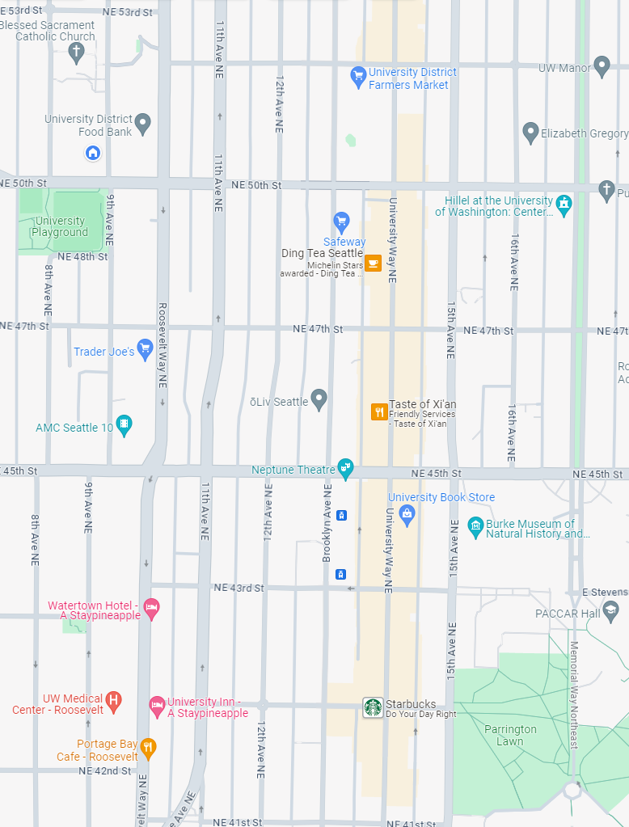
How many different ways can I walk to work?
Only taking “efficient” routes
Make the problem discrete
Directed Graph model: Intersections and streets
Assume the graph is a directed acyclic graph (DAG)
Problem: compute the number of paths from vertex h to vertex w

Slide 12
P[v]: Number of paths from v to v₀
How do you compute P[v] if you know P[x], P[y], and P[z]?
v
x
y
z

Slide 13
Recursive Algorithm
v₆
PC(v){
if (v == v₀)
return 1;
count = 0;
foreach (w in N⁺(v)){
count = count + PC(w);
}
return count;
}
v₅
v₄
v₃
v₂
v₁
v₀

Slide 14
Ordering the vertices
How do you order the vertices of a DAG such that if there is an edge from v to w, w comes before v in the ordering?

Slide 15
Path Counting
G=(V,E) is an n node directed acyclic graph, with v_{n-1}, v_{n-2}, . . ., v₁, v₀ a topological order of the vertices. An array is computed giving the number of paths from each vertex to v₀.
CountPaths(G, P){
P[0] = 1;
for (i = 1 to n-1){
P[i] = 0;
foreach (w in N⁺(v_{i})){
P[i] = P[i] + P[w];
}
}

Slide 16
Typesetting
Layout text on a page to optimize readability and aesthetic measures
Skilled profession replaced by computing
Goal – give text a uniform appearance which is primarily done by choosing line breaks to balance white space
Interword spacing can stretch or shrink
Hyphenation is sometimes available

Slide 17
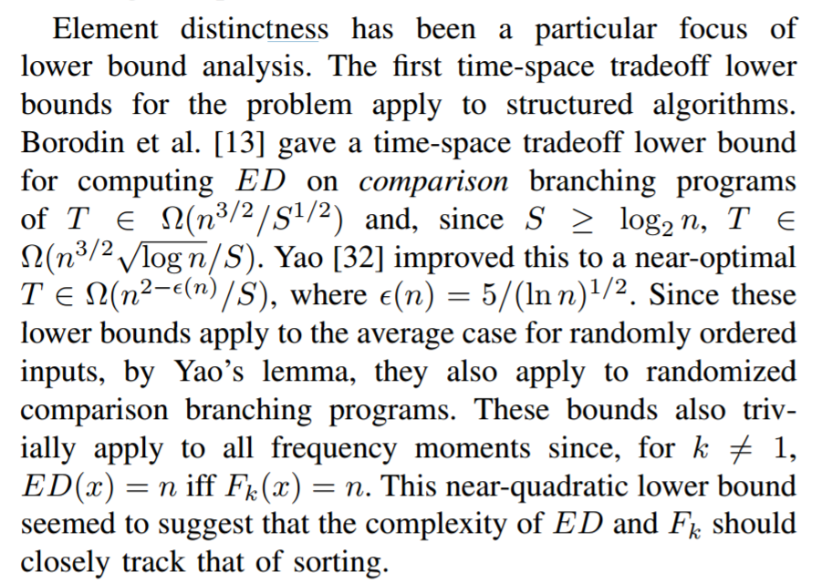
Optimal line breaking The LaTeX algorithm

Slide 18
Optimal Line Breaking
Words have length w_{i}, line length L
Penalty related to white space or overflow of the line
Quadratic measure often used
Pen(i, j): Penalty for putting w_{i}, w_{i+1},…,w_{j} on the same line
Opt[m]: minimum penalty for ending a line with w_{m}

Slide 19
The quick brown fox jumped over the lazy dog.
The quick brown fox jumped over the lazy dog.
Pen(“The quick brown”) = 1
Pen(“fox jumped over”) = 2
Pen(“fox jumped”) = 8
Pen(“the lazy dog”) = 6
Pen(“over the lazy dog.”) = 4
Pen(i, j): Penalty for putting w_{i}, w_{i+1},…,w_{j} on the same line

Slide 20
Optimal Line Breaking
Optimal score for ending a line with w_{m}
Opt[m] = min _{i} { Opt [ i ] + Pen(i+1,m)} for 0 < i < m
For words w₁, w₂, . . . , w_{n}, we compute Opt[n] to find the optimal layout

Slide 21
Optimal Line Breaking
Opt[0] = 0;
for m = 1 to n {
Find i that minimizes Opt [ i ] + Pen(i+1,m);
Opt[m] = Opt [ i ] + Pen(i+1,m);
Pred[m] = i;
}

