Slide 1
CSE 421
Greedy Algorithms / Minimizing Lateness
Yin Tat Lee

Slide 2
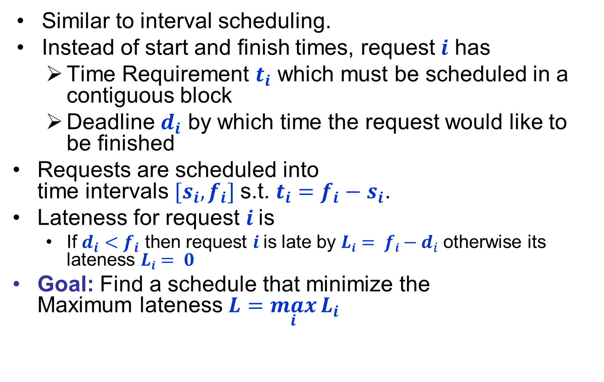


Scheduling to Minimizing Lateness
Similar to interval scheduling.
Instead of start and finish times, request $i$ has
  Time Requirement $t_{i}$ which must be scheduled in a contiguous block
  Deadline $d_{i}$ by which time the request would like to be finished
Requests are scheduled into
time intervals $[s_{i},f_{i}]$s.t. $t_{i}=f_{i}−s_{i}$.
Lateness for request $i$is
  If $d_{i}<f_{i}$ then request $i$is late by $Li= fi−d_{i}$otherwise its lateness $Li= 0$
Goal: Find a schedule that minimize the
Maximum lateness $L=\max_{i}{L_{i}}$
1
2
3
4
5
6
$$t_{j}$$
3
2
1
4
3
2
$$d_{j}$$
6
8
9
9
14
15
lateness = 2
lateness = 0
max lateness = 6
d₃ = 9
d₂ = 8
d₆ = 15
d₁ = 6
d₅ = 14
d₄ = 9
0
1
2
3
4
5
6
7
8
9
10
11
12
13
14
15

Slide 3
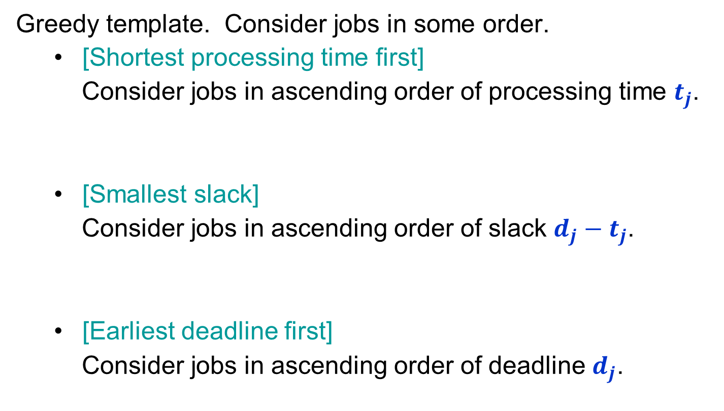
Minimizing Lateness:
Greedy Algorithms
Greedy template. Consider jobs in some order.
  [Shortest processing time first]
  Consider jobs in ascending order of processing time $t_{j}$.
  [Smallest slack]
  Consider jobs in ascending order of slack $d_{j}−t_{j}$.
  [Earliest deadline first]
  Consider jobs in ascending order of deadline $d_{j}$.
1
2
t_{j}
1
10
d_{j}
100
10
counterexample
1
2
t_{j}
1
10
d_{j}
2
10
counterexample
Notes:
If we still have lots of time, we shouldn’t do the homework yet
d – t is the last time we can do without being late. But doing according to this is bad. It is better to late for some very difficult homework.

Slide 4

Greedy Algorithm:
Earliest Deadline First
Sort deadlines in increasing order $(d_{1}≤d_{2}≤⋯≤d_{n})$
$$f  0$$
for $i←1$ to $n$ to
$s_{i}  f$
$fi  s_{i}+t_{i}$
$f  f_{i}$
end for
1
2
3
4
5
6
$$t_{j}$$
3
2
1
4
3
2
$$d_{j}$$
6
8
9
9
14
15
max lateness = 1
d₁ = 6
d₂ = 8
d₃ = 9
d₄ = 9
d₅ = 14
d₆ = 15
0
1
2
3
4
5
6
7
8
9
10
11
12
13
14
15

Slide 5
Minimizing Lateness: No Idle Time
Observation.
There exists an optimal schedule with no idle time.
Observation.
The greedy schedule has no idle time.
d = 4
d = 6
d = 12
0
1
2
3
4
5
6
7
8
9
10
11
d = 4
d = 6
d = 12
0
1
2
3
4
5
6
7
8
9
10
11

Slide 6

Proof for Greedy Algorithm:
Exchange Argument
We will show that if there is another schedule $O$ (think optimal schedule) then we can gradually change $O$ so that
  at each step the maximum lateness in $O$ never gets worse.
  it eventually becomes the same cost as $A$ (by greedy).

Slide 7

Minimizing Lateness: Inversions
Definition
An adjacent inversion in schedule $S$ is a pair of jobs $i$ and $j$ such that
  $d_{i}<d_{j}$
  Job $i$ is scheduled immediately after Job $j$
Observation
Greedy schedule has no adjacent inversions.
inversion
before swap
j
i

Slide 8
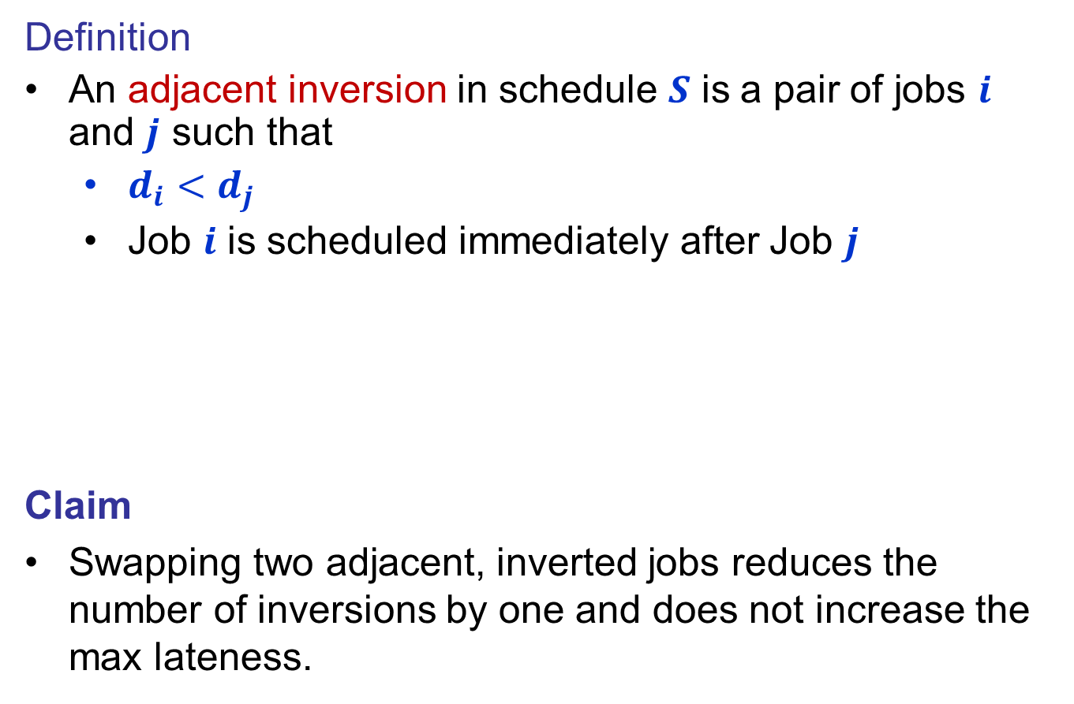


Minimizing Lateness: Inversions
Definition
An adjacent inversion in schedule $S$ is a pair of jobs $i$ and $j$ such that
  $d_{i}<d_{j}$
  Job $i$ is scheduled immediately after Job $j$
Claim
Swapping two adjacent, inverted jobs reduces the number of inversions by one and does not increase the max lateness.
inversion
$$f_{i}$$
before swap
j
i
after swap
i
j
$$f_{j}^{′}$$

Slide 9
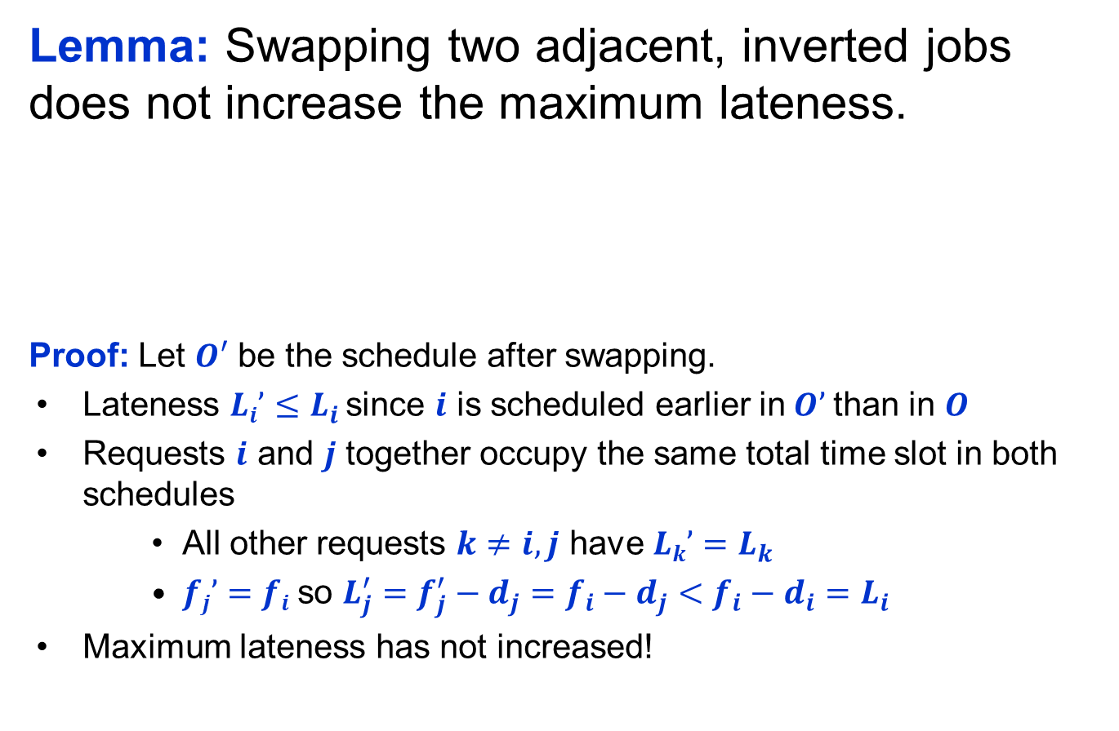


Minimizing Lateness: Inversions
Lemma: Swapping two adjacent, inverted jobs does not increase the maximum lateness.
Proof: Let $O′$ be the schedule after swapping.
Lateness $Li’≤L_{i}$ since $i$ is scheduled earlier in$O’$than in $O$
Requests $i$ and $j$ together occupy the same total time slot in both schedules
    All other requests $k≠i,j$ have $Lk’=L_{k}$
    $fj’=fi$so $L_{j}^{′}=f_{j}^{′}−d_{j}=f_{i}−d_{j}<f_{i}−d_{i}=L_{i}$
Maximum lateness has not increased!
inversion
$$f_{i}$$
before swap
j
i
after swap
i
j
$$f_{j}^{′}$$

Slide 10
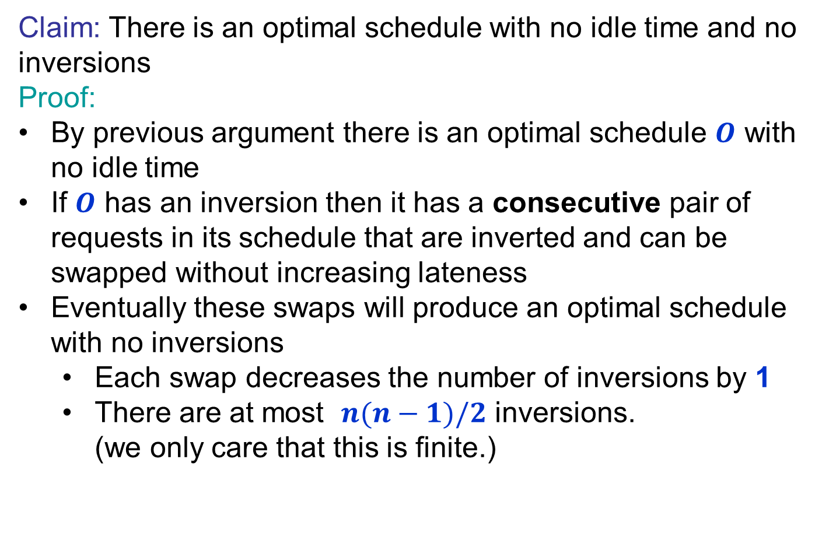
Optimal schedules and inversions
Claim: There is an optimal schedule with no idle time and no inversions
Proof:
By previous argument there is an optimal schedule $O$ with no idle time
If $O$ has an inversion then it has a consecutive pair of requests in its schedule that are inverted and can be swapped without increasing lateness
Eventually these swaps will produce an optimal schedule with no inversions
  Each swap decreases the number of inversions by 1
  There are at most $n(n−1)/2$ inversions.
  (we only care that this is finite.)

Slide 11
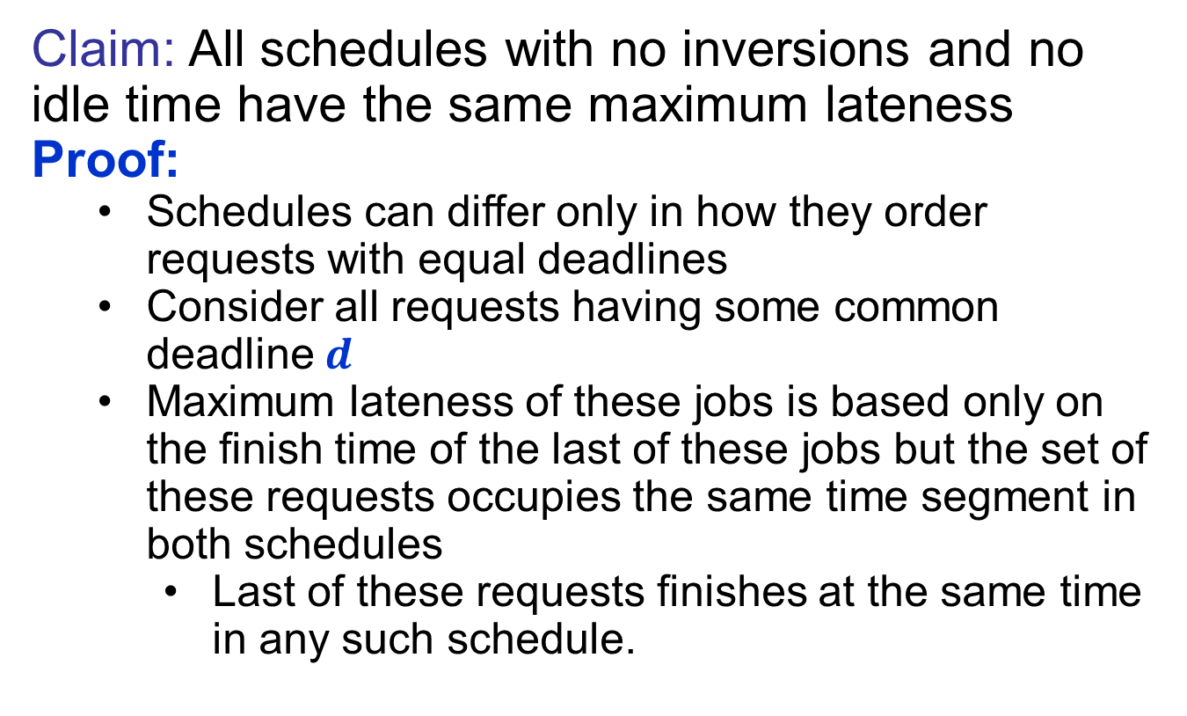
Idleness and Inversions are the only issue
Claim: All schedules with no inversions and no idle time have the same maximum lateness
Proof:
  Schedules can differ only in how they order requests with equal deadlines
  Consider all requests having some common deadline $d$
  Maximum lateness of these jobs is based only on the finish time of the last of these jobs but the set of these requests occupies the same time segment in both schedules
    Last of these requests finishes at the same time in any such schedule.

Slide 12
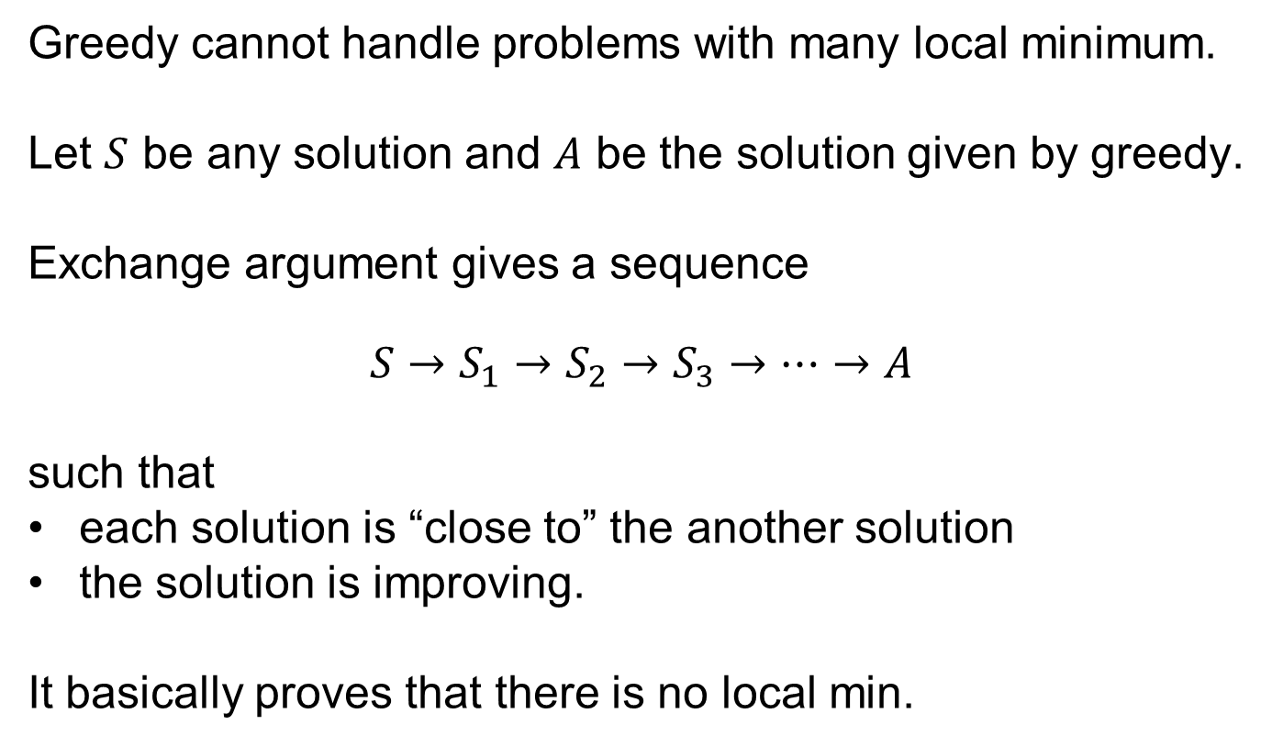
Why Exchange Argument?
Greedy cannot handle problems with many local minimum.
Let $S$ be any solution and $A$ be the solution given by greedy.
Exchange argument gives a sequence
$$S→S_{1}→S_{2}→S_{3}→⋯→A$$
such that
each solution is “close to” the another solution
the solution is improving.
It basically proves that there is no local min.

Slide 13
CSE 421
Greedy Algorithms / Caching Problem
Yin Tat Lee

Slide 14
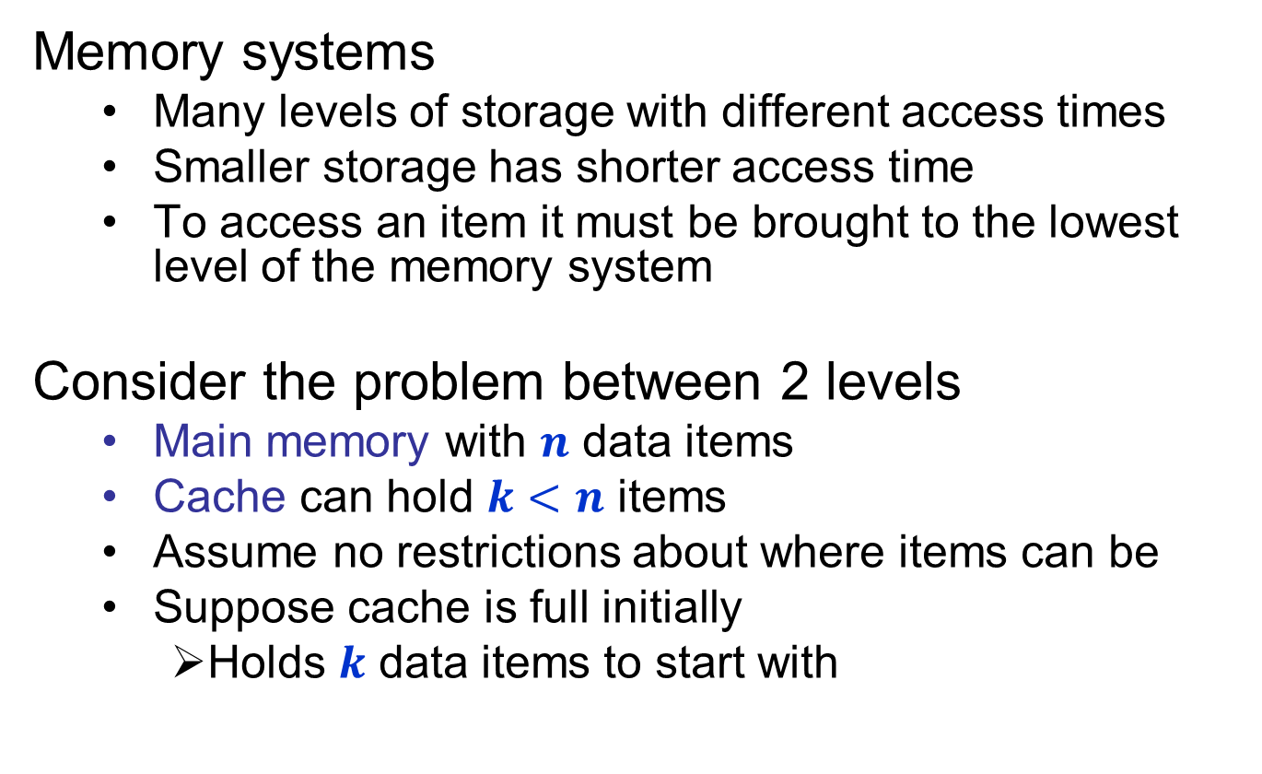
Optimal Caching/Paging
Memory systems
  Many levels of storage with different access times
  Smaller storage has shorter access time
  To access an item it must be brought to the lowest level of the memory system
  Consider the problem between 2 levels
  Main memory with $n$ data items
  Cache can hold $k<n$ items
  Assume no restrictions about where items can be
  Suppose cache is full initially
    Holds $k$ data items to start with

Slide 15
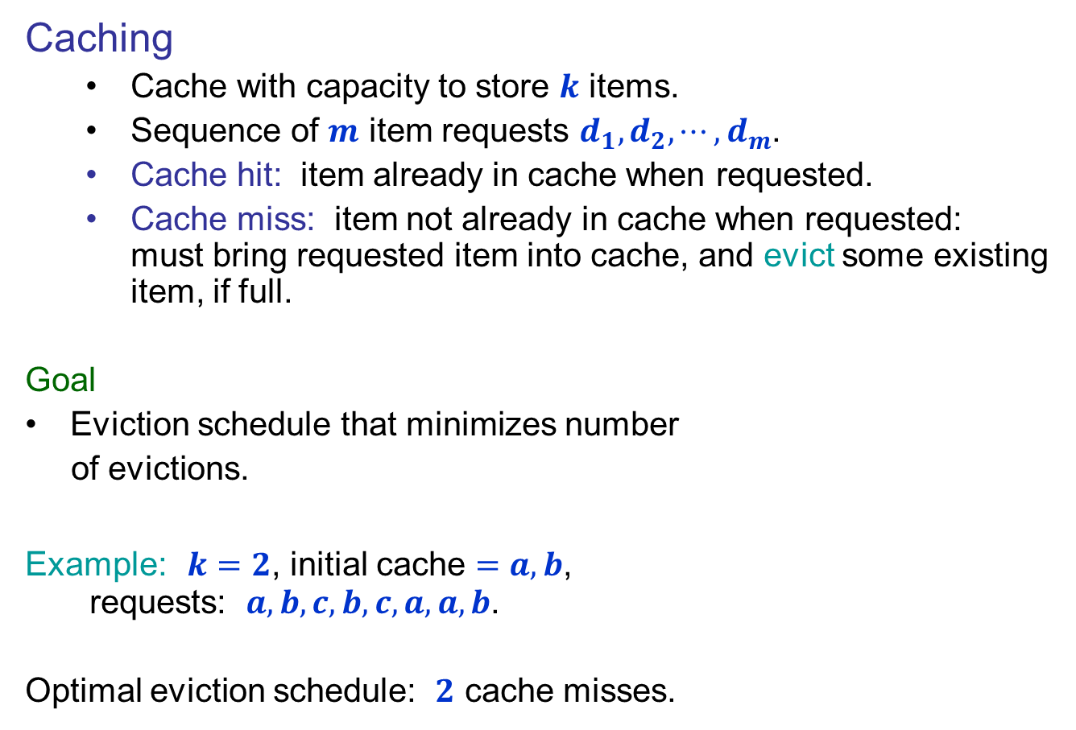

Optimal Offline Caching
Caching
  Cache with capacity to store $k$ items.
  Sequence of $m$ item requests $d_{1},d_{2},⋯,d_{m}$.
  Cache hit: item already in cache when requested.
  Cache miss: item not already in cache when requested: must bring requested item into cache, and evict some existing item, if full.
Goal
Eviction schedule that minimizes number
of evictions.
Example: $k=2$, initial cache $=a,b$,
requests: $a,b,c,b,c,a,a,b$.
Optimal eviction schedule: $2$ cache misses.
a
a
b
b
a
b
c
c
b
b
c
b
c
c
b
a
a
b
a
a
b
b
a
b
requests
cache
Why $2$ is optimal?

Slide 16
Optimal Offline Caching:
Farthest-In-Future
Which item we should evict?
Farthest-in-future
Evict item in the cache that is not requested until farthest in the future.
Theorem
[Bellady, 1960s] FIF is an optimal eviction schedule.
Exchange Argument
We can swap choices to convert other schedules to Farthest-In-Future without losing quality
current cache:
a
b
c
d
e
f
future queries:
g a b c e d a b b a c d e a f a d e f g h ...
cache miss
eject this one

Slide 17
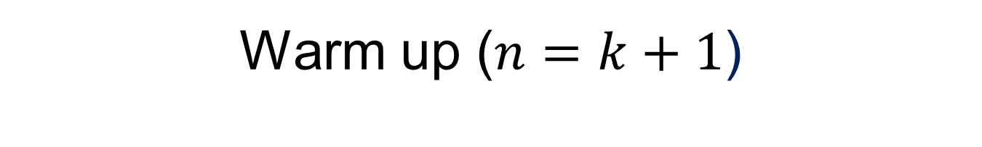
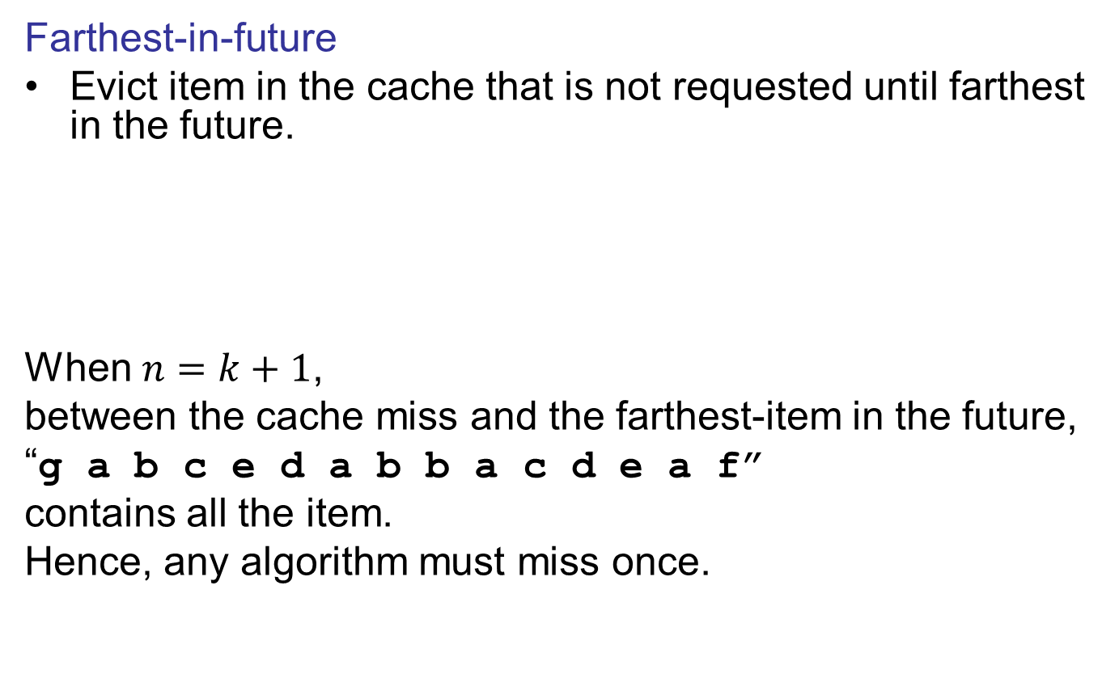
Warm up ($n=k+1$)
Farthest-in-future
Evict item in the cache that is not requested until farthest in the future.
When $n=k+1$,
between the cache miss and the farthest-item in the future,
“g a b c e d a b b a c d e a f”
contains all the item.
Hence, any algorithm must miss once.
current cache:
a
b
c
d
e
f
future queries:
g a b c e d a b b a c d e a f a d e f g h ...
cache miss
eject this one

Slide 18
Online Caching
Online vs. offline algorithms.
  Offline: full sequence of requests is known a priori.
  Online (reality): requests are not known in advance.
  Caching is among most fundamental online problems in CS.
LIFO. Evict page brought in most recently.
LRU. Evict page whose most recent access was earliest.
Theorem. FIF is optimal offline eviction algorithm.
  Provides basis for understanding and analyzing online algorithms.
  LRU is k-competitive. [Section 13.8]
  LIFO is arbitrarily bad.
FIF with direction of time reversed!

