Slide 1
CSE 421: Introduction to Algorithms
Graph
Yin-Tat Lee

Slide 2
Exercise: #edges
Let $G=(V,E)$ be a graph with $n=|V|$ vertices and $m=\left|E\right|$ edges.
Claim: $0≤m≤\left({n \atop 2}\right)=\frac{n\left(n−1\right)}{2}=O(n^{2})$
Pf: Since every edge connects two distinct vertices (i.e., G has no loops)
and no two edges connect the same pair of vertices (i.e., G has no multi-edges)
It has at most $\left({n \atop 2}\right)$ edges.

Slide 3
Exercise: Degree 1 vertices
Claim: If G has no cycle, then it has a vertex of degree $≤1$
(Every tree has a leaf)
Proof: (By contradiction)
Suppose every vertex has degree $≥2.$
Start from a vertex $v_{1}$ and follow a path, $v_{1},…,v_{i}$ when we are at $v_{i}$ we choose the next vertex to be different from $v_{i−1}.$ We can do so because $\deg\left(v_{i}\right)≥2.$
The first time that we see a repeated vertex ($v_{j}=v_{i})$ we get a cycle.
We always get a repeated vertex because $G$ has finitely many vertices
$$v_{1}$$
$$v_{2}$$
$$v_{3}$$
$$v_{4}$$
$$v_{5}$$

Slide 4
Exercise: Trees and Induction
Claim: Every tree with $n$ vertices has $n−1$ edges.
Proof: (Induction on $n$.)
Base: $n=1$, the tree has no edge
Induction: Let $T$ be a tree with $n$ vertices.
So, $T$ has a vertex $v$ of degree $1$.
Remove $v$ and the neighboring edge, and let $T’$ be the new graph.
We claim $T’$ is a tree: It has no cycle, and it must be connected.
So, $T’$ has $n−2$ edges and $T$ has $n−1$ edges.

Slide 5
Sparse Graphs
A graph is called sparse if $m≪n^{2}$ and it is called dense otherwise.
Sparse graphs are very common in practice
Friendships in social network
Planar graphs
Web graph
$O(n+m)$ is usually much better runtime than $O\left(n^{2}\right)$.

Slide 6
Storing Graphs
Vertex set $V=\left\{v_{1},…,v_{n}\right\}.$
Adjacency Matrix: A
For all, $i,j, A\left[i,j\right]=1$ iff $\left(v_{i},v_{j}\right)∈E$
Storage: $n^{2}$ bits
Advantage:
$O(1)$ test for presence or absence of edges
Disadvantage:
Inefficient for sparse graphs both in storage and edge-access
1
2
4
3
$$\begin{matrix} & 1 & 2 & 3 & 4 \\ 1 & 0 & 0 & 0 & 1 \\ 2 & 0 & 0 & 1 & 1 \\ 3 & 0 & 1 & 0 & 1 \\ 4 & 1 & 1 & 1 & 0\end{matrix}$$

Slide 7
Storing Graphs
1
2
4
Adjacency List:
O($n+m$) words
Advantage
Compact for sparse
Easily see all edges
Disadvantage
Bad memory access
Not good for parallel algorithms.
3
1
4
2
3
4
3
2
4
4
1
2
3

Slide 8
Storing Graphs
1
2
4
Adjacency Array:
O($n+m$) words
Advantage
More compact for sparse
Easily see all edges
Better for memory access
Better for parallel algorithms.
Disadvantage
Difficult to update the graph
3
1
2
4
6
4
3 4
2 4
1 2 3

Slide 9
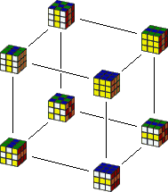
Storing Graphs
Implicit Representation:
$f(v)$ outputs an iterator of neighbor of $v$.
Aka, f(v)->next()->next()->next()->next()
Advantage
No space is required
Disadvantage
Mainly work for abstractly defined graph
2,125,922,464,947,725,402,112,000 states.

Slide 10
Storing Graphs
In practice, pick the representation according to the algorithm.
In this course, we focus on asymptotic runtime.
We can simply do this:
For each vertex, use a hash table to store its neighbors
This gives O(1) time for many operations
Insert, Delete, Find, Next, …

Slide 11
CSE 421: Introduction to Algorithms
Breadth First Search
Yin Tat Lee

Slide 12
Graph Traversal
Walk (via edges) from a fixed starting vertex $s$ to all vertices reachable from $s$.
Applications:
Web crawling
Social networking
Network Broadcasting
Garbage Collection
…

Slide 13
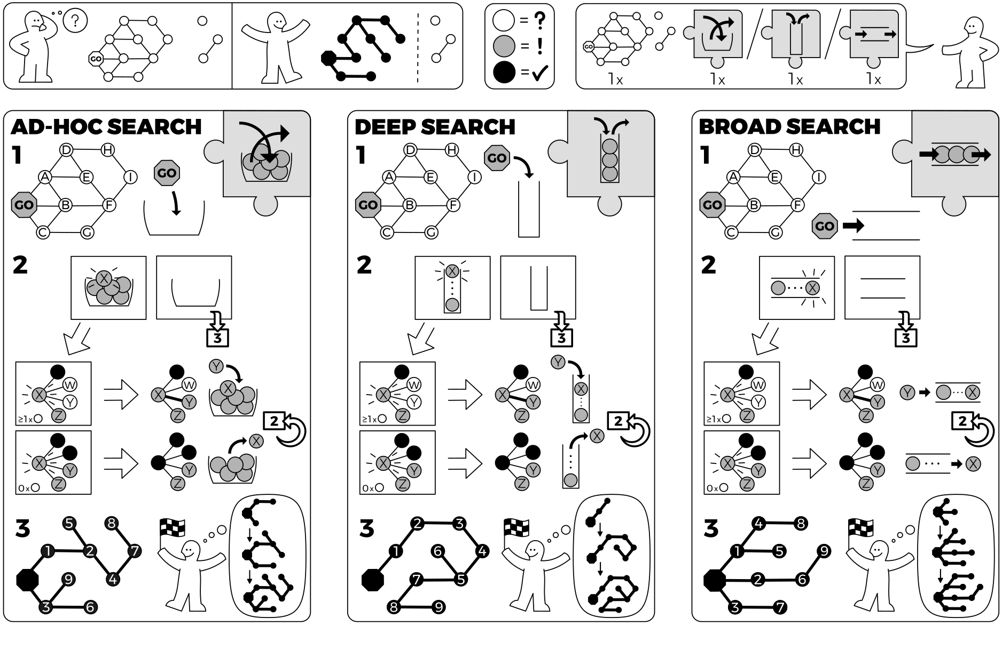
https://idea-instructions.com/

Slide 14
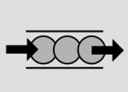
Breadth First Search (BFS)
Completely explore the vertices in order of their distance from $s$.
Three states of vertices:
Undiscovered
Discovered
Fully-explored
Naturally implemented using a queue
The queue will always have the list of Discovered vertices

Slide 15
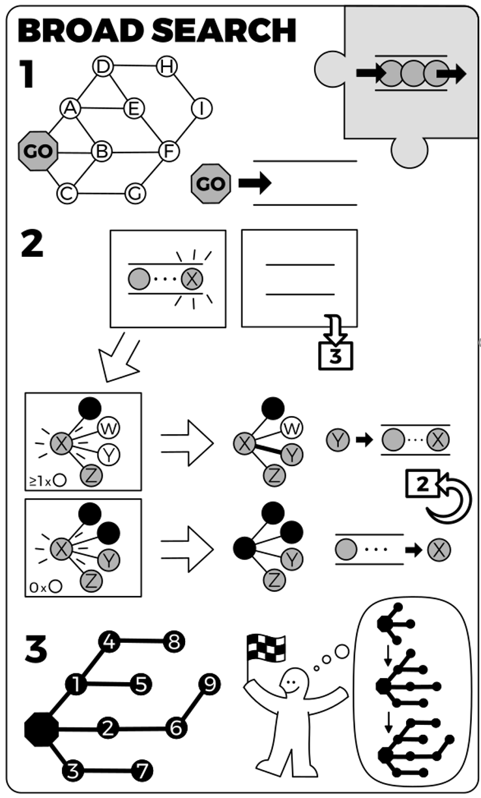
BFS implementation
Initialization: mark all vertices "undiscovered"
BFS($s$)
mark $s$ discovered
queue $Q=\{s\}$
Level[s] = 0
while $Q$ is not empty
$u=Q.dequeue()$
for each edge $\{u,x\}$
if ($x$ is undiscovered)
mark $x$ discovered
append $x$ on $Q$
$x.parent=u$
Level[x] = Level[u] + 1.
mark $u$ fully-explored

Slide 16
BFS(1)
1
Queue:
1
2
3
4
6
7
9
5
11
12
10
8
13
Notes:
mark s "discovered"
queue = { s }
while queue not empty
u = remove_first(queue)
for each edge {u,x}
if (x is undiscovered)
mark x discovered
append x on queue
mark u fully explore

Slide 17
BFS(1)
1
Queue:
2 3
2
3
4
6
7
9
5
11
12
10
8
13
Notes:
mark s "discovered"
queue = { s }
while queue not empty
u = remove_first(queue)
for each edge {u,x}
if (x is undiscovered)
mark x discovered
append x on queue
mark u fully explore

Slide 18
BFS(1)
1
Queue:
3 4
2
3
4
6
7
9
5
11
12
10
8
13
Notes:
mark s "discovered"
queue = { s }
while queue not empty
u = remove_first(queue)
for each edge {u,x}
if (x is undiscovered)
mark x discovered
append x on queue
mark u fully explore

Slide 19
BFS(1)
1
Queue:
4 5 6 7
2
3
4
6
7
9
5
11
12
10
8
13
Notes:
mark s "discovered"
queue = { s }
while queue not empty
u = remove_first(queue)
for each edge {u,x}
if (x is undiscovered)
mark x discovered
append x on queue
mark u fully explore

Slide 20
BFS(1)
1
Queue:
5 6 7 8 9
2
3
4
6
7
9
5
11
12
10
8
13
Notes:
mark s "discovered"
queue = { s }
while queue not empty
u = remove_first(queue)
for each edge {u,x}
if (x is undiscovered)
mark x discovered
append x on queue
mark u fully explore

Slide 21
BFS(1)
1
Queue:
7 8 9 10
2
3
4
6
7
9
5
11
12
10
8
13
Notes:
mark s "discovered"
queue = { s }
while queue not empty
u = remove_first(queue)
for each edge {u,x}
if (x is undiscovered)
mark x discovered
append x on queue
mark u fully explore

Slide 22
BFS(1)
1
Queue:
8 9 10 11
2
3
4
6
7
9
5
11
12
10
8
13
Notes:
mark s "discovered"
queue = { s }
while queue not empty
u = remove_first(queue)
for each edge {u,x}
if (x is undiscovered)
mark x discovered
append x on queue
mark u fully explore

Slide 23
BFS(1)
1
Queue:
9 10 11 12 13
2
3
4
6
7
9
5
11
12
10
8
13
Notes:
mark s "discovered"
queue = { s }
while queue not empty
u = remove_first(queue)
for each edge {u,x}
if (x is undiscovered)
mark x discovered
append x on queue
mark u fully explore

Slide 24
BFS(1)
1
Queue:
2
3
4
6
7
9
5
11
12
10
BFS(1) finds a tree
This tree contains all vertices reachable from 1
We call it BFS tree
8
13
Notes:
mark s "discovered"
queue = { s }
while queue not empty
u = remove_first(queue)
for each edge {u,x}
if (x is undiscovered)
mark x discovered
append x on queue
mark u fully explore

Slide 25
BFS Analysis
Initialization: mark all vertices "undiscovered"
BFS($s$)
mark $s$ discovered
queue $Q=\{s\}$
while $Q$ is not empty
$u=Q.dequeue()$
for each edge $\{u,x\}$
if ($x$ is undiscovered)
mark $x$ discovered
append $x$ on $Q$
$x.parent=u$
mark $u$ fully-explored
O(n) times:
At most once per vertex
O(m) times:
At most twice per edge

Slide 26
Properties of BFS
BFS($s$) visits a vertex $v$ if and only if there is a path from $s$ to $v$
Edges into then-undiscovered vertices define a tree – the “BFS tree” of $G$
All nontree edges join vertices on the same or adjacent levels of the tree
Level $i$ in the tree are exactly all vertices $v$ s.t., the shortest path (in $G$) from the root $s$ to $v$ is of length $i$

Slide 27
BFS Application: Shortest Paths
BFS Tree gives shortest
paths from 1 to all vertices
1
0
2
1
3
4
6
2
7
9
5
3
11
12
10
8
4
All edges connect same
or adjacent levels
13
Notes:
mark s "discovered"
queue = { s }
while queue not empty
u = remove_first(queue)
for each edge {u,x}
if (x is undiscovered)
mark x discovered
append x on queue
mark u fully explore

Slide 28
BFS Application: Shortest Paths
BFS Tree gives shortest
paths from 1 to all vertices
1
0
2
3
1
4
5
6
7
2
8
9
10
11
3
4
All edges connect same
or adjacent levels
12
13
Notes:
mark s "discovered"
queue = { s }
while queue not empty
u = remove_first(queue)
for each edge {u,x}
if (x is undiscovered)
mark x discovered
append x on queue
mark u fully explore

Slide 29
Properties of BFS
Claim: All nontree edges join vertices on the same or adjacent levels of the tree
Proof: Consider an edge $\{x,y\}$
Say $x$ is first discovered and it is added to level $i$.
We show y will be at level $i$ or $i+1$
This is because when vertices incident to $x$ are considered in the loop, if $y$ is still undiscovered, it will be discovered and added to level $i+1$.

Slide 30
Properties of BFS
Lemma: All vertices at level $i$ of BFS($s$) have shortest path distance $i$ to $s$.
Claim: If $L\left(v\right)=i$ then shortest path $≤i$
Pf: Because there is a path of length $i$ from $s$ to $v$ in the BFS tree
Claim: If shortest path $=i$ then $L\left(v\right)≤i$
Pf: If shortest path $=i$, then say $s=v_{0},v_{1},…,v_{i}=v$ is the shortest path to v.
By previous claim,
$$L\left(v_{1}\right)≤L\left(v_{0}\right)+1$$
$$L\left(v_{2}\right)≤L\left(v_{1}\right)+1$$
$$…$$
$$L\left(v_{i}\right)≤L\left(v_{i−1}\right)+1$$
So, $L\left(v_{i}\right)≤i.$
This proves the lemma.

Slide 31
Why Trees?
Trees are simpler than graphs
Many statements can be proved on trees by induction
So, computational problems on trees are simpler than general graphs
This is often a good way to approach a graph problem:
Find a "nice" tree in the graph, i.e., one such that non-tree edges have some simplifying structure
Solve the problem on the tree
Use the solution on the tree to find a “good” solution on the graph

Slide 32
CSE 421: Introduction to Algorithms
Application of BFS
Yin Tat Lee

Slide 33
BFS Application: Connected Component
We want to answer the following type questions (fast):
Given vertices $u,v$ is there a path from $u$ to $v$ in $G$?
Idea: Create an array $A$ such that
For all $u$ in the same connected component, $A[u]$ is same.
Therefore, question reduces to
If $A\left[u\right]=A[v]$?

Slide 34
BFS Application: Connected Component
Initial State: All vertices undiscovered, $c = 0$
For $v$ = $1$ to $n$ do If state($v$) != fully-explored then
Run BFS($v$)
Set $A\left[u\right]←c$ for each $u$ found in BFS($v$)
$c=c+1$
Note: We no longer initialize to undiscovered in the BFS subroutine
Total Cost: $O(m+n)$
In every connected component with $n_{i}$ vertices and $m_{i}$ edges BFS takes time $O\left(m_{i}+n_{i}\right).$
Note: one can use DFS instead of BFS.

Slide 35
Connected Components
Lesson: We can execute any algorithm on disconnected graphs by running it on each connected component.
We can use the previous algorithm to detect connected components.
There is no overhead, because the algorithm runs in time $O(m+n).$
So, from now on, we can (almost) always assume the input graph is connected.

Slide 36
Cycles in Graphs
Claim: If an $n$ vertices graph$G$ has at least $n$ edges, then it has a cycle.
Proof: If $G$ is connected, then it cannot be a tree. Because every tree has $n−1$ edges. So, it has a cycle.
Suppose $G$ is disconnected. Say connected components of G have $n_{1},…,n_{k}$vertices where $n_{1}+…+n_{k}=n$
Since $G$ has $≥n$ edges, there must be some $i$ such that a component has $n_{i}$ vertices with at least $n_{i}$ edges.
Therefore, in that component we do not have a tree, so there is a cycle.

Slide 37
Quiz
Problem: Give an algorithm to detect whether a given undirected graph contains a cycle.

Slide 38
Bipartite Graphs
Definition: An undirected graph $G=(V,E)$ is bipartite
if you can partition the vertex set into 2 parts (say, blue/red or left/right) so that
all edges join vertices in different parts
i.e., no edge has both ends in the same part.
Application:
Scheduling: machine=red, jobs=blue
Stable Matching: men=blue, woman=red
a bipartite graph

Slide 39
Testing Bipartiteness
Problem: Given a graph $G$, is it bipartite?
Many graph problems become:
Easier/Tractable if the underlying graph is bipartite (matching)
Before attempting to design an algorithm, we need to understand structure of bipartite graphs.
v₂
v₃
v₂
v₁
v₄
v₆
v₅
v₄
v₃
v₅
v₆
v₇
v₁
v₇
a bipartite graph G
another drawing of G

Slide 40
An Obstruction to Bipartiteness
Lemma: If $G$ is bipartite, then it does not contain an odd length cycle.
Proof: We cannot $2$-color an odd cycle, let alone $G$.
?
bipartite (2-colorable)
not bipartite (not 2-colorable)

Slide 41
A Characterization of Bipartite Graphs
Lemma: Let $G$ be a connected graph, and let $L0, …, L_{k}$ be the layers produced by BFS($s$). Exactly one of the following holds.
(i) No edge of $G$ joins two nodes of the same layer, and $G$ is bipartite.
(ii) An edge of $G$ joins two nodes of the same layer, and $G$contains an odd-length cycle (and hence is not bipartite).
L₁
L₂
L₃
L₁
L₂
L₃
Case (i)
Case (ii)

Slide 42
A Characterization of Bipartite Graphs
Lemma: Let $G$ be a connected graph, and let $L0, …, L_{k}$ be the layers produced by BFS($s$). Exactly one of the following holds.
(i) No edge of $G$ joins two nodes of the same layer, and $G$ is bipartite.
(ii) An edge of $G$ joins two nodes of the same layer, and $G$contains an odd-length cycle (and hence is not bipartite).
Proof. (i)
Suppose no edge joins two nodes in the same layer.
By previous lemma, all edges join nodes on adjacent levels.
Bipartition: blue = nodes on odd levels, red = nodes on even levels.
L₁
L₂
L₃
Case (i)

Slide 43
A Characterization of Bipartite Graphs
Lemma: Let $G$ be a connected graph, and let $L0, …, L_{k}$ be the layers produced by BFS($s$). Exactly one of the following holds.
(i) No edge of $G$ joins two nodes of the same layer, and $G$ is bipartite.
(ii) An edge of $G$ joins two nodes of the same layer, and $G$contains an odd-length cycle (and hence is not bipartite).
Proof. (ii)
Suppose $\{x, y\}$ is an edge & $x,y$ in same level $L_{j}$.
Let $z=$ their lowest common ancestor in BFS tree.
Let $L_{i}$ be level containing $z$.
Consider cycle that takes edge from $x$ to $y$, then tree from $y$ to $z$, then tree from $z$ to $x$.
Its length is $1+\left(j−i\right)+(j−i)$, which is odd.
z = lca(x, y)

Slide 44
Obstruction to Bipartiteness
Corollary: A graph $G$ is bipartite if and only if it contains no odd length cycles.
Furthermore, one can test bipartiteness using BFS.
bipartite (2-colorable)
not bipartite (not 2-colorable)

Slide 45
Summary
BFS($s$) implemented using queue.
Edges into then-undiscovered vertices define a tree – the “Breadth First spanning tree” of $G$
Level $i$ in the tree are exactly all vertices $v$ s.t., the shortest path (in $G$) from the root $s$ to $v$ is of length $i$
All nontree edges join vertices on the same or adjacent layers of the tree
Applications:
Shortest Path
Connected component
Test bipartiteness / 2-coloring

