Slide 1
CSE 421
NP-Completeness
Yin Tat Lee

Slide 2
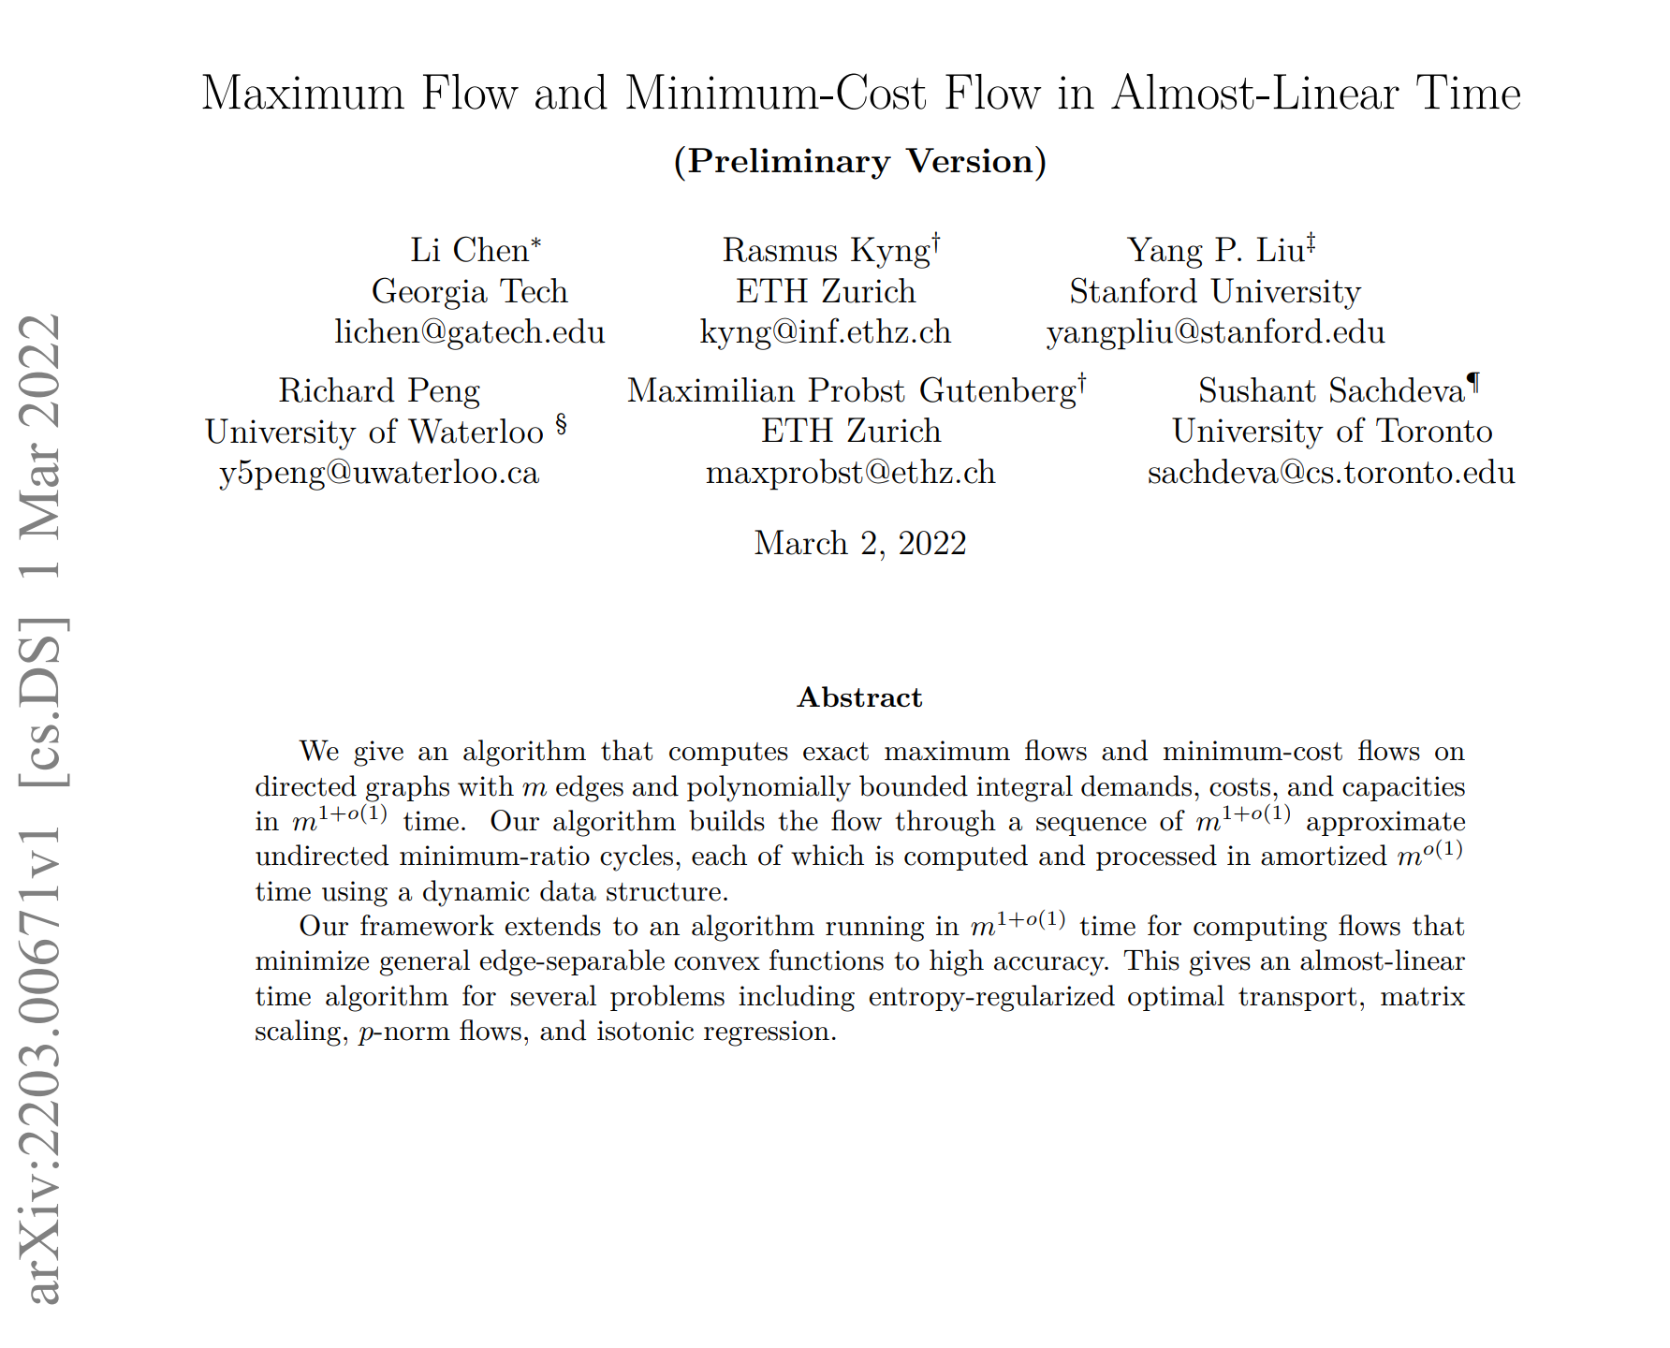
Latest News
Yesterday 5pm

Slide 3
Rough Idea
Don’t quote me on this. This paper is 1-day new.
I haven’t really read it.
The algorithm has $m$ iterations.
Each iterations send an approximate shortest path from $s$ to $t$.
They maintain $n^{o(1)}$ spanning tree-ish and use the shortest paths on these tree.

Slide 4
Rough Idea
Don’t quote me on this. This paper is 1-day new.
I haven’t really read it.
Use data structure to send the flow in $n^{o(1)}$ time.
The length is defined to be how saturated is an edge. It is selected to ensures only the length of $n^{o(1)}$ edges changes sufficiently.

Slide 5
Rough Idea
Don’t quote me on this. This paper is 1-day new.
I haven’t really read it.
I will “probably” have a 599 course on this next year.
To find the data structure efficiently, the recursively reduce # of edges and # of vertices.

Slide 6
Decision Problems
A decision problem is a computational problem where the answer is just yes/no.
We can define a problem by a set $X⊂{\left\{0,1\right\}}^{n}$.
The answer for the input $s$ is YES iff $s∈X$.
Certifier: Algorithm C(s, t) is a certifier for problem A if
$s∈X$ if and only if (There is a $t$ such that $C\left(s,t\right)=YES$))
NP: Set of all decision problems for which there exists a poly-time certifier.
3CNF: $\left(x_{1}∨\overline{x_{2}}∨x_{9}\right)∧\left(\overline{x_{2}}∨x_{3}∨x_{7}\right)∧…$

Slide 7
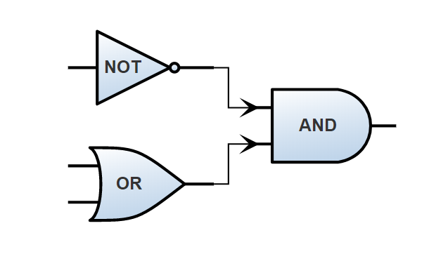
Cook-Levin Theorem
Theorem (Cook 71, Levin 73): 3-SAT is NP-complete, i.e., for all problems $A∈NP,$ $A≤_{p}$ 3-SAT.
Pf (Draft. Take CSE 431 for more.):
Since $A∈NP$, there is a polytime certifier $C$ such that
$s∈A$ iff $C\left(s,t\right)=1$ for some $t$
To solve the problem $A$, it suffices to find $t$.
Since $C$ is polytime, we can convert $C$ to a poly size circuit (of AND OR NOT).
Some input are the given $s$.
Some input are 𝑡.
Our goal is to find $t$ to make the output is TRUE.

Slide 8
Cook-Levin Theorem
To find an input such that output is true,
we convert the circuit to 3CNF $\left(x_{1}∨\overline{x_{2}}∨x_{9}\right)∧\left(\overline{x_{2}}∨x_{3}∨x_{7}\right)∧…$
An OR gate with input a,b and output c can be represented by
$$\left(a∨b∨\overline{c}\right)∧(\overline{a}∨c)∧(\overline{b}∨c)$$
A NOT gate with input a and output c can be represented by
$$\left(a∨c\right)∧(\overline{a}∨\overline{c})$$
An AND gate can be represented by OR and NOT
X and Y = not ((not X) or (not Y))

Slide 9
Cook-Levin Theorem
To find an input such that output is true,
we convert the circuit to 3CNF $\left(x_{1}∨\overline{x_{2}}∨x_{9}\right)∧\left(\overline{x_{2}}∨x_{3}∨x_{7}\right)∧…$
Suppose the circuit gate $C_{1},C_{2},⋯,C_{q}$.
For each circuit $C_{i}$, we create a new variable $c_{i}$.
The relation between the inputs of $C_{i}$ and its output $c_{i}$ is a 3CNF.
We write that as ${\overline{C}}_{i}$
The whole formula is 3CNF is ${\overline{C}}_{1}∧{\overline{C}}_{2}∧⋯∧{\overline{C}}_{q}∧c_{q}$.

Slide 10
Steps to Proving Problem B is NP-complete
Show B is NP-hard:
State which NP-hard Problem A you want to solve using B.
Show what the map f is.
Argue that f is polynomial time
Argue correctness: two directions Yes for A implies Yes for B and vice versa.
Show B is in NP
State what hint/certificate is and why it works
Argue that it is polynomial-time to check.

Slide 11
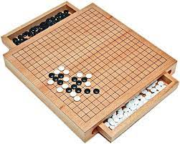
Is NP-complete as bad as it gets?
NO! NP-complete problems are frequently encountered, but there are worse:
Some problems provably require exponential time.
Ex: Does M halt on input x in 2^{|x|} steps?
Some require $2^{n}, 2^{2^{n}},⋯$ steps
And some are just plain uncomputable.
I was wrong last lecture. There are natural problems that is not in P. Go is EXP-COMPLETE.

Slide 12
3-SAT $≤_{p}$ Independent Set
Map a 3-CNF to (G,k). Say m is number of clauses
Create a vertex for each literal
Joint two literals if
They belong to the same clause (blue edges)
The literals are negations, e.g., $x_{i}, \overline{x_{i}}$ (red edges)
Set k be the # of clauses.
$$\left(x_{1}∨\overline{x_{3}}∨x4\right)∧\left( x_{2}∨\overline{x_{4}}∨x3\right)∧\left( x_{2}∨ \overline{x_{1}}∨x3\right)$$
$$x_{1}$$
$$x_{2}$$
$$x_{2}$$
Polynomial-Time Reduction
$$\overline{x_{3}}$$
$$\overline{x_{4}}$$
$$\overline{x_{1}}$$
$$x_{4}$$
$$x_{3}$$
$$x_{3}$$

Slide 13
Correctness of 3-SAT $≤_{p}$ Indep Set
F satisfiable => An independent of size k
Given a satisfying assignment, Choose one node from each clause where the literal is satisfied
$$\left(x_{1}∨\overline{x_{3}}∨x_{4}\right)∧\left(x_{2}∨\overline{x_{4}}∨x_{3}\right)∧\left(x_{2}∨\overline{x_{1}}∨x_{3}\right)$$
Satisfying assignment: $x_{1}=T,x_{2}=F,x_{3}=T,x_{4}=F$
S has exactly one node per clause => No blue edges between S
S follows a truth-assignment => No red edges between S
S has one node per clause => |S|=k
$$x_{1}$$
$$x_{2}$$
$$x_{2}$$
$$\overline{x_{3}}$$
$$\overline{x_{4}}$$
$$\overline{x_{1}}$$
$$x_{4}$$
$$x_{3}$$
$$x_{3}$$

Slide 14
Correctness of 3-SAT $≤_{p}$ Indep Set
An independent set of size k => A satisfying assignment
Given an independent set S of size k.
S has exactly one vertex per clause (because of blue edges)
S does not have $x_{i},\overline{x_{i}}$ (because of red edges)
So, S gives a satisfying assignment
Satisfying assignment: $x_{1}=F,x_{2}=?,x_{3}=T,x_{4}=T$
$$\left(x_{1}∨\overline{x_{3}}∨x_{4}\right)∧\left(x_{2}∨\overline{x_{4}}∨x_{3}\right)∧\left(x_{2}∨\overline{x_{1}}∨x_{3}\right)$$
$$x_{1}$$
$$x_{2}$$
$$x_{2}$$
$$\overline{x_{3}}$$
$$\overline{x_{4}}$$
$$\overline{x_{1}}$$
$$x_{4}$$
$$x_{3}$$
$$x_{3}$$

Slide 15
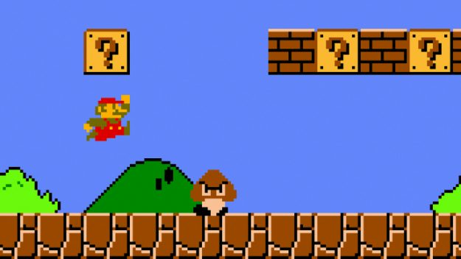
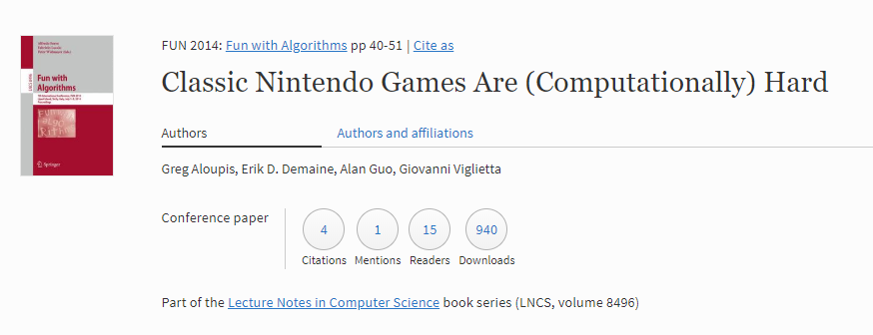
Yet another example of NP completeness
Prove that Super Mario Bros is NP-complete.
What do we need to show?
The problem is in NP.
Some NP complete problem is easier than Super Mario.
Approach:
3SAT $≤_{P}$ Super Mario

Slide 16
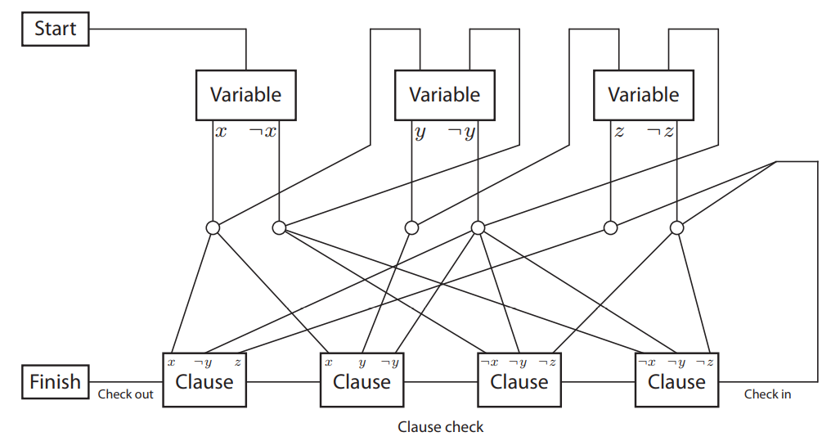
Yet another example of NP completeness
Given a 3SAT, we need to create a level.
We ignore the following issues:
Need to consider the “crossing” coz the level is 2-D.
Assume Mario can go both left or right.

Slide 17
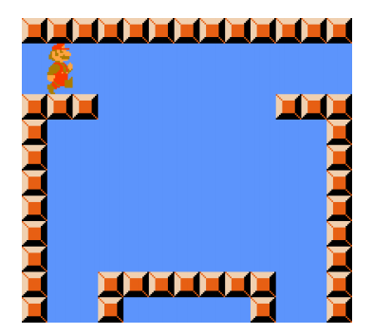
Question 1: How to create this part?

Slide 18
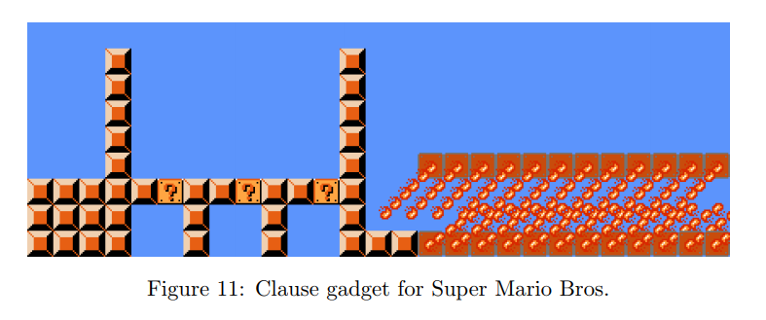
Question 2: How to create this part?

Slide 19
So, what you need to prove?
If the 3SAT is satisfiable, then indeed the level is solvable.
Usually, this part is easy. This is basically due to the design of your reduction.
If the level is solvable, then the 3SAT is satisfiable
This part usually requires more argument. Need to prove no tricky way to solve the problem without solving the 3SAT.

Slide 20
More NP-completeness
Subset-Sum problem (Decision version of Knapsack)
Given n integers w₁,…,w_{n} and integer W
Is there a subset of the n input integers that adds up to exactly W?
O(nW) solution from dynamic programming but if W and each w_{i} can be n bits long then this is exponential time

Slide 21
3-SAT ≤_{P}Subset-Sum
Given a 3-CNF formula with m clauses and n variables
Will create 2m+2n numbers that are m+n digits long
Two numbers for each variable x_{i}
t_{i} and f_{i} (corresponding to x_{i} being true or x_{i} being false)
Two extra numbers for each clause
u_{j} and v_{j} (filler variables to handle number of false literals in clause C_{j})

Slide 22
3-SAT ≤_{P}Subset-Sum
i j
C₃=(x₁∨¬ x₂∨ x₅)
1 2 3 4 … n 1 2 3 4 … m
t₁
1 0 0 0 … 0 0 0 1 0 … 1
f₁
1 0 0 0 … 0 1 0 0 1 … 0
t₂
0 1 0 0 … 0 0 1 0 0 … 1
f₂
0 1 0 0 … 0 0 0 1 1 … 0
… ….
u₁=v₁
0 0 0 0 … 0 1 0 0 0 … 0
u₂=v₂
0 0 0 0 … 0 0 1 0 0 … 0
… ….
W
1 1 1 1 … 1 3 3 3 3 … 3

Slide 23
Graph Colorability
Defn: Given a graph G=(V,E), and an integer k, a k-coloring of G is
an assignment of up to k different colors to the vertices of G so that the endpoints of each edge have different colors.
3-Color: Given a graph G=(V,E), does G have a 3-coloring?
Claim: 3-Color is NP-complete
Proof: 3-Color is in NP:
Certificate is an assignment of red,green,blue to the vertices of G
Easy to check that each edge is colored correctly

Slide 24
3-SAT ≤_{P}3-Color
Reduction:
We want to map a 3-CNF formula F to a graph G so that
G is 3-colorable iff F is satisfiable

Slide 25
3-SAT ≤_{P}3-Color
O
F
T
Base Triangle

Slide 26
3-SAT ≤_{P}3-Color
¬x_{n}
x_{n}
...
Variable Part:
in 3-coloring, variable
colors correspond to
some truth assignment
(same color as T or F)
x₂
¬x₂
x₁
O
¬x₁
F
T

Slide 27
3-SAT ≤_{P}3-Color
(x_{n} ∨ x₂ ∨ ¬x₁)
¬x_{n}
x_{n}
...
x₂
(x₁ ∨ x₃ ∨ x₆)
¬x₂
x₁
O
¬x₁
F
T
Clause Part:
Add one 6 vertex gadget per clause connecting
its ‘outer vertices’ to the literals in the clause

Slide 28
3-SAT ≤_{P}3-Color
O
(x_{n} ∨ x₂ ∨ ¬x₁)
x_{n}
T
¬x_{n}
F
T
F
...
O
F/T
x₂
O
¬x₂
(x₁ ∨ x₃ ∨ x₆)
x₁
O
¬x₁
F/T
F
T
Any truth assignment satisfying the formula
can be extended to a 3-coloring of the graph
Notes:
Any satisfying statement has a T. We can color the corresponding vertex in the gadget F and in the triangle O.
Other two, we just use O in the gadget and T F in the triangle.

Slide 29
3-SAT ≤_{P}3-Color
F
(x_{n} ∨ x₂ ∨ ¬x₁)
¬x_{n}
x_{n}
T
O
...
x₂
¬x₂
(x₁ ∨ x₃ ∨ x₆)
x₁
O
¬x₁
F
T
Any 3-coloring of the graph colors
each gadget triangle using each color

Slide 30
3-SAT ≤_{P}3-Color
F
(x_{n} ∨ x₂ ∨ ¬x₁)
¬x_{n}
x_{n}
T
O
...
x₂
F
¬x₂
(x₁ ∨ x₃ ∨ x₆)
x₁
O
¬x₁
F
T
Any 3-coloring of the graph has an F opposite
the O color in the triangle of each gadget

Slide 31
3-SAT ≤_{P}3-Color
F
(x_{n} ∨ x₂ ∨ ¬x₁)
¬x_{n}
x_{n}
T
O
...
x₂
F
¬x₂
(x₁ ∨ x₃ ∨ x₆)
x₁
O
¬x₁
T
F
T
Any 3-coloring of the graph has T at the
other end of the blue edge connected to the F

Slide 32
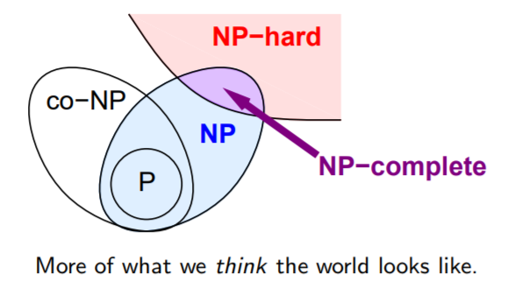
Summary
If a problem is NP-hard it does not mean that all instances are hared, e.g., Vertex-cover has a polynomial-time algorithm in trees
We learned the crucial idea of polynomial-time reduction. This can be even used in algorithm design, e.g., we know how to solve max-flow so we reduce image segmentation to max-flow
NP-Complete problems are the hardest problem in NP
NP-hard problems may not necessarily belong to NP.
Polynomial-time reductions are transitive relations

