Slide 1
CSE 421
Dynamic Programming
Yin Tat Lee
Notes:
Divide and conquer is about cutting the problem by 2. It usually gives very good runtime. But it is non-trivial to merge two problems.
Dynamic programming is more like reducing the problem size by 1. We are often better at arguing what happens when we remove 1 element.

Slide 2
Announcement
  No Homework due this week.
  Office hour is both on Zoom and in person this and next week.
    (As requested by some student.)
  My OH is on Monday. (Sorry that it was not clear in the website before)
  We haven’t graded the midterm. It will be done this week.

Slide 3

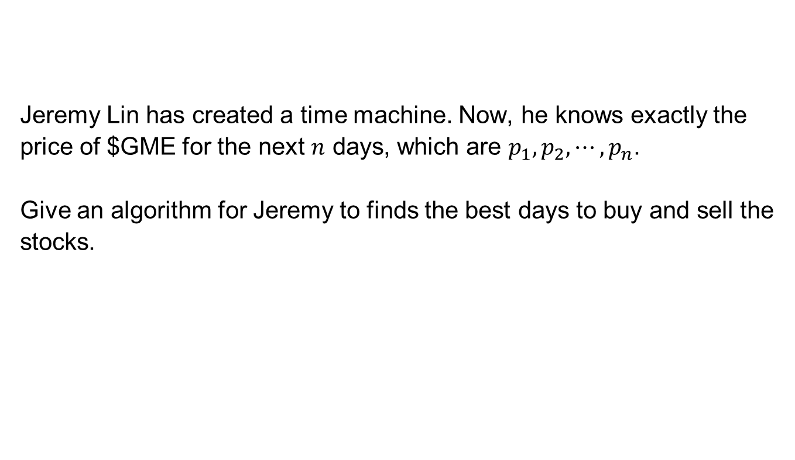
Quiz
  Jeremy Lin has created a time machine. Now, he knows exactly the price of $GME for the next $n$ days, which are $p_{1},p_{2},⋯,p_{n}$.
  Give an algorithm for Jeremy to finds the best days to buy and sell the stocks.

Slide 4
Weighted Interval Scheduling

Slide 5

Interval Scheduling
  Job $j$ starts at $s(j)$ and finishes at $f\left(j\right)$ and has weight $w_{j}$
  Two jobs compatible if they don’t overlap.
  Goal: find maximum weight subset of mutually compatible jobs.
a
b
b
c
d
e
e
f
g
h
h
Time
0
1
2
3
4
5
6
7
8
9
10
11

Slide 6
Unweighted Interval Scheduling: Review
  Recall: Greedy algorithm works if all weights are 1:
  Consider jobs in ascending order of finishing time
  Add job to a subset if it is compatible with prev added jobs.
  Observation: Greedy ALG fails spectacularly if arbitrary weights are allowed:
weight = 1000
b
by finish
weight = 1
a
Time
0
1
2
3
4
5
6
7
8
9
10
11
weight = 1000
b
by weight
weight = 999
a₁
a₁
a₁
a₁
a₁
a₁
a₁
a₁
a₁
a₁
Time
0
1
2
3
4
5
6
7
8
9
10
11

Slide 7

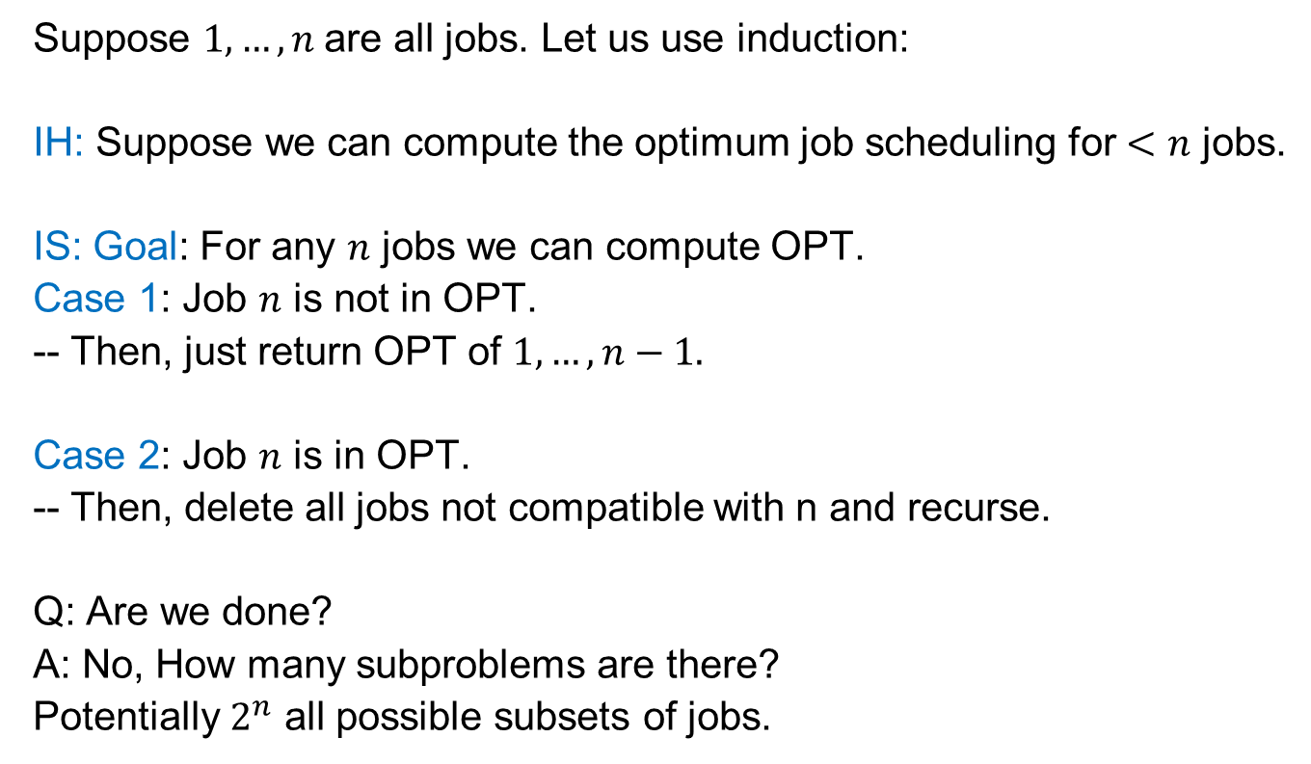






Weighted Job Scheduling by Induction
  Suppose $1,…,n$are all jobs. Let us use induction:
  IH: Suppose we can compute the optimum job scheduling for $<n$ jobs.
  IS: Goal: For any $n$ jobs we can compute OPT.
  Case 1: Job $n$ is not in OPT.
  -- Then, just return OPT of $1,…,n−1.$
  Case 2: Job $n$ is in OPT.
  -- Then, delete all jobs not compatible with n and recurse.
  Q: Are we done?
  A: No, How many subproblems are there?
  Potentially $2^{n}$ all possible subsets of jobs.
Take best of the two
$$n$$
$$n−1$$
$$n−2$$
$$n−2$$
$$n−3$$
$$n−3$$
$$n−4$$

Slide 8







Sorting to Reduce Subproblems
Why can’t we order by start time?
  Sorting Idea: Label jobs by finishing time $f\left(1\right)≤…≤f(n)$
  IS: For jobs $1,…,n$ we want to compute OPT
  Case 1: Suppose OPT has job $n$.
  So, all jobs $i$ that are not compatible with $n$ are not OPT
  Let $p\left(n\right)=$ largest index $i<n$ such that job $i$ is compatible with $n$.
  Then, we just need to find optimal schedule for jobs $1,…,p(n)$
$$1$$
$$p(n)$$
$$p(n)+1$$
$$n−2$$
$$n−1$$
$$n$$

Slide 9
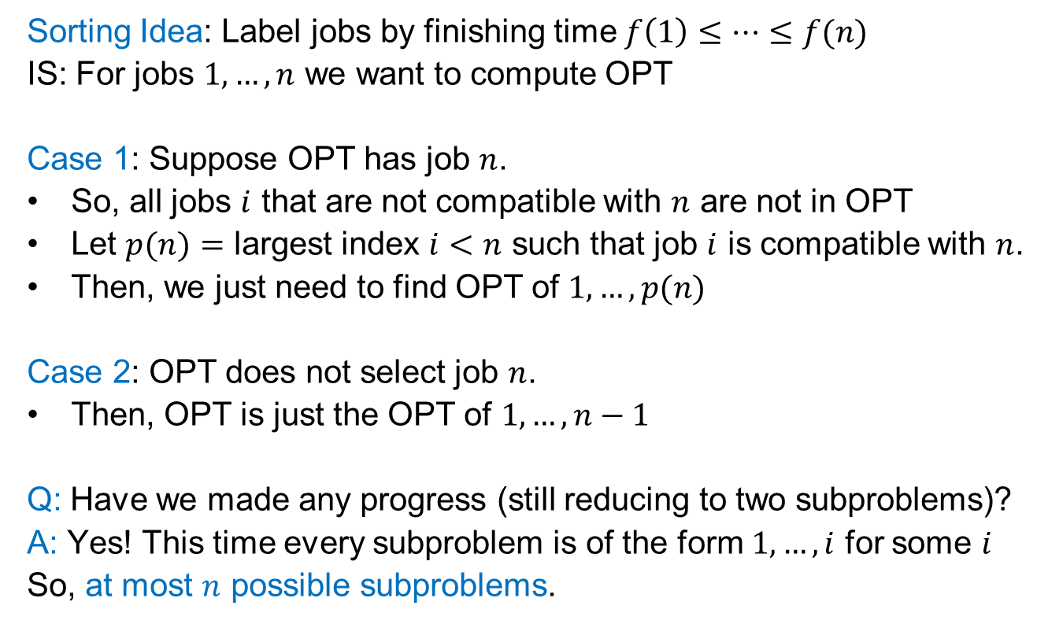
Sorting to Reduce Subproblems
  Sorting Idea: Label jobs by finishing time $f\left(1\right)≤…≤f(n)$
  IS: For jobs $1,…,n$ we want to compute OPT
  Case 1: Suppose OPT has job $n$.
  So, all jobs $i$ that are not compatible with $n$ are not in OPT
  Let $p(n)=$ largest index $i<n$ such that job $i$ is compatible with $n$.
  Then, we just need to find OPT of $1,…,p(n)$
  Case 2: OPT does not select job $n$.
  Then, OPT is just the OPT of $1,…,n−1$
  Q: Have we made any progress (still reducing to two subproblems)?
  A: Yes! This time every subproblem is of the form $1,…,i$ for some $i$
  So, at most $n$ possible subproblems.
Take best of the two

Slide 10
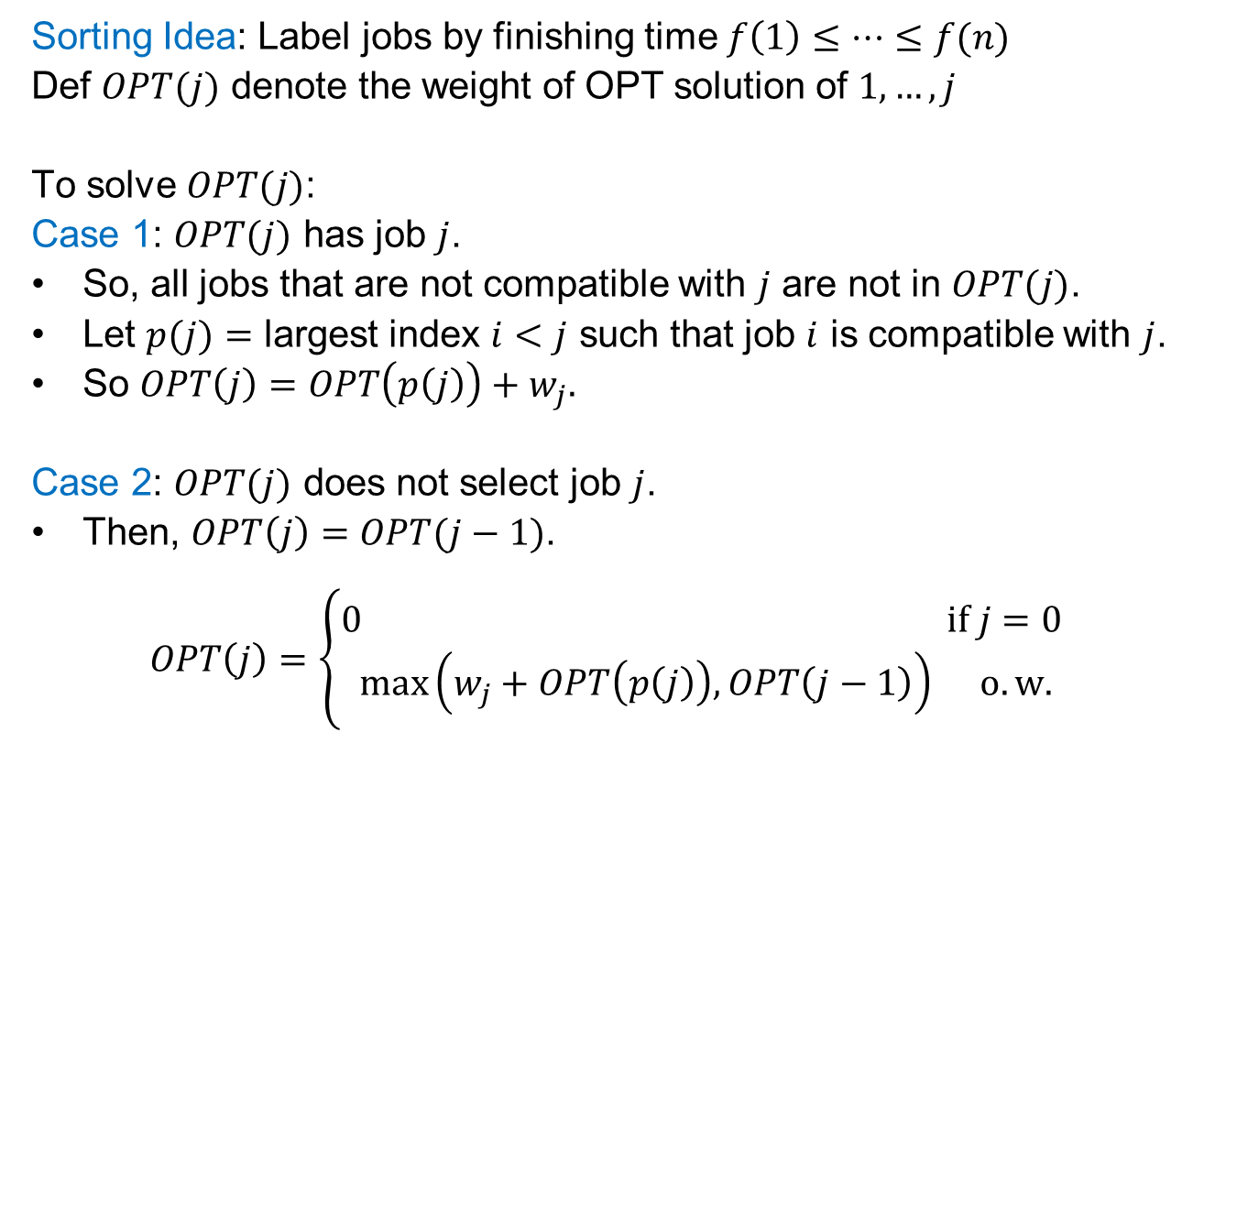
Weighted Job Scheduling by Induction
  Sorting Idea: Label jobs by finishing time $f\left(1\right)≤…≤f(n)$
  Def $OPT(j)$ denote the weight of OPT solution of $1,…,j$
  To solve $OPT(j)$:
  Case 1: $OPT(j)$ has job $j$.
  So, all jobs that are not compatible with $j$ are not in $OPT(j)$.
  Let $p(j)=$ largest index $i<j$ such that job $i$ is compatible with $j$.
  So $OPT\left(j\right)=OPT\left(p\left(j\right)\right)+w_{j}.$
  Case 2: $OPT(j)$ does not select job $j$.
  Then, $OPT\left(j\right)=OPT(j−1)$.
  $$OPT\left(j\right)=\left\{\begin{aligned}0 if j=0 \\ \max\left(w_{j}+OPT\left(p\left(j\right)\right), OPT\left(j−1\right)\right) o.w.\end{aligned}\right.$$
The most important part of a correct DP; It fixes IH

Slide 11
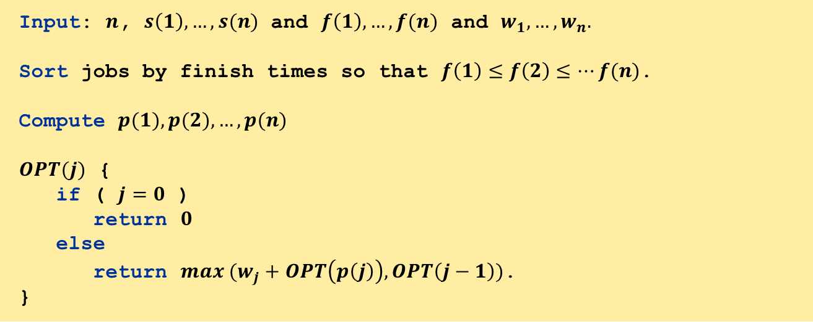
Algorithm
Input: $n$, $s\left(1\right),…,s(n)$ and $f\left(1\right),…,f(n)$ and $w_{1},…,w_{n}.$
Sort jobs by finish times so that $f\left(1\right)≤f\left(2\right)≤…f(n)$.
Compute $p(1), p(2), …, p(n)$
$OPT(j)$ {
if ( $j=0$ )
return $0$
else
return $max (w_{j}+OPT\left(p\left(j\right)\right),OPT\left(j−1\right))$.
}

Slide 12


Recursive Algorithm Fails
Even though we have only $n$ subproblems, if we do not store the solution to the subproblems
we may re-solve the same problem many many times.
Ex. Number of recursive calls for family of "layered" instances grows like Fibonacci sequence
5
1
4
3
2
3
3
2
2
1
4
2
1
1
0
1
0
5
$$p\left(1\right)=0,p\left(j\right)=j−2$$
1
0

Slide 13

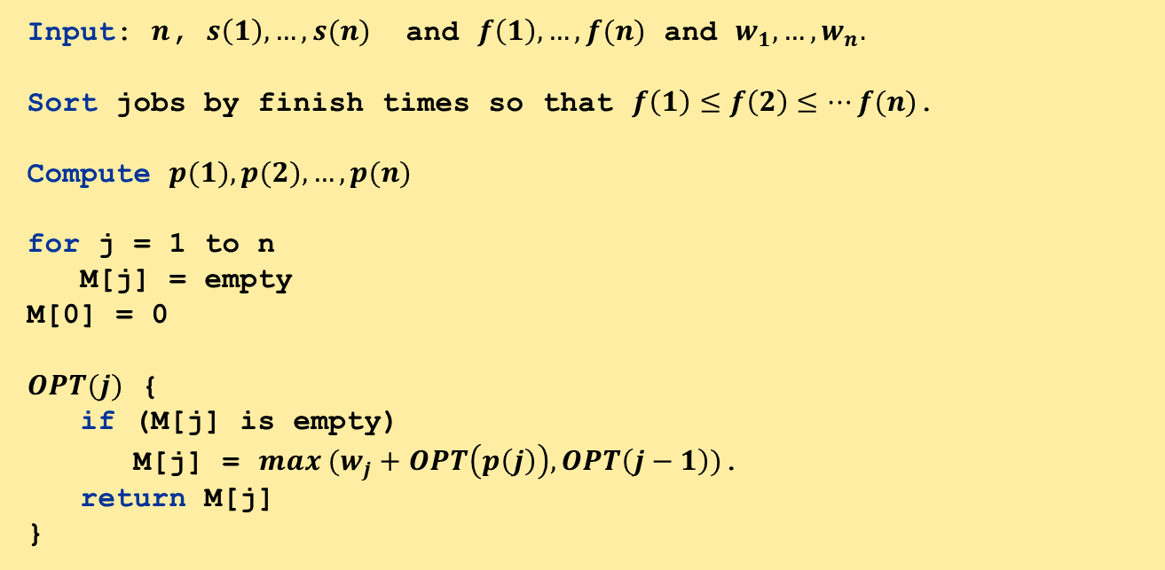
Algorithm with Memoization
Memorization. Compute and Store the solution of each sub-problem in a cache the first time that you face it. lookup as needed.
Input: $n$, $s\left(1\right),…,s(n)$ and $f\left(1\right),…,f(n)$ and $w_{1},…,w_{n}.$
Sort jobs by finish times so that $f\left(1\right)≤f\left(2\right)≤…f(n)$.
Compute $p(1), p(2), …, p(n)$
for j = 1 to n
M[j] = empty
M[0] = 0
$OPT(j)$ {
if (M[j] is empty)
M[j] = $max (w_{j}+OPT\left(p\left(j\right)\right),OPT\left(j−1\right))$.
return M[j]
}
In practice, you may get if $n≫{10}^{6}$ (depends on the language).

Slide 14
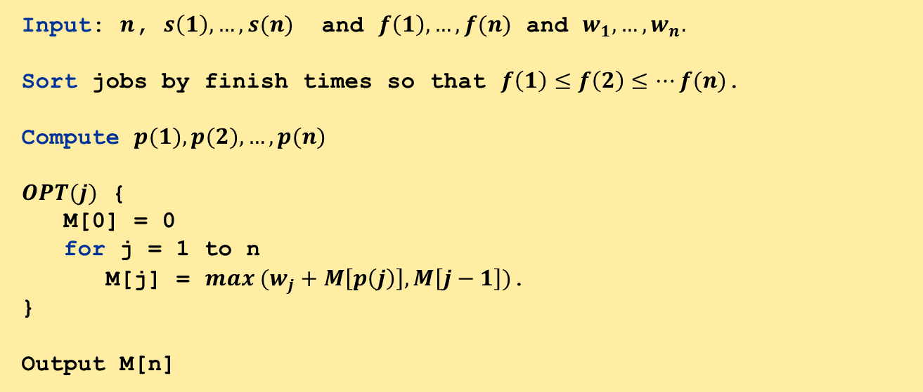
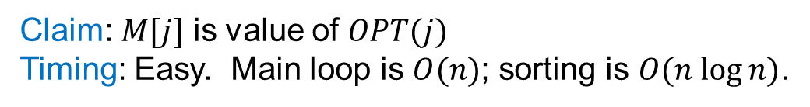
Bottom up Dynamic Programming
You can also avoid recursion
recursion may be easier conceptually when you use induction
Input: $n$, $s\left(1\right),…,s(n)$ and $f\left(1\right),…,f(n)$ and $w_{1},…,w_{n}.$
Sort jobs by finish times so that $f\left(1\right)≤f\left(2\right)≤…f(n)$.
Compute $p(1), p(2), …, p(n)$
$OPT(j)$ {
M[0] = 0
for j = 1 to n
M[j] = $max (w_{j}+M\left[p\left(j\right)\right],M\left[j−1\right])$.
}
Output M[n]
Claim: $M[j]$ is value of $OPT(j)$
Timing: Easy. Main loop is $O(n)$; sorting is $O(n log⁡n)$.

Slide 15

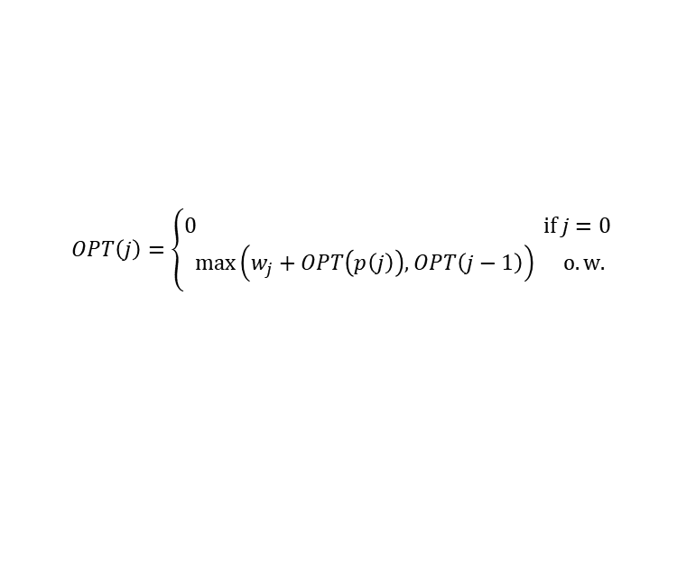

Example
  $$OPT\left(j\right)=\left\{\begin{aligned}0 if j=0 \\ \max\left(w_{j}+OPT\left(p\left(j\right)\right), OPT\left(j−1\right)\right) o.w.\end{aligned}\right.$$
Label jobs by finishing time: $f\left(1\right)≤…≤f\left(n\right).$
$p(j)=$ largest index $i<j$ such that job $i$ is compatible with $j$.
j
$$w_{j}$$
p(j)
OPT(j)
0
0
1
1
3
0
2
2
4
0
3
3
1
0
4
4
3
1
5
5
4
0
6
6
3
2
7
7
2
3
8
0
1
2
3
4
5
6
7
8
9
10
11
8
4
5
Time

Slide 16
Example
  $$OPT\left(j\right)=\left\{\begin{aligned}0 if j=0 \\ \max\left(w_{j}+OPT\left(p\left(j\right)\right), OPT\left(j−1\right)\right) o.w.\end{aligned}\right.$$
Label jobs by finishing time: $f\left(1\right)≤…≤f\left(n\right).$
$p(j)=$ largest index $i<j$ such that job $i$ is compatible with $j$.
j
$$w_{j}$$
p(j)
OPT(j)
0
0
1
1
3
0
3
2
2
4
0
3
3
1
0
4
4
3
1
5
5
4
0
6
6
3
2
7
7
2
3
8
0
1
2
3
4
5
6
7
8
9
10
11
8
4
5
Time

Slide 17
Example
  $$OPT\left(j\right)=\left\{\begin{aligned}0 if j=0 \\ \max\left(w_{j}+OPT\left(p\left(j\right)\right), OPT\left(j−1\right)\right) o.w.\end{aligned}\right.$$
Label jobs by finishing time: $f\left(1\right)≤…≤f\left(n\right).$
$p(j)=$ largest index $i<j$ such that job $i$ is compatible with $j$.
j
$$w_{j}$$
p(j)
OPT(j)
0
0
1
1
3
0
3
2
2
4
0
4
3
3
1
0
4
4
3
1
5
5
4
0
6
6
3
2
7
7
2
3
8
0
1
2
3
4
5
6
7
8
9
10
11
8
4
5
Time
Notes:
The red rows. One is the previous row…One is the row in p(j)...

Slide 18
Example
  $$OPT\left(j\right)=\left\{\begin{aligned}0 if j=0 \\ \max\left(w_{j}+OPT\left(p\left(j\right)\right), OPT\left(j−1\right)\right) o.w.\end{aligned}\right.$$
Label jobs by finishing time: $f\left(1\right)≤…≤f\left(n\right).$
$p(j)=$ largest index $i<j$ such that job $i$ is compatible with $j$.
j
$$w_{j}$$
p(j)
OPT(j)
0
0
1
1
3
0
3
2
2
4
0
4
3
3
1
0
4
4
4
3
1
5
5
4
0
6
6
3
2
7
7
2
3
8
0
1
2
3
4
5
6
7
8
9
10
11
8
4
5
Time

Slide 19
Example
  $$OPT\left(j\right)=\left\{\begin{aligned}0 if j=0 \\ \max\left(w_{j}+OPT\left(p\left(j\right)\right), OPT\left(j−1\right)\right) o.w.\end{aligned}\right.$$
Label jobs by finishing time: $f\left(1\right)≤…≤f\left(n\right).$
$p(j)=$ largest index $i<j$ such that job $i$ is compatible with $j$.
j
$$w_{j}$$
p(j)
OPT(j)
0
0
1
1
3
0
3
2
2
4
0
4
3
3
1
0
4
4
4
3
1
6
5
5
4
0
6
6
3
2
7
7
2
3
8
0
1
2
3
4
5
6
7
8
9
10
11
8
4
5
Time

Slide 20
Example
  $$OPT\left(j\right)=\left\{\begin{aligned}0 if j=0 \\ \max\left(w_{j}+OPT\left(p\left(j\right)\right), OPT\left(j−1\right)\right) o.w.\end{aligned}\right.$$
Label jobs by finishing time: $f\left(1\right)≤…≤f\left(n\right).$
$p(j)=$ largest index $i<j$ such that job $i$ is compatible with $j$.
j
$$w_{j}$$
p(j)
OPT(j)
0
0
1
1
3
0
3
2
2
4
0
4
3
3
1
0
4
4
4
3
1
6
5
5
4
0
6
6
6
3
2
7
7
2
3
8
0
1
2
3
4
5
6
7
8
9
10
11
8
4
5
Time

Slide 21
Example
  $$OPT\left(j\right)=\left\{\begin{aligned}0 if j=0 \\ \max\left(w_{j}+OPT\left(p\left(j\right)\right), OPT\left(j−1\right)\right) o.w.\end{aligned}\right.$$
Label jobs by finishing time: $f\left(1\right)≤…≤f\left(n\right).$
$p(j)=$ largest index $i<j$ such that job $i$ is compatible with $j$.
j
$$w_{j}$$
p(j)
OPT(j)
0
0
1
1
3
0
3
2
2
4
0
4
3
3
1
0
4
4
4
3
1
6
5
5
4
0
6
6
6
3
2
7
7
7
2
3
8
0
1
2
3
4
5
6
7
8
9
10
11
8
4
5
Time

Slide 22
Example
  $$OPT\left(j\right)=\left\{\begin{aligned}0 if j=0 \\ \max\left(w_{j}+OPT\left(p\left(j\right)\right), OPT\left(j−1\right)\right) o.w.\end{aligned}\right.$$
Label jobs by finishing time: $f\left(1\right)≤…≤f\left(n\right).$
$p(j)=$ largest index $i<j$ such that job $i$ is compatible with $j$.
j
$$w_{j}$$
p(j)
OPT(j)
0
0
1
1
3
0
3
2
2
4
0
4
3
3
1
0
4
4
4
3
1
6
5
5
4
0
6
6
6
3
2
77
7
7
2
3
7
8
0
1
2
3
4
5
6
7
8
9
10
11
8
4
5
Time

Slide 23
Example
  $$OPT\left(j\right)=\left\{\begin{aligned}0 if j=0 \\ \max\left(w_{j}+OPT\left(p\left(j\right)\right), OPT\left(j−1\right)\right) o.w.\end{aligned}\right.$$
Label jobs by finishing time: $f\left(1\right)≤…≤f\left(n\right).$
$p(j)=$ largest index $i<j$ such that job $i$ is compatible with $j$.
j
$$w_{j}$$
p(j)
OPT(j)
0
0
1
1
3
0
3
2
2
4
0
4
3
3
1
0
4
4
4
3
1
6
5
5
4
0
6
6
6
3
2
7
7
7
2
3
7
8
0
1
2
3
4
5
6
7
8
9
10
11
8
4
5
10
Time

Slide 24
Example
  $$OPT\left(j\right)=\left\{\begin{aligned}0 if j=0 \\ \max\left(w_{j}+OPT\left(p\left(j\right)\right), OPT\left(j−1\right)\right) o.w.\end{aligned}\right.$$
Label jobs by finishing time: $f\left(1\right)≤…≤f\left(n\right).$
$p(j)=$ largest index $i<j$ such that job $i$ is compatible with $j$.
j
$$w_{j}$$
p(j)
OPT(j)
0
0
1
1
3
0
3
2
2
4
0
4
3
3
1
0
4
4
4
3
1
6
5
5
4
0
6
6
6
3
2
7
7
7
2
3
7
8
0
1
2
3
4
5
6
7
8
9
10
11
8
4
5
10
Time

Slide 25
Dynamic Programming
    Give a solution of a problem using smaller (overlapping) sub-problems where
    the parameters of all sub-problems are determined in-advance
    Useful when the same subproblems show up again and again in the solution.

Slide 26
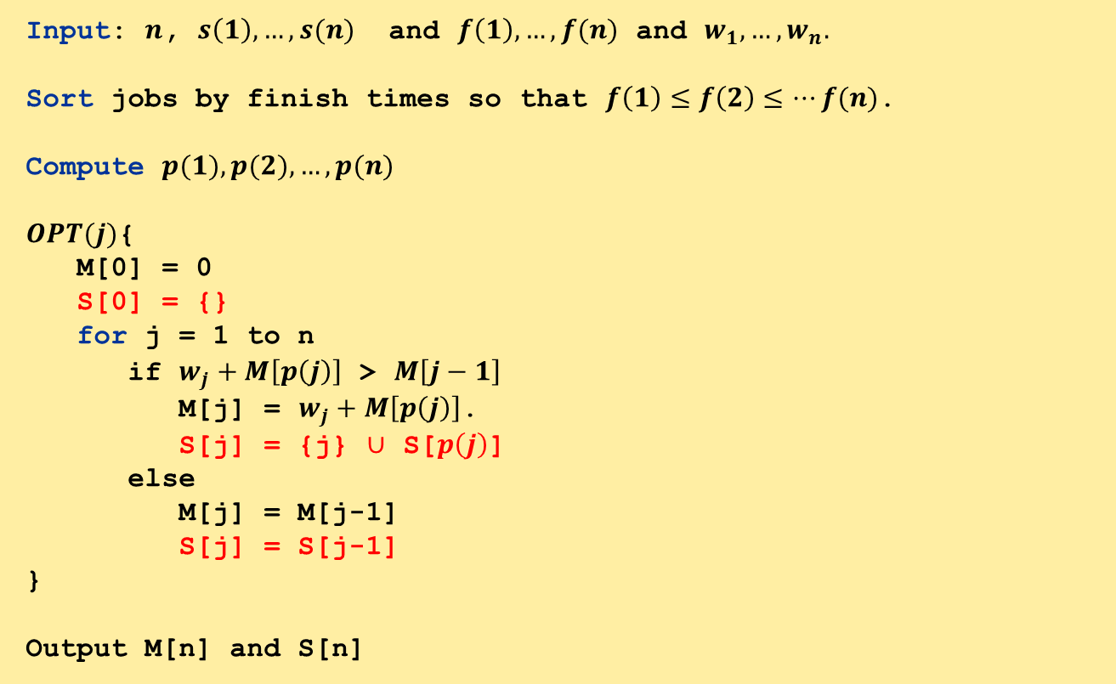



How to recover the solution?
We can simply maintain the solution.
Input: $n$, $s\left(1\right),…,s(n)$ and $f\left(1\right),…,f(n)$ and $w_{1},…,w_{n}.$
Sort jobs by finish times so that $f\left(1\right)≤f\left(2\right)≤…f(n)$.
Compute $p(1), p(2), …, p(n)$
$OPT(j)${
M[0] = 0
S[0] = {}
for j = 1 to n
if $w_{j}+M\left[p\left(j\right)\right]$ > $M\left[j−1\right]$
M[j] = $w_{j}+M\left[p\left(j\right)\right]$.
S[j] = {j} $∪$ S[$p\left(j\right)$]
else
M[j] = M[j-1]
S[j] = S[j-1]
}
Output M[n] and S[n]
What is the runtime of this new algorithm?
Each S[j] points to some vertices of a tree.
We add leaf $j$ with its parent $S[p\left(j\right)]$.
$O(1)$ time
$O(1)$ time

Slide 27
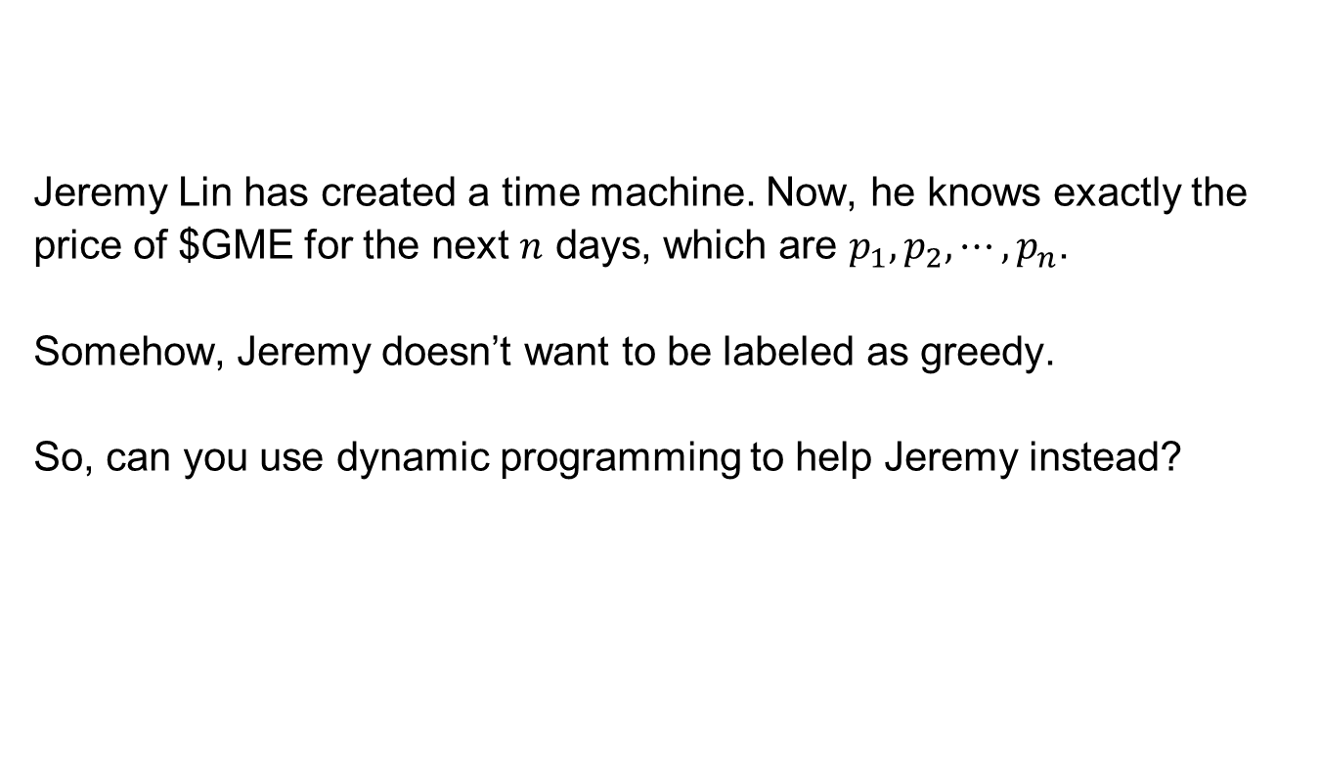
Quiz
  Jeremy Lin has created a time machine. Now, he knows exactly the price of $GME for the next $n$ days, which are $p_{1},p_{2},⋯,p_{n}$.
  Somehow, Jeremy doesn’t want to be labeled as greedy.
  So, can you use dynamic programming to help Jeremy instead?

Slide 28
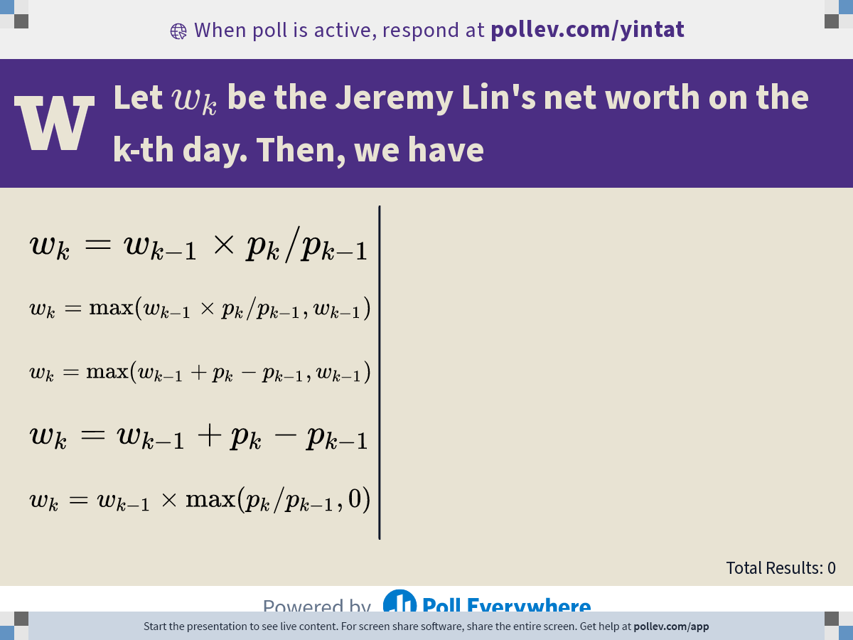
Notes:
Poll Title: Do not modify the notes in this section to avoid tampering with the Poll Everywhere activity.
More info at polleverywhere.com/support
Let $$w_k$$ be the Jeremy Lin's net worth on the k-th day. Then, we have
https://www.polleverywhere.com/multiple_choice_polls/fSfymfisecZYAahgylfZJ?display_state=chart&activity_state=opened&state=opened&flow=Default&onscreen=persist

Slide 29

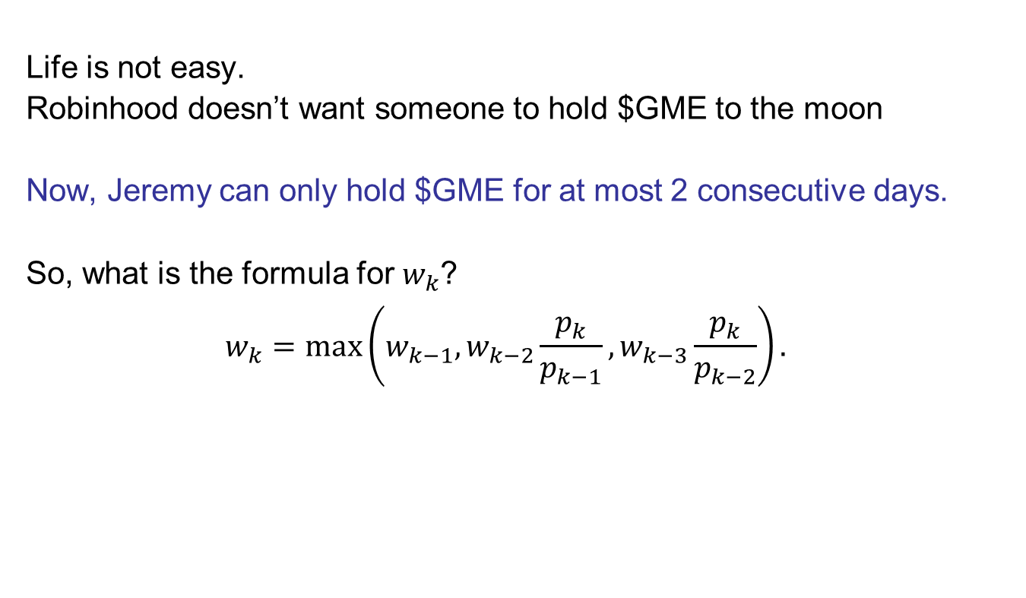
Quiz
  Life is not easy.
  Robinhood doesn’t want someone to hold $GME to the moon
  Now, Jeremy can only hold $GME for at most 2 consecutive days.
  So, what is the formula for $w_{k}$?
  $$w_{k}=\max\left(w_{k−1},w_{k−2}\frac{p_{k}}{p_{k−1}},w_{k−3}\frac{p_{k}}{p_{k−2}}\right).$$

Slide 30
Knapsack Problem

Slide 31

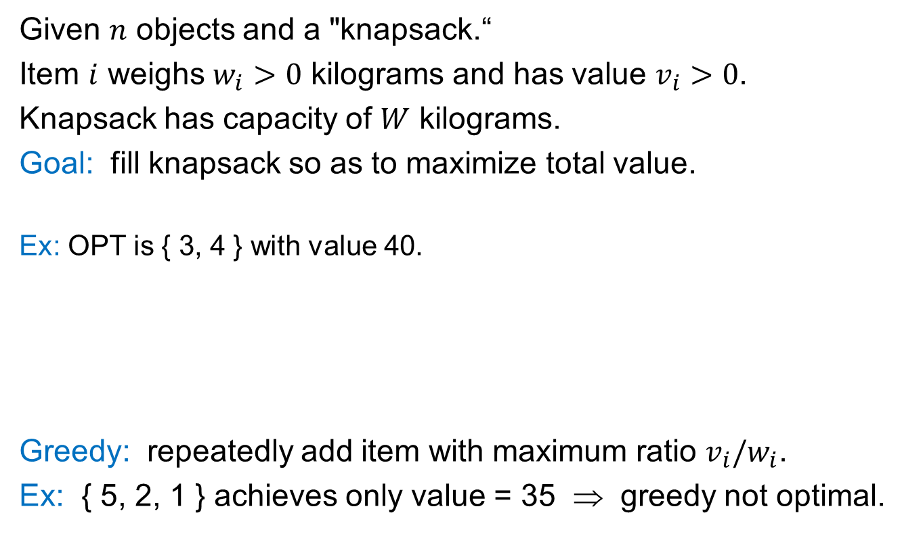
Knapsack Problem
  Given $n$ objects and a "knapsack.“
  Item $i$ weighs $w_{i}>0$ kilograms and has value $v_{i}>0$.
  Knapsack has capacity of $W$ kilograms.
  Goal: fill knapsack so as to maximize total value.
  Ex: OPT is { 3, 4 } with value 40.
Greedy: repeatedly add item with maximum ratio $v_{i}/w_{i}$.
Ex: { 5, 2, 1 } achieves only value = 35 ⇒ greedy not optimal.
Item
Value
Weight
1
1
1
W = 11
2
6
2
3
18
5
4
22
6
5
28
7

Slide 32
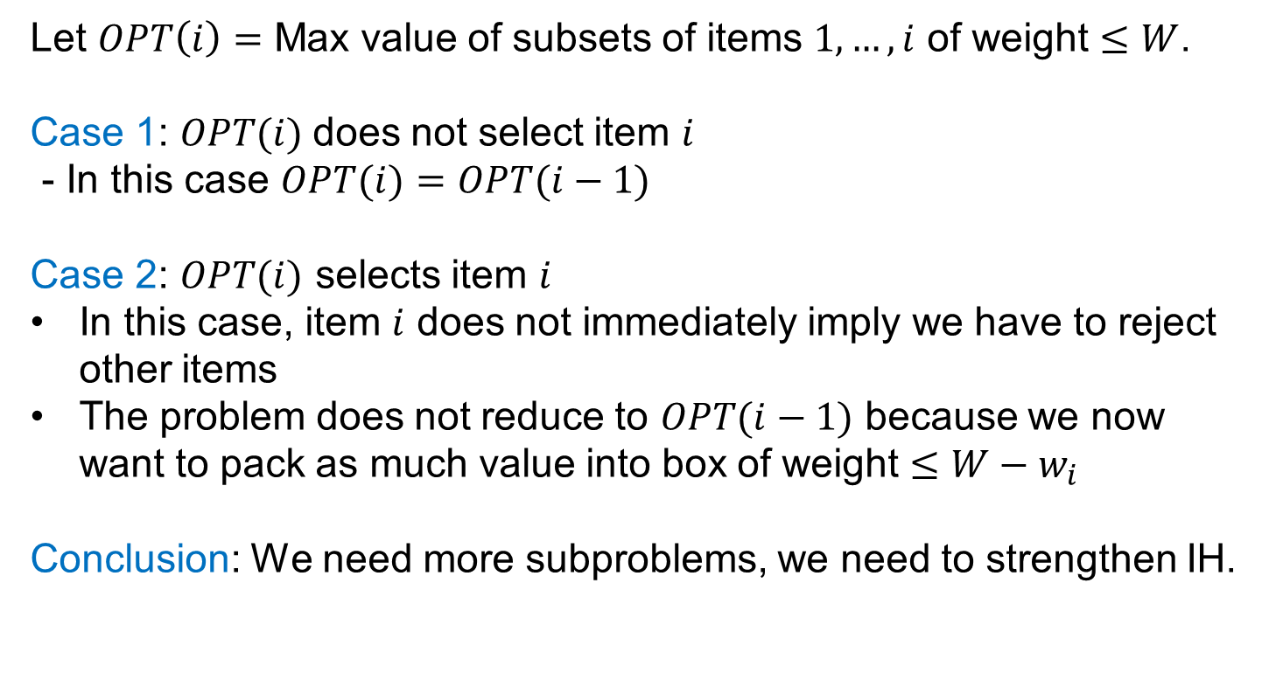
Dynamic Programming: First Attempt
  Let $OPT\left(i\right)=$ Max value of subsets of items $1,…,i$ of weight $≤W$.
  Case 1: $OPT(i)$does not select item $i$
  - In this case $OPT(i)=OPT(i−1)$
  Case 2: $OPT(i)$ selects item $i$
  In this case, item $i$ does not immediately imply we have to reject other items
  The problem does not reduce to $OPT(i−1)$ because we now want to pack as much value into box of weight $≤W−w_{i}$
  Conclusion: We need more subproblems, we need to strengthen IH.

Slide 33
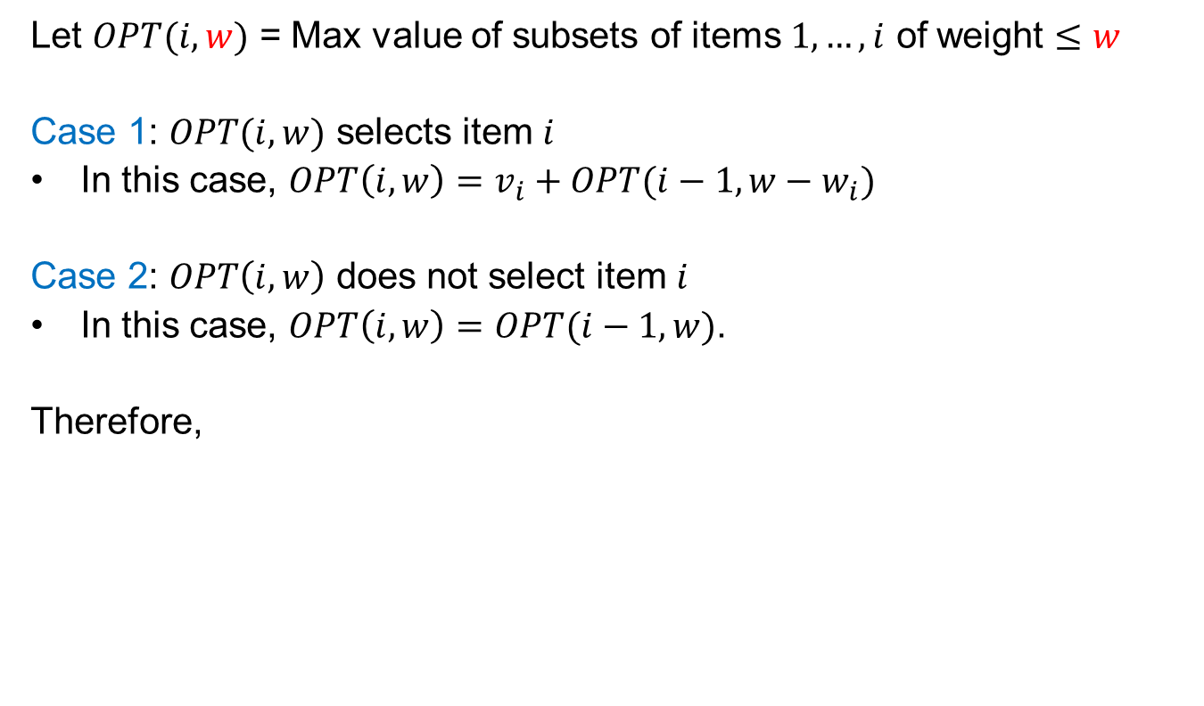
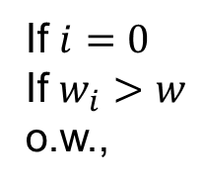
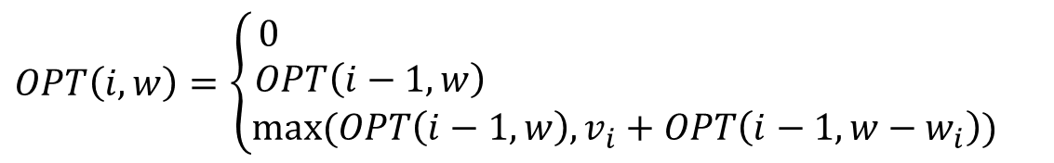
Stronger DP (Strengthening Hypothesis)
What is the ordering of item we should pick?
  Let $OPT(i,w)$ = Max value of subsets of items $1,…,i$ of weight $≤w$
  Case 1: $OPT(i,w)$ selects item $i$
  In this case, $OPT\left(i,w\right)=v_{i}+OPT(i−1,w−w_{i})$
  Case 2: $OPT\left(i,w\right)$ does not select item $i$
  In this case, $OPT\left(i,w\right)=OPT(i−1,w)$.
  Therefore,
Take best of the two
$$OPT\left(i,w\right)=\left\{\begin{aligned}0 \\ OPT\left(i−1,w\right) \\ max⁡(OPT\left(i−1,w\right),v_{i}+OPT\left(i−1,w−w_{i}\right))\end{aligned}\right.$$
If $i=0$
If $w_{i}>w$
o.w.,

Slide 34
DP for Knapsack
Comp-OPT(i,w)
if M[i,w] == empty
if (i==0)
M[i,w]=0
else if (w_{i} > w)
M[i,w]= Comp-OPT(i-1,w)
else
M[i,w]= max {Comp-OPT(i-1,w), v_{i} + Comp-OPT(i-1,w-w_{i})}
return M[i, w]
recursive
for w = 0 to W
M[0, w] = 0
for i = 1 to n
for w = 1 to W
if (w_{i} > w)
M[i, w] = M[i-1, w]
else
M[i, w] = max {M[i-1, w], v_{i} + M[i-1, w-w_{i} ]}
return M[n, W]
Non-recursive

Slide 35
DP for Knapsack
W + 1
0
1
2
3
4
5
6
7
8
9
10
11
φ
0
0
0
0
0
0
0
0
0
0
0
0
{ 1 }
0
n + 1
{ 1, 2 }
0
{ 1, 2, 3 }
0
{ 1, 2, 3, 4 }
0
{ 1, 2, 3, 4, 5 }
0
Item
Value
Weight
W = 11
1
1
1
if (w_{i} > w)
M[i, w] = M[i-1, w]
else
M[i, w] = max {M[i-1, w], v_{i} + M[i-1, w-w_{i} ]}
2
6
2
3
18
5
4
22
6
5
28
7

Slide 36
DP for Knapsack
W + 1
0
1
2
3
4
5
6
7
8
9
10
11
φ
0
0
0
0
0
0
0
0
0
0
0
0
{ 1 }
0
1
1
1
1
1
1
1
1
1
1
1
n + 1
{ 1, 2 }
0
{ 1, 2, 3 }
0
{ 1, 2, 3, 4 }
0
{ 1, 2, 3, 4, 5 }
0
Item
Value
Weight
W = 11
1
1
1
if (w_{i} > w)
M[i, w] = M[i-1, w]
else
M[i, w] = max {M[i-1, w], v_{i} + M[i-1, w-w_{i} ]}
2
6
2
3
18
5
4
22
6
5
28
7

Slide 37
DP for Knapsack
W + 1
0
1
2
3
4
5
6
7
8
9
10
11
φ
0
0
0
0
0
0
0
0
0
0
0
0
{ 1 }
0
1
1
1
1
1
1
1
1
1
1
1
n + 1
{ 1, 2 }
0
1
6
7
{ 1, 2, 3 }
0
1
{ 1, 2, 3, 4 }
0
1
{ 1, 2, 3, 4, 5 }
0
1
Item
Value
Weight
W = 11
1
1
1
if (w_{i} > w)
M[i, w] = M[i-1, w]
else
M[i, w] = max {M[i-1, w], v_{i} + M[i-1, w-w_{i} ]}
2
6
2
3
18
5
4
22
6
5
28
7
Notes:
The greenbox, one up, one up and left by w_i.

Slide 38
DP for Knapsack
W + 1
0
1
2
3
4
5
6
7
8
9
10
11
φ
0
0
0
0
0
0
0
0
0
0
0
0
{ 1 }
0
1
1
1
1
1
1
1
1
1
1
1
n + 1
{ 1, 2 }
0
1
6
7
7
7
7
7
7
7
7
7
{ 1, 2, 3 }
0
1
6
7
7
18
19
{ 1, 2, 3, 4 }
0
1
{ 1, 2, 3, 4, 5 }
0
1
Item
Value
Weight
W = 11
1
1
1
if (w_{i} > w)
M[i, w] = M[i-1, w]
else
M[i, w] = max {M[i-1, w], v_{i} + M[i-1, w-w_{i} ]}
2
6
2
3
18
5
4
22
6
5
28
7

Slide 39
DP for Knapsack
W + 1
0
1
2
3
4
5
6
7
8
9
10
11
φ
0
0
0
0
0
0
0
0
0
0
0
0
{ 1 }
0
1
1
1
1
1
1
1
1
1
1
1
n + 1
{ 1, 2 }
0
1
6
7
7
7
7
7
7
7
7
7
{ 1, 2, 3 }
0
1
6
7
7
18
19
24
25
25
25
25
{ 1, 2, 3, 4 }
0
1
6
7
7
18
22
24
28
29
{ 1, 2, 3, 4, 5 }
0
1
Item
Value
Weight
W = 11
1
1
1
if (w_{i} > w)
M[i, w] = M[i-1, w]
else
M[i, w] = max {M[i-1, w], v_{i} + M[i-1, w-w_{i} ]}
2
6
2
3
18
5
4
22
6
5
28
7

Slide 40
DP for Knapsack
W + 1
0
1
2
3
4
5
6
7
8
9
10
11
φ
0
0
0
0
0
0
0
0
0
0
0
0
{ 1 }
0
1
1
1
1
1
1
1
1
1
1
1
n + 1
{ 1, 2 }
0
1
6
7
7
7
7
7
7
7
7
7
{ 1, 2, 3 }
0
1
6
7
7
18
19
24
25
25
25
25
{ 1, 2, 3, 4 }
0
1
6
7
7
18
22
24
28
29
29
40
{ 1, 2, 3, 4, 5 }
0
1
6
7
7
18
22
28
29
34
34
40
OPT: { 4, 3 }
value = 22 + 18 = 40
Item
Value
Weight
W = 11
1
1
1
if (w_{i} > w)
M[i, w] = M[i-1, w]
else
M[i, w] = max {M[i-1, w], v_{i} + M[i-1, w-w_{i} ]}
2
6
2
3
18
5
4
22
6
5
28
7

Slide 41
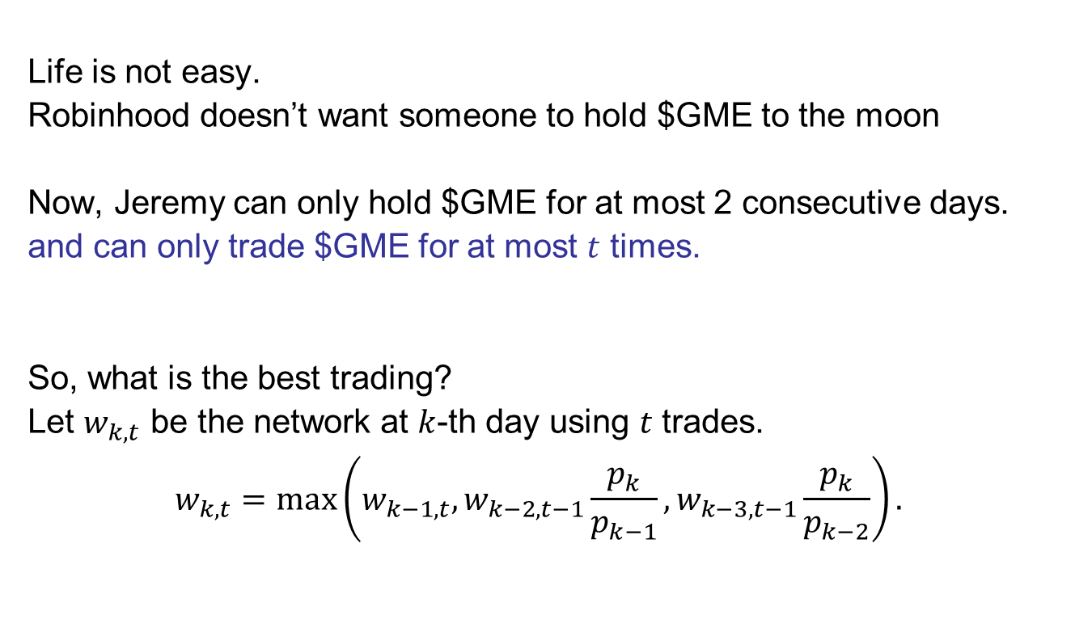
Quiz
  Life is not easy.
  Robinhood doesn’t want someone to hold $GME to the moon
  Now, Jeremy can only hold $GME for at most 2 consecutive days.
  and can only trade $GME for at most $t$ times.
  So, what is the best trading?
  Let $w_{k,t}$ be the network at $k$-th day using $t$ trades.
  $$w_{k,t}=\max\left(w_{k−1,t},w_{k−2,t−1}\frac{p_{k}}{p_{k−1}},w_{k−3,t−1}\frac{p_{k}}{p_{k−2}}\right).$$

Slide 42
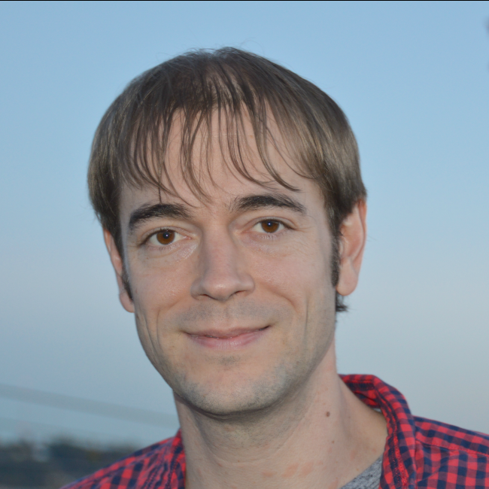

Knapsack Problem: Running Time
Running time: $Θ(n⋅W)$
Not polynomial in input size!
"Pseudo-polynomial.“
Decision version of Knapsack is NP-complete.
Knapsack approximation algorithm:
There exists a polynomial algorithm that produces a feasible solution that has value within 0.01% of optimum
in time Poly($n$).
UW Expert

Slide 43
DP Ideas so far
  You may have to define an ordering to decrease #subproblems
  You may have to strengthen DP, equivalently the induction, i.e., you have may have to carry more information to find the Optimum.
  This means that sometimes we may have to use two dimensional or three dimensional induction

